Slide 1
ONLINE E-COMMERCE PLATFORM
Sellers list products | Buyers purchase | Admins manage the system
REVIEW 1 - Project Structure, Database Design, JDBC & UI/UX
Role-based dashboards for Admin / Seller / Buyer | Java Swing + JDBC + MySQL 8.0
Database: ecommerce_db | 6 Tables | DAO Pattern | Collections & Multithreading
Team: abhishek.25scse1010473@galgotiasuniversity.ac.in | Deadline: 15 October 2026
© 2024 GUVI Geek Network Pvt. Ltd.

Slide 2
01 | Problem Statement & Objective
GUVI | HCL Hackathon
Goal: Develop an e-commerce platform where sellers can list products, buyers can purchase
products, and administrators can manage the overall system. Each user type will have a dedicated
dashboard to manage their activities and view relevant information.
3 Roles
Admin / Seller / Buyer
● User Management Admin manages user accounts and roles (name, email, role) with confirmation messages
● Product Management Admin oversees listings (name, description, price) to ensure compliance
● Order Management Manage order processing and fulfillment with status updates (PENDING to SHIPPED to DELIVERED)
● Seller Capabilities Product Listing, Inventory Management, Order Processing, Sales Performance
● Buyer Capabilities Product Browsing (search & filter), Purchase, Order Tracking, Wishlist, Account Overview
3 Dashboards
Role-based access
6 Tables
MySQL ecommerce_db
Stack
Java 26 + Swing + JDBC

Slide 3
02 | User Types & Functionalities
GUVI | HCL Hackathon
Admin | Seller | Buyer - Each with dedicated dashboard
ADMIN
SELLER
BUYER
Manages Users, Products & Orders
Lists Products, Manages Inventory
Browses, Purchases, Tracks Orders
● User Mgmt: Input (name,email,role) to Confirmation to Manage accounts/roles
● Product Listing: Input (name,desc,price) to Confirmation to Create & manage listings
● Product Browsing: Input (search & filter) to List of products to Browse & search
● Product Mgmt: Input (name,desc,price) to Confirmation to Oversee listings & compliance
● Inventory Mgmt: Input (inventory details) to Inventory updates to Track & manage levels
● Purchase Products: Input (selected products) to Order confirmation to Purchase & confirm
● Order Mgmt: Input (order details) to Status updates to Manage fulfillment
● Order Processing: Input (order details) to Status updates to Process & fulfill orders
● Order Tracking: Input (order details) to Status updates to Track status & delivery

Slide 4
03 | System Architecture - 3-Tier Layered Design
GUVI | HCL Hackathon
Presentation to Business Logic to Data Access to Database
Presentation Layer
Swing GUI | ECommerceGUI
Login + 3 Dashboards
CardLayout + JTables
Layer 1
Business Logic Layer
AuthService, InventoryService
Validation, Stock Alerts
Streams & Generics
Layer 2
Data Access Layer (DAO)
DAO Interfaces + Impl
JDBC + PreparedStatement
DBConnection (Singleton)
Layer 3
Database Layer
MySQL 8.0 | ecommerce_db
6 Tables + FK + Indexes
schema.sql
Layer 4
Tech Stack: Java 26 | Swing (UI) | JDBC (mysql-connector-j 8.0.33) | MySQL 8.0 | VS Code | Git/GitHub

Slide 5
04 | Module Breakdown & Packages
GUVI | HCL Hackathon
src/com/ecommerce/* | Modular, role-wise separation
model/
dao/ + dao/impl/
service/
POJOs & Enums
Data Access Objects
Business Logic
User (abstract) to Admin, Seller, Buyer
Product, Order, OrderItem, Role
Encapsulation + Inheritance
Interfaces: UserDAO, ProductDAO, OrderDAO
Impl: JDBC + PreparedStatement
Exception Handling (SQLException)
AuthService (login/register, fallback)
InventoryService (ConcurrentHashMap)
Generics & Streams
util/
ui/
Utilities
Presentation
DBConnection (Singleton)
DriverManager.getConnection
Config: URL, USER, PASSWORD
ECommerceGUI extends JFrame
CardLayout: LOGIN / ADMIN / SELLER / BUYER
JTables, Tabs, Search & Filter

Slide 6
05 | Core Java Concepts - OOP in Project
GUVI | HCL Hackathon
Inheritance | Polymorphism | Abstraction | Encapsulation | Exception Handling
Inheritance
Abstraction
Polymorphism
abstract class User to Admin, Seller, Buyer
Code reuse, hierarchy, is-a relationship
abstract methods getDashboardType(), displayInfo()
Interfaces UserDAO, ProductDAO, OrderDAO
UserDAO to UserDAOImpl (JDBC)
User reference holds Admin/Seller/Buyer
Method overriding
User.java:42
User.java / dao/*.java
UserDAOImpl.java
Encapsulation
Exception Handling
Composition
Private fields + getters/setters
Controlled access, validation
try-with-resources, SQLException
AuthService fallback to memory
Order contains List<OrderItem>
InventoryService has ConcurrentHashMap
Product.java, Order.java
DBConnection.java
Order.java

Slide 7
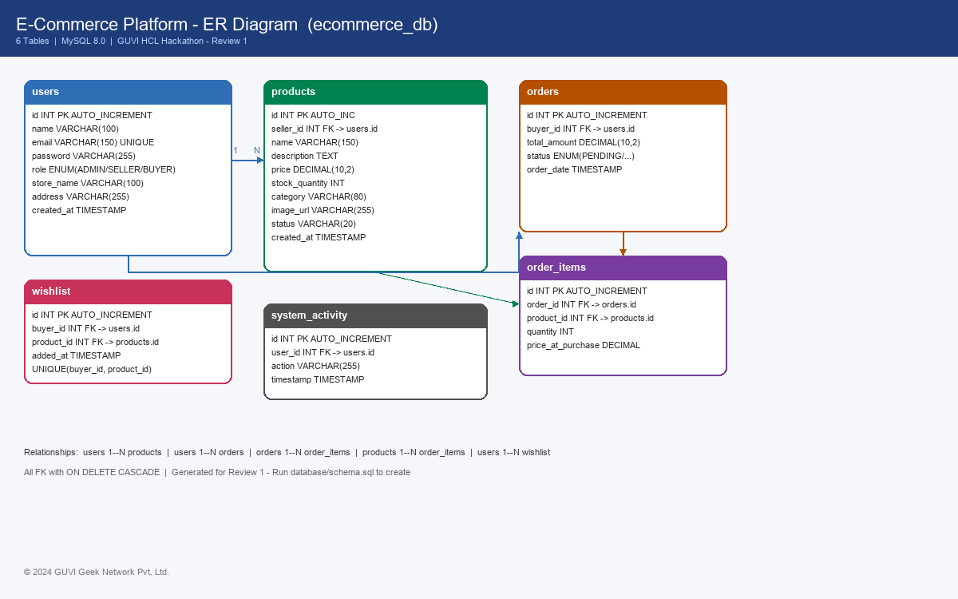
06 | Database Design - ecommerce_db (6 Tables)
GUVI | HCL Hackathon
MySQL 8.0 | Foreign Keys | ENUMs | Indexes | Dummy Data

Slide 8
07 | Database Connectivity - JDBC
GUVI | HCL Hackathon
DBConnection (Singleton) | PreparedStatement | DAO Pattern
// util/DBConnection.java - Singleton
public static synchronized DBConnection getInstance() {
if (instance == null) instance = new DBConnection();
return instance;
}
public Connection getConnection() throws SQLException {
return DriverManager.getConnection(URL, USER, PASSWORD);
}
// dao/impl/UserDAOImpl.java - PreparedStatement
String sql = "INSERT INTO users (name,email,password,role) VALUES (?,?,?,?)";
try (Connection conn = DBConnection.getInstance().getConnection();
PreparedStatement ps = conn.prepareStatement(sql)) {
ps.setString(1, user.getName());
ps.setString(2, user.getEmail());
ps.setString(4, user.getRole().name());
return ps.executeUpdate() > 0;
}
Why This Design?
● Driver Loading Class.forName(com.mysql.cj.jdbc.Driver)
● Singleton Single DBConnection instance - thread-safe
● PreparedStatement Prevents SQL injection vs Statement
● try-with-resources Auto-close Connection/Statement/ResultSet
● DAO Pattern Separation: Interface to Impl (JDBC)
● Fallback AuthService: DB first, then in-memory demo
Proof for Review: Button Test Database Connection (JDBC) in Login Panel to SwingWorker (background thread) to DBConnection.testConnection() to Dialog Database Connected Successfully!

Slide 9
08 | Collections, Generics & Multithreading
GUVI | HCL Hackathon
InventoryService | AuthService | SwingWorker
Collections
Generics
Multithreading
Synchronization
● List<Product> getAllProducts()
● Optional<User> getUserByEmail()
● ExecutorService.newFixedThreadPool(4)
● synchronized block on inventory
● Map<Product,Integer> (Cart concept)
● <T extends Product> void addProduct(T p)
● Future<Boolean> processOrderAsync()
● ConcurrentHashMap thread-safe
● ConcurrentHashMap<Integer,Product> inventory
● DAO<T> pattern with type safety
● synchronized updateStock()
● Prevents race on stock_quantity
● Collectors.groupingBy(category)
● List<Order> with streams filter
● SwingWorker for DB test (non-blocking UI)
● Executor shutdown handling
Example: inventory.values().stream().filter(Product::isLowStock).collect(Collectors.toList()) to lowStockProducts | groupByCategory() with Collectors.groupingBy

Slide 10
09 | UI/UX Design - Swing Dashboards (Role-Based)
GUVI | HCL Hackathon
ECommerceGUI.java | CardLayout | JTables | Search & Filter | Responsive layout
ADMIN DASHBOARD
4 Tabs
SELLER DASHBOARD
4 Tabs
BUYER DASHBOARD
4 Tabs (Spec Exact)
● User Management: Table + Add/Edit/Delete
● Product Listings: Create & manage
● 1. Product Browsing History: Recently viewed
● Product Management: All products + compliance
● Order Management: Fulfill seller orders
● 2. Order History: Past orders + tracking
● Order Management: Status updates
● Inventory Overview: Low-stock alerts
● 3. Wishlist: Favorites + price changes
● System Activity: Real-time log
● Sales Performance: Reports & trends
● 4. Account Overview: Details/payment/address
Login Panel (Role-based routing)
Responsive | Aesthetic | GUVI Branding
3 Demo accounts: admin@ecommerce.com / rahul@seller.com / amit@buyer.com to Auto-routes to correct dashboard | Test DB button (SwingWorker)

Slide 11
10 | Project Structure & How to Run
GUVI | HCL Hackathon
VS Code | GitHub | MySQL Workbench
ecommerce-platform/
├-- src/com/ecommerce/
│ ├-- model/ User, Admin, Seller, Buyer, Product, Order
│ ├-- dao/ UserDAO, ProductDAO, OrderDAO (interfaces)
│ ├-- dao/impl/ UserDAOImpl, ProductDAOImpl, OrderDAOImpl
│ ├-- service/ AuthService, InventoryService
│ ├-- util/ DBConnection (Singleton)
│ └-- ui/ ECommerceGUI.java
├-- database/
│ ├-- schema.sql (DDL + dummy data)
│ └-- er-diagram.png
├-- lib/
│ └-- mysql-connector-j-8.0.33.jar
├-- docs/
│ ├-- er-diagram.png
│ └-- Review1_Presentation.pptx
├-- bin/ (compiled .class)
├-- run.bat (one-click compile & run)
└-- README.md
How to Run (2 mins)
1. Database Setup
mysql -u root -p < database/schema.sql
# Or run in MySQL Workbench
2. Configure Credentials
Edit src/com/ecommerce/util/DBConnection.java
# URL: localhost:3306/ecommerce_db
3. Run Application
Double-click run.bat
# Or: java -cp bin;lib/* com.ecommerce.ui.ECommerceGUI
4. Login & Demo
Use demo credentials (no DB needed)
Admin / Seller / Buyer dashboards
GitHub: Public Repo | README with setup | .gitignore (bin/ excluded)

Slide 12
11 | Review 1 Deliverables & Next Plan
GUVI | HCL Hackathon
What is DONE vs What is NEXT - Clear roadmap to final submission
✓ REVIEW 1 - DONE (This Submission)
→ REVIEW 2 - NEXT PLAN
● Project Structure: Maven/VS Code layout, modular packages
○ Full CRUD Integration: Connect every UI action to DAO (DB live)
● Database Design: 6 tables, ER diagram, FK, schema.sql
○ Validation & Security: Email format, password hash, input checks
● DB Connectivity: JDBC, DAO, PreparedStatement, Singleton
○ Charts & Reports: JFreeChart for Inventory & Sales graphs
● UI/UX Design: Swing GUI, 3 dashboards, 12 tabs, search/filter
○ Cart & Checkout Flow: End-to-end purchase with order creation
● OOP & Concepts: Inheritance, Interfaces, Collections, Threads
○ Testing & Polish: JUnit tests, exception handling, logging
● Documentation: README, run.bat, PPT, ER diagram
○ Deployment: Runnable JAR + User Manual
Submission Checklist: GitHub Public | README | schema.sql | ER Diagram | Screenshots (add after demo) | PPT | Code Comments & Modular

Slide 13
THANK YOU
Online E-Commerce Platform - Review 1
We have demonstrated Project Structure, Database Design,
Database Connectivity (JDBC) and UI/UX Design as required.
Ready for Review 2
© 2024 GUVI Geek Network Pvt. Ltd. | All rights reserved. | abhishek.25scse1010473@galgotiasuniversity.ac.in

