Slide 1
LABS 1–11: Probability and Statistics Lab
Diabetes and
lifestyle indicators
Statistical analysis with R
BMAT202P Probability and Statistics Lab
YASH RAJ - 24BDS1209
HRISHIKESH DAMODAR NAYAK - 24BDS1007
HARDIK LALLA - 24BDS1010
ARYAN RAJ - 24BDS1094
Data → graphs → models → statistical tests
Notes:
Introduce the project and four team members. The main dataset is the processed CDC BRFSS 2015 derivative. Experimental datasets supplement the methods that require genuine pairing or randomized designs. Suggested time: 20 seconds.
Sources:
https://www.cdc.gov/brfss/annual_data/annual_2015.html
https://www.kaggle.com/datasets/alexteboul/diabetes-health-indicators-dataset
https://archive.ics.uci.edu/dataset/891/cdc+diabetes+health+indicators
https://stat.ethz.ch/R-manual/R-devel/library/MASS/html/anorexia.html
https://kwstat.github.io/agridat/reference/cochran.crd.html
https://kwstat.github.io/agridat/reference/gomez.seedrate.html
https://kwstat.github.io/agridat/reference/goulden.latin.html
https://www.itl.nist.gov/div898/handbook/eda/section3/eda35f.htm
Calculations: matching saved R lab outputs. All29 original figures remain in the complete atlas.

Slide 2
LAB 1: Data types, import and export (dataset overview)
Dataset and aim
Aim: describe health patterns, study BMI relationships and apply the course statistical methods.
253,680
3,000
21
source records
sampled people
health predictors
Health status in the sample
Key variables
Variable | What it measures
BMI | Body mass index (kg/m²)
Mental / physical health | Poor-health days, 0–30
Age / income / education | Grouped categories
Activity / smoking | Yes / No indicators
Source: CDC BRFSS 2015, processed by Alex Teboul on Kaggle.
469 people (15.63%) report prediabetes or diabetes.
1 / 11
Notes:
Secondary data collection: CDC BRFSS 2015, processed by Alex Teboul on Kaggle. Exact derivative: 253680 rows, 22 raw columns (21 predictors plus target). Random sample without replacement, seed101. Combined positive status includes prediabetes OR diabetes:469/3000=15.633%. Original CDC survey441456 records. The derivative omits survey-design weights, so the study supports sample associations rather than national prevalence. Explain source, relevance, size and variables. Suggested time: 65 seconds.
Sources:
https://www.cdc.gov/brfss/annual_data/annual_2015.html
https://www.kaggle.com/datasets/alexteboul/diabetes-health-indicators-dataset
https://archive.ics.uci.edu/dataset/891/cdc+diabetes+health+indicators
https://stat.ethz.ch/R-manual/R-devel/library/MASS/html/anorexia.html
https://kwstat.github.io/agridat/reference/cochran.crd.html
https://kwstat.github.io/agridat/reference/gomez.seedrate.html
https://kwstat.github.io/agridat/reference/goulden.latin.html
https://www.itl.nist.gov/div898/handbook/eda/section3/eda35f.htm
Calculations: matching saved R lab outputs. All29 original figures remain in the complete atlas.

Slide 3
LAB 1: Data types, import and export
Data preparation
Import → sample → validate → prepare for analysis
Import
Sample
Validate
Prepare
CSV source
3,000 random rows
Codes and ranges
Labels and types
Types used in R
Quality checks
Type | Examples
Numeric | BMI and poor-health days
Categorical | Health status, sex and smoking
Grouped categories | Age, income and education
Check | Result
Missing entries | 0
Invalid codes / ranges | 0
Health-day range | 0–30 days
Sample selection | Seed 101
Import CSV → label categories → export clean data for the exercises
Readable labels and correct data types make every later analysis easier.
2 / 11
Notes:
Course Experiment1: types, import/export. Labs00/01. We read CSV, select3000 with seed101, inspect schema, missingness and allowed codes/ranges, and convert categories to readable factors. Missing cells0, invalid records0. The sample has13 repeated feature profiles, which do not establish duplicated people. RDS preserves factor levels and CSV provides portable output. Scripts retain source-row lineage. BMI/health days remain numeric, age/income/education are ordered bands but regression uses category contrasts. Suggested time: 50 seconds.
Sources:
https://www.cdc.gov/brfss/annual_data/annual_2015.html
https://www.kaggle.com/datasets/alexteboul/diabetes-health-indicators-dataset
https://archive.ics.uci.edu/dataset/891/cdc+diabetes+health+indicators
https://stat.ethz.ch/R-manual/R-devel/library/MASS/html/anorexia.html
https://kwstat.github.io/agridat/reference/cochran.crd.html
https://kwstat.github.io/agridat/reference/gomez.seedrate.html
https://kwstat.github.io/agridat/reference/goulden.latin.html
https://www.itl.nist.gov/div898/handbook/eda/section3/eda35f.htm
Calculations: matching saved R lab outputs. All29 original figures remain in the complete atlas.

Slide 4
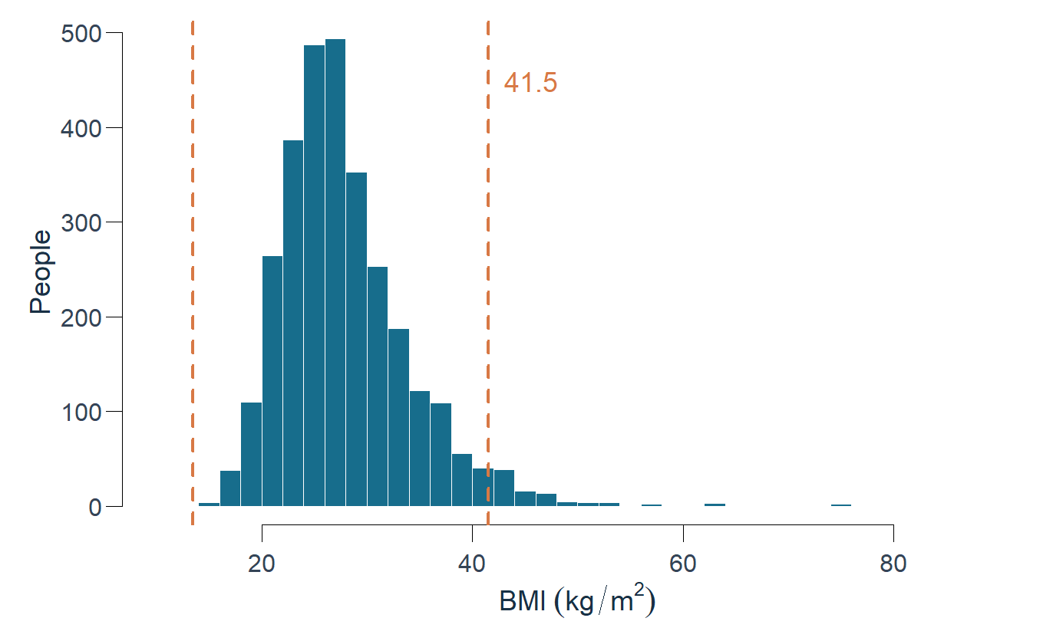
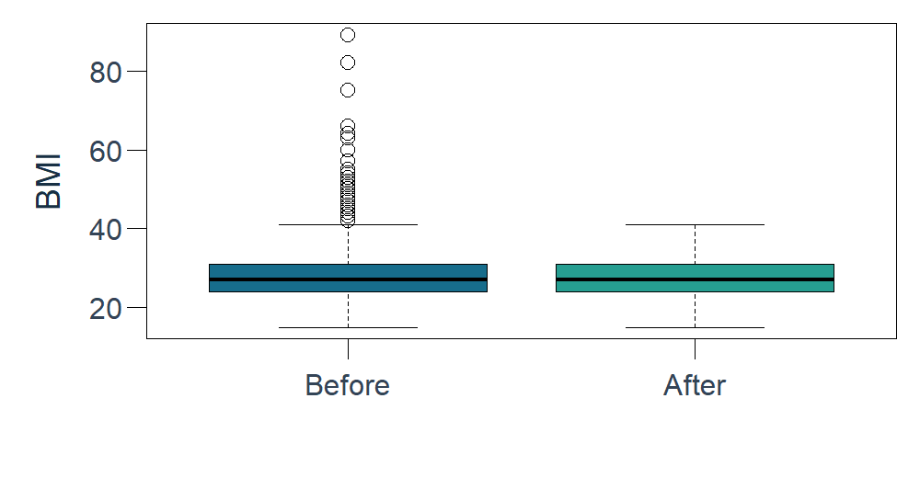
LAB 1 EXTENSION: Data preparation and outlier analysis
Outlier analysis and removal
Q1 = 24 • Q3 = 31 • IQR = 7 • Q1 − 1.5×IQR to Q3 + 1.5×IQR → 13.5 to 41.5
Detect unusual BMI values
Compare before and after
Measure | Before | After
People | 3,000 | 2,886
Mean BMI | 28.40 | 27.65
BMI variance | 40.34 | 24.59
Positive status | 15.63% | 14.62%
114 high BMI values (3.8%) were flagged. Removing them lowers the average and spread.
3 / 11
Notes:
Lab01B, additional presentation requirement. Fences are Q1−1.5IQR and Q3+1.5IQR.114 observations (3.8%) are high-side flags. The source-row ledger records their BMI/status. Demonstrate actual removal with the2886-row sensitivity dataset and compare mean, variance and status composition. Valid extreme BMI values stay in the primary analysis because being unusual does not establish error. The removal comparison is explicitly a different analysis sample. Suggested time: 80 seconds.
Sources:
https://www.cdc.gov/brfss/annual_data/annual_2015.html
https://www.kaggle.com/datasets/alexteboul/diabetes-health-indicators-dataset
https://archive.ics.uci.edu/dataset/891/cdc+diabetes+health+indicators
https://stat.ethz.ch/R-manual/R-devel/library/MASS/html/anorexia.html
https://kwstat.github.io/agridat/reference/cochran.crd.html
https://kwstat.github.io/agridat/reference/gomez.seedrate.html
https://kwstat.github.io/agridat/reference/goulden.latin.html
https://www.itl.nist.gov/div898/handbook/eda/section3/eda35f.htm
Calculations: matching saved R lab outputs. All29 original figures remain in the complete atlas.

Slide 5
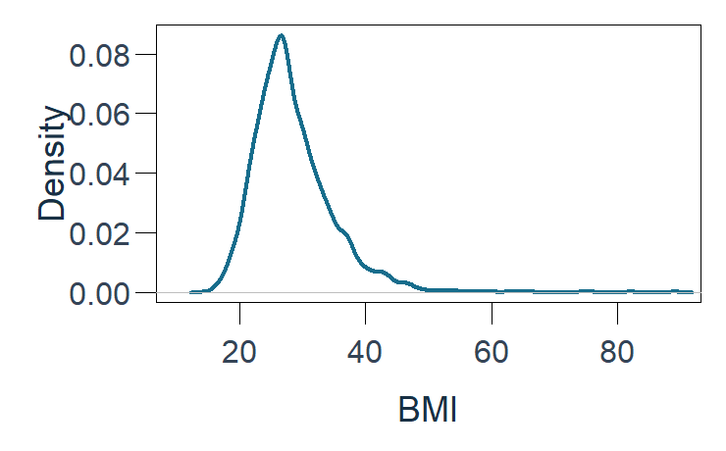
LAB 2: Summary statistics and graphical representations
Summary statistics and graphs
Mean = average • SD = standard deviation • Variance = squared spread
Variable | Mean | Median | SD | Variance
BMI | 28.40 | 27 | 6.35 | 40.34
Mental-health days | 3.26 | 0 | 7.39 | 54.67
Physical-health days | 4.15 | 0 | 8.62 | 74.24
Education: group sizes
Sex: sample share
BMI: distribution shape
BMI has a long right tail. Most people report few poor-health days.
4 / 11
Notes:
Course Experiment2, Lab02. The numeric summary uses sample SD/variance (n−1). BMI units kg/m²; variance squared units. Mental/physical days have median0, while means3.256 and4.152 indicate right-skewness. Graphs demonstrate histogram, boxplot, density, education bar and sex pie; physical-day bar and all29 original drawings are in the atlas. The no-school group has2 respondents. Explain bar comparison, pie proportions and the density right tail. Suggested time: 80 seconds.
Sources:
https://www.cdc.gov/brfss/annual_data/annual_2015.html
https://www.kaggle.com/datasets/alexteboul/diabetes-health-indicators-dataset
https://archive.ics.uci.edu/dataset/891/cdc+diabetes+health+indicators
https://stat.ethz.ch/R-manual/R-devel/library/MASS/html/anorexia.html
https://kwstat.github.io/agridat/reference/cochran.crd.html
https://kwstat.github.io/agridat/reference/gomez.seedrate.html
https://kwstat.github.io/agridat/reference/goulden.latin.html
https://www.itl.nist.gov/div898/handbook/eda/section3/eda35f.htm
Calculations: matching saved R lab outputs. All29 original figures remain in the complete atlas.

Slide 6
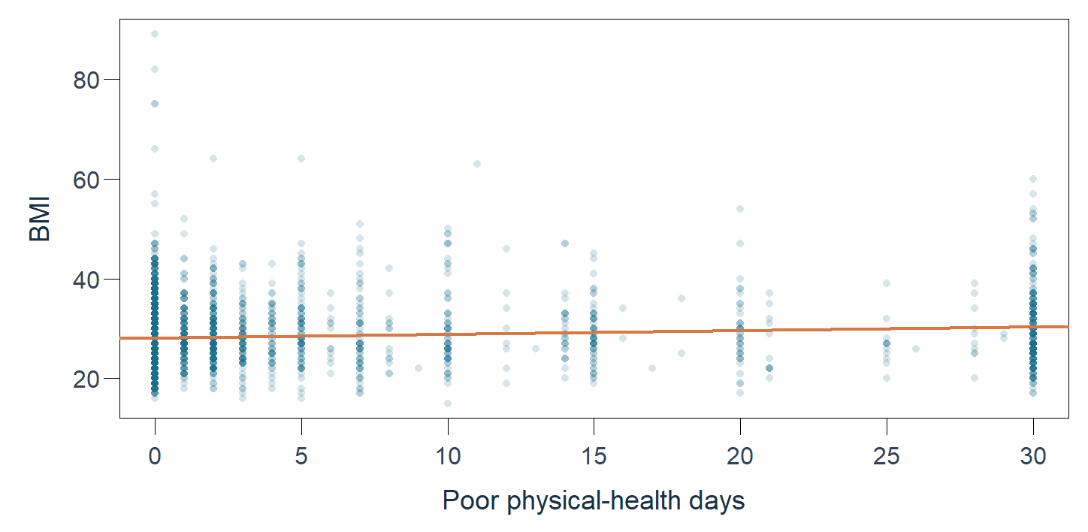
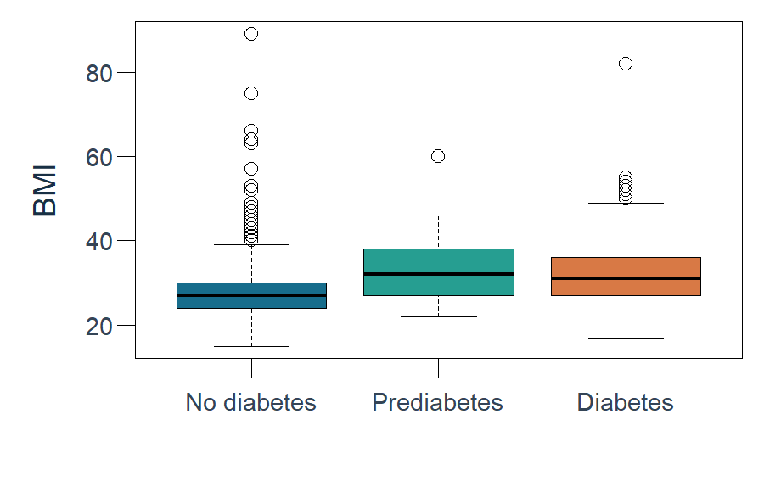
LAB 3: Correlation, simple linear regression and R²
Correlation and simple regression
Predicted BMI = 28.09 + 0.0749 × poor physical-health days
Poor-health days and BMI
BMI by health group
Average BMI
No diabetes | Prediabetes | Diabetes
27.72 | 32.85 | 31.98
Pearson r | Spearman r | Covariance | R²
0.102 | 0.108 | 5.56 | 1.03%
r = 0.102: weak positive relation. R² = 1.03%: very little BMI variation is explained.
5 / 11
Notes:
Course Experiment3, Lab03. Pearsonr .101606,95%CI .06606–.13689,p<.001; Spearman .107897. Slope .074898,95%CI .048637–.101159. Covariance5.56044 BMI×days measures shared variation; correlation scales it. R² .0103238. A one-day increase is associated with0.075BMI units in the fitted line. Boxplots and means show higher average BMI in prediabetes/diabetes, with overlapping distributions. Prediabetesn48 limits precision. The model estimates BMI associations rather than causal effects. Suggested time: 90 seconds.
Sources:
https://www.cdc.gov/brfss/annual_data/annual_2015.html
https://www.kaggle.com/datasets/alexteboul/diabetes-health-indicators-dataset
https://archive.ics.uci.edu/dataset/891/cdc+diabetes+health+indicators
https://stat.ethz.ch/R-manual/R-devel/library/MASS/html/anorexia.html
https://kwstat.github.io/agridat/reference/cochran.crd.html
https://kwstat.github.io/agridat/reference/gomez.seedrate.html
https://kwstat.github.io/agridat/reference/goulden.latin.html
https://www.itl.nist.gov/div898/handbook/eda/section3/eda35f.htm
Calculations: matching saved R lab outputs. All29 original figures remain in the complete atlas.

Slide 7
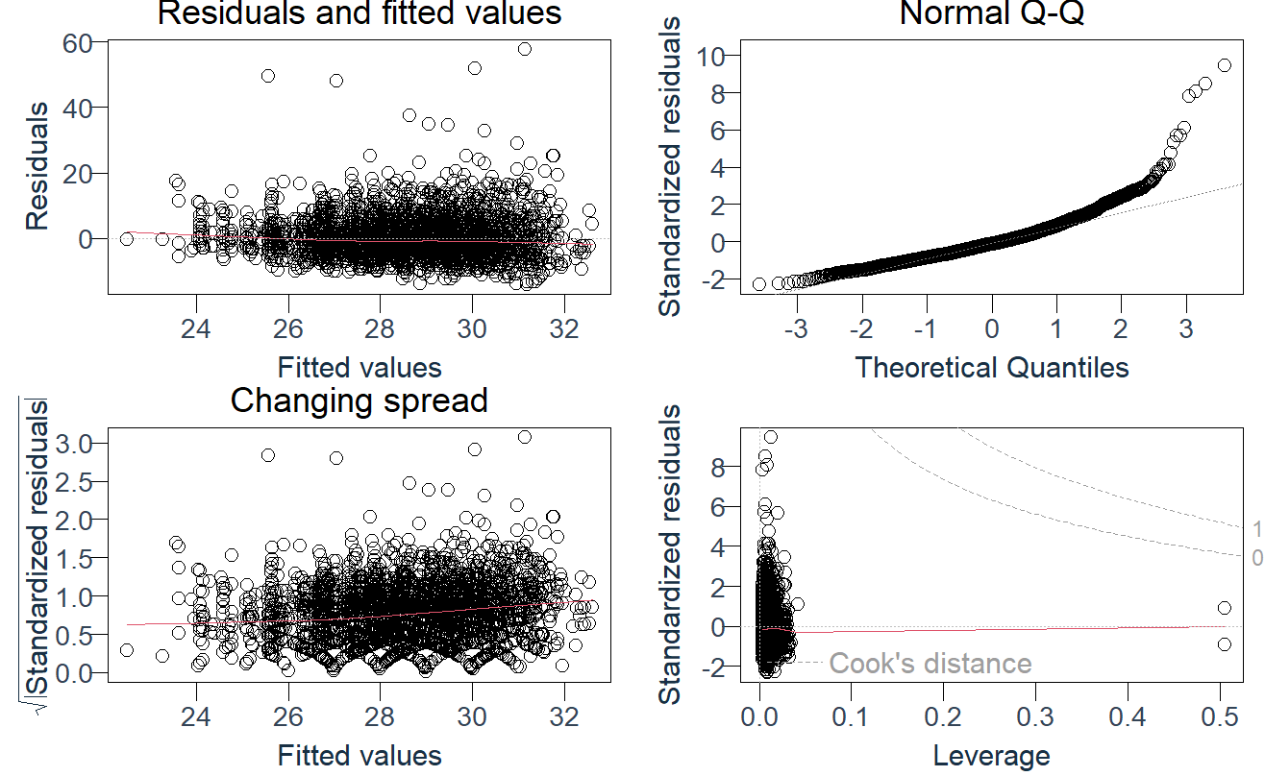
LAB 4: Multiple linear regression
Multiple regression and model checks
Predict BMI using age, activity, income, education and smoking. R² = variation explained.
6.81%
5.99%
Check the fitted model
R²
Adjusted R²
Which predictors matter?
Predictor | F | p
Age | 9.17 | <0.001
Physical activity | 13.30 | <0.001
Income | 4.43 | <0.001
Education | 8.03 | <0.001
Smoking | 0.07 | 0.786
Residuals show uneven spread and a long upper tail.
Age, activity, income and education relate to BMI. The model explains only a small share of variation.
6 / 11
Notes:
Course Experiment4, Lab04. BMI response with factor Age/Income/Education, activity and ever100-cigarettes indicator. References age50–54, income35–50k, high school, inactive, never100. R² .068067,adjusted .059917. Joint partialF tests account for other predictors. Smoking BMI coefficient−.0633,CI−.5206 to .3940,p.786. The right-skewed residuals and uneven spread limit the approximation. Cook4/n flags140 for review. Filtering yields adjustedR²4.89%. Full coefficients, confidence intervals and VIFs remain in the report/CSV. No diabetes classification accuracy is claimed. Suggested time: 90 seconds.
Sources:
https://www.cdc.gov/brfss/annual_data/annual_2015.html
https://www.kaggle.com/datasets/alexteboul/diabetes-health-indicators-dataset
https://archive.ics.uci.edu/dataset/891/cdc+diabetes+health+indicators
https://stat.ethz.ch/R-manual/R-devel/library/MASS/html/anorexia.html
https://kwstat.github.io/agridat/reference/cochran.crd.html
https://kwstat.github.io/agridat/reference/gomez.seedrate.html
https://kwstat.github.io/agridat/reference/goulden.latin.html
https://www.itl.nist.gov/div898/handbook/eda/section3/eda35f.htm
Calculations: matching saved R lab outputs. All29 original figures remain in the complete atlas.

Slide 8
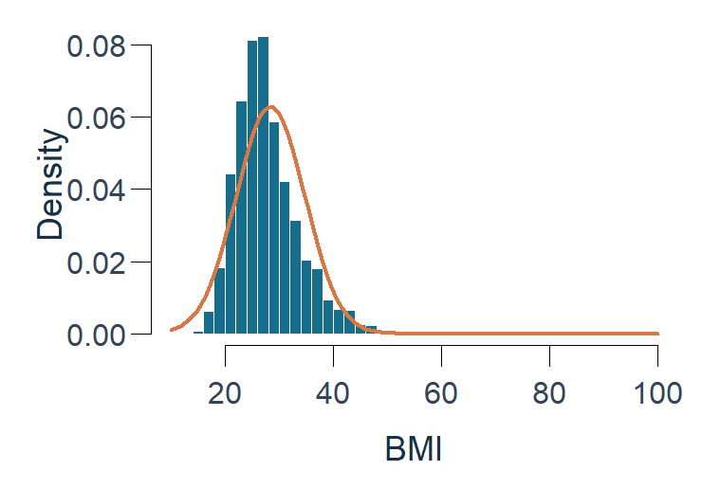
LAB 5: Binomial fitting LAB 6: Normal and Poisson fitting
Fitting probability distributions
Compare the observed pattern with the pattern each model expects.
Binomial
Normal
Poisson
Positive cases in groups of 10.
p = 0.156, 300 groups.
BMI: mean 28.40, SD 6.35.
The curve misses the long tail.
Physical-health days: mean 4.15,
variance 74.24. Many zeros.
Test p = 0.962
Test p < 0.001
Test p < 0.001
Fits the grouped counts reasonably.
BMI is not normally distributed.
Variance is far above the mean.
A useful analysis explains why a model fits or fails.
7 / 11
Notes:
Course Experiments5/6, Labs05/06. Binomial:300 artificial groups of10,rawpositivep .156333; pooled MLE .154999,chi .287105,df3,p .962435,expectedmin16.65. Plot aggregates5–10 into5+ for readability. NormalBMI mean28.398,SD6.351,ShapiroW.896929,p<.001. Poisson rawmeanlambda4.151667,var74.240077,dispersion17.88199,zeros62.9%,30days7.4%. Native chart aggregates full support, including>30. Formal pooled test uses grouped MLElambda1.797448,chi41781.676,df6,p<.001,expectedmin7.65. Ordinary overlay uses rawmean; the two estimation procedures are distinguished in the report. Describe why normal/Poisson fail rather than forcing a good fit. Suggested time: 90 seconds.
Sources:
https://www.cdc.gov/brfss/annual_data/annual_2015.html
https://www.kaggle.com/datasets/alexteboul/diabetes-health-indicators-dataset
https://archive.ics.uci.edu/dataset/891/cdc+diabetes+health+indicators
https://stat.ethz.ch/R-manual/R-devel/library/MASS/html/anorexia.html
https://kwstat.github.io/agridat/reference/cochran.crd.html
https://kwstat.github.io/agridat/reference/gomez.seedrate.html
https://kwstat.github.io/agridat/reference/goulden.latin.html
https://www.itl.nist.gov/div898/handbook/eda/section3/eda35f.htm
Calculations: matching saved R lab outputs. All29 original figures remain in the complete atlas.

Slide 9
LAB 7: One-sample tests LAB 8: Two-sample tests LAB 9: Independent and paired t-tests
Hypothesis tests and paired measurements
At α = 0.05, p < 0.05 supports a difference. Read the size of the change too.
Six questions, six test results
Paired example: same 29 patients
Question / comparison | Method | Result | p
Mean BMI vs 27 | One-sample t | 28.40 | <0.001
Positive share vs 11% | One proportion | 15.63% | <0.001
BMI: female − male | Welch t | −0.65 | 0.004
Positive share: never / ever smoked | Two proportions | 14.09% / 17.36% | 0.016
Poor-health days: female − male | Independent t | +1.25 days | <0.001
Weight: after − before | Paired t | +3.01 lb | 0.035
Mean gain: +3.01 lb
95% CI: +0.23 to +5.79 lb
Reference values 27 and 11% are classroom assumptions.
Paired tests compare the same people twice. Independent tests compare different groups.
8 / 11
Notes:
Course Experiments7/8/9, Labs07/08/09a/09b. All alternatives two-sided. BMI27 and positive proportion11% are hypothetical classroom benchmarks. Welch BMI differencefemale−male−.6494,CI−1.0958 to−.2030,p.004368; smokerpositive14.087% versus17.361%,difference−3.273pp,CI−5.953 to−.594,p.015765 using continuity correction. PhysHlthfemale−male1.2463days,CI.6343 to1.8584,p<.001. Genuine paired example uses29 CBT patients from MASS anorexia, postminuspre mean3.0069lb,CI.2269 to5.7869,t2.2156,df28,p.0350. Non-normal differences Shapiro.00795 and signed-rank sensitivityp.0645 make this result method-sensitive. A within-group change does not prove treatment efficacy. Patient trajectories are blue and average orange. Suggested time: 110 seconds.
Sources:
https://www.cdc.gov/brfss/annual_data/annual_2015.html
https://www.kaggle.com/datasets/alexteboul/diabetes-health-indicators-dataset
https://archive.ics.uci.edu/dataset/891/cdc+diabetes+health+indicators
https://stat.ethz.ch/R-manual/R-devel/library/MASS/html/anorexia.html
https://kwstat.github.io/agridat/reference/cochran.crd.html
https://kwstat.github.io/agridat/reference/gomez.seedrate.html
https://kwstat.github.io/agridat/reference/goulden.latin.html
https://www.itl.nist.gov/div898/handbook/eda/section3/eda35f.htm
Calculations: matching saved R lab outputs. All29 original figures remain in the complete atlas.

Slide 10
LAB 10: Chi-square goodness of fit and contingency tables
Chi-square: category patterns and relationships
Goodness of fit checks category counts. Independence tests check whether two categories are related.
Test | χ² | p
Age groups: equal frequency (GOF) | 678.12 | <0.001
Status × high BP | 226.28 | <0.001
Status × smoking | 6.07 | 0.014
Blood pressure: larger difference
Smoking: smaller difference
Association size: V = 0.275
Association size: V = 0.045
Positive status is more closely related to high blood pressure than to ever-smoking in this sample.
9 / 11
Notes:
Course Experiment 10. Equal-frequency age GOF is a hypothetical teaching null across 13 unequal-width bands: chi-square 678.1247, df12, p<.001. Status means prediabetes or diabetes. Independence tests use Pearson chi-square without continuity correction: status×HighBP 226.2818, df1, p<.001, Cramer V .27464; status×Smoker 6.0746, df1, p .013714, V .0449985. Expected cells exceed five. No-high-BP positive share 118/1703=6.929%; high-BP 351/1297=27.062%. Never/ever100-cigarette shares 14.087% and17.361%. Compare association magnitudes, not p-values alone. These are observational relationships. Suggested time: 90 seconds.
Sources:
https://www.cdc.gov/brfss/annual_data/annual_2015.html
https://www.kaggle.com/datasets/alexteboul/diabetes-health-indicators-dataset
https://archive.ics.uci.edu/dataset/891/cdc+diabetes+health+indicators
https://stat.ethz.ch/R-manual/R-devel/library/MASS/html/anorexia.html
https://kwstat.github.io/agridat/reference/cochran.crd.html
https://kwstat.github.io/agridat/reference/gomez.seedrate.html
https://kwstat.github.io/agridat/reference/goulden.latin.html
https://www.itl.nist.gov/div898/handbook/eda/section3/eda35f.htm
Calculations: matching saved R lab outputs. All29 original figures remain in the complete atlas.

Slide 11
LAB 11: ANOVA in completely randomized designs, randomized blocks and Latin Square
ANOVA and experimental designs
ANOVA compares means. CRD has no blocks. RBD controls one factor and Latin Square controls two.
Comparison | F | p
BMI by education (survey) | 14.41 | <0.001
Potato CRD: 32 plots, 7 groups | 3.61 | 0.010
Education: existing survey groups.
CRD: 32 randomized plots, 7 sulfur treatments.
Both tests detect a difference between means.
F does not identify every differing pair.
RBD: one blocking factor (rice)
Latin Square: rows and columns
Term | F | p
Block | 5.86 | 0.007
Rate | 2.17 | 0.113
B | D | E | A | C
C | A | B | E | D
D | C | A | B | E
E | B | C | D | A
A | E | D | C | B
Wheat: 5 treatments in a 5 × 5 grid. Each letter occurs once per row and column.
F = 21.03, p < 0.001
6 rates in each block.
44.8% lower error.
C: highest mean, 13.12.
Weekly dusting.
X: seeding rate (kg/ha). Y: yield (kg/ha). Rate p = 0.113.
Blocks reduce unexplained error. Weekly dusting (C) has the highest wheat yield in its experiment.
10 / 11
Notes:
Course Experiment 11. BMI by education is observational ANOVA, F14.4064,p<.001,eta-square .02349. Unequal variances motivate Welch p .000351 and Holm separate-variance pair comparisons. Genuine Cochran potato CRD:32 plots,7 sulfur treatments,F3.6081,p .010262; control8 replicates,others4 each; Tukey control-minus-F12 difference16.875 percentage points,p .005965. Gomez rice complete-block design:24 plots,6 rates,4 blocks. Block F5.8622,p .007416; rate F2.1678,p .112809. Residual MSE decreases from200152 to110558,44.76%. Goulden wheat Latin Square:5 treatments in5 rows and5 columns. Row p .01328,column p .26343,treatment F21.0321,p .00002366; Cweeklydusting mean13.12 exceeds each other treatment with Tukey adjustment. Yield units unspecified for wheat, kg/ha for rice. Models are additive with negligible interaction assumed; genuine published designs are separate from survey data. Suggested time: 150 seconds.
Sources:
https://www.cdc.gov/brfss/annual_data/annual_2015.html
https://www.kaggle.com/datasets/alexteboul/diabetes-health-indicators-dataset
https://archive.ics.uci.edu/dataset/891/cdc+diabetes+health+indicators
https://stat.ethz.ch/R-manual/R-devel/library/MASS/html/anorexia.html
https://kwstat.github.io/agridat/reference/cochran.crd.html
https://kwstat.github.io/agridat/reference/gomez.seedrate.html
https://kwstat.github.io/agridat/reference/goulden.latin.html
https://www.itl.nist.gov/div898/handbook/eda/section3/eda35f.htm
Calculations: matching saved R lab outputs. All29 original figures remain in the complete atlas.

Slide 12
LABS 1–11: Findings, limitations and next steps
Conclusion: findings and next steps
We described health patterns and applied every course method using documented data.
What we found
Limits
Higher average BMI in positive groups
2015, self-reported data.
Small groups add uncertainty.
Associations do not prove causes.
Low R² limits prediction.
27.72 without diabetes, 32.85 prediabetes, 31.98 diabetes.
Individual values still overlap.
Regression explains a small share
R²: 1.03% (simple), 6.81% (multiple).
Most BMI variation remains unexplained.
Next steps
Outliers and model checks matter
Removing 114 flags lowers mean BMI from 28.40 to 27.65.
Binomial fits reasonably. Normal and Poisson fit poorly.
Use newer, better measurements.
Add useful BMI predictors.
Evaluate on unseen data.
Repeat the model checks.
The design changes the comparison
BP has a larger status association than smoking.
Blocks cut error by 44.8%. Wheat treatment C yields most.
All 11 labs are covered. The findings follow the data and their limitations.
11 / 11
Notes:
Final review of all course experiments. Mean BMI is higher in prediabetes/diabetes groups with overlapping individual distributions. Pearson r .102 and simple R-square1.03% show a weak association; the different multiple specification explains6.81%, not validated prediction accuracy. Removing114BMI flags changes mean28.40to27.65 and variance40.34to24.59. Binomial grouped fit is adequate to this test; normal and ordinary Poisson descriptions fail. BP status association V .275 exceeds smoking .045. Published paired/design supplements demonstrate the appropriate data structure. Rice blocks reduce residual MSE44.8%; weekly-dusting C has greatest wheat yield mean13.12 with significant adjusted pair comparisons. Limitations:historical,self-report,omitted complex survey design,sparse categories,confounding,model diagnostics and method-sensitive paired result. Next steps:more recent/better data, useful predictors, evaluation on unseen observations, repeat model checks. Explain findings as associations and course demonstrations. Suggested time: 100 seconds.
Sources:
https://www.cdc.gov/brfss/annual_data/annual_2015.html
https://www.kaggle.com/datasets/alexteboul/diabetes-health-indicators-dataset
https://archive.ics.uci.edu/dataset/891/cdc+diabetes+health+indicators
https://stat.ethz.ch/R-manual/R-devel/library/MASS/html/anorexia.html
https://kwstat.github.io/agridat/reference/cochran.crd.html
https://kwstat.github.io/agridat/reference/gomez.seedrate.html
https://kwstat.github.io/agridat/reference/goulden.latin.html
https://www.itl.nist.gov/div898/handbook/eda/section3/eda35f.htm
Calculations: matching saved R lab outputs. All29 original figures remain in the complete atlas.

