Slide 1
Sales Conversion Prediction
A Client-Facing AI Solution for Intelligent Lead Scoring
Presented By: Aryan Mohapatra
Date: 21/07/2025

Slide 2
Business Understanding
Business Challenge:
B2B sales teams often struggle with low conversion rates due to the lack of a smart system that ranks and prioritizes leads. To boost efficiency, there is a need for a predictive model that accurately pinpoints leads with the highest conversion potential, enabling smarter allocation of sales efforts.
Project Goals:
By deploying the proposed solution, businesses can significantly improve their marketing performance by strategically targeting leads most likely to convert, resulting in better engagement and higher ROI.
Success Metrics:
Category | Target Outcome
Business | Achieve at least a 25% increase in the number of qualified leads
ML | Reach a minimum of 80% model accuracy
Economic | Reduce lead acquisition costs by a minimum of 15%

Slide 3
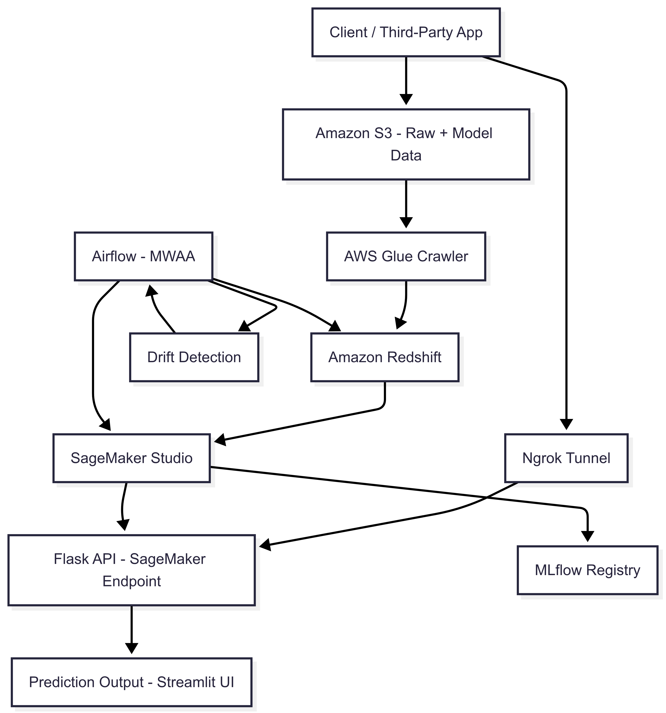
System Architecture

Slide 4
Data Understanding & EDA Insights
Understanding the underlying patterns in our lead dataset was the first critical step toward building a high-performing sales conversion prediction system. The dataset consists of 9,240 customer leads and includes 37 features, capturing information about user behavior, source of the lead, interests, and interaction history.
Target : Converted (1: Converted, 0: Not Converted)
Missing Values: Lead Quality, Tags, and Occupation had 25–50% missingness; handled via imputation or removal.
Skewed Data: Features like Total Visits and Page Views were right-skewed → log transformation applied.
Imbalance: 38.5% of leads were converted → stratified sampling used for fairness during training.
High Impact Features:
Leads spending more time on site are more likely to convert.
Repeat visits also strongly correlate with conversion.

Slide 5
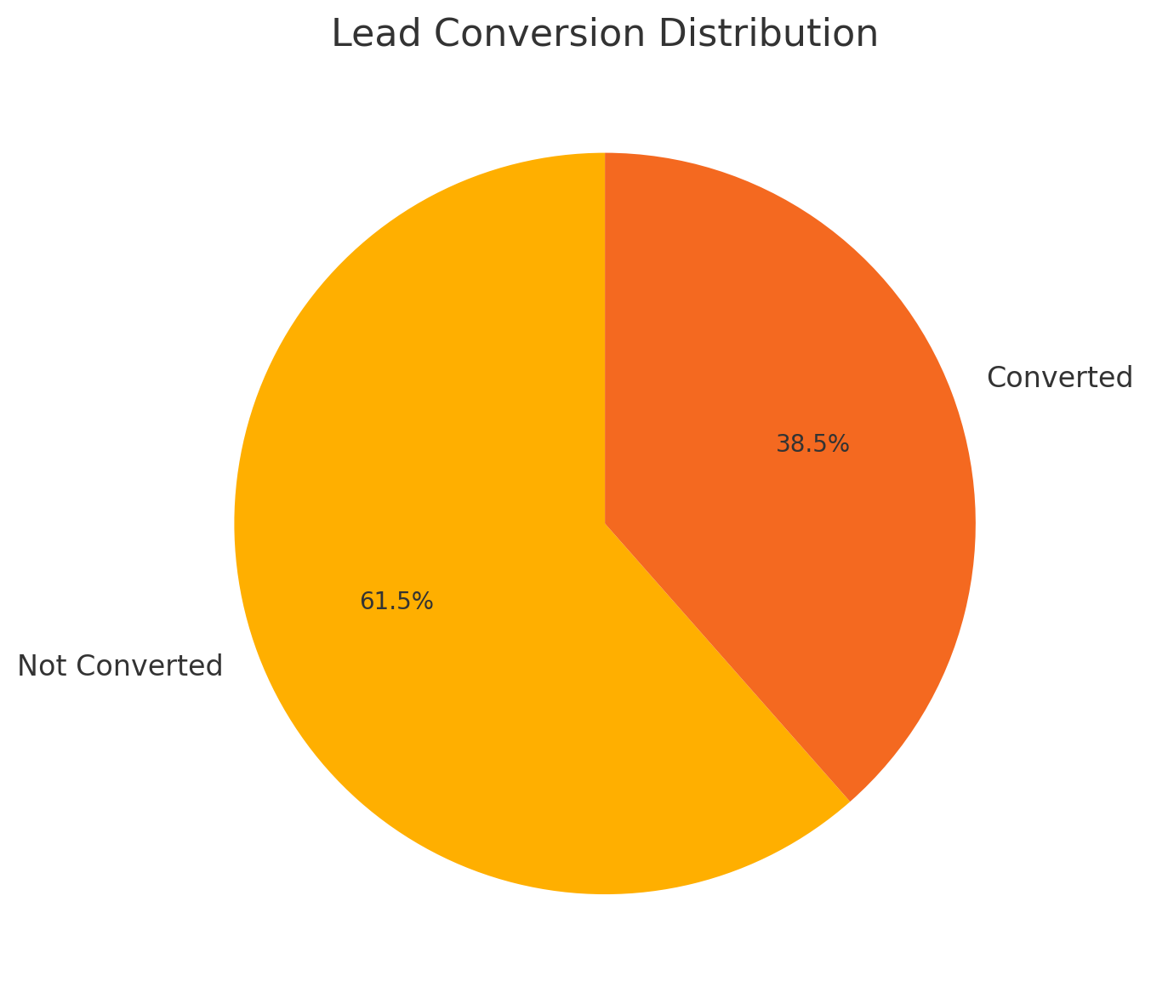
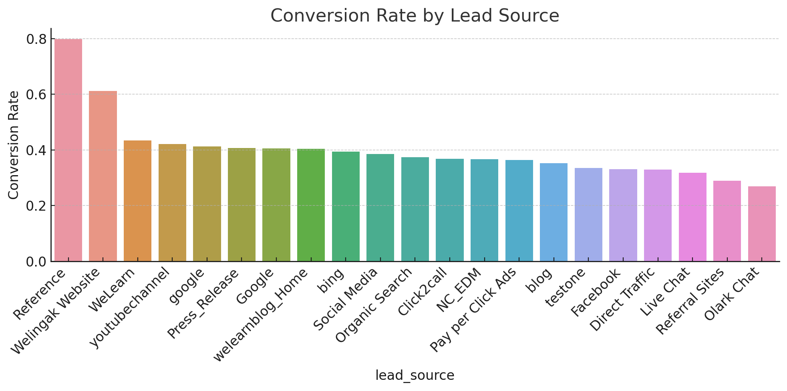


Slide 6

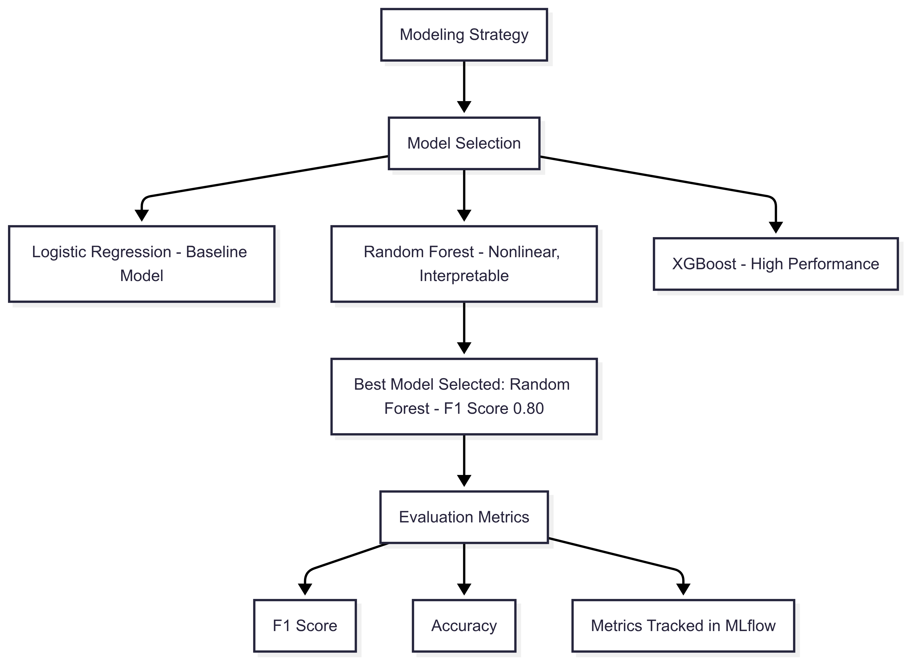
Modelling: Strategy & Algorithms
We explored multiple models including Logistic Regression, Random Forest, and XGBoost. Based on F1 Score and Accuracy tracked via MLflow, Random Forest performed the best with an F1 Score of 0.80 and was selected for deployment.

Slide 7
Benchmark Set
Business Benchmark:
The core objective was to assist the sales and marketing teams in improving lead conversion rates. The benchmark was set to build a predictive model capable of supporting at least an 80% lead conversion efficiency, ensuring better prioritization and smarter allocation of resources.
Technical Benchmark:
From a technical standpoint, the model was evaluated using classification metrics, primarily ROC AUC Score. A minimum threshold of 0.85 ROC AUC was set to ensure the model could effectively distinguish between converting and non-converting leads, even under imbalanced conditions.
The final Random Forest model achieved an F1 Score of 0.80 and a ROC AUC Score exceeding 0.85, meeting both the business and technical benchmarks. This confirms that the solution is not only statistically robust but also valuable for real-world deployment in sales optimization workflows.

Slide 8
Cloud-Based Architecture (AWS)
Amazon S3:
Used as the central data lake, it stores raw lead data, processed intermediate files, and trained model artifacts.
AWS Glue:
Automatically infers schema from files in S3 and updates the AWS Glue Data Catalog, enabling easy querying and data transformation.
Amazon Redshift:
Acts as the analytical data warehouse where cleaned and structured data is stored for training and monitoring purposes.
SageMaker + Mlflow:
SageMaker is used for model development and training, while MLflow tracks experiments, evaluates metrics (like F1 and ROC AUC), and registers the best models.
Flask API (Hosted):
A lightweight Flask application deployed to serve the best model via REST API, allowing real-time predictions through web or UI clients.

Slide 9
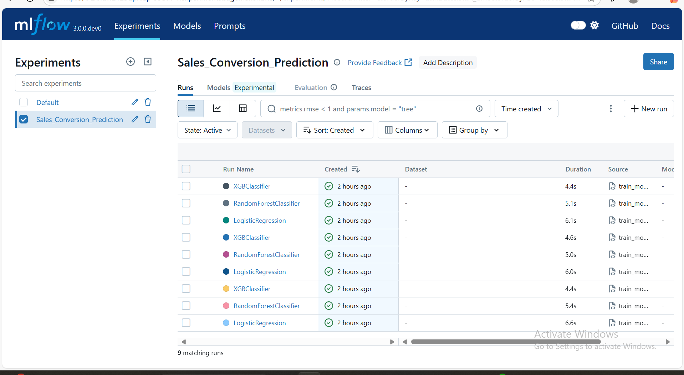
Model Monitoring via MLflow
We leveraged MLflow to manage the complete model lifecycle, enabling a systematic, trackable, and production-ready development process.
Experiment Tracking: All hyperparameters and performance metrics (e.g., ROC AUC) were auto-logged for every training session.
Model Comparison: MLflow interface helped us visually analyze and compare models to select the most effective one.
Best Model Registration: The top-performing model was registered through MLflow and saved to S3, making it deployment-ready.

Slide 10
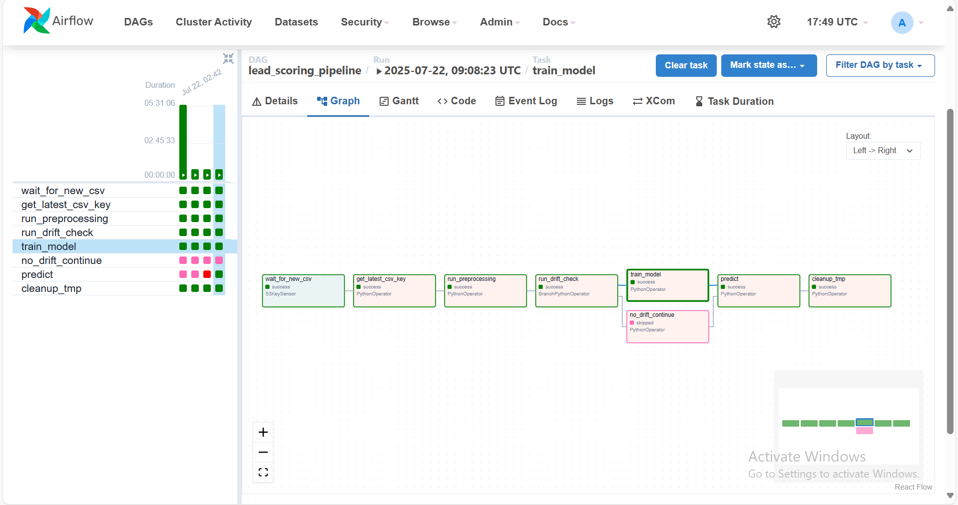
Automation with Apache Airflow
Used MWAA (Managed Workflows for Apache Airflow).
DAG includes:
– S3 file check
– Preprocessing script execution
– Model training / evaluation
– Drift check & alert branching
– Flask deployment trigger
Enables complete retraining and monitoring cycle automatically.

Slide 11
Conclusion & Next Steps
We have delivered a complete ML solution following the CRISP-DM methodology transforming raw lead data into a fully deployed and continuously monitored scoring system on AWS.
Next Steps & Recommendations:
- Real-Time Scoring: We plan to build a lightweight Flask application to let your sales team instantly retrieve lead scores. For seamless integration, the SageMaker model will connect directly to your CRM.
- Ongoing Monitoring: Regularly revisit model accuracy (quarterly) to maintain performance and ensure it stays aligned with business objectives.

