Slide 1

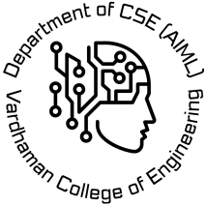
VARDHAMAN COLLEGE OF ENGINEERING, HYDERABAD
Autonomous institute affiliated to JNTUH
DEPARTMENT OF CSE(AI&ML)
IV-Year Major Project Abstract Level Review
Title: Vision Language Robotics for Collaborative Manufacturing
Domain: Artificial Intelligence | Computer Vision | Robotics | Industry 4.0
BATCH ID : 03
S. No | Roll. No | Student Name
1 | 23881A6623 | Hanumakonda Aryan
2 | 23881A6639 | Kottam Eshwar Reddy
3 | 23881A6654 | Sanaboina Rathik Raj
Supervisor
Dr. Ramachandro Majji
Associate Professor
Department of Computer Science And Engineering ( AI & ML )

Slide 2
Outlines
Abstract
Introduction
Literature Review
Existing System with Pros and Cons (comparison with existing systems- Table)
Objectives & Expected Deliverables
SDG Mapping
PO Mapping
PSO Mapping
Timeline
References

Slide 3
Abstract
Collaborative robots are expected to work alongside human operators in dynamic production environments where the assembly task itself can change mid-shift.
Current Vision-Language-Action approaches generalize well across objects and instructions but operate under a fixed-task assumption, leaving real-time task adaptation unaddressed.
This work proposes a framework that lets a collaborative robot reinterpret its own task plan when the operator issues a changeover instruction, rather than requiring manual reconfiguration.
The system builds on OpenVLA as the manipulation backbone, adding a re-planning layer that converts natural-language changeover commands into an updated subtask sequence.
Scene understanding and variant identification are handled through vision-language grounding, keeping the robot aware of which product configuration is currently active.
The framework will be evaluated in simulation against existing VLM-based baselines, measuring task success and how quickly the system adapts once a changeover is issued.

Slide 4
Introduction
Manufacturing is moving toward greater flexibility, with human operators and robots increasingly expected to work side by side rather than in separated, fixed roles.
This shift is part of the broader Industry 5.0 movement, which prioritizes adaptability and human-centered production over rigid automation.
Advances in large language models and vision-language models have opened a new path for robots to understand natural instructions and visual context together, rather than relying on hard-coded rules.
This has given rise to Vision-Language-Action models, which connect perception, language understanding, and physical action in a single pipeline.
Early results in this space have been promising, with robots showing an ability to generalize across new objects, environments, and phrased instructions without task-specific reprogramming.
Our project builds on this momentum, applying it specifically to the unresolved problem of task adaptation in collaborative manufacturing settings.

Slide 5
Existing System
Traditional industrial robots
Pre-programmed, fixed-sequence robots with no language or visual understanding , reprogrammed manually for every task change.
General-purpose VLA models (RT-2, OpenVLA)
Use vision-language pretraining to generalize manipulation across objects and instructions, but assume one fixed task.
VLM-guided HRC systems (Fan & Zheng, 2024)
Combine CLIP + LLM to resolve ambiguous human instructions (e.g., "hand me that one") within a fixed assembly task.
Common limitation
All existing systems assume the task itself stays constant — none adapt the plan when the product or task changes mid-shift.

Slide 6
Pros and Cons of Existing System
Pros:
Strong generalization to new objects and language instructions (RT-2, OpenVLA)
Open-source and fine-tunable on custom data (OpenVLA)
Resolves referential ambiguity in human commands (Fan & Zheng, 93.3% success)
High success rates reported in controlled benchmark settings
Cons:
Assumes a fixed, unchanging assembly task
No mechanism to adapt the task plan in real time
Still requires manual reprogramming when the product/variant changes
Precision insufficient for fine industrial assembly tasks
High computational requirements, not optimized for manufacturing deployment

Slide 7
Problem Statement
High-mix manufacturing changes products frequently.
Industries like aerospace, medical devices, and custom electronics switch product variants multiple times per shift.
Robots can't keep up without manual reprogramming.
Every variant switch forces a stop-and-reprogram cycle, causing downtime and reducing flexibility.
Existing VLA models don't solve this.
RT-2, OpenVLA, and even ambiguity-resolution work like Fan & Zheng (2024) assume a fixed task — none adapt the plan itself when the task changes.
No system currently lets a robot adapt its plan in real time from a spoken instruction.
This is the exact gap our project addresses.

Slide 8
Ref | Paper | Year | Methodology | Dataset | Performance Metrics | Key Findings | Research Gap
[1] | Vision-Language Model-Based Human-Robot Collaboration for Smart Manufacturing: A State-of-the-Art Survey | 2025 | Systematic survey of VLMs in collaborative manufacturing | 109 selected research papers | Reviews 109 publications covering assembly, inspection and HRC | Provides taxonomy, industrial challenges and future research directions | No implementation or quantitative benchmarking
[2] | Vision-Language-Action Models for Robotics: A Review Towards Real-World Applications | 2025 | Comprehensive survey of VLA architectures, datasets, benchmarks and deployment strategies | Survey Literature | Reviews 100+ VLA studies and compares evaluation protocols | Summarizes recent advances, benchmarks and deployment challenges | No experimental implementation or quantitative evaluation
[3] | Vision-Language Models for Human-Robot Collaboration | 2025 | Review of multimodal perception, language understanding and collaborative robotics | Human-Robot Collaboration Literature | Comparative analysis of recent VLM-based HRC frameworks | Summarizes multimodal reasoning and collaborative task execution | Limited discussion on manufacturing deployment and industrial validation
[4] | A vision-language-guided robotic action planning approach for ambiguity mitigation in HRC manufacturing (Fan & Zheng) | 2024 | CLIP for visual grounding + LLM-based referred-object retrieval + action planner | Custom industrial HRC assembly dataset | 93.3% success rate | Resolves ambiguous object references ("hand me that one") in a fixed assembly task | No mechanism to adapt the task/plan itself when the manufacturing goal changes (e.g., variant switch)
[5] | OpenVLA: An Open-Source Vision-Language-Action Model | 2024 | Open-source Vision-Language-Action (VLA) model for robotic manipulation | Open X-Embodiment | 16.5% absolute improvement over RT-2-X across 29 tasks (verify exact base success-rate figure against the paper before citing) | Achieves state-of-the-art manipulation performance with efficient fine-tuning and open-source deployment | Requires high computational resources and lacks manufacturing-specific optimization
[6] | QUAR-VLA: Vision-Language-Action Model for Quadruped Robots | 2024 | Vision-Language-Action framework for autonomous navigation and manipulation on quadruped robots | QUARD (259K simulated + 3K real-world episodes) | Trained on 262K demonstrations with strong sim-to-real generalization | Enables language-guided locomotion, manipulation and reasoning | Focused on quadruped robots instead of collaborative industrial manipulators
[7] | Towards Open-World Grasping with Large Vision-Language Models | 2024 | VLM integrated with segmentation, grasp synthesis and contact reasoning | OCID-VLG, Grasp-MultiObject, Real Robot Evaluation | Outperforms previous supervised and zero-shot LLM baselines in simulation and real hardware | Improves zero-shot grasp planning for unseen objects | Limited to grasping rather than complete manufacturing workflows
[8] | RT-2: Vision-Language-Action Models Transfer Web Knowledge to Robotic Control | 2023 | Co-fine-tunes a VLM on web-scale + robot trajectory data, outputs actions as text tokens | Internet-scale image-text + robot demonstration data | 62% success rate (custom evaluation) | First major VLA; shows web-scale semantic knowledge transfers to robot control | General manipulation only; no manufacturing-specific optimization or task-adaptation mechanism

Slide 9
Objectives & Deliverables Proposed System
Objective 1: Develop a Vision-Language Robotics framework capable of understanding natural language instructions and visual inputs for collaborative manufacturing tasks.
Objective 2: Implement multimodal learning techniques that combine computer vision, language models, and robotic control for intelligent task planning and execution.
Objective 3: Design a collaborative robotic system that improves manufacturing flexibility, task accuracy, human-robot interaction, and workplace safety.
Expected Deliverables:
An intelligent Vision-Language robotic prototype capable of understanding natural language instructions and executing collaborative manufacturing tasks.
A real-time multimodal robotic system integrating computer vision, language reasoning, and autonomous task planning for smart manufacturing.

Slide 10
SDG Mapping
SDG No. | Goal Title | Justification
SDG 4 | Quality Education | The project promotes learning and research in artificial intelligence, robotics, computer vision, and intelligent automation by providing a practical implementation of Vision-Language Robotics for engineering education and skill development.
SDG 8 | Decent Work and Economic Growth | By automating repetitive manufacturing tasks and enabling safe human-robot collaboration, the system enhances workforce productivity, improves operational efficiency, and supports sustainable industrial growth.
SDG 9 | Industry, Innovation and Infrastructure | The proposed framework integrates Vision-Language Models, computer vision, and collaborative robotics to develop intelligent manufacturing solutions, fostering industrial innovation and smart factory infrastructure.
SDG 12 | Responsible Consumption and Production | Production The robotic system improves production efficiency, minimizes material waste, reduces manufacturing errors, and optimizes resource utilization through intelligent decision-making and automation.
SDG 17 | Partnerships for the Goals | the Goals The project encourages collaboration among academia, industry, and AI research communities by integrating open-source robotics frameworks, Vision-Language Models, and advanced manufacturing technologies.

Slide 11
PO Mapping
Po number | Name of the PO | Targeted Justification
PO1 | Engineering knowledge | Apply principles of Artificial Intelligence, Computer Vision, Machine Learning, Robotics for collaborative manufacturing.
PO2 | Problem analysis | Analyze challenges in conventional industrial automation, to design effective AI-driven manufacturing solutions.
PO3 | Design/Development of Solutions | Design and develop a multimodal robotic framework integrating Vision-Language Models, computer vision, and execution in manufacturing environments.
PO5 | Engineering Tool Usage | Utilize modern engineering tools and technologies implement and evaluate the proposed system.
PO7 | Ethics | Develop an AI-enabled robotic system that emphasizes safe, reliable, and ethical human-robot collaboration.
PO8 | Individual and Collaborative Team Work | Work effectively as an individual and as a team to design, develop, integrate, test, and validate the Vision-Language robotic system through collaborative project execution
PO11 | Life-Long Learning | Continuously explore emerging to develop innovative and future ready manufacturing solutions

Slide 12
PSO Mapping
PSO Number | Name of the PSO | Justification
PSO1 | Apply the knowledge of Artificial Intelligence to design, develop, and evaluate computational solutions for complex problems in diverse domains, such as healthcare, finance, and automation. | The project applies Artificial Intelligence, Computer Vision, and Vision-Language Models to develop an intelligent collaborative robotic system capable of perceiving its environment, understanding human instructions, and autonomously performing manufacturing tasks, thereby addressing complex automation challenges.
PSO2 | Demonstrate expertise in using advanced ML tools, techniques, and frameworks to develop innovative solutions for data analysis, pattern recognition, and intelligent decision-making systems. | The project utilizes advanced machine learning frameworks, deep learning models, robotic middleware, and multimodal learning techniques to enable real-time perception, semantic reasoning, intelligent decision-making, and adaptive task execution in collaborative manufacturing environments.

Slide 13
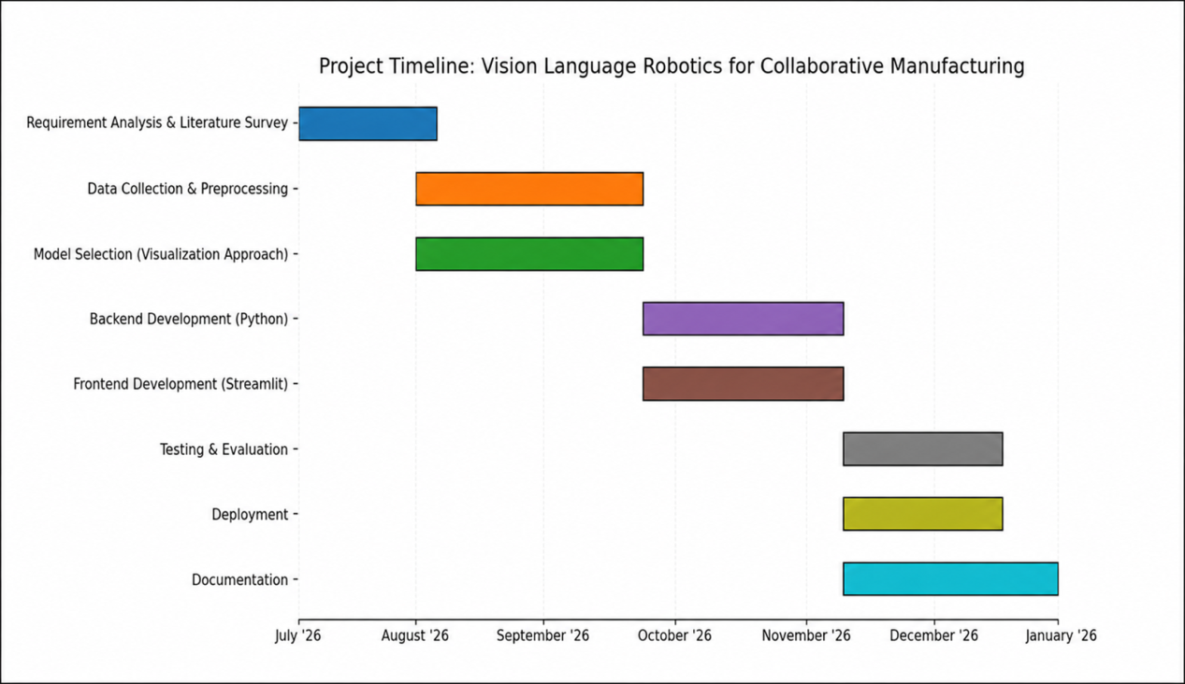
Timelines

Slide 14
References
[1] A. Brohan et al., "RT-2: Vision-Language-Action Models Transfer Web Knowledge to Robotic Control," in Proc. 7th Conf. on Robot Learning (CoRL), 2023, pp. 2165–2183.
[2] M. J. Kim et al., "OpenVLA: An Open-Source Vision-Language-Action Model," in Proc. 8th Conf. on Robot Learning (CoRL), vol. 270, 2025, pp. 2679–2713.
[3] A. O'Neill et al., "Open X-Embodiment: Robotic Learning Datasets and RT-X Models," in Proc. IEEE Int. Conf. on Robotics and Automation (ICRA), Yokohama, Japan, 2024, pp. 6892–6903.
[4] D. Guo et al., "What Matters in Building Vision-Language-Action Models for Generalist Robots," Nature Machine Intelligence, vol. 7, 2025.
[5] F. Xia et al., "RoboCat: A Self-Improving Foundation Agent for Robotic Manipulation," Transactions on Machine Learning Research (TMLR), 2024.
[6] H. Liu, D. Guo, and A. Cangelosi, "Embodied Intelligence: A Synergy of Morphology, Action, Perception, and Learning," ACM Computing Surveys, vol. 57, no. 1, pp. 1–36, 2025.
[7] H. Liu, Y. Zhu, K. Kato, A. Tsukahara, I. Kondo, and Y. Hasegawa, "Enhancing the LLM-Based Robot Manipulation Through Human–Robot Collaboration," IEEE Robotics and Automation Letters, vol. 9, pp. 6904–6911, 2024.
[8] J. Fan and P. Zheng, "A Vision-Language-Guided Robotic Action Planning Approach for Ambiguity Mitigation in Human–Robot Collaborative Manufacturing," Journal of Manufacturing Systems, vol. 74, pp. 1009–1018, 2024.
[9] J. Fan, Y. Yin, T. Wang, W. Dong, P. Zheng, and L. Wang, "Vision-Language Model-Based Human-Robot Collaboration for Smart Manufacturing: A State-of-the-Art Survey," Frontiers of Engineering Management, vol. 12, no. 1, pp. 177–200, 2025.

Slide 15


