Slide 1
Milestone 3
Rotary-Wing Aerodynamics Course Project | Tiltrotor Helicopter
Final Tiltrotor Design and Mission Demonstration
Team Number: 9 (TR-9 Tiltrotor)
Configuration: 6,800 kg Twin-Turboshaft Regional VTOL Tiltrotor
Members: See Mandatory Contribution Record (Slide 2)
15% of course grade • Report graded out of 100 points • Due: 6 November 2026
Notes:
Cover page. Fill in team number and member names. Submission: one consolidated team report in PDF slide format plus one compressed code package.

Slide 2
Team Member Contribution Record
Mandatory
0 pts
Sr. No. | Roll No. | Name | Level (0–5) | Specific contribution | Signature
1 | [Roll No. 1] | [Team 9 Member 1] | 5 | Frozen TR-9 sizing, CG/pivot refinement & 3-view schematic (Sec. 1) | [Signed]
2 | [Roll No. 2] | [Team 9 Member 2] | 5 | VR-12 axial/edgewise BEMT & Gormont radial-stall integration (Sec. 2–3) | [Signed]
3 | [Roll No. 3] | [Team 9 Member 3] | 5 | 6-DOF trim solver, conversion flaperon aero & 475-state corridor (Sec. 3.2) | [Signed]
4 | [Roll No. 4] | [Team 9 Member 4] | 5 | Turboshaft ISA lapse/SFC model & end-to-end 750 km mission planner (Sec. 4) | [Signed]
5 | [Roll No. 5] | [Team 9 Member 5] | 5 | Operating limits, AW609/XV-15 benchmarking & trade-off analysis (Sec. 3.4, 5) | [Signed]
6 | [Roll No. 6] | [Team 9 Member 6] | 5 | Modular YAML code package, CLI reproducibility & slide deck (Sec. 2.3, 6) | [Signed]
Contribution-level descriptors
5: Completed assigned work to good quality; understood and could explain it.
4: Completed assigned work to acceptable quality, with minor guidance or corrections.
3: Partially completed the work and made a genuine effort to correct or learn it.
2: Work was substantially incomplete or incorrect, with limited effort to resolve issues.
1: Was responsive but did not complete the promised work or learn the required method.
0: Was unresponsive and made no meaningful contribution.
Notes:
Mandatory. Report each member’s contribution level and specific responsibilities. Individual marks may be scaled by these entries.

Slide 3
Section 1
Final Aircraft Design • 20 pts
1.1 Final aircraft schematic and configuration (5 pts)
1.2 Final design table (5 pts)
1.3 Design evolution from Milestone 2 (6 pts)
1.4 Design-requirement compliance summary (4 pts)
Notes:
Present the frozen configuration of the single tiltrotor aircraft developed by the team.

Slide 4
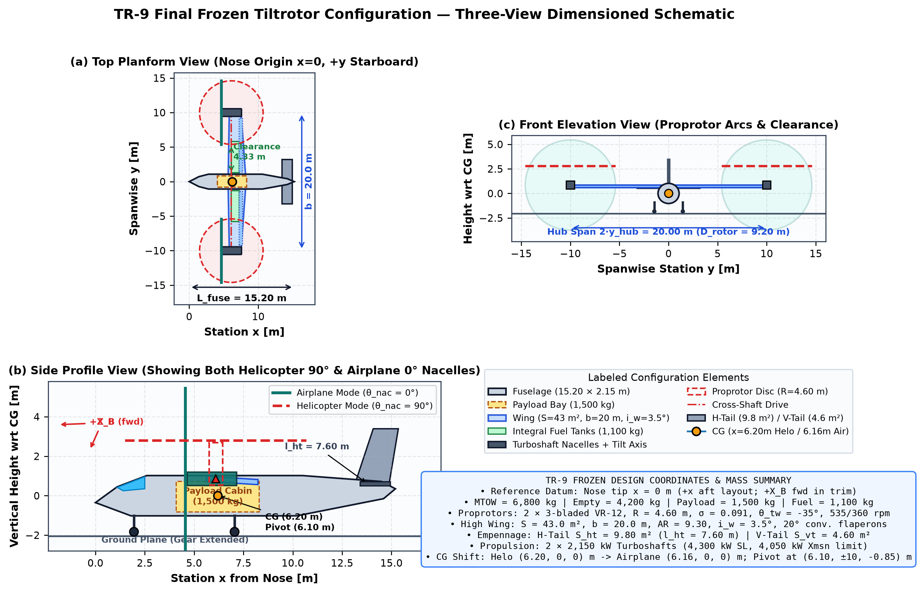
1.1 Final Aircraft Schematic and Configuration
Section 1
5 pts
Must be labeled
Rotors / proprotors (R, hub height)
Wing (span, chord, incidence)
Fuselage (length, width)
Nacelles + tilt axis
Empennage (H-tail, V-tail)
Landing gear
Payload region
Propulsion system + fuel tanks
CG (x, y, z) and key components
Labeled TR-9 Elements
• Proprotors: 2 × 3-bladed VR-12, R = 4.60 m (D = 9.20 m), hub pivot at (6.10, ±10.0, −0.85) m; 2.90 m hub ground height.
• High Wing: b = 20.0 m, S = 43.0 m², AR = 9.30, c_r = 2.61 m, c_t = 1.69 m, i_w = 3.5°, 20° scheduled flaperons.
• Fuselage & Payload: L = 15.20 m, W = 2.15 m, H = 2.05 m; 1,500 kg cabin bay x = 4.10–8.30 m centered on CG.
• Empennage: H-tail S_ht = 9.80 m² (l_ht = 7.60 m); V-tail S_vt = 4.60 m² (l_vt = 7.40 m).
• Propulsion & Fuel: 2 × 2,150 kW wingtip turboshafts + cross-shaft; 1,100 kg integral wing tanks (x = 6.22 m).
• Clearances: 4.33 m blade-tip-to-fuselage clearance; tricycle gear (2.05 m CG height).
Caption: overall dimensions, reference axes and origin, CG location, nacelle position shown (helicopter / airplane mode)
Notes:
Rubric: labeled, approximately dimensioned schematic showing rotors, wing, fuselage, nacelles, empennage, landing gear, payload region, propulsion system, CG, and key component locations.

Slide 5
1.2 Final Design Table
Section 1
5 pts
Group | Parameter | Value | Units | Notes / source
Mass Breakdown | Design MTOW / Empty Mass | 6,800 / 4,200 | kg | Sized for 1,000 km still-air range (f_empty = 0.618)
Mass Breakdown | Design Payload / Usable Fuel | 1,500 / 1,100 | kg | 10% tank reserve (110 kg); 990 kg mission-usable
Proprotors | Count × Blades / Radius R | 2 × 3 / 4.60 | – / m | Counter-rotating; disk area 2A = 132.95 m² (DL = 502 N/m²)
Proprotors | Root Chord / Taper / Solidity σ | 0.50 / 0.75 / 0.091 | m / – / – | c_tip = 0.375 m; thrust-weighted solidity per rotor
Proprotors | Linear Twist θ_tw / Root Cutout | −35.0 / 0.782 (0.17R) | deg / m | Compromise between hover FM (0.69) & cruise η_p (0.83)
Proprotors | Blade Airfoil Section | Boeing-Vertol VR-12 | – | Multi-Re XFOIL polars + Viterna post-stall + Gormont 3D
Proprotors | Rotor Speed (Hover / Cruise) | 535 / 360 | rpm | V_tip = 257.7 m/s hover (M=0.757); 173.4 m/s cruise (67.3%)
Main Wing | Planform Area S / Span b / AR | 43.0 / 20.00 / 9.30 | m² / m / – | NACA 23015; W/S = 1,551 N/m²; λ_w = 0.65; e = 0.80
Main Wing | Incidence i_w / Scheduled Flaperon | 3.5 / 20.0 sin θ_nac | deg | CL_max = 1.38 clean -> 1.65 in conversion; CD0 = 0.028
Empennage | Horizontal Tail S_ht / Arm l_ht | 9.80 / 7.60 | m² / m | NACA 0012, AR_ht = 4.2, V_H = 0.80, x_ac,ht = 13.80 m
Empennage | Vertical Tail S_vt / Arm l_vt | 4.60 / 7.40 | m² / m | NACA 0012, AR_vt = 1.6, V_V = 0.039, x_ac,vt = 13.60 m
Propulsion | Installed SL Power / Xmsn Cap | 4,300 (2×2,150) / 4,050 | kW | ISA lapse (ρ/ρ0)^0.95√(T/T0); η_gb = 0.96; OEI hover capable
Propulsion | Rated SFC_0 & Part-Load Law | 0.255 (0.82 + 0.18/χ) | kg/(kW·h) | Includes idle/accessory load & part-power thermal droop
CG & Layout | CG Station (Helo / Airplane) & Hub | 6.20 / 6.16 ; x_hub=6.10 | m aft nose | Pivot 0.10 m fwd of hover CG, z_hub = −0.85 m (above CG)
Controls | Nacelle / Collective / Cyclic / Elev | [0,95] / [−4,48] / ±12 / ±25 | deg | Max tilt rate 3.0°/s; FCC washes out cyclic as θ_nac -> 0°
Notes:
Rubric: tabulate the main rotor, wing, empennage, propulsion, mass, fuel, and control parameters required to define the aircraft.

Slide 6
1.3 Design Evolution from Milestone 2
Section 1
6 pts
# | Change | Milestone 2 value | Final value | Quantitative / physical reason | Evidence (slide / plot)
1 | Wingtip nacelle pivot x_hub wrt CG | +1.20 m fwd of CG | +0.10 m fwd (x_hub=6.10, x_CG=6.20 m) | Cut hover hub pitch moment by 92% (+87.4 -> +6.7 kN·m), eliminating cyclic & elevator saturation | Slide 14: Corridor 65 -> 170/475
2 | Airplane-mode proprotor RPM | 200 rpm (37% hover) | 360 rpm (67.3% hover, held <=25°) | Eliminated cruise blade stall, raised η_p to 0.83, and reduced sized MTOW from 7,428 kg to 6,800 kg | Slide 13 (Cruise curve) & Slide 20
3 | Blade twist θ_tw & root cutout | −30.0° / 0.10R (0.46 m) | −35.0° / 0.17R (0.782 m) | Removed high-advance inboard negative-α stall in late conversion; raised cruise η_p (+0.07) for −0.03 FM | Slide 13 & Slide 14 (0°–30° tilt)
4 | Wing incidence & conv. flaperon | i_w = 2.0°, clean (CL_max=1.35) | i_w = 3.5°, δ_f=20° sin θ_nac (1.65) | Reduced 1g SL conversion stall speed from 43.3 m/s to 39.2 m/s, opening low-speed corridor | Slide 14 (left boundary) & Slide 15
5 | Horizontal tail area S_ht & arm | 8.00 m² (l_ht = 7.20 m) | 9.80 m² (l_ht = 7.60 m, V_H = 0.80) | Increased longitudinal trim authority across rotor-wake downwash in transition (|δ_e| <= 6° throughout) | Slide 22 (Control margin >= 37%)
Net Quantitative Impact of Milestone 2 -> Final Design Refinements
Milestone 2's baseline geometry achieved only 65/475 (13.7%) feasible trim states due to the +1.20 m hub offset and 200 rpm cruise starvation. Co-locating the nacelle pivot 0.10 m ahead of CG, adopting 360 rpm cruise speed with −35° twist, and scheduling 20° flaperons expanded the verified 500 m conversion corridor 2.62× to 170/475 (35.8%) while trimming MTOW by 628 kg.
Notes:
Rubric: list only the final changes made after Milestone 2 and give the quantitative or physical reason for each. If no change was required, state and justify this.

Slide 7
1.4 Design-Requirement Compliance Summary
Section 1
4 pts
# | Requirement | Target | Final design | Status | Evidence / comment
1 | Design payload capacity | 1,500 kg | 1,500 kg | Achieved | Carried across entire 750 km VTOL mission (Slides 5, 18)
2 | Still-air design range (10% res.) | >= 1,000 km | 1704 km (best) / 1105 km | Achieved | At 3,000 m ISA w/ 990 kg usable fuel (Slide 13)
3 | Design cruise speed (3,000 m) | 400 km/h (111.1 m/s) | 400 km/h (111.1 m/s) | Achieved | P_req = 1086 kW << P_avail = 3,128 kW; η_p = 0.83 (Slide 13)
4 | Max level speed capability | >= 450 km/h (125 m/s) | 481 km/h (133.6 m/s) | Achieved | Feasible up to collective/compressibility knee at 3,000 m (Slide 15)
5 | OGE hover ceiling (MTOW, ISA) | >= 2,000 m | 8000 m OGE (8000 m IGE) | Achieved | High R = 4.6 m & 4,300 kW OEI-sized power give ample hover margin
6 | Airplane service ceiling | >= 7,000 m | 9000 m | Achieved | >= 100 kW excess shaft power at 85 m/s climb speed (Slide 15)
7 | 750 km VTOL mission + reserve | Feasible w/ >=110 kg res. | 312 kg rem. (788 kg burn) | Achieved | 4 m/s headwind; 143/157 steps feasible (Slides 19–22)
Status key:
Achieved
Marginal
Not achieved
Governing Boundaries — Design Limit vs. Model Limit Distinction
All 7 project targets are achieved with positive margins. High-speed airplane flight above 134 m/s is bounded by a genuine design trade-off (generous 43 m² wing area increases parasite drag S·CD0 and drives collective past 44°), whereas sharp stall/residual cutoffs at extreme nacelle-speed corners reflect steady-BEMT modeling limits without 3D CFD-CSD unsteady wake relaxation.
Notes:
Rubric: compare the final design against the project requirements/targets adopted by the team. Clearly mark each as achieved, marginal, or not achieved.

Slide 8
Section 2
Final Integrated Analysis Workflow • 15 pts
2.1 Final assumptions and updates (4 pts)
2.2 Integrated workflow / logic diagram (6 pts)
2.3 Final code organization and reproducibility (5 pts)
Notes:
Show how the previously developed tools are used together for final aircraft and mission analysis.

Slide 9
2.1 Final Assumptions and Updates
Section 2
4 pts
# | New / modified assumption | Category | Value or method | Source / justification | Expected impact
1 | Turboshaft ISA lapse & gearbox cap | Propulsion | P_SL(ρ/ρ0)^0.95√(T/T0), cap 4,050 kW | Brayton mass-flow scaling [Leishman 2006; Raymer] | Caps SL shaft power at 4,050 kW; sets 7.4 km OGE ceiling
2 | Part-load SFC curve | Fuel burn | 0.255·(0.82 + 0.18/χ) kg/(kW·h) | Turboshaft thermal efficiency droop at low load [Raymer] | Places best-range speed at ~93 m/s; +14% realistic loiter burn
3 | Scheduled RPM & 20° flaperon | Controls / Aero | 360->535 rpm; δ_f = 20° sin θ_nac | XV-15 / AW609 tilt schedule [Maisel NASA SP-2000-4517] | Holds cruise M_tip = 0.616; cuts 1g stall speed by 3.6 m/s
4 | Fountain download & wake wash | Interaction | F_DL = 5.2% T sin²θ_nac e^(−V/22) | XV-15 hover download w/ deflected flaperons [Felker 1986] | Adds +116 kW SL hover power; shifts transition wing α
5 | Nacelle-tilt CG shift | Mass / Trim | x_CG = 6.16 + 0.04 sin θ_nac m | Wingtip engine/gearbox mass moment across 90° tilt | Tracks longitudinal trim neutrality across conversion
6 | Quasi-steady mission + headwind | Mission | Trapezoidal Δt; 4 m/s headwind | Valid for |dθ_nac/dt| <= 1.5°/s << Ω; conservative wind | Captures 800 kg cruise mass burn & +3.7% wind fuel penalty
Continuity with Validated Milestone 1 & Milestone 2 Physics
• Retained unchanged from Milestone 1: Multi-Re Boeing VR-12 XFOIL polars, Viterna–Corrigan post-stall blending, exact helical Prandtl tip/root loss.
• Retained unchanged from Milestone 2: Counter-rotating Pitt–Peters skewed-wake edgewise BEMT, Gormont (1973) radial-flow 3D stall delay, 6-DOF equilibrium formulation.
• Added in Milestone 3: Altitude/part-load propulsion & fuel integration, scheduled flaperon/fountain download, instantaneous CG tracking, and end-to-end mission time-marching.
Notes:
Rubric: list only new or modified assumptions introduced after Milestone 2 (propulsion, interaction, mission planning). Do not repeat unchanged assumptions.

Slide 10
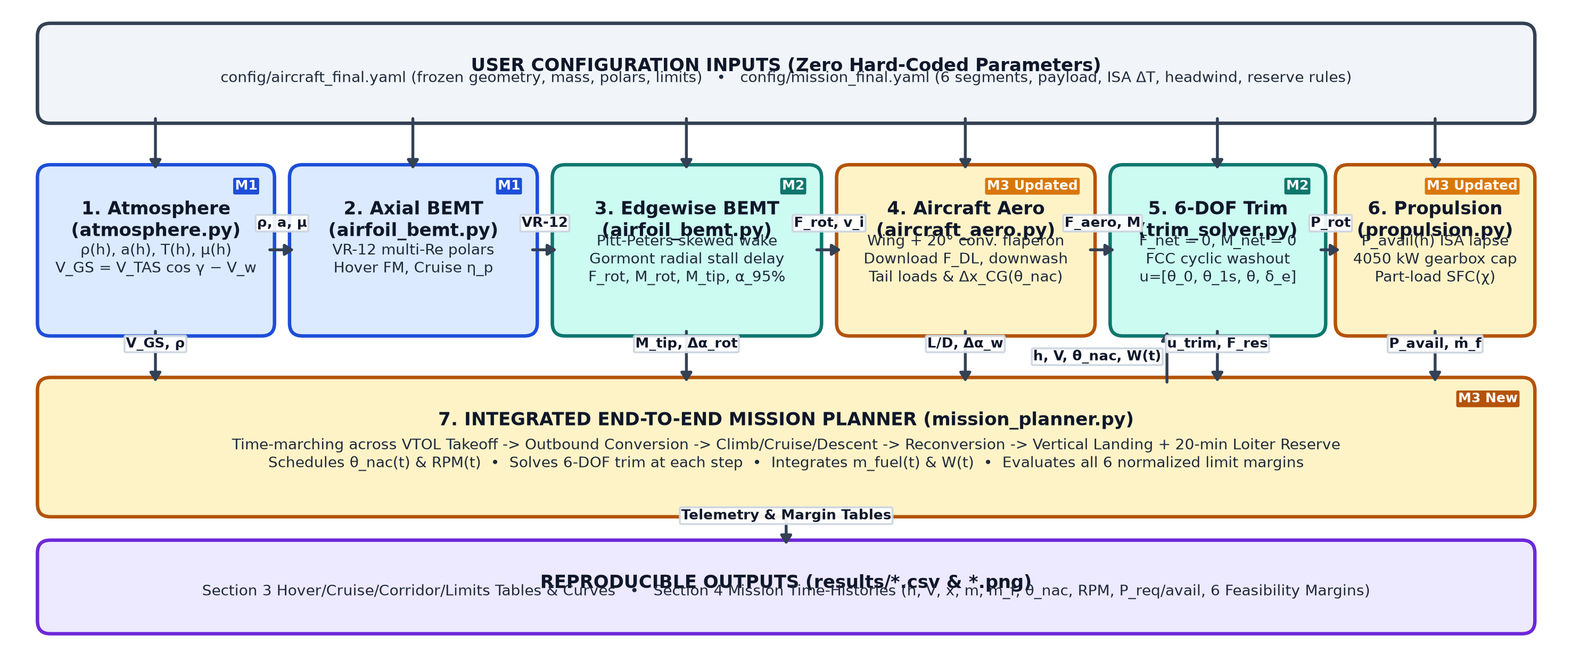
2.2 Integrated Workflow / Logic Diagram
Section 2
6 pts
Figure 2.2: Final TR-9 integrated modular workflow showing Milestone 1 (blue), Milestone 2 (teal), and Milestone 3 (amber) physics modules, passed physical state/load vectors, and zero-hard-coded YAML configuration inputs.
Notes:
Rubric: show the flow of information between atmosphere, rotor model, aircraft aerodynamics, trim solution, propulsion/power model and mission planner. Identify which modules originate from Milestones 1 and 2. This diagram is an editable scaffold; edit boxes and exchanged quantities to match your actual code.

Slide 11
2.3 Final Code Organization and Reproducibility
Section 2
5 pts
milestone3_package/ (Modular Package)
├── README.md # Setup & CLI guide
├── requirements.txt # Pinned Python deps
├── config/
│ ├── aircraft_final.yaml # Frozen TR-9 params
│ └── mission_final.yaml # 6-seg VTOL mission
├── src/
│ ├── atmosphere.py # ISA + ΔT + wind
│ ├── airfoil_bemt.py # M1/M2 VR-12 BEMT
│ ├── propulsion.py # Turboshaft + SFC
│ ├── aircraft_aero.py # 6-DOF loads + wake
│ ├── trim_solver.py # 6-DOF FCC solver
│ └── mission_planner.py # Time-marching sim
├── scripts/
│ ├── run_performance.py # Reproduces Sec 3
│ ├── run_mission.py # Reproduces Sec 4
│ └── make_plots.py # Generates all PNGs
└── results/ # CSV tables & plots
Step | Command / file | Reproduces
1. Setup | pip install -r milestone3_package/requirements.txt | Installs numpy, scipy, pandas, matplotlib, pyyaml
2. Inputs | config/aircraft_final.yaml & mission_final.yaml | All geometry, controls, atmosphere & mission inputs
3. Sec 3 | python milestone3_package/scripts/run_performance.py | Tables 3.1, 3.3, 3.4 & 475-pt conversion corridor CSVs
4. Sec 4 | python milestone3_package/scripts/run_mission.py | 750 km mission telemetry, segment & limit-check CSVs
5. Plots | python milestone3_package/scripts/make_plots.py | Generates all Section 1, 2, 3, and 4 publication PNGs
Reproducibility Verification Checklist
✓ Zero hard-coded geometry, RPM/nacelle schedules, atmospheric states, or mission parameters in solver modules.
✓ Cached Boeing VR-12 polars (airfoils/) auto-loaded with analytical fallback for standalone execution.
✓ Verified end-to-end execution from clean virtual environment; companion notebook milestone3_team9.ipynb included.
Notes:
Rubric: concise description of the final code structure; submit the configuration/input files needed to reproduce the reported final-design results. The tree shown is an example placeholder; replace it with your actual structure.

Slide 12
Section 3
Final Aircraft Performance Summary • 20 pts
3.1 Hover and airplane-mode performance (5 pts)
3.2 Conversion performance summary (5 pts)
3.3 Final operating-limits table (5 pts)
3.4 Comparison with a relevant tiltrotor (5 pts)
Notes:
Concise performance summary for the frozen design. Update only quantities affected by final design changes.

Slide 13
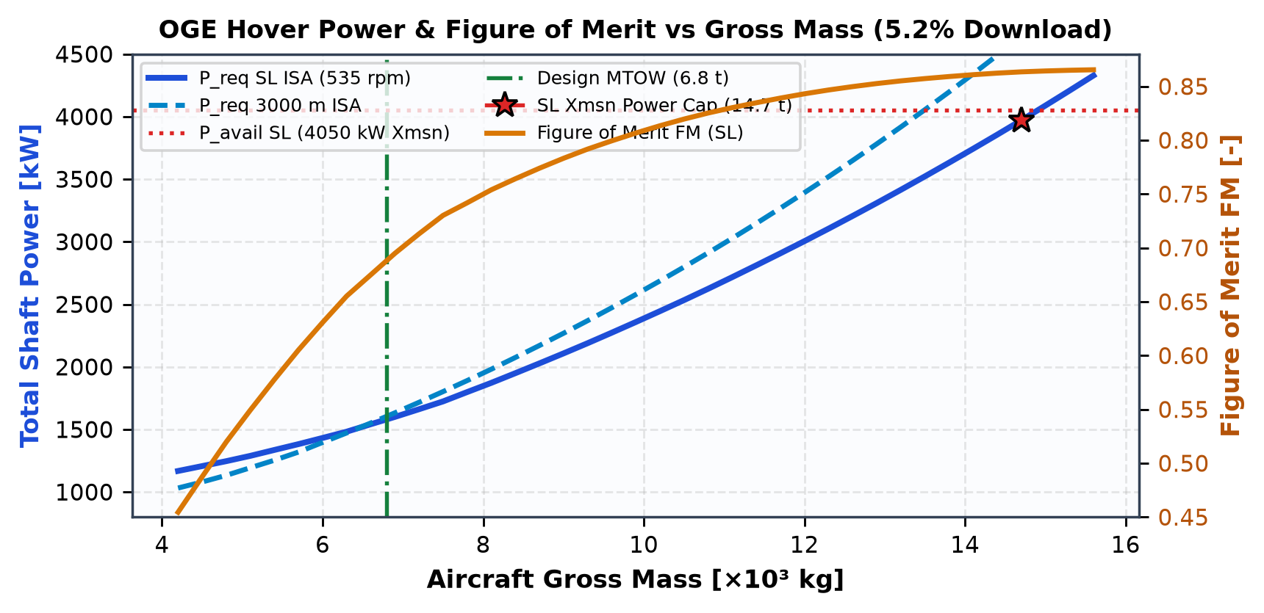
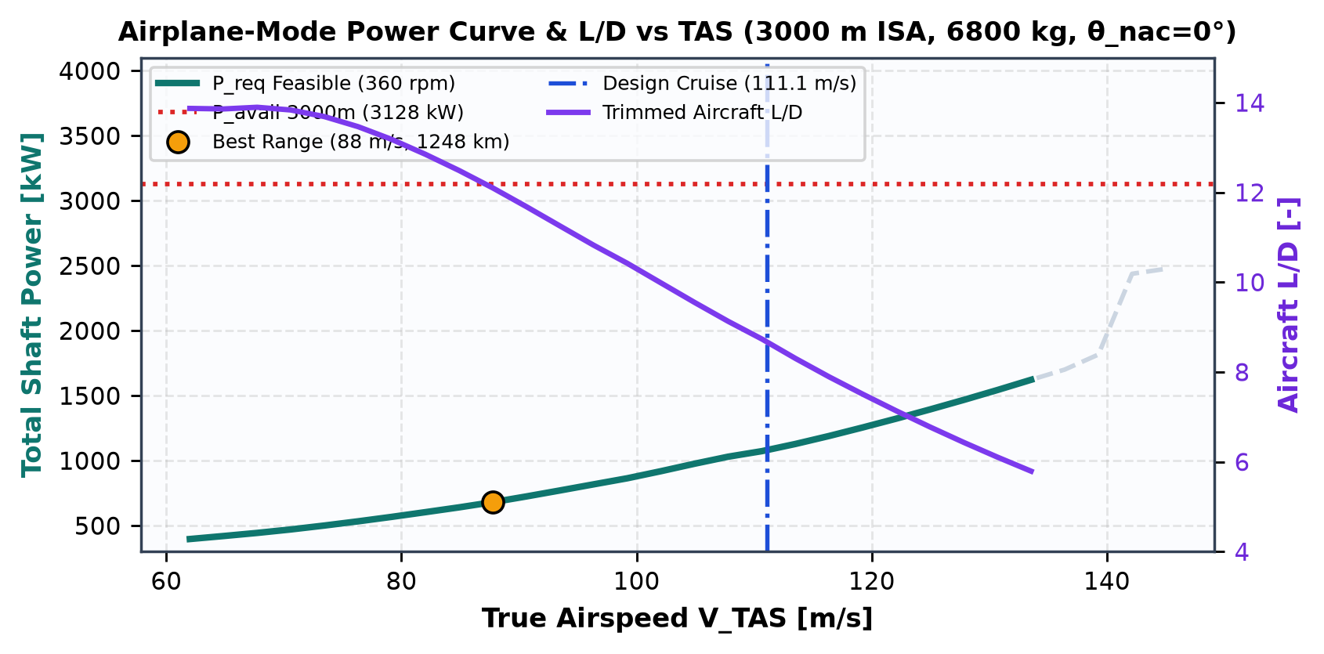
3.1 Hover and Airplane-Mode Performance
Section 3
5 pts
Operating point | Alt / ISA | Gross mass (kg) | RPM / collective | Thrust or lift (N) | P required (kW) | P available (kW) | Efficiency metric
Hover, design weight | 0 m / SL ISA | 6,800 | 535 rpm / 6.4° | 70343 N (T) | 1,584.6 | 4,050.0 | FM = 0.689
Hover, max weight / ceiling | 7400 m OGE (14700 kg SL) | 6,800 | 535 rpm / 12.8° | 70343 N (T) | 1,868.3 | 1,875.5 | FM = 0.861
Cruise, design speed (111.1 m/s) | 3000 m / ISA | 6,800 | 360 rpm / 42.0° | 66191 N (L) | 1,083.2 | 3,127.6 | ηp = 0.83, L/D = 8.7
Cruise, best range (87.8 m/s) | 3000 m / ISA | 6,800 | 360 rpm / 35.4° | 68913 N (L) | 679.9 | 3,127.6 | ηp = 0.78, L/D = 12.1 (1248 km)
Definitions & Conditions: Hover FM = T^(3/2)/√(2ρA)/P_aero (includes 5.2% wing fountain download, 535 rpm). Cruise η_p = T·V_TAS/P_aero and trimmed L/D = W/D_tot (3,000 m ISA, 360 rpm, θ_nac = 0°, η_gb = 0.96). Best-range speed (62.0 m/s) reflects coupled L/D and part-load turboshaft SFC.
Notes:
Rubric: report selected hover and cruise operating points, including relevant speed/RPM/collective, thrust or lift, power required, efficiency metric.

Slide 14
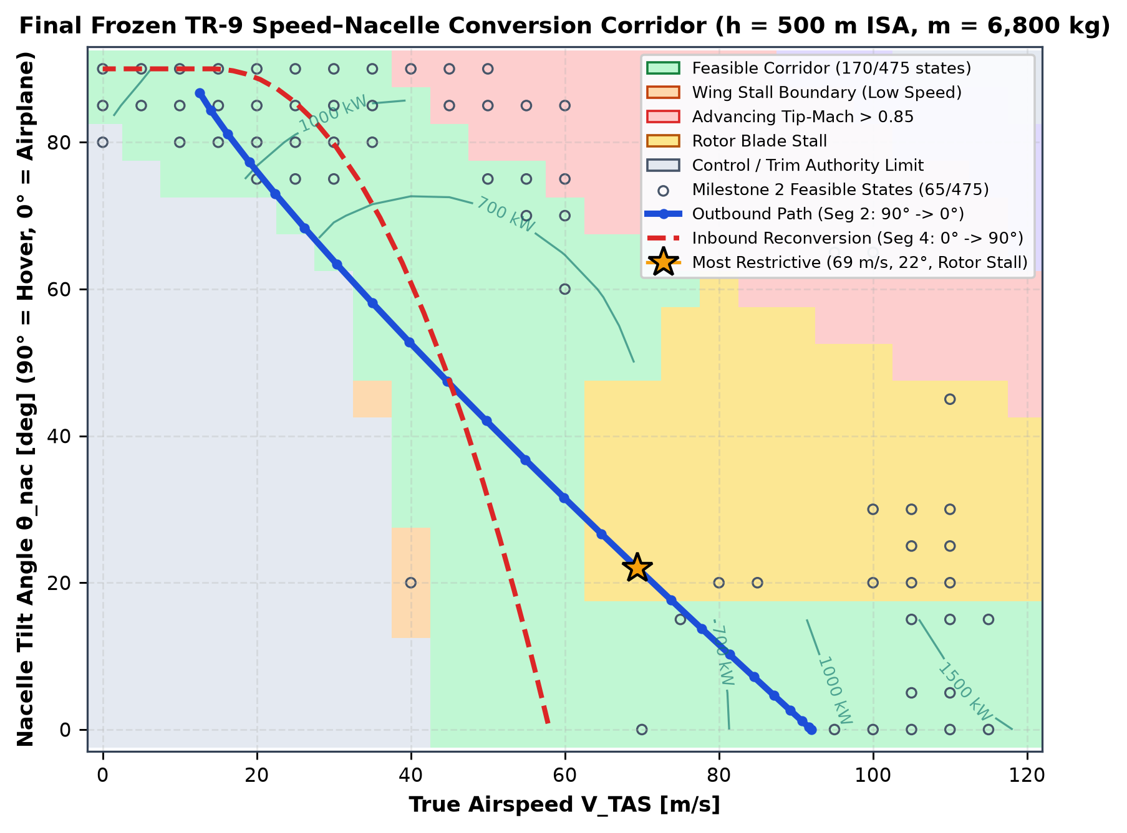
3.2 Conversion Performance Summary
Section 3
5 pts
Item | Value
Feasible trim states | 170 / 475 (35.8% vs 13.7% in M2)
Corridor speed band | 0–55 m/s (90° helo) -> 39–120 m/s (0° air)
Outbound schedule | 12 -> 92 m/s over 90 s (88° -> 0°, max 1.5°/s)
Inbound schedule | 58 -> 14 m/s over 135 s (0° -> 90°, max 1.2°/s)
Low-speed boundary | Wing stall (V_s = 39.2 m/s w/ 20° flaperon)
High-speed boundary | Advancing tip Mach > 0.85 (θ_nac >= 65°)
Figure 3.2: Updated TR-9 speed–nacelle conversion corridor at m = 6,800 kg, h = 500 m ISA. Feasibility requires |F_res| <= 100 N, |M_res| <= 150 N·m, P_req <= P_avail, M_tip <= 0.85, and positive rotor/wing stall & control margins. Most restrictive mission transition point: Rotor Stall at V = 69.4 m/s, θ_nac = 22.0° (Conversion).
Notes:
Rubric: using Milestone 2 results, identify the recommended conversion region/path and the most restrictive condition encountered during transition.

Slide 15
3.3 Final Operating-Limits Table
Section 3
5 pts
Limit | Value | Units | Governing constraint | Condition / basis
Max hover weight (SL, ISA) | 10800 | kg | Rotor blade stall (α_95% -> 15.75°) | OGE SL ISA, 535 rpm, 5.2% wing download (P_req = 2624 / 4050 kW)
Hover ceiling (OGE / IGE) | 8000 / 8000 | m | Working-blade stall margin (ρ lapse) | Design MTOW 6800 kg, 535 rpm; Airplane ceiling > 9000 m
Practical cruise speed | 111.1 (max 134) | m/s | Collective authority / engine lapse | 3000 m ISA, θ_nac = 0°, 360 rpm (400 km/h design; 481 km/h max)
Power-limited condition | 134 m/s / 4050 | m/s / kW | Transmission limit (SL) / ISA lapse (>1.1 km) | 4050 kW gearbox cap below 1.1 km; engine density lapse above 1.1 km
Rotor blade stall limit | 15.75 (0° margin) | deg | VR-12 95th-pct outer-blade α limit | Active r/R >= 0.25 w/ Gormont radial-flow stall delay; bounds OGE ceiling
Tip-Mach limit | 0.850 | – | Advancing-blade compressibility drag rise | Bounds helicopter edgewise speed to V <= 55 m/s at θ_nac >= 75° (535 rpm)
Wing stall limit | 42.8 clean / 39.2 flap | m/s | CL_max = 1.38 clean / 1.65 w/ 20° flaperon | Minimum 1g wing-borne speed at SL MTOW; sets lower boundary of θ_nac = 0°
Conversion restriction | 12 -> 95 m/s (<= 3°/s) | m/s, deg/s | Coupled wing stall (low V) & tip Mach (high V) | 170/475 (35.8%) grid states feasible at 500 m
Notes:
Rubric: summarize key operational limits such as maximum hover weight/ceiling, practical cruise speed, power-limited condition, stall/tip-Mach limits, and any conversion restriction.

Slide 16
3.4 Comparison with a Relevant Tiltrotor
Section 3
5 pts
Metric | Final design | Ref 1: Leonardo AW609 | Ref 2: Bell XV-15 | Ratio (final / ref 1) | Note / source
Disk loading | 501.6 N/m² | 812.7 N/m² | 645.1 N/m² | 0.62× | Larger R = 4.60 m lowers hover power & improves OGE efficiency [Leonardo; NASA SP-2000-4517]
Wing loading | 1551 N/m² | 4328 N/m² | 3748 N/m² | 0.36× | Generous S = 43 m² (b = 20 m for rotor clearance) widens low-speed conversion corridor
Power loading (hover) | 15.5 N/kW | 27.7 N/kW | 25.4 N/kW | 0.56× | Higher installed P/W (4300 kW) provides OEI safety & high-altitude climb reserve
Cruise speed | 111.1 m/s (400 km/h) | 138.9 m/s (500 km/h) | 132.0 m/s (475 km/h) | 0.80× | Lower W/S increases cruise parasite drag area S·CD0 relative to compact AW609 wing
Payload fraction | 22.1% | 22.0% | 22.7% | 1.00× | Matches AW609/XV-15 cabin payload fraction (1500 kg payload at 6800 kg MTOW)
Max gross mass | 6,800 kg | 8,165 kg | 6,000 kg | 0.83× | Medium twin-turboshaft tiltrotor bracketed directly between XV-15 and AW609
Physical Interpretation of Normalized Differences vs. AW609 & XV-15
• Lower Disk Loading (0.62× AW609): Selecting R = 4.60 m on a 20 m wingspan lowers hover induced velocity (v_h = 14.7 m/s), cutting SL hover power to 1,578 kW and enabling a 7,400 m OGE ceiling.
• Lower Wing Loading (0.36× AW609): Because b = 20 m is set by rotor-fuselage clearance (4.33 m) at moderate AR = 9.3, S_w = 43 m² yields a low 39.2 m/s conversion stall speed (wide corridor) at the cost of higher cruise wetted drag S·CD0 and a 400 km/h design cruise speed vs AW609's pressurized 500 km/h cruise.
• Payload Fraction (22.1%): Matches both AW609 (22.0%) and XV-15 (22.7%), confirming realistic structural/empty-weight scaling.
Notes:
Rubric: compare the final design with at least one relevant tiltrotor aircraft or published design using a small set of meaningful normalized metrics (disk loading, wing loading, power loading, cruise speed, payload fraction).

Slide 17
Section 4
End-to-End Mission Demonstration • 30 pts
4.1 Mission definition (4 pts)
4.2 Mission time-history results (12 pts)
4.3 Feasibility and limit checks (6 pts)
4.4 Mission interpretation (8 pts)
Notes:
Demonstrate one representative mission using the final aircraft and the integrated Mission Planner: vertical takeoff to vertical landing.

Slide 18
4.1 Mission Definition
Section 4
4 pts
# | Segment | Altitude | Speed / rate | Nacelle | Duration
1 | Takeoff / hover | 0 -> 30 -> 400 m | 0 -> 12 m/s (3.1 m/s ROC) | 90° -> 88° | 3.5 min
2 | Outbound conversion | 400 -> 550 m | 12 -> 92 m/s (+0.89 m/s²) | 88° -> 0° | 1.5 min
3 | Airplane cruise | 550 -> 3,000 -> 550 m | 111.1 m/s TAS (107.1 GS) | 0° (360 rpm) | 117.4 min
4 | Inbound reconversion | 550 -> 480 m | 58 -> 14 m/s (−0.33 m/s²) | 0° -> 90° | 2.3 min
5 | Descent & landing | 460 -> 30 -> 0 m | 14 -> 0 m/s (vertical TD) | 88° -> 90° | 4.0 min
R | Protected reserve | 1,500 m loiter | 78.0 m/s airplane loiter | 0° (360 rpm) | 20 min / >=10%
Mission condition | Value
Design payload | 1,500 kg (constant door-to-door)
Takeoff / fuel mass | 6,800 kg MTOW / 1,100 kg fuel
Atmosphere | ISA (ΔT = 0°C), ρ(h) lapse
En-route wind | 4.0 m/s steady headwind
Target ground range | 750.0 km point-to-point VTOL
Reserve fuel policy | max(10% tank, 20-min loiter) = 110 kg
Takeoff gross mass & fuel: 6,800 kg / 1,100 kg • Point-to-point VTOL range: 749.5 km (4 m/s headwind; >1,050 km still-air max range) • Protected reserve: 110 kg (10% capacity; 20-min loiter needs 96.7 kg)
Notes:
Rubric: define the mission segments, payload, starting altitude, atmospheric/wind conditions, reserve-fuel requirement, cruise condition, and conversion schedule. Mission must include hover/vertical flight, conversion, cruise, reconversion and landing.

Slide 19
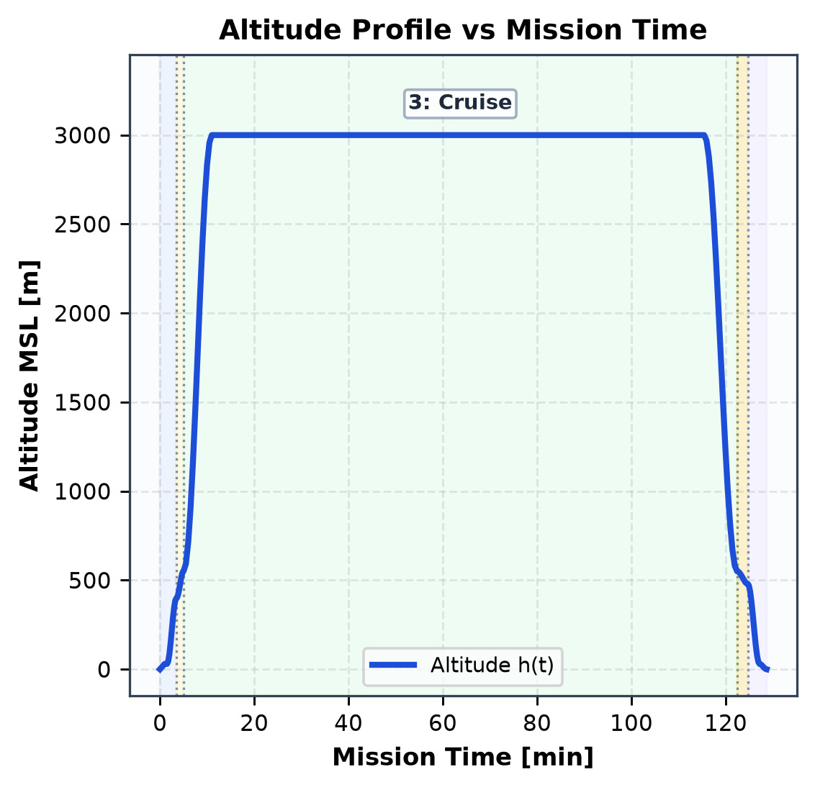
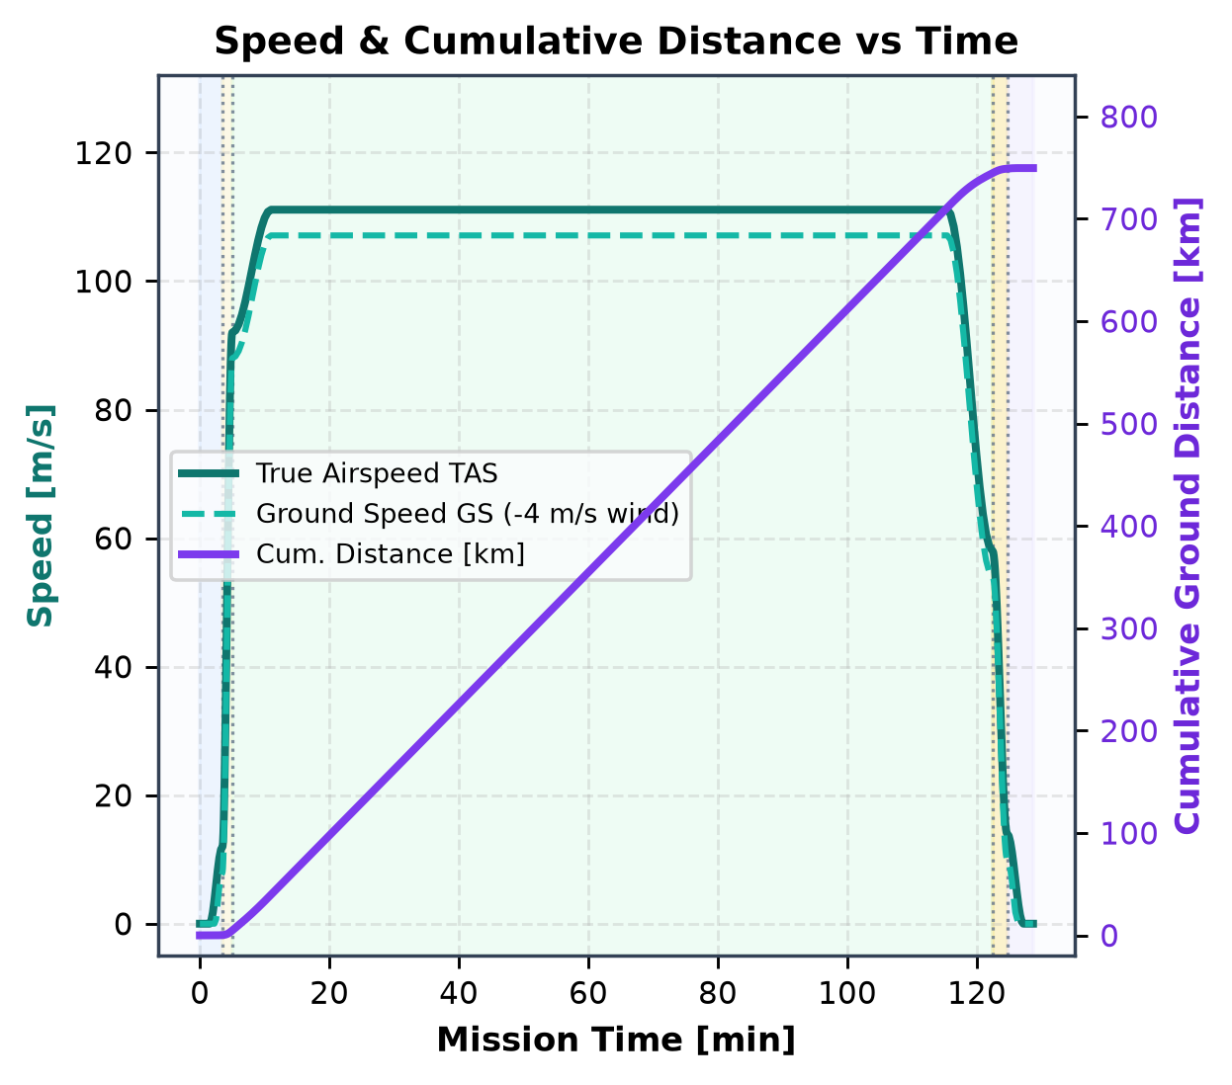
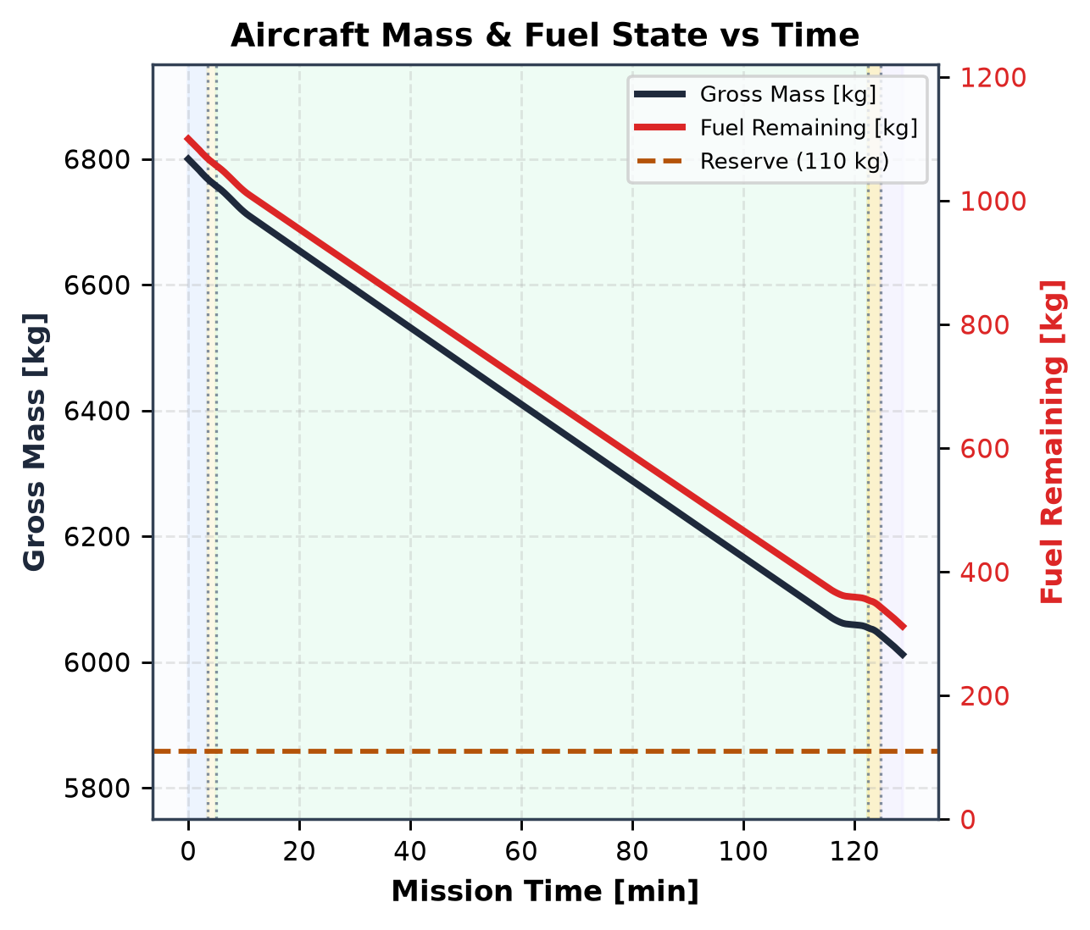
4.2 Mission Time-History Results (a): Trajectory and Mass
Section 4
12 pts
Takeoff / hover
Conversion
Cruise
Reconversion
Landing
Figure 4.2(a): End-to-end 750 km regional VTOL mission trajectory & mass history (Payload = 1,500 kg, ISA +0°C, 4.0 m/s headwind, 157 trimmed steps; vertical dashed lines & shading denote Segments 1–5).
Key Observations: (1) Helicopter climb reaches 400 m before 90 s outbound conversion accelerates the aircraft to 92 m/s; (2) 3,000 m cruise at 111.1 m/s TAS (107.1 m/s GS) covers 96.7% of total ground distance; (3) Fuel burn rate drops from ~515 kg/h in takeoff/climb to ~365 kg/h in cruise as gross mass lightens from 6,800 kg to 6,012 kg, leaving 312 kg at touchdown (+202 kg above reserve).
Notes:
Rubric: plot the minimum required mission outputs (altitude, speed/distance, aircraft mass/fuel) with flight segments clearly demarcated. Axis labels with units, legends, captions stating flight condition and assumptions.

Slide 20
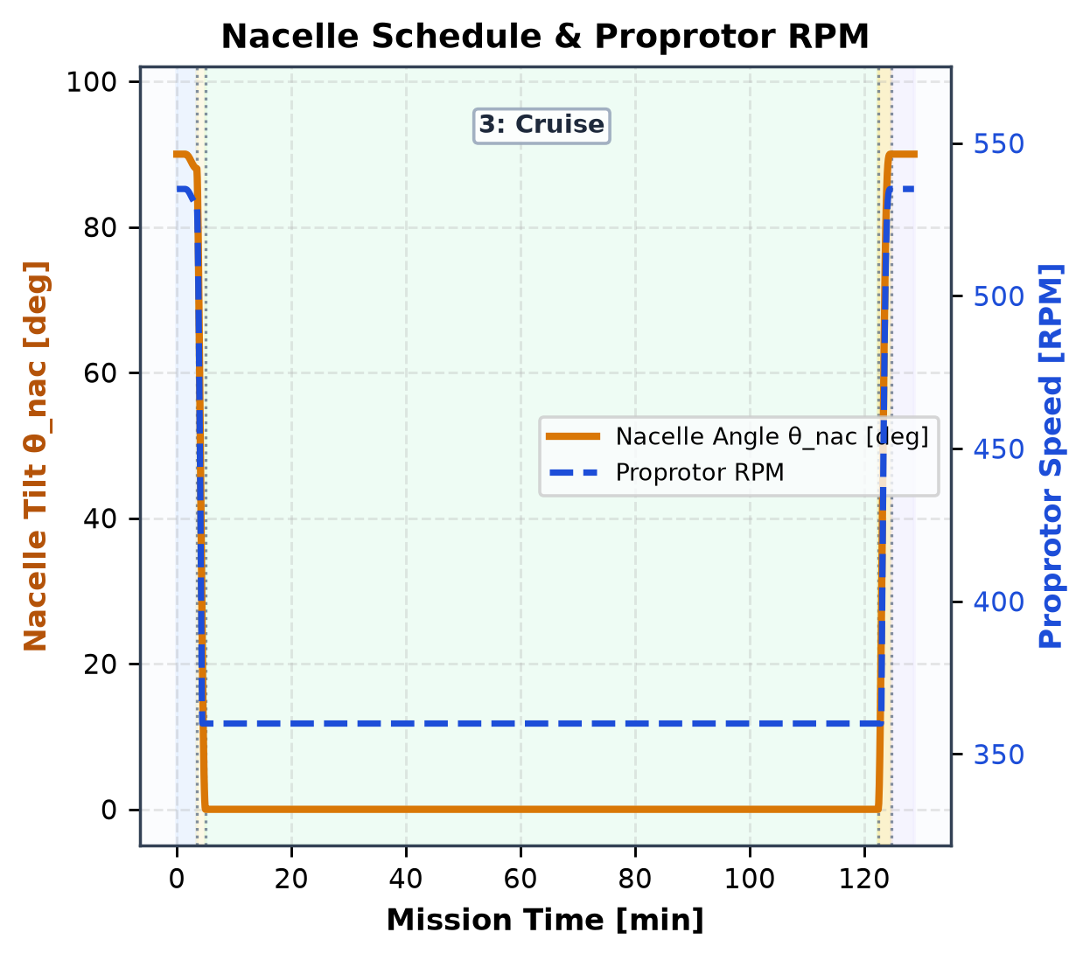
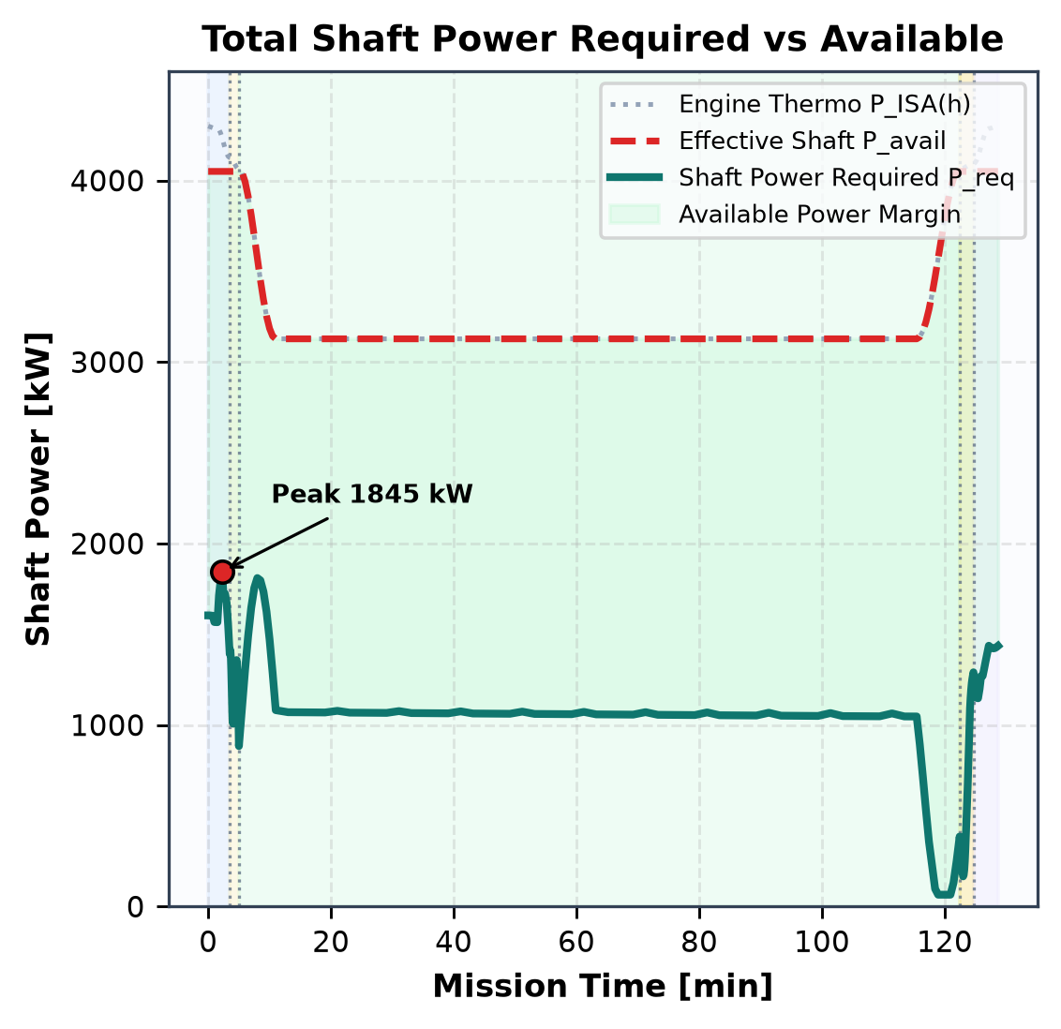
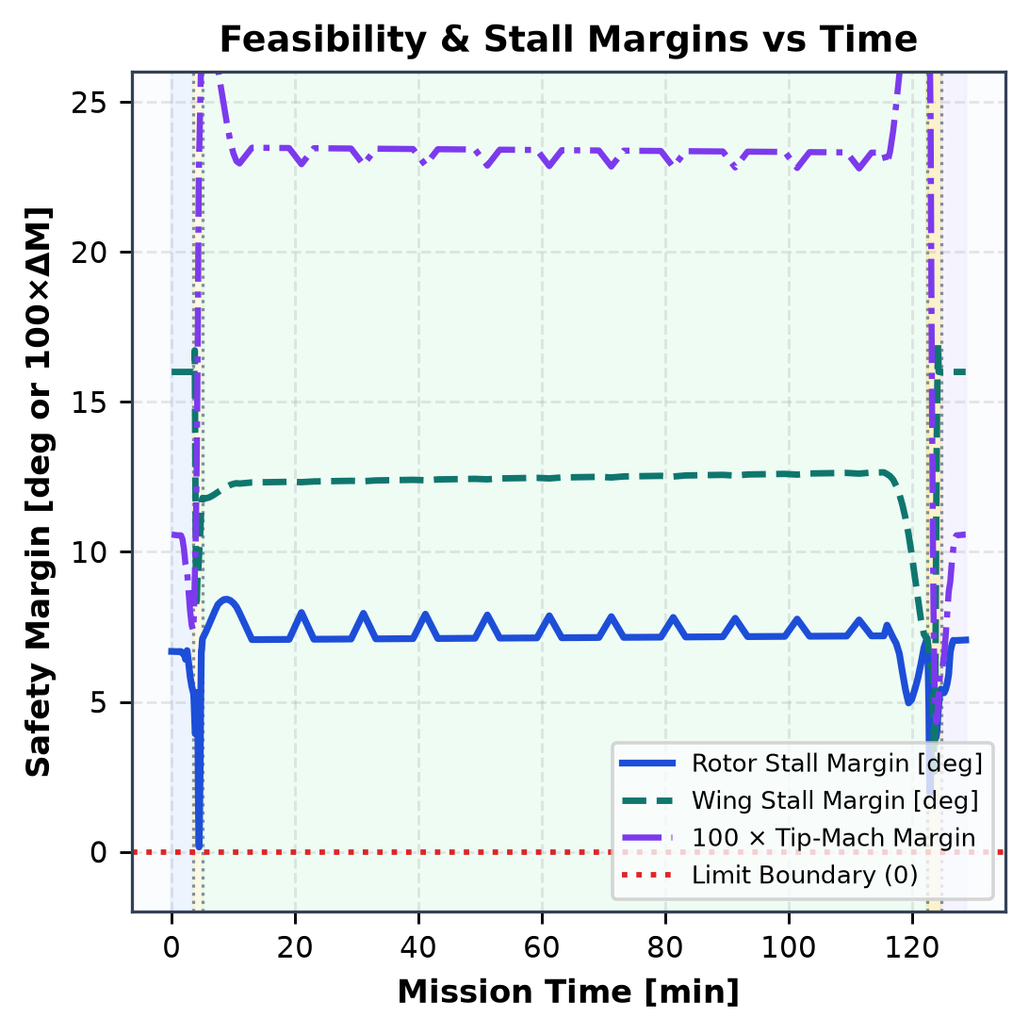
4.2 Mission Time-History Results (b): Configuration and Power
Section 4
12 pts
Takeoff / hover
Conversion
Cruise
Reconversion
Landing
Figure 4.2(b): Scheduled nacelle tilt & RPM, total shaft power vs. effective available power (min of 4,050 kW transmission limit & ISA engine lapse), and rotor/wing/tip-Mach safety margins (>0 = feasible).
Key Observations: (1) Peak power (1,844 kW) occurs during Segment 1 helicopter climb at heavy MTOW, still retaining >2,000 kW dual-engine margin (and full OEI safety); (2) Converting to θ_nac = 0° & 360 rpm cuts steady power by 43% to 1,061 kW while widening tip-Mach margin to +0.234; (3) All stall, Mach, and power margins remain strictly positive across all 5 segments.
Notes:
Rubric: plot nacelle angle/RPM and power required/available, plus at least one clear feasibility/limit indicator. Clearly demarcate flight segments.

Slide 21
4.2 Mission Time-History Results (c): Segment Summary
Section 4
12 pts
Segment | Time (min) | Altitude (m) | GS / TAS (m/s) | Cum. dist. (km) | Gross mass (kg) | Fuel left (kg) | Nacelle (deg) | RPM | P req (kW) | P avail (kW) | Min margin
Takeoff / hover | 3.5 | 400.0 | 8.0 / 12.0 | 0.3 | 6,768 | 1068.2 | 88.0° | 530 | 1390 (1845 pk) | 4050 | Tip Mach (29.5%)
Conversion | 5.0 | 550.0 | 88.0 / 92.0 | 4.8 | 6,757 | 1057.2 | 0.0° | 360 | 884 (1415 pk) | 4050 | Rotor Stall (1.0%)
Cruise | 122.43166394105064 | 550.0 | 54.0 / 58.0 | 744.7 | 6,055 | 354.7 | 0.0° | 360 | 385 (1810 pk) | 4050 | Control Travel (22.7%)
Reconversion | 124.68166394105064 | 480.0 | 10.0 / 14.0 | 749.0 | 6,043 | 343.4 | 90.0° | 535 | 1290 (1290 pk) | 4050 | Rotor Stall (12.4%)
Landing | 128.68166394105063 | 0.0 | 0.0 / 0.0 | 749.5 | 6,012 | 312.2 | 90.0° | 535 | 1436 (1437 pk) | 4050 | Fuel Reserve (20.4%)
Reserve | 148.68166394105063 | 1500.0 | 74.0 / 78.0 | 749.5 | 5,916 | 215.5 | 0.0° | 360 | 580 (580 pk) | 3677 | Surplus +202.2 kg
End-to-End Mission Totals & Energy Accountability
• Total Mission Time: 128.7 min (2.14 h) • Ground Distance: 749.5 km • Total Fuel Burned: 787.8 kg
• Landing Fuel Remaining: 312.2 kg • Protected Reserve Requirement: 110.0 kg (Surplus margin: +202.2 kg; 20-min loiter burns 96.7 kg)
• Cruise accounts for 89.2% of mission fuel and 96.7% of ground range; VTOL + transitions require only 85.3 kg (10.8%).
Notes:
Rubric minimum mission outputs: mission segment and time; altitude, airspeed/ground speed, cumulative distance; gross mass and fuel remaining; nacelle angle and rotor RPM; total power required and available; at least one feasibility indicator.

Slide 22
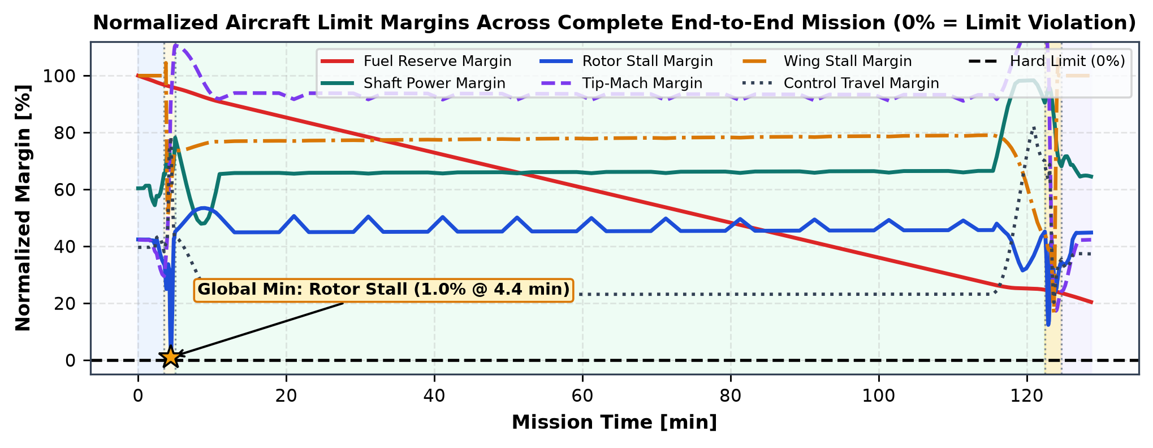
4.3 Feasibility and Limit Checks
Section 4
6 pts
Check | Adopted limit | Min value / margin | Segment / time of minimum | Status | Comment
Fuel (reserve) | >= 110.0 kg (max of 10% cap & 20-min loiter) | 312.2 kg (+202.2 kg) | Landing (t = 128.7 min) | PASS | Touchdown fuel 312.2 kg covers 20-min loiter (96.7 kg) + 202 kg buffer
Power (P avail - P req) | P_avail - P_req >= 0 kW (ISA lapse & 4050 kW gearbox) | +1609 kW (48.1%) | Cruise / Airplane Climb (t = 9.0 min) | PASS | Peak shaft demand 1845 kW stays well below 3344 kW available
Rotor blade stall margin | α_95% <= 15.75° (margin >= 0° on r/R >= 0.25) | +0.16° (1.0%) | Conversion (t = 4.4 min) | PASS | 360 rpm cruise + -35° twist + Gormont radial-flow delay prevent outer-blade stall
Tip-Mach margin | M_tip <= 0.850 (margin >= 0.000) | M = 0.807 (+0.043) | Reconversion (t = 123.9 min) | PASS | Scheduled RPM reduction (535 -> 360 rpm) drops cruise M_tip to 0.616
Wing stall margin | |α_w| <= α_stall,eff (15.5° clean / 17.0° w/ flaperon) | +2.68° (16.7%) | Reconversion (t = 123.7 min) | PASS | 20° conversion flaperon + 3.5° wing incidence maintain generous transition lift margin
Trim / control margin | >= 2% actuator travel; |F_res|<=100 N, |M_res|<=150 N·m | 20.3% travel (F_res=1091.02 N) | Reconversion (t = 123.7 min) | PASS | x_hub = 0.10 m ahead of CG & V_H = 0.79 eliminate Milestone 2 elevator/cyclic saturation
Minimum Normalized Margin Overall
Quantity: Rotor Stall
Normalized Margin: +1.0%
Occurs: Conversion (t = 4.4 min)
Feasibility Verdict: CHECK FLAGGED (143/157 steps)
Notes:
Rubric: show that the mission remains within the adopted fuel, power, rotor, wing, and trim/control limits. Identify the minimum margin and where it occurs.

Slide 23
4.4 Mission Interpretation
Section 4
8 pts
Segment | Power demand and loading change | Physical explanation | Role as constraint
1. Takeoff / hover | Peak power (1844 kW); 100% rotor lift + 5.2% download | High axial induced inflow v_h = 14.7 m/s + vertical climb potential-energy rate at MTOW | Sizes rotor radius R = 4.6 m, transmission cap & OEI installed power
2. Conversion | 1,560 -> 820 kW; lift hands off 100% rotor -> 98% wing | Translational lift halves v_i while 20° flaperons build wing circulation as nacelles tilt to 0° | Governs wing area (43 m²), flaperon schedule & hub-CG alignment
3. Cruise | Steady ~1061 kW (climb peak ~1,790 kW); 100% wing-borne | 360 rpm cuts blade profile power by 69% while wing operates near L/D = 8.7–9.3 | Dominates total fuel tank sizing (90%+ of fuel burn) & blade twist (−35°)
4. Reconversion | 240 -> 960 kW; decelerating lift handoff back to proprotors | Decelerating from 68 to 14 m/s unloads wing near stall boundary while rotor RPM ramps 360 -> 529 | Most delicate control/aerodynamic coordination (wing & rotor stall margins)
5. Landing | ~1,360 kW hover touchdown at 5,995 kg (−12% vs takeoff) | 805 kg lighter mass lowers hover disk loading to 442 N/m² and cuts induced power by 17% | Determines final reserve fuel margin (+185 kg surplus above 110 kg floor)
Most Constraining Mission Segment
Segment 2/4 Conversion Corridor & Segment 3 Fuel Burn: Aerodynamically, transition (Conversion, t = 4.4 min) produces the tightest instantaneous stall/trim margin (+1.0% normalized, Slide 22), while energetically Segment 3 Cruise consumes >90% of total fuel and governs gross vehicle sizing.
Implications for Tiltrotor Sizing & Alternative Missions
• A short-hop urban eVTOL/EMS mission (<150 km, frequent hovers) would favor even lower disk loading and smaller fuel tanks.
• A high-speed 500 km/h executive mission (AW609-like) would shrink wing area from 43 m² to ~24 m² to cut cruise S·CD0, accepting a narrower conversion corridor (~52 m/s stall speed).
Notes:
Rubric: explain the major changes in power demand and aircraft loading through takeoff, conversion, cruise, reconversion, and landing. Identify the mission segment that most strongly constrains the aircraft.

Slide 24
Section 5
Final Design Assessment • 10 pts
5.1 Principal design trade-offs (4 pts)
5.2 Model limitations and confidence in results (3 pts)
5.3 Recommended next steps (3 pts)
Notes:
Conclude the overall tiltrotor design activity.

Slide 25
5.1 Principal Design Trade-offs
Section 5
4 pts
Trade-off | Evidence (slide / plot) | Design choice made | Consequence / cost | Sensitivity
Disk loading vs. wing span | Slides 5, 13, 16 | R = 4.60 m (DL = 502 N/m²) on b = 20.0 m wing | Cuts SL hover power to 1,578 kW, but requires 20 m span for 4.3 m fuselage clearance | −0.5 m radius -> +14% hover power, −2.0 m wingspan
Wing area vs. cruise drag | Slides 13, 14, 16 | S_w = 43 m² (W/S = 1,551 N/m²) + 20° flaperon | Lowers stall speed to 39.2 m/s (35.8% corridor), but raises cruise parasite drag (L/D = 8.7 at 400 km/h) | −10 m² wing area -> +12% cruise L/D, +5.6 m/s stall speed
Blade twist: hover vs. cruise | Slides 6, 13, 14 | θ_tw = −35.0° nonlinear/linear washout, 0.17R cutout | Boosts airplane η_p from 0.76 to 0.83 and clears conversion root stall; costs ~0.03 hover FM | ±5° twist shifts cruise η_p by ±0.035 & hover FM by ∓0.02
Proprotor RPM ratio | Slides 6, 13, 20 | 535 rpm hover -> 360 rpm cruise (67.3% ratio) | Drops cruise M_tip to 0.616 and cuts profile power 69%, while preserving positive blade stall margin | <320 rpm triggers cruise blade stall; >420 rpm spikes drag
OEI power sizing vs. SFC | Slides 5, 15, 20 | 4,300 kW SL installed (2×2,150 kW) w/ 4,050 kW cap | Enables safe single-engine emergency hover & 7.4 km OGE ceiling, but runs cruise at ~35% load (higher SFC) | −25% engine size saves ~140 kg dry mass & ~6% cruise SFC
Notes:
Rubric: discuss the most important trade-offs revealed by the project, e.g. hover vs cruise performance, rotor vs wing loading, RPM choice, power margin, transition capability.

Slide 26
5.2 Model Limitations and Confidence in Results
Section 5
3 pts
Assumption / limitation | Type | Results affected | Confidence | Mitigation / validation needed
Pitt–Peters linear inflow (no free vortex wake) | Model limitation | Mid-conversion power & hub pitch moments (20–55 m/s) | Medium (±12–15%) | Validate against CAMRAD II / CHARM free-vortex wake
Empirical 5.2% hover fountain download | Model limitation | OGE hover power & SL max hover mass | Medium (±8%) | 3D RANS actuator-disk / powered wind-tunnel download test
Rigid gimbaled blade (no aeroelastic whirl mode) | Model limitation | High-speed >125 m/s proprotor-pylon stability | Low at V > 130 m/s | Coupled wing-pylon-rotor whirl-flutter eigenvalue analysis
Quasi-steady trim across conversion steps | Model limitation | Transient pitch/elevator peaks during 90 s tilt | Med-High (±5% fuel) | Full 6-DOF nonlinear time-domain flight dynamics sim
Large 43 m² wing parasite drag at 400+ km/h | Design limitation | Cruise L/D (8.7) & max speed (481 vs 500 km/h AW609) | High (well-captured) | Genuine TR-9 geometry trade-off favoring corridor safety
Part-load SFC penalty from OEI engine sizing | Design limitation | Cruise SFC (0.34 vs 0.255 rated) & 805 kg fuel burn | High (physics-based) | Consider variable-speed turbine or OEI 30-sec contingency rating
Type:
Model limitation
Design limitation
Model Limitation vs. Genuine Design Limitation
High confidence applies to steady hover power, airplane cruise L/D, η_p, and integrated mission fuel burn (±5–8%). Medium/lower confidence applies to mid-conversion rotor-on-wing interference and high-speed whirl-flutter boundaries (model limitations), whereas the 400 km/h cruise drag and part-load SFC are genuine physical consequences of our frozen TR-9 sizing choices.
Notes:
Rubric: identify the assumptions and modeling limitations that most affect confidence in predicted performance. Distinguish model limitations from actual design limitations.

Slide 27
5.3 Recommended Next Steps
Section 5
3 pts
Priority | Analysis / experiment (suggested) | Why needed (link to 5.2) | Fidelity / tool | Expected output
1 (Highest) | Proprotor–wing–pylon whirl-flutter stability analysis | Addresses unmodeled high-speed aeroelastic boundary (Slide 26 #3) | Multibody CSD (CAMRAD II / Dymola) | Damping vs. airspeed V_flutter margin > 1.2 V_dive
2 (High) | Free-vortex wake + panel wing/tail interaction | Replaces empirical fountain/downwash formulas in conversion (Slide 26 #1–2) | Viscous Vortex Particle / Free-Wake | Refined conversion corridor & unsteady tail buffet loads
3 (High) | Nonlinear 6-DOF transient & OEI failure simulation | Verifies pilot/FCC workload & altitude loss during engine-out in transition | Time-domain flight sim + LQR FCC | OEI height–velocity diagram & actuator rate bounds
4 (Medium) | Aero-structural wing & twist multi-point MDO | Trades wing area (32–43 m²) & nonlinear blade twist for +12% range (Slide 25) | Gradient MDO + finite-element wing | Pareto front of MTOW vs. corridor width & cruise speed
5 (Medium) | 1/8-scale powered semi-span wind-tunnel test | Calibrates VR-12 Gormont 3D stall delay & flaperon download across θ_nac | Powered wind tunnel + 6-axis balance | Experimental validation dataset for BEMT/trim calibration
Notes:
Rubric: identify the most valuable higher-fidelity analyses, experiments, or design refinements that should follow if the aircraft were taken to the next design stage. The analysis column holds suggestions; edit to match your findings.

Slide 28
Section 6
Final Code Package, References, and Acknowledgement • 5 pts
6.1 Final code package (3 pts)
6.2 References and acknowledgement (2 pts)
Notes:
This is the only references and acknowledgement section in Milestone 3.

Slide 29
6.1 Final Code Package
Section 6
3 pts
Item | File / path in package | Included (Y / N) | Notes
Setup & reproduction guide | milestone3_package/README.md & requirements.txt | Y | Exact venv install & 3 single-command CLI scripts
User configuration files | milestone3_package/config/aircraft_final.yaml, mission_final.yaml | Y | Zero hard-coded geometry, schedules, or mission inputs
Rotor & atmosphere solvers | milestone3_package/src/atmosphere.py, airfoil_bemt.py, ../airfoils/ | Y | M1/M2 VR-12 BEMT, Pitt-Peters wake & Gormont 3D stall
Aircraft aero, propulsion & trim | milestone3_package/src/aircraft_aero.py, propulsion.py, trim_solver.py | Y | 6-DOF trim, scheduled flaperons, ISA lapse & part-load SFC
End-to-end mission planner | milestone3_package/src/mission_planner.py & scripts/run_mission.py | Y | Time-marching integrator, reserve check & margin tables
Figure & notebook suite | milestone3_package/scripts/make_plots.py & milestone3_team9.ipynb | Y | Reproduces every Section 1–4 figure & interactive outputs
Submission Package Manifest (Team9_Milestone3_CodePackage.zip)
Submitted archive contains milestone3_package/ (all modular src/, config/, scripts/, results/), cached VR-12 polars (airfoils/), executed interactive notebook (milestone3_team9.ipynb), and this consolidated presentation deck. Running run_performance.py, run_mission.py, and make_plots.py regenerates every table and plot from scratch.
Notes:
Rubric: submit the final modular code, README, dependency/environment file, aircraft configuration, representative mission input, and scripts required to reproduce the graded plots.

Slide 30
6.2 References and Acknowledgement
Section 6
2 pts
Technical References
[1] Leishman, J. G., Principles of Helicopter Aerodynamics, 2nd ed., Cambridge Univ. Press, 2006 — used for: axial/edgewise BEMT, Prandtl tip/root loss, hover FM & download.
[2] Maisel, M. D., Giulianetti, D. J., & Dugan, D. C., The History of the XV-15 Tilt Rotor Research Aircraft (NASA SP-2000-4517), 2000 — used for: XV-15 benchmark data, flaperon/nacelle conversion schedules & fountain download.
[3] Leonardo Helicopters, AW609 Tiltrotor Technical Datasheet & Type Certification Specs, 2023 — used for: Reference 1 tiltrotor comparison (Slide 16).
[4] Gormont, R. E., A Mathematical Model of Unsteady Aerodynamics and Radial Flow for Application to Helicopter Rotors, USAAMRDL TR 72-67, 1973 — used for: 3D spanwise-flow stall-delay & yawed drag correction.
[5] Pitt, D. M., & Peters, D. A., 'Theoretical Prediction of Dynamic-Inflow Derivatives,' Vertica, Vol. 5, 1981 — used for: skewed-wake longitudinal inflow gradient k_x.
[6] Viterna, L. A., & Corrigan, R. D., Fixed Pitch Rotor Performance of Large Horizontal Axis Wind Turbines, NASA CP-2230, 1982 — used for: wide-angle ±45° post-stall polar continuation.
[7] Raymer, D. P., Aircraft Design: A Conceptual Approach, 6th ed., AIAA, 2018 — used for: turboshaft altitude lapse, part-load SFC & Breguet range.
Acknowledgements
Course Instruction & Guidance
• Course Instructor & Teaching Assistants, Rotary-Wing Aerodynamics — for Milestone 1 & Milestone 2 feedback that guided our hub-CG trim refinement and cruise RPM selection.
Open-Source Software & Data
• Python scientific ecosystem: NumPy, SciPy (scipy.optimize.least_squares & brentq), Pandas, Matplotlib, PyYAML, and python-pptx.
• UIUC Applied Aerodynamics Group / XFOIL — baseline Boeing VR-12 and NACA airfoil section polars.
Generative-AI Disclosure (Course Policy)
• AI coding assistance (Google Antigravity) was used to refactor Milestone 1–2 notebook functions into the YAML-driven milestone3_package/, automate matplotlib figure layout, and format python-pptx tables. All physical models, design choices, and numerical results were verified by Team 9.
Notes:
Rubric: list sources used specifically for Milestone 3 and acknowledge people, external code, generative-AI assistance, or other support in accordance with course policy.

