Slide 1
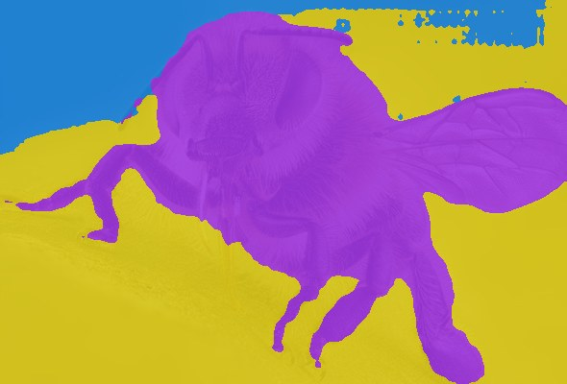
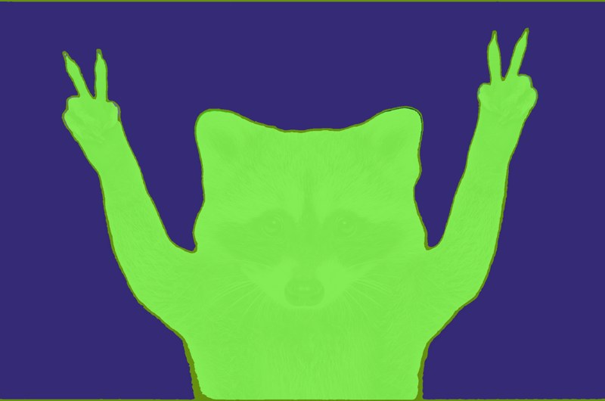
Teaching a model to see animals through a coloured filter
AI of GOD 5.0 | Round 2 presentation
Team The Yeagerists
Aryan Raj (25JE0322)
Arnesh Upadhyaya (25JE0319)
Best public score so far: 0.9235 macro-F1
Notes:
Hi everyone, we are The Yeagerists. The task was to name the animal in an image that has been covered by a coloured segmentation overlay. The two pictures on the right are real training images. In this talk we explain our data checks, the preprocessing, our two best models, and everything else we tried, including the things that did not work. Our best public score so far is 0.9235 macro-F1.

Slide 2
The task: 72 animals, about 43 photos each
3,087
1,179
72
labelled training images
test images to predict
animal classes
What the images are
How we are scored
A real photo with a coloured segmentation overlay on top
The original photo is not given separately
Sizes from 145 to 4,854 px wide, all 8-bit RGB
Macro-averaged F1: every class counts equally
Classes range from 23 images (jellyfish) to 51 images
So small classes matter as much as big ones
Notes:
The numbers: 3,087 labelled images, 1,179 test images and 72 classes. The class sizes are not equal. Jellyfish has only 23 training images and raccoon 34, while the biggest classes have 51. The metric is macro F1, so a weak small class hurts as much as a weak big one. The images are a photo with a coloured mask on top, and image sizes vary a lot.

Slide 3
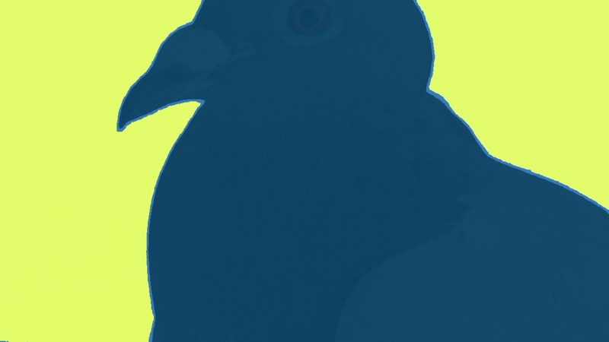
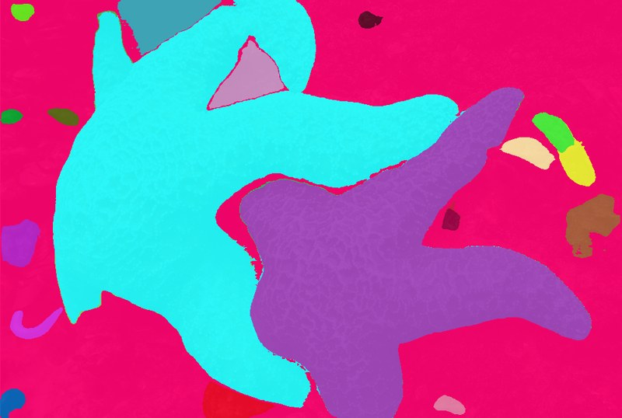
What the images actually look like
Four random training images: the tint colour is different every time
Colour is arbitrary
Photo detail shows through
Quality varies a lot
The same animal can be purple, green or blue. Colour carries no class information, so we treated it as noise.
Fur, eyes and feathers are faintly visible. A sample of 200 train images had a median of about 1,900 unique colours (min 174, max 18,792), so these are not flat masks.
Some images are a clean animal-vs-background, others have many coloured blobs, tight crops, or are tiny (about 300 x 170 px).
Notes:
These are real training images. Notice that the colour of the overlay changes from image to image, and the data description says colour is not a reliable clue to the class. But the overlay is semi-transparent, so you can still faintly see fur, eyes and feathers underneath. We counted unique colours on a sample of 200 images and found a median of about 1,900, far from a flat mask. Quality varies: some images are clean, some have many blobs, and some are very small.

Slide 4
What we checked before modelling
Question | What we found | What we did
Does image size reveal the class? | Random forest on width, height, aspect: 1.65% accuracy vs 1.39% for random guessing | Nothing to exploit. Resize everything the same way
Exact duplicate files? | 0 inside train, 0 between train and test (MD5 hash) | Nothing to remove
Does test look different from train? | A classifier could not tell them apart (AUC 0.49). Mean confidence 0.908 on validation vs 0.903 on test | No domain shift to correct
Near-duplicate photos? | 32.8% of train images have a neighbour with cosine similarity above 0.8 (test to train: 29.3%) | Treat random-fold CV with care
Notes:
Before building models we ran four checks. Size: a random forest using only width, height and aspect ratio got 1.65 percent, basically chance, so there is no size shortcut. Duplicates: an MD5 hash of the raw files found zero exact copies. Shift: we trained a classifier to separate train features from test features and got an AUC of 0.49, which is chance, and the model was equally confident on both. Near-duplicates: about a third of the training images have a very similar neighbour, meaning the same photo or scene may appear more than once. That is why we were careful with cross-validation numbers.

Slide 5
Preprocessing: keep the whole animal
1 Read
2 Pad to square
3 Resize
4 Normalise
>
>
>
RGB image, any size
grey borders, no stretching
224 px (DINOv2) | 320 px (EfficientNet)
mean / std of the pretrained model
Training augmentation (EfficientNet only)
Why these choices
Mild random crop (65-100% of the area)
Random horizontal flip
Hue rotation up to +/-0.5
Random shuffle of the R, G, B channels
Aspect ratios run from 0.42 to 3.5, so we pad instead of stretching or centre-cropping the head off
Colour is random, so hue and channel changes stop the model using it
At test time EfficientNet averages 4 views: original, flip, RGB-to-BGR, and both
Notes:
Preprocessing is the same idea for both models. First we pad each image to a square with grey borders and then resize, so animals are never stretched or cut. DINOv2 uses 224 pixels and EfficientNet uses 320. Then we normalise with the model's own mean and standard deviation. For the fine-tuned EfficientNet we add augmentation during training: a mild random crop, horizontal flip, hue rotation and random channel shuffle. The last two exist only because colour is arbitrary here. At prediction time we average four views of each image: original, flipped, channel-swapped, and both.

Slide 6
The models we used, and why
DINOv2 ViT-B/14
EfficientNetV2-S
ConvNeXt
Vision transformer, self-supervised (Meta)
Convolutional network (Google), ImageNet-21k pretrained
Modern convolutional network (Meta)
What it is
What it is
What it is
Pretrained without labels on about 142M images. Outputs 768 numbers per image that describe shape and parts.
Built for good accuracy with fast training and a small size (about 21M parameters).
A CNN redesigned with ideas from transformers, such as large kernels and LayerNorm.
Why we tried it
Why we tried it
Why we tried it
With only about 43 images per class and random tint colours, we wanted shape-based features we could use frozen.
Fine-tuning adapts the whole network to tinted images, and it trains in minutes on a free T4 GPU.
A second, different CNN to compare against EfficientNet on the same data.
Public score 0.9231
Public score 0.9235
Public score 0.8166 (did not match EfficientNet in our run)
Notes:
These are the three models we compared. DINOv2 is a self-supervised vision transformer from Meta. We use it frozen as a feature extractor, because with about 43 images per class and random colours we wanted shape-based features without training a big network. EfficientNetV2-S is a convolutional network from Google, designed to be accurate and quick to train. We fine-tune all of it so it adapts to tinted images, and it fits easily on a free T4 GPU. ConvNeXt is a modern convolutional network that borrows ideas from transformers. We tried it as a second, different CNN to compare with EfficientNet; in our run it scored 0.8166, so it did not match EfficientNet.

Slide 7
Best model 1: DINOv2 + logistic regression
What it is
DINOv2 ViT-B/14: a vision transformer pretrained without labels on a very large image set
We do not train it. It turns each 224 x 224 image into 768 numbers
A simple classifier (StandardScaler + logistic regression, C = 1) learns the 72 classes from those numbers
Fast to train: only the small classifier is fitted
5-fold CV 0.911
Public leaderboard 0.9231
Notes:
Our first model is deliberately simple. DINOv2 is a vision transformer trained without labels on a huge image collection, and we keep it frozen. Each image becomes a list of 768 numbers. Then we train a standard logistic regression with feature scaling on those numbers. Five-fold cross-validation gave 0.911 on average, and the folds were very consistent, between 0.903 and 0.921. On the public leaderboard it scored 0.9231. The code is the notebook Dinov2-b.ipynb: extract features with timm, then StandardScaler and LogisticRegression.

Slide 8
Best model 2: EfficientNetV2-S fine-tuned
Model | tf_efficientnetv2_s.in21k_ft_in1k (timm)
Input | 320 x 320, padded to square
Optimiser | AdamW, lr 3e-4, weight decay 1e-2, one-cycle schedule
Training | 15 epochs, batch 32, fp16, dropout 0.2, label smoothing 0.1
Data | Fold 0 only: 80% of train, 20% for validation
Checkpoint | Best validation macro-F1 epoch
Validation F1 0.9207 (0.9206 with TTA)
Public leaderboard 0.9235
Notes:
The second model is a fine-tuned convolutional network: EfficientNetV2-S, pretrained on ImageNet-21k and fine-tuned on our images at 320 pixels. We train all of its weights with AdamW and a one-cycle learning rate for 15 epochs, using label smoothing and mixed precision. The curve shows it reaches about 0.89 by epoch five and plateaus near 0.92 after epoch ten. This single model was trained on one fold only, so on 80 percent of the data, and it scored 0.9207 on the held-out fold and 0.9235 on the public leaderboard. The code is EfficientNetv2fold1.ipynb.

Slide 9
Why they work, and where they still fail
Our reading of the results
With about 43 photos per class, a strong pretrained model matters more than a big new one
DINOv2 features describe shape and parts, which survive a colour tint
EfficientNet saw random hue and channel changes in training, so tint cannot be a shortcut
Two different model families both landed near 0.923, which hints that a few hard classes set a ceiling
Interpretation, not a proven cause.
Each class has only about 8 validation images, so single-class scores are noisy.
Notes:
Why do these simple recipes do well? Our reading is that with around 43 images per class, a strong pretrained model matters more than anything else. DINOv2 features describe shape and parts, so a colour tint does not hurt much, and the EfficientNet is trained with random hue and channel shuffles so it cannot use colour. The chart shows the ten weakest classes for EfficientNet on its validation fold. Rat, swan, whale, pig, parrot and bear showed up as weak in both our EfficientNet and our DINOv2-family results too. We label this as interpretation: we did not run an experiment to prove the cause. Also, each class has only about eight validation images, so single-class numbers are noisy.

Slide 10
All experiments: public leaderboard scores
The pattern
The two simplest, best-pretrained recipes scored highest
Our frozen ensemble of bigger models scored lower
More complexity did not mean a better score
Notes:
This chart shows the public leaderboard scores of the experiments we can name. The two top bars are our two best models. The frozen ensemble of bigger models, DINOv2-Large at higher resolution plus CLIP and SigLIP, scored 0.898, which is lower than the simple DINOv2-Base baseline. Our ConvNeXt fine-tune scored 0.8166. The lesson was that more complexity did not automatically help on this data.

Slide 11
What each experiment taught us
Experiment | Result | What we learned
Frozen ensemble: DINOv2-L at 336 px + CLIP-L + SigLIP, plus one round of pseudo-labels | Random-fold CV 0.977 (DINOv2-L 0.975, SigLIP 0.921, CLIP 0.868). Public score 0.898 | A very high CV did not carry over to the leaderboard. We suspect near-duplicate photos in train inflated it. Pseudo-labels added only +0.0006 in CV
ConvNeXt fine-tune | Public score 0.8166 | Did not match EfficientNetV2-S in our run
Train vs test shift checks | AUC 0.49, similar confidence | The gap was not caused by test images being different
Notes:
The big experiment was the frozen ensemble. In random 5-fold cross-validation it looked excellent: 0.977, with DINOv2-Large alone at 0.975. But on the leaderboard it scored 0.898, below our simple baseline. Our explanation is that near-duplicate photos in the training set let a strong model look better in cross-validation than it really is on new images. This is a hypothesis; we did not fully prove it. Pseudo-labelling added almost nothing. The ConvNeXt fine-tune did not match EfficientNet in our setup, and the train-versus-test checks showed no shift.

Slide 12
What we learned
Check validation against the leaderboard
Simple, well-pretrained beats complex
Random CV matched the public score for our two simple models, but not for the large ensemble. A validation score is only as good as its last check.
With about 43 images per class, DINOv2-B + logistic regression and a fine-tuned EfficientNetV2-S were the strongest.
Treat arbitrary colour as noise
The hard classes repeat
Hue shifts and channel shuffles during training let the model focus on shape and texture.
Rat, whale, swan, parrot, bear, pig and possum were among the weakest in both our EfficientNet results and our DINOv2-family results.
Next ideas (prepared, not yet validated): average 5 EfficientNet folds and blend with DINOv2; class weights for small classes such as jellyfish.
Notes:
Four lessons. First, always compare validation with the leaderboard; our large ensemble showed how a high cross-validation score can mislead. Second, on small data a strong pretrained model with a simple head or a careful fine-tune beat more complex setups. Third, colour is noise here, so augmenting hue and channels made sense. Fourth, the same classes keep being hard. The last line is honest about what we have not tested yet: averaging five EfficientNet folds with the DINOv2 model, and class weights for the smallest classes.

Slide 13
Our two best notebooks at a glance
Dinov2-b.ipynb
EfficientNetv2fold1.ipynb
model = timm.create_model(
"vit_base_patch14_dinov2.lvd142m",
pretrained=True, num_classes=0,
img_size=224)
feats = model(batch) # (N, 768), frozen
scaler = StandardScaler().fit(X[tr])
clf = LogisticRegression(
max_iter=2000, C=1.0)
clf.fit(scaler.transform(X[tr]), y[tr])
model = timm.create_model(
"tf_efficientnetv2_s.in21k_ft_in1k",
pretrained=True, num_classes=72,
drop_rate=0.2)
opt = AdamW(lr=3e-4, weight_decay=1e-2)
sched = OneCycleLR(opt, max_lr=3e-4,
pct_start=0.1)
crit = CrossEntropyLoss(
label_smoothing=0.1)
# fp16 autocast, 15 epochs, TTA
Both: pad to square, resize, normalise, predict the 1,179 test images, write image_id,animal_class
Both were checked on held-out folds before submission
Notes:
For the judges, here are the core lines of both notebooks. Dinov2-b.ipynb creates the frozen DINOv2 model with no classification head, extracts 768 numbers per image, and fits a scaler and logistic regression. EfficientNetv2fold1.ipynb creates EfficientNetV2-S with 72 outputs, trains it with AdamW, a one-cycle schedule, label smoothing and mixed precision, and predicts test images with four-view test-time augmentation. Both write a CSV with image_id and animal_class, and both were validated on held-out folds first.

Slide 14
Thank you. Questions?
Best models: DINOv2-B + logistic regression (0.9231) and EfficientNetV2-S fine-tune (0.9235)
Team The Yeagerists
Notes:
Thank you. We are happy to walk through either notebook or any of the experiments.

