Slide 1




Multimedia and Animation
22CAH-255

Slide 2
Stop Motion Animation
By : Aryan Khatri (22BCA10138)

Slide 3
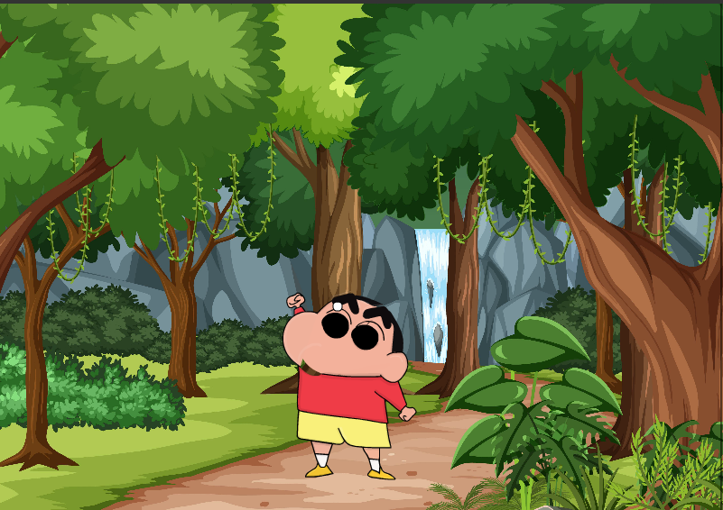

Slide 4
Types of
Stop Motion Animation

Slide 5
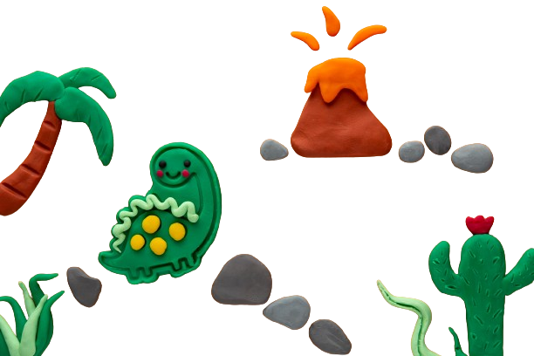
Clay Animation
1
Also known as claymation.
Involves sculpting characters and objects out of clay .

Slide 6
Pixilation Animation
2
Using real people or objects as characters .
Performers moving in small increments between each frame .

Slide 7
Cut-Out Animation
3
Involves moving flat objects or characters cut from paper, cardstock, or other materials .

Slide 8
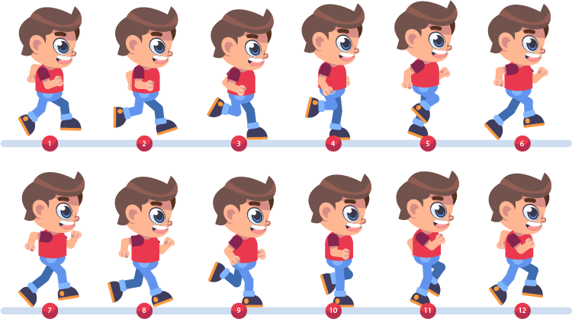
Working of Stop Animation

Slide 9


Slide 10


Slide 11
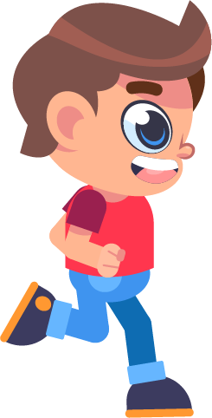

Slide 12


Slide 13


Slide 14


Slide 15


Slide 16


Slide 17
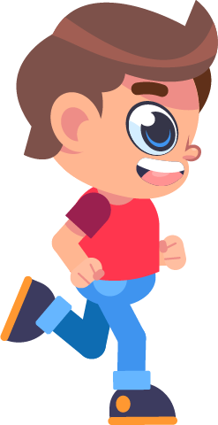

Slide 18


Slide 19


Slide 20


Slide 21

Final Output

Slide 22
Conclusion
Offers endless creative possibilities
Stop motion can lead to incredible storytelling and visual experiences

Slide 23
Thank You!!!

