Slide 1


9th International Conference for Convergence in Technology (9th I2CT 2024)
Galaxy Type Classification With Sub-categorization Using Deep Learning Framework
Paper ID: 1547
Aryan Kamat aryankamat03@gmail.com
Nitish Kumar Pathak 4nitishkr@gmail.com
Aditya Phatak adiphatak21@gmail.com
Akash Kulkarni akash.Kulkarni@kletech.ac.in
Kaushik Mallibhat kaushik@kletech.ac.in

Slide 2
Contents
Introduction
Literature Survey
Dataset
Block diagram
Working of the model
Results
Conclusion

Slide 3
Introduction
This paper presents a robust approach to galaxy categorization utilizing machine learning and image processing techniques, emphasizing Galaxy Zoo and Galaxy10 datasets. At the same time, image pre-processing procedures ensure dataset standardization indicating its usefulness in categorizing galaxies into Elliptical, Spiral, and Irregular types, as well as detailed subclassifications such as E0, E3, E7 for elliptical galaxies and Normal Spiral, Barred Spiral for spiral galaxies. The subclassification models use image processing to extract morphological traits, demonstrating the possibility for automated study of astronomical information and contributing to advances in astrophysics research.

Slide 4
Literature Survey

Slide 5
Dataset
For training and testing the model, we used the Galaxy Zoo and galaxy10 data sets, which consist of spiral, elliptical, and irregular images in JPEG and PNG formats. This section briefly describes the labeled dataset we generate from the Galaxy Zoo and Galaxy 10 DECaLS datasets. For the training dataset, we used around 1500 images for elliptical galaxies, which consist of 500 images of E0, 500 images of E3 and, 500 of E7 elliptical galaxies, respectively, 1500 images of a spiral galaxy, which have 750 images of a typical spiral galaxy, and 750 images of the barred spiral galaxy, and 1000 images of irregular galaxy. We used 400 images of each spiral galaxy, elliptical galaxy, and irregular galaxy labeled dataset for testing purposes.

Slide 6
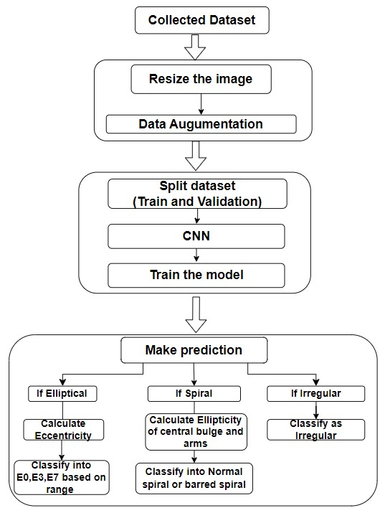
Block Diagram

Slide 7
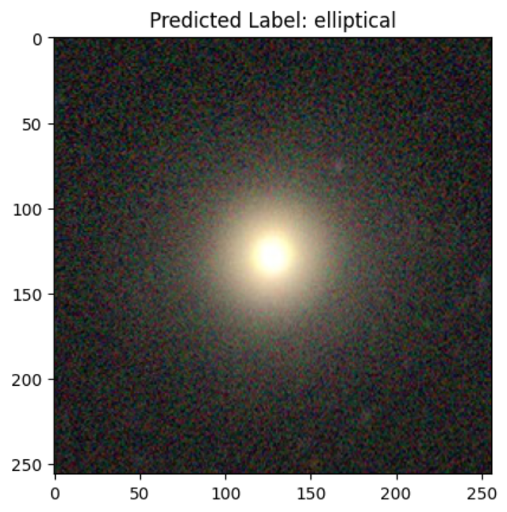
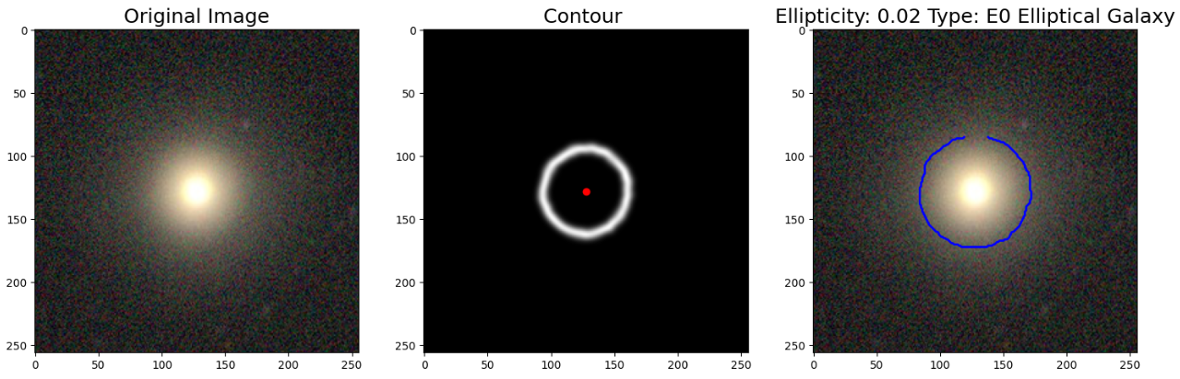
Results
The predicted galaxy is elliptical
Subclassified as E0 type

Slide 8
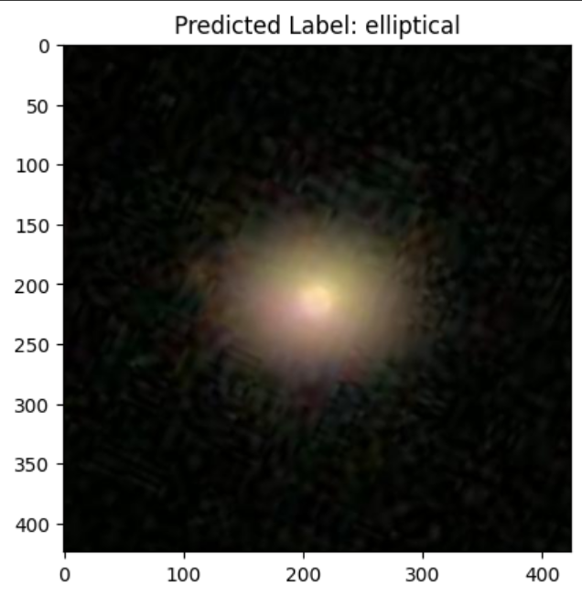
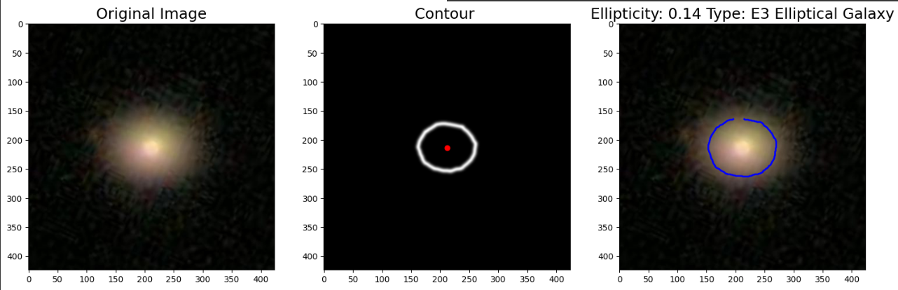
The predicted galaxy is elliptical
Subclassified as E3 type

Slide 9
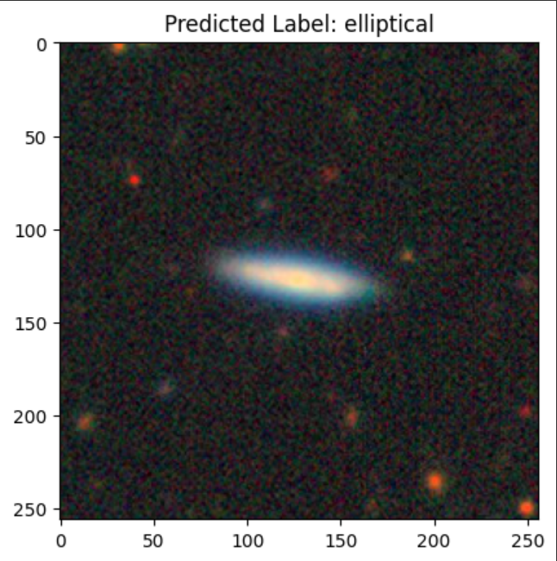
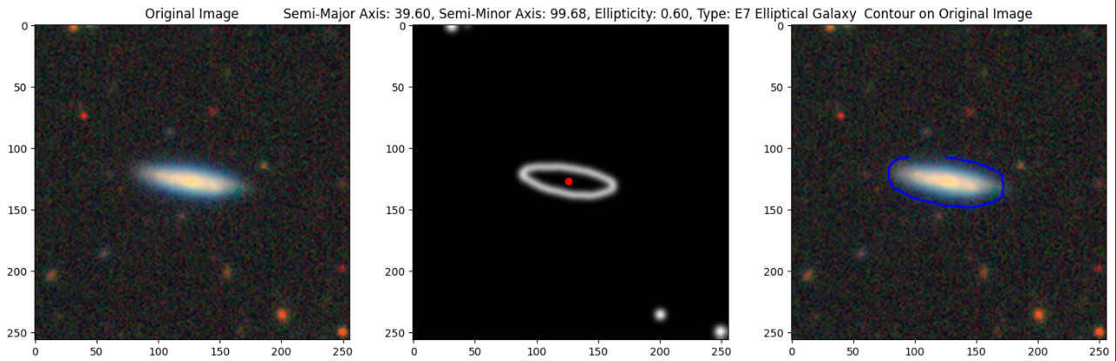
The predicted galaxy is elliptical
Subclassified as E7 type

Slide 10
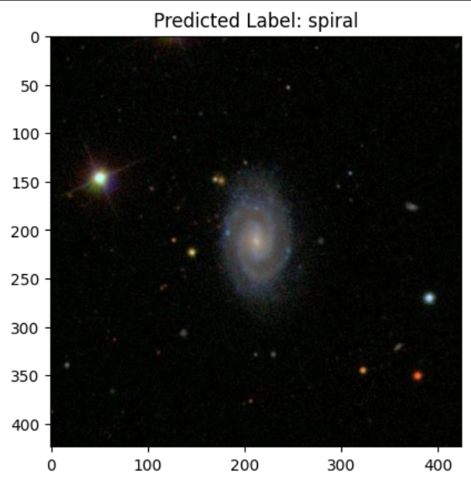
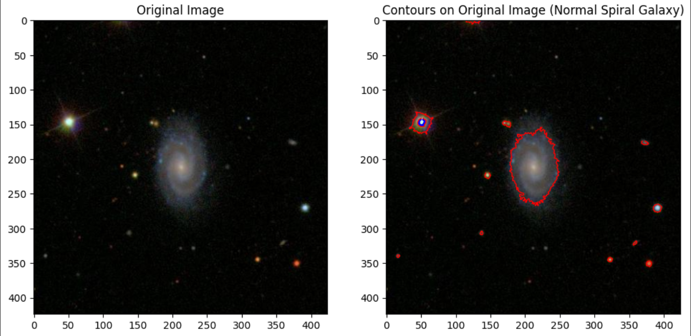
Predicted galaxy is spiral
Subclassified as Normal Spiral type

Slide 11
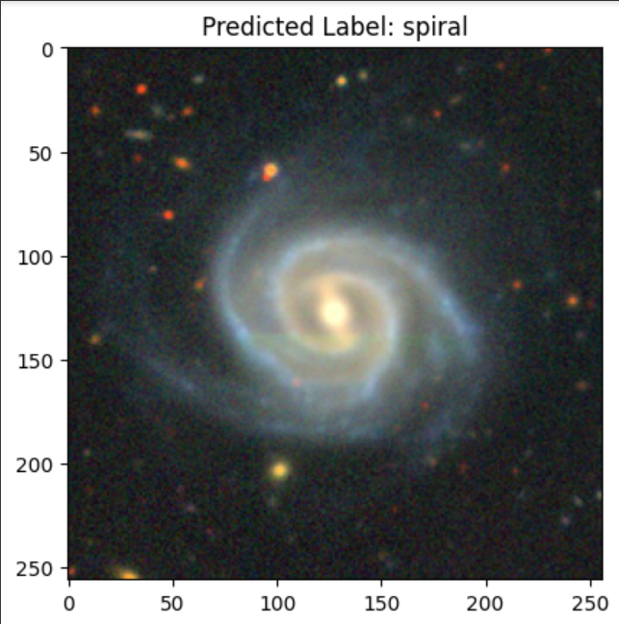
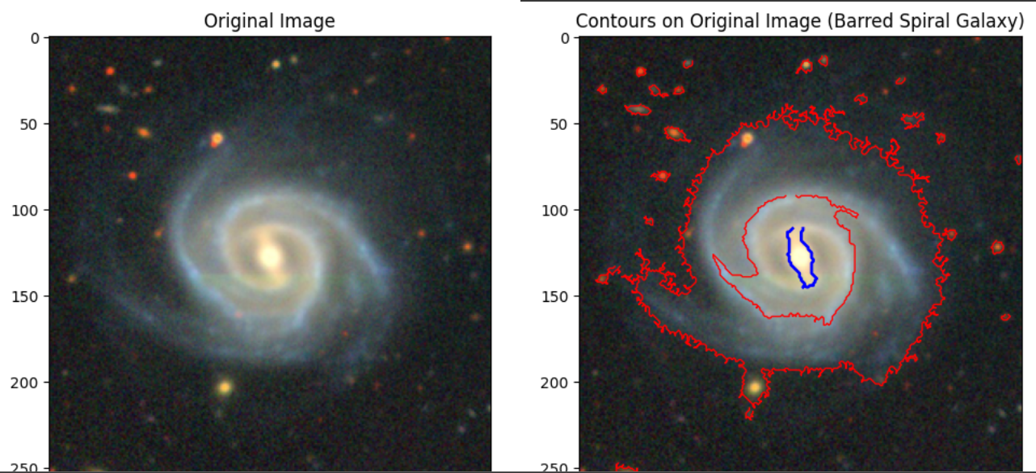
Predicted galaxy is Spiral
Subclassified as Barred spiral type

Slide 12
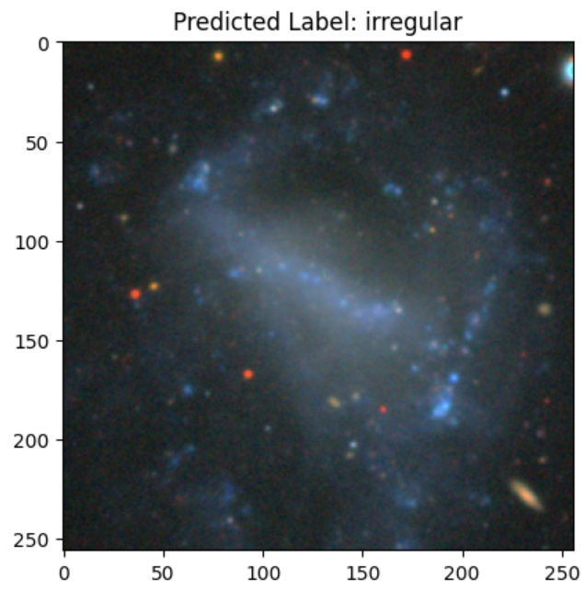
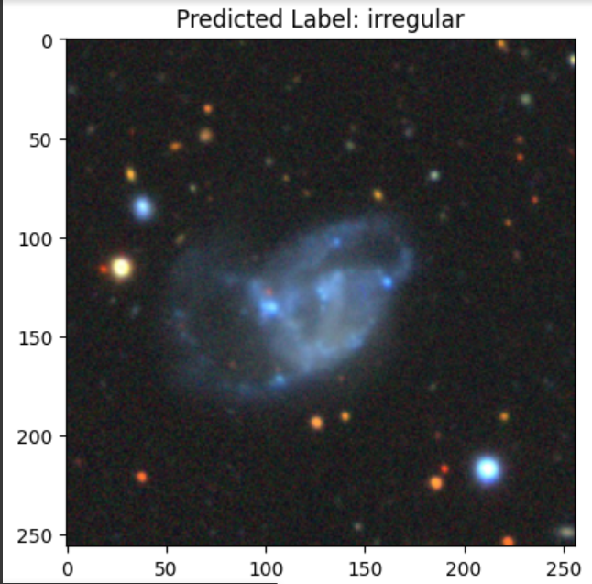
Predicted galaxy is irregular

Slide 13
Conclusion
We have shown encouraging results in successfully classifying galaxy photos into multiple categories and subcategories using our implementation of Convolutional Neural Networks utilizing the MobileNetV2 architecture.
With the help of the GalaxyZoo dataset and Galaxy10decals, our model could train with an impressive accuracy of 91% on the testing dataset.
To improve the features of our model, we applied image processing and data augmentation techniques.
However, an important limitation was that the irregular class's predictions were skewed in favour of the spiral class when combined with merged and distorted galaxy images were used. To provide reliable and objective model performance, this emphasizes the significance of dataset creation and the necessity of giving differences within particular classes a significant thought.

