Slide 1

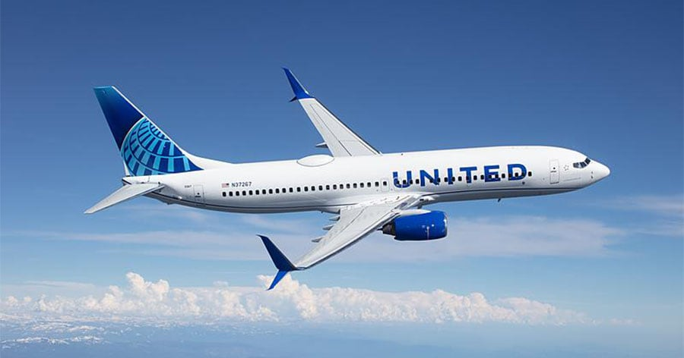
Data Analytics Project:
Analyzing Customer Call Data
United Airlines Hackathon
Aryan Kuhar
Unnat Bharol
Delhi Technological University

Slide 2

Agenda
1
2
Sentiment Analysis
IVR Improvements
Objective: To analyze customer call data to identify trends and areas for improvement in customer service.
Analyze call timing, call reasons and other attributes and propose actionable recommendations.
Analysis of AHT and AST
Analysis of
Call Reasons
4
3
Predictive
Models
Identifying Self-Solvable Issues
5
6

Slide 3
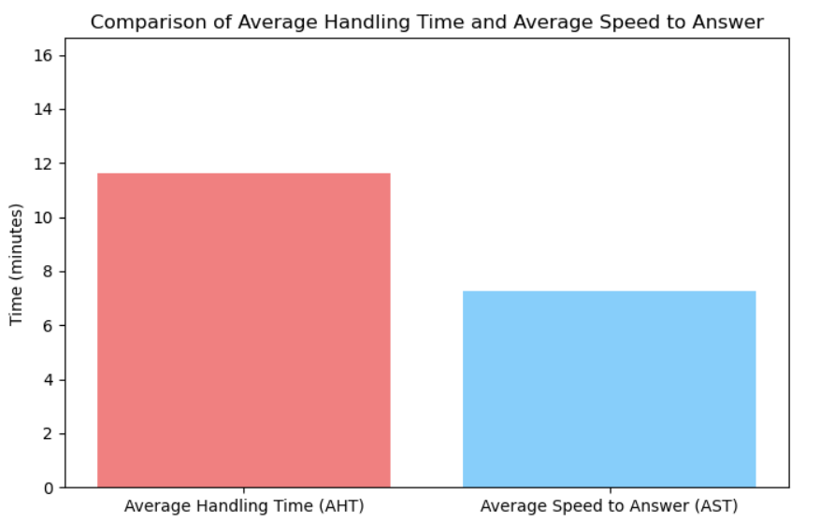
Analysis of AHT and AST
Average handle time = 11.6 min
Average answer speed = 7.2 min
Average call time = 18.9 min
Attribute Importance bar graph shows importance of attributes in deciding the handle time of a call.
We can conclude attributes which have most importance in deciding handle time is Primary call reason.
So, to reduce AHT we have to focus more on Primary call reasons and how we can reduce handle time from it.
(I calculated this graph by using random forest classifier)

Slide 4
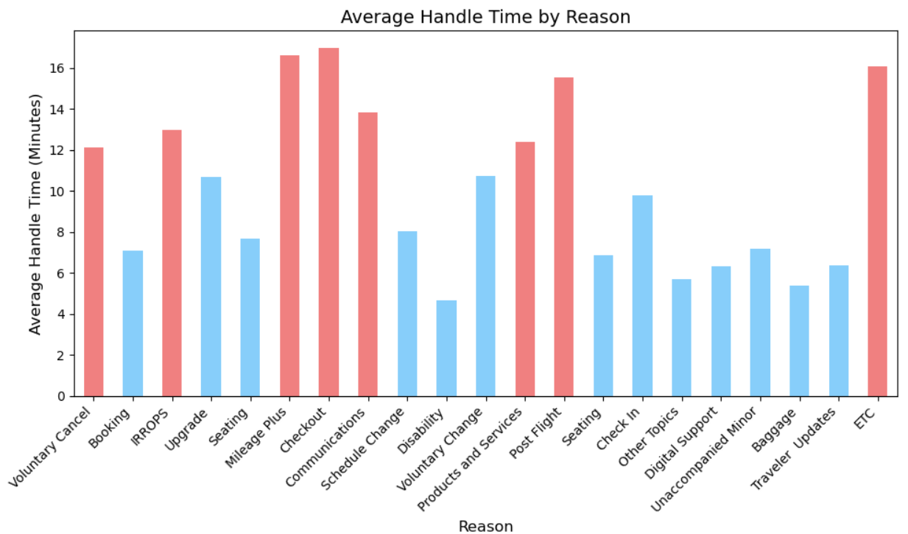
Analysis of Call Reasons
Most frequent call reason: IRROPS
(AHT: 12.99 minutes)
Least frequent call reason: Unaccompanied Minor
(AHT: 7.17 minutes)
Percentage difference in AHT: 81.26%
The bar graph shows average handle time of different call reasons. The reasons whose AHT is more than average are highlighted in red.
We can see reasons which have high AHT are Voluntary cancel, IRROPS, Mileage plus, Communications, Products & service, Post flight and ETC. To reduce AHT we have to work on these call reasons.

Slide 5
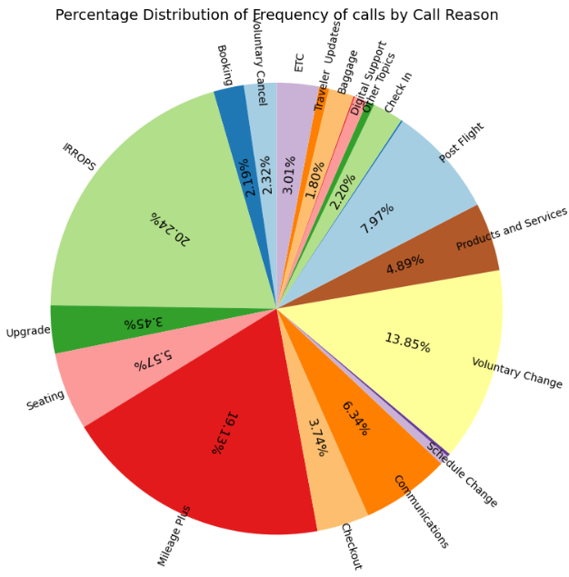
Analysis of Call Reasons Contd.
This pie chart shows Distribution of call reasons by frequency of calls. This tells us the Call reasons which occur the most which are:
IRROPS (20.24%)
Mileage Plus(19.13%)
Voluntary Change (13.85%)
Post Flight (7.97%)
Communications(6.34%)

Slide 6
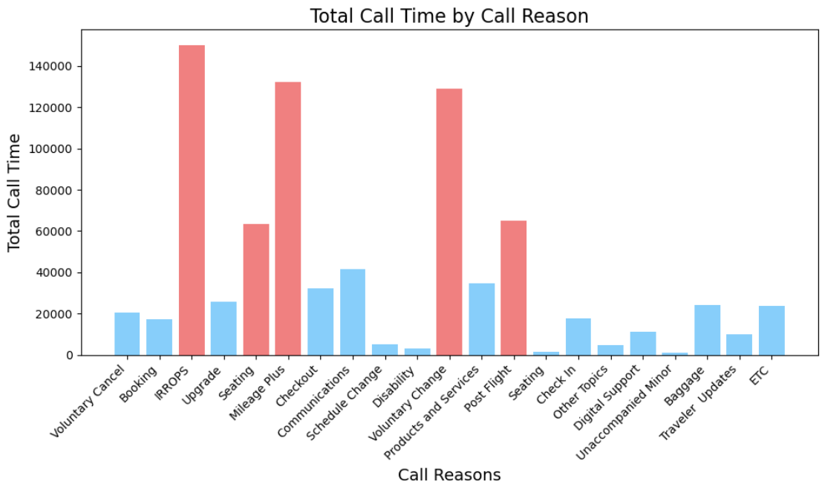
Analysis of Total Call Time
This graph shows total call time of different call reasons and we can see many outliers which singlehandedly increase handle time of calls.
Outliers are:
IRROPS
Seating
Mileage Plus
Voluntary Change
Post Flight

Slide 7
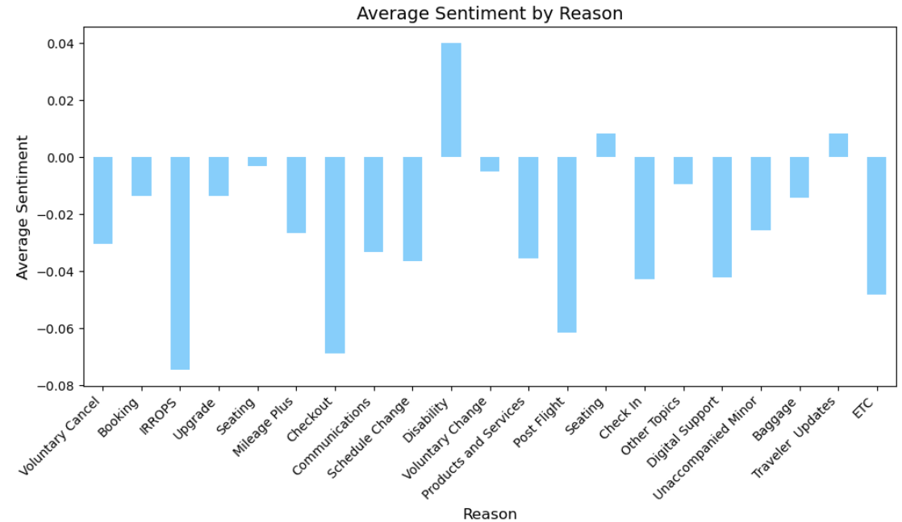
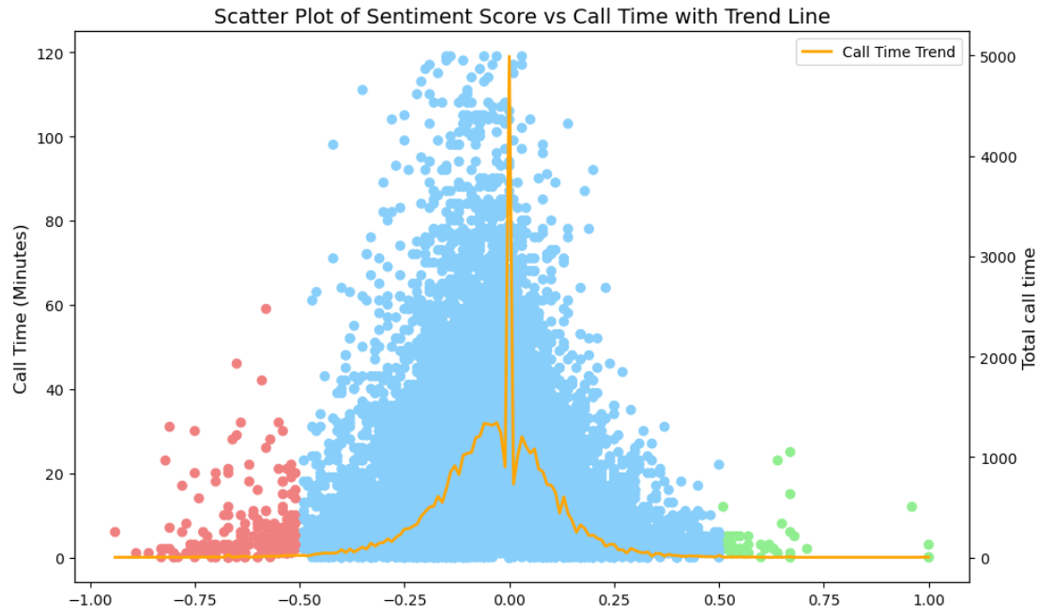
Analysis of Sentiment
In scatter plot we can see sentiment scores at different call time. Orange trend line shows total call time.
The scatter plot clearly tells us there are more negative sentiment scores than positive sentiment scores. And the call reasons responsible for that is shown by bar graph.
The bar graph shows us average sentiment scores of different call reasons.
Reasons which have most negative average sentiment scores are:
IRROPS
Checkout
Postflight

Slide 8
Identifying Self-Solvable Issues
After analyzing transcripts and call reasons, We have come up with few call reasons that can self resolvable via airline website or better communication:
Recurring Call Reasons like booking changes. These can be directly done on airline website. Calls of this nature can be redirected to website.
Fixing of airline website : After analyzing transcripts, I found out customers were complaining that sometimes website was not working properly. We have to make sure website is in order always. If website is not working properly there will be a large influx of self-solvable calls.
Improvement in Communication : Many customers were also asking for information about flights this can be solved by improving communication with the customer. As shown by data one of the most time-consuming call reason was IRROPS , this can be solved by proper communication channels, whether it is Emails or SMS. Customers were asking about various scenarios such weather condition affecting their flight time. These can be resolved easily.
Identify Low-Complexity Queries like booking, seating, upgrade, schedule change, check-in can be done in easy automated steps and don’t require an agent. This is supported by data in analysis of call reasons.
Reduce Total Call Time : If we identify these self solvable issues, we can reduce total call time by 3,00,000 minutes or 40%. This will greatly reduce total call time.

Slide 9
IVR Improvements
To effectively reduce agent intervention and streamline the customer experience, the following IVR improvements are proposed, based on the analysis of call reasons and call data patterns:
Automate Flight Status and Notifications: One of the most common reason to call was flight status. To solve this we can integrate real-time flight status updates into the IVR, allowing customers to check the status of their flight (delays, cancellations, gate changes) by providing their flight number or booking reference.
Booking Modifications and Voluntary Changes: Around 25 % of calls were about booking modification or cancellation, so we can enable customers to make basic booking modifications (such as seat changes, voluntary cancellations, or upgrades) through the IVR without the need for agent assistance.
MileagePlus Program Self-Service: Around 19% of calls were about MileagePlus Program, we can solve this by creating a self-service IVR option where MileagePlus members can check their point balance, redeem miles, and inquire about rewards.
Proactive Call Deflection via Notifications: Proactively send SMS or email notifications to customers for flight delays, cancellations, or gate changes, with a link to a self-service portal or IVR option for further assistance. This will automatically solve most of the problems of customers and reduce agent assistance.
Detailed Pre-Screening for Complex Requests: We can use the IVR system to gather relevant details such as flight number , name etc., before routing more complex queries (such as special assistance or unaccompanied minor requests) to an agent. This will reduce the agent’s workload by pre-collecting necessary information which will further reduce handle time.

Slide 10
Predictive Model
We have also built a predictive model for predicting call reasons from call id, we used these simple steps to accomplish the task:
We made a data frame from test.csv file which has call id and combined them with their respective transcripts from call.csv file.
Identified call reasons and key words for each call reason by reading transcripts.
Used transcripts to predict call reasons for each call id on test.csv.
Updated the data frame with call reasons.
Saved data on a new csv file called test_predicted.csv .

Slide 11
END

