Slide 1
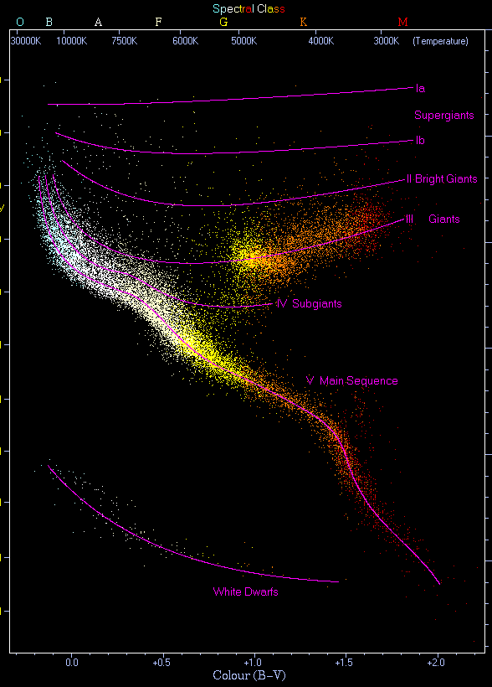
History
1920s: Hertzsprung-Russell Revolution Ejnar Hertzsprung and Henry Norris Russell independently discovered the correlation between luminosity and temperature, creating the HR diagram - the foundation of stellar evolution theory.^{[1]}
1930s-1950s: Stellar Structure Breakthroughs Arthur Eddington established mass-luminosity relations; Subrahmanyan Chandrasekhar defined white dwarf mass limits; Fred Hoyle formulated nucleosynthesis theory.

Slide 2

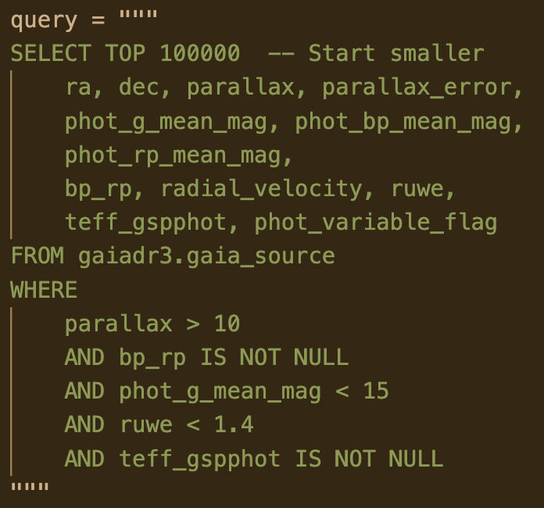
Data Collection
Source: Gaia DR3 (ESA’s space observatory).
Filters:
Stars within 100 pc (parallax > 10 mas).
High-quality astrometry (ruwe < 1.4).
Bright stars (phot_g_mean_mag < 15).
Sample Size: 100,000 stars.
Key Attributes:
Parallax, BP/RP magnitudes, temperature (teff_gspphot).
Variability flag, radial velocity.

Slide 3

Python Libraries used
Data Query | astroquery.gaia
Data Processing | pandas, numpy
Visualization | matplotlib, seaborn
Clustering | scikit-learn (KMeans, GMM)

Slide 4
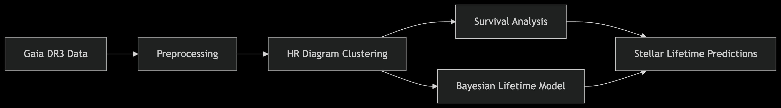
Planned workflow
Data preprocessing for the parallax and absolute magnitude
HR diagram clustering on the threshold of bp_rp and abs_mag, with ML models like GMM, DBSCAN.
Stellar lifeline prediction using the models like Kaplan-Meier estimator and Cox PH.

Slide 5

Results So Far
Initial Shape: (73,148 rows, 12 columns) -> Final Shape: (70118, 12)
Filter Applied:
Keep stars with parallax error < 20%
distance_pc= ${1000}/{parallax}$
M_{G} = phot_g_mean_mag−5 x log(distance_pc)+5
parallax | distance_pc | phot_g_mean_mag | abs_mag
0 | 13.398257 | 74.636572 | 13.470652 | 9.105894
1 | 19.588654 | 51.049959 | 6.224640 | 2.684663
2 | 10.326266 | 96.840427 | 13.695807 | 8.765524
3 | 11.136129 | 89.797807 | 14.756236 | 9.989907
4 | 17.357228 | 57.612888 | 10.476051 | 6.673453

Slide 6
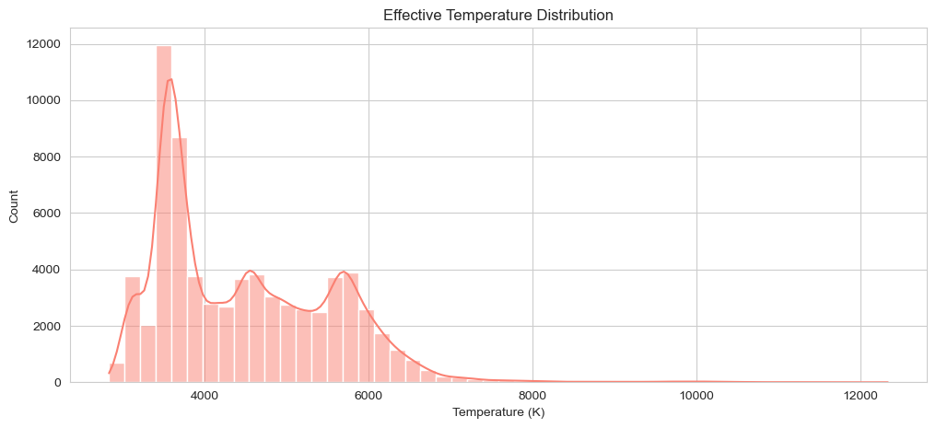
Effective temperature distribution
The distribution is skewed , with a peak around 3,500–4,000 K .
Most stars have temperatures in the range of 3,000–6,500 K .
Few stars are present at higher temperatures (>6,000 K).
The peak suggests that main-sequence stars dominate the dataset.

Slide 7
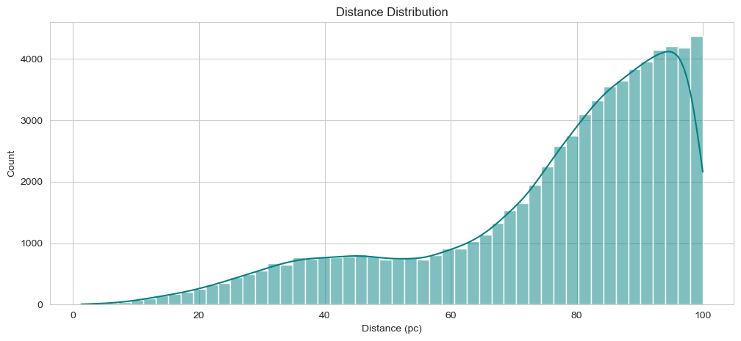
Density Distribution
The distribution shows a peak around 85–95 parsecs .
There is a gradual increase in the number of stars as distance increases up to ~95 pc.
Beyond 95 pc, the count decreases sharply.
Most stars in the dataset are located within 65–95 parsecs , indicating a focus on nearby stars.
The decline beyond 100 pc suggests that the dataset prioritizes stars with closer stars.

Slide 8
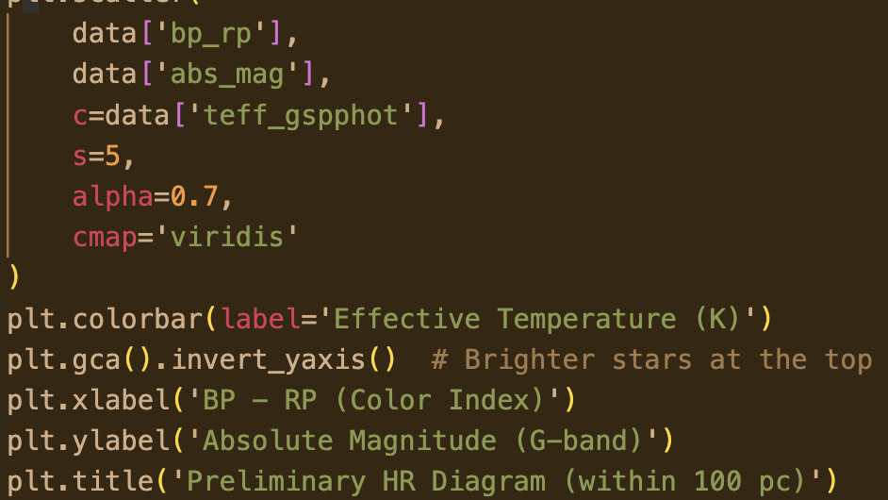
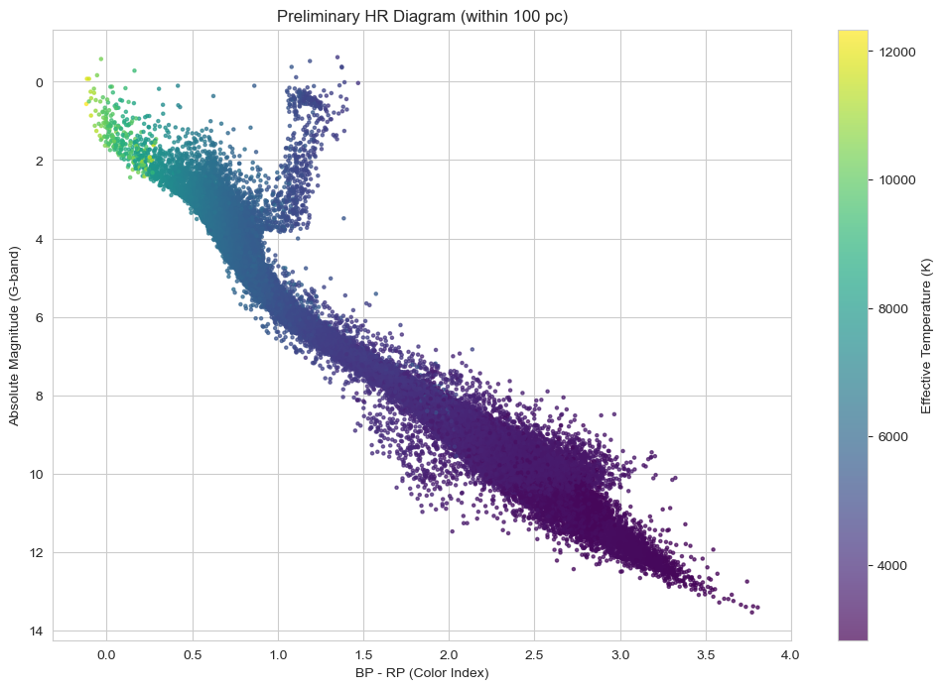
Preliminary HR Diagram
A clear diagonal band where most stars lie, indicating a strong correlation between temperature and luminosity.
Cooler stars (higher BP - RP) have lower temperatures and are darker, which can be red giants.
Hotter stars (lower BP - RP) have higher temperatures and are brighter, can be white Dwarfs.

Slide 9

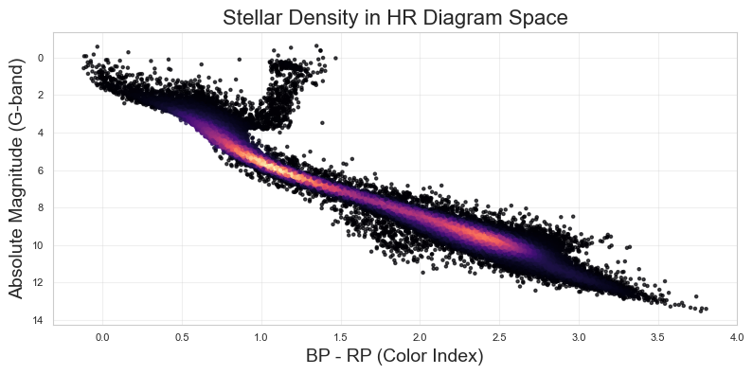
Stellar Density
The diagonal band is clearly visible, representing the main sequence where most stars lie.
Brighter Regions (Red/Orange): Indicate areas with higher stellar density.
Darker Regions (Black): Indicate areas with lower stellar density.
The main sequence shows a high density of stars, as expected.
The main sequence is the most densely populated region, reflecting the prevalence of active hydrogen-burning stars.

Slide 10

References
[1] Wikipedia contributors. (2025, April 23). Hertzsprung–Russell diagram. In Wikipedia, The Free Encyclopedia. Retrieved 12:57, June 13, 2025,from https://en.wikipedia.org/w/index.php?title=Hertzsprung%E2%80%93Russell_diagram&oldid=1287087896.
[2] Maltsev, K., Schneider, F. R. N., Röpke, F. K., Jordan, A. I., Qadir, G. A., Kerzendorf, W. E., Riedmiller, K., & Van Der Smagt, P. (2023). Scalable stellar evolution forecasting. Astronomy and Astrophysics, 681, A86. https://doi.org/10.1051/0004-6361/202347118.
[3] Kaplan, E. L., & Meier, P. (1958). Nonparametric Estimation from Incomplete Observations. Journal of the American Statistical Association, 53(282), 457–481. https://doi.org/10.1080/01621459.1958.10501452.

