Slide 1
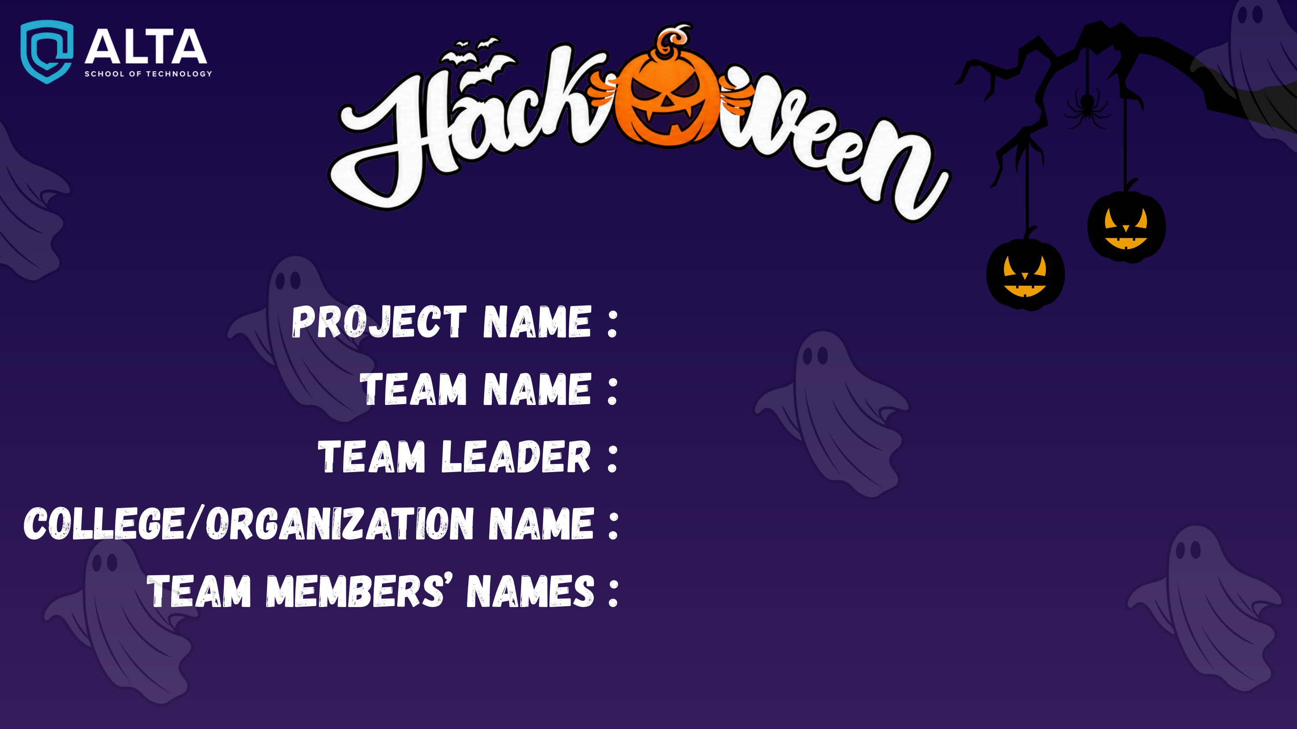
CivicHelp — Autonomous Incident Platform
Apex Coders
Aryan Mall
Sushant University
Aditya, Bhavy Nanda, Ashish Kumar, Aryan Mall

Slide 2


Apex Coders
APEX
CODERS
CORE PROBLEM STATEMENT:
Smart Cities — From Citizen Reports to Verified Resolution
PARADIGM SHIFT: BROKEN STATUS QUO ➔ CIVICHELP AUTONOMOUS RESOLUTION
• Broken Legacy: Citizen Report ──▶ Manual Routing ──▶ Fake Photo / Premature Closure ──▶ Citizen Frustration
• CivicHelp Mesh: Dual-Mode Intake (GPS/Unconfirmed) ──▶ Gemini AI Triage ──▶ Strict SLA Timer ──▶ SHA-256 Photo QA (Auto-Reopens on failure)
Evidence Deficit
Zero geofence checks allow contractors to falsely mark jobs resolved without physical repairs.
Siloed Departments
Roads, Drainage, and Lighting operate in silos with no cross-department escalation mesh.
Fiscal Blindspots
Citizens lack visibility into municipal ward funds, work orders, and contractor scorecards.

Slide 3
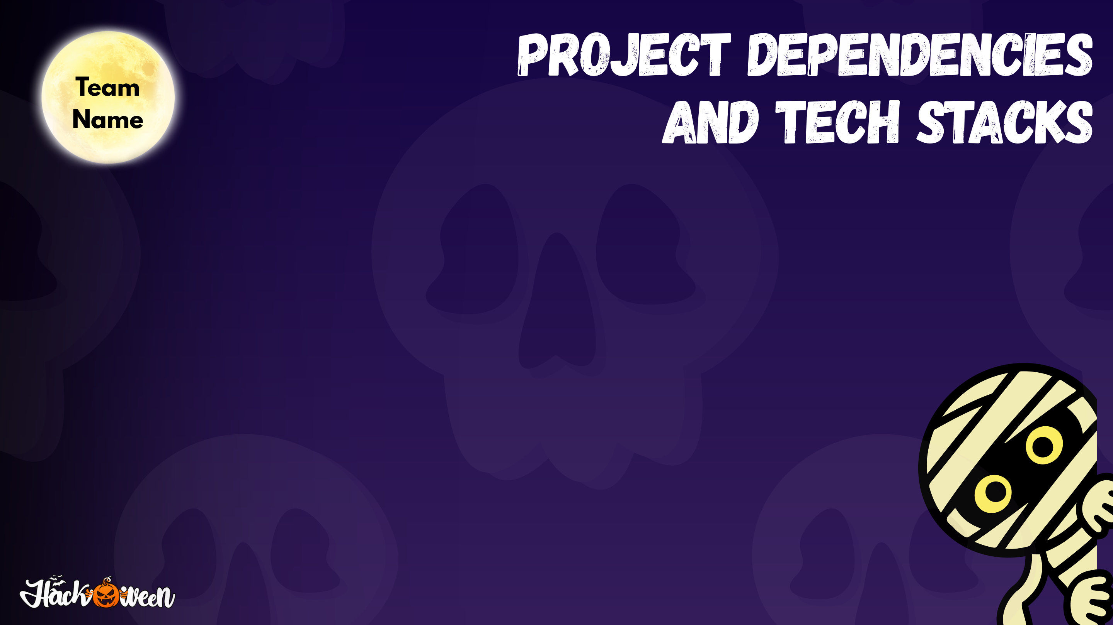
Apex Coders
APEX
CODERS
TIER 1: FRONTEND & SPATIAL CLIENT
TIER 2: BACKEND & SECURITY ENGINE
TIER 3: AI INTELLIGENCE & ROUTING
• Framework:
React 18 + TypeScript + Vite 5 + Tailwind CSS
• Map Engine:
Leaflet + Leaflet MarkerCluster (Color-blind accessible palette)
• Cinematic 3D:
Three.js procedural night city rendering
• UI & Audio:
Lucide Icons + Web Speech API (Bilingual EN/HI speech)
• Core Framework:
FastAPI (Python 3.14) + Uvicorn ASGI Server
• Database & ORM:
SQLAlchemy ORM + SQLite/PostgreSQL (450 demo records)
• Security & RBAC:
PBKDF2-HMAC-SHA256 Hashing + PyJWT 6-Role Authorization
• Audit Chain:
Tamper-evident SHA-256 cryptographic audit logs
• LLM Copilot:
Google Gemini AI (gemini-3.8-flash) with candidate fallbacks
• Road Dispatch:
OSRM Open Source Routing Engine (Real live driving ETAs)
• PDF Generator:
ReportLab for cryptographic municipal summary reports
• Automated QA:
69 / 69 passing Pytest automated test baseline

Slide 4

Apex Coders
APEX
CODERS
OPERATIONAL FEASIBILITY
✔ Zero Hardware Barrier
100% web-based SPA. Works on any smartphone or tablet without installing native apps.
✔ Dual-Mode Citizen Intake
Supports precise GPS lock + Unconfirmed locality reporting without spoofing fake GPS.
✔ Turnkey Government Integration
Pre-configured 6-role RBAC (Admin, Reviewer, PWD Operator, Auditor, Field Crew, Finance).
✔ Dual Deployment Architecture
Runs live on Vercel (Frontend) + Render (Backend) with full offline fallback mesh.
✔ Field-Tested Reliability
69 end-to-end automated test suites verifying SLAs, audit chains, and auto-reopening.
MEASURABLE CIVIC IMPACT
★ 100% Cryptographic Proof
Every resolved incident requires verifiable geofence photo evidence; prevents false closures.
★ 60% Faster Emergency Response
Live road distance and ETA calculation using OSRM to nearest 112 police, fire, & trauma centers.
★ Autonomous Failure Recovery
Automatically reopens cases and increases priority if post-repair photo inspection fails.
★ Fiscal Ward Transparency
Public dashboard tracks municipal budget, fund releases, and contractor performance scores.
★ Community Participation
Citizens vote on ward improvement proposals and earn redeemable civic reward points.

Slide 5
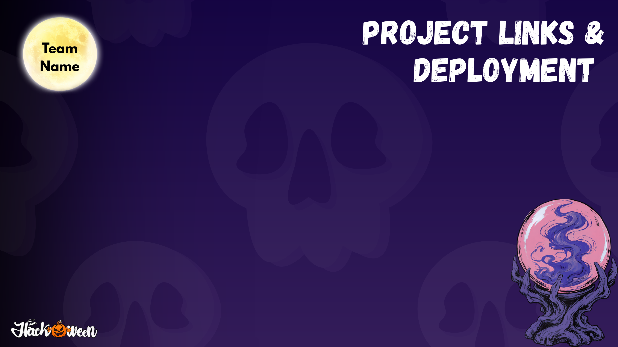
Apex Coders
APEX
CODERS
LIVE DEPLOYMENT CHANNELS & REPOSITORY
• GitHub Repository: https://github.com/aryanTmall/Apex-Coderss
• Live Web Application (Vercel): Configured SPA with full offline resilience & route rewrites
• Backend Web Service (Render): FastAPI Python backend with automated CI/CD blueprint (render.yaml)
• Automated Test Suite: 69 / 69 passing Pytest suites (tests/test_master_upgrade.py)
EVALUATOR 1-CLICK TEST CREDENTIALS (PRE-SEEDED & PRE-FILLED)
🔑 Administrator (Full Ops): admin@civichelp.gov.in | Password: CivicHelp@Admin2026!
🔑 Verification Reviewer (Visual QA): reviewer@civichelp.gov.in | Password: CivicHelp@Review2026!
🔑 PWD Operator (Roads & Dispatch): pwd.operator@civichelp.gov.in | Password: CivicHelp@Pwd2026!
🔑 Whistleblower Ombudsman (Anti-Corruption): auditor@civichelp.gov.in | Password: CivicHelp@Auditor2026!

Slide 6

Apex Coders
APEX
CODERS
AUTONOMOUS RESOLUTION MESH & INNOVATIONS
END-TO-END AUTONOMOUS RESOLUTION PIPELINE:
① Citizen Intake (Precise GPS / Unconfirmed) ──▶ ② Gemini AI Triage & SLA ──▶ ③ Dept Dispatch & Contractor WO ──▶ ④ Photo Geofence QA Check ──▶ ⑤ Immutable SHA-256 Closure
Autonomous Failure Recovery
If post-repair evidence fails geofence check (deviation > 50m) or duplicate detection, CivicHelp autonomously reopens the case and escalates priority.
Live 112 Emergency ETA (OSRM)
Calculates true turn-by-turn road driving distance and estimated arrival time to verified police, fire, & trauma stations; never invents false ETAs.
Public Intelligence & News Feed
Grounded AI civic summaries categorize news into Around Me, City, State, National, and Global, directly linking articles to active map incidents.
Municipal Funds & Voting Vault
Public ward-wise municipal fund ledger with contractor scorecards, plus participatory budgeting polls and tamper-evident whistleblower reporting.

Slide 7

CivicHelp — From Citizen Reports to Verified Outcomes
Team: Apex Coders | Sushant University
Team Leader: Aryan Mall | Members: Aditya, Bhavy Nanda, Ashish Kumar
GitHub: github.com/aryanTmall/Apex-Coderss • Open for Q&A

