Slide 1
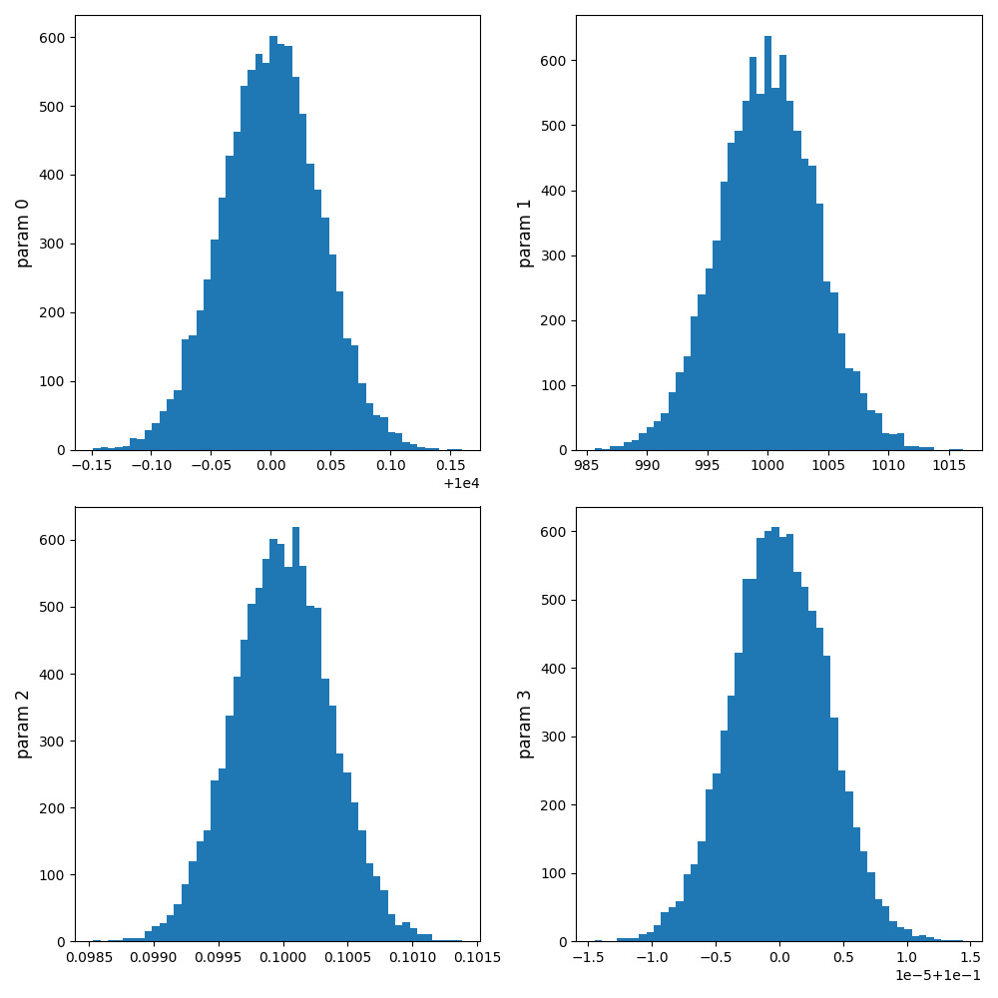
Histogram of the drawn samples
LM + MCMC on a known ARES curve
Parameters used:
'pop_rad_yield_0_': 1E4,
'pop_rad_yield_2_': 1E3,
'fesc': 0.1,
'fX': 0.1}
Inverse of Covariance Matrix for this Combination of Parameters:
1.64e-03, 1.96e-02, -4.39e-07, -5.37e-08,
1.96e-02, 1.60e+01, -1.44e-03, -5.94e-06,
-4.39e-07, -1.44e-03, 1.38e-07, 2.15e-10,
-5.37e-08, -5.94e-06, 2.15e-10, 1.38e-11
Mean and standard deviation of the drawn samples
(As a sanity check to make sure the drawn samples are behaving as we expect):
mean: [9.99999993e+03, 1.00002933e+03, 9.99962873e-02, 1.00000029e-01])
Std: [4.08174690e-02 4.03138658e+00 3.74407952e-04 3.72581029e-06]
Notes:
I will later talk about the physical meaning of this parameters and how they were chosen
The mean should be in agreement with the original parameters
The std should be app the square root of diagonal elements of the inverse of covariance matrix
Why inverse? (cause we need to use the matrix which the diagonal elements give use the errorbars, and that’s the inverse of covariance matrix)

Slide 2
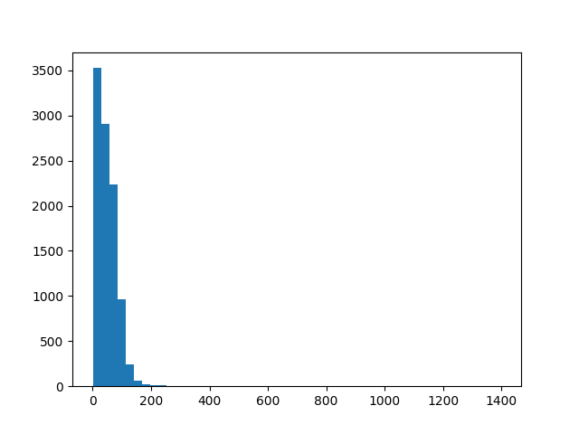
Histogram of Chi-Square of drawn samples
Mean: 49.20
Deviation: 41.98

Slide 3
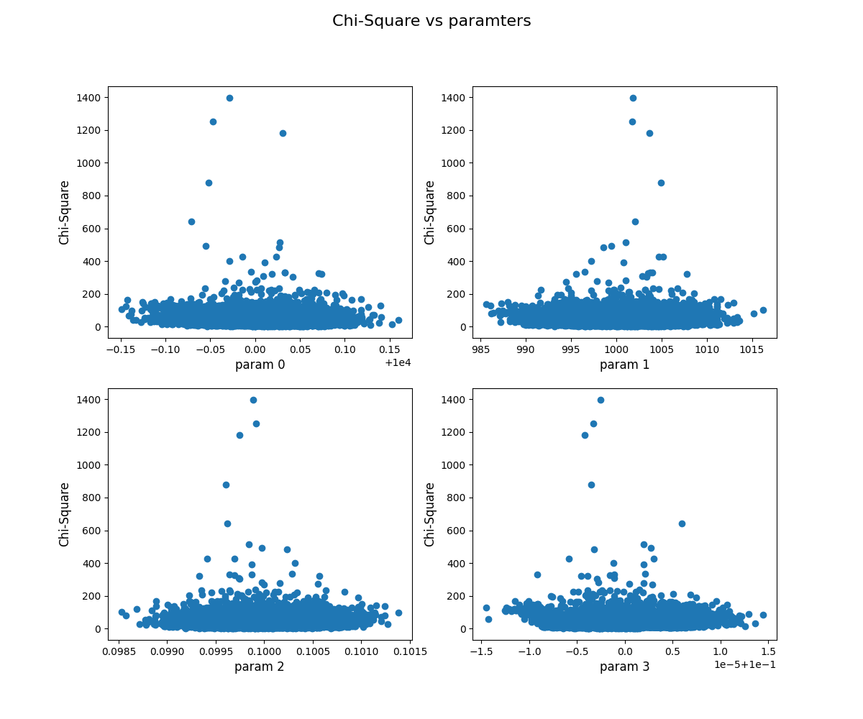
Chi-Square of Drawn samples vs parameter values

Slide 4
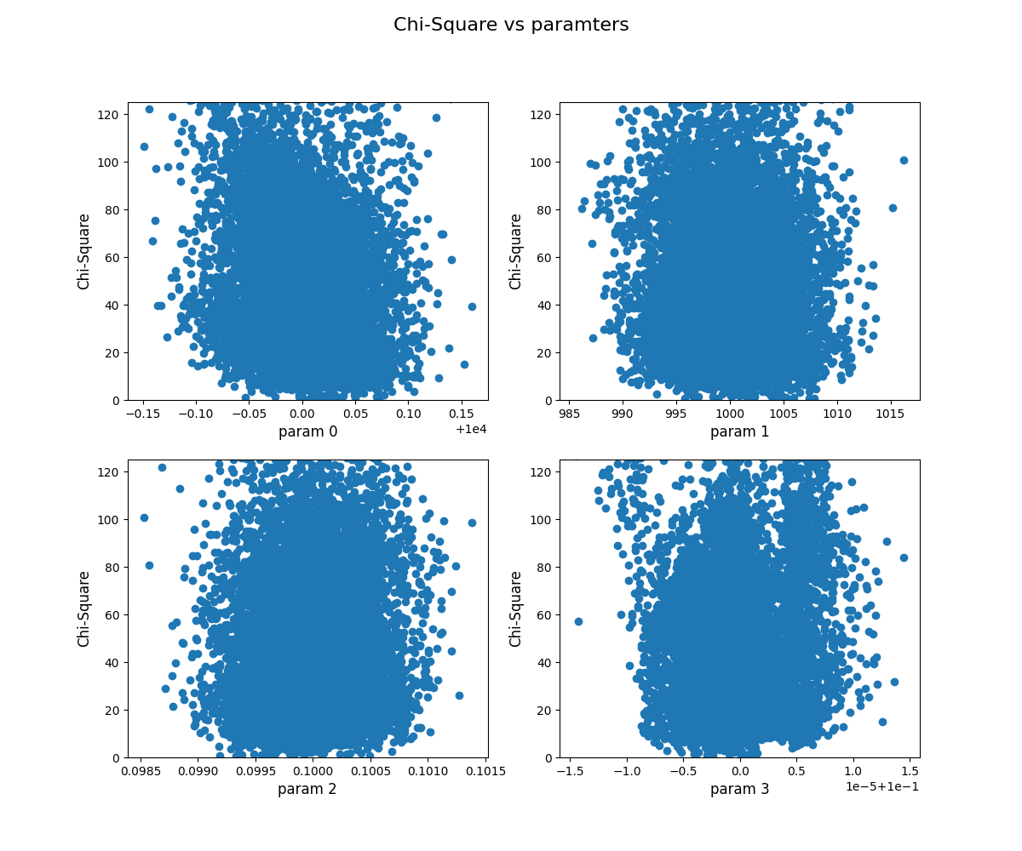
y-axis limit: (0, 125)

Slide 5
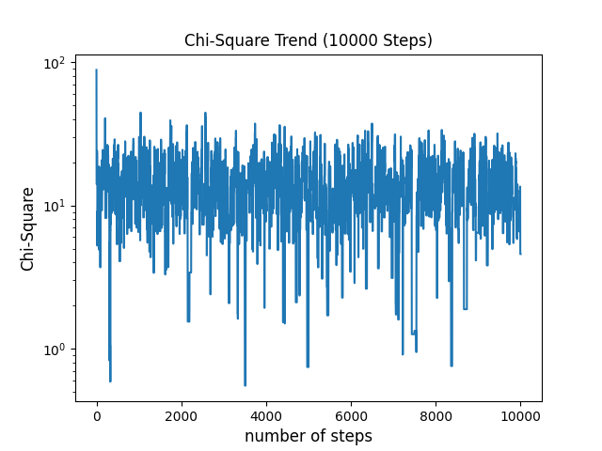
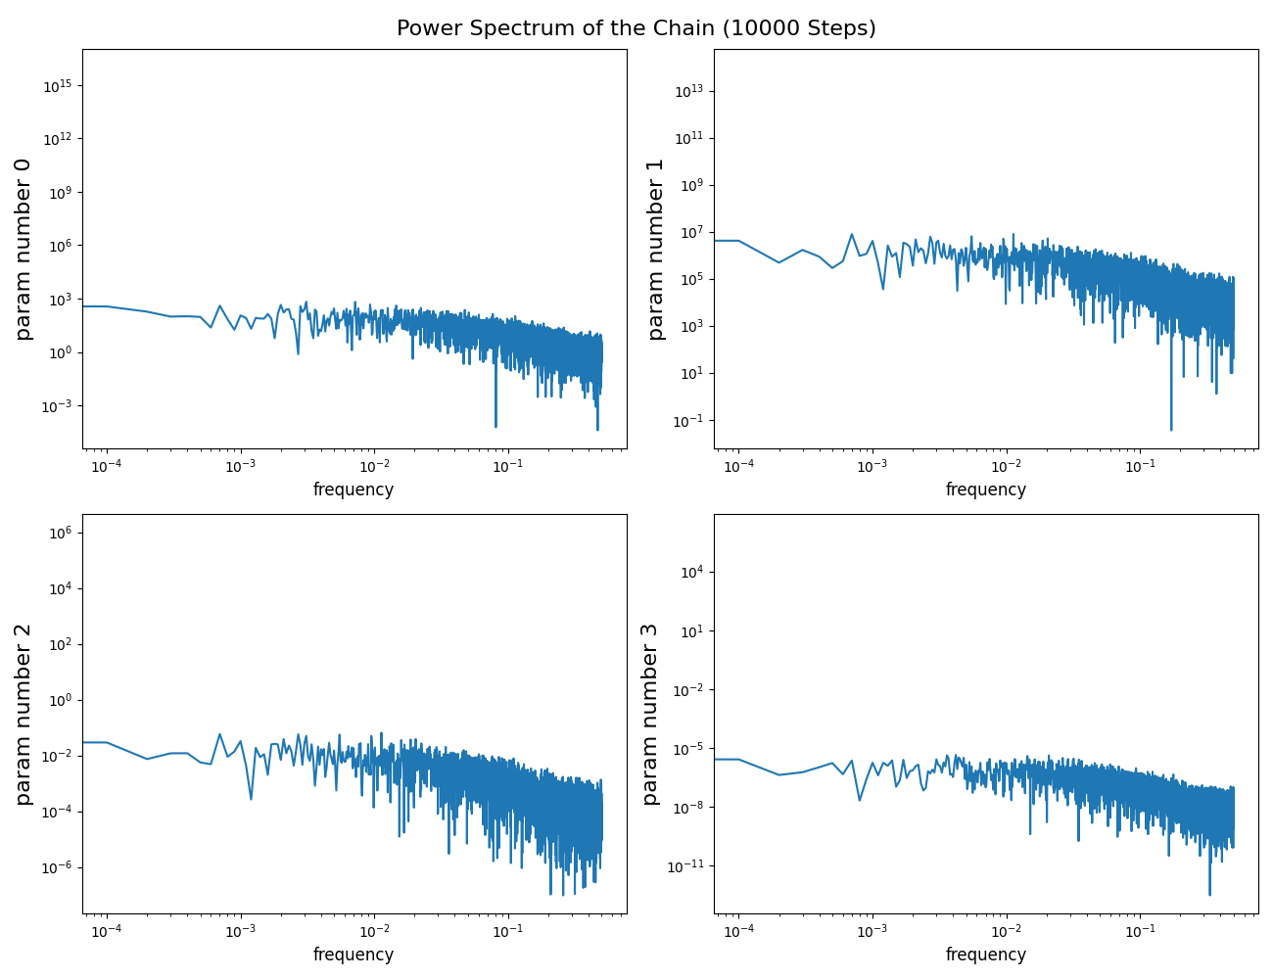
Feeding the samples to MCMC
Acceptance ratio for 10000 Steps: 22.12%

Slide 6
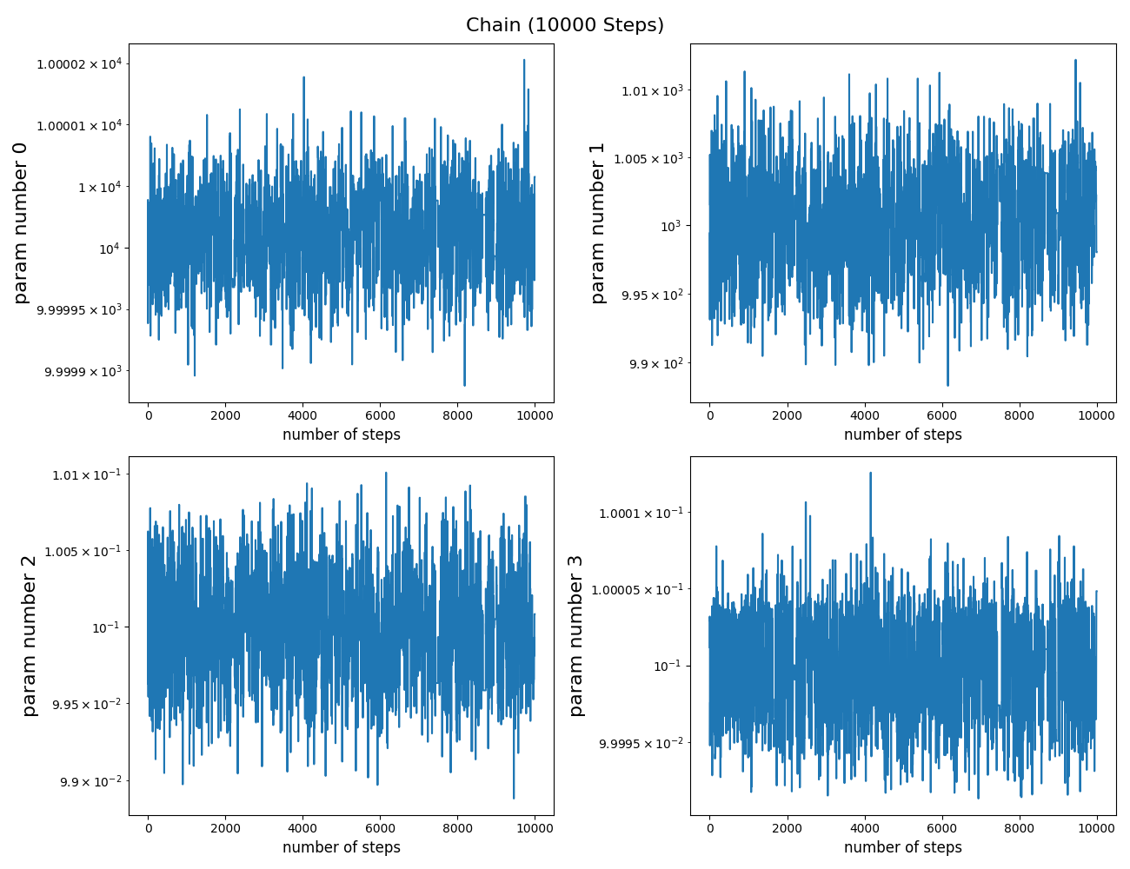
True Parameters:
1.e+04, 1.e+03,
1.e-01, 1.e-01
Fitted parameters:
1.00000112e+04, 1.00028045e+03,
9.99804682e-02, 9.99997672e-02
Error bar of fit:
3.50690161e-02, 3.77185397e+00,
3.48906276e-04, 3.35946795e-06

Slide 7
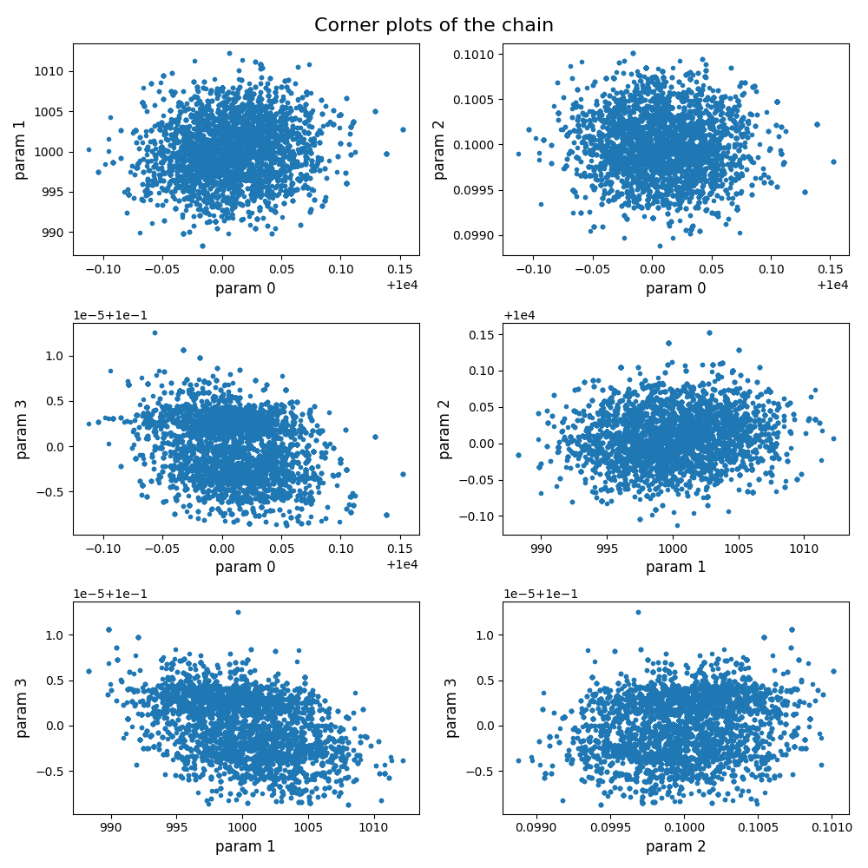
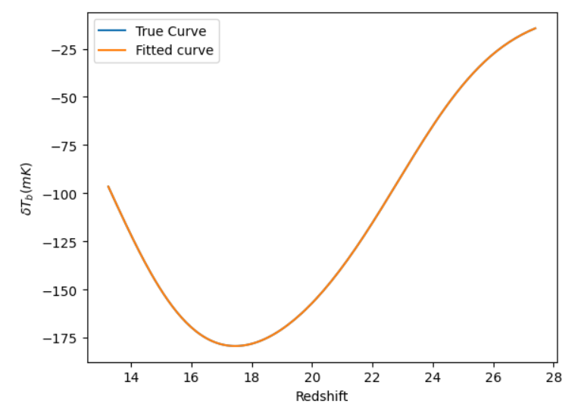

Slide 8
LM + MCMC on EDGES data
on iteration 0 chisq is 9747.329626187573 and lambda is 1
on iteration 1 chisq is 8159.367412755325 and lambda is 0.6666666666666666
on iteration 2 chisq is 8159.367412755325 and lambda is 1.5
on iteration 3 chisq is 8074.891683514397 and lambda is 1.0
on iteration 4 chisq is 8074.891683514397 and lambda is 2.25
on iteration 5 chisq is 8056.520525545141 and lambda is 1.5
on iteration 6 chisq is 8028.450223507109 and lambda is 1.0
on iteration 7 chisq is 8011.247617830618 and lambda is 0.6666666666666666
on iteration 8 chisq is 8011.247617830618 and lambda is 1.5
on iteration 9 chisq is 8011.247617830618 and lambda is 3.375
on iteration 10 chisq is 8011.247617830618 and lambda is 7.59375
on iteration 11 chisq is 8010.907299395982 and lambda is 5.0625
on iteration 12 chisq is 8008.634292903948 and lambda is 3.375
on iteration 13 chisq is 8007.347490614724 and lambda is 2.25
on iteration 14 chisq is 8006.679031433592 and lambda is 1.5
on iteration 15 chisq is 8006.679031433592 and lambda is 3.375
on iteration 16 chisq is 8006.679031433592 and lambda is 7.59375
on iteration 17 chisq is 8006.679031433592 and lambda is 17.0859375
on iteration 18 chisq is 8006.679031433592 and lambda is 38.443359375
on iteration 19 chisq is 8006.655661443841 and lambda is 25.62890625
Notes:
Where all the problems start
This is the result of LM on edges data, it does not exactly converge in the definition of LM, but it reaches a point that is not able to find a set of parameters with lower chi-square but it keeps increasing the lambda
It was so hard to find a set of parameters and a starting point that can run LM up to 20 steps because it keeps going to the regions that ARES is unable to handle and the code crashes.

Slide 9
Best-fit Point:
4.54933009e+03, 2.47592394e+03, 3.70100011e-01, 1.36397790e-01
Chi-Square at the best-fit point:
8006.655661443841
Inverse of Covariance Matrix:
3.24667471e+04, 5.68112552e+06, -8.51686688e+02, 5.65856615e-01,
5.68112552e+06, 2.43358043e+10, -3.63874836e+06, 5.64163649e+00,
-8.51686688e+02, -3.63874836e+06, 5.44075269e+02, -9.80887059e-04,
5.65856615e-01, 5.64163649e+00, -9.80887059e-04, 3.92215290e-05

Slide 10
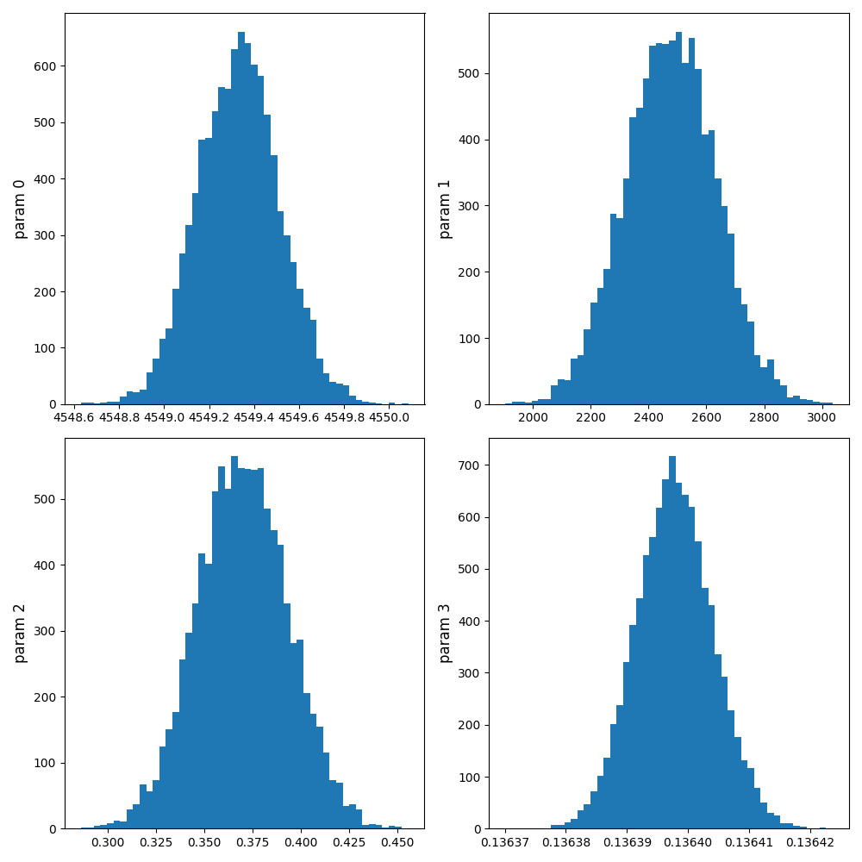
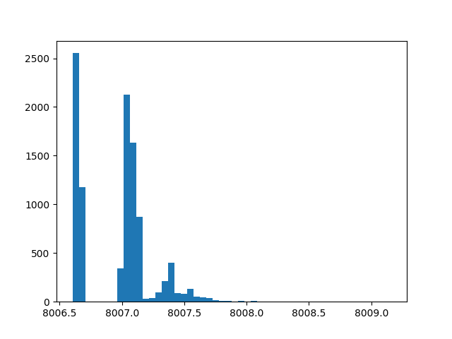
Histogram of the drawn samples
Histogram of difference between the chi-square of drawn samples
Mean: 0.305
Deviation: 0.289

Slide 11
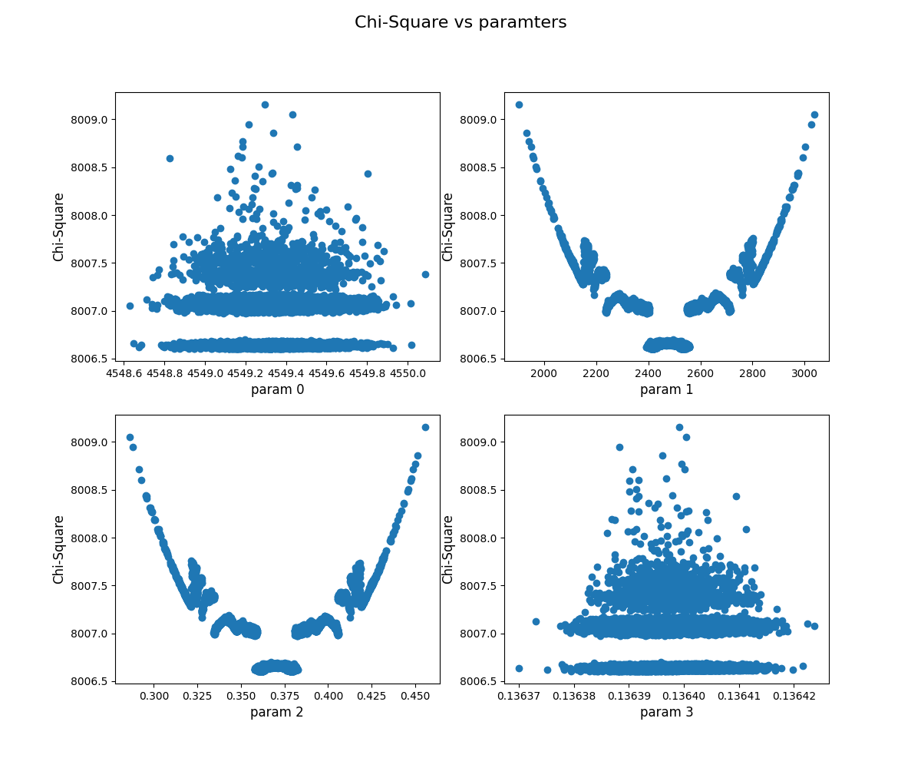
Chi-Square of Drawn samples vs parameter values

Slide 12
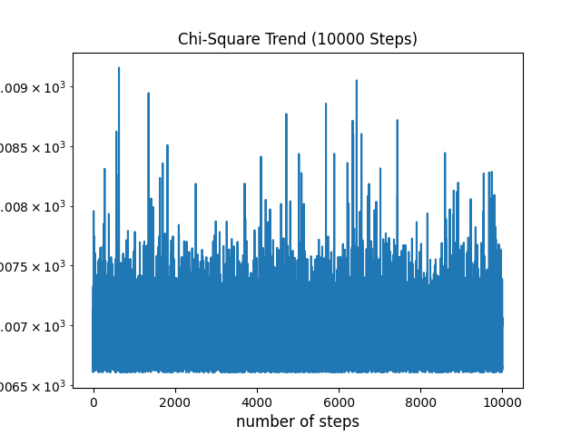
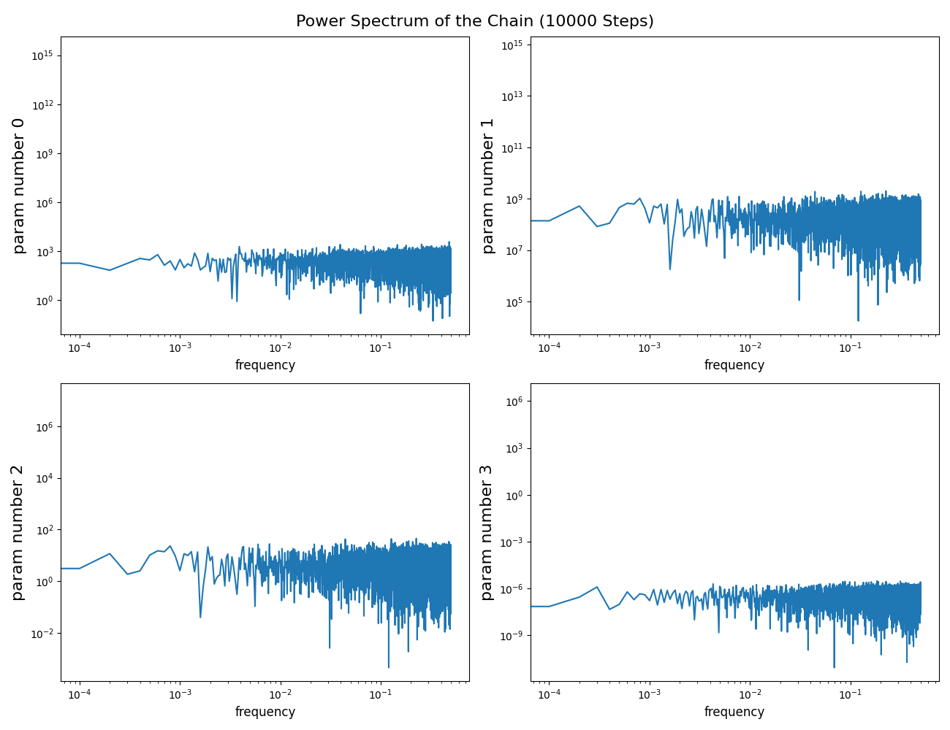
Chi-Square of the starting point of MCMC (result of LM): 8006.655661443841
Chi-Square of MCMC best-fit point:
Acceptance ratio for 10000 Steps: 22.12%

Slide 13
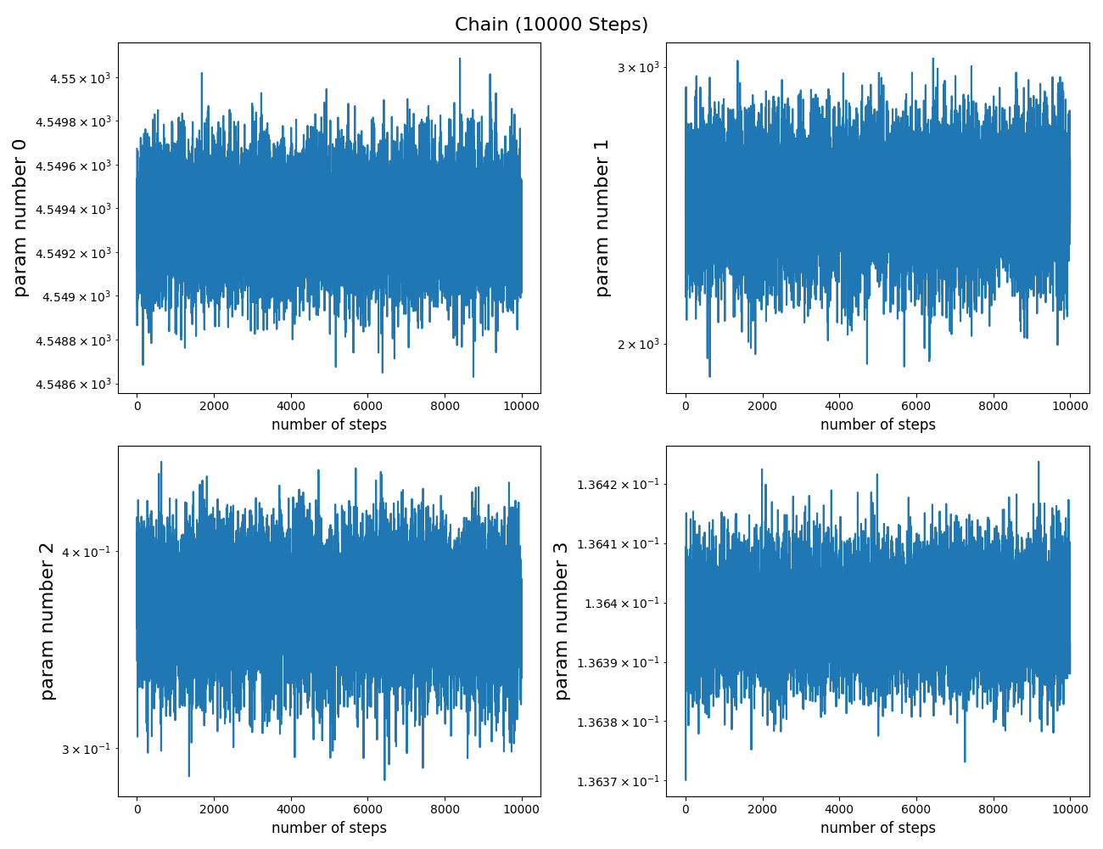
Fitted Parameters:
[4.54933238e+03 2.47654876e+03 3.70006283e-01 1.36397845e-01]
Error Bars:
[1.81616137e-01 1.56788160e+02 2.34431702e-02 6.32705006e-06]

Slide 14
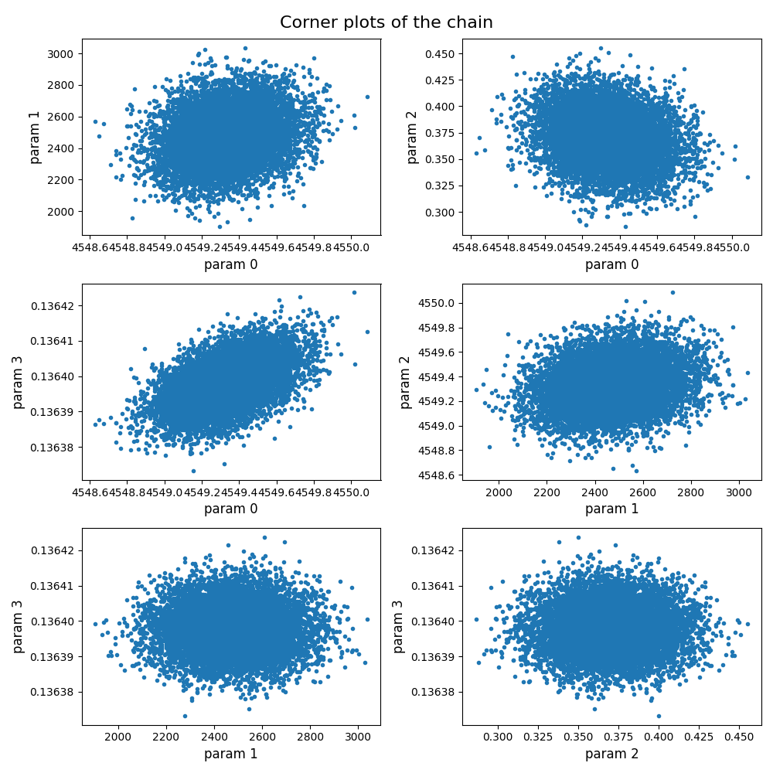
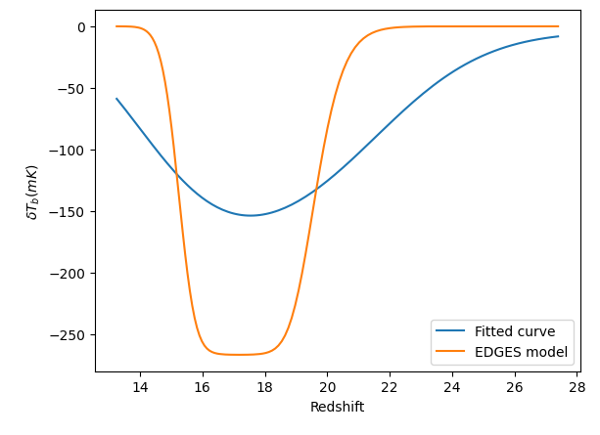

Slide 15
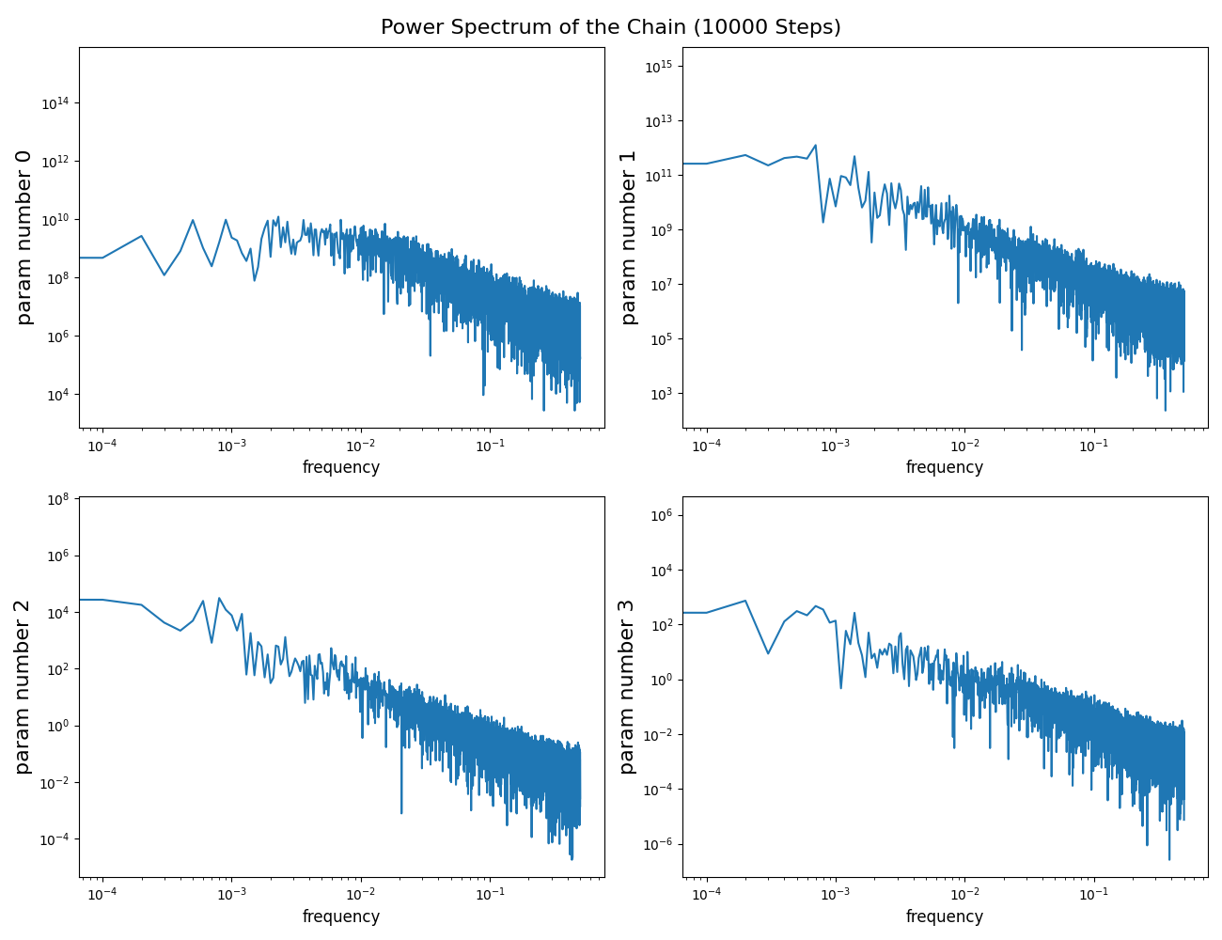
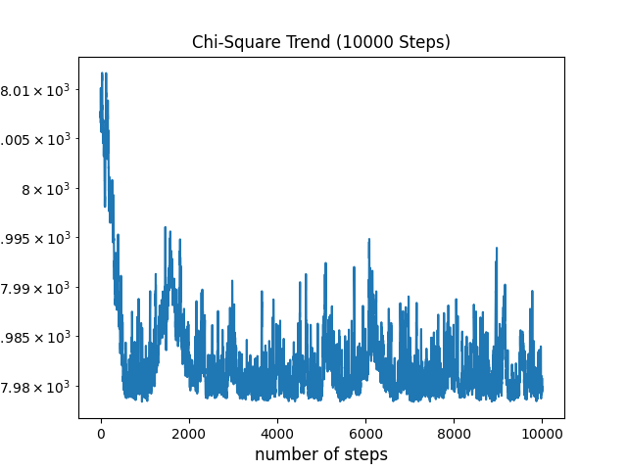
Simple MCMC
Samples are not drawn from the covariance matrix
Only the starting point comes from LM
Chi-Square of the starting point of MCMC (result of LM): 8006.655
Chi-Square of MCMC best-fit point: 7978.887
Acceptance ratio for 10000 Steps: 78.3%

Slide 16
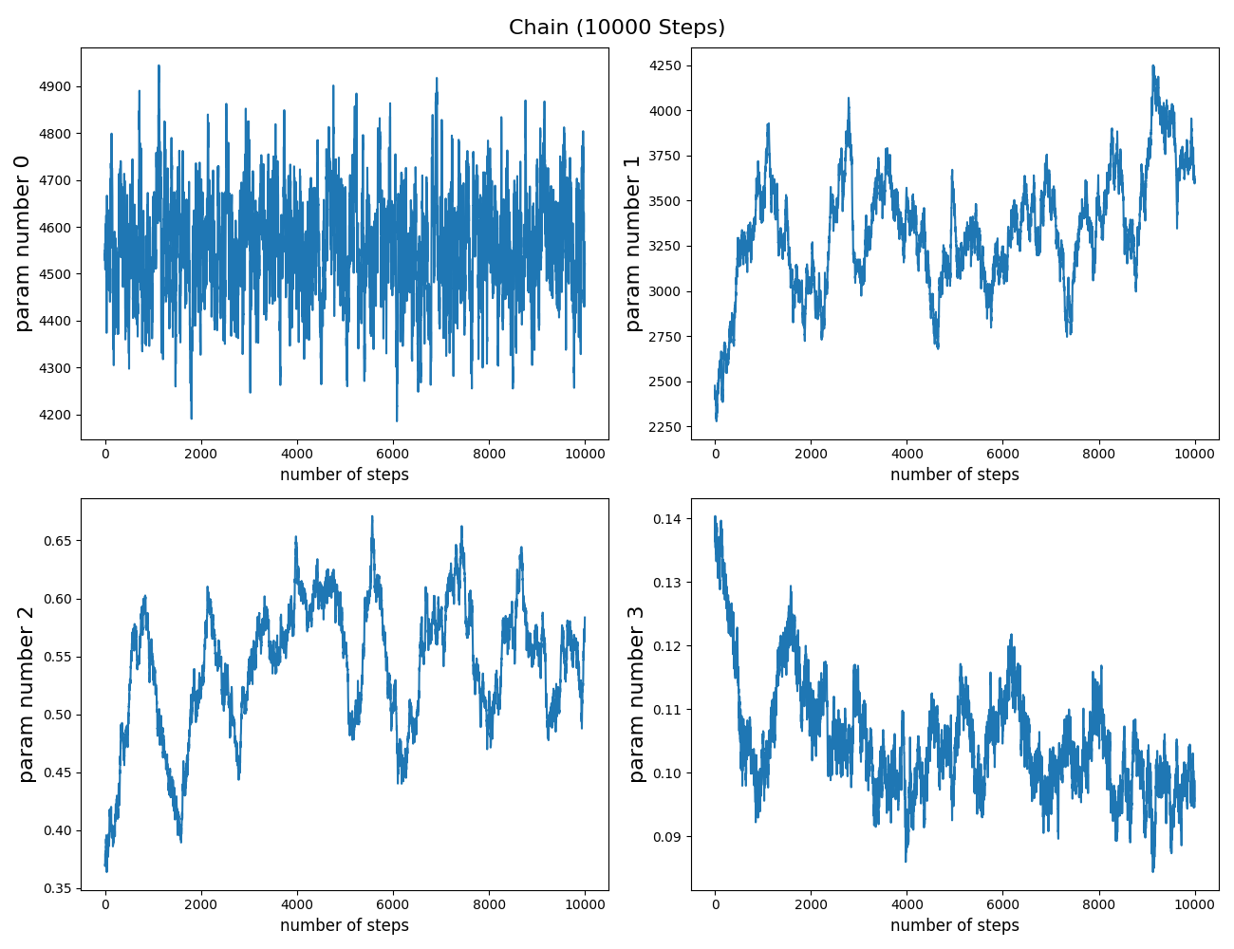
Fitted Parameters:
[4.55952291e+03, 3.33655523e+03, 5.41704221e-01, 1.04942202e-01]

Slide 17
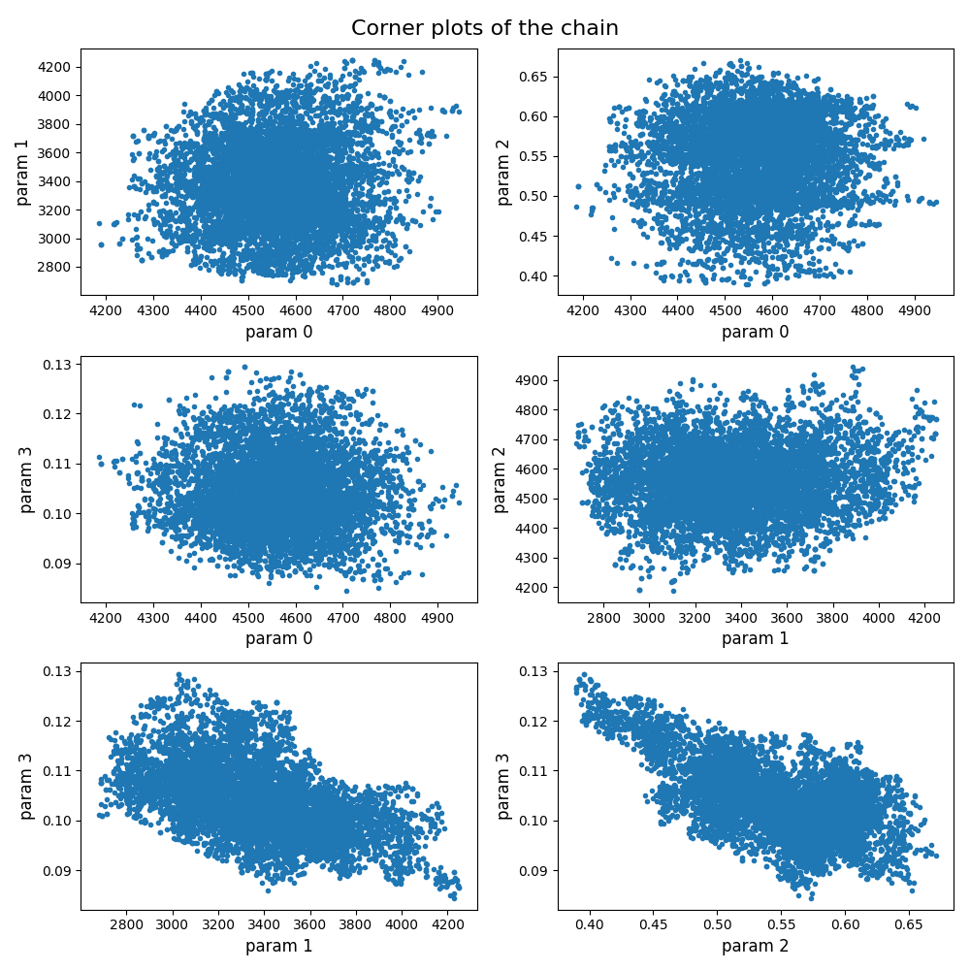
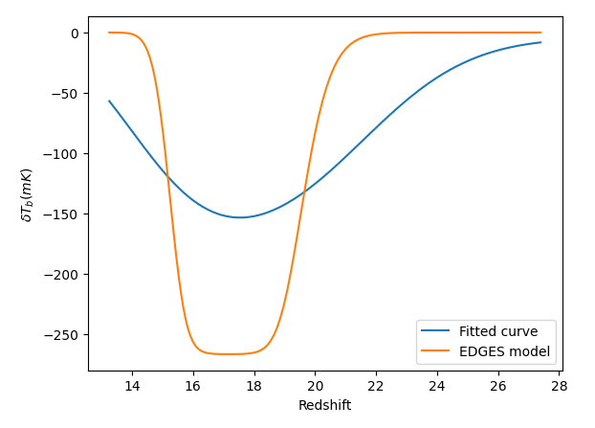

Slide 18
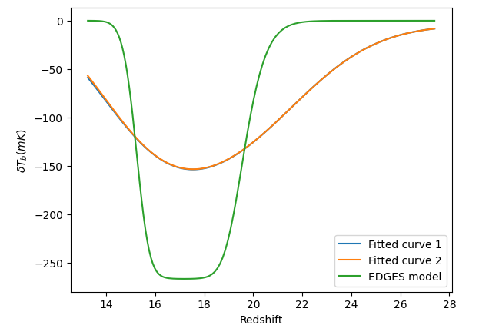
Comparison between the two fits

Slide 19


Physical Explanation of Parameters:
Fesc
fraction of ionizing photons that escape their host galaxy into the IGM
Nion
mean number of ionizing photons produced per baryon of star formation
Globally-averaged ionizing efficiency
Ionizing efficiency
Furlanetto 2006, eq 82 & 83

Slide 20
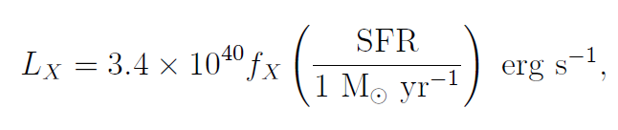
fX:
high- redshift renormalization factor in the relation between X-ray luminosity and star formation rate (Furlanetto 2006, eq 68)
Nlw:
number of photons emitted in the Lyman-Werner band (photon energy in the range of 11.2 to 13.6 eV) per baryon of star formation
Notes:
Extrapolation of the redshift to high redshifts due to enormous uncertainties about the nature of high-redshift objects making it impossible to describe the high-redshift X-ray background

