Slide 1
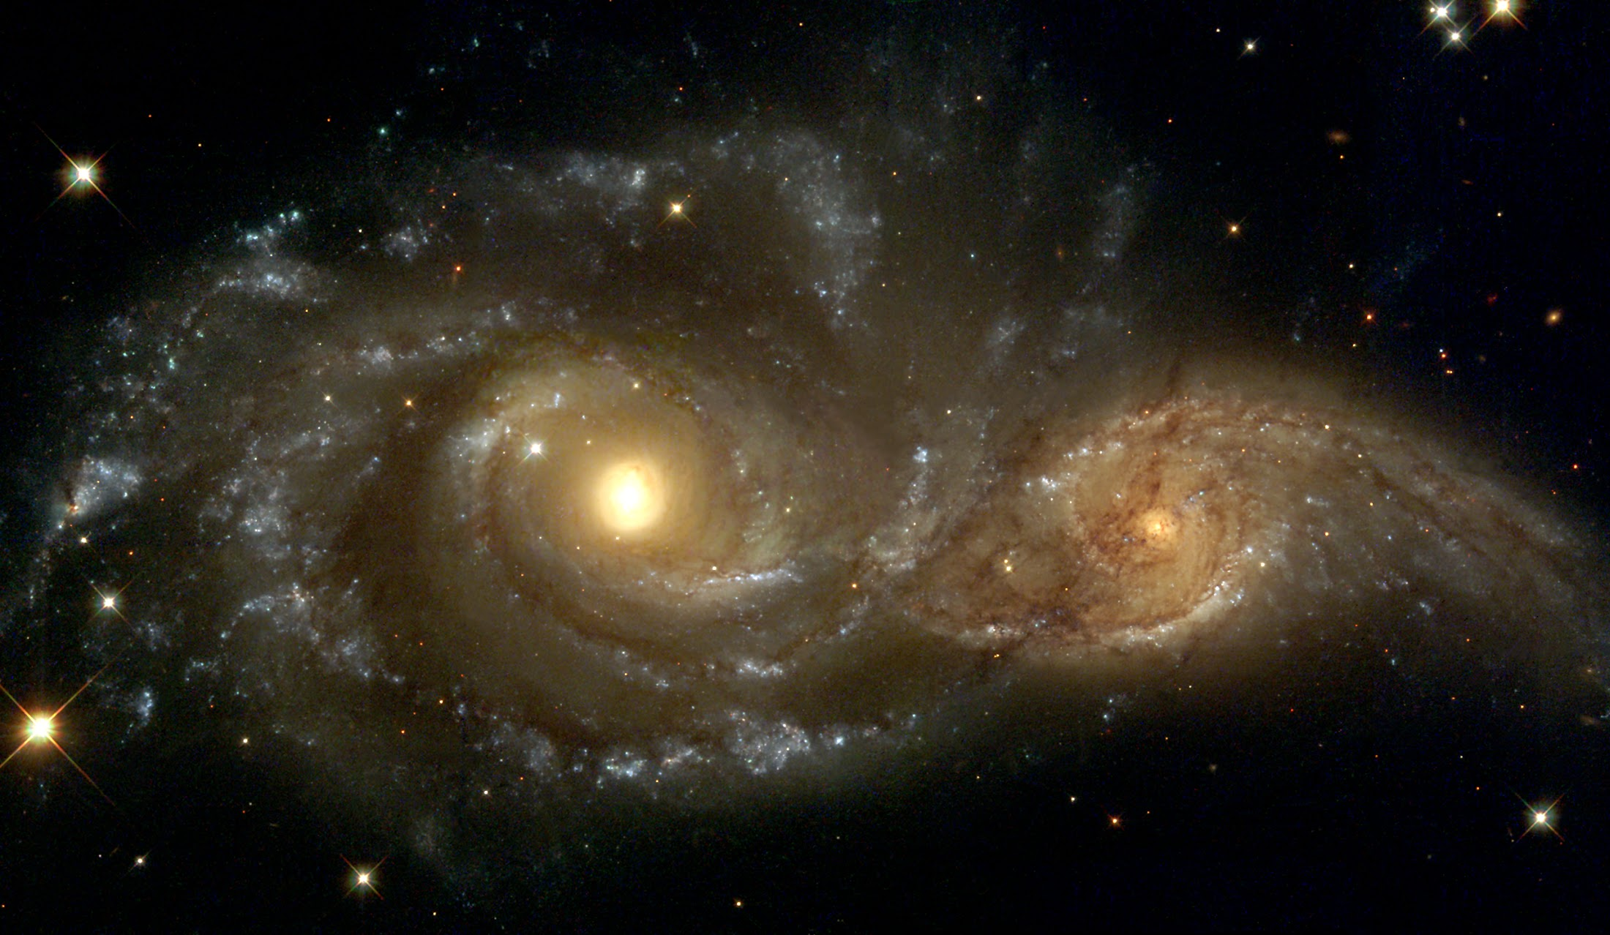

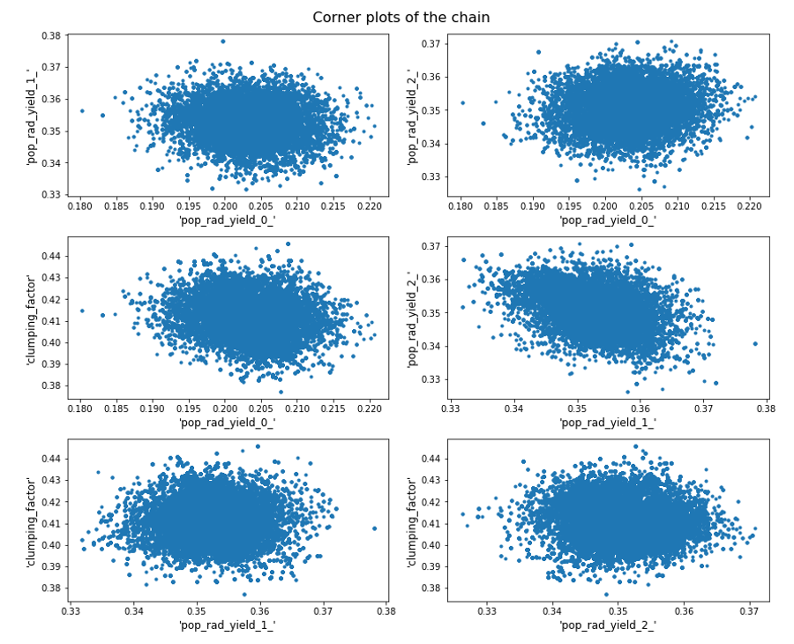
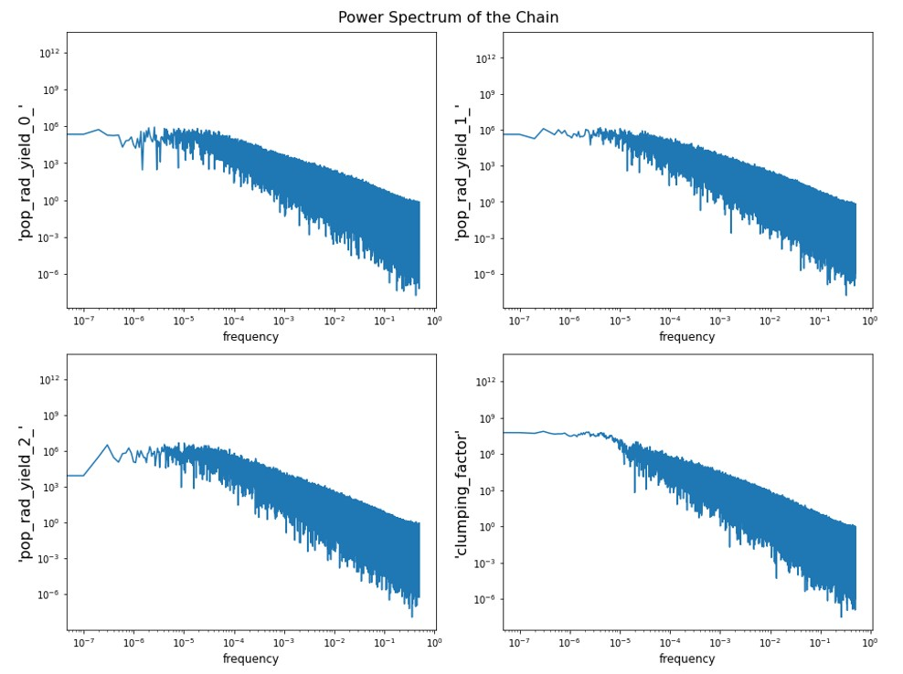
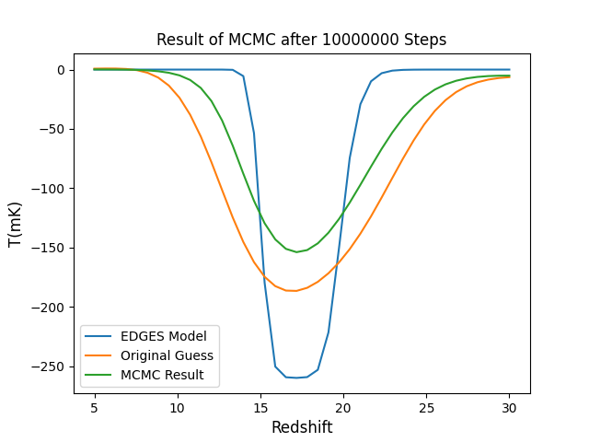
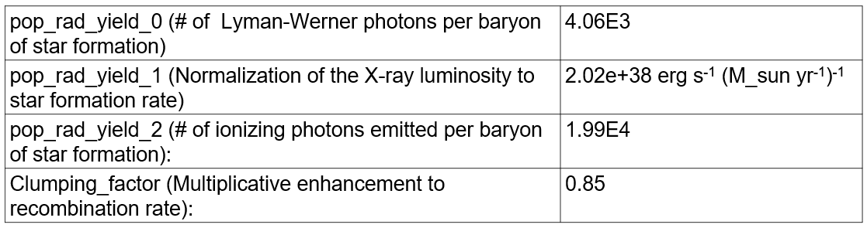
Parameter Estimation of Global 21cm Signal Aryana Haghjoo¹, Jonathan Sievers^{1, 2} , Oscar Hernandez^{1, 3} ¹ McGill University, ² University of KwaZulu-Natal, ³ Marianopolis College
Methods
We have developed a Python script that uses MCMC to fit the parameters of the global 21cm signal. At each step of the algorithm, the model generated by ARES is compared to observational data by calculating the chi-square. We used data released by the EDGES group as the basis for our fitting process, but our script is open to future datasets (for this specific run, we used EDGES model with half of the original amplitude).
As ARES can have long runtimes, we developed an emulator based on ARES curves using radial basis function interpolation. This emulator can generate global 21cm curves approximately a thousand times faster than ARES.
With the emulator's help, we were able to run the MCMC for up to ten million steps. We confirmed the convergence of this chain by analyzing its power spectrum, which exhibited a flat behavior on low frequencies.
Abstract
We adopt the Markov Chain Monte Carlo (MCMC) method combined with the Levenberg Marquardt (LM) algorithm to estimate the best-fit physical parameters (e.g., clumping factor, star formation efficiency) of the theoretical 21cm curves. We use the Accelerated Reionization Era Simulations (ARES) to generate models for the global 21-cm signal. Our method is flexible to the choice of parameters from ARES.
The knowledge of these best-fit parameters will help us to constrain future proposed models and set theoretical limits for the precision of upcoming experiments to observe non-standard effects.
Corner plots of the chain after subtracting the burn-in phase
In order to achieve faster convergence of MCMC chains, we are exploring various methods, one of which involves using a posterior distribution that accounts for correlations between different parameters.
To generate this posterior distribution, we first use a Levenberg-Marquardt fitter to obtain a set of best-fit parameters and the covariance matrix of parameters based on the local derivatives of the likelihood at the best-fit point. We then draw samples from this covariance matrix to generate the posterior distribution. Currently, we are using this method to improve the convergence of our MCMC chains.
Introduction
The global 21cm signal has been used to study the period between the end of the cosmic dark ages and the formation of the first stars and galaxies.
In this study, we explore the potential of this signal to reveal non-standard physics by means of providing a new path to test fundamental physical theories. The 21cm signal is sensitive to the density and temperature of neutral hydrogen in the early universe and the presence of the first stars and galaxies. Therefore, any deviation from the predictions of the standard cosmological model of this signal could indicate the presence of new physics beyond the standard model.
Results
The four best-fit parameters are as follows:
References
[1] Judd D Bowman et al. Nature 555.7694 (2018), pp. 67–70.
[2] Aviad Cohen et al. Monthly Notices of the Royal Astronomical Society 472.2 (2017), pp. 1915–1931.
[3] Jordan Mirocha. Monthly Notices of the Royal Astronomical Society 443.2 (2014), pp. 1211–1223.

