Slide 1
PERFORMANCE + STATISTICAL RELIABILITY
Parallel Monte Carlo
Four implementations. One laptop.
Two questions: how fast, and how reliable?
Rajrup Mal — MPI
Dev Visoulia — OpenMP
Aryan Sheikh — CUDA & integration
CSE (AI & ML) · AIML-C2
Monte Carlo / OpenMP · MPI · CUDA
01
Notes:
Open with the question: can a faster estimate still be statistically unreliable? This is an applied comparison, not a new Monte Carlo algorithm. Team: Dev explains OpenMP, Rajrup explains MPI, Aryan explains CUDA and integration.

Slide 2
01 / PROBLEM
Estimate an area by counting points
π estimate = 4 × inside points / total points
Generate independent uniform points (x, y).
Count points where x² + y² ≤ 1.
Typical sampling error decreases as 1 / √N.
Motivation: numerical integration, uncertainty analysis and particle simulation.
Monte Carlo / OpenMP · MPI · CUDA
02
Notes:
Uniform points lie in the unit square. The part inside x²+y²≤1 has area pi/4, so four times the inside fraction estimates pi. More independent samples reduce typical error at the rate 1/sqrt(N); ten times lower error needs roughly 100 times more samples.

Slide 3
02 / SCOPE
What this project contributes
Compare sequential C++, OpenMP, MPI and CUDA.
Separate execution speed from estimate quality.
Test separated streams against deliberate stream reuse.
Connect timing to GPU counters and GPU-only energy.
Monte Carlo / OpenMP · MPI · CUDA
03
Notes:
Do not describe pi estimation as novel. The contribution is a reproducible four-way implementation comparison plus a deliberately broken stream control, interval coverage checks, and scoped hardware measurements. We do not implement a production financial or physics solver.

Slide 4
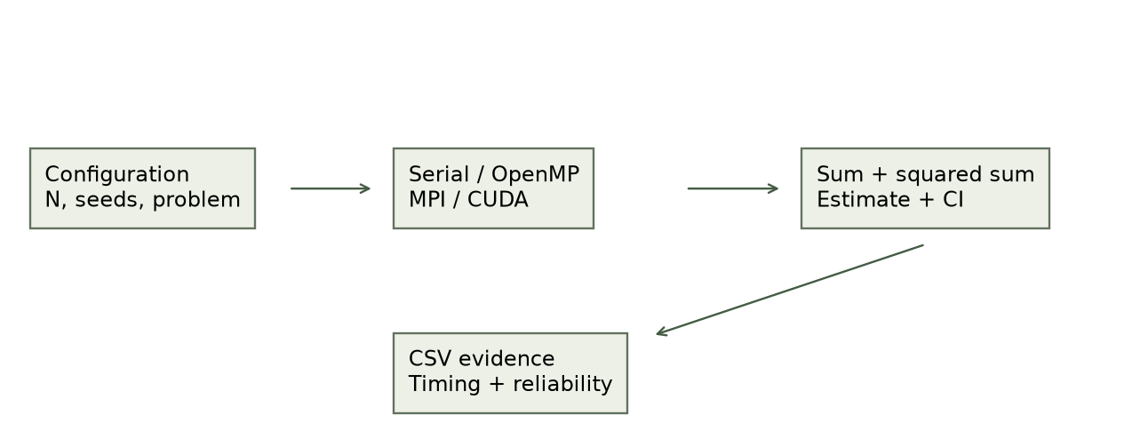
03 / ARCHITECTURE
One experiment, four execution paths
The same statistical output makes correctness checks and comparisons possible.
Monte Carlo / OpenMP · MPI · CUDA
04
Notes:
The input specifies problem, N, seed and backend configuration. Each backend produces sums and squared sums. Shared statistics compute the estimate and confidence interval, then CSV analysis produces comparisons. This diagram shows data flow, not simultaneous execution of every backend.

Slide 5
04 / IMPLEMENTATION
How work is divided
Sequential: one CPU execution path processes every chunk.
OpenMP: threads share memory and reduce partial sums.
MPI: local processes own chunks and combine results.
CUDA: GPU threads sample points and reduce block totals.
MPI was tested on one laptop; these are not multi-node cluster results.
Monte Carlo / OpenMP · MPI · CUDA
05
Notes:
Dev: OpenMP uses a static parallel loop with private RNGs and reductions. Rajrup: rank r takes chunks r, r+P and so on; all ranks enter MPI collectives, even those without work. Aryan: CUDA threads process a grid-stride loop and reduce within blocks; the host combines block totals. CPU chunks have 4096 samples.

Slide 6
05 / RANDOM STREAMS
A fast estimate can still be unreliable
CPU: MT19937-64 streams assigned to fixed chunks.
GPU: Philox subsequences assigned to global thread IDs.
Negative control: reuse streams across chunks or blocks.
Repeated samples contain less information than fresh samples.
CPU and GPU use different RNG families: their speedup is an implementation comparison.
Monte Carlo / OpenMP · MPI · CUDA
06
Notes:
A seed initializes an RNG. A stream is the sequence of generated values. CPU engines are assigned to fixed chunks, which preserves sample mapping across worker counts. CUDA uses Philox subsequences indexed by global thread ID. The negative control deliberately repeats streams. Different seeds alone do not prove independence.

Slide 7
06 / EXPERIMENTAL SETUP
Measure under stated conditions
Intel Core Ultra 7 255HX + RTX 5060 Laptop GPU.
Common comparison: 30 trials per configuration.
Three shuffled rounds reduce fixed-order timing effects.
Report total trial time separately from GPU kernel time.
MPI startup and process launch are outside the reported trial timing.
Monte Carlo / OpenMP · MPI · CUDA
07
Notes:
Hardware: Intel Core Ultra 7 255HX and RTX 5060 Laptop GPU. The randomized common comparison has 48 configurations, 3 shuffled rounds of 10 trials, totaling 1440 trials and 30 distinct seeds per configuration. The separate CUDA study has 60 GPU configurations times 100 trials and 9 serial configurations times 30, totaling 6270 observations. Do not combine their speedup figures.

Slide 8
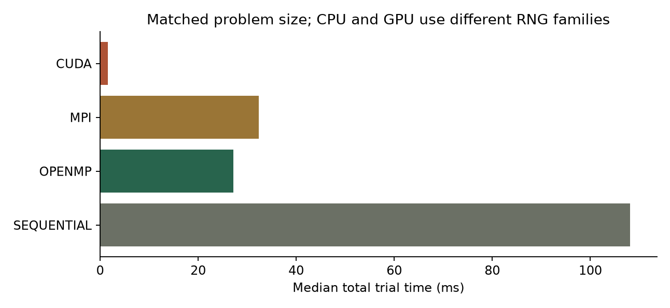
07 / RESULTS
Ten million samples: measured comparison
3.98× OpenMP
3.34× MPI
68.00× CUDA
Eight CPU workers / ranks · CUDA block 256 · total trial timing
Monte Carlo / OpenMP · MPI · CUDA
08
Notes:
Values are medians in milliseconds for separated streams at N=10^7: sequential 108.1431; OpenMP with 8 threads 27.18275; MPI with 8 ranks 32.35380; CUDA block 256 1.5904. Ratios are serial median divided by backend median. Different RNG families prevent interpreting the CUDA ratio as hardware alone.

Slide 9
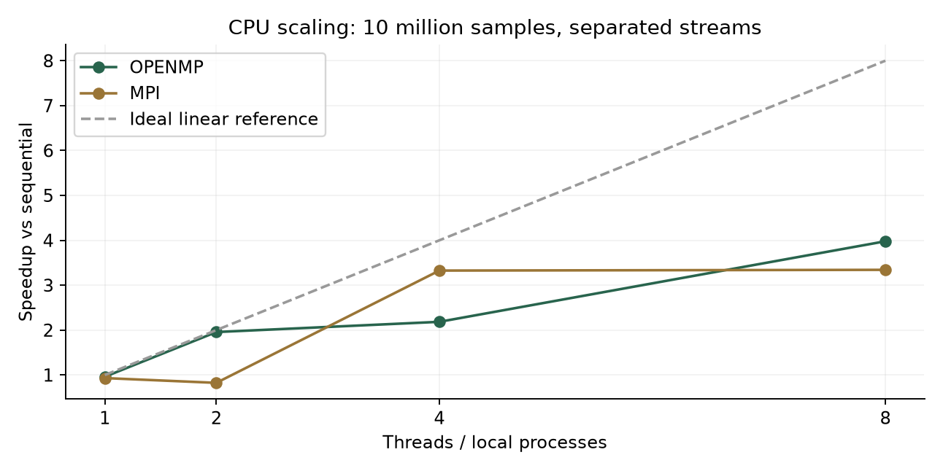
08 / CPU SCALING
Scaling is useful—and imperfect
8-worker efficiency
OpenMP 49.7%
MPI 41.8%
Do not use CUDA thread count as an efficiency denominator.
The two-rank MPI slowdown remains a limitation to investigate.
Monte Carlo / OpenMP · MPI · CUDA
09
Notes:
CPU efficiency is speedup divided by workers: 49.7% for OpenMP and 41.8% for MPI at eight workers. Two-rank MPI was slower than serial in the rerun; do not invent a confirmed cause. Earlier fixed-order superlinear values did not reproduce. Laptop scheduling, clock and thermal effects remain possible influences that need controlled experiments.

Slide 10
09 / STATISTICAL RESULTS
Reliability: test intervals across seeds
Separated streams
Repeated streams
98 / 100
12 / 100
intervals covered π
intervals covered π
Separate CUDA study · N = 10⁹ · block 256 · 100 distinct run seeds
Monte Carlo / OpenMP · MPI · CUDA
10
Notes:
A 95% confidence procedure should contain the true value in roughly 95% of independent repetitions under its assumptions; it is not a 95% probability assigned to a fixed computed interval. At N=10^9 and block 256, 100 CUDA trials yielded coverage 98/100 for separated streams and 12/100 for repeated streams. Variance/theory was 0.781 versus 162.268. Finite trial uncertainty remains; these checks do not prove RNG independence.

Slide 11
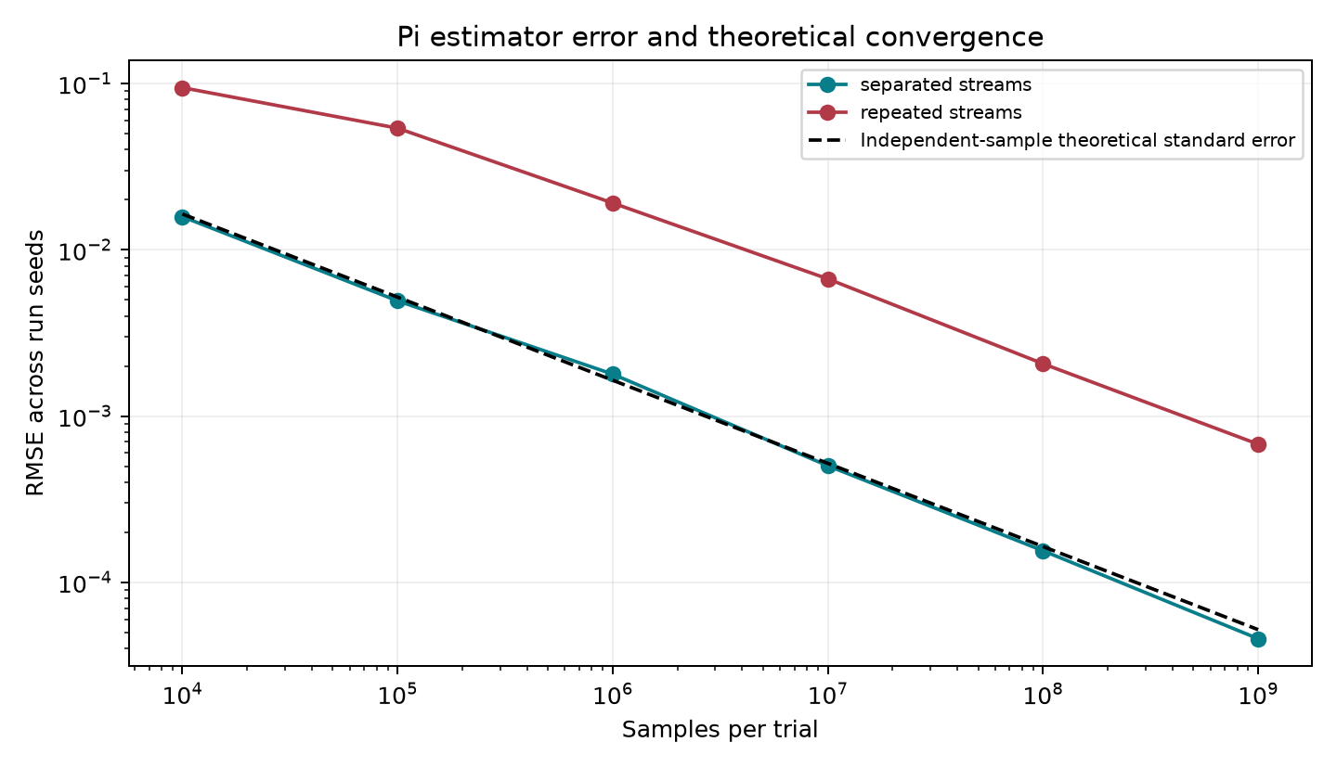
10 / CONVERGENCE
Error decreases with sample count
Check the error bars,
not just the digits.
Also tested a known-answer integral in 2, 8, 16 and 32 dimensions.
Monte Carlo / OpenMP · MPI · CUDA
11
Notes:
RMSE means root mean squared error across run seeds; it combines squared departures from true pi. The dashed theoretical line assumes independent points. Repeated streams can still improve with N while remaining much worse than the independent reference. The known higher-dimensional integral averages squared coordinates and equals 1/3; its variance decreases with dimension by construction, so it does not demonstrate a cure for the curse of dimensionality.

Slide 12
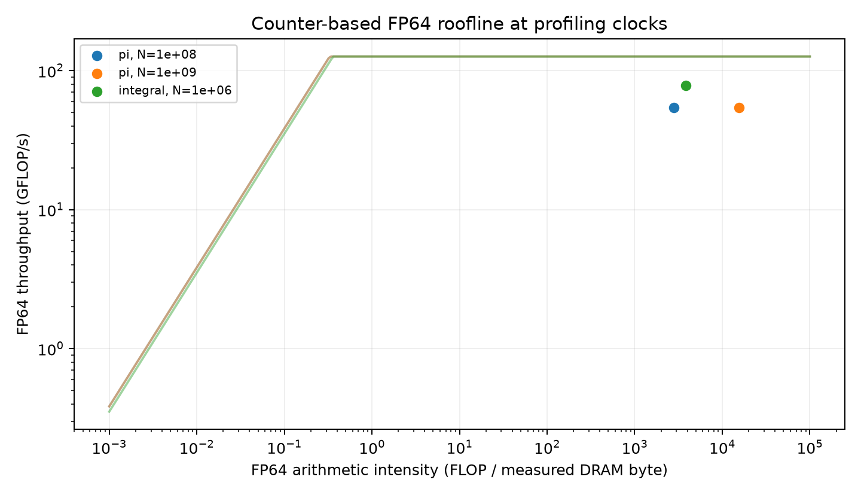
11 / PROFILING + ENERGY
What limits the tested CUDA kernels?
≈54 GFLOP/s
FP64 π kernel
≈303 million
samples / GPU joule
Counter diagnosis is configuration-specific; GPU-only energy includes the aligned workload window.
Monte Carlo / OpenMP · MPI · CUDA
12
Notes:
Roofline compares floating-point throughput with compute and memory ceilings. Pi achieved about 54 FP64 GFLOP/s against 126.36, or 42.7%. FP64 pipeline utilization near 85–87% is a different counter and must not be called percent of theoretical FLOP peak. Low DRAM throughput and high pipeline activity support an FP64 arithmetic bottleneck for tested configurations. Philox integer work is excluded from the FLOP count. Profiling uses replay and requested base clocks. Energy averages about 303 million samples per GPU joule over three sustained windows, not whole-system energy.

Slide 13
12 / RELATED WORK
How this fits existing research
OpenMC: production transport across GPU vendors [1].
Transport RNG work: reproducible stream assignment [2].
cuVegas: adaptive multidimensional integration [3].
Our scope: a small, explainable benchmark with reliability checks.
[1] arXiv:2403.12345 [2] arXiv:2403.06362 [3] arXiv:2408.09229
Monte Carlo / OpenMP · MPI · CUDA
13
Notes:
References: Tramm et al., arXiv:2403.12345, portable production transport; Cuneo and Variansyah, arXiv:2403.06362, transport RNG management; Tolotti et al., arXiv:2408.09229, cuVegas adaptive integration; Salmon et al., SC11 DOI 10.1145/2063384.2063405, counter-based RNGs. Production studies have different workloads, hardware and baselines, so do not compare raw speedup ratios as rankings. Full bibliography is in the report.

Slide 14
13 / PRESENTATION
Live demonstration
Open http://127.0.0.1:8765
Choose 1,000,000 samples, 5 trials and 4 workers.
Run all four backends; explain timing and estimate columns.
Hover labels for definitions, then export the measured CSV.
Keep a labelled recorded run as backup. Short demonstrations do not validate RNG quality.
Monte Carlo / OpenMP · MPI · CUDA
14
Notes:
Start scripts/start_demo.bat beforehand and confirm all four backend badges. Use one million samples, five trials, four CPU workers, block 256 and separated streams. Run once; explain total time, kernel time and confidence intervals by hovering labels. Download CSV. A five-trial demo is not evidence of 95% coverage. If execution fails, show explicitly labelled previously measured results.

Slide 15
14 / TAKEAWAYS
Conclusions and limits
All four implementations are complete and validated.
CUDA accelerates the tested workload; RNG strategy still matters.
One laptop, different RNG families and local MPI limit generalization.
Next: matched RNGs, repeated profiles and broader hardware tests.
Monte Carlo / OpenMP · MPI · CUDA
15
Notes:
Main finding: the GPU is fastest in the quoted tested configuration, while repeated streams severely weaken confidence-interval coverage. The result is scoped to this laptop and these implementations. Remaining work: matched RNG families, controlled CPU anomaly investigation, repeated profiles and broader hardware. No A-star acceptance, universal independence or whole-system energy claim is justified. Invite questions and use backup slides for formulas and timing boundaries.

Slide 16
APPENDIX A
Backup: formulas for the viva
π estimate = 4H / N
Theoretical variance = (4π − π²) / N
Approximate 95% interval = estimate ± 1.96 × standard error
Integral: mean of d squared coordinates; exact value = 1/3
Independent samples are required for these standard-error formulas.
Monte Carlo / OpenMP · MPI · CUDA
16
Notes:
Let p=pi/4 and H be the inside count among N independent points. H is binomial, so Var(4H/N)=(4pi-pi²)/N. For per-point values Z=4 times the inside indicator, sample variance is divided by N−1. The interval uses estimate ±1.96 sqrt(s²/N). For the integral, averaging d independent x² values yields variance 4/(45dN). Explain assumptions before quoting formulas.

Slide 17
APPENDIX B
Backup: timing and correctness
Speedup = sequential median / parallel median.
CPU efficiency = speedup / workers.
Kernel time is only one part of CUDA total trial time.
Correctness checks cover chunk boundaries, seeds and reductions.
Monte Carlo / OpenMP · MPI · CUDA
17
Notes:
OpenMP includes parallel-region creation and reduction. MPI excludes startup and the pre-trial barrier; it includes sampling and moment reduction and reports the maximum rank time. CUDA total includes allocation, kernel, transfer, host accumulation and free, but excludes context startup and process launch. Kernel includes RNG initialization. CPU checks cover 1,2,4,8 workers; sample counts 2,4095,4096,4097,100000; both problems and stream modes; integral tolerance 1e-12. Sixteen CUDA sanitizer cases were recorded as passing.

