Slide 1
Living Lab setpoints & Energy Work
By: Aryan Rajesh Aher

Slide 2
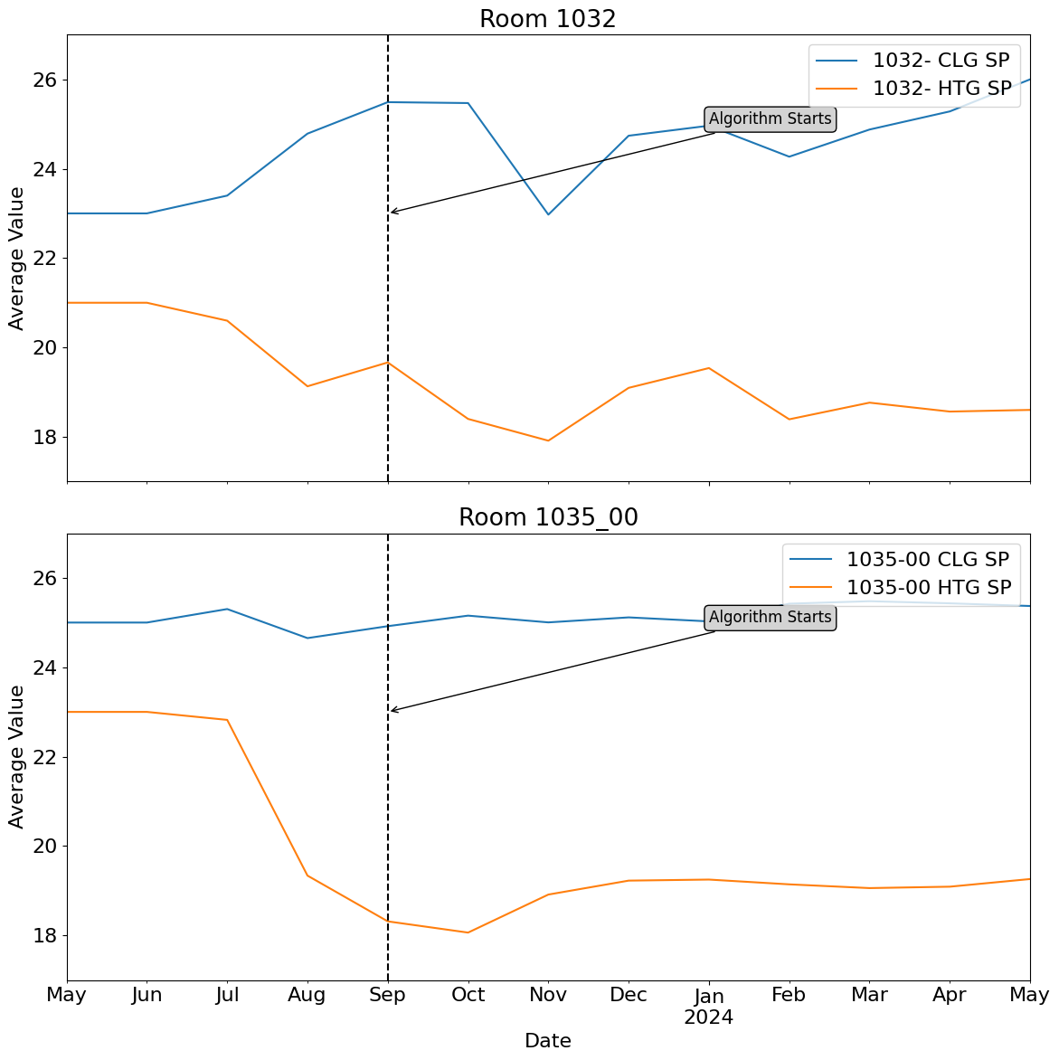
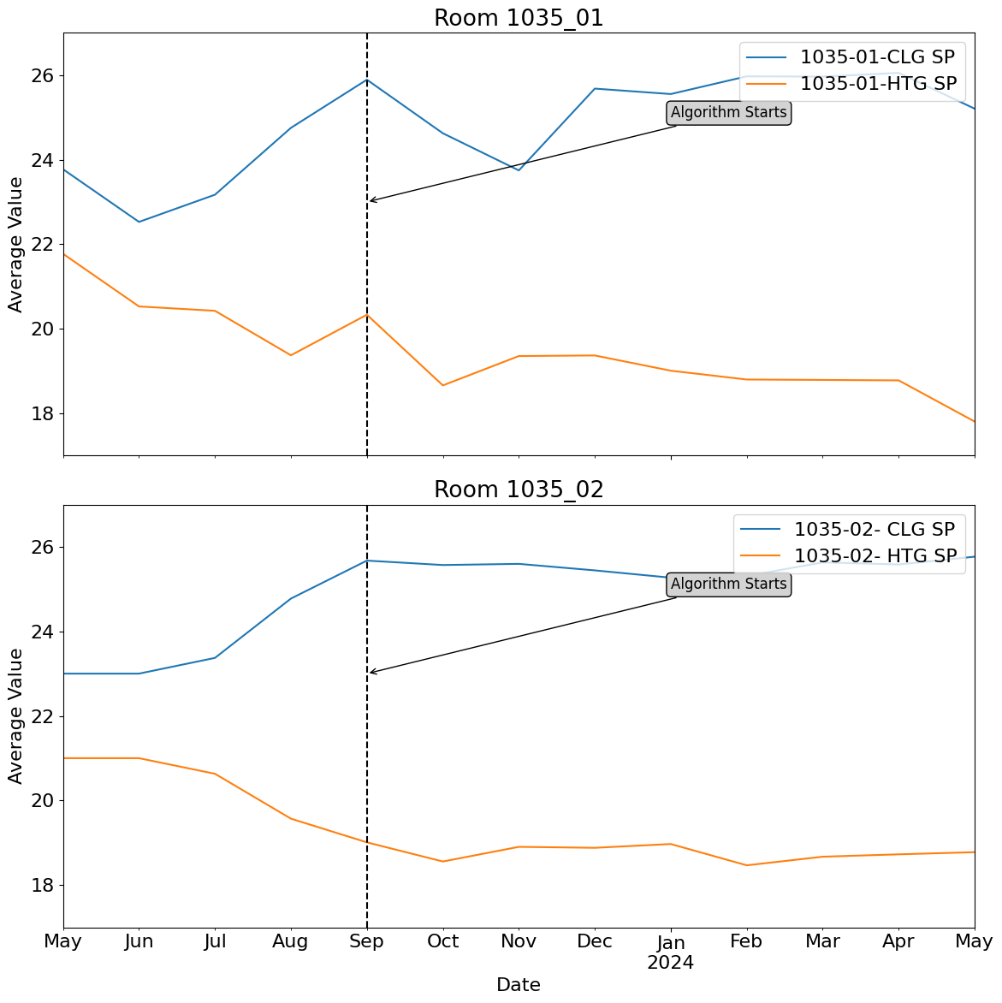
Monthly average of setpoints over the year

Slide 3
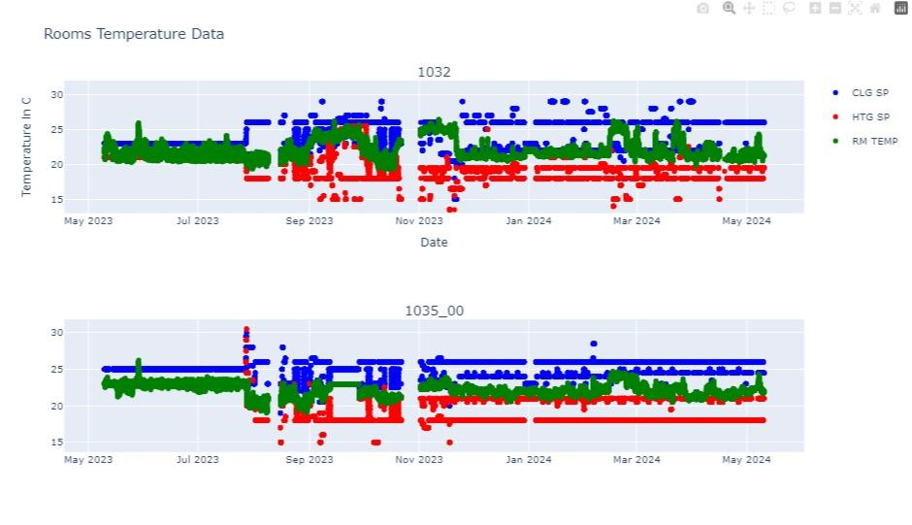
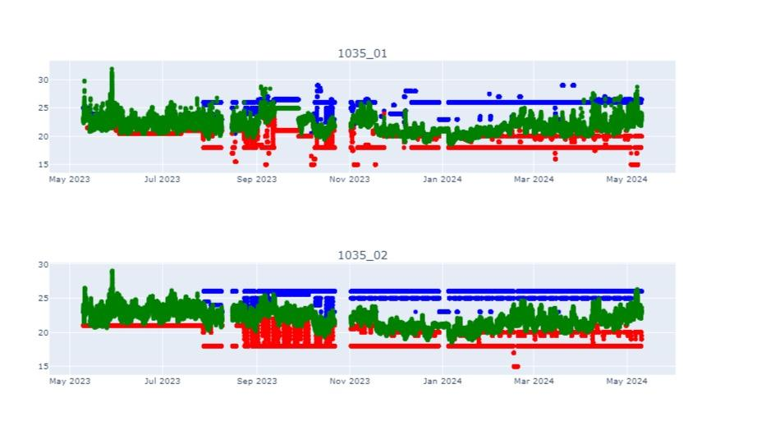
Set-points and temperature throughout the year

Slide 4
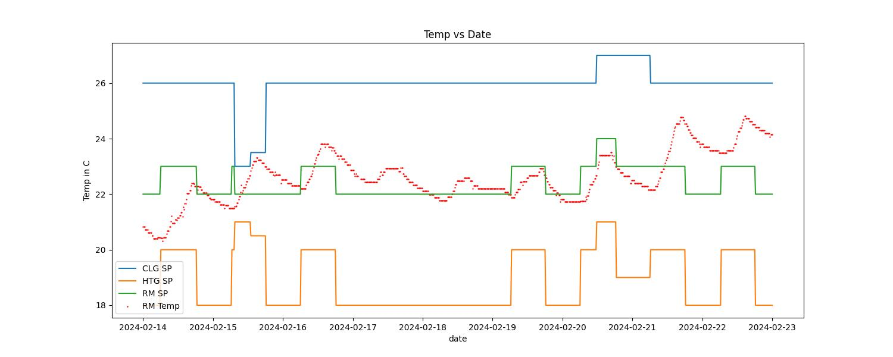
Enlarged image for 1035_01
Graph showing temperature and set_points variations from 14th feb to 23th feb

Slide 5
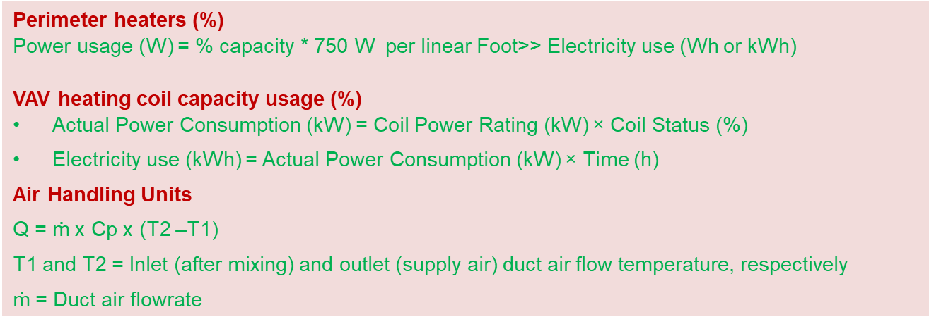
Energy Plots
The number on the bar shows the percent of data available in that month.
The energy calculations is done using the following equations.

Slide 6
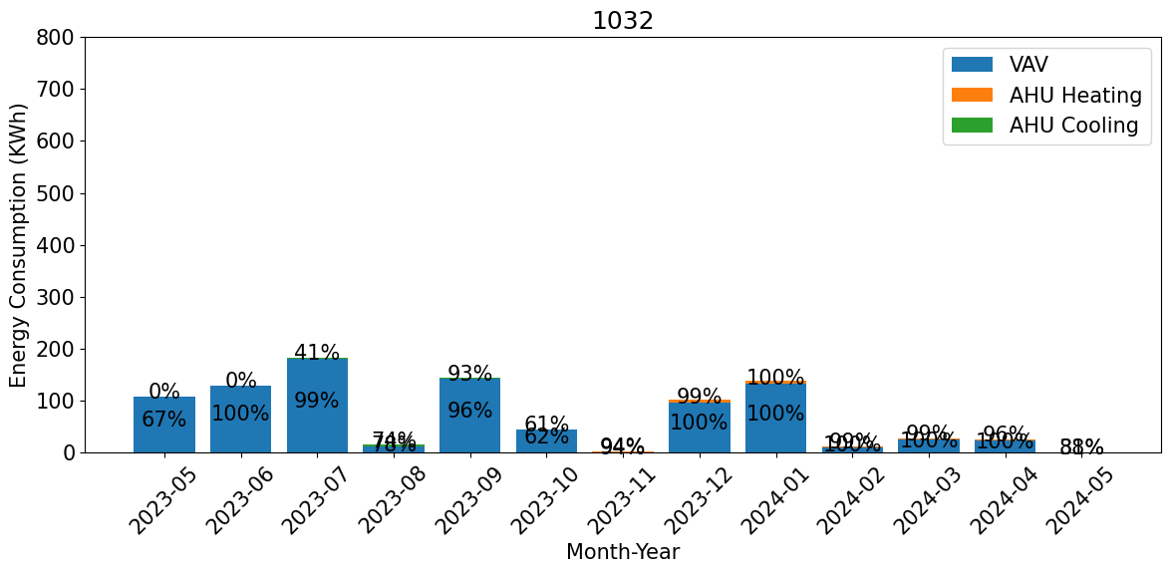
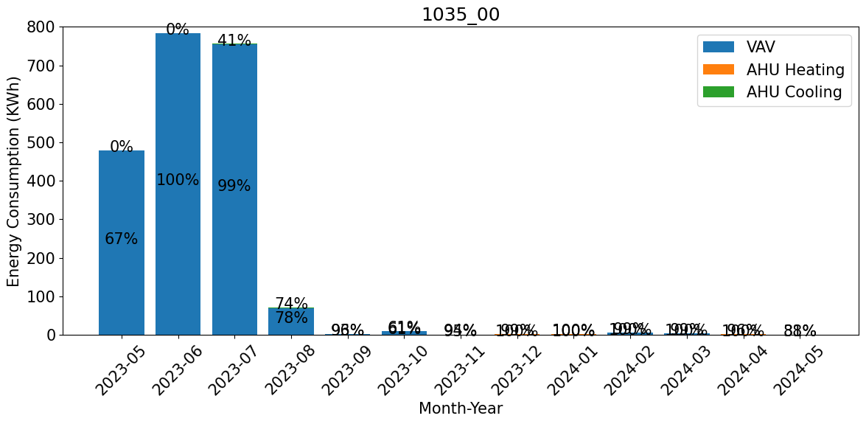
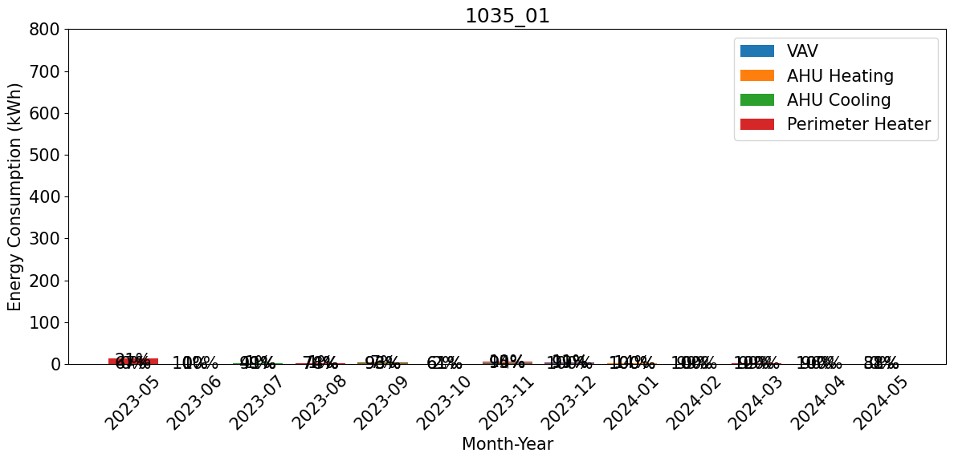
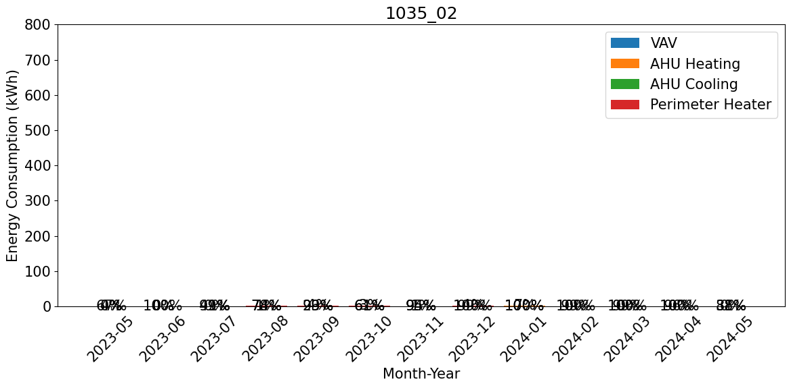

Slide 7
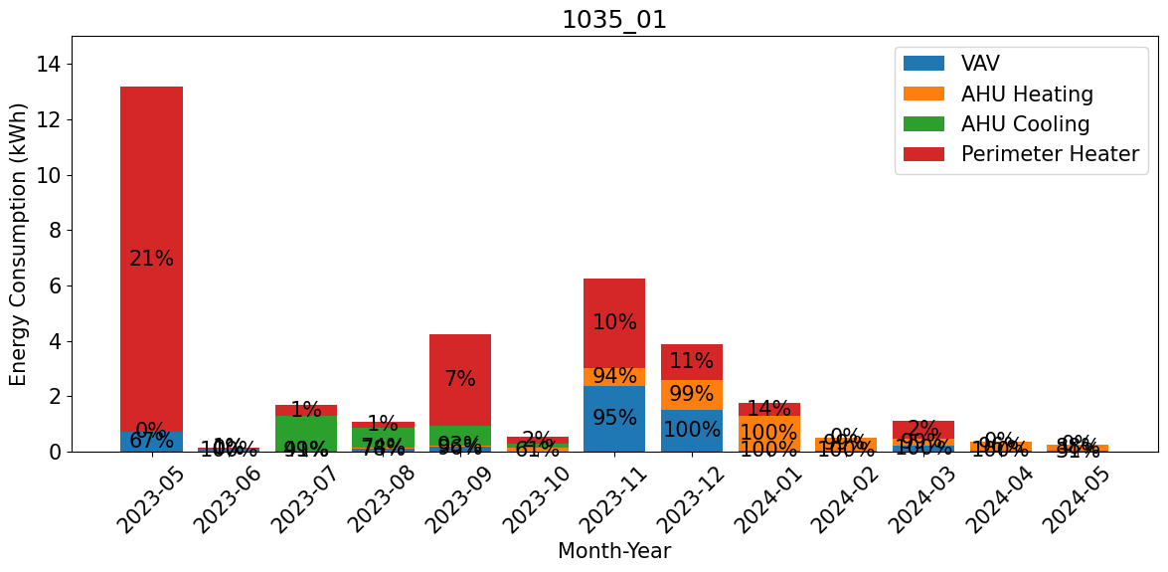
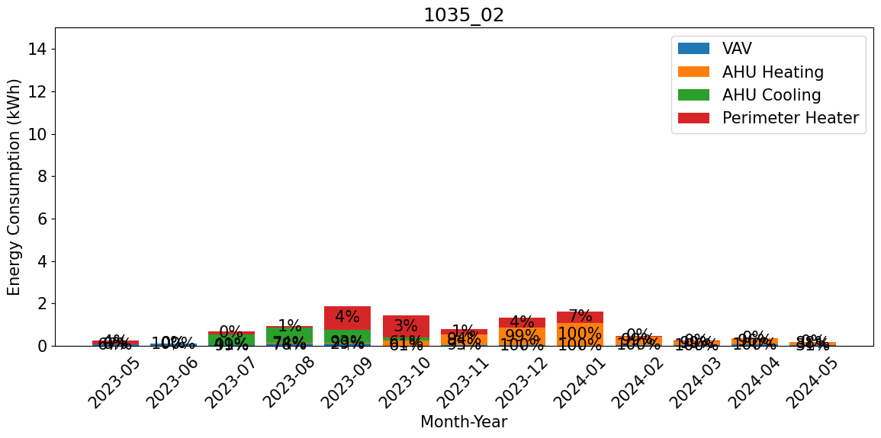
Enlarged plots for 1035_01 and 1035_02
The values are small in the bottom rooms when when compared to one at the top. Below are enlarged plots of those rooms.

Slide 8
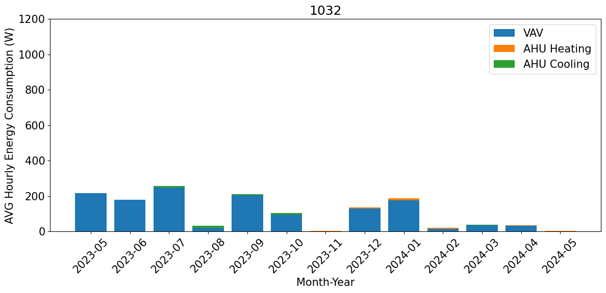
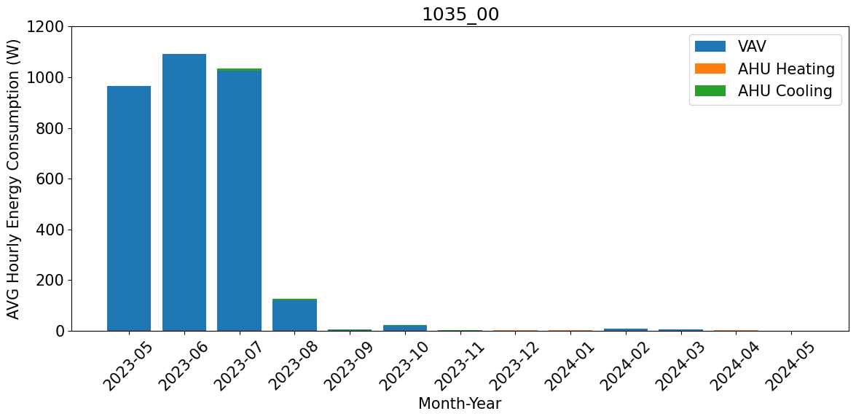
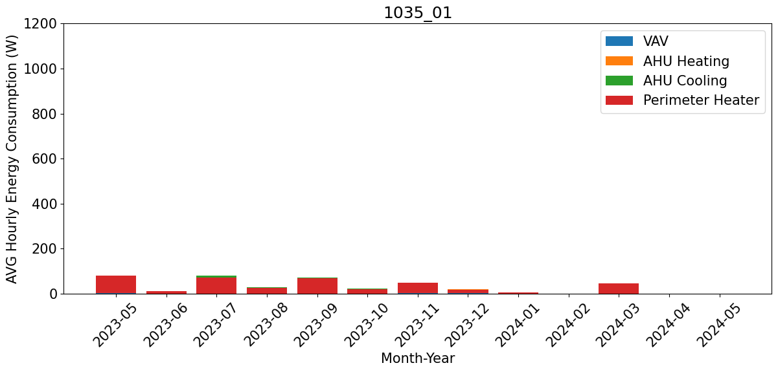
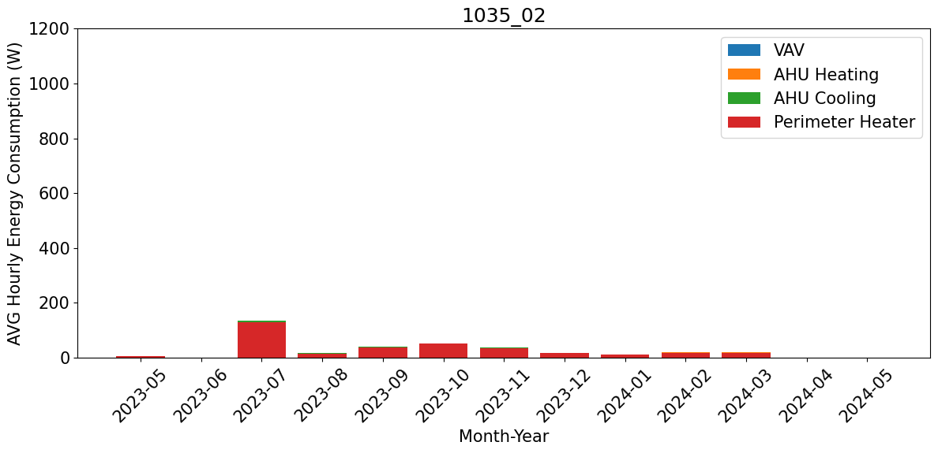
Avg hourly energy consumption

Slide 9
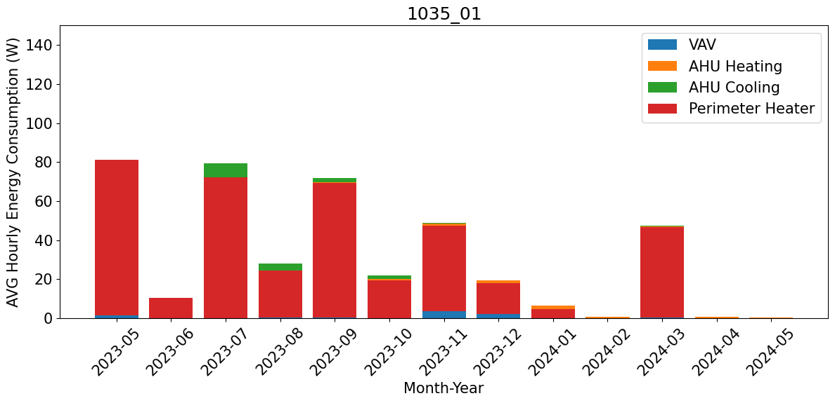
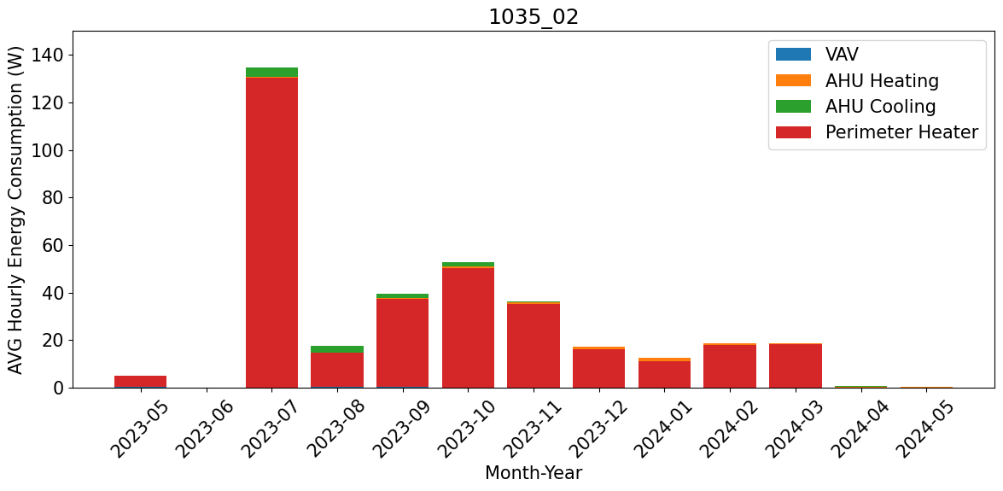
Enlarged plots for 1035_01 and 1035_02

Slide 10
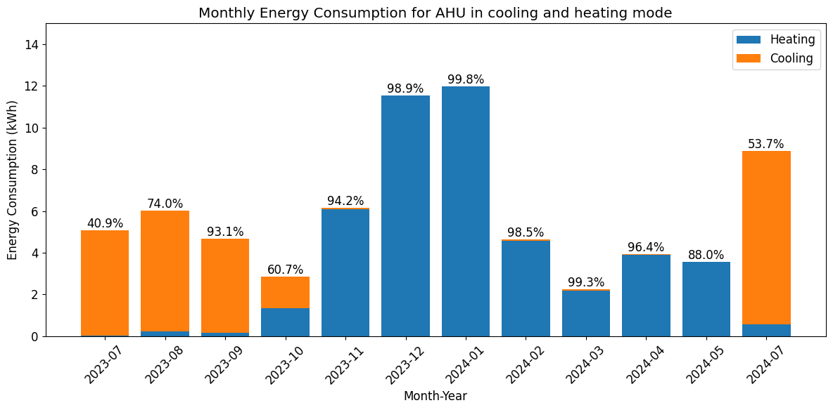
Total AHU consumption
The number on the top represents the percentage of data available in each month.

