Slide 1

BMS – Concordia university SIEMENS DESIGO CC
ENERGY BENCHMARKING
Presented by:
Muhammad Zeeshan Siddique
Supervisor(s):
Dr. (-Ing) Ursula Eicker
Dr. Mohamed Ouf
Dr. Mazdak Nik-Bakht
Department of Building, Civil and Environmental Engineering, Concordia University, Montreal, Canada

Slide 2
BMS – Concordia university SIEMENS DESIGO CC
HIGHLIGHTS
  Energy consumption per Zones
    Perimeter heaters:
        Perimeter heaters electric current (Ampere)
        Perimeter heaters capacity usage (%)
      VAV system:
        VAV heating coil capacity usage (%)
      AHU
        AHU based heating allocation per zone
        AHU based cooling allocation per zone
    EUI per zone
    Regression Analysis
Notes:
In order to further minimize the difference between the wi-fi connection and camera-based occupancy counts and get a realistic conversion factor

Slide 3
BMS – Concordia university SIEMENS DESIGO CC
ENERGY CONSUMPTION
Starting date of data point: 01.10.2022
Ending date: 30.09.2023
Zones | Name | Area | AHU | PH | VAV coil
Zone-I | 1035-01 | 10.4 | Yes | Yes | Yes
Zone-II | 1035-02 | 11 | Yes | Yes | Yes
Zone-III | 1035-00 | 50.5 | Yes | No | Yes
Zone-IV | 1032 | 127 | Yes | No | Yes
Missing Data:
PH_1035-01 (~2.5 months i.e., Jul – Sep 23)
PH_1035-02 (~5.5 months i.e., Oct 22 – Feb 23)
Perimeter heaters (%)
Power usage (W) = % capacity * 750 W per linear Foot>> Electricity use (Wh or kWh)
VAV heating coil capacity usage (%)
Actual Power Consumption (kW) = Coil Power Rating (kW) × Coil Status (%)
Electricity use (kWh) = Actual Power Consumption (kW) × Time (h)
Air Handling Units
Q = ṁ x Cp x (T2 –T1)
T1 and T2 = Inlet (after mixing) and outlet (supply air) duct air flow temperature, respectively
ṁ = Duct air flowrate
Notes:
In order to further minimize the difference between the wi-fi connection and camera-based occupancy counts and get a realistic conversion factor

Slide 4
BMS – Concordia university SIEMENS DESIGO CC
Perimeter Heaters
PH_1035-01 (Ampere)
PH_1035-01
No perimeter heaters in 1035-00 and 1032 is zero
Rated_capacity = 0.75 kW
Missing data
(~2.5 months)
PH_1035-02 (Ampere)
PH_1035-02
Rated_capacity = 0.75 kW
Missing data
(~5 months)

Slide 5
BMS – Concordia university SIEMENS DESIGO CC
VAV Coils
VAV_1035-00 (Percentage capacity)
VAV_1035-00
VAV consumption in 1035-01 and 1035-02 is zero
Rated_capacity = 1.5 kW
VAV_1032 (Percentage capacity)
VAV_1032
Rated_capacity = 2.5 kW

Slide 6
BMS – Concordia university SIEMENS DESIGO CC
Air Handling Unit
AHU Air Method Heating
AHU_1032
~ 15 %
~ 12 %
~ 4 %
~ 4 %
AHU_1035-01
AHU_1035-02
AHU_1035-00

Slide 7
BMS – Concordia university SIEMENS DESIGO CC
Air Handling Unit
AHU Air Method Cooling
~ 15 %
~ 12 %
~ 4 %
AHU_1032
~ 4 %
AHU_1035-01
AHU_1035-02
AHU_1035-00

Slide 8
BMS – Concordia university SIEMENS DESIGO CC
Total Energy Consumption (before removing missing months)
H_1035-01
H_1035-02
H_1035-00
H_1032

Slide 9
BMS – Concordia university SIEMENS DESIGO CC
Total Energy Consumption (after removing missing months)
H_1035-01
H_1035-02
H_1035-00
H_1032

Slide 10
BMS – Concordia university SIEMENS DESIGO CC
Total Energy Consumption (before removing missing months)
Monthly variation of total energy consumption for all zones

Slide 11
BMS – Concordia university SIEMENS DESIGO CC
Total Energy Consumption (after removing missing months)
Monthly variation of total energy consumption for all zones

Slide 12
BMS – Concordia university SIEMENS DESIGO CC
Energy Unit Intensity (before removing missing months)
EUI (H_1035-01)
EUI (H_1035-02)
EUI (H_1035-00)
EUI (H_1032)

Slide 13
BMS – Concordia university SIEMENS DESIGO CC
Energy Unit Intensity (after removing missing months)
EUI (H_1035-01)
EUI (H_1035-02)
EUI (H_1035-00)
EUI (H_1032)

Slide 14
BMS – Concordia university SIEMENS DESIGO CC
Energy Unit Intensity (before removing missing months)
A_1035-01 = 10.4 m²
A_1035-02 = 11 m²
A_1035-01 = 50.5 m²
A_1035-01 = 127 m²
EUI (kWh.m⁻²/month) = Total Energy Consumption / Area (m²)
Monthly variation of EUI for all zones

Slide 15
BMS – Concordia university SIEMENS DESIGO CC
Energy Unit Intensity (after removing missing months)
A_1035-01 = 10.4 m²
A_1035-02 = 11 m²
A_1035-01 = 50.5 m²
A_1035-01 = 127 m²
EUI (kWh.m⁻²/month) = Total Energy Consumption / Area (m²)
Monthly variation of EUI for all zones

Slide 16
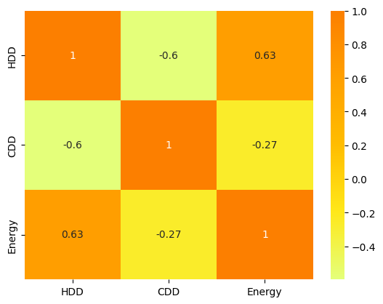
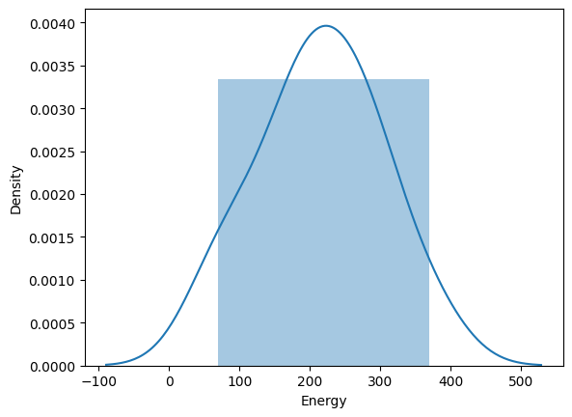
BMS – Concordia university SIEMENS DESIGO CC
Regression Analysis
Calculating the averaged hourly outdoor temperature (Oct 22 – Sep 23)
Base temperature for the estimation of HDD (Oct – May) and CDD (June – Sep)
  Base temperature for HDD: 18
  Base temperature for CDD: 22
Estimating the HDDs and CDDs based on the assumed base temperatures
Co-relation between the independent (HDDs, CDDs) and dependent (Energy kWh) variable
Energy (kWh) follows the normal distribution
Applying the simple linear regression

Slide 17
BMS – Concordia university SIEMENS DESIGO CC
Regression Analysis (Based on HDDs)
H_1035-01
H_1035-02
H_1035-00
H_1032

Slide 18
BMS – Concordia university SIEMENS DESIGO CC
Regression Analysis (Based on CDDs)
H_1035-01
H_1035-02
H_1035-00
H_1032

