Slide 1
Bank Management Desktop Software (Java)
Created By: Nakul Arya

Slide 2
Features:
Purpose/Usage:
MD-5 Password Protection
This application is built in order to test personal capability on creating a well-maintained, bug free desktop software using Java as the main language and MySQL for database.

Slide 3
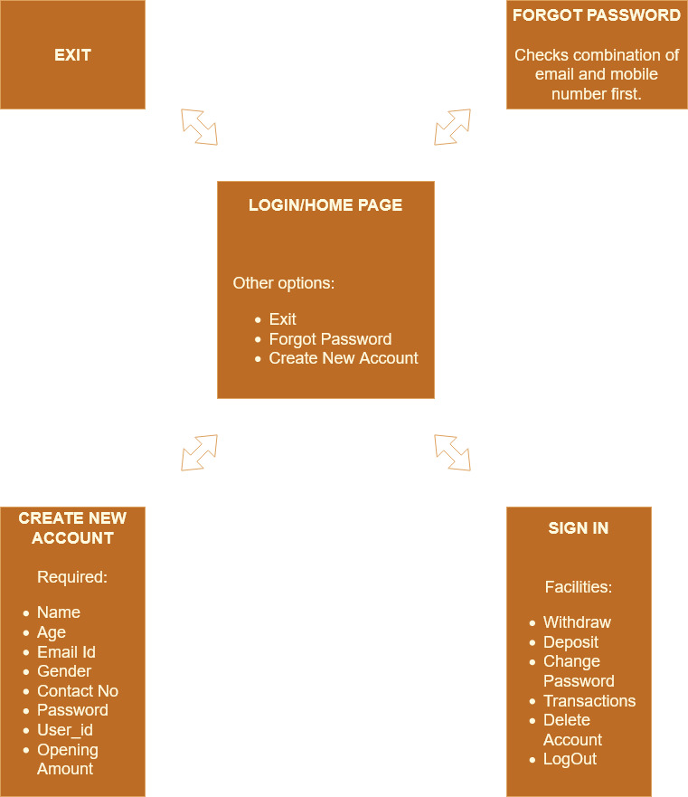
Work Flow

Slide 4
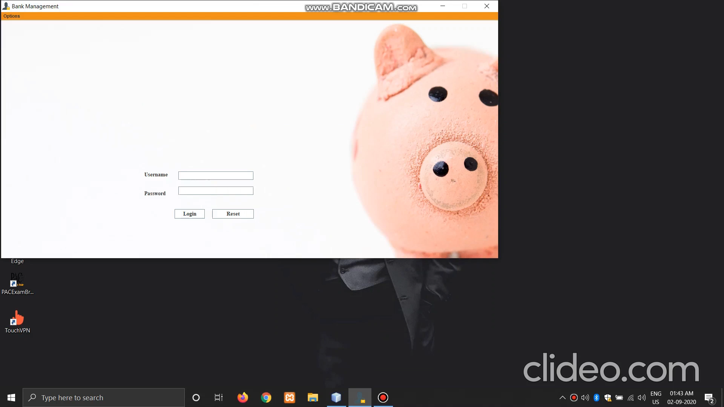

Slide 5
THANK YOU

