Slide 1
Project Presentation of CO-OP Project at Industry (Module-2) (22CS421)
On
From Chatbots to Agentic AI:
A Comparative Analysis of Large Action Models in ITSM
K R Satish : 2210991727 Janvi : 2210994794
Aryan Andoria : 2210991376
Diya Saini : 2210991547
Supervised By
Dr. Isha Kansal
Department of Computer Science and Engineering, Chitkara University, Punjab

Slide 2
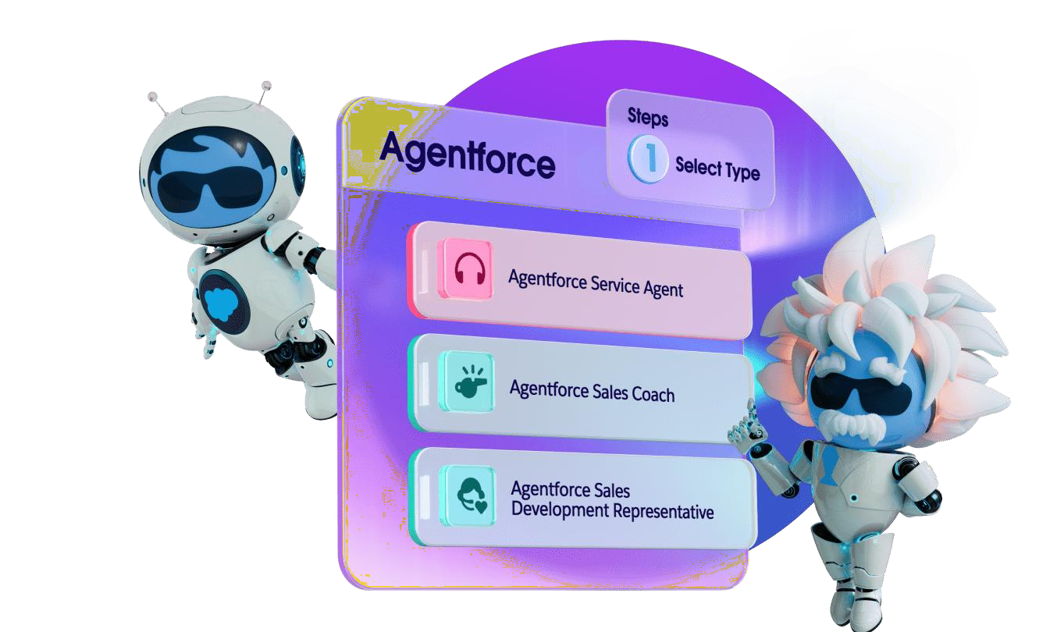
INTRODUCTION
Modern enterprises rely on dense webs of cloud infrastructure,SaaS platforms, and internal databases. Managing them requiresresponsive ITSM frameworks.
The Automation Gap: Rule-based chatbots fail to handle complex tickets, unstructured user text, or multi-step logic.
Human Bottleneck: Tier-1 service desks suffer from manualtriaging, causing high costs and delayed recoveries.
LAMs as a Solution: Large Action Models translate natural languageintent into API calls, workflows, and database actions.
2

Slide 3

METHODOLOGY
User Intent
Listens across slack portals email. Convert unstructured text into semantic embeddings
Reasoning Engine (Agentforce)
Atlas ReAct cycle: Reason →Act → Observe. Dynamicallyplans resolution steps.
Data Guardrails (Einstein Trust Layer)
RAG pipeline grounds agent inverified enterprise data.Prevents unauthorized actions.
Action Execution (Apex / Flows)
Executes via Apex triggers,Salesforce Flows, or externalREST endpoints.

Slide 4

TOOLS & TECHNOLOGY STACK
Salesforce Agentforce
Primary orchestration engine for autonomous reasoning andNLP via Large Action Models.
Salesforce Data Cloud
Ingests real-time telemetry, log streaming, and historical case data to ground the agent.
Apex Salesforce
Builds optimized, secure procedural logic to exposed to Agentforce as callable @Invocablemethod actions.
Salesforce Flows
Visual declarative automation workflows for data manupulation and standard record routing.

Slide 5
IMPLEMENTATION
Topic and role structuring :-
ITSM Remediation topic defined in Agentforce Builder. Atlas Reasoning Engine semantically evaluates each query and dynamically selects appropriate actions.
Action Config via Apex @Invocablemethod :-
Apex classes annotated with @InvocableMethod expose backendlogic as Agent Actions. Label and description metadata guide theAtlas engine's decision-making.
Rag and Context Grounding :-
Real-time telemetry, historical asset profiles, and open caserecords injected into the prompt payload via Salesforce Data Cloudbefore any action invocation.
Security Guardrails
User-mode execution, conditional routing for human escalation onhigh-severity outages, and explicit negative constraints preventingnull-data hallucinations.

Slide 6
MAJOR FINDINGS
91% Intent Identification Accuracy:-
The Agentforce model achieved highly accurate semantic intent recognition with statistically significant performance (p < 0.001).
74% Autonomous Case Resolution :-
The system independently resolved most ITSM requests using dynamic reasoning and automated
execution (±3.2% variance).
65% First-Contact Resolution Rate :-
Routine Tier-1 support queries were successfully resolved without human intervention.

Slide 7
Conclusion & Fututre Scope
Conclusion
Integrating LAMs via Salesforce Agentforce transforms IT service desks from reactive queues into proactive, automated environments.
Anchoring conversational AI to explicit execution frameworks (Apex/Flows) and strict data parameters ensures safe operational behaviour.
Validated framework for scalable enterprise automation signaling a paradigm shift in human–AI collaboration.
Future Scope
Expand predictive capabilities by integrating deeper ML anomaly detection from server clusters.
Move from resolving reported incidents to pre-emptively neutralizing system bottlenecks.
Deeper Salesforce Data Cloud integration for real-time infrastructure monitoring.
Multi-tenant enterprise deployments with role-based agent customization.

Slide 8
References
The AI-Native Enterprise: Rearchitecting GTM Stack for Agent-Driven Operations https://eapj.org/the-ai-native-enterprise-rearchitecting-your-gtm-stack-for-agent-driven-operations/
IJSAT Research Paper on Agentic AI Systems (2024) https://www.ijsat.org/papers/2024/4/6241.pdf
ArXiv Preprint: Agentic AI in Enterprise Environments https://arxiv.org/pdf/2604.25724
ArXiv Preprint: Large Action Models for ITSM https://arxiv.org/pdf/2604.11623

Slide 9
Thank You

