Slide 1
AI-Powered Urban Air Quality Intelligence
From Reactive Monitoring to Proactive, Evidence-Based Intervention
Smart Cities • Environmental Intelligence • Geospatial Analytics • Public Health
Delhi + Mumbai · Real CPCB Data · 6 Chained AI Agents

Slide 2
India's Air Quality Crisis Is a National Emergency
1.67M
218
24/50
31%
premature deaths/year
attributed to air pollution
(Lancet Planetary Health)
Delhi's average AQI in
2024-25 — 'Poor' or worse
for 200+ days
of India's most polluted
cities are Tier 1/2 urban
centres (CPCB, 2024)
of monitored cities have
any actionable multi-agency
response protocol (CAG audit)
The data exists. The intelligence layer to act on it does not.
900+ CAAQMS stations deployed nationally under NCAP — yet most cities can't turn readings into action.
2

Slide 3
One Platform, Four Connected Capabilities
A chained multi-agent system: each agent's output feeds the next — not four disconnected tools.
1
Hyperlocal Forecasting
+ Multi-City
Comparison
1-3 day AQI prediction, beats naive baseline by 7-14% (real RMSE)
Delhi vs. Mumbai run through the identical pipeline — comparison comes free, not bolted on.
2
Source Attribution
Chemistry-based scoring: traffic, dust, industry, biomass, photochemical
3
Enforcement Intelligence
Ranked, evidence-backed action list — severity × confidence × trend
4
Citizen Health Advisory
Multilingual (Hindi/Marathi), 3 channels: app, display, IVR
3

Slide 4
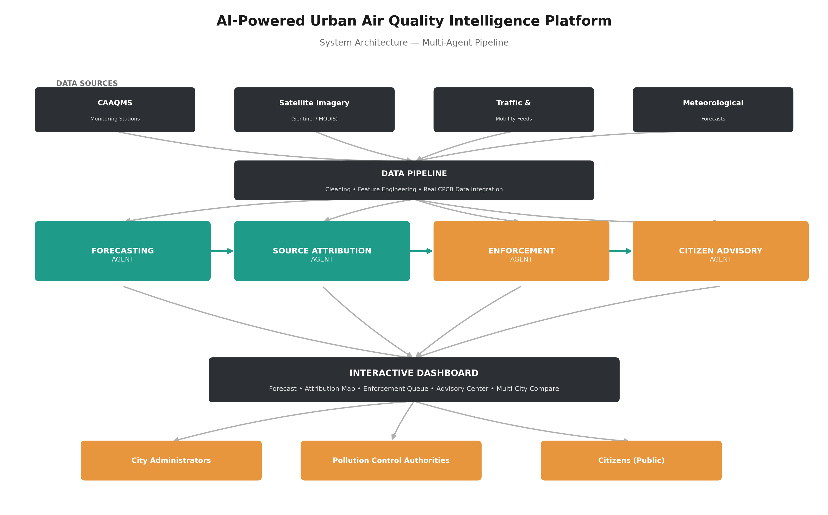
System Architecture
4

Slide 5
Agent 1: Hyperlocal Forecasting — Real Validated Results
Random Forest model vs. persistence baseline ("tomorrow = today") — strict time-based train/test split, no leakage.
Why Delhi improves less
Delhi's winter smog is so persistently high that even the naive baseline is already accurate — volatility comes from external shocks (crop burning, inversions), not smooth trends.
This is exactly why source attribution matters more for Delhi than pure forecasting.
1,603 / 629
284 / 112
training days
(Delhi / Mumbai)
held-out test days
(never seen in training)
5

Slide 6
Agent 2: Source Attribution — Grounded in Real Chemistry
Not synthetic guesswork — built on real pollutant signatures used in actual source-apportionment science.
Signal | Indicates
NO2 + CO | Vehicular traffic exhaust
PM10 vs. PM2.5 ratio | Construction / road dust (coarse particles)
SO2 | Industrial combustion
PM2.5 spike, Oct 15–Nov 15 | Crop residue / stubble burning (Delhi)
O3 | Secondary / photochemical formation
Fair scoring, not
winner-take-all noise
Each source signal is ranked against its own history, then blended with a literature-informed prior (~30% traffic, ~20% dust, ~15% industrial baseline for Indian metros) — so no single noisy metric dominates by statistical accident.
Result: Traffic correctly leads in both cities (matching real-world consensus), with a defensible confidence score per ward.
Ward-level split across 12 named zones (Anand Vihar, Okhla, Chembur…) is a documented SIMULATED layer — real hyperlocal sensor data isn't public.
6

Slide 7
Agent 3: Enforcement Intelligence — Ranked & Evidence-Backed
Not every source is enforceable — the system distinguishes actionable sources from weather-driven ones.
Rank | Ward | AQI | Source | Action | Enforceable
#1 | Okhla Industrial (Delhi) | 138 | Industrial | Inspect stack emissions | YES
#2 | Anand Vihar (Delhi) | 128 | Construction/Dust | Inspect dust-control compliance | YES
#3 | Rohini (Delhi) | 114 | Construction/Dust | Inspect dust-control compliance | YES
#7 | Chembur (Mumbai) | 67 | Industrial | Inspect stack emissions | YES
Priority Score Formula
Non-Enforceable Example
Severity × Actionability Multiplier × Forecast Trend Boost
Secondary/Photochemical (ozone) sources → "Issue public health advisory" instead of an inspection — there's no physical site to raid for a regional weather-driven process.
Actionable sources get 1.3× weight; non-enforceable (photochemical/weather) get 0.6× and route to advisories instead of raids.
7

Slide 8
Agent 4: Citizen Health Advisory — Multilingual, Multi-Channel
72 alert records generated: 12 wards × 2 languages × 3 channels.
📱
📺
☎️
Mobile App
Public Display
IVR Voice Script
Sensitive groups may experience mild discomfort. Consider reducing prolonged outdoor exertion.
AQI ALERT - Anand Vihar - Moderate
Sensitive groups take precaution.
This is an automated air quality alert for Anand Vihar. Sensitive groups should limit outdoor exertion.
Hand-written translations, not machine translation
Hindi (Delhi) / Marathi (Mumbai) advisory text is deliberately hand-composed, not run through live machine translation — mistranslated health guidance carries real risk. Zero internet dependency at generation time.
हवा की गुणवत्ता मध्यम है। संवेदनशील लोग सावधान रहें।
8

Slide 9
Multi-City Comparative Intelligence
The same pipeline runs Delhi and Mumbai side-by-side — comparison is architectural, not an afterthought.
Insight: Mumbai's coastal sea-breeze effect naturally disperses pollution, while Delhi's landlocked geography + winter inversions trap it — explaining both the AQI gap and Delhi's higher construction/dust share.
9

Slide 10
Built on Real Data — Transparent About What's Simulated
REAL
CHEMISTRY-DERIVED
SIMULATED (documented)
• CPCB Air Quality Data (2015-2020)
• Source attribution scores
• Ward/zone-level geographic split
• AQI, PM2.5, PM10, NO2, SO2, CO, O3
• Computed from real pollutant ratios
• Named after real CPCB station areas
• Delhi: 1,897 days • Mumbai: 751 days
• Calibrated against literature-informed
• Zone-type multipliers (traffic/industrial)
• Real dates → real seasonal patterns
• priors for Indian metro source splits
• Real ward sensors aren't public data
10

Slide 11
Mapped to Evaluation Criteria
25%
Business Impact
Enforcement agent turns signals into prioritised municipal action; forecast enables scheduling, not just reacting
25%
Technical Excellence
Real data, validated RMSE vs. baseline, documented bug-fix (attribution scoring), no data leakage
20%
Scalability
Same pipeline already runs 2 cities identically; adding a city = adding a CSV, no architecture change
15%
Innovation
Chemistry-grounded attribution (not black-box ML) + actionability-aware enforcement routing
15%
User Experience
One dashboard, 5 tabs, plain-language multilingual citizen alerts across 3 channels
11

Slide 12
Honest Limitations & Roadmap
We'd rather show you what we know is incomplete than hide it.
LIMITATION
ROADMAP
Forecast is city-level, not per-ward
Integrate gridded meteorological + traffic data for true 1km-grid resolution
LIMITATION
ROADMAP
Ward attribution is a simulated layer
Partner with municipal bodies for real ward-level CAAQMS deployment
LIMITATION
ROADMAP
Only 2 cities, data through mid-2020
Extend pipeline to Kolkata, Bengaluru, Chennai; refresh with live CPCB feed
LIMITATION
ROADMAP
No satellite/thermal anomaly data yet
Add Sentinel/MODIS integration for direct fire/hotspot detection
12

Slide 13
From Measuring to Acting
A working, validated, honestly-documented prototype — ready to extend from 2 cities to every Tier 1/2 city in India.
Thank you

