Slide 1


Understanding Menstruation
A Comprehensive Overview
Presented by : Aryan Bhandari

Slide 2

What is Menstruation ?

Slide 3

Menstruation
Menstruation is a natural and essential biological process that plays a crucial role in female reproductive health.
It marks a significant phase in the reproductive cycle and is a key indicator of overall health and well-being.
Understanding menstruation helps in promoting better health practices and breaking down social stigmas associated with it.
Menstruation

Slide 4
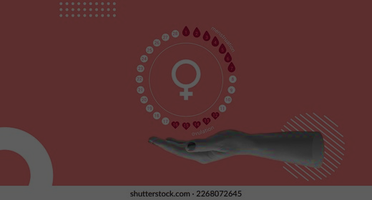
Significance of Menstruation
Menstruation is a vital part of the female reproductive cycle, preparing the body for potential pregnancy.
Involves complex hormonal changes that regulate the cycle and affect overall health.
Regular menstruation is a sign of good health and hormonal balance.
Irregularities can indicate underlying health problems, such as hormonal imbalances or reproductive disorders

Slide 5

The Menstrual Cycle Phases
Menstrual Phase
This phase lasts for 3-7 days and involves the shedding of the uterine lining, resulting in menstrual bleeding. It marks the beginning of the cycle.

Slide 6
The Menstrual Cycle Phases
Menstrual Phase
Follicular Phase
This phase lasts for 3-7 days and involves the shedding of the uterine lining, resulting in menstrual bleeding. It marks the beginning of the cycle.
Spanning about 10-14 days, this phase starts on the first day of menstruation and continues until ovulation. The pituitary gland releases Follicle Stimulating .

Slide 7
The Menstrual Cycle Phases
Menstrual Phase
Follicular Phase
Ovulation
This phase lasts for 3-7 days and involves the shedding of the uterine lining, resulting in menstrual bleeding. It marks the beginning of the cycle.
Spanning about 10-14 days, this phase starts on the first day of menstruation and continues until ovulation. The pituitary gland releases Follicle Stimulating .
Occurring around the 14th day of the cycle, ovulation is the release of a mature egg from the ovary. Signs of ovulation include an increase in basal body temperature .

Slide 8
The Menstrual Cycle Phases
Menstrual Phase
Follicular Phase
Ovulation
Luteal Phase
This phase lasts for 3-7 days and involves the shedding of the uterine lining, resulting in menstrual bleeding. It marks the beginning of the cycle.
Spanning about 10-14 days, this phase starts on the first day of menstruation and continues until ovulation. The pituitary gland releases Follicle Stimulating .
Occurring around the 14th day of the cycle, ovulation is the release of a mature egg from the ovary. Signs of ovulation include an increase in basal body temperature .
Lasting about 14 days, this phase begins after ovulation. The corpus luteum forms and secretes progesterone, preparing the uterus for the potential implantation of a fertilized egg.

Slide 9


Myth Vs Facts
Myth
Fact
Menstruation is a sign of illness.
Women should avoid physical activity during their period.
Menstruation is something to be ashamed of.
Menstruation is impure.
Menstruation is a healthy, natural part of the female reproductive cycle.
Regular physical activity can help reduce menstrual cramps and improve mood.
Menstruation is a natural biological process and should be openly discussed and normalized.
Menstruation is a natural and healthy biological process, not a sign of impurity.

Slide 10
Conclusion
In conclusion, menstruation is a natural and essential biological process that plays a crucial role in female reproductive health. Understanding the menstrual cycle, from the menstrual phase to the luteal phase, helps in recognizing the significance of hormonal changes and their impact on overall health. Regular menstruation is an indicator of good health, while irregularities can signal underlying health issues. Promoting awareness, education, and open conversations about menstruation is vital in breaking down societal stigmas and ensuring proper menstrual hygiene and health management. By comprehending the intricacies of the menstrual cycle, we can better support and promote the well-being of those who menstruate.

