Slide 1
PMCA698J · DISSERTATION-I / INTERNSHIP-1 · REVIEW-1
TAIS
A Telemetry Assessment and Integrity System for AIS-140 Vehicle Tracking
PRESENTED BY
Aryan Bhagat · 25MCA0022
UNDER THE GUIDANCE OF
Dr. Sathiyamoorthy E, Professor Grade 2
DEPARTMENT
Computer Applications, SCORE · Fall Semester 2026-2027
DATE
14 August 2026
VIT – School of Computer Science Engineering and Information Systems

Slide 2
ROADMAP
What We'll Cover
01
Introduction & Problem Statement
02
Objectives & Scope
Why AIS-140 telemetry integrity matters now
What TAIS sets out to build — and deliberately won't
03
Proposed System & Trust Score Engine
04
Literature Survey & Research Gap
The 5-stage pipeline and scoring formula
16 papers reviewed — where TAIS fits
05
Methodology, Requirements & Architecture
06
UML Diagrams & Summary
Evaluation plan, FR/NFR, system design
Use case, class diagram, and takeaways
TAIS | Review-1 | 25MCA0022 – Aryan Bhagat
2

Slide 3
OVERVIEW
Abstract
India's AIS-140 standard mandates GPS/NavIC-based vehicle tracking on all commercial vehicles — and this same telemetry now underpins the country's transition to GNSS-based satellite tolling, where a vehicle's reported GPS position will directly determine the toll charged. Existing tamper detection is physical-only; nothing verifies whether the telemetry data itself is internally consistent. TAIS is a server-side system that assesses AIS-140 telemetry integrity by computing a weighted Trust Score (0–100) with an explained confidence level — operating entirely on fields the standard already transmits, with zero hardware changes.
4
Independent Consistency Checks
Motion · Trajectory · Signal Quality · Temporal
0–100
Explainable Trust Score
Four independent checks. One transparent score. Zero black boxes.
With a High / Medium / Low confidence level
Zero
Hardware Required
Keywords: AIS-140 · GNSS Integrity · Telemetry Trust Scoring · Vehicle Tracking · Spoofing Detection · Satellite Tolling · Anomaly Detection · Kinematic Plausibility
Simulation-first — real device feed is future work
TAIS | Review-1 | 25MCA0022 – Aryan Bhagat
3

Slide 4




BACKGROUND
Introduction
Mandatory & Enforced
A New Financial Layer
AIS-140, mandated by MoRTH and certified by ARAI, requires every commercial vehicle in India to run GPS/NavIC tracking — strict since 2018, tightened further in 2023.
MoRTH has announced GNSS-based satellite tolling — continuously reported GPS location, not a toll booth, will decide the charge. Pilots are live on NH-275 and NH-709.
The Blind Spot
TAIS's Response
Tamper detection today is physical-only — enclosure breach, SIM removal. Nothing checks whether the position, speed, and heading reported are internally consistent.
A server-side system computing a Trust Score with an explained confidence level — flagging implausible data before it reaches a billing decision.
TAIS | Review-1 | 25MCA0022 – Aryan Bhagat
4

Slide 5
THE GAP
Problem Statement
1
2
3
Physical-Only Detection
Compliance → Financial Risk
No Interpretable Fix Exists
AIS-140's tamper protection flags enclosure breach or SIM removal — never whether the telemetry itself is internally consistent.
Under GNSS tolling, that blind spot becomes a real-time billing risk: inconsistent data could over- or under-charge a vehicle owner.
RAIM needs raw receiver data AIS-140 never exposes; telematics scores driver behaviour, not authenticity; ML trajectory models are black boxes.
RESEARCH QUESTION
Can a server-side system, using only the fields AIS-140 already transmits, reliably tell physically plausible telemetry from implausible telemetry — and explain that distinction well enough to support a real billing decision?
TAIS | Review-1 | 25MCA0022 – Aryan Bhagat
5

Slide 6
GOALS
Objectives
01
Characterize the available data — document which AIS-140 backend fields are confirmed vs. assumed (completed Week 1).
02
Build a scenario-driven telemetry simulator generating labelled, realistic sequences for highway, city, and degraded-signal conditions.
03
Design a rule-based Trust-Scoring Engine flagging kinematic inconsistency across 4 sub-scores, with explanation and confidence level.
04
Demonstrate end-to-end via a dashboard visualizing scores, per-flag explanations, and tiered actions (Normal / Flagged / Escalate).
05
Evaluate quantitatively using precision, recall, F1-score, detection latency, and false-positive rate against labelled ground truth.
TAIS | Review-1 | 25MCA0022 – Aryan Bhagat
6

Slide 7


BOUNDARIES
Scope of the Project
IN SCOPE
OUT OF SCOPE — FUTURE WORK
Telemetry-level consistency checks using only currently-mandated AIS-140 fields
No RF signal transmission of any kind (illegal and unnecessary)
Simulated data generation for 3 driving scenarios — highway, city, degraded signal
No live integration with government / NHAI billing servers
6 deliberately injected anomaly types (position jump, drift, speed injection, heading change, replay, GPS freeze)
No claim to detect anomaly cause (spoofing vs. tunnel) — TAIS flags implausibility, not intent
Rule-based trust scoring across 4 sub-dimensions with a weighted composite score
No real-world field data collection — simulation-first by design
Human-readable explanation generation with confidence levels
No modifications to vehicle-side AIS-140 hardware or firmware
Dashboard visualization with tiered response (Normal / Flagged / Escalate)
Quantitative evaluation against labelled ground truth
TAIS | Review-1 | 25MCA0022 – Aryan Bhagat
7

Slide 8





APPROACH
Proposed System
TAIS is a server-side telemetry assessment system built as a five-stage pipeline — from synthetic data generation through to an auditable, explained decision.
1
›
2
›
3
›
4
›
5
Telemetry
Simulator
Anomaly
Injector
Trust-Scoring
Engine
Explanation
Layer
Dashboard
Labelled sequences — Highway, City, Degraded Signal — on the locked schema.
Deliberately anomalous variants across 6 anomaly types from genuine logs.
4 sub-scores fused into a weighted Trust Score (0–100).
Confidence level + specific triggered reasons for every score.
Scores over time, per-flag explanations, tiered response actions.
Simulator › Anomaly Injector › Trust-Scoring Engine › Explanation Layer › Dashboard
TAIS | Review-1 | 25MCA0022 – Aryan Bhagat
8

Slide 9




THE CORE CONTRIBUTION
Trust Score Engine
Trust Score = w₁(Motion) + w₂(Trajectory) + w₃(Signal Quality) + w₄(Temporal)
Motion Consistency
Trajectory Consistency
Signal Quality
Temporal Consistency
Is reported speed & acceleration physically achievable?
Is the position sequence a plausible path — no teleports?
HDOP/PDOP and satellite count vs. expected thresholds.
Timestamps in order, expected intervals, no replay.
Weights are domain-informed defaults, refined empirically during evaluation — chosen for interpretability and auditability over black-box accuracy.
Confidence: High / Medium / Low
Action: Normal / Flagged for Review / Escalate
TAIS | Review-1 | 25MCA0022 – Aryan Bhagat
9

Slide 10

SCOPE BOUNDARY
Threat Model
Assumed Trusted
Attacker (Vehicle Owner) Can
• The backend server and its storage
• Control or fabricate telemetry values before transmission
• The communication channel's authenticity, at the point the server receives the data
• Replay old, genuine telemetry as if it were current
Out of scope: Backend compromise, breaking channel cryptography, and physical device tampering — already covered by AIS-140's existing detection.
Why server-side, not on-device: the vehicle owner benefits most from faked telemetry — a check on their own device can't be trusted. Scoring belongs where the transport authority actually receives the data.
TAIS | Review-1 | 25MCA0022 – Aryan Bhagat
10

Slide 11
PROBLEM DEFINITION & LITERATURE SURVEY
Literature Survey
1 of 4
# | Author & Title | Merits | Demerits
1 | Huang et al. (2025) A survey of GNSS receiver autonomous integrity monitoring | Comprehensive taxonomy of RAIM techniques; highlights ML-based integrity monitoring. | Over-relies on aviation/simulated data; lacks realistic automotive datasets.
2 | Martin (2020) Advanced receiver autonomous integrity monitoring in tightly integrated GNSS/Inertial systems | Demonstrates tightly-coupled GNSS/IMU integration for robust integrity monitoring. | Needs receiver-level raw pseudorange & continuous IMU access unavailable at AIS-140 backends.
3 | Psiaki & Humphreys (2016) GNSS spoofing and detection | Foundational overview of GNSS spoofing mechanics and signal-level countermeasures. | Focuses on RF/receiver-level detection rather than backend telemetry checks.
4 | Wu et al. (2020) Spoofing and anti-spoofing technologies of GNSS: A survey | Comprehensive catalogue of anti-spoofing techniques across GNSS architecture. | Doesn't cover standardized post-receiver vehicle telemetry validation.
TAIS | Review-1 | 25MCA0022 – Aryan Bhagat
11

Slide 12
PROBLEM DEFINITION & LITERATURE SURVEY
Literature Survey
2 of 4
# | Author & Title | Merits | Demerits
5 | Thombre et al. (2020) GNSS threat monitoring and reporting: Past, present, and a proposed future | Catalogues intentional (spoofing/jamming) and unintentional (multipath) threats. | Focuses on threat reporting frameworks, not automated backend telemetry scoring.
6 | Zidan et al. (2020) GNSS vulnerabilities and existing solutions: A review | Systematic review of vulnerabilities across signal, receiver, and system layers. | Confirms absence of protection at the post-transmission backend telemetry stage.
7 | Bhatti & Humphreys (2017) Hostile control of ships via false GPS signals | Real-world empirical proof of vehicle spoofing feasibility. | Limited to maritime receivers; doesn't address automotive telemetry standards.
8 | Dasgupta et al. (2022) A sensor fusion-based GNSS spoofing attack detection framework | Kalman-filter GPS/IMU sensor fusion specifically for vehicular spoofing. | Assumes raw continuous IMU stream, whereas AIS-140 gives discrete boolean flags.
TAIS | Review-1 | 25MCA0022 – Aryan Bhagat
12

Slide 13
PROBLEM DEFINITION & LITERATURE SURVEY
Literature Survey
3 of 4
# | Author & Title | Merits | Demerits
9 | Fakharian et al. (2011) Adaptive Kalman filtering based navigation | Adaptive Kalman filtering for GPS/IMU navigation accuracy. | Built for tunnel-type signal loss, not adversarial telemetry manipulation.
10 | Zhang et al. (2005) Navigation with IMU/GPS/digital compass with unscented Kalman filter | Unscented Kalman Filter for non-linear multi-sensor navigation fusion. | An on-board navigation filter, not a server-side audit mechanism.
11 | Shen et al. (2019) Integrated navigation accuracy improvement via multi-sensor fusion | Validates multi-sensor fusion for vehicular navigation accuracy. | Targets hardware-level sensor integration, not cloud telemetry.
12 | Dhongade & Khandekar (2019) GPS and IMU integration on an autonomous vehicle using Kalman filter | Practical LabVIEW implementation of GPS/IMU trajectory tracking. | Lacks automated anomaly scoring or auditable explanation generation.
TAIS | Review-1 | 25MCA0022 – Aryan Bhagat
13

Slide 14
PROBLEM DEFINITION & LITERATURE SURVEY
Literature Survey
4 of 4
# | Author & Title | Merits | Demerits
13 | Liu et al. (2020) Online anomalous trajectory detection with deep generative sequence modeling | VAE-RNN sequence modeling detects anomalous GPS trajectories online. | Black-box classification — no per-decision explanation for billing disputes.
14 | Song et al. (2018) Anomalous trajectory detection using recurrent neural network | RNNs for temporal sequence-based trajectory anomaly detection. | Needs large training corpora; lacks AIS-140-specific field constraints.
15 | Cao et al. (2024) Anomaly detection for in-vehicle network using self-supervised learning | Advanced self-supervised vehicle-cloud anomaly detection. | Targets in-vehicle CAN bus traffic, not AIS-140 backend telemetry.
16 | Semanjski et al. (2020) Detecting GNSS spoofing using supervised machine learning | ML classifiers (RF, SVM, NN) achieving >95% spoofing detection accuracy. | Relies on receiver-internal signal features (C/N0) not in AIS-140 packets.
TAIS | Review-1 | 25MCA0022 – Aryan Bhagat
14

Slide 15
WHERE TAIS FITS
Findings & Research Gap
1
Wrong Layer
2
Unaddressed Gap
RAIM & sensor fusion need raw receiver data — pseudoranges, continuous IMU — that AIS-140 backends never receive.
Protection concentrates at signal/receiver stages; nobody checks the backend telemetry-reporting layer itself.
3
Black-Box Ceiling
4
No Labelled Data
ML trajectory models (Liu 2020, Song 2018) detect anomalies but can't explain them — unusable for billing disputes.
Huang et al. (2025) confirm real-world automotive GNSS-integrity datasets are scarce — motivating a simulation-first approach.
TAIS's Contribution: a telemetry-level, not receiver-level, trust-scoring system with interpretable, explained outputs — built for AIS-140's regulatory context in India.
TAIS | Review-1 | 25MCA0022 – Aryan Bhagat
15

Slide 16
PIPELINE
Methodology & Evaluation
TAIS implements a five-stage pipeline — Simulator → Anomaly Injector → Trust-Scoring Engine → Explanation Layer → Dashboard — evaluated with a labelled-simulation methodology, since no real-world spoofing-confirmed AIS-140 dataset exists.
EVALUATION METRICS
Precision
Recall
F1-Score
Detection Latency
False-Positive Rate
TOOLS & TECHNOLOGIES
Python (pandas, NumPy)
scikit-learn (optional ML comparison)
Flask / Streamlit (dashboard)
GitHub (version control)
Threat Model: Attacker can manipulate telemetry pre-transmission or replay old data; backend server & channel authenticity are assumed trusted.
Evaluation Methodology: Labelled simulated sequences stand in as ground truth, measured on degraded-signal baseline scenarios.
TAIS | Review-1 | 25MCA0022 – Aryan Bhagat
16

Slide 17
SOFTWARE REQUIREMENTS
Functional Requirements
FR-01
FR-02
Generate simulated AIS-140 telemetry for highway, city, and degraded-signal scenarios.
Inject 6 anomaly categories (position jump, drift, speed injection, heading change, replay, GPS freeze).
FR-03
FR-04
Compute composite Trust Score (0–100) across 4 consistency sub-dimensions.
Generate human-readable explanations with confidence levels (High/Medium/Low).
FR-05
FR-06
Classify decisions into tiered actions (Normal / Flagged for review / Escalate).
Provide a web dashboard for real-time visualization and report export.
TAIS | Review-1 | 25MCA0022 – Aryan Bhagat
17

Slide 18



SOFTWARE REQUIREMENTS
Non-Functional Requirements
Performance
Scalability
Trust Score computation within 100ms per telemetry window.
Support concurrent streams from at least 10 simulated devices.
Auditability
Maintainability
100% of scoring decisions accompanied by structured reason lists.
Schema-locked architecture (src/schema.py) strictly enforced across all modules.
TAIS | Review-1 | 25MCA0022 – Aryan Bhagat
18

Slide 19
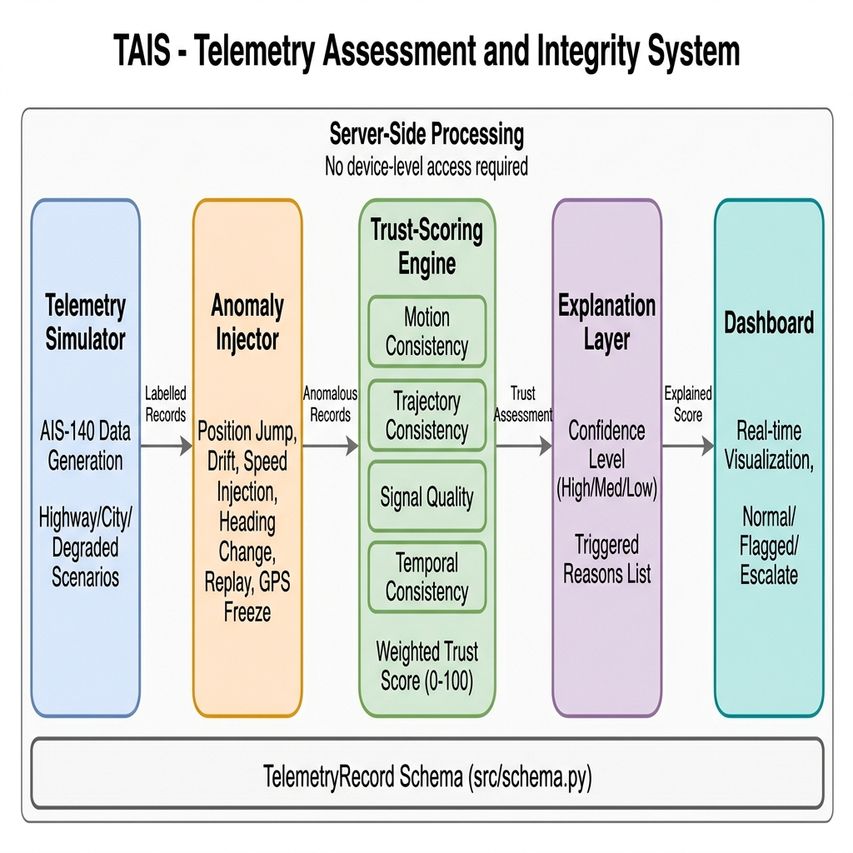
PROPOSED ARCHITECTURE
System Architecture
Telemetry Simulator
Scenario-driven data generation
Anomaly Injector
6 anomaly types, software-only
Trust-Scoring Engine
4 sub-scores → weighted score
Explanation Layer
Confidence + triggered reasons
Dashboard
Live view, tiered actions
Fig. 9.1 — server-side, no device-level access required.
TAIS | Review-1 | 25MCA0022 – Aryan Bhagat
19

Slide 20
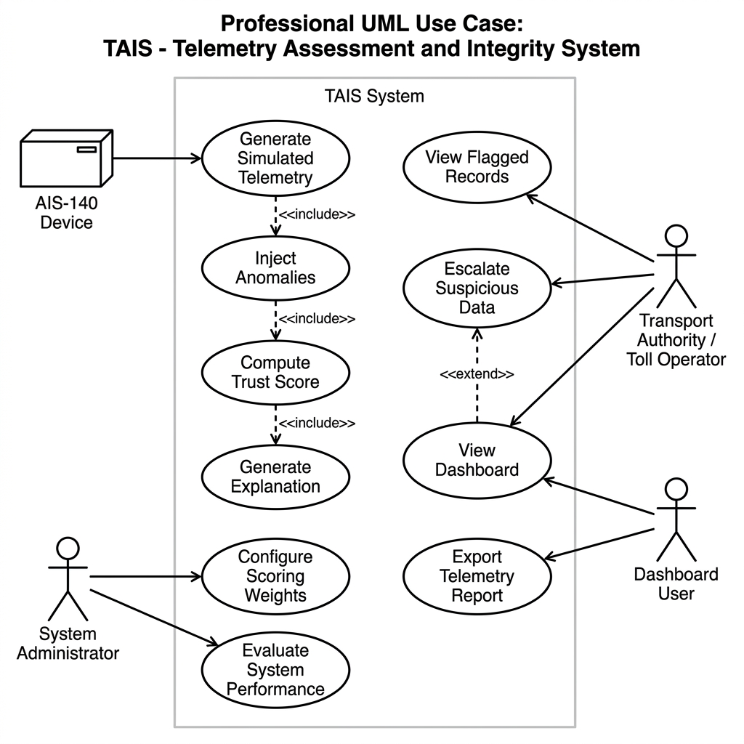
UML · FIG. 10.1
Use Case Diagram
Four actors — AIS-140 Device, System Administrator, Transport Authority / Toll Operator, and Dashboard User — interact with the simulate-inject-score-explain core.
TAIS | Review-1 | 25MCA0022 – Aryan Bhagat
20

Slide 21
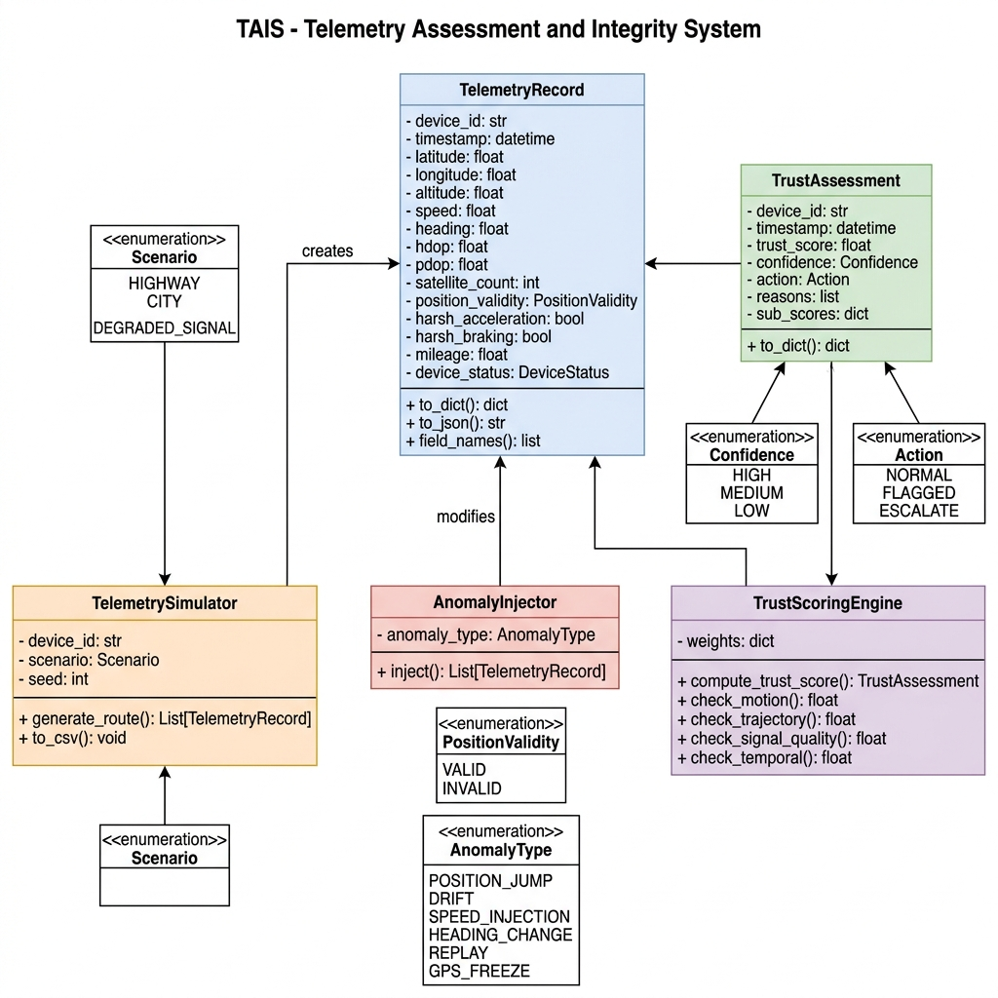
UML · FIG. 10.2
Class Diagram
TAIS | Review-1 | 25MCA0022 – Aryan Bhagat
21

Slide 22
TAKEAWAY
Summary
This Review-1 deliverable presents the complete architectural and theoretical groundwork for TAIS — a timely response to a real operational gap in Indian transport infrastructure. By establishing a simulation-first methodology, a locked schema contract, a 5-stage processing pipeline, and an auditable rule-based trust scoring engine, TAIS provides a robust framework for detecting kinematically implausible vehicle data.
Interpretable
Auditable
Zero Hardware
Every score ships with specific triggered reasons — never a black-box number.
100% of decisions carry structured, human-readable justification for billing disputes.
Simulation-first: no field deployment risk, architecture ready for a real feed later.
TAIS | Review-1 | 25MCA0022 – Aryan Bhagat
22

Slide 23
Thank You
Questions & Discussion
Aryan Bhagat · 25MCA0022
Under the guidance of Dr. Sathiyamoorthy E, Professor Grade 2

