Slide 1


aryanbochare4@gmail.com
TRAINPRO
TrAINING INSTITUTE MANAGEMENT & ANALYTICS SYSTEM
DBMS MINI PROJECT | MYSQL 8.0+
B.SC. DATA SCIENCE — SEMESTER III | ACADEMIC YEAR 2026–2027
PREPARED BY: ARYAN BOCHARE

Slide 2

1. PROJECT OVERVIEW
01
What is Data Analytics?
08
A relational database system for managing a training institute.
Manages students, trainers, courses, batches, enrollments, attendance and assessment results.
Provides analytical reports for enrollment, attendance and performance.
Demonstrates database planning, relationships, SQL queries and business analysis.
14
Key Takeaways

Slide 3

2. PROBLEM STATEMENT
Training institutes handle multiple types of operational data.
Separate or repeated records make maintenance and reporting difficult.
TRAINPRO organizes data into related tables using primary and foreign keys.
The database converts operational records into useful management information.

Slide 4
3. OBJECTIVES
Identifies Create a structured MySQL database for a training institute.
Maintain valid relationships using primary and foreign keys.
Store realistic sample data for meaningful analysis.
Generate business reports using joins and aggregate functions.
Use views, subqueries and window functions where suitable.
Identify high enrollment, low attendance and student performance.
opportunities

Slide 5
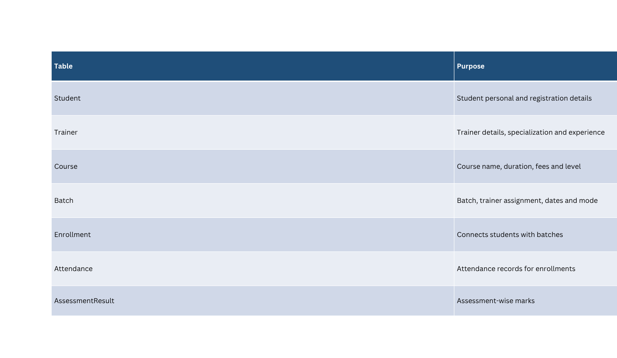

4. DATABASE TABLES

Slide 6
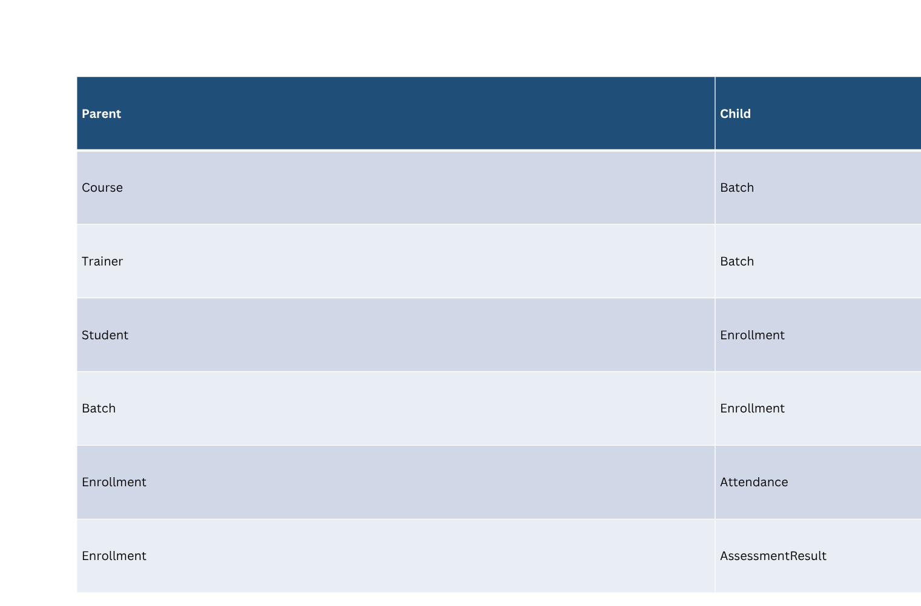
5. RELATIONSHIPS

Slide 7
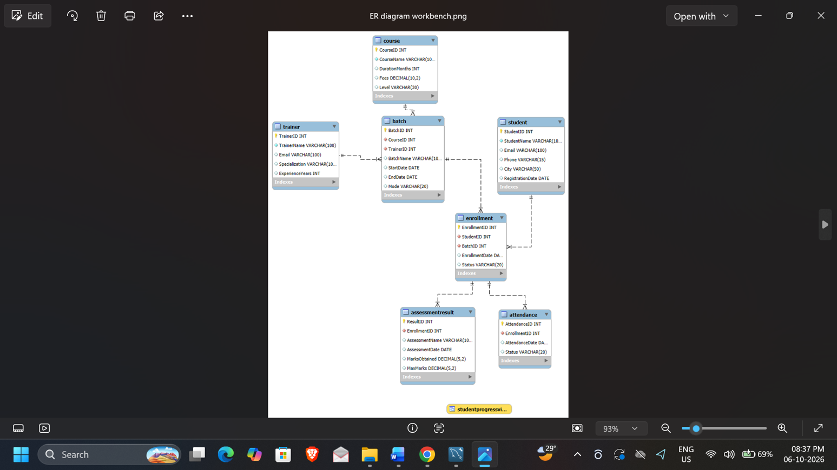
6. ER DIAGRAM

Slide 8
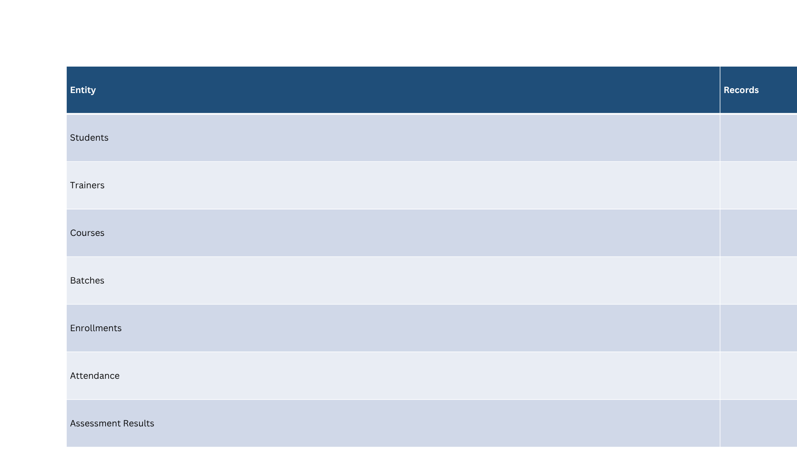
7. DATASET SUMMARY

Slide 9

8. SQL CONCEPTS DEMONSTRATED
CREATE DATABASE and CREATE TABLE
PRIMARY KEY, FOREIGN KEY, NOT NULL and UNIQUE constraints
INSERT and SELECT
Multiple-table INNER JOINs
COUNT, AVG, MIN, MAX with GROUP BY
HAVING and ORDER BY
Subqueries
Reusable VIEW for student progress
RANK() window function

Slide 10
9. KEY BUSINESS QUESTIONS
Which course has the highest student enrollment?
Which students have attendance below 75%?
What is the average assessment score for each student?
Who are the top-performing students?
How do courses compare in student performance?
How can students be ranked according to assessment results?
How can a student-wise progress report be generated?

Slide 11
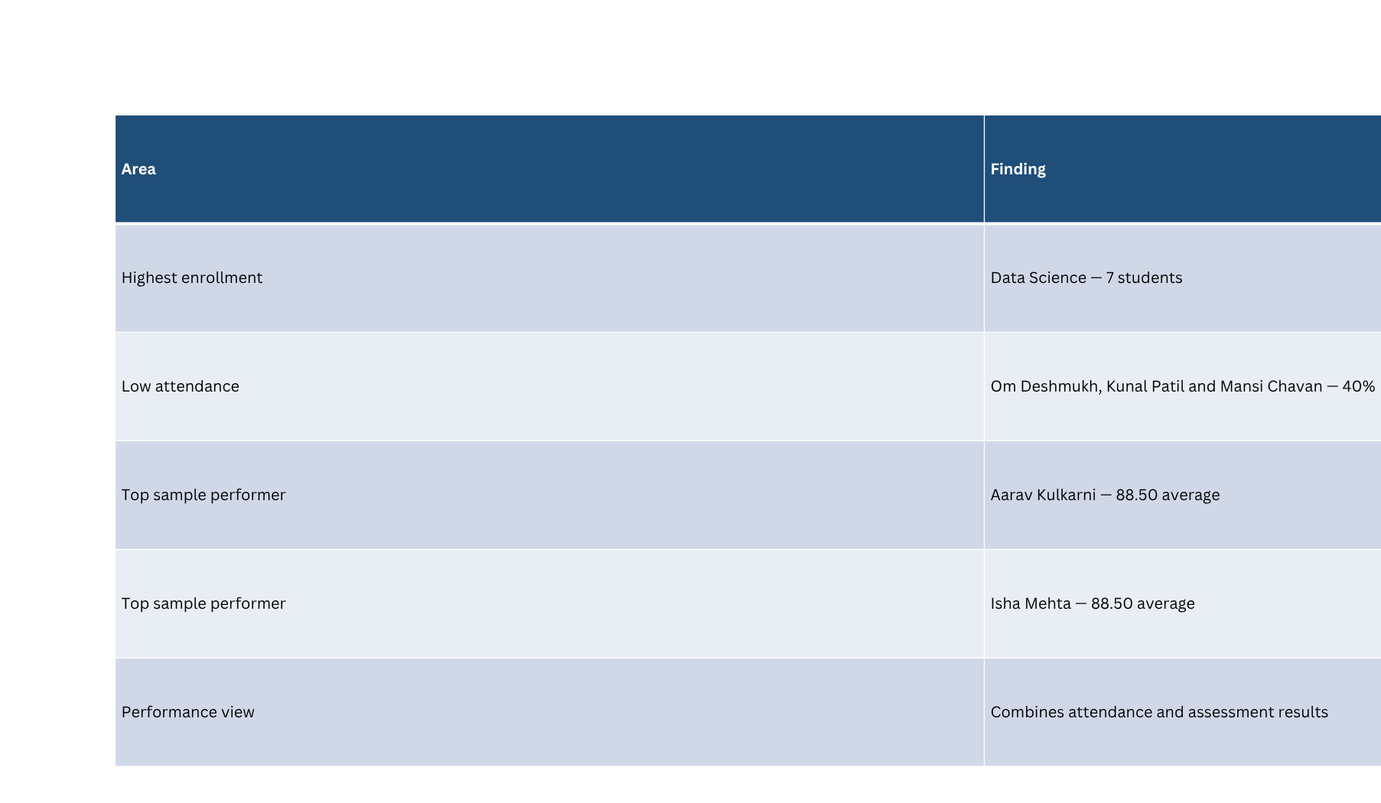
10. SAMPLE ANALYTICAL FINDINGS

Slide 12
11. MANAGEMENT INSIGHTS
Data Science shows the strongest enrollment demand in the sample.
Students below the attendance threshold can be identified automatically.
Low-performing students can receive additional academic support.
High performers can be recognized through mentoring or advanced opportunities.
Course-wise performance analysis can guide academic improvements.
The progress view provides a reusable management report.

Slide 13
12. CONCLUSION & FUTURE SCOPE
TRAINPRO successfully implements a relational Training
Institute Management System in MySQL.
The project demonstrates database design, referential integrity
and analytical SQL.
Future scope: fee management, certificates, role-based login,
web dashboard, feedback and automated alerts.
Final deliverables: SQL script, ER diagram, project report, screenshots and presentation.
Poor data quality

Slide 14

THANK YOU

