Slide 1
NGO / SOCIAL INTERNSHIP
INTERN
at CJ Darcl Logistics Ltd.
ARYAN CHHAWRA 25SCS1003003666 B.Tech CSE AI/ML with IBM Semester 3 | Batch 2026–27
Under CSR/NGO Initiative “Shikshalaya”
01 JUNE 2026 — 01 JULY 2026
INTERNSHIP REPORT & PRESENTATION

Slide 2
Internship Overview
02
A participation-focused social internship under Shikshalaya
ORGANIZATION
CSR / NGO INITIATIVE
DURATION
CJ Darcl Logistics Ltd.
Shikshalaya
1 June 2026 – 1 July 2026
The internship focused on practical participation in social and community-oriented activities rather than development of a software product.
• Social welfare activities
• Community outreach
• Awareness programmes
• Assigned responsibilities
IILM University | School of Computer Science & Engineering

Slide 3
Executive Internship Overview
03
What the internship involved
SOCIAL PARTICIPATION
COMMUNITY OUTREACH
PROFESSIONAL CONDUCT
Active participation in organised social welfare activities carried out under the Shikshalaya initiative.
Engagement with community-oriented activities and awareness programmes as assigned during the internship.
Responsibilities were carried out with sincerity, responsibility and dedication, with emphasis on discipline and accountability.
Focus: contribution • communication • cooperation • responsibility • awareness
IILM University | School of Computer Science & Engineering

Slide 4
Host Organization Profile
04
CJ Darcl Logistics Ltd. | CSR/NGO Initiative “Shikshalaya”
CJ Darcl Logistics Ltd.
REGISTERED OFFICE
The internship was completed under the organisation’s CSR/NGO initiative “Shikshalaya”.
Darcl House, Plot No. 55P, Sector-44, Institutional Area, Gurugram – 122003, Haryana, India.
INTEGRATED MANAGEMENT SYSTEM
ISO 9001:2015-QMS • ISO 45001:2018-OHSMS • ISO 14001:2015-EMS
WORKPLACE CERTIFICATION
The report intentionally keeps the initiative’s internal structure general because the certificate does not provide further programme-level details.
The certificate also displays a Great Place To Work certification.
IILM University | School of Computer Science & Engineering

Slide 5
Internship Objectives
05
Academic learning translated into social participation
01
02
Participate actively in social welfare activities under Shikshalaya.
Contribute to community outreach and awareness programmes.
03
04
Complete assigned responsibilities sincerely and responsibly.
Develop practical understanding of organised social initiatives.
05
06
Strengthen discipline, communication, cooperation and accountability.
Understand social responsibility alongside academic and professional development.
IILM University | School of Computer Science & Engineering

Slide 6
Core Internship Responsibilities
06
Activity-oriented responsibilities documented in the report
SOCIAL WELFARE
Support activities intended to contribute to social welfare.
COMMUNITY OUTREACH
Participate in interaction and engagement with the community.
AWARENESS PROGRAMMES
Contribute to programmes intended to spread awareness on relevant social issues.
ASSIGNED RESPONSIBILITIES
Complete allocated responsibilities with sincerity and accountability.
PROFESSIONAL CONDUCT
Maintain discipline, responsibility and dedication throughout the internship.
IILM University | School of Computer Science & Engineering

Slide 7
Working Resources & Skills
07
No specialised software-development stack was specified
COMMUNICATION
DOCUMENTATION
AWARENESS MATERIALS
TEAM COORDINATION
Interaction and coordination required for community outreach and assigned responsibilities.
Recording and organising internship-related information and report material.
Use of relevant communication material in awareness-oriented activities, where applicable.
Coordination with people involved in social welfare and outreach activities.
The source report explicitly does not claim a programming task, database system, software product or technical deliverable.
IILM University | School of Computer Science & Engineering

Slide 8
Internship Activity Flow
08
Functional workflow for a social internship
01
02
03
04
05
06
Shikshalaya CSR/NGO Initiative
Orientation & Assigned Responsibilities
Social Welfare + Outreach + Awareness
Participation, Coordination & Responsibility
Completion of Assigned Activities
Completion & Evaluation
A conventional technical system architecture was not applicable; the internship followed a practical participation cycle.
IILM University | School of Computer Science & Engineering

Slide 9
Methodology
09
Activity-based and participation-oriented approach
1. ORIENTATION
2. PARTICIPATION
3. EXECUTION
Understand the nature of the NGO/Social Internship and responsibilities under Shikshalaya.
Take part in social welfare, community outreach and awareness programmes as assigned.
Carry out assigned duties sincerely, responsibly and with dedication.
4. COORDINATION
5. COMPLETION & EVALUATION
Maintain discipline, responsibility and cooperation during activities.
Complete the internship and receive certification recording satisfactory conduct, discipline and overall performance.
IILM University | School of Computer Science & Engineering

Slide 10
Expected Outcomes
10
Skills and understanding developed through participation
SOCIAL AWARENESS
RESPONSIBILITY
DISCIPLINE
Improved understanding of social welfare and community-oriented activities.
Greater awareness of responsible participation and accountability.
Development of discipline through completion of assigned responsibilities.
COMMUNICATION
SOCIAL RESPONSIBILITY
ORGANISATIONAL EXPOSURE
Improved communication and coordination in outreach settings.
A stronger sense of social responsibility.
Practical exposure to an organised CSR/NGO initiative.
IILM University | School of Computer Science & Engineering

Slide 11
Internship Evaluation
11
What the completion certificate confirms
SUCCESSFULLY COMPLETED
PERIOD
The completion certificate records that Aryan Chhawra successfully completed the NGO/Social Internship with CJ Darcl Logistics Ltd. under the CSR/NGO initiative “Shikshalaya”.
1 June 2026 – 1 July 2026
CERTIFICATE DATE
18 July 2026
PERFORMANCE
Conduct, discipline and overall performance were recorded as satisfactory.
IILM University | School of Computer Science & Engineering

Slide 12
Key Learnings
12
Professional qualities gained alongside academic development
• Understanding how organised social initiatives depend on consistent participation.
• Practising responsibility and accountability while completing assigned activities.
• Strengthening communication and cooperation through outreach-oriented work.
• Developing discipline and professional conduct in an organisational setting.
• Recognising social responsibility as a complement to technical and academic growth.
ARYAN CHHAWRA • B.Tech CSE AI/ML with IBM
IILM University | School of Computer Science & Engineering

Slide 13
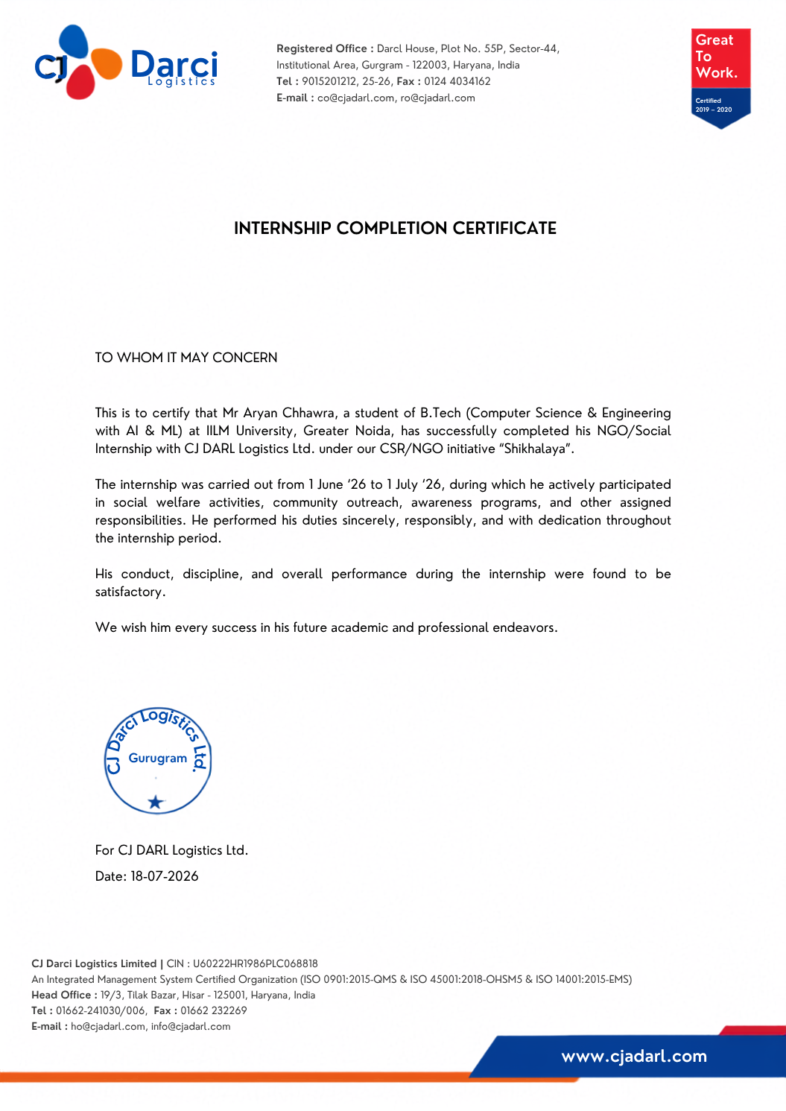
Internship Completion Certificate
13
Documentary proof of completion
IILM University | School of Computer Science & Engineering

Slide 14
THANK YOU
NGO / Social Internship
CJ Darcl Logistics Ltd. | CSR/NGO Initiative “Shikshalaya”
ARYAN CHHAWRA
25SCS1003003666 • B.Tech CSE AI/ML with IBM • Batch 2026–27
Questions & Discussion
IILM University | School of Computer Science & Engineering

