Slide 1
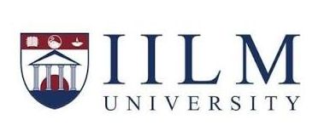
IILM
IILM
PYTHON FULLSTACK
UNIVERSITY
DEVELOPER VIRTUAL INTERNSHIP
INTERNSHIP PRESENTATION
Student
Enrollment Number
Aryan Raj
2410031289
Program & Semester
Organization
B.Tech CSE • Semester IV
EduSkills
IILM University, Greater Noida • Academic Session 2026–27

Slide 2
1
Internship Overview
• 8-week Python Fullstack Developer Virtual Internship under the AICTE–EduSkills Virtual Internship framework.
• Documented internship period: June – August 2026.
• Focus areas: frontend development, backend development, databases and version control.
• Core technologies: HTML, CSS, Bootstrap, JavaScript, jQuery, Python, Django, SQL/MySQL and Git.
• Designed to build a structured foundation for Python-based full-stack web development.
EduSkills • Python Fullstack Developer Virtual Internship

Slide 3
2
Internship Curriculum
HTML
CSS
Bootstrap
Structure, elements, forms, tables and semantic tags.
Selectors, box model, Flexbox, Grid and responsive styling.
Responsive/mobile-first design, components and utilities.
JavaScript
jQuery
Python
Fundamentals, DOM manipulation and event handling.
DOM traversal, animations, events and AJAX.
Syntax, data types, loops, functions and OOP.
Django
SQL / MySQL
Git
Models, views, templates, routing and authentication.
Queries, database design, CRUD and management.
Version control and source-code management.
EduSkills • Python Fullstack Developer Virtual Internship

Slide 4
3
Learning Objectives
• Understand the fundamentals of modern web page structure and styling.
• Create responsive, mobile-first interfaces using Bootstrap.
• Use JavaScript and jQuery for client-side interaction and DOM manipulation.
• Develop programming fundamentals with Python.
• Understand Django-based backend concepts and application structure.
• Learn SQL, database design and CRUD operations.
• Understand Git for source-code management and development workflow.
EduSkills • Python Fullstack Developer Virtual Internship

Slide 5
4
Full-Stack Technology Stack
PRESENTATION | HTML • CSS • Bootstrap
CLIENT-SIDE | JavaScript • jQuery
BACKEND | Python • Django
DATABASE | SQL • MySQL
VERSION CONTROL | Git
EduSkills • Python Fullstack Developer Virtual Internship

Slide 6
5
Week-wise Methodology
WEEK | MODULE | LEARNING FOCUS
1 | HTML | Structure, elements, forms, tables, semantic tags and layouts.
2 | CSS | Selectors, box model, positioning, Flexbox, Grid and responsive styling.
3 | Bootstrap | Responsive/mobile-first development, components, grid and utilities.
4 | JavaScript | Fundamentals, DOM manipulation and event handling.
5 | jQuery | DOM traversal, animations, event handling and AJAX.
6 | Python | Syntax, data types, loops, functions, OOP and backend fundamentals.
7 | Django | Models, views, templates, routing and authentication.
8 | MySQL & Database | SQL, database design, CRUD and Django integration.
EduSkills • Python Fullstack Developer Virtual Internship

Slide 7
6
Development Workflow
01 Plan
02 Build UI
03 Add Interaction
Understand requirements and define application structure.
Create responsive interfaces with HTML, CSS and Bootstrap.
Use JavaScript and jQuery for client-side behaviour.
04 Develop Backend
05 Manage Data
06 Version Control
Use Python and Django for application logic.
Apply SQL/MySQL database concepts and CRUD.
Track and manage source code with Git.
EduSkills • Python Fullstack Developer Virtual Internship

Slide 8
7
Skills & Learning Outcomes
Frontend Development
Backend Development
Understanding of page structure, responsive design and client-side interactions.
Foundational understanding of Python programming and Django.
Database Management
Version Control
Understanding of SQL, database design and CRUD operations.
Understanding of Git for source-code management.
Overall Outcome
A structured foundation for continuing Python full-stack development and building web applications.
EduSkills • Python Fullstack Developer Virtual Internship

Slide 9
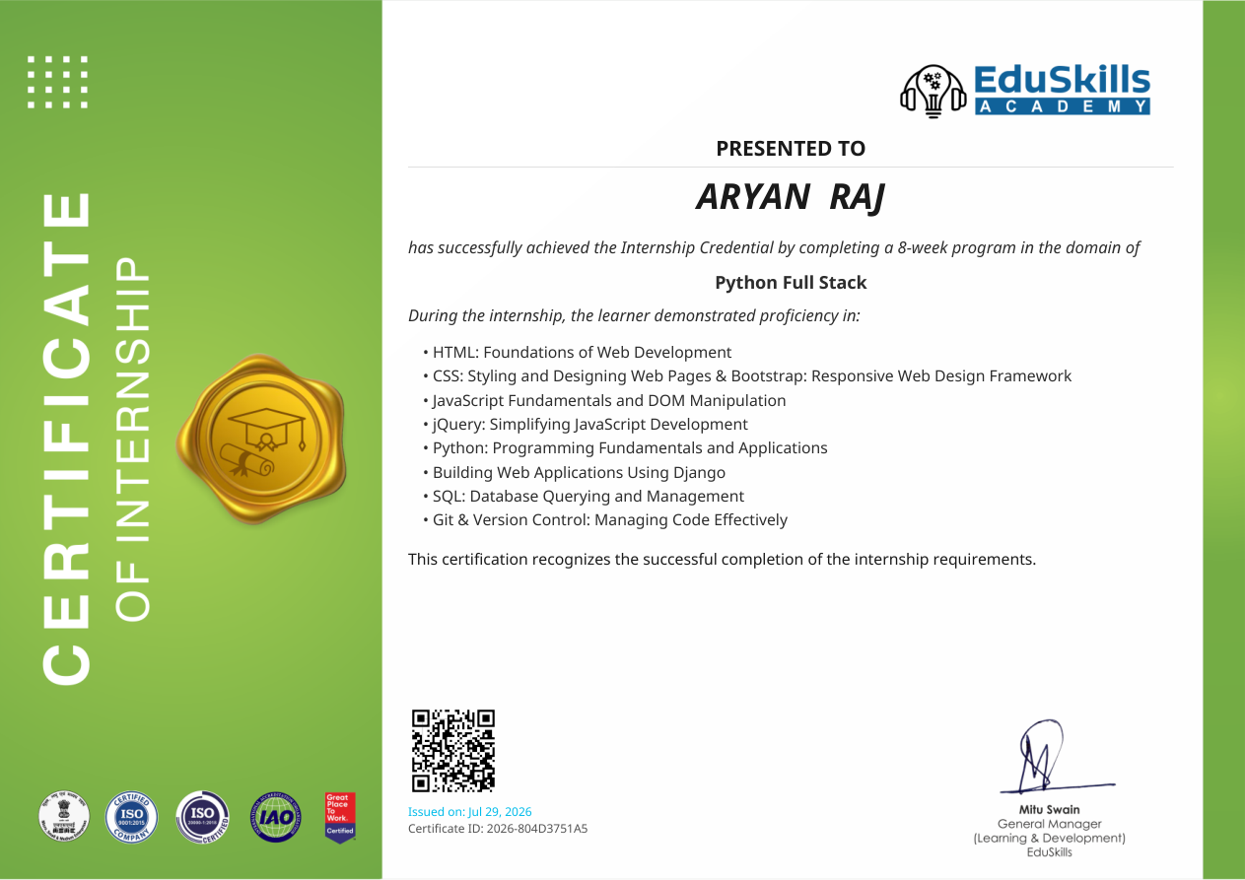
8
Internship Certificate
Certificate
8-week Python Fullstack Developer Virtual Internship
Issued On
29 July 2026
Certificate ID
49dcb99c3586fec612b1
EduSkills • Python Fullstack Developer Virtual Internship

Slide 10
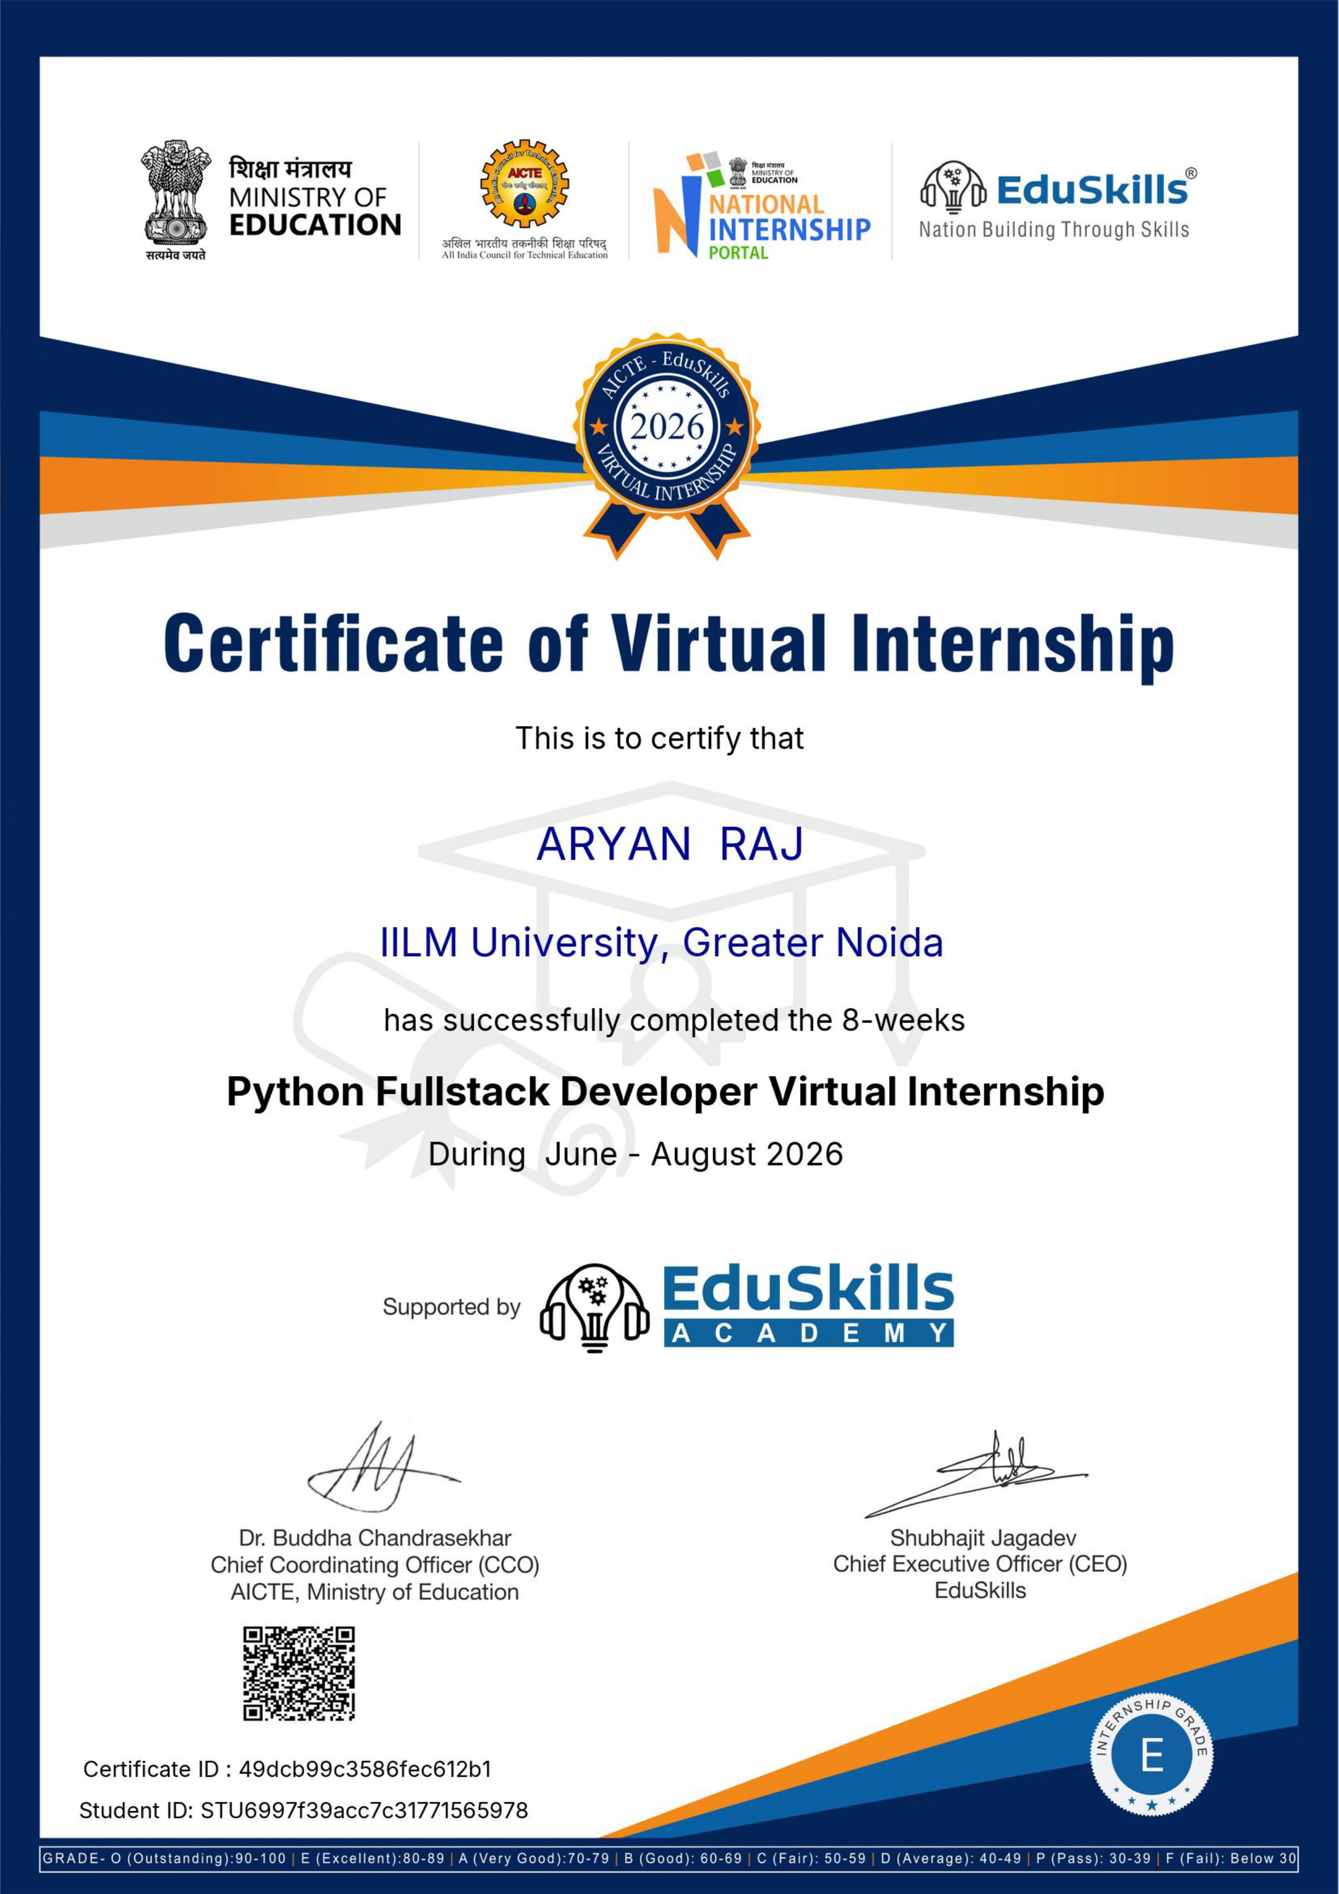

Slide 11
9
Conclusion
• The internship provided a structured introduction to Python full-stack development.
• It connected frontend, client-side scripting, backend, databases and version control.
• The week-wise curriculum strengthened understanding of the complete web-development workflow.
• The learning provides a foundation for future projects and deeper Django/full-stack development.
THANK YOU
EduSkills • Python Fullstack Developer Virtual Internship

Slide 12
ARYAN RAJ
B.Tech CSE • Enrollment No. 2410031289
Python Fullstack Developer Virtual Internship
IILM University, Greater Noida
Thank You

