Slide 1
DevOps CA2
CI/CD, IaC, Kubernetes and Monitoring for a Quote Service
Aryan | TYCSA | Symbiosis Institute of Technology, Pune

Slide 2
Architecture
GitHub
Source + Actions
GHCR
Container images
Kubernetes
3 replicas, rolling updates
Prometheus
Scrapes /metrics
Grafana
Uptime, latency, errors
Ansible prepares the host runtime (Docker, app user, directories). The Flask service exposes /health, /quote and /metrics.

Slide 3
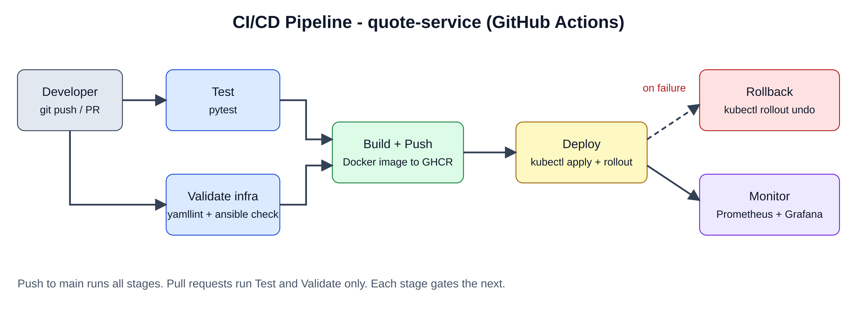
Pipeline flow
Push to main: test, validate, build, push, deploy. A failed rollout triggers kubectl rollout undo.

Slide 4
Challenges
1
Zero-downtime rollouts
Readiness probes on /health keep traffic away from pods that are not ready yet.
2
Meaningful latency metric
A histogram lets Grafana compute p95, not just an average.
3
Idempotent configuration
Ansible modules (apt, user, file) instead of shell, so reruns change nothing.

Slide 5
Lessons learned
Gate every stage so broken code never reaches the cluster
Health probes and resource limits make rolling updates safe
Instrument the app first; dashboards follow from good metrics
Keep everything in Git: pipeline, playbook, manifests, dashboard

