Slide 1
Navisense
An AI-Powered Accessibility-First Browser
Presented by:
1. Laxman Prasad Mishra
B.Tech in Computer Science and Engineering
(Specialisation in Data Science and Analytics)
IIIT Nagpur (Indian Institute of Information Technology, Nagpur).
2. Neha Rathure
B.Tech in Computer Science and Engineering
Indira Gandhi Delhi Technical University for Women (IGDTUW)

Slide 2
Problem Statement
• Many websites are not accessible to visually impaired users
• Buttons and form fields often lack proper labels
• Clickable elements are not keyboard or screen reader friendly
• Screen readers can only read content, not fix structure
• Users must depend on developers to correct accessibility issues

Slide 3
Motivation
• Real-life challenges faced by visually impaired users
• Difficulty accessing forms, login pages, and dynamic content
• Existing tools do not correct accessibility issues
• Desire to build a practical, independent accessibility solution

Slide 4
Limitations of Existing Solutions
• Screen readers cannot modify webpage structure
• Accessibility plugins are limited and unreliable
• Developers often ignore accessibility guidelines
• No AI-based real-time accessibility correction tools exist

Slide 5
Proposed Solution: Navisense
• A desktop browser focused on accessibility
• Loads real websites normally
• Uses AI to analyze webpage structure
• Automatically generates accessibility fixes
• Improves screen reader experience in real time

Slide 6
System Working
1. User enters a website URL
2. Webpage loads normally
3. HTML snapshot is extracted
4. AI analyzes accessibility issues
5. AI generates JavaScript fixes
6. Fixes are applied to the live webpage
7. Screen reader experience improves

Slide 7
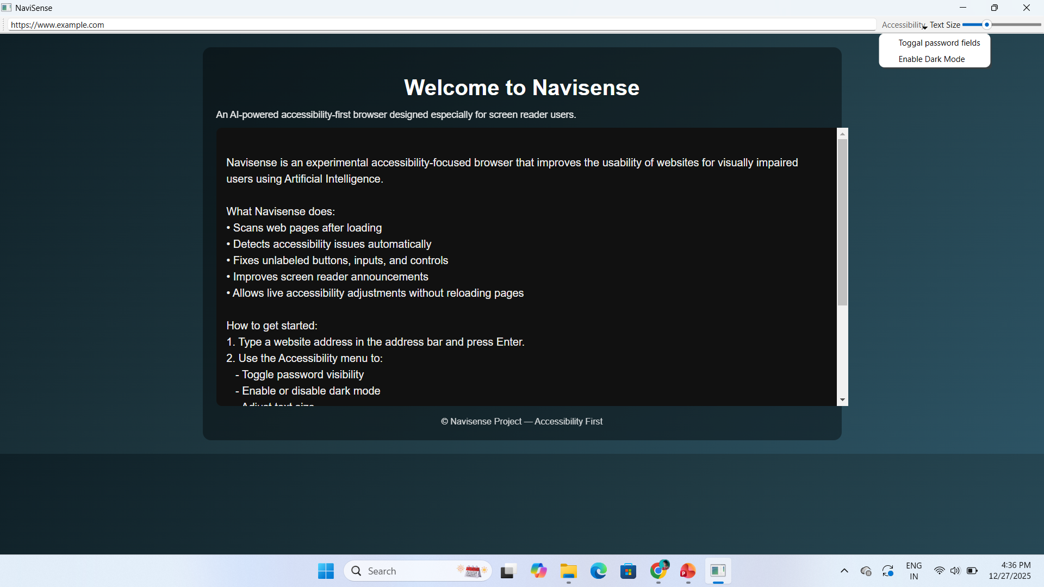
Key Features
• AI-based accessibility correction
• Fixes unlabeled buttons and form inputs
• Converts clickable divs into buttons
• Accessibility control menu
• Dark mode, text size control, password toggle
• Accessibility-aware CAPTCHA assistance for visually impaired users

Slide 8
Accessibility-Focused Design
• Designed specifically for screen reader users
• Keyboard-friendly navigation
• No dependency on browse mode
• Readable welcome page using editable content
• Tested using NVDA screen reader

Slide 9
Technical Challenges
• Screen reader limitations in embedded browsers
• Maintaining JavaScript functionality
• Ensuring reversibility of accessibility changes
• Secure handling of AI API keys

Slide 10
Learning Outcomes
• Practical accessibility engineering
• Understanding screen reader behavior
• Safe integration of AI models
• Desktop application development and packaging

Slide 11
Impact and Use Cases
• Improves digital independence for visually impaired users
• Helps access forms, services, and login pages
• Useful for education and government portals
• Reduces dependency on website developers

Slide 12
Future Scope w
• Hybrid browser integration for full accessibility
• Per-website accessibility profiles
• Advanced AI-based corrections
• Support for more assistive technologies
• AI-assisted generation of meaningful alternative text for images• Accessibility-aware CAPTCHA assistance for visually impaired usersw

Slide 13
Conclusion
• Navisense demonstrates AI-driven web accessibility
• Focuses on real user problems
• Designed with honesty and responsibility
• A step toward inclusive digital access

Slide 14
Thank You
Questions are welcome.

