Slide 1
Title: Cyclistic Bike-Share Case Study (2019 & 2020)
Subtitle: Usage Insights & Recommendations
Presented by: Aryan Farswan
Date: May4,2025

Slide 2
Business Task
Objective: Analyze how annual members and casual riders use Cyclistic bikes.
Goal: Identify marketing strategies to convert casual users into members.

Slide 3
Data Overview
Sources: Cyclistic trip data for 2019 and 2020
Tools Used: Microsoft Excel, Google Sheets
Note: Separate analysis due to column differences

Slide 4
Data Cleaning Steps
Removed missing/duplicate records
Calculated ride length from timestamps
Removed negative values
Extracted weekday info
Segregated user types

Slide 5
Data Analysis
Key Metrics -2019
Key Metrics-2020
Total Rides: 365070
Member Rides: 341906
Casual Rides: 23163
Avg. Ride Length (Member): 00:11:30
Avg. Ride Length (Casual): 00:37:04
Total Rides: 426770
Member Rides: 378407
Casual Rides: 48363
Avg. Ride Length (Member): 00:11:34
Avg. Ride Length (Casual): 00:40:13

Slide 6
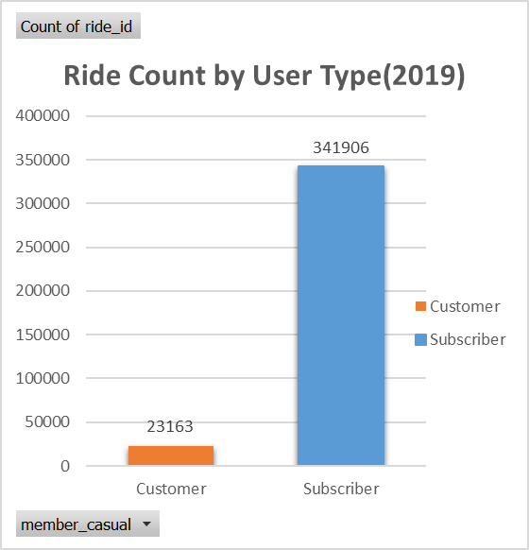
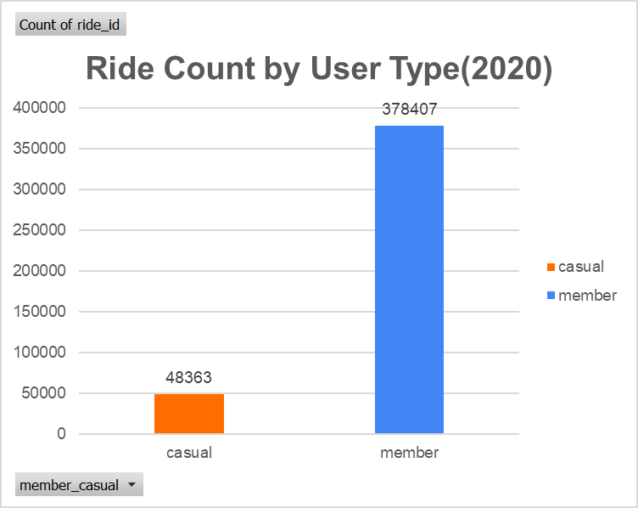
Total rides based on user type in each year

Slide 7
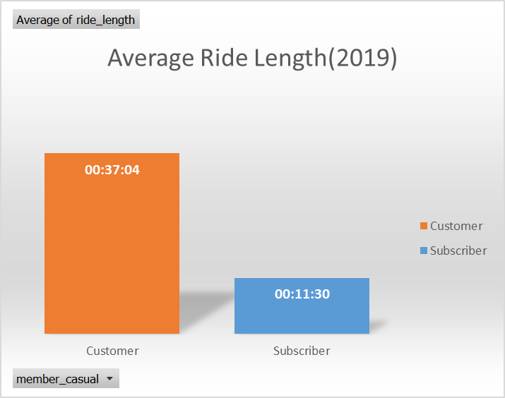
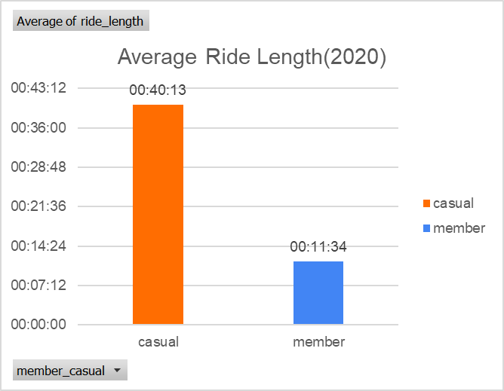
Average Ride Length Comparison
• In 2020, casual users' ride length rose to 40:13, up from ~3 minutes in 2019.
• Member ride lengths slightly increased.

Slide 8
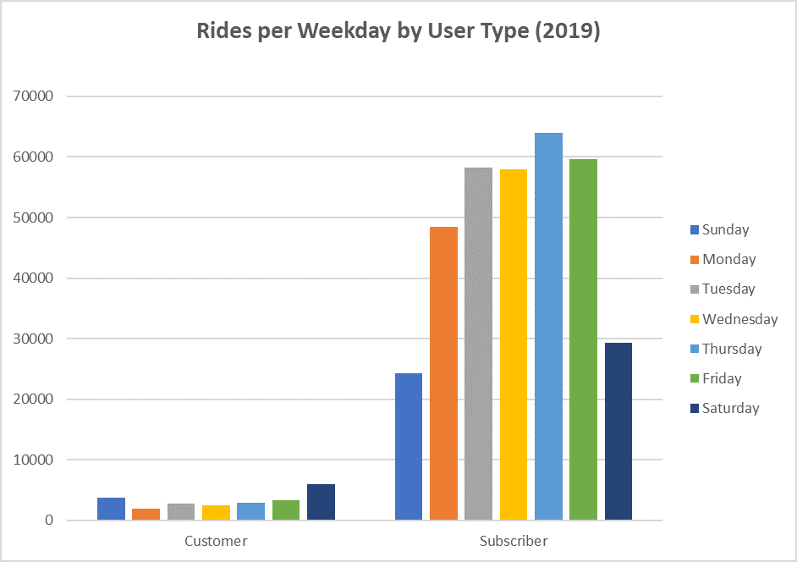
Weekly Ride Patterns (2019)
• Members ride mostly on weekdays, especially Tue/Wed.
• Casual users ride mostly on weekends.

Slide 9
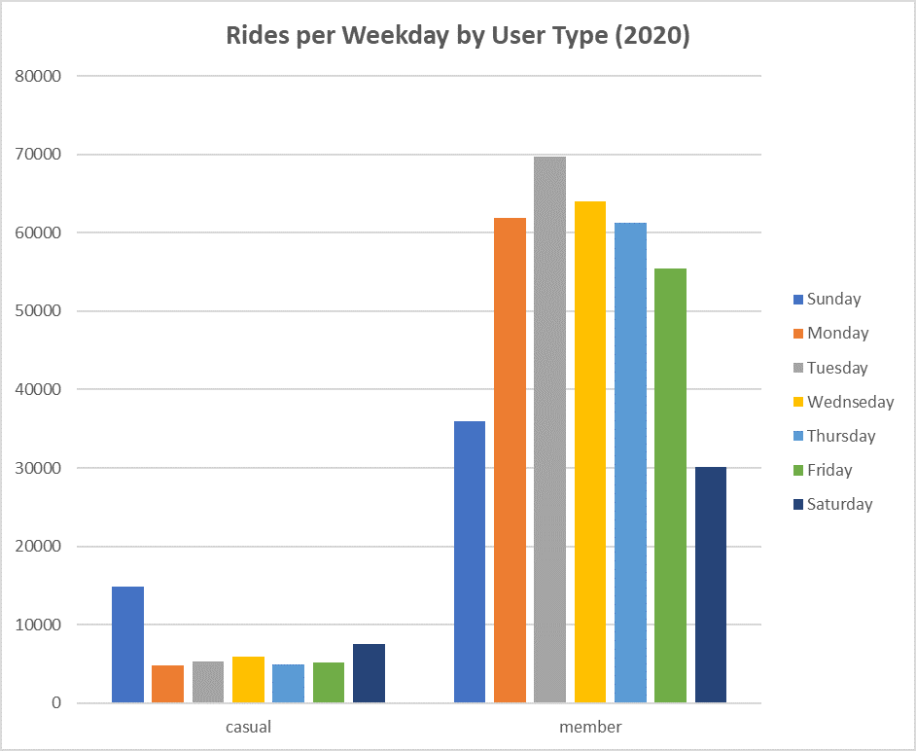
Weekly Ride Patterns (2020)
• Weekday trend continues for members.
• Weekend rides dominate for casual users.

Slide 10
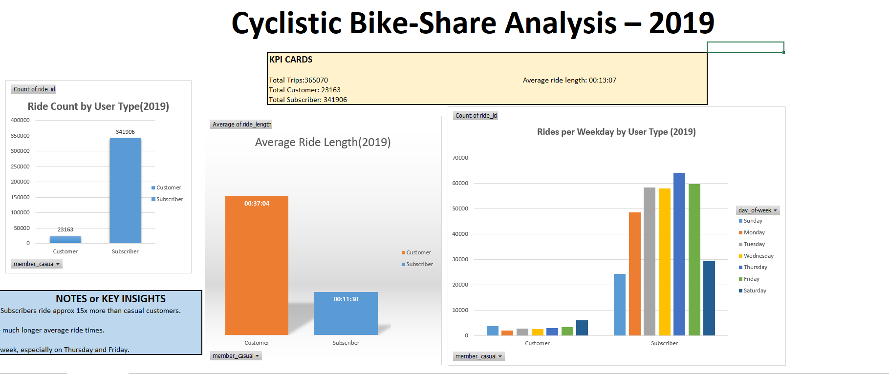
2019 Dashboard

Slide 11
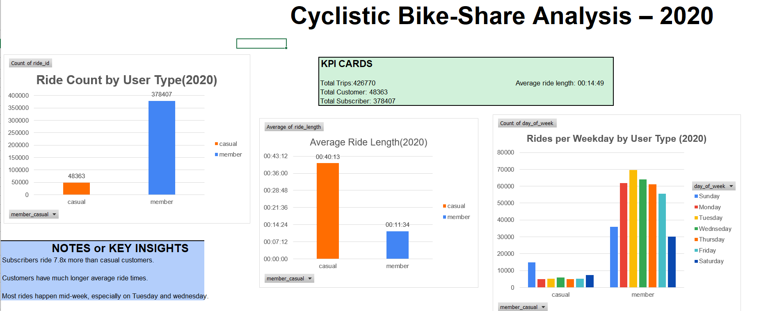
2020 Dashboard

Slide 12
Insights
Casual riders take longer rides, especially on weekends.
Annual members ride more frequently but for shorter durations.
Weekends see more casual usage; weekdays see more member activity.
For Members highest ride counts observed on Tuesday, lowest on Saturday.
For Casuals highest ride counts observed on Sunday, lowest on Thursday.

Slide 13
Business Questions Answered
1. How do annual members and casual riders use bikes differently?
Casuals: Longer rides, weekends.
Members: Frequent, shorter rides, weekdays.
2. Why would casual riders buy annual memberships?
Incentives for frequent users.
Time-saving for regular commuters.
Promotions on weekend rides or bundled offers.

Slide 14
Business Questions Answered
3. How can Cyclistic use digital media to influence casual riders to become members?
Targeted email/social media campaigns.
Mobile app promotions.
Highlighting member benefits with ride comparisons.

Slide 15
Recommendation
We can upgrade Casual riders to Members by providing some special offers at weekends.
By using social media and mobile app we can highlights the benefits of a rider in membership compare to casual.
We can give gifts or coupon cards to the users having memberships which are more frequent users and are joined with cyclistic for a long time.

Slide 16
Summary of Insights
• Casual users ride longer, but less frequently.
• Member rides are shorter, but more consistent.
• Weekday vs weekend highlights commuter vs leisure.

Slide 17
Thankyou
Questions or Feedback?

