Slide 1

Major Project-1 Presentation-I B.E. (Computer) Sem - VII
Lokmanya Tilak College of Engineering, Navi Mumbai
Computer Engineering
2025-26

Slide 2

Pathoscope: AI-powered Pathogenic Mutation Prediction And Clinical Variant Analysis Platform
Group members:
1) Aakash Medge 266
2) Roshan Gaud 269
3) Aditya Sonkar 261
Name of Project Guide:
Prof. Shobha Lolge

Slide 3
Presentation Outline
Abstract
Introduction
Literature Survey
Limitations of Existing system
Problem Statement and Objectives
Scope
Proposed System
References

Slide 4
ABSTRACT
This project, PathoScope: AI-Powered Pathogenic Mutation Prediction and Clinical Variant Analysis Platform, focuses on predicting the pathogenicity of DNA mutations, specifically single-nucleotide variants (SNVs), which are often linked to severe genetic disorders such as cancer.
The system leverages Evo2, a state-of-the-art genome-scale language model trained on 9.3 trillion base pairs, to classify mutations as pathogenic or benign. Users can browse genome assemblies, search genes like BRCA1, view reference genome sequences, and analyze mutations through an interactive web interface.
The platform also integrates ClinVar data to allow comparison between AI predictions and existing clinical classifications.
Built with a Python FastAPI backend deployed on GPU infrastructure via Modal and a modern Next.js and React frontend, the system offers researchers, clinicians, and students an accessible, real-time tool for understanding the impact of genetic variations.

Slide 5
INTRODUCTION
DNA is the fundamental blueprint of life, consisting of sequences of four nucleotides—A, T, G, and C—that control how our bodies grow and function. Even a small change in this sequence, known as a mutation, can lead to serious so serious genetic disorders such as cancer. Among these,) Single-nucleotide variants (SNVs) are the most common type of mutation.
Understanding whether a mutation is harmful (pathogenic) or harmless (benign) is critical for research and clinical diagnosis. However, traditional analysis requires specialized expertise and complex tools. With advancements in artificial intelligence, it is now possible to predict the edict the pathogenicity of such mutations more accurately and efficiently.
This project introduces an AI-powered platform that enables users to analyze genetic variants in a simple, accessible way, bridging the gap between complex bioinformatics models and user-friendly applications.

Slide 6
LITERATURE SURVEY
Sr. No | Authors | Title of the paper & year of publish | Major contributions/ Methods Used | Gaps
1 | Elsevier Journal | A deep learning framework for predicting pathogenicity of human variant (2022) | Uses deep learning to check if DNA changes are harmful, with good accuracy. | Too complex for beginners and not connected to clinical databases.
2 | Cheng Ji. | Alpha Missense: A variant effect predictor for missense mutations (2023) | Shows how AI can predict whether certain DNA changes (missense mutations) are harmful or safe. | Works only for missense mutations, and cannot browse the full genome.
3 | Brixi Re. | Genome modeling and design across all domains of life with Evo2 (2025) | Introduces Evo2, a super-powerful AI model trained on a huge amount of DNA data to study genetic mutations. | No simple interface for students or doctors and no real-time clinical integration.

Slide 7
LIMITATIONS OF EXISTING SYTEM
Analysis of SNVs requires expert knowledge and advanced tools.
Existing systems are complex and not user-friendly.
Lack of real-time AI-driven prediction platforms.
No proper integration with clinical databases like ClinVar.
Limited accessibility for researchers, clinicians, and students without a
bioinformatics background.

Slide 8
PROBLEM STATEMENT & OBJECTIVES
Current tools for analyzing single-nucleotide variants (SNVs) are often complex, require advanced expertise, and lack accessible, user-friendly platforms. Existing AI models provide predictions but do not support real-time analysis or integration with clinical databases such as ClinVar.
This creates a gap for researchers, clinicians, and students who need a reliable and intuitive system for predicting and validating the pathogenicity of DNA mutations.
OBJECTIVES
To develop an AI-powered web platform for analyzing single-nucleotide variants
To implement the Evo2 model for accurate pathogenicity prediction.
To provide real-time analysis with prediction confidence scores.
To integrate the ClinVar database for validation and comparison.
To enable genome browsing and gene search functionality (e.g., BRCA1).
To design a modern, responsive UI for accessibility to researchers, and students.

Slide 9
SCOPE
The system enables prediction of the pathogenicity of SNVs using AI.
Provides an interactive platform for genome browsing and gene mutation analysis.
Facilitates comparison with standard clinical data (ClinVar) for validation.
Designed to support academic research, healthcare studies, and learning purposes.
Can be extended in the future to include other mutation types and broader genomic
datasets.
Built as a scalable cloud-based application, ensuring accessibility across devices.

Slide 10
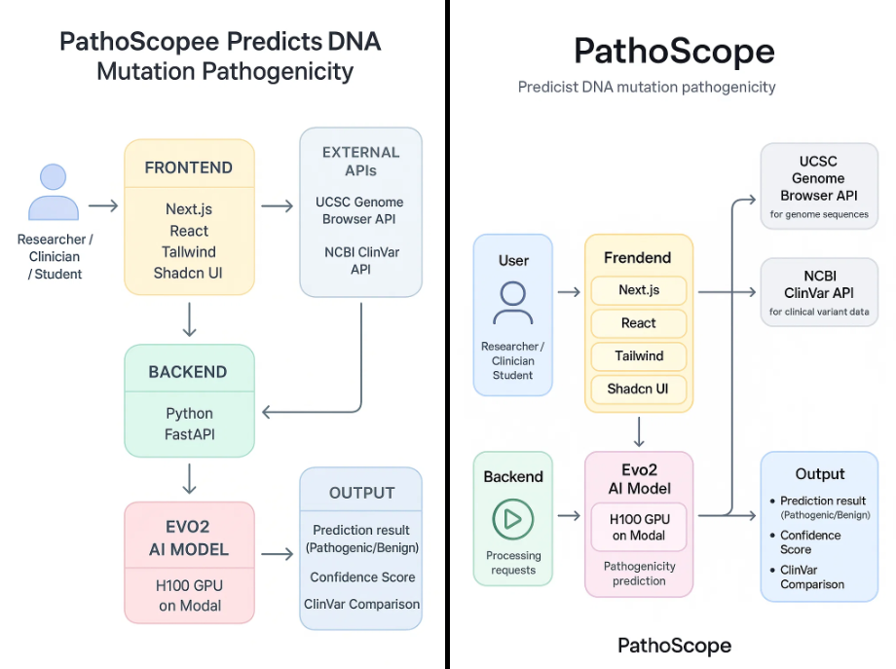
PROPOSED SYSTEM

Slide 11
REFERENCES
Brixi, R. et al. Genome modeling and design across all domains of life with Evo2.
bioRxiv, 2025.
Cheng, J. et al. AlphaMissense: a variant effect predictor for missense mutations.
Nature, 2023.
Elsevier Journal. A deep learning framework for predicting pathogenicity of human
variants. 2022.
NCBI ClinVar Database. https://www.ncbi.nlm.nih.gov/clinvar/
UCSC Genome Browser. https://genome.ucsc.edu/
Modal Documentation – GPU Serverless Deployment. https://modal.com

Slide 12
Thank You!

