Slide 1
Statistical Analysis on the fundamentals of stock and trend prediction

Slide 2
Motivation
Our study aims to examine the relationship between quarterly results and future stock price movements
In this study, we are examining the impact of four key financial parameters on the future stock price of a company: margin, EBITDA, profit, and revenue.
Limited research on the specific impact of a company’s quarterly results on its future stock price
Broader implications for the understanding of stock price movements

Slide 3
Motivation
Previous research has shown a relationship between financial performance and stock price
Limited research on the specific impact of quarterly results on stock price
Understanding the factors that influence stock price changes after the release of quarterly results
We can provide valuable insights for investors and analysts seeking to make informed investment decisions

Slide 4
Motivation
Role of financial performance in the market
Aims to fill this gap in knowledge by examining the relationship between quarterly results and future stock price movements
Aims to across some relationship between these two parameters
Our research can be used by investors and analysts to make decisions

Slide 5
Dataset Preparation
Data source:
Quarterly results and stock price data for companies
listed on the National Stock Exchange in India,
obtained via web scraping from Moneycontrol.com
Financial parameters:
Margin, EBITDA, profit, and revenue
Data cleaning:
Removed missing or duplicate data, normalized values

Slide 6
Dataset Preparation
Classification:
Each quarter classified into one of 16 categories
based on changes in financial parameters
compared to previous quarter
Net change calculation:
Minimum and maximum stock prices in next
three months after quarter's results, compared
to price on results date; greater absolute value
of percentage change taken as net change

Slide 7
Dataset Preparation
Limitations:
Limited to publicly-traded companies listed on NSE,
may not capture all relevant data
Final dataset:
1500+ companies, over 16,000 quarters of data,
3-year period

Slide 8
Methodology
Tools and Libraries used:
Python
Pandas Library : For DataFrames
Jupyter Notebook : IDE
BeautifulSoup Library : For Scrapping Data
Requests Library : For making requests

Slide 9
Methodology
Step 1 :
The Quarterly Results of every company listed on National Stock Exchange(NSE) was collected using python , pandas , requests and BeautifulSoup library from Moneycontrol.com.
Step 2:
The dates of the results of the results for every quarter was collected from Moneycontrol.com using BeautifulSoup.

Slide 10
Methodology
Step 3:
The Stock Price of every stock over the previous 4 years gathered from www1.nseindia.com.
Step 4:
Iterating through every quarter of every company and comparing the value of margin, EBITDA, profit and revenue with the previous quarter.

Slide 11
Methodology
Step 5.1:
To classify each quarter into one of 16 categories, we compared the values of the four financial parameters in each quarter to those in the previous quarter.
Step 5.2:
For each parameter, we assigned a value of 1 if the value in the current quarter was higher than in the previous quarter, and a value of 0 if it was lower or unchanged.

Slide 12
Methodology
Step 5.3 :
This resulted in a total of 16 possible categories, depending on the combination of 1s and 0s for the four parameters.
Step 5.4:
For example, a quarter with higher values for all four parameters would be classified as category 15 (1111 in binary), while a quarter with lower values for all four parameters would be classified as category 0 (0000 in binary)

Slide 13

Methodology
Step 6.1 :
Identify the minimum price (Pmin) and maximum price (Pmax) in the three months following the quarter's results date.
Step 6.2:
Calculate the percentage change of each price with respect to the price on the results date (Pr). The percentage change of Pmin is given by :
$$(Pmin − Pr) / Pr⁡$$
The percentage change of Pmax is given by:
$(Pmax − Pr) / Pr⁡$

Slide 14

Methodology
Step 6.3 :
Calculating Net Change:
Select the greater of the two absolute percentage changes as the net change (NetChange). This can be done using the following equation: $NetChange =f\left(x\right)=\left\{\begin{aligned}\frac{Pmin −\operatorname{Pr}{}}{Pr}, \frac{|Pmin−Pr|{}}{\operatorname{Pr}{}}>(|Pmax−Pr⁡|)/Pr \\ \frac{\&Pmax−\operatorname{Pr}{}}{Pr},\frac{|Pmin−Pr|{}}{\operatorname{Pr}{}}<(|Pmax−Pr⁡|)/Pr\end{aligned}\right.$

Slide 15
Methodology
Step 7 :
Calculating Results :
For each category calculate the percentage of stocks going up and the percentage of stocks going down
Average Change is calculated by finding the average of all the net change values for a particular category.

Slide 16
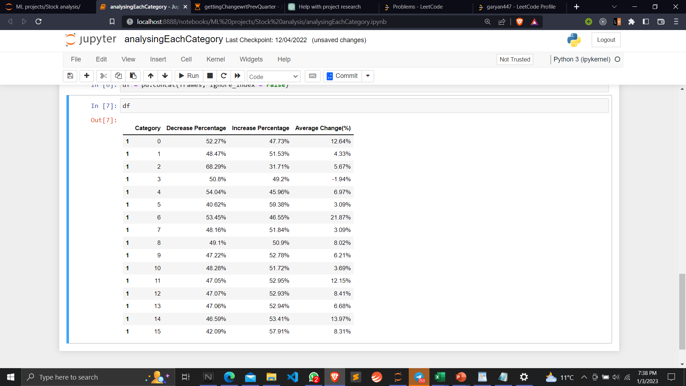
Results:
These are the Category wise results of increase and decrease percentage along with the average change.
Every Category has nearly 50-50 percentage of time stock going up and down respectively
Only Category 2 has a nearly 70% as decreasing percentage and 30% as increasing percentage

Slide 17
Conclusion
Our result suggest that the relationship between the categories of quarterly results and the net change in stock price is not particularly strong or consistent
This could be due to the influence of other factors or variables that are not being considered in our analysis

Slide 18
Future Work
Incorporating additional variables or factors that may influence the relationship between the categories of quarterly results and the net change in stock price
For example: industry sector, market conditions, macroeconomic context
Applying more advanced or sophisticated machine learning algorithms or techniques to improve the predictive accuracy of your model

Slide 19

Thankyou

