Slide 1

Basic Details of the Team and Problem Statement
Ministry/Organization Name/Student Innovation: Startup India Section, Department for Promotion of Industry and Internal Trade (DPIT), Ministry of Commerce and Industry.
PS Code: KK1182
Problem Statement Title: Shared usage of workshops and labs by all Educational Institutions at National Level
Team Name: Ctrl C Ctrl V
Team Leader Name: Aryan Gupta
Institute Code (AISHE): U-1056
Institute Name: Netaji Subhas University of Technology
Theme Name: Innovation in Educational Sector

Slide 2
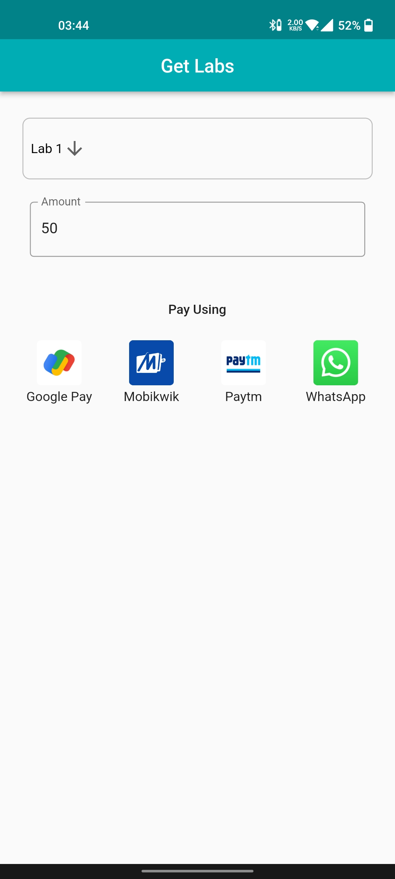
Idea/Approach Details
Describe your idea/Solution/Prototype here:
Due to Covid scenario students often are unable to practice lab activities which hinders their learning process.
Sometimes institutions lack the facilities required by students and the student is often left helpless.
To facilitate students to utilize the facilities of Institutions closer to their homes, labs in institutions could be booked by students.
This would enable the students to use the lab facilities of institutions near them whenever it wouldn’t be convenient for them to avail the lab facilities of their own institute.
Describe your Technology stack here:
MERN framework: MongoDB, Express, React, Node
Firebase
AWS for cloud

Slide 3
Idea/Approach Details
Describe your Use Cases here
Describe your Dependencies / Show stopper here
Vey useful in COVID scenario where students are staying far away from their institutes.
Even in a NON-COVID scenario, our platform will help students studying in institutes which do not have proper facilities or equipment.
Very useful for research students who are preparing for exams and need a lab for practice.
Useful for people involved in R&D.
Useful for doctors in the research field who need access to a well equipped lab.
Our show stopper is our novel idea which has no competition in the market currently.
Backed with innovative and user-friendly tech, our portal is highly accessible and given that our target audience is the youth which is very responsive and active, our product has the potential to be a widely used platform.
Our multiple revenue models offer many revenue streams to the company.
Also the flexible business models offers users the choice to select a payment plan according to his/her requirements.

Slide 4
Team Member Details
Team Leader Name: Aryan Gupta
Branch (Btech/Mtech/PhD etc): BTech Stream (ECE, CSE etc): IT NS Year (I,II,III,IV): II
Team Member 1 Name: Harshita Varshney
Branch (Btech/Mtech/PhD etc): BTech Stream (ECE, CSE etc): IT NS Year (I,II,III,IV): ||
Team Member 2 Name: Akshit Lalit
Branch (Btech/Mtech/PhD etc): BTech Stream (ECE, CSE etc): IT NS Year (I,II,III,IV): II
Team Member 3 Name: Priyanshi Goel
Branch (Btech/Mtech/PhD etc): BTech Stream (ECE, CSE etc): IT NS Year (I,II,III,IV): II
Team Member 4 Name: Madhur Ahuja
Branch (Btech/Mtech/PhD etc): BTech Stream (ECE, CSE etc): ME Year (I,II,III,IV): II
Team Member 5 Name: Nikhil Vashisht
Branch (Btech/Mtech/PhD etc): Stream (ECE, CSE etc): Year (I,II,III,IV): II
Team Mentor 1 Name: Dr. Mohinder Pal Singh Bhatia
Category (Academic/Industry): Expertise: AI/ML/Blockchain etc Domain Experience(in years):30 years
Team Mentor 2 Name: Manu Sheel Gupta
Category (Academic/Industry): Expertise : AI/ML/Blockchain etc Domain Experience (in years):15 years

Slide 5
Important Pointers
Please ensure below pointers are met while
Kindly keep the maximum slides limit to 4 pages
All the topics should be utilized for description of your idea
Try to avoid paragraphs and post your idea in points
Keep your explanation precisely and easy to understand
Idea should be unique and novel. If it has a business potential more weightage will be given.
Apart from this PPT abstract of your idea will be asked separately while submitting
You need to save the file in PDF and upload the same on portal. No PPT, Word Doc or any other format will be supported
You can delete this slide (Important Pointers) when you upload the details of your idea on SIH portal.

