Slide 1

Foreign Students at DU:
Negotiating Cultural Diversity
Vasudhaiva Kutumbakam — The World is One Family
A Survey-Based Exploration of Life at Delhi University
VAC Course Presentation
Aryan Kushwaha - 245703428
name 1 -
name 2 -

Slide 2
Objectives and Methodology
Course Objective
Survey Method
Respondent Profile
To learn to adapt, interact, and celebrate our pluralistic culture through lived experience and dialogue.
Google Form distributed to foreign students across DU colleges to collect authentic lived experiences.
25 students from 16 countries across Asia, Africa, Europe, and the Americas.
25
16
12
5
100%
Total Responses
Countries
DU Colleges
Survey Dimensions
Consent Rate
Cultural Lens Approach: The data is viewed through a cultural lens to understand human connections rather than just demographic percentages. Survey dimensions include cultural adaptation, empathy & belonging, communication barriers, academic collaboration, and overall experience.
Foreign Students at DU | Objectives

Slide 3
Cultural Adaptability — Integrating into a New World
Top Cultural Shocks
● Spicy food — 40% of respondents
● Religious practices everywhere — 36%
● Flexible "Indian Standard Time" — 32%
● Loud noises everywhere — 32%
● Gender segregation — 28%
Most Appreciated Aspects
● Festival celebrations — 24%
● Hospitality and warmth — 24%
● Food variety — 16%
● Music and arts — 12%
52% adapted within 6 months
32% felt at home within 1 month
Takeaway: Despite initial shocks, a significant proportion demonstrated high cultural adaptability by integrating local customs into daily routines.
Foreign Students at DU | Adaptability

Slide 4
Empathy and Pluralism on Campus
"I am proud to belong to a religion which has taught the world both tolerance and universal acceptance. I am proud to belong to a nation which has sheltered the persecuted and the refugees of all religions and all nations of the earth."
— Swami Vivekananda, Chicago Address, 1893
Empathy & Belonging Index
Critical Reflection: While 64% found DU welcoming, nearly 1 in 3 students do not feel included — a gap between Vivekananda's ideal and current campus reality.
Foreign Students at DU | Empathy

Slide 5
Bridging Gaps through Effective Communication
Faculty Interaction Ratings
2.9 / 5
Average rating
● Only 16% rated excellent
● 24% rated poor
32%
Language barriers — the #1 complaint among foreign students
Qualitative Insight
Students from non-English-speaking backgrounds (Bhutan, Afghanistan, Nigeria) consistently reported lower faculty interaction scores. This suggests that empathetic listening is the primary tool students use to overcome language barriers — rather than formal language support structures.
Takeaway: Applying communication skills in everyday life helps build genuine connections. The survey underscores the need for more structured empathetic communication channels between faculty and international students.
Foreign Students at DU | Communication

Slide 6
"United We Stand" — Cross-Cultural Teamwork
Academic Growth Contribution
Collaboration Insight: Despite academic challenges (52% reported minimal/no growth), the "diverse student body" emerged as DU's strongest advantage — suggesting peer-to-peer knowledge sharing is the primary driver of value.
Takeaway: Teamwork and group activities are essential to addressing challenges in metropolitan cities. When students collaborate across cultural boundaries, they discover DU's greatest strength.
Foreign Students at DU | Teamwork

Slide 7
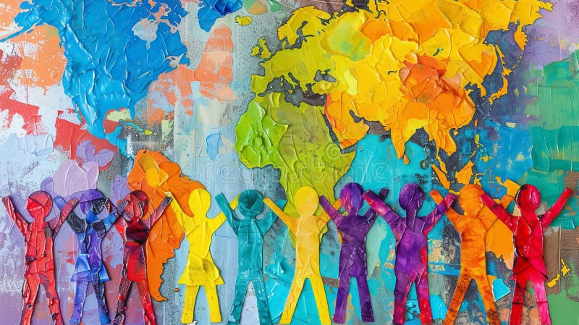
Conclusion — Dialogue Between Past and Present
Engaging in a dialogue with foreign students allows us to engage in a dialogue between the past and the present, inculcating principles for a meaningful life.
Only 32% would definitely recommend DU — revealing significant room for improvement in the foreign student experience.
Closing Thought: Interacting with a diverse group equips us to work towards an ethically robust society, an inclusive community, and strengthens the nation. Vasudhaiva Kutumbakam is not merely an ancient ideal — it is a call to action.
"As the different streams... all mingle their water in the sea, so, O Lord, the different paths which men take... all lead to Thee." — Swami Vivekananda
Thank You

