Slide 1


LONG-TERM MEMORY ENGINE FOR AI AGENTS
Department of Information Technology
College of Engineering, Guindy
Anna University, Chennai-25
Second Project Review
GUIDE:
DR. BAMA SRINIVASAN
DEPARTMENT OF INFORMATION TECHNOLOGY
CEG, ANNA UNIVERSITY
TEAM MEMBERS:
M. KRITHIKRAJ, 2023115004
ALSTON S, 2023115006
ARYAN I, 2023115021
HARI SRINIVASAN, 2023115022
Notes:
We are Team 13, and this is our second review of the Long-Term Memory Engine for AI agents, written in Rust.
The engine stores what an agent is told, keeps every fact tied to its source, and brings the right facts back in a later session.
We will go through the problem, what changed since the first review, the design, the numbers we measured and what is still left to do. Pi in this deck is the Pi coding agent, not a Raspberry Pi.

Slide 2
PROBLEM STATEMENT
General purpose AI agents operating without persistent memory may lose relevant user instructions and project decisions when tasks continue across sessions.
When instructions change, these agents may reuse outdated information or miss earlier corrections, leading to inconsistent results.
Users must repeatedly provide context and correct the same mistakes, making long-running tasks difficult to manage.
Notes:
An LLM call has no memory of earlier calls, so an agent that works over many sessions needs a store of what was said, what changed and where each fact came from. Lost in the Middle found that models often answer worse when the relevant passage sits in the middle of a long input [1].
LongMemEval lists five things a memory system has to do: extract information, reason across sessions, reason about time, handle updates and say when it does not know [2]. The boxed statement is the problem we build for: raw events as evidence, facts with a validity interval, and a context that fits a token budget where every item shows its quote and its status.
The Friday and Tuesday example shows the behaviour we require. Our scripted Pi check tests the same thing with a fact that is told and then corrected.

Slide 3
LITERATURE SURVEY
Work | Mechanism | Evidence as reported by the source | Limitation | Relevance here
MemGPT, later Letta, Packer et al., 2023 [3]. | Prompt split into main context and external recall and archival storage. The model moves data between them with function calls. | Authors’ own tests on OpenAI models. Deep memory retrieval: 92.5% with GPT-4 plus MemGPT against 32.1% for GPT-4 reading a summary. | Memory edits depend on the model’s function calling. No latency or token cost figures in the paper. | Origin of memory kept outside the prompt. Here, service code applies the version rules to claims the model extracts.
Zep and Graphiti, Rasmussen et al., 2025 [4]. | Temporal knowledge graph of episodes, entities and facts. Each fact has valid and invalid times, and a contradicting fact ends the old one. | Authors’ own LongMemEval run: 71.2% with gpt-4o against 60.2% for the full 115k-token history. | Single configuration, no repeated runs. The authors call their other benchmark (DMR) weak. Needs a graph database. | Closest design for validity intervals. We also run Neo4j, but only as a projection we can rebuild.
Mem0, Chhikara et al., 2025 [5]. | An LLM extracts candidate facts, compares each with the nearest stored memories, then chooses add, update, delete or no-op. | LoCoMo only, authors’ run. Judge score 66.9 for Mem0, 72.9 for the full history, which had a p95 latency of 17 s against 1.4 s. | One benchmark and an unnamed judge model. The open-source release has since dropped update, delete and graph memory. | Same extract then compare idea. Here the update rule is code (cardinality and correction flag), not an LLM choice per fact.
Supermemory, Daga et al., 2026 [6]. | Atomic memories linked to source chunks, with updates, extends and derives links and two timestamps. | Reports LongMemEval-S results by category from its own run. Numbers not repeated here. | Engine source closed. The headline depends on the answer model, and the metric “aggregation” is not defined. | Named as a design influence in our repository. Used for mechanism only.
Hindsight, Latimer et al., 2025 [7]. | Retain, recall and reflect operations. Recall fuses four retrieval strategies by rank fusion and packs to a token budget. | Reports LongMemEval and LoCoMo results run by the authors. Numbers not repeated here. | Not peer reviewed. No ablation or variance found, and the token budget used is not stated. | Named design influence. We have no reranker.
Notes:
MemGPT is a preprint, and we found no peer reviewed version [3]. Letta grew out of it, and the current Letta documentation calls the original memory blocks legacy, so the row describes the paper and not the product.
Zep and Mem0 report their own results, and the authors of both work for those companies [4], [5]. Zep reports 71.2% on LongMemEval with gpt-4o against 60.2% for the full history, and Mem0 used only LoCoMo, where the full history scored higher than Mem0 on the judge metric.
We cite Supermemory and Hindsight for how they work only, and we do not repeat their numbers [6], [7]. The five works use different benchmarks, judges and models, so their scores cannot be ranked against each other.

Slide 4
CHALLENGES/ ISSUES IDENTIFIED
Fine-tuning
Moving beyond synthetic examples: Early models scored well on generated tests but struggled with conversations. Only 18 of 33 conversation segments passed extraction checks, requiring changes to the data, prompts and output validation.
Making facts traceable to their sources: Models mismatched quotations, source references and dates. We revised the output format and reviewed training labels to reduce unsupported facts.
Improving one task without weakening another: Fine-tuning improved combining facts and answering questions, but fact coverage fell from 50/55 to 41/55. Reliable extraction remains an open challenge.
System integration
Handling corrections without losing history: The model could extract an outdated value again. We revised correction handling to distinguish the current instruction from earlier versions.
Maintaining memory across sessions: Repeated messages created duplicates, recent information was unavailable during processing, and failed jobs blocked later work. Storage, retrieval and retry handling required changes.
Returning useful information quickly: Unrelated memories entered prompts, while date interpretation added delays. We introduced relevance filtering and reduced unnecessary model calls.
Preventing information loss in long conversations: The deployed model silently cut off inputs that exceeded its limit, leaving some information unprocessed. We added input-length checks and processed conversations in smaller sections while preserving the original messages.
Notes:
In the First Review we treated memory as plain chunks of text that we searched by keywords and vectors, with no context around a fact. So we could not tell which fact was newer, what it was linked to, or where it came from.
The right column lists what went wrong when we actually ran it on 2026-10-06, and each one was reproduced against a live service. Most of them are fixed or reduced now, but repeated facts, memory output fed back as input and a misleading health check are still open.
The knowledge graph fixed the design problems, because facts are linked to each other and to their quotes, and it helped us a lot while building it. Vijaylaxmi Ma’am’s guidance pointed us towards the graph, and we have not measured the retrieval gain yet because the LongMemEval run is pending.

Slide 5
OBJECTIVES OF THE PROJECT
Retain useful information for general-purpose AI agents across sessions.
Keep updated instructions while preserving earlier versions.
Link stored facts to their original messages for verification.
Fine-tune a small local model to extract facts, combine related information and answer from evidence.
Retrieve relevant information quickly within a limited context size.
Evaluate memory accuracy and retrieval performance through repeatable tests.
Notes:
The first seven rows are the objectives we set in the First Review, and the Pi row is the only one we added. Reproducibility had no number in the First Review, so we describe it in words.
Every number in the Measured column comes from one machine on 2026-10-06, mostly from our own user:dev namespace with 323 facts, so none of it is a benchmark result. The two targets we miss are the median context size and the latency when the date planner runs.
Retrieval quality is not run yet, because LongMemEval-S needs a 277 MB dataset and a lot of model use.

Slide 6
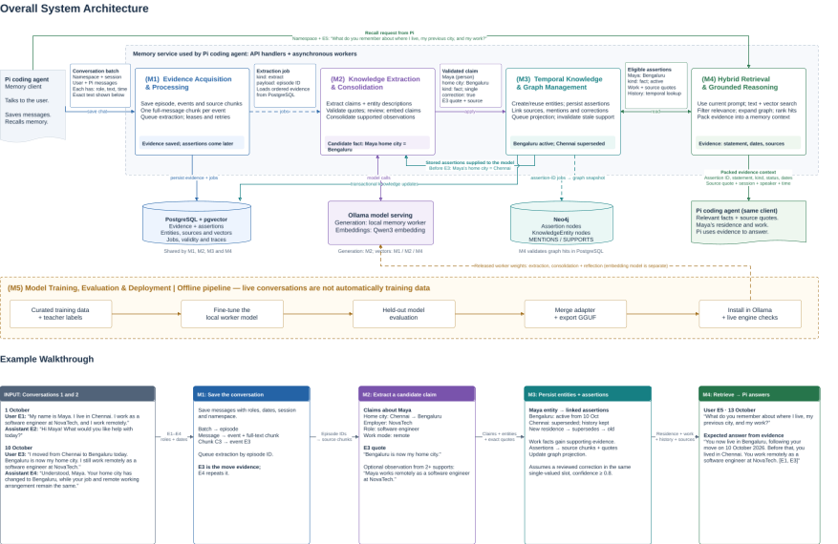

Slide 7
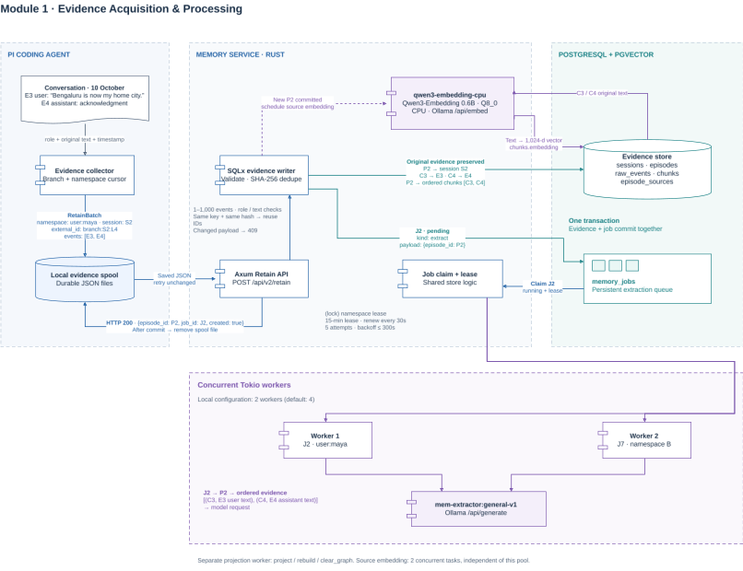

Slide 8
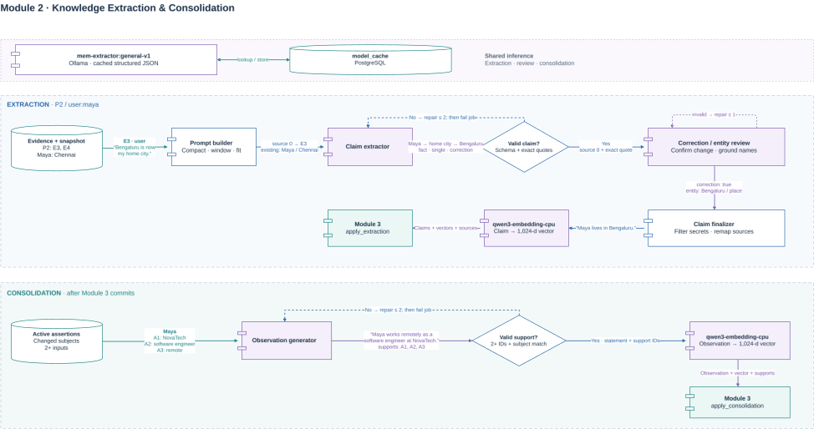

Slide 9
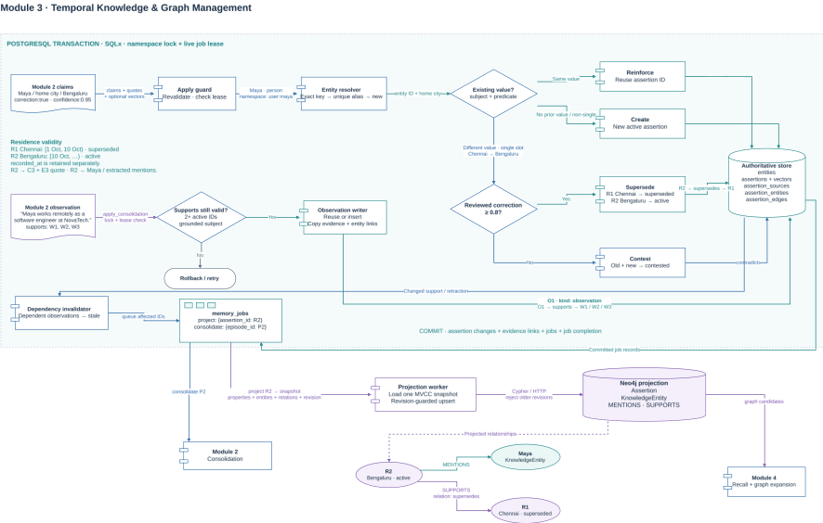

Slide 10
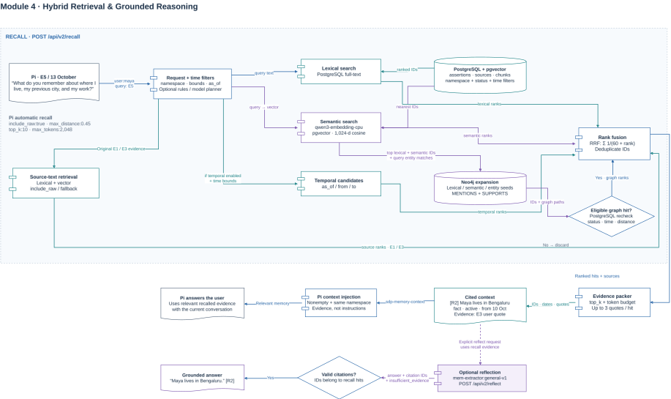

Slide 11
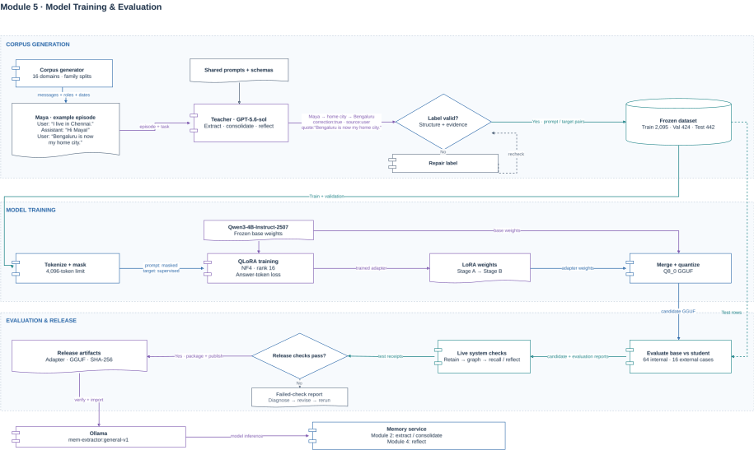

Slide 12
ALGORITHMS OR METHODOLOGY
Algorithm | Purpose
Priority-based context selection | Selects relevant existing facts that fit the extraction model’s input limit.
Entity resolution and memory versioning | Matches entities and handles repeated facts, corrections and conflicting values.
Memory consolidation and invalidation | Combines supporting facts and marks conclusions outdated when their evidence changes.
Hybrid retrieval and graph traversal | Finds memories through keywords, meaning, dates and connections.
Reciprocal Rank Fusion and context packing | Combines search rankings and fits selected memories into the available context.
Evidence-based answer generation | Produces answers from retrieved memories with checked source references.

Slide 13
ALGORITHMS OR METHODOLOGY
1. Priority-based context selection
Input: Existing facts, new messages and available input space.
IF all existing facts fit:
Return all facts.
Score facts by subject and value mentions in new messages.
Rank stronger matches first; use recency to break ties.
Use binary search to find the largest ranked subset that fits.
Return selected facts in their original order.
2. Entity resolution and memory versioning
Input: A new fact and stored memories.
Match entity by type and normalised name,
or a unique stored alias; otherwise create an entity.
IF the same fact exists:
Attach the new evidence.
ELSE IF no conflicting single-value fact exists:
Store the new fact as active.
ELSE IF explicit correction AND confidence ≥ 0.8:
Supersede the old fact; activate the new fact.
ELSE:
Mark both values as disputed.

Slide 14
ALGORITHMS OR METHODOLOGY
3. Memory consolidation and invalidation
Input: Active facts about the affected entities.
Ask the Extractor SLM to combine related facts into observations.
Require at least two distinct supporting facts.
Check support IDs and the observation’s subject.
Recheck that supporting facts are active before saving.
Store each observation with its evidence links.
WHEN a supporting fact changes or is retracted:
Recursively find dependent observations.
Mark them as stale.
4. Hybrid retrieval and graph traversal
Input: A question and optional date restrictions.
Resolve supported date phrases when planning is enabled.
Find candidates using keyword and vector searches.
Include time-based candidates when a date window exists.
Start graph traversal from matching facts and entities.
Expand through entity/support links for two bounded rounds.
Filter results by validity and any supplied relevance cutoff.
Return candidate lists for ranking.

Slide 15
ALGORITHMS OR METHODOLOGY
5. Reciprocal Rank Fusion and context packing
Input: Ranked candidate lists and a context budget.
FOR each memory:
Score = SUM[1 / (60 + rank)] across search lists.
Sort by decreasing score; break ties by memory ID.
FOR each ranked memory:
Build a block containing the fact and source evidence.
Add it if it fits; otherwise consider the next memory.
Stop when the requested number of memories is reached.
Return the packed context.
6. Evidence-based answer generation
Input: A question and retrieved memories.
IF no memories were retrieved:
Return “Insufficient evidence.”
Ask the extractor SLM to answer from the retrieved evidence.
Restrict citation IDs to the retrieved memories.
Check the response format and citation IDs.
Require citations when sufficient evidence is claimed.
Return the answer, or reject invalid output.

Slide 16
TOOLS AND TECHNOLOGIES
Tool | Role
Rust, Tokio, Axum and SQLx | Build the memory service, handle API requests, run background workers and access the database.
PostgreSQL 17 with pgvector | Store original messages, facts, correction history and processing jobs; support text and vector search.
Neo4j 5.26 | Store connections between facts and entities for graph-based retrieval.
Ollama | Run the memory model and embedding model locally.
Fine-tuned Qwen3-4B-Instruct-2507 | Extract facts, combine supported information and answer questions using retrieved evidence.
Qwen3-Embedding-0.6B | Convert messages, facts and queries into vectors for meaning-based search.
Pi agent harness | Capture session messages and add retrieved memory to the agent’s context.
React, TypeScript, Vite and Bootstrap | Build the dashboard, session controls and interactive memory graph.
Python, PyTorch, Transformers, PEFT and bitsandbytes | Prepare datasets and fine-tune the memory model using QLoRA.
lama.cpp and GGUF | Convert and quantize the trained model for deployment through Ollama.
Docker Compose, Caddy and ttyd | Run the supporting services and provide browser access to the application and Pi console.
Notes:
Versions come from Cargo.lock, rust-toolchain.toml and docker-compose.yml. Compose pins only the floating tag pg17, the running database reports pgvector 0.8.6, and Pi is locked at 1.0.2 while 0.85.0 is installed on the workstation.
The local Qwen2.5-14B extractor is In progress and not usable yet, because it passed validation on 2 of 10 test batches.
The development namespace user:dev was filled through POST /api/v2/retain with the project documents and source plus invented example facts. The distillation corpus holds 784 windows and 3,706 memories from 10 LoCoMo conversations, with 642 training windows from 8 of them and 142 held out from the other 2. LoCoMo [15] is released under CC BY-NC 4.0, so we still have to confirm that keeping its turns in the repository is allowed.

Slide 17
DATASET
Fine-tuning (Qwen3-4B-Instruct-2507) dataset
Fine-tuning task example
Assistant: “You could learn violin this winter.”
User: “No, that is not my plan. I am learning watercolor painting.”
Expected memory: The user is learning watercolor painting.
Dataset Aspect | Details
Scope | Started with coding conversations; expanded to 16 domains, including family, food, travel, education, work and software.
Data sources | Synthetic conversations generated by gpt-5.6-sol (teacher), cross checked via adversarial model and cleaned.
Dataset size | 2,961 task examples: 2,095 training · 424 validation · 442 test.
Instruct Tasks | Extract useful facts, combine related facts and answer questions using stored evidence.
External evaluation example (LoCoMo)
User (Caroline): Did you make that plate?
User (Melanie): Yes, during yesterday’s pottery class. I find pottery relaxing and creative.
User (Caroline): I haven’t tried pottery. I’ve been painting and recently finished a picture.
User (Melanie): What inspired your painting?
User (Caroline): A visit to the beach last week inspired it.
Expected Memory: Melanie made a plate in pottery class. Caroline painted a picture inspired by her beach visit.
External evaluation dataset
Dataset Aspect | Details
Data sources | LoCoMo: conversations spanning multiple sessions.
Dataset size | 16 conversation segments from 10 conversations, with 40 reference facts.
Purpose | Check whether the model extracts useful facts from conversations outside our training dataset.

Slide 18
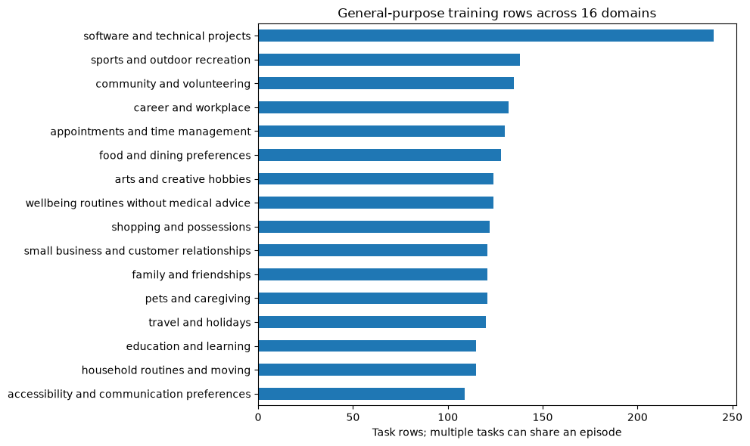
DATASET

Slide 19
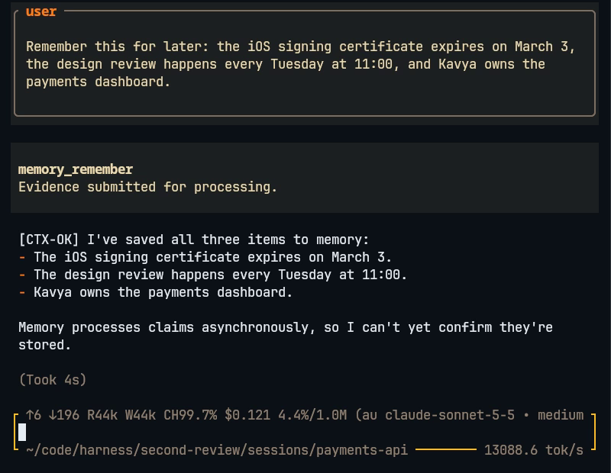
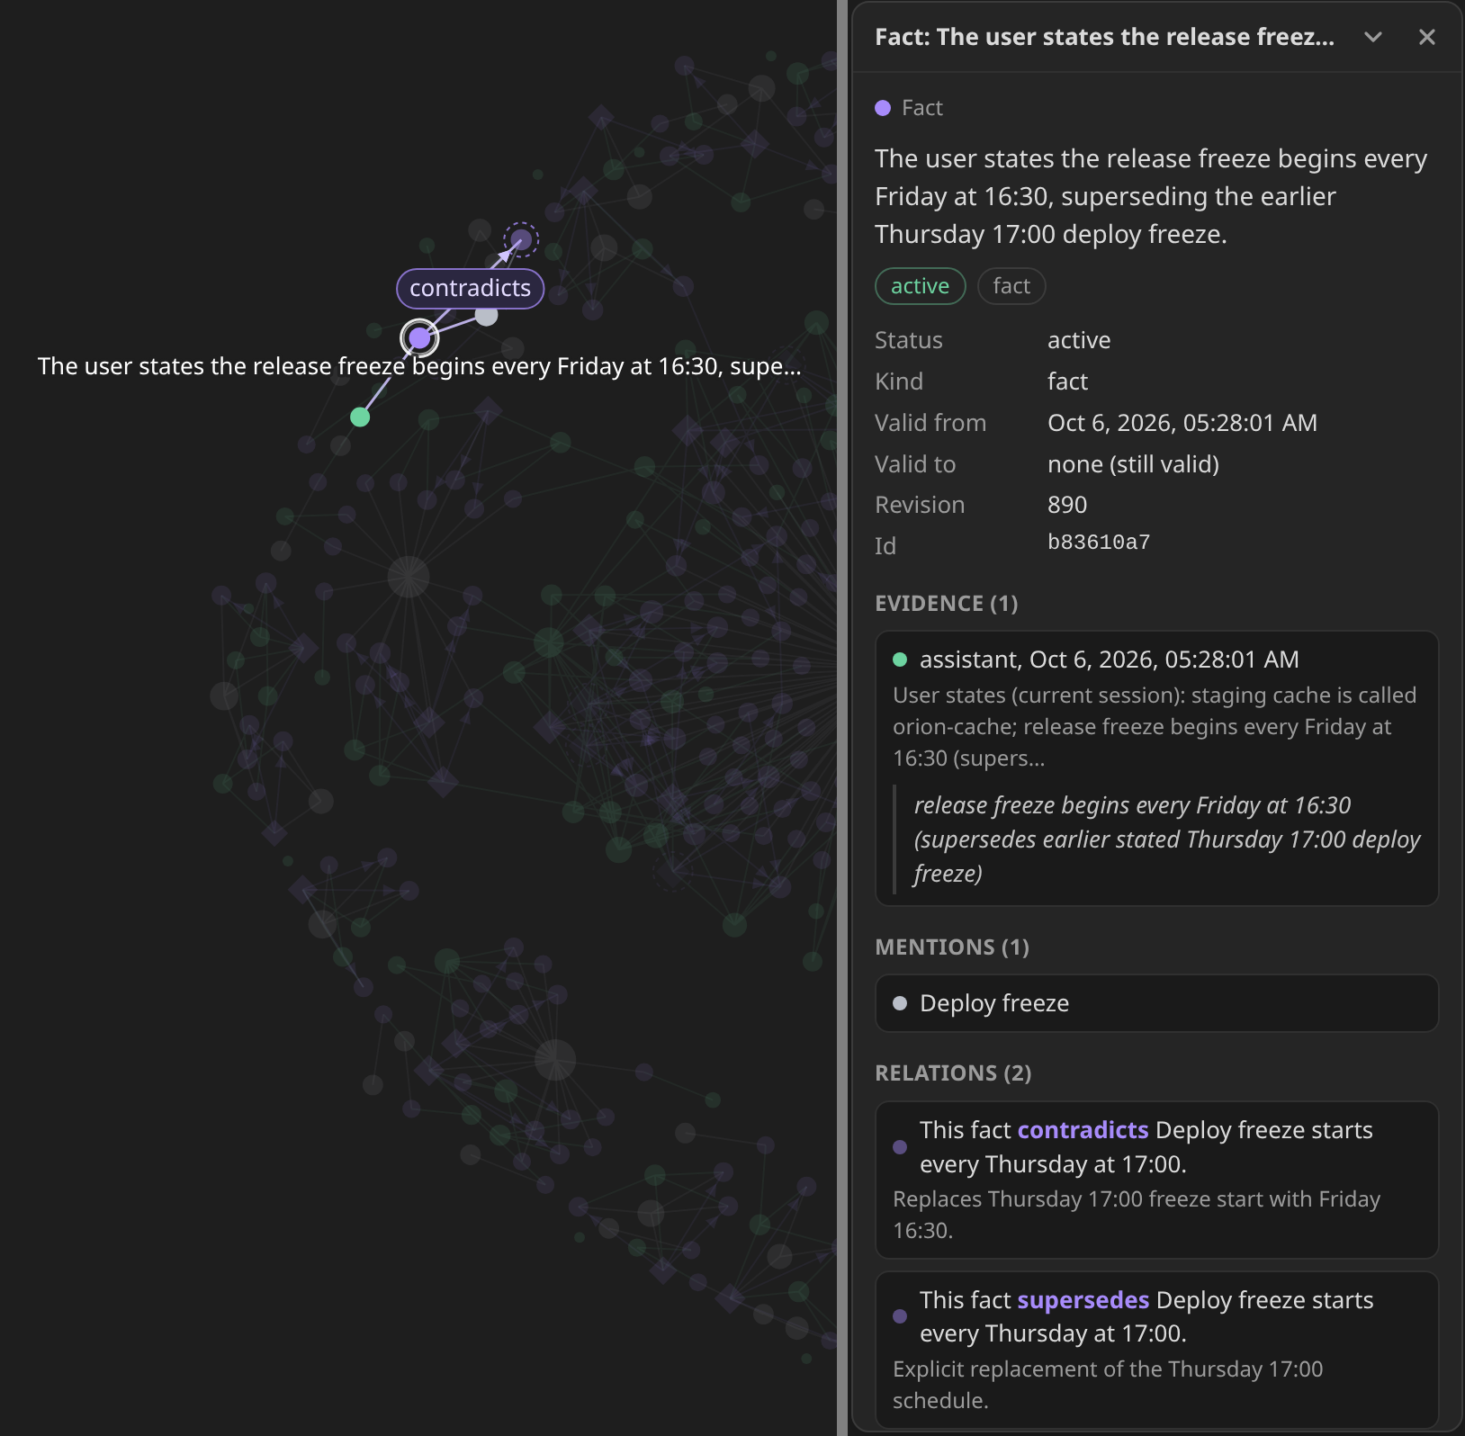
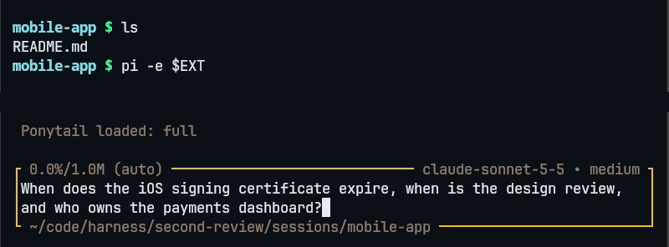
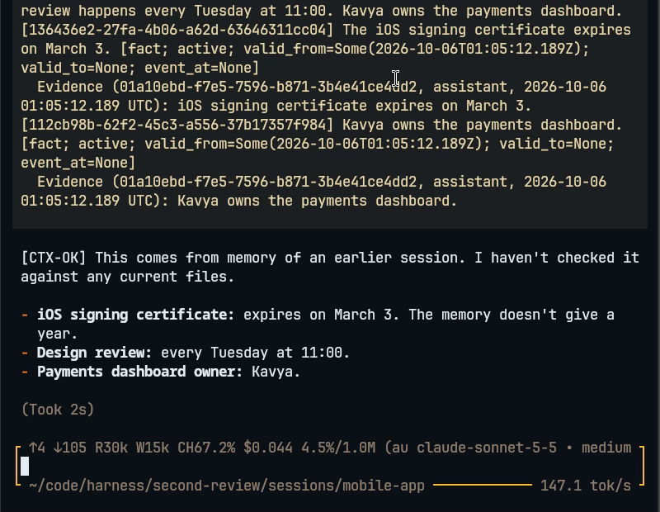
OUTPUT SCREENSHOTS
Figure 1. Recording information: In the first session, the user provides a certificate expiry date, a weekly review time and the dashboard owner’s name. These are submitted for memory processing.
Figure 2. Asking in a new session: The user opens a fresh session in another project directory and asks for the same details without repeating them.
Figure 3. Recalling earlier information: Memory from the first session is added to the agent’s context. It answers: March 3, Tuesday at 11:00, and Kavya.
Figure 4. Viewing a corrected fact: The graph shows Friday at 16:30 as the current release-freeze time, linked to the previous Thursday at 17:00 value. The side panel displays the supporting message and correction history.
Notes:
Figures 1 to 3 are real captures from one screen recording, pi-two-sessions-shared-memory.mp4, which is 86 seconds long and sits in the second-review folder next to this deck, so copy it to the presenting machine. It shows two real interactive Pi sessions with the memory extension, driven by real keystrokes.
In Figure 1 session 1 in payments-api is told three invented example facts and saves them with memory_remember, and in Figure 2 session 2 in mobile-app starts with no history. Figure 3 shows the memory the extension injected from session 1 and then the answer, and the CTX-OK marker comes from my own Pi instructions, not from the memory system.
Figure 4 is a screenshot of our graph page for user:dev, cropped to the selected fact and its details panel, where the release freeze fact supersedes and contradicts the earlier Thursday fact. A hosted copy runs Pi next to the same graph for a live demo, and the recording is the fallback.

Slide 20
RESULTS AND OBSERVATIONS
Memory carried a corrected instruction into a new session.
In a three-session coding demonstration, a program’s required output changed from milliseconds to microseconds. During the next session, the system supplied this correction to the agent without the user repeating it, and the agent preserved the changed requirement.
Updating one fact did not overwrite unrelated information.
A test conversation first recorded a person’s city and food preference, then changed only the city. The system answered using the new city, retained the old city as history, and still recalled the original food preference.
Stored facts could be traced to their original messages.
In the recorded database audit, all 142 stored source quotations matched their original text exactly. This makes the supporting evidence inspectable, although a matching quotation alone does not prove that the model interpreted it correctly.
Related facts were combined with supporting links.
The same audit found 8 combined observations, each linked to at least two supporting facts. In the separate model comparison, fine-tuning improved correct combined observations from 1/16 to 13/16.
Date handling remains a weakness.
Some relative dates were interpreted incorrectly. For example, “tomorrow” in a June 1 message became June 3. Overall improvement across long conversation histories is still unverified because the full benchmark is incomplete.
Notes:
Every row is one measurement on one machine, mostly on our own user:dev namespace, so none of this is a benchmark result. The two numbers that miss their target are the median context size and the latency when the date planner runs.
For latency we sent 300 requests at 10 per second, using 40 questions about the stored project. Four questions contain words such as when or before, which start a date-planning model call of 1.6 to 2.1 s, and without that call p95 is 72 ms.
The local model row replays 10 of the 18 document batches that the hosted model had already processed, and the 14B model passed 2 of them. LongMemEval-S has not been run, because it needs a 277 MB dataset and a lot of model use, so we cannot say yet that memory improves answers.

Slide 21
RESULTS AND OBSERVATIONS
Qwen3-4B was evaluated before and after fine-tuning on 64 unseen tasks across 16 domains.
Combining facts and answering questions improved, but the model missed more information during extraction.
On 16 external conversation samples, expected facts recovered also declined: 16/40 → 13/40.
Correct output format did not guarantee correct meaning. Date interpretation and unsupported claims remain issues.
Measurement | Before fine-tuning | After fine-tuning
Correctly combined related facts | 1/16 | 13/16
Correct answers using supplied evidence | 10/16 | 15/16
Expected facts recovered | 50/55 | 41/55
Extracted claims supported by the source | 92.1% | 90.5%
Corrections handled correctly | 8/8 | 8/8
Outputs passing format checks | 64/64 | 63/64
Qwen3-1.7B performed well on synthetic examples but struggled with natural conversations.
Only 18/33 extraction windows passed validation after refinement.
Main issues: incorrect source attribution, mismatched quotes and invalid IDs. These findings motivated broader training data, stricter output constraints and Qwen3-4B.
Notes:
Every row is one measurement on one machine, mostly on our own user:dev namespace, so none of this is a benchmark result. The two numbers that miss their target are the median context size and the latency when the date planner runs.
For latency we sent 300 requests at 10 per second, using 40 questions about the stored project. Four questions contain words such as when or before, which start a date-planning model call of 1.6 to 2.1 s, and without that call p95 is 72 ms.
The local model row replays 10 of the 18 document batches that the hosted model had already processed, and the 14B model passed 2 of them. LongMemEval-S has not been run, because it needs a 277 MB dataset and a lot of model use, so we cannot say yet that memory improves answers.

Slide 22
STATUS AND PENDING WORK
Module | Implemented functionality | Available evidence | Pending work | Status
M1 Evidence Acquisition & Processing | Captures Pi messages and tool results; saves evidence in PostgreSQL; handles duplicate requests, offline queuing and background jobs. | Pi integration tests cover capture, retries and namespace changes. Saved runs confirm evidence retention. | Add API access control and verify backup/restore procedures. | Implemented
M2 Knowledge Extraction & Consolidation | Extracts facts with source quotes; reviews correction intent and entity mentions; generates embeddings and combines supported facts into observations. | Extraction and review tests; model evaluations; saved live checks for facts and supported observations. | Improve missed-fact coverage, date interpretation and source attribution. Measure the added review step’s quality and latency. | Implemented; quality improvements pending
M3 Temporal Knowledge & Graph Management | Resolves entities, reinforces facts, handles corrections and conflicts, preserves history, invalidates dependent observations and updates Neo4j. Includes graph rebuild and namespace deletion. | Integration tests cover validity intervals, conflicts, dependency invalidation and graph cleanup. Saved live checks confirm correction history and projection. | Extend evaluation to ambiguous updates, aliases and longer correction histories. | Implemented; broader validation pending
M4 Hybrid Retrieval & Grounded Reasoning | Combines text, vector, temporal and graph retrieval; ranks and packs cited evidence; injects relevant memory into Pi. Supports optional cited reflection. | Retrieval tests and saved live checks for source-backed recall and cited answers. | Complete LongMemEval-S, compare graph/consolidation ablations and report retrieval quality and latency. | Implemented; full benchmark pending
M5 Model Training & Evaluation | Fine-tuned Qwen3-4B using QLoRA; exported Q8 GGUF; integrated the model with Ollama and published the release. | Training receipts; 64 internal tasks and 16 external conversation windows; saved deployment checks. | Address extraction regression and temporal errors; expand external testing and independent human review. | Training and integration complete; evaluation ongoing
Notes:
Completed means the feature is implemented in code, and it does not mean it has been measured to be good. The results slide shows which modules have numbers so far and which have none.
M4 covers jobs, consolidation, traces, metrics and the LongMemEval runner, and decay, re-embedding and backup are Planned. The local 14B extractor is In progress because it passed validation on only 2 of 10 test batches.
The student is In progress because we have the pipeline, corpus and scores but not the 139 MB adapter in the repository, and nothing serves it yet. Serving it needs the LoRA weights combined with the base model, a GGUF conversion, ollama create and a schema decision, since the student learned the V1 style schema.

Slide 23
REFERENCES
[1] N. F. Liu, K. Lin, J. Hewitt, A. Paranjape, M. Bevilacqua, F. Petroni, and P. Liang, "Lost in the middle: How language models use long contexts," Trans. Assoc. Comput. Linguist., vol. 12, pp. 157-173, 2024. [Online]. Available: https://aclanthology.org/2024.tacl-1.9/
[2] D. Wu, H. Wang, W. Yu, Y. Zhang, K.-W. Chang, and D. Yu, "LongMemEval: Benchmarking chat assistants on long-term interactive memory," in Proc. Int. Conf. Learn. Represent. (ICLR), 2025, pp. 86809-86836. [Online]. Available: https://proceedings.iclr.cc/paper_files/paper/2025/hash/d813d324dbf0598bbdc9c8e79740ed01-Abstract-Conference.html. Also arXiv:2410.10813.
[3] C. Packer, S. Wooders, K. Lin, V. Fang, S. G. Patil, I. Stoica, and J. E. Gonzalez, "MemGPT: Towards LLMs as operating systems," arXiv preprint arXiv:2310.08560, Oct. 2023 (rev. Feb. 2024). [Online]. Available: https://arxiv.org/abs/2310.08560
[4] P. Rasmussen, P. Paliychuk, T. Beauvais, J. Ryan, and D. Chalef, "Zep: A temporal knowledge graph architecture for agent memory," arXiv preprint arXiv:2501.13956 [cs.CL], Jan. 2025. [Online]. Available: https://arxiv.org/abs/2501.13956
[5] P. Chhikara, D. Khant, S. Aryan, T. Singh, and D. Yadav, "Mem0: Building production-ready AI agents with scalable long-term memory," in Proc. 28th Eur. Conf. Artif. Intell. (ECAI), Oct. 2025, ser. Frontiers in Artificial Intelligence and Applications, vol. 413. IOS Press, 2025, pp. 2993-3000, doi: 10.3233/FAIA251160. Also arXiv:2504.19413 [cs.CL].
[6] S. Daga, S. Sreedhar, and D. Shah, "LongMemEval," supermemory research (vendor-hosted evaluation report on LongMemEval-S, not peer reviewed), May 2026. [Online]. Available: https://supermemory.ai/research/longmembench/ (accessed Oct. 6, 2026).
[7] C. Latimer, N. Boschi, A. Neeser, C. Bartholomew, G. Srivastava, X. Wang, and N. Ramakrishnan, "Hindsight is 20/20: Building agent memory that retains, recalls, and reflects," arXiv preprint arXiv:2512.12818 [cs.CL], Dec. 2025. [Online]. Available: https://arxiv.org/abs/2512.12818
[8] Neo4j, Inc., "Query the database," in Neo4j HTTP API Manual, Version 5 (page marked deprecated in 5.26). Neo4j, Inc., 2026. [Online]. Available: https://neo4j.com/docs/http-api/5/query/ (accessed Oct. 6, 2026).
[9] M. Zechner et al., "pi: AI agent toolkit (unified LLM API, agent loop, TUI, coding agent CLI)," package @earendil-works/pi-coding-agent, v1.0.2 (version locked by the project's package-lock.json; latest is 1.0.4 on Oct. 6, 2026), GitHub repository, 2026. [Online]. Available: https://github.com/earendil-works/pi (accessed Oct. 6, 2026).
[10] PostgreSQL Global Development Group, "PostgreSQL 17 Documentation, Chapter 12: Full Text Search (Sections 12.2.2, 12.3.2, 12.3.3, 12.9) and Section 64.4: GIN Indexes," PostgreSQL 17.11 documentation, 2026. [Online]. Available: https://www.postgresql.org/docs/17/textsearch.html (accessed Oct. 6, 2026).
[11] A. Kane et al., "pgvector: Open-source vector similarity search for Postgres," source code repository and README (0.8.6 installed in the test database, v0.8.7 tag also released), Oct. 2026. [Online]. Available: https://github.com/pgvector/pgvector (accessed Oct. 6, 2026).
[12] G. V. Cormack, C. L. A. Clarke, and S. Büttcher, "Reciprocal rank fusion outperforms Condorcet and individual rank learning methods," in Proc. 32nd Int. ACM SIGIR Conf. Research and Development in Information Retrieval (SIGIR '09), Boston, MA, USA, Jul. 2009, pp. 758-759, doi: 10.1145/1571941.1572114.
[13] Y. Zhang, M. Li, D. Long, X. Zhang, H. Lin, B. Yang, P. Xie, A. Yang, D. Liu, J. Lin, F. Huang, and J. Zhou, "Qwen3 Embedding: Advancing text embedding and reranking through foundation models," arXiv preprint arXiv:2506.05176 [cs.CL], Jun. 2025. [Online]. Available: https://arxiv.org/abs/2506.05176
[14] T. Dettmers, A. Pagnoni, A. Holtzman, and L. Zettlemoyer, "QLoRA: Efficient finetuning of quantized LLMs," in Advances in Neural Information Processing Systems 36 (NeurIPS 2023), 2023, pp. 10088-10115, doi: 10.52202/075280-0441. Also arXiv:2305.14314.
[15] A. Maharana, D.-H. Lee, S. Tulyakov, M. Bansal, F. Barbieri, and Y. Fang, "Evaluating very long-term conversational memory of LLM agents," in Proc. 62nd Annu. Meeting Assoc. Comput. Linguistics (Volume 1: Long Papers), Bangkok, Thailand, Aug. 2024, pp. 13851-13870, doi: 10.18653/v1/2024.acl-long.747. [Online]. Available: https://aclanthology.org/2024.acl-long.747/ (preprint: arXiv:2402.17753)
Notes:
All entries were checked against their primary sources on 2026-10-06.
Peer reviewed: Liu et al. (TACL 2024), Wu et al. (ICLR 2025), Maharana et al. (ACL 2024), Chhikara et al. (ECAI 2025), Cormack et al. (SIGIR 2009) and Dettmers et al. (NeurIPS 2023).
Preprints: Packer et al., Rasmussen et al. (written by Zep staff), Latimer et al. (vendor affiliated) and Zhang et al.
PostgreSQL and Neo4j are official documentation, and pgvector and Pi are software repositories.
Reference [6] is a vendor hosted web report and is not peer reviewed, and its numbers are vendor reported and were not reproduced by us, so the deck cites it for mechanism only.

