Slide 1


LONG-TERM MEMORY ENGINE FOR AI AGENTS
IN RUST
Department of Information Technology
College of Engineering, Guindy
Anna University, Chennai-25
Second Project Review
GUIDE:
DR. BAMA SRINIVASAN
DEPARTMENT OF INFORMATION TECHNOLOGY
CEG, ANNA UNIVERSITY
TEAM MEMBERS:
M. KRITHIKRAJ, 2023115004
ALSTON S, 2023115006
ARYAN I, 2023115021
HARI SRINIVASAN, 2023115022
Notes:
We are Team 13, and this is our second review of the Long-Term Memory Engine for AI agents, written in Rust.
The engine stores what an agent is told, keeps every fact tied to its source, and brings the right facts back in a later session.
We will go through the problem, what changed since the first review, the design, the numbers we measured and what is still left to do. Pi in this deck is the Pi coding agent, not a Raspberry Pi.

Slide 2
PROBLEM STATEMENT
1
WHY IT IS HARD
2
ENGINEERING STATEMENT
Context limits. A full history costs a lot of tokens, and models tend to miss facts in the middle of a long input [1].
Forgetting. A new session starts empty unless the old one was stored.
Corrections. A new value should replace the old one without erasing it.
Time. A question like “what did I decide last month” needs dated facts [2].
Provenance. An answer should point to the evidence it came from.
Input: an append-only stream of interaction events (user turns, assistant turns, tool results), each with a timestamp.
Keep: the raw evidence, and every fact derived from it with a validity interval.
Return: at query time, a context within a token budget. Each item names its source evidence and says whether it is current.
3
WORKED EXAMPLE
Session 1: “I deploy on Fridays.”
retain
Memory engine
Keeps both values
Ends the Friday interval
Stores a source quote
Expected context
Current: Tuesdays
source: session 3
History: Fridays, until session 3
source: session 1
Answer: Tuesday
Session 3: “I deploy on Tuesdays now.”
retain
cited context
Query: “Which day do I deploy?”
recall request
Notes:
An LLM call has no memory of earlier calls, so an agent that works over many sessions needs a store of what was said, what changed and where each fact came from. Lost in the Middle found that models often answer worse when the relevant passage sits in the middle of a long input [1].
LongMemEval lists five things a memory system has to do: extract information, reason across sessions, reason about time, handle updates and say when it does not know [2]. The boxed statement is the problem we build for: raw events as evidence, facts with a validity interval, and a context that fits a token budget where every item shows its quote and its status.
The Friday and Tuesday example shows the behaviour we require. Our scripted Pi check tests the same thing with a fact that is told and then corrected.

Slide 3
LITERATURE SURVEY: MEMORY SYSTEMS
Work and source type | Mechanism | Evidence as reported by the source | Limitation | Relevance here
MemGPT, later Letta, Packer et al., 2023 [3]. Preprint. | Prompt split into main context and external recall and archival storage. The model moves data between them with function calls. | Authors’ own tests on OpenAI models. Deep memory retrieval: 92.5% with GPT-4 plus MemGPT against 32.1% for GPT-4 reading a summary. | Memory edits depend on the model’s function calling. No latency or token cost figures in the paper. | Origin of memory kept outside the prompt. Here, service code applies the version rules to claims the model extracts.
Zep and Graphiti, Rasmussen et al., 2025 [4]. Preprint, vendor-authored. | Temporal knowledge graph of episodes, entities and facts. Each fact has valid and invalid times, and a contradicting fact ends the old one. | Authors’ own LongMemEval run: 71.2% with gpt-4o against 60.2% for the full 115k-token history. | Single configuration, no repeated runs. The authors call their other benchmark (DMR) weak. Needs a graph database. | Closest design for validity intervals. We also run Neo4j, but only as a projection we can rebuild.
Mem0, Chhikara et al., 2025 [5]. Peer reviewed (ECAI 2025), authors are Mem0 staff. | An LLM extracts candidate facts, compares each with the nearest stored memories, then chooses add, update, delete or no-op. | LoCoMo only, authors’ run. Judge score 66.9 for Mem0, 72.9 for the full history, which had a p95 latency of 17 s against 1.4 s. | One benchmark and an unnamed judge model. The open-source release has since dropped update, delete and graph memory. | Same extract then compare idea. Here the update rule is code (cardinality and correction flag), not an LLM choice per fact.
Supermemory, Daga et al., 2026 [6]. Company report, not peer reviewed. | Atomic memories linked to source chunks, with updates, extends and derives links and two timestamps. | Reports LongMemEval-S results by category from its own run. Numbers not repeated here. | Engine source closed. The headline depends on the answer model, and the metric “aggregation” is not defined. | Named as a design influence in our repository. Used for mechanism only.
Hindsight, Latimer et al., 2025 [7]. Preprint, vendor-affiliated. | Retain, recall and reflect operations. Recall fuses four retrieval strategies by rank fusion and packs to a token budget. | Reports LongMemEval and LoCoMo results run by the authors. Numbers not repeated here. | Not peer reviewed. No ablation or variance found, and the token budget used is not stated. | Named design influence. We have no reranker.
Notes:
MemGPT is a preprint, and we found no peer reviewed version [3]. Letta grew out of it, and the current Letta documentation calls the original memory blocks legacy, so the row describes the paper and not the product.
Zep and Mem0 report their own results, and the authors of both work for those companies [4], [5]. Zep reports 71.2% on LongMemEval with gpt-4o against 60.2% for the full history, and Mem0 used only LoCoMo, where the full history scored higher than Mem0 on the judge metric.
We cite Supermemory and Hindsight for how they work only, and we do not repeat their numbers [6], [7]. The five works use different benchmarks, judges and models, so their scores cannot be ranked against each other.

Slide 4
CHALLENGES AND ISSUES IDENTIFIED
1
WHAT WE DID WRONG IN THE DESIGN
2
WHAT WENT WRONG WHEN WE RAN IT
We treated memory as plain chunks of text and searched them, with no context around each fact.
Chunk search cannot tell that a new fact replaces an old one, so old and new values came back together.
Nothing linked related facts, so a question that needs two connected facts could find only one of them.
We had no way to show where an answer came from.
Our first small distilled model was trained on the old memory format, so we retrained it for the fact format the graph uses.
Memory was per repository, so a session in another directory saw nothing.
We re-sent the whole chat every turn: 4 turns stored 32 events and only 14 were different.
A fresh session right after the first got no memory, because we embedded only after extraction.
A bad model reply was cached, so every retry repeated it and later jobs got stuck behind it.
The model re-extracted the old Friday value as new, and the current Tuesday value was lost.
Recall had no distance limit, so about 2,000 tokens of unrelated text went in before almost every prompt.
The date planner called a model on words like “when”, which took 4.46 s and 19.28 s on two queries.
The default worker had no credentials, and Ollama silently cut 15 of 18 batches at its 4,096 token default.
3
WHAT THE KNOWLEDGE GRAPH FIXED
Facts are nodes with links (supersedes, contradicts, extends). A correction keeps the old fact as history. Every fact points to its exact quote and raw event, and recall follows links to related facts.
Prof. Vijaylaxmi Ma’am’s guidance pointed us to the knowledge graph.
Notes:
In the First Review we treated memory as plain chunks of text that we searched by keywords and vectors, with no context around a fact. So we could not tell which fact was newer, what it was linked to, or where it came from.
The right column lists what went wrong when we actually ran it on 2026-10-06, and each one was reproduced against a live service. Most of them are fixed or reduced now, but repeated facts, memory output fed back as input and a misleading health check are still open.
The knowledge graph fixed the design problems, because facts are linked to each other and to their quotes, and it helped us a lot while building it. Vijaylaxmi Ma’am’s guidance pointed us towards the graph.

Slide 5
PROJECT OBJECTIVES
Objective | Target | Measured | Status
Provenance | 100% of stored memories pass an automated provenance check. | 323 of 323 facts in user:dev have a source, and every quote is found word for word in its stored text. | Completed
Correct version history | Zero incorrect active versions on held-out update cases. | 0 of 106 single-value slots hold two active facts, and the scripted Pi check (told, corrected, asked again) passes. There is no held-out update set yet, and only 2 facts are superseded. | In progress
Small local extractor | Student F1 within 5 points of the teacher at one third of its latency. | Retrained as Qwen3-4B and served by Ollama as the worker. Internal test: consolidation 1 of 16 to 13 of 16, reflection 10 of 16 to 15 of 16, but extraction coverage fell from 50 of 55 to 41 of 55. The 0.398 F1 was for the old 1.7B model. | In progress
Retrieval latency | p95 retrieval at most 300 ms at 10 QPS. | Date planning off: p50 58 ms, p95 72 ms, p99 75 ms (300 requests, 0 errors). With the date planner in the path p95 is 1,870 ms, because 4 of 40 test questions start a model call of 1.6 to 2.1 s. | In progress
Context size | Median returned context at most 1,000 tokens. | Median 1,942 tokens, p95 2,041, with the 2,048 token budget Pi sends (characters divided by four). Target not met. | In progress
Reproducibility | Models, prompts and configuration pinned. | Worker model pinned to a Hugging Face revision and SHA-256 checksum. The Docker image tag still floats. | In progress
Cross-session memory in Pi (new) | A fact told in one Pi session is recalled in a fresh session in another directory. | 14 of 14 scripted checks in each of 4 runs (claude-haiku-4-5 or claude-sonnet-5-5 through Pi). One scenario, one machine. | Completed
Notes:
The first six rows are the objectives we set in the First Review, and the Pi row is the only one we added. Reproducibility had no number in the First Review, so we describe it in words.
Every number in the Measured column comes from one machine on 2026-10-06, mostly from our own user:dev namespace with 323 facts, so treat it as one-machine measurements. The two targets we miss are the median context size and the latency when the date planner runs.

Slide 6
CHANGES SINCE FIRST REVIEW
Area | First Review | Now
Stores | One PostgreSQL 17 database, no graph store | PostgreSQL 17 with pgvector, plus a Neo4j 5.26 graph projection
API | Four routes: session events, request status, context, delete | /api/v1 with 8 routes and /api/v2 with 13 (retain, recall, reflect, jobs, graph)
Write path | One transaction, then 202 and a request id | Retain stores episode, chunks and an extract job in one transaction. Workers extract later.
Extraction | Distilled Qwen3-1.7B student on the serving path | Fine-tuned Qwen3-4B worker (mem-extractor) served by Ollama, with exact-quote checks and two repairs. Pi is only the coding agent.
Retrieval | Full-text and vector search, rank fusion | Lexical, semantic, temporal and graph searches, rank fusion (k = 60), raw evidence fallback, optional distance cutoff
Agent integration | None | Pi extension: spool, retain, recall, injected context
Graph view | None | Live page at /graph that draws the memory of one namespace from the real data
Tests | None reported | Rust 83, Python 5 and TypeScript 9, all passing (slide 15)
Observability | Request traces, OpenTelemetry | Traces in PostgreSQL, /healthz, /metrics, JSON logs
Claims that no longer hold
First Review: no second store. Now: PostgreSQL plus a Neo4j 5.26 graph projection.
First Review: the student is Qwen3-1.7B. Now: it is Qwen3-4B, retrained on the fact format and wired in as the worker.
First Review: no memory data leaves the machine. Now: extraction runs locally, but Pi sends the coding chat to its own hosted model.
Notes:
The First Review design was one PostgreSQL store with a distilled Qwen3-1.7B doing the extraction. Since then we added a graph projection, background workers and a Pi extension, and the next slide redraws the architecture to match.
Three First Review claims changed: there is a second store, which is Neo4j 5.26 as a projection we can rebuild, the student is now a retrained Qwen3-4B instead of Qwen3-1.7B and it runs as the worker through Ollama, and Pi still sends the coding conversation to its own hosted model even though extraction is local.
The route list in the First Review, with its 202 status and its delete route, does not match the code: V1 has 8 routes, V2 has 13, and retraction replaces deletion.

Slide 7
REFINED SYSTEM ARCHITECTURE
Coding sessions
prompts, output
AI agent in Pi
memory extension
Developer
reviewer, browser
OFFLINE TRAINING
INTERFACE
In progress
events
context
browser
not in the request path
REST API, /api/v1 and /api/v2
v2 retain, recall, reflect; /swagger-ui, /healthz, /metrics
fetch JSON
Console UI
ui.html at /
Teacher LLM, hosted
labels the windows
recall
retain
status, traces
APPLICATION
RETRIEVAL
INGESTION
M4 Maintenance and evaluation
jobs, traces, metrics
memory labels
M3 Hybrid retrieval
four arms, RRF
M1 Service and persistence
extract job
M2 Extraction and embeddings
Silver corpus
784 windows, 3,706 memories
claims
decay, backup
prompts, text
claims, vectors
training pairs
DATA AND MODELS
Cypher, 2 hops
episode, jobs
MODEL PROVIDERS, VIA TRAITS
QLoRA distillation
Qwen3-4B, 4-bit NF4
Pi, hosted model
coding agent only
Ollama, local
embedder, worker
Neo4j 5.26
knowledge graph, rebuildable projection
candidate SQL
PostgreSQL 17 with pgvector
evidence, assertions, jobs, traces
SQLx pool of 10
GGUF
Azure OpenAI
hosted, In progress
mem-extractor
local, the worker
model
Model artifact
GGUF on Hugging Face
project, Cypher
Implemented in code
In progress
Planned
Actor, not code
Key box
Labelled data or call
Notes:
This is the architecture figure from the First Review, redrawn to match the code as it is now. The routes are /api/v1 and /api/v2, PostgreSQL is the authoritative store, and Neo4j is a second store that we can rebuild from it [8]. Coding sessions are the input: the developer's prompts and the tool output of each session go to the memory extension in Pi, which sends them on as events.
On the way in, retain stores an episode, its chunks and an extract job in one transaction, a worker turns the model output into versioned facts, and a projection job copies them to Neo4j. On the way out, recall runs lexical, vector, temporal and graph searches and fuses them by rank, and the next slide draws both paths step by step.
Offline training is separate and not in the request path: a hosted teacher labels windows and we train Qwen3-4B with QLoRA. The trained model is published as a GGUF and served through Ollama as mem-extractor, which is the worker. Pi is the coding agent [9] and the Azure OpenAI adapter is hosted.

Slide 8
INGESTION AND RETRIEVAL PATHS
1
INGESTION PATH
Pi extension
hooks, local spool
events
POST /api/v2/retain
1 to 1,000 events
request
One transaction
episode, chunks, extract job
episode id
Early embedding
Ollama chunk vectors,
after the reply
episode id
extract job
Worker queue
memory_jobs, 15 min lease
claimed job
Extraction worker
mem-extractor, Ollama,
local
JSON reply
Validate and repair
schema, exact quotes,
2 repairs
valid claims
Resolve versions
one active value per slot,
queues the Neo4j job
repair prompt
2
RETRIEVAL PATH
AI agent in Pi
before_agent_start hook and memory_recall tool
inject the context as a message
recall request
POST /api/v2/recall
bounds, date window if
temporal, embeds the query
vector, window
Candidate arms
lexical, semantic, temporal, graph
raw text if extraction pending
candidates
Validity filter
active or contested, or the
interval at as_of
valid ids
context
Response
context, trace id, reasons,
trace rows saved
packed blocks
Token-bounded packer
ceil(characters / 4),
whole blocks, up to 3 quotes
ranked hits
Rank fusion
RRF, k = 60, no reranker,
ties broken by id
Implemented in code
Actor, not code
Key box
Labelled data or call
Notes:
The Pi extension writes each batch to a spool file and sends it to POST /api/v2/retain, which stores one episode, its events, one chunk per event and an extract job in a single PostgreSQL transaction. A background task then embeds the new chunks with Ollama, and workers claim jobs under a 15 minute lease and retry up to 5 times.
The extraction prompt carries up to 80 known facts and the model must answer with JSON claims that have exact quotes, then version resolution queues a Neo4j project job [8].
Recall checks its bounds, plans a date window only for time questions, embeds the query locally and runs four searches of at most 40 ids each, plus raw text for evidence that is still waiting for extraction. Lexical search uses a GIN index [10], vector search an HNSW index [11], and fusion is reciprocal rank fusion with k = 60 [12] and no reranker. The latency of this path is on slide 14.

Slide 9
WORKER ARCHITECTURE
1
JOB CHAIN FOR ONE EPISODE
Retain
episode, extract job
episode
Extract job
claimed under a lease
prompt
Student model
mem-extractor on Ollama
reply
Validate and repair
exact quotes,
2 repairs
job
valid claims
Store claims
supersede or reinforce
consolidate
Consolidate job
same model reads facts,
writes observations
facts
Project job
entities and edges
written to Neo4j
edges
Graph and recall
live graph page,
graph hops at recall
project job
2
LEASES AND FAILURES
Job lease
one attempt owns a job,
renewed every 30 s
Namespace lease
one episode at a time
per namespace
Parallel namespaces
default 4, at most 8
Token fencing
late work cannot commit
on error
Pi stays out
it is not the worker
No fallback model
a bad reply fails the job
Retry
failure kept on the job
Implemented in code
Actor, not code
Key box
Labelled data or call
Notes:
Retaining a conversation and interpreting it are separate jobs. Retain stores the episode and queues an extract job in one transaction. A worker claims that job under a lease, sends windows of about 2,800 tokens to mem-extractor on Ollama, and checks every reply against the engine's rules, with at most two repairs. Valid claims are stored as facts: a new value in a single-value slot supersedes the old one, and the old one stays as history. Storing an episode queues a consolidate job, where the same model combines two or more facts into observations, and a project job that copies entities and edges to Neo4j. A job lease renewed every 30 seconds lets one attempt own a job, and a namespace lease keeps one episode per namespace at a time, so four namespaces run in parallel by default. A late attempt that lost its lease cannot commit. There is no fallback model: if the model is unreachable or never gives a valid reply, the job fails and is retried.

Slide 10
DATA MODEL AND KNOWLEDGE GRAPH
1
TABLES AND LINKS
3
GRAPH PROJECTION
raw_events
role, content, occurred_at
metadata, processing_state
entities, aliases
type, name, normalized_name
alias with its grounding chunk
subject_id
assertions
slot_key: subject_id::predicate
cardinality: single, multiple, event
status: active, superseded, contested, stale, retracted
valid_from, valid_to: belief applies
event_at: event happened
recorded_at: engine stored it
PostgreSQL 17, authoritative
Entities resolve by exact type and name, else one grounded alias, never by similarity. Every update raises a revision.
raw_event_id
chunks
one per event, never split
embedding, search_vector
assertion_sources
assertion_id, chunk_id, quote
quote is exact chunk text
assertion id, revision
chunk_id
assertion_id
Neo4j 5.26, projection
Assertion, KnowledgeEntity and MemoryNamespace nodes, MENTIONS and SUPPORTS edges. A write with an older revision is dropped.
chunk_id
from_id, to_id
episodes
one retain call, idempotent
episode_sources keep order
assertion_edges
supersedes, extends, contradicts, causes
supports: observation to its facts
derives: no writer, Status to confirm
candidate ids, paths
Graph arm in recall
Seeds: top 5 lexical, top 5 semantic, 10 by entity name. Two expansion rounds, 200 rows at most. PostgreSQL checks every id again.
2
VERSION CHAIN FOR ONE SLOT
deploys on: Friday
status: superseded, valid_to: session 3
valid_from: session 1
supersedes
deploys on: Tuesday
status: active, valid_to: empty
valid_from: session 3
Every fact traces back to its exact quote, chunk and raw event. Graph results are ranked by Neo4j row order, and we have not measured what the graph search adds.
Notes:
Arrows point from the table that holds the foreign key to the table it references, and evidence is never rewritten. Each event is one chunk with no splitting, and an episode is the events from one retain call, keyed by UNIQUE(namespace, external_id).
An assertion has four time columns: valid_from and valid_to say when a belief applies, event_at says when a dated event happened, and recorded_at says when the engine stored it. A partial unique index allows one active assertion per single-valued slot, so a correction closes the old interval and keeps the old row.
PostgreSQL is authoritative, and Neo4j [8] is a projection we can replay, with a revision number that rejects older writes. Recall seeds the graph with at most 20 assertions, expands two rounds, and checks every returned id in PostgreSQL again before rank fusion.

Slide 11
PI INTEGRATION
PI CODING AGENT [9]
EXTENSION IN INTEGRATIONS/PI
MEMORY SERVICE, 127.0.0.1:8080
Ingestion hooks
tool_result, agent_settled
tool output, new messages
hook events
Local spool
temp file, fsync, rename
one file per batch
retain batch
POST /api/v2/retain
episode, chunks, job,
one transaction
Retrieval hook
before_agent_start adds
message sdp-memory-context
prompt text
Recall client, tools
max_tokens 2048, top_k 10
memory_recall, memory_remember
recall request
POST /api/v2/recall
context, trace_id,
degraded_reasons
context text
context + trace id
What | How it works
Namespace | One per user, user:<login>, shared by all directories
Retention | New messages only, tracked by a cursor entry
Automatic recall | Date planner off, 15 s timeout, raw text included, max_distance 0.45
Tests | Completed, 9 TypeScript tests
INSTALL, PRIVACY AND CHECKS
Not decided yet: a global install with pi install, and whether every session may be retained.
Not retained: the injected message and the results of the memory tools.
Command /memory-status flushes the spool and shows job state.
Scripted check, 14 checks per run: 14 of 14 in four runs (claude-haiku-4-5 or claude-sonnet-5-5 through Pi). One fact, one machine.
Recall cutoff: Completed
Automatic recall passes max_distance 0.45. The memory_recall tool passes none.
Notes:
Pi here is the coding agent, not a Raspberry Pi, and our extension runs inside it on five hooks that recall before a prompt and queue new text afterwards [9]. Pi worker processes run with MEMORY_WORKER=1, so extraction never retains its own output. Delivery is at least once with idempotency: a spool batch is deleted only after retain succeeds, and the server returns the existing episode when the content hash matches.
Namespaces are per user and not per directory, which is why a fact told in payments-api can be recalled from mobile-app, and a cursor makes each turn send only new messages. Automatic recall sends max_distance 0.45 so far facts are dropped before ranking, and the explicit memory_recall tool sends none.
The scripted check starts real pi --mode rpc processes and passed 14 of 14 in four runs, but it is one fact and one correction on one machine, so it says nothing about answer quality or latency.

Slide 12
ALGORITHMS
1
WRITE PATH: HOW A CONVERSATION BECOMES FACTS
2
READ PATH: HOW A QUESTION BECOMES CONTEXT
extract(episode):
prompt = rules + 80 newest current facts + events
for attempt in 1..3: (call, then 2 repairs)
claims = model(prompt)
error = validate(claims) (schema, quotes, ids)
if error: prompt += claims + error, else stop
if error: fail the job (backoff, 5 attempts)
embed missing chunks, then claim statements
for claim in claims: (one transaction)
slot = subject_id :: predicate
start = claim.valid_from, else first cited event time
same slot and value: add quote, keep status
multiple, event, or no old row: insert as active
single, correction, confidence >= 0.8:
old: superseded, valid_to = max(old.valid_from, start)
new: active, edge new supersedes old
single otherwise: old and new become contested
old row left active: mark dependants stale
consolidate job: observation needs 2+ active supports
recall(query, as_of, max_tokens = 8192, top_k = 20):
if time words in query: ask model for a date window
lexical = full text search (valid rows, 40)
semantic = nearest(embed(query)) (valid rows, 40)
temporal = newest in window (if a window is set)
graph = expand(seeds), keep valid ids
if max_distance: drop far vector hits
if all arms empty, or extraction pending, or include_raw:
add raw chunk matches
score each id by RRF, sort by score, then by id
used = 0, blocks = 0
for block in ranked:
if blocks == top_k: stop
if used + tokens(block) <= max_tokens:
add block, used += tokens(block), blocks += 1
return context, trace_id
# In words: four searches each rank the facts they find, the ranks are
# fused into one list, and the best blocks that fit the budget are returned
Rank fusion (RRF), in words
score(d) = sum over searches i of 1 / (60 + rank_i(d)) [12]
Each search ranks its results. A result gets 1 / (60 + rank) from every search that found it, and the scores add up. The 60 is the paper’s constant, not tuned.
Token estimate
tokens(block) = ceil(characters / 4)
A rough rule for English text. It stops us adding blocks once the budget is full.
What validation proves
Each quote occurs word for word in the event it cites. It may still not support the claim.
Notes:
The left panel is how a conversation turns into stored facts: the model reads the events and returns claims with quotes, we check every quote, and then each claim is added as a new fact, a correction or a conflict. The right panel is how a question turns into a context: four searches each rank candidate facts, we fuse the rankings, and we pack the best ones into the token budget.
Reciprocal rank fusion gives a result 1 divided by 60 plus its rank from every search that found it, so results that several searches agree on rise to the top [12]. The value 60 comes from the original paper and we did not tune it.
We estimate tokens as characters divided by four, which is a rough rule for English text and not a real tokenizer count. Quote matching proves where a claim came from, not that the quote supports it.

Slide 13
TOOLS AND DATASET
Tool | Version | Actual role | Runs
Rust, Tokio, Axum, SQLx | 1.96.1, 1.53.1, 0.8.9, 0.9.0 | Service, async runtime, REST API and database access | Local
PostgreSQL, pgvector | 17, pgvector 0.8.6 | Authoritative store, full-text search [10] and HNSW cosine index [11]. Compose pins the floating tag only | Local, Docker
Neo4j | 5.26 | Graph projection over the HTTP endpoint, marked deprecated in 5.26 [8] | Local, Docker
Ollama | 0.13.5 | Qwen3-Embedding-0.6B, 1024-d [13], and the mem-extractor worker: Qwen3-4B, Q8_0 GGUF, 4.3 GB, pinned Hugging Face revision | Local
Pi coding agent | 1.0.2 locked, 0.85.0 installed | Hosts the memory extension [9]. It is the coding agent, not the extraction worker. Completed | Local agent, hosted model
Azure OpenAI | text-embedding-3-small | Extractor and embedder behind the same traits. In progress: written, not in the main code yet | Hosted
Qwen3-4B student | 4-bit NF4 QLoRA [14] | Fine-tuned for extraction, consolidation and reflection. Published as a GGUF and served by Ollama as mem-extractor | Local
Development and demo data
Namespace user:dev: the project’s own documents and source, 79 batches through POST /api/v2/retain, plus invented example facts from four Pi recordings.
Scripted Pi check: one fact told, corrected and asked from fresh sessions, 14 checks per run.
Extraction-training data
2,961 task rows in sixteen domains: 2,095 train, 424 validation, 442 test, from 1,181 episode IDs including replay. Labelled by a hosted teacher.
LoCoMo [15] is used only for evaluation, never for training. It is CC BY-NC 4.0.
Notes:
Versions come from Cargo.lock, rust-toolchain.toml and docker-compose.yml. Compose pins only the floating tag pg17, the running database reports pgvector 0.8.6, and Pi is locked at 1.0.2 while 0.85.0 is installed on the workstation.
The worker is the fine-tuned Qwen3-4B served by Ollama. The older Qwen2.5-14B extractor passed validation on only 2 of 10 test batches and is no longer the default.
The development namespace user:dev was filled through POST /api/v2/retain with the project documents and source plus invented example facts. The fine-tuning set holds 2,961 task rows in sixteen domains, split 2,095, 424 and 442. LoCoMo [15] is released under CC BY-NC 4.0 and only sixteen held-out windows of it are used, for evaluation.

Slide 14
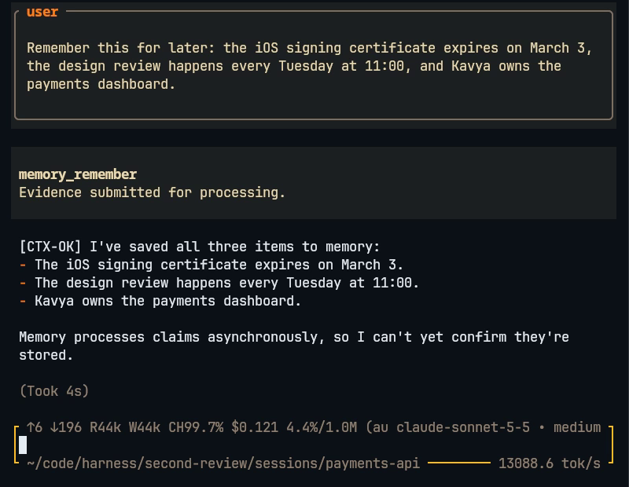
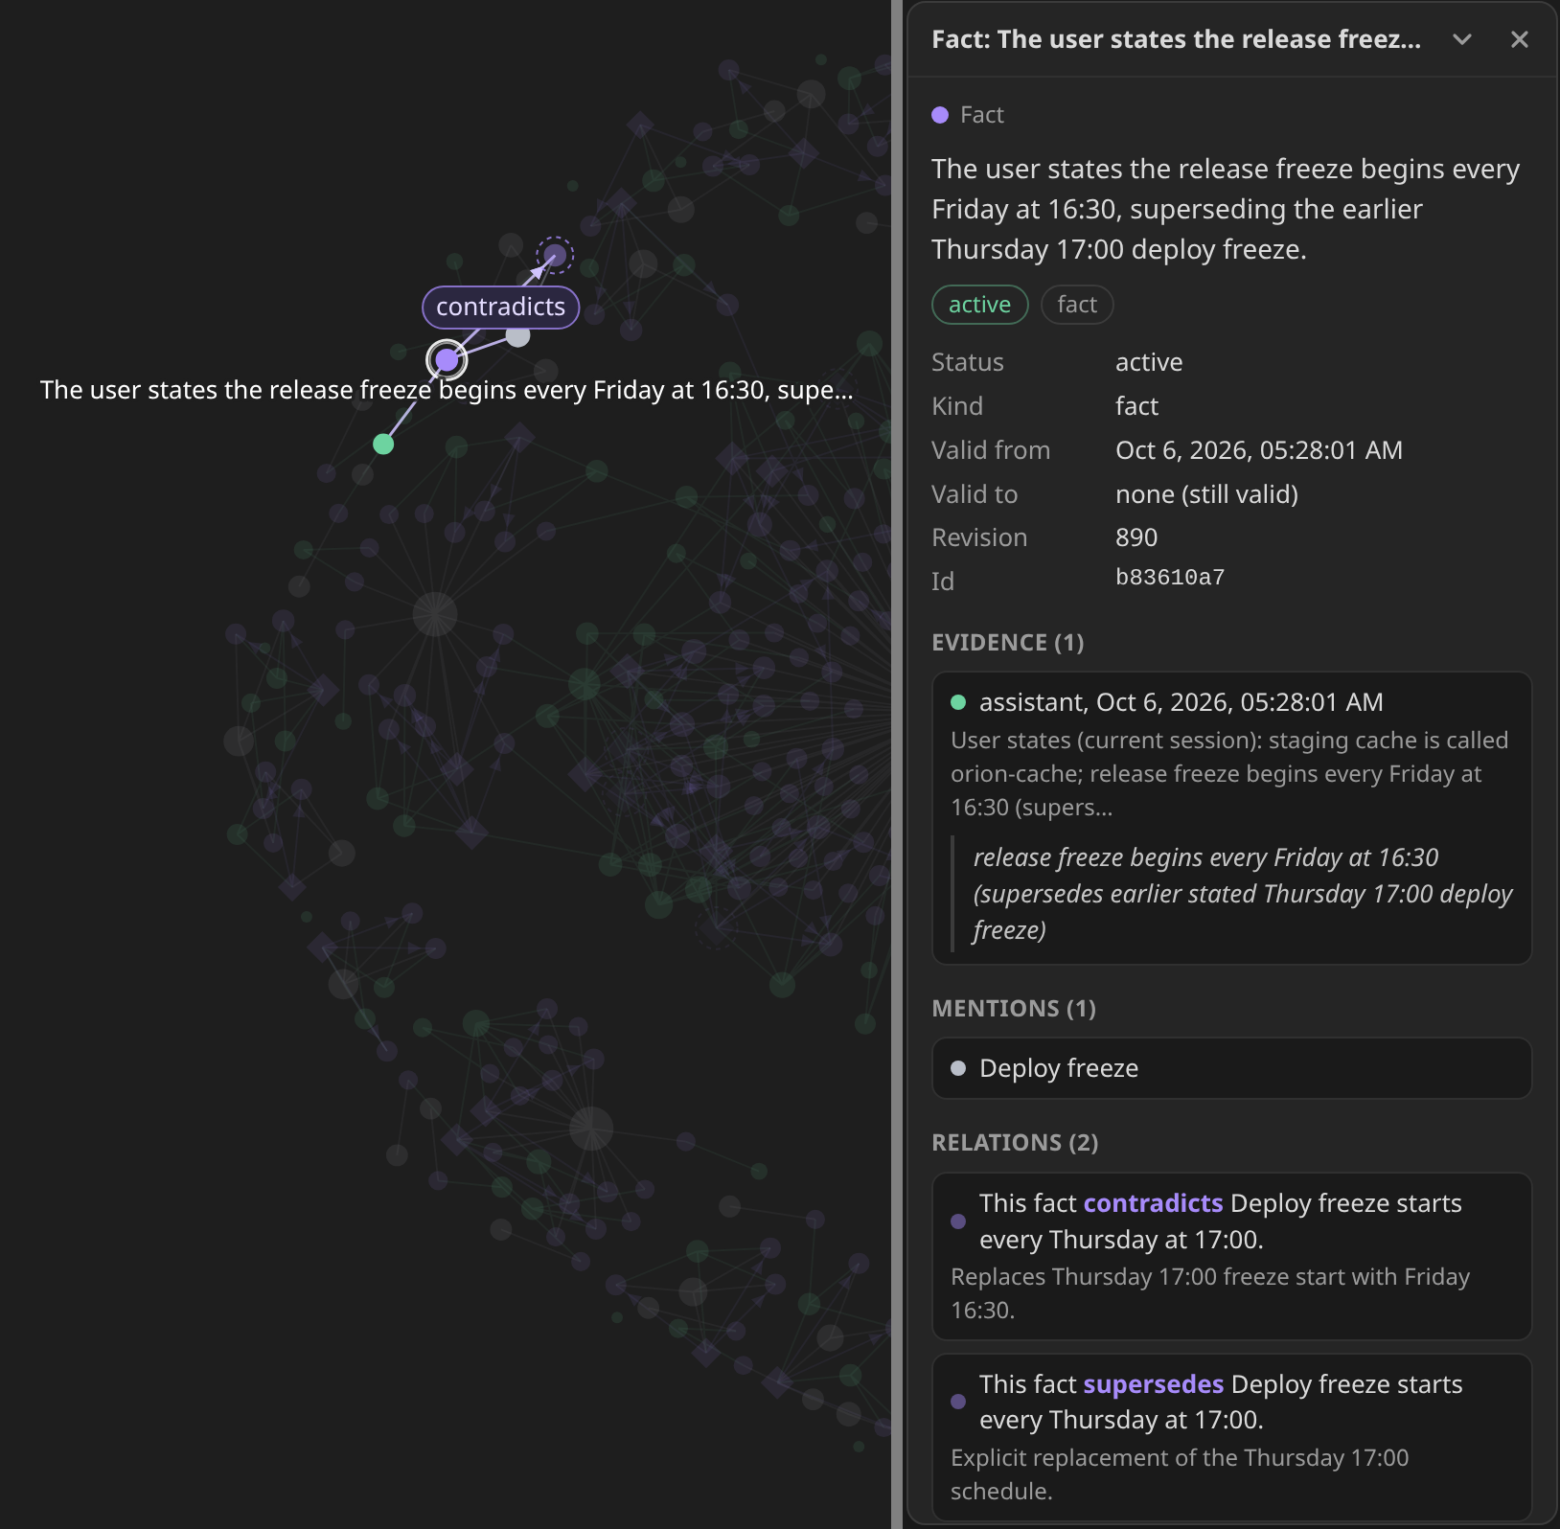
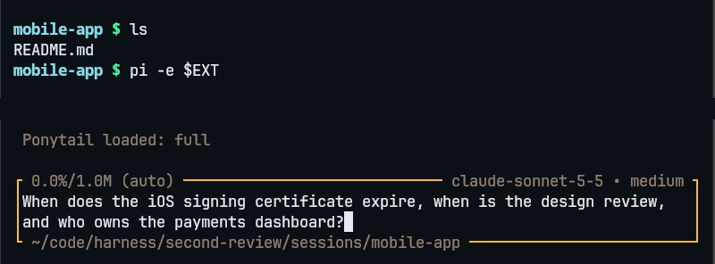
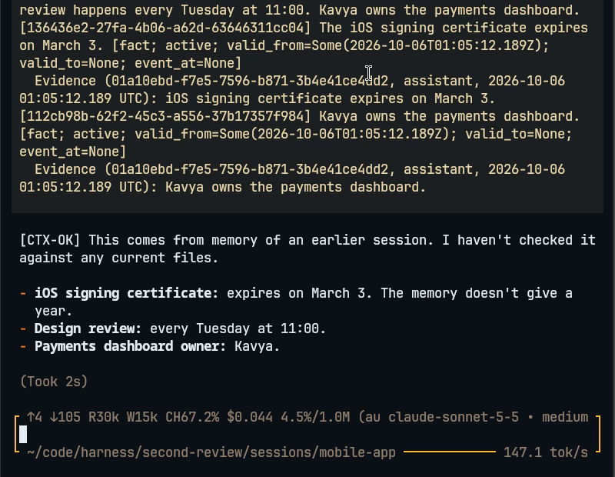
OUTPUT SCREENSHOTS
Figure 1. Session 1 in payments-api, 2026-10-06. The user tells Pi three example facts: the iOS signing certificate expires on March 3, the design review is every Tuesday at 11:00, and Kavya owns the payments dashboard. Pi calls memory_remember, which answers "Evidence submitted for processing", and replies that it saved all three items but cannot yet confirm they are stored. The CTX-OK marker comes from the presenter’s own Pi instructions, not from the memory system.
Figure 2. Session 2 in mobile-app, a fresh start with no history: ls shows only README.md. The question about the certificate date, the design review and the dashboard owner is typed in the editor. The empty lower part of the terminal is cropped away.
Figure 3. Session 2 after the answer. The upper part is the end of the memory the extension injected from session 1, so its first line starts mid-sentence: the facts, each with status active and an evidence line. Below it the answer gives March 3 (no year), every Tuesday at 11:00 and Kavya.
Figure 4. Graph page, user:dev, 2026-10-06. Two crops of one capture, joined at the grey line. Left: the selected fact (white ring), a contradicts relation and the superseded Thursday 17:00 fact (dashed ring). Right: its details panel, with status active, the evidence quote, the entity Deploy freeze and the relations contradicts and supersedes. Invented example facts.
Notes:
Figures 1 to 3 are real captures from one screen recording, pi-two-sessions-shared-memory.mp4, which is 86 seconds long and sits in the second-review folder next to this deck, so copy it to the presenting machine. It shows two real interactive Pi sessions with the memory extension, driven by real keystrokes.
In Figure 1 session 1 in payments-api is told three invented example facts and saves them with memory_remember, and in Figure 2 session 2 in mobile-app starts with no history. Figure 3 shows the memory the extension injected from session 1 and then the answer, and the CTX-OK marker comes from my own Pi instructions, not from the memory system.
Figure 4 is a screenshot of our graph page for user:dev, cropped to the selected fact and its details panel, where the release freeze fact supersedes and contradicts the earlier Thursday fact. A hosted copy runs Pi next to the same graph for a live demo, and the recording is the fallback.

Slide 15
RESULTS AND OBSERVATIONS
Measured finding | Result | Limit kept with it
Retrieval latency and context size | Date planning off: p50 58 ms, p95 72 ms, p99 75 ms at 10 requests per second (300 requests, 0 errors). With the planner: p95 1,870 ms, because 4 of 40 questions start a model call of 1.6 to 2.1 s. Median context 1,942 tokens, p95 2,041 | One machine, local embeddings, 323 facts. Not tried on a large namespace. Tokens are characters divided by four
Provenance and version audit | 323 of 323 facts have a source with a quote found word for word in its chunk. 0 of 106 single-value slots hold two active facts. Memory at idle: service 35 MB, PostgreSQL 224 MiB, Neo4j 1.27 GiB | Run on user:dev only, where just 2 facts are superseded, so it is not a held-out update set
Pi sessions, recording and scripted check | Session 2 (claude-sonnet-5-5), in another directory with no history, answered all three example facts. The scripted check passed 14 of 14 in four configurations | One scenario, invented facts, one machine, run by us. Shows the path works, not answer quality
Recall cutoff, 80 queries | Target fact in the context: 39 of 55 with no cutoff, 49 at 0.45. Follow-ups and small talk: mean context 6,925 to 1,250 characters | The same queries tuned the cutoff, so the claim is weak. Short prompts such as “ok” still pull in 3 to 5 kB
Local 14B extraction, 10 batches | Validation passed on 2 of 10 batches, the hosted model on 10 of 10. Before the context fix Ollama cut 15 of 18 prompts at 4,096 tokens, now 16,384 in and 4,096 out. GPU memory 10.6 GB at 4,096 and 12.9 GB at 16,384 | One machine, one model, no repeats, stopped at 10 of 18 batches. Not usable for extraction yet
Live graph, user:dev | Neo4j projection: 382 nodes, 473 relationships. 133 of the 147 memories support at least one fact. Graph API counts equal direct Cypher and SQL counts, about 0.10 s per call at limit 200 | One user, invented example facts. Chrome only, untested above a few thousand nodes
Automated tests | scripts/test.sh exits 0: Rust 83 (45 unit, 24 evidence_graph, 13 ollama_context, 1 postgres_api), Python 5, TypeScript 9 | Database tests need TEST_DATABASE_URL and TEST_NEO4J_URL. Three live Ollama tests are opt-in and passed once
Fine-tuned worker, internal test | Consolidation 1 of 16 to 13 of 16, reflection 10 of 16 to 15 of 16. Extraction coverage fell from 50 of 55 to 41 of 55 facts | Labels and grading share a teacher family, so not independent human accuracy. Relative dates still wrong in places
Notes:
Every row is one measurement on one machine, mostly on our own user:dev namespace, so treat each as a single measurement. The two numbers that miss their target are the median context size and the latency when the date planner runs.
For latency we sent 300 requests at 10 per second, using 40 questions about the stored project. Four questions contain words such as when or before, which start a date-planning model call of 1.6 to 2.1 s, and without that call p95 is 72 ms.
The local model row replays 10 of the 18 document batches that the hosted model had already processed, and the 14B model passed 2 of them.

Slide 16
STATUS AND PENDING WORK
Module | Implemented functionality | Available evidence | Pending work | Status
M1 Service and persistence | REST API (8 V1, 13 V2 routes), console, PostgreSQL store, job queue | src/api.rs, knowledge_store.rs; 83 Rust tests | Authentication and hard delete: Status to confirm | Completed
M2 Extraction and embeddings | JSON claims, exact-quote checks, two repairs; Ollama embeddings, 1024-d | src/worker.rs, providers.rs. Pi check: 14 of 14 | Extraction quality at scale is unmeasured | Completed
Local 14B extraction | Qwen2.5-14B in Ollama, 16,384 token context | Passed validation on 2 of 10 test batches, hosted 10 of 10 | Run the other 8 batches. Planned: constrained decoding, fewer related ids, a larger repair budget | In progress
M3 Hybrid retrieval and graph | Four searches, RRF k = 60, validity filter, token packing, Neo4j projection, live graph page, distance cutoff | src/v2.rs, graph.rs, tests/evidence_graph.rs; latency on slide 15 | Shorter context, graph ablation, a rule for short prompts. A derives writer and a move off the deprecated Neo4j HTTP endpoint: Status to confirm | Completed
M4 Maintenance and evaluation | Retries, heartbeats, consolidation, traces, /healthz, /metrics | src/worker.rs | Human audit (Planned). Decay, re-embedding, backup: none exists | Completed
Pi integration | Hooks, local spool, memory tools, injected context message | integrations/pi/, 9 tests, scripted check 14 of 14 | Global install and the privacy of retaining all sessions: Status to confirm | Completed
Fine-tuned worker (mem-extractor) | QLoRA of Qwen3-4B on 2,095 rows; Q8_0 GGUF served by Ollama | slm-distill/, release receipt | Coverage fell, relative dates weak. Live smoke check passed | In progress
Azure adapter and V1 console | AzureExtractor, AzureEmbedder, V1 console, browse and stats endpoints | Written: 12 files, 1,587 lines added | Rebase onto the V2 code (conflicts in src/main.rs and src/ui.html), then add a JsonModel adapter for the V2 worker | In progress
Notes:
Completed means the feature is implemented in code, and it does not mean it has been measured to be good. The results slide shows which modules have numbers so far and which have none.
M4 covers jobs, consolidation, traces and metrics, and decay, re-embedding and backup are Planned. The local 14B extractor is In progress because it passed validation on only 2 of 10 test batches.
The fine-tuned worker is In progress because its internal scores are mixed: consolidation and reflection improved, extraction coverage fell.

Slide 17
REFERENCES
[1] N. F. Liu, K. Lin, J. Hewitt, A. Paranjape, M. Bevilacqua, F. Petroni, and P. Liang, "Lost in the middle: How language models use long contexts," Trans. Assoc. Comput. Linguist., vol. 12, pp. 157-173, 2024. [Online]. Available: https://aclanthology.org/2024.tacl-1.9/
[2] D. Wu, H. Wang, W. Yu, Y. Zhang, K.-W. Chang, and D. Yu, "LongMemEval: Benchmarking chat assistants on long-term interactive memory," in Proc. Int. Conf. Learn. Represent. (ICLR), 2025, pp. 86809-86836. [Online]. Available: https://proceedings.iclr.cc/paper_files/paper/2025/hash/d813d324dbf0598bbdc9c8e79740ed01-Abstract-Conference.html. Also arXiv:2410.10813.
[3] C. Packer, S. Wooders, K. Lin, V. Fang, S. G. Patil, I. Stoica, and J. E. Gonzalez, "MemGPT: Towards LLMs as operating systems," arXiv preprint arXiv:2310.08560, Oct. 2023 (rev. Feb. 2024). [Online]. Available: https://arxiv.org/abs/2310.08560
[4] P. Rasmussen, P. Paliychuk, T. Beauvais, J. Ryan, and D. Chalef, "Zep: A temporal knowledge graph architecture for agent memory," arXiv preprint arXiv:2501.13956 [cs.CL], Jan. 2025. [Online]. Available: https://arxiv.org/abs/2501.13956
[5] P. Chhikara, D. Khant, S. Aryan, T. Singh, and D. Yadav, "Mem0: Building production-ready AI agents with scalable long-term memory," in Proc. 28th Eur. Conf. Artif. Intell. (ECAI), Oct. 2025, ser. Frontiers in Artificial Intelligence and Applications, vol. 413. IOS Press, 2025, pp. 2993-3000, doi: 10.3233/FAIA251160. Also arXiv:2504.19413 [cs.CL].
[6] S. Daga, S. Sreedhar, and D. Shah, "LongMemEval," supermemory research (vendor-hosted evaluation report on LongMemEval-S, not peer reviewed), May 2026. [Online]. Available: https://supermemory.ai/research/longmembench/ (accessed Oct. 6, 2026).
[7] C. Latimer, N. Boschi, A. Neeser, C. Bartholomew, G. Srivastava, X. Wang, and N. Ramakrishnan, "Hindsight is 20/20: Building agent memory that retains, recalls, and reflects," arXiv preprint arXiv:2512.12818 [cs.CL], Dec. 2025. [Online]. Available: https://arxiv.org/abs/2512.12818
[8] Neo4j, Inc., "Query the database," in Neo4j HTTP API Manual, Version 5 (page marked deprecated in 5.26). Neo4j, Inc., 2026. [Online]. Available: https://neo4j.com/docs/http-api/5/query/ (accessed Oct. 6, 2026).
[9] M. Zechner et al., "pi: AI agent toolkit (unified LLM API, agent loop, TUI, coding agent CLI)," package @earendil-works/pi-coding-agent, v1.0.2 (version locked by the project's package-lock.json; latest is 1.0.4 on Oct. 6, 2026), GitHub repository, 2026. [Online]. Available: https://github.com/earendil-works/pi (accessed Oct. 6, 2026).
[10] PostgreSQL Global Development Group, "PostgreSQL 17 Documentation, Chapter 12: Full Text Search (Sections 12.2.2, 12.3.2, 12.3.3, 12.9) and Section 64.4: GIN Indexes," PostgreSQL 17.11 documentation, 2026. [Online]. Available: https://www.postgresql.org/docs/17/textsearch.html (accessed Oct. 6, 2026).
[11] A. Kane et al., "pgvector: Open-source vector similarity search for Postgres," source code repository and README (0.8.6 installed in the test database, v0.8.7 tag also released), Oct. 2026. [Online]. Available: https://github.com/pgvector/pgvector (accessed Oct. 6, 2026).
[12] G. V. Cormack, C. L. A. Clarke, and S. Büttcher, "Reciprocal rank fusion outperforms Condorcet and individual rank learning methods," in Proc. 32nd Int. ACM SIGIR Conf. Research and Development in Information Retrieval (SIGIR '09), Boston, MA, USA, Jul. 2009, pp. 758-759, doi: 10.1145/1571941.1572114.
[13] Y. Zhang, M. Li, D. Long, X. Zhang, H. Lin, B. Yang, P. Xie, A. Yang, D. Liu, J. Lin, F. Huang, and J. Zhou, "Qwen3 Embedding: Advancing text embedding and reranking through foundation models," arXiv preprint arXiv:2506.05176 [cs.CL], Jun. 2025. [Online]. Available: https://arxiv.org/abs/2506.05176
[14] T. Dettmers, A. Pagnoni, A. Holtzman, and L. Zettlemoyer, "QLoRA: Efficient finetuning of quantized LLMs," in Advances in Neural Information Processing Systems 36 (NeurIPS 2023), 2023, pp. 10088-10115, doi: 10.52202/075280-0441. Also arXiv:2305.14314.
[15] A. Maharana, D.-H. Lee, S. Tulyakov, M. Bansal, F. Barbieri, and Y. Fang, "Evaluating very long-term conversational memory of LLM agents," in Proc. 62nd Annu. Meeting Assoc. Comput. Linguistics (Volume 1: Long Papers), Bangkok, Thailand, Aug. 2024, pp. 13851-13870, doi: 10.18653/v1/2024.acl-long.747. [Online]. Available: https://aclanthology.org/2024.acl-long.747/ (preprint: arXiv:2402.17753)
Notes:
All entries were checked against their primary sources on 2026-10-06.
Peer reviewed: Liu et al. (TACL 2024), Wu et al. (ICLR 2025), Maharana et al. (ACL 2024), Chhikara et al. (ECAI 2025), Cormack et al. (SIGIR 2009) and Dettmers et al. (NeurIPS 2023).
Preprints: Packer et al., Rasmussen et al. (written by Zep staff), Latimer et al. (vendor affiliated) and Zhang et al.
PostgreSQL and Neo4j are official documentation, and pgvector and Pi are software repositories.
Reference [6] is a vendor hosted web report and is not peer reviewed, and its numbers are vendor reported and were not reproduced by us, so the deck cites it for mechanism only.

