Slide 1
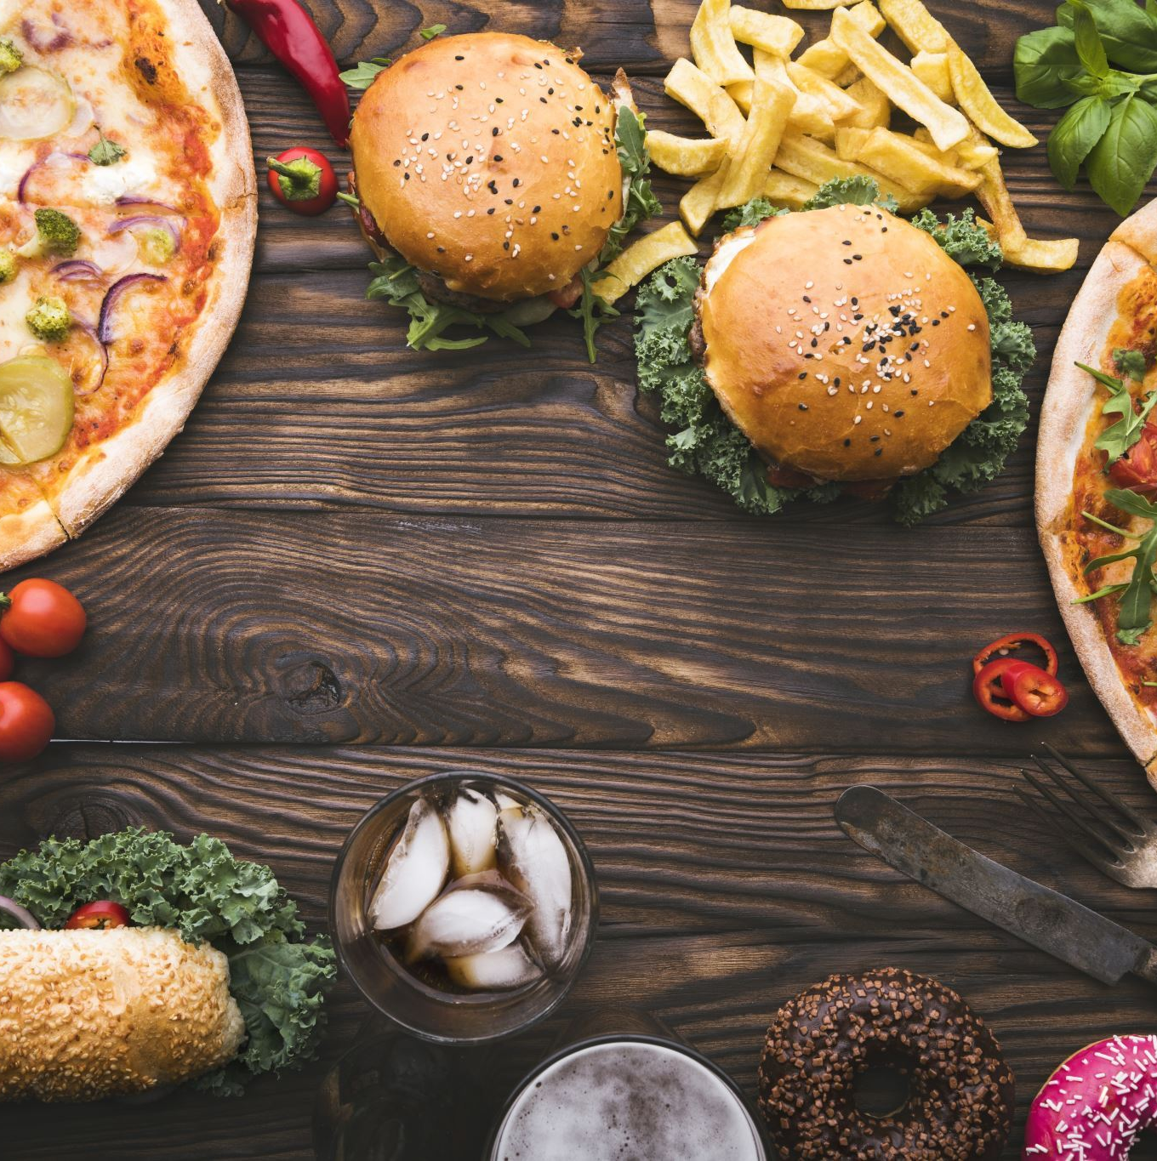
Fast Food Chain Nutrition Dataset
Alireza Hatami
Aryan Jain
Ziheng Chen (George)
Sai Pokuri

Slide 2
Introduction and Purpose of Dataset
The main goal is to furnish nutritional details from prominent fast-food chains, namely KFC, McDonald's, Dairy Queen, and Chick-fil-A. The dataset encompasses nutrient facts for every item on the menu for each of these fast-food establishments. Specific nutrient information provided includes:
Calories , Total Fat (g), Saturated Fat (g), Trans Fat (g), Cholesterol (mg), Sodium (mg), Total Carbohydrates (g), Dietary Fiber (g), Sugars (g), Added Sugars (g), Protein (g)
This dataset aims to provide a detailed breakdown of nutritional components for consumers, researchers, and professionals interested in understanding and evaluating the nutritional profiles of items offered by these specific fast-food chains.

Slide 3
Potential Users and Applications
Researchers, health professionals, and nutritionists can analyze fast-food menus and study the impact on public health, obesity rates, and dietary choices.
Government agencies like the FDA or CDC can use the dataset for public health and nutrition assessments.
Food and beverage industry companies, including fast-food chains, may utilize the data for market research, developing nutritious menu options, and enhancing product profiles.
Insurance companies can explore the dataset to assess risk factors related to diet and nutrition, potentially influencing insurance premiums and policies.
Educational institutions, including schools, colleges, and universities, can integrate the dataset for academic purposes, such as research projects, teaching materials, and student assignments across disciplines like nutrition science, public health studies, economics, and marketing.

Slide 4

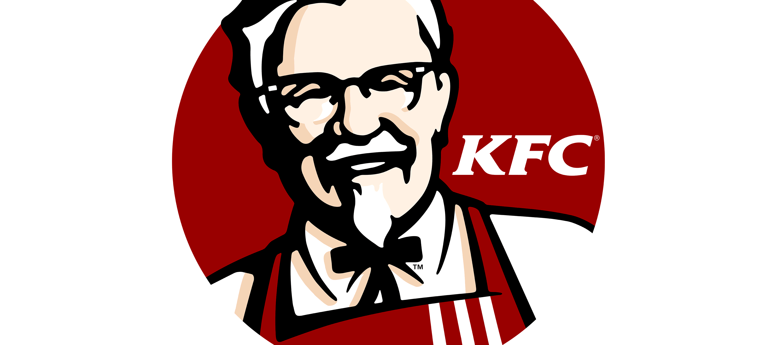
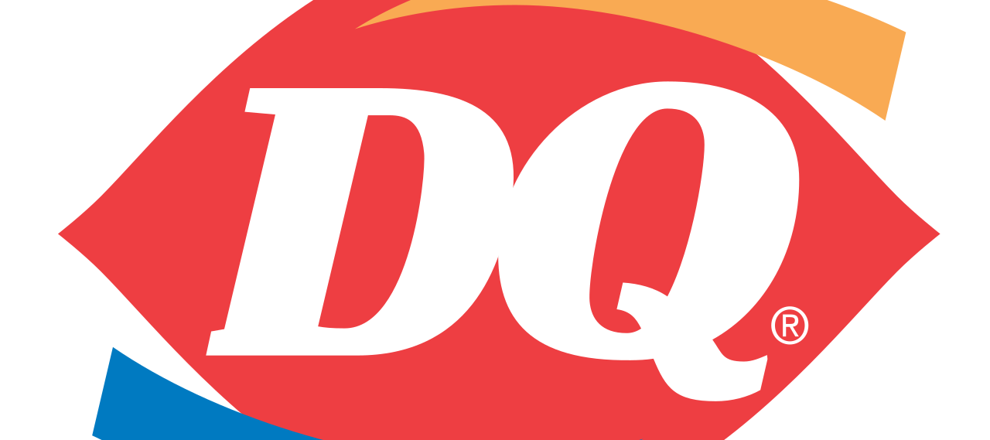
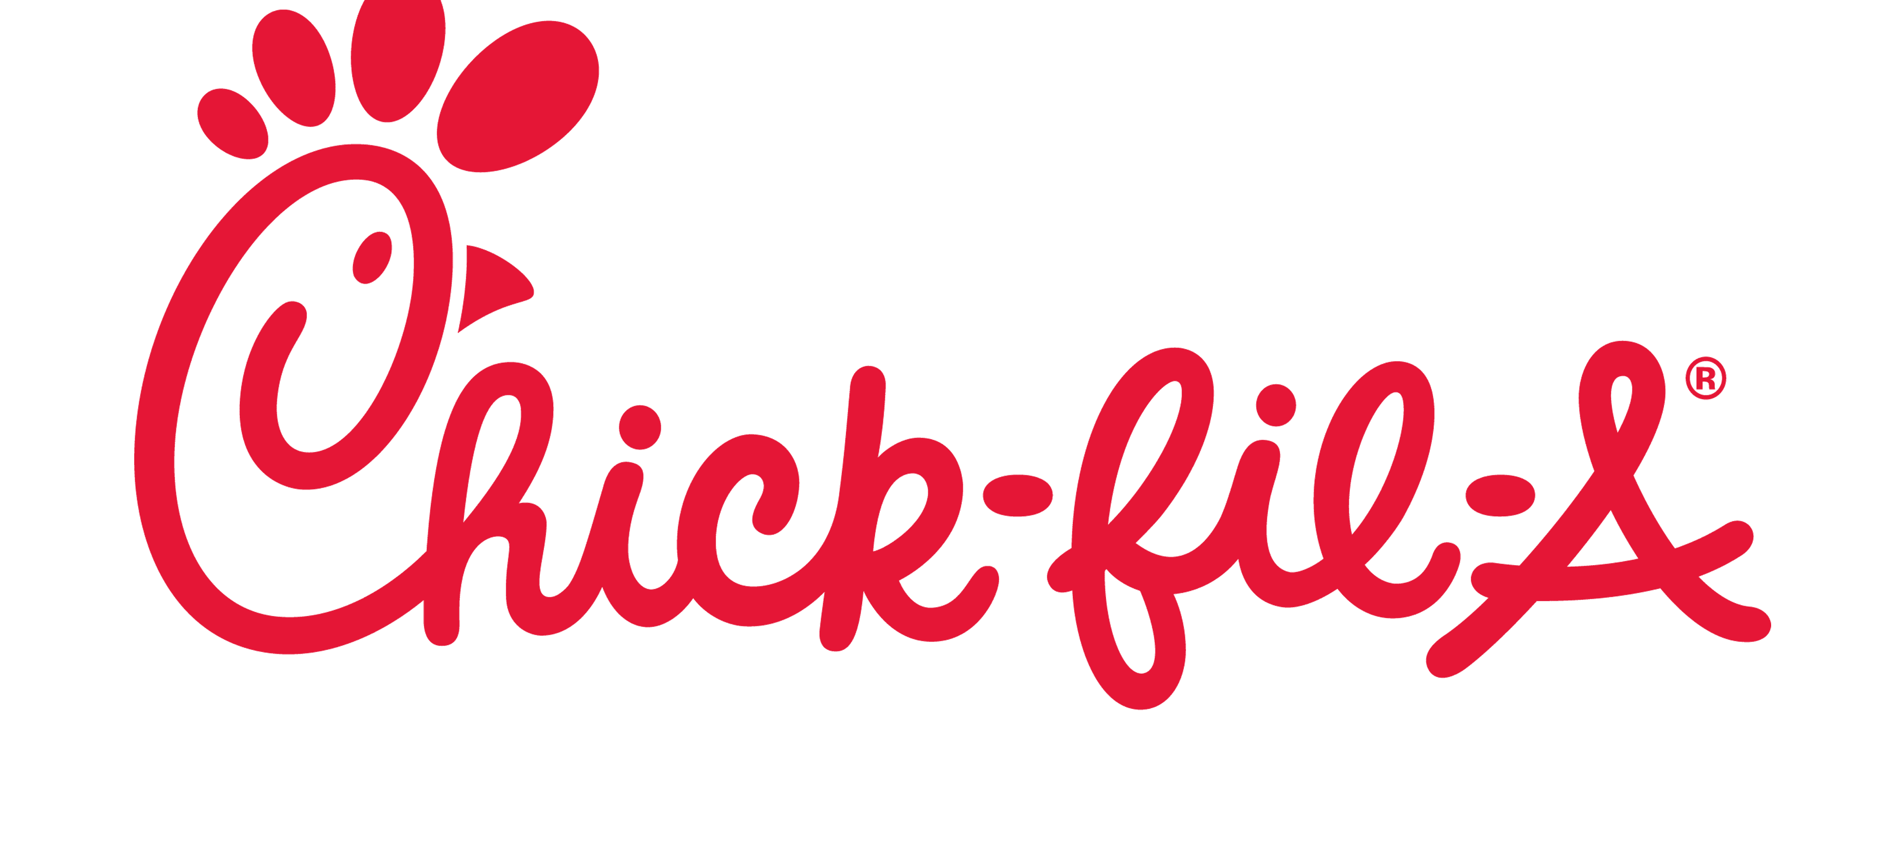
Source of Data
McDonalds
Kentucky Fried Chicken (KFC)
Dairy Queen
Chick-fil-A

Slide 5
Approach to Acquiring the Data
Web Scraping:
In this web scraping task, the "requests" library and its get method were employed to send HTTP requests to a specified URL. This step allowed us to retrieve the HTML content of the web page.
Subsequently, the "BeautifulSoup" library was utilized to create a BeautifulSoup object. This object served as a powerful tool for parsing and navigating through the HTML content obtained from the web page.
Finally, employing the find_all method provided by BeautifulSoup, we located and extracted all HTML tables on the page. This approach sets the stage for further data extraction and analysis from the identified tables.
In summary, the combination of "requests" and "BeautifulSoup" libraries facilitated the retrieval and parsing of web page content, enabling the systematic extraction of data from HTML tables for subsequent processing.

Slide 6
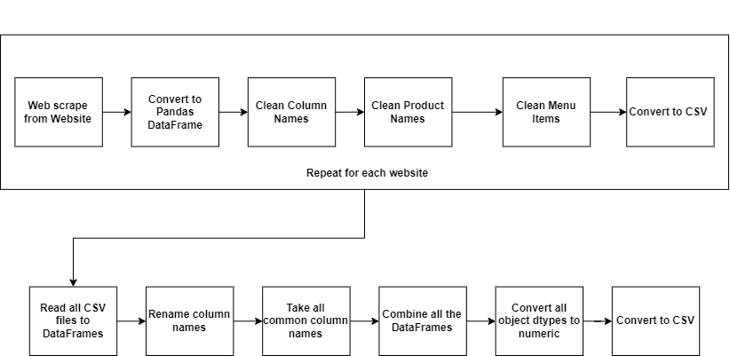
Approach to Preprocessing Data

Slide 7
Distribution Approach
Github
https://github.com/aryanj10/DSCI-511-Final-Project

Slide 8
Discussion of Access Rights
The statement you provided indicates that before engaging in web scraping activities for four fast-food chains, certain precautions were taken:
Checking Robots.txt: The robots.txt files for the four fast-food chains were examined. The robots.txt file is a standard used by websites to communicate with web crawlers, indicating which parts of the site should not be crawled or scraped. This is a responsible practice to ensure that the web scraping activity aligns with the guidelines set by the website owners. If the robots.txt file explicitly disallows certain paths or content, it's generally considered good practice to respect those directives.
Reviewing Terms and Conditions: The terms and conditions of the fast-food chains were also reviewed. This is an important step to understand the rules and limitations set by the website owners regarding the use of their online services, including any restrictions on data usage. In the case of Chick-fil-A, it was noted that there are limitations, and a specific term prohibits the use of the available data for certain purposes, including selling it to a third-party entity.
Prohibition on Data Use and Selling: The terms and conditions of Chick-fil-A include a restriction on the use of the data available on their website. Specifically, it prohibits users from using the data for any unlawful, fraudulent, or malicious purposes. Additionally, it explicitly prohibits the selling of the data to a third-party entity. This means that users should not scrape Chick-fil-A's data with the intention of selling it to others.

Slide 9
Issues and Limitations
Challenges or difficulties encountered while attempting to extract nutrition information for different sizes of items from the menus of Chick-fil-A and McDonald's.
Variability in Menu Structure: Fast-food menus often have a diverse structure, and the representation of information can vary. If the structure of the menus for Chick-fil-A and McDonald's is not consistent across different items or sizes, it can complicate the extraction process.
Dynamic Web Pages: Some websites use dynamic content loading, meaning that information is loaded onto the page after the initial page load through JavaScript or other technologies. Web scraping tools might struggle to extract data from dynamically loaded content, especially if the process involves interacting with elements that load information.
Data Presentation Format: If the nutrition information for different sizes is presented in a non-uniform manner or if it requires interacting with elements like dropdowns, tabs, or buttons to switch between sizes, extracting this information programmatically becomes more challenging.
Limited Accessibility to Specific Information: Nutrition information for different sizes might be stored in a way that makes it less accessible through traditional scraping methods. Some websites might provide this information through APIs or other data access methods that are more structured.

Slide 10
Team & Contributions
Sr. No | Work | Member
1. | Scraping Mcdonalds Menu | Aryan
2. | Scraping KFC Menu | Alireza
3. | Scraping Dairy Queen Menu | Sai
4. | Scraping Chick-fil-A Menu | George
5. | Pre-Processing | All Members

