Slide 1
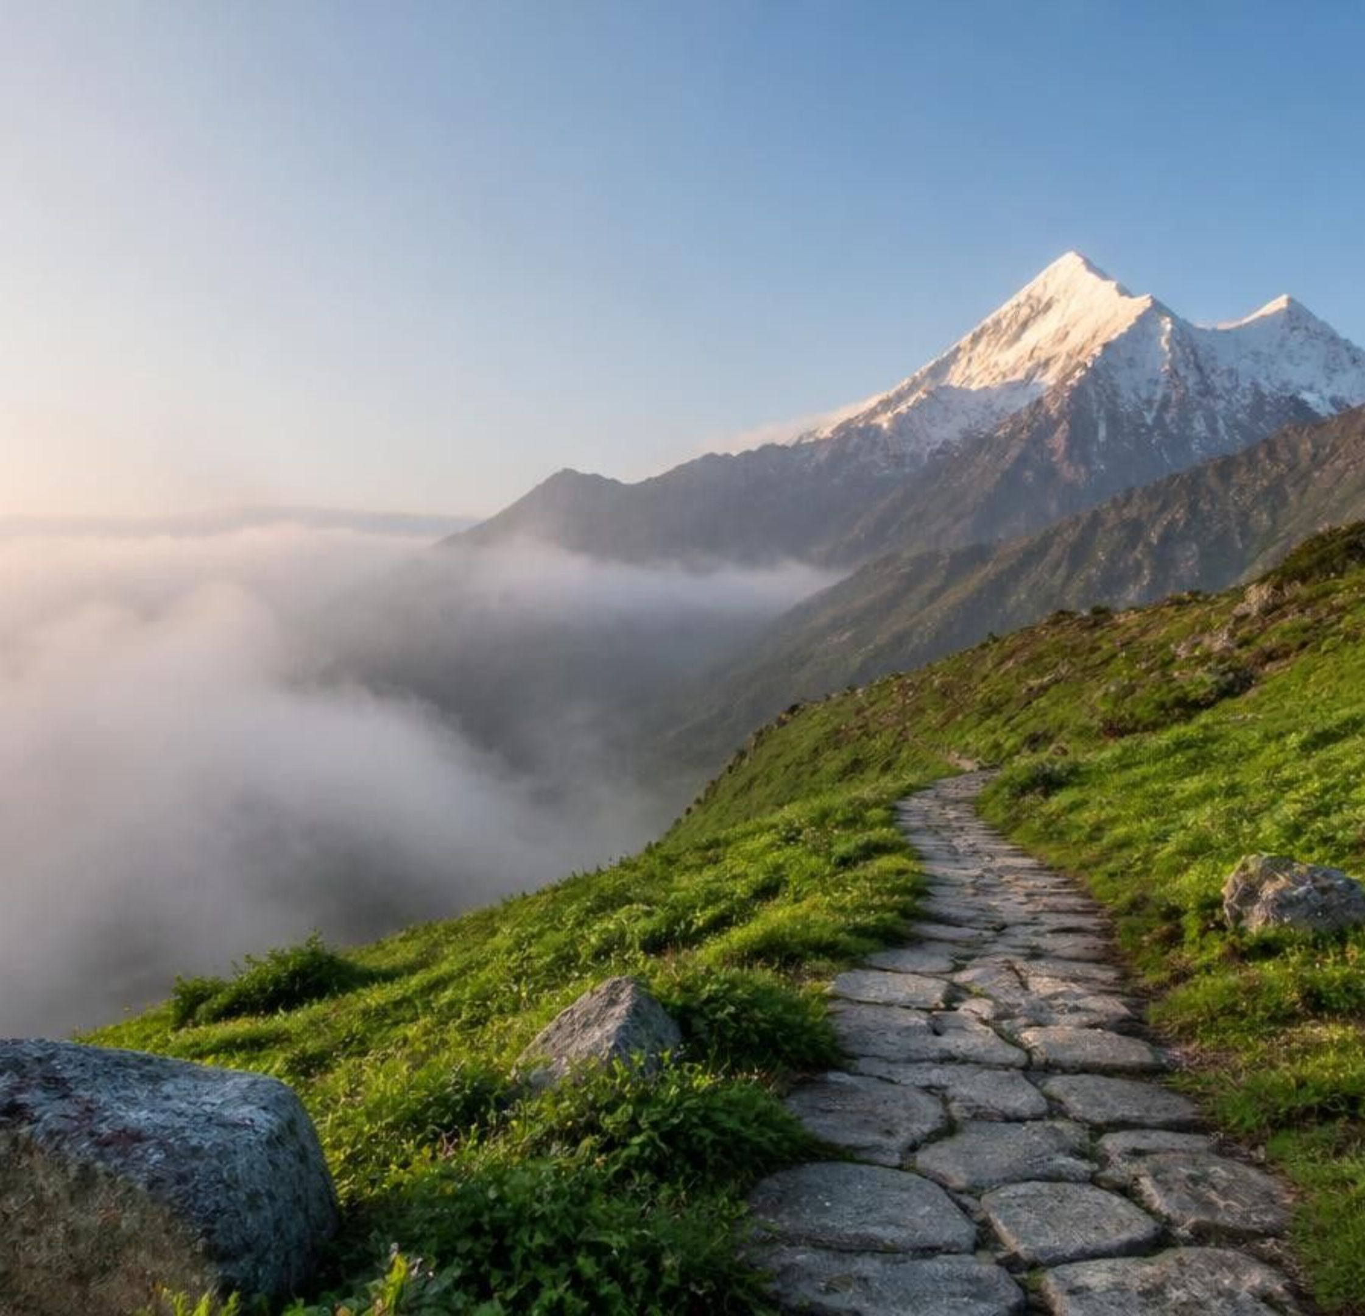
AN INTELLIGENT, BEGINNER-FRIENDLY TREKKING PLANNING PLATFORM
PINNACLE
PATHS
From First Step to Summit — Plan Smarter, Trek Better.
Discover. Prepare. Explore.

Slide 2





THE CHALLENGE
Trekking Begins with Uncertainty
First-time trekkers struggle to plan safe and suitable treks because essential information is fragmented across multiple platforms.
Fragmented Information
Unclear Preparation
Difficult Assessment
Research spread across websites, blogs and videos.
Confusion about gear and fitness requirements.
Beginners cannot identify suitable treks.
Budget Uncertainty
Safety and Weather
Hard to estimate transport and overall expenses.
Limited clarity on conditions, terrain and precautions.

Slide 3
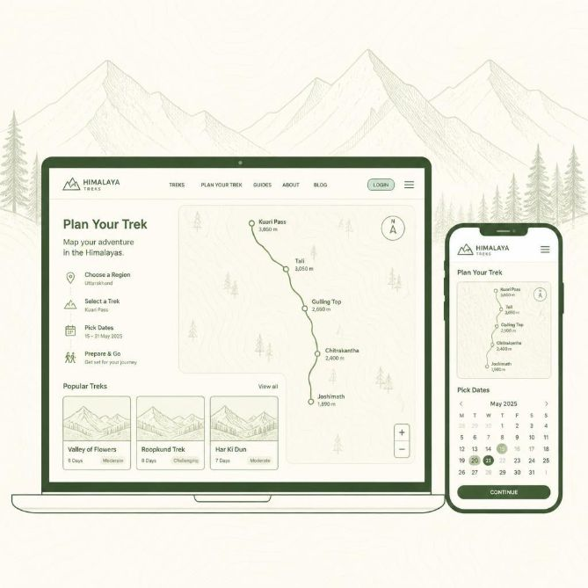
THE PLATFORM
One Platform. Every Step of the Journey.
Pinnacle Paths centralizes trek discovery, personalized recommendations, preparation guidance and trip planning in one accessible platform.
01
02
03
Explore Treks
Set Preferences
Get Recommendations
04
05
View Trek Roadmap
Prepare & Plan

Slide 4







CORE FEATURES
Built for Beginners. Designed for Exploration.
From static trek information to personalized, actionable preparation.
Smart Trek Discovery
INNOVATION
INNOVATION
Personalized Recommendations
Trek Progression Roadmap
Filter by difficulty, destination, duration, season, budget and altitude.
Match experience, fitness, budget and time.
Build skills through easier preparatory treks before advanced expeditions.
Intelligent Equipment Checklist
Weather & Route Insights
Budget & Itinerary Planner
Pack by season, terrain and duration.
Forecasts, locations, transport and advisories.
Trip cost estimates and a structured itinerary.

Slide 5
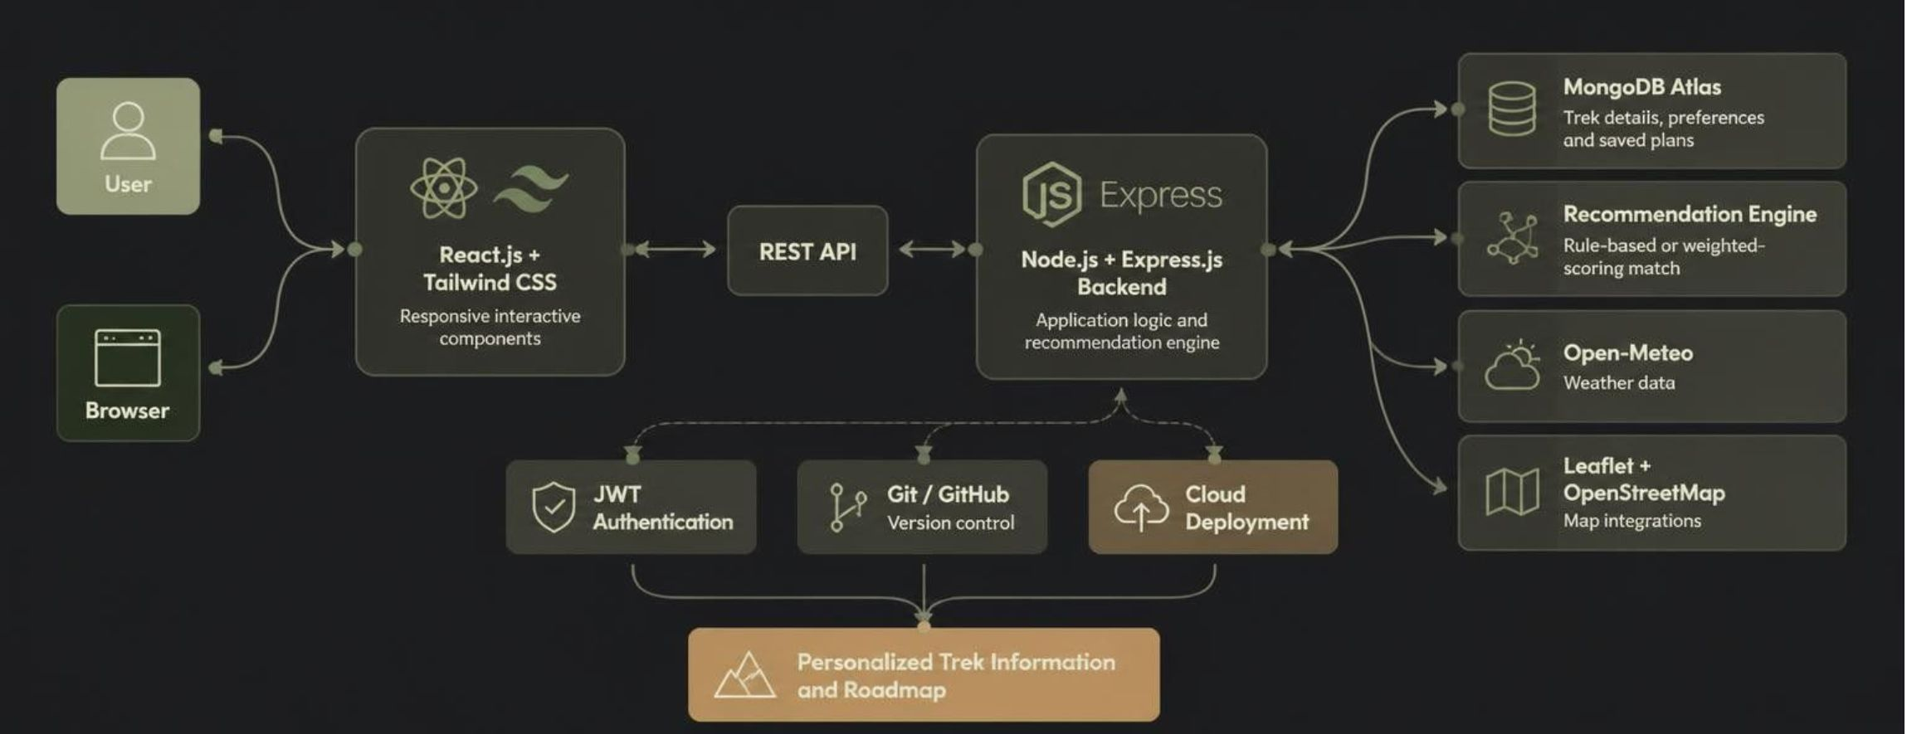
SYSTEM ARCHITECTURE
Technology Behind Pinnacle Paths
Frontend: React.js + Tailwind CSS, responsive interactive components.
Backend: Node.js + Express.js, REST APIs, application logic, recommendation engine. Database: MongoDB Atlas for trek details, preferences, saved plans.
Integrations: Open-Meteo API (weather); Leaflet + OpenStreetMap (maps). Supporting: JWT authentication, Git/GitHub, cloud deployment. The recommendation engine is rule-based or weighted-scoring, matching user preferences to curated trek attributes. It is not a trained AI model.

Slide 6



Practical Today. Scalable Tomorrow.
Feasibility
Four-stage path to expansion
 | Technical | Widely adopted web technologies and existing APIs.
 | Economic | Low-cost prototype on open-source tools and free-tier infrastructure.
 | Operational | Beginner-friendly interface with centralized planning tools.
Phase 1, MVP: Curated trek catalog, recommendation engine, checklists, budget planner.
Phase 2, Enhanced Experience: User profiles, saved plans, maps, reviews, weather integration.
Phase 3, Platform Expansion: Verified operator partnerships, bookings, equipment rentals.
Phase 4, Adventure Ecosystem: More destinations, outdoor activities, mobile apps.
Key consideration: trek information, weather and permits need reliable sourcing and periodic updates.

Slide 7








PROPOSED FUTURE EXTENSIONS
Creating Value Beyond the Trail
Making trekking preparation simpler, more accessible and better informed.
Freemium
Affiliate Partnerships
Gear & Rental Partnerships
Free essential trek information, with optional premium planning tools.
Referral commissions via verified operators and travel providers.
Equipment sellers and rental providers.
AUDIENCE
First-time trekkers
Students and budget travelers
Adventure enthusiasts
Trekking communities

Slide 8

THE PROMISE
Making Every Trek Begin with Confidence
Centralized, searchable trek information
Personalized trek selection and preparation roadmap
Clear equipment, budget and travel guidance
Better accessibility of trek planning for beginners
Extensible foundation for future adventure services
Pinnacle Paths bridges the gap between the desire to explore and the knowledge required to begin.
Discover → Prepare → Explore.
Thank You.

