Slide 1
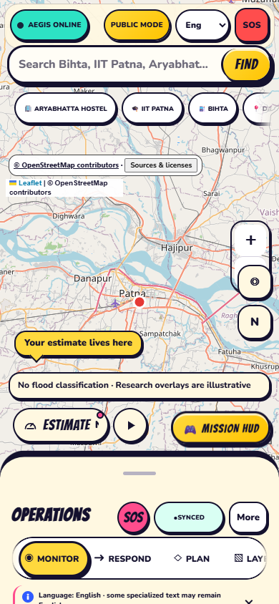
A
SOFTWARE-ONLY ? PATNA, BIHAR
PROJECT
AEGIS
Flood-data awareness and community resilience?
with uncertainty made visible.
INSPECT ? PREPARE ? COORDINATE
Research prototype ? not an official alert
Patna-area research prototype

Slide 2
A
PROJECT AEGIS ? CLIMATE RESILIENCE
Preparedness information is fragmented
A useful local workflow needs more than a map pin or a single risk number.
01 ? CONTEXT
02 ? UNCERTAINTY
03 ? CONNECTIVITY
Weather models, historical records, mapped facilities and community observations answer different questions. Keep their sources distinct.
Freshness, coverage and missing feeds affect what users can responsibly infer. Show gaps instead of filling them with invented certainty.
When the network drops, cached information and locally queued actions can still help?without pretending fresh data is available.
DESIGN GOAL
One place to inspect available evidence, find mapped resources and prepare?with honest limits.
RESEARCH PROTOTYPE ? NOT AN OFFICIAL ALERT
02

Slide 3
A
PROJECT AEGIS ? CLIMATE RESILIENCE
One map-first workflow, five connected tabs
The interface is organized around what a resident or response team may need to do next.
1
MONITOR
Review estimate, inputs, confidence and source health.
2
PLAN
Explore supported what-if simulations and compare scans.
3
RESPOND
Find mapped services, routes and response tools.
4
LAYERS
Inspect imagery, historical context and evidence.
5
COMMUNITY
Submit and review explicitly unverified observations.
MAP ? SEARCH ? DATA HEALTH ? SOURCE ATTRIBUTION ? PROTOTYPE DISCLAIMER
RESEARCH PROTOTYPE ? NOT AN OFFICIAL ALERT
03

Slide 4
A
PROJECT AEGIS ? CLIMATE RESILIENCE
A real interface: map, estimate dock and operations
ESTIMATE DOCK
Collapsed until opened; the scan shortcut uses the existing scan flow.
VISIBLE CAVEATS
Map imagery and illustrative overlays are explicitly labeled; source credits remain accessible.
OPERATIONS TABS
Monitor ? Respond ? Plan ? Layers ? Community keep key actions reachable.
Screenshot: local browser emulation; not a physical-device test.
RESEARCH PROTOTYPE ? NOT AN OFFICIAL ALERT
04

Slide 5
A
PROJECT AEGIS ? CLIMATE RESILIENCE
How the research estimate is produced
WEATHER +
MODELED FLOW
HISTORICAL
EVENT LABELS
PATNA
RESEARCH MODEL
INSPECTABLE
OUTPUT
Open-Meteo weather and GloFAS modeled discharge
IIT Delhi India Flood Inventory; sparse documented events
Separate 24h / 48h / 72h Extra Trees models
Estimate + observed inputs + data coverage
TRAINING CONTEXT
WHAT THE OUTPUT IS ? AND IS NOT
3,287 daily feature rows
14 documented Patna event windows
A single-point, uncalibrated research estimate. Not a flood polygon, gauge observation, official warning or validated forecast.
Sources: Open-Meteo Historical Weather / Flood APIs; GloFAS/Copernicus; IIT Delhi HydroSense Lab IFI-Impacts, DOI 10.5281/zenodo.16994648. Counts are project training-period counts, not a complete flood inventory.
RESEARCH PROTOTYPE ? NOT AN OFFICIAL ALERT
05

Slide 6
A
PROJECT AEGIS ? CLIMATE RESILIENCE
What judges can explore in the app
MONITOR
PLAN
Research estimate, ?Why this estimate??, input availability, source health, confidence formula, forecast/status, scan comparison.
Model-backed what-if controls use training-data ranges; horizon selection; scan comparison and separate clearly marked DEMO scenarios.
RESPOND
LAYERS
Nearby mapped resources, route geometry when service responds, incident/report workflows, alert drafts and situation-room tools.
OSM/map imagery, historical district inundation, documented events, evidence timeline and source status.
COMMUNITY
Water observations, feedback, volunteer/shelter check-ins, supply handoffs, preparedness plans and training exercises.
Some operational actions are illustrative or require configured feeds/authentication; exercises do not dispatch real responders.
RESEARCH PROTOTYPE ? NOT AN OFFICIAL ALERT
06

Slide 7
A
PROJECT AEGIS ? CLIMATE RESILIENCE
Useful when connected; honest when not
FIND
CACHE
SHARE
Search places and browse OSM listings for hospitals, shelters, pharmacies, police, schools, water, fuel and markets.
Keep report submissions queued locally and retry when connectivity returns. Cached resource data can be old.
Create a Situation Card PNG/link from a saved scan and cached resources; shared coordinates are rounded.
COMMUNITY REPORT SAFEGUARDS
EMERGENCY MODE
Reports start UNVERIFIED ? confirmations/disputes shape a bounded trust heuristic ? abuse flags go to review ? reports never change the official-looking model risk.
112 call link ? SMS draft ? nearest cached help. No automatic dispatch.
OSM listings are not verified open or available. Routes are not checked against flood depth or closures. Offline means cached?not necessarily current.
RESEARCH PROTOTYPE ? NOT AN OFFICIAL ALERT
07

Slide 8
A
PROJECT AEGIS ? CLIMATE RESILIENCE
Trust is a product feature?not a footnote
WE SHOW
WE DO NOT CLAIM
?
Data freshness and missing inputs
!
Official flood alerts or validated forecasts
?
Confidence as a data-coverage indicator
!
Live gauge readings by default
?
Model-wide importance?not causal explanation
!
Flood depth or safe road routing
?
User reports as separate and unverified
!
Open/available shelter capacity
?
Map imagery as imagery, not classification
!
Dispatch, delivery, or lives saved
Confidence is capped at MEDIUM; independent source agreement is not assessed. The inventory is sparse, and an unlisted date is not proof of no flood.
RESEARCH PROTOTYPE ? NOT AN OFFICIAL ALERT
08

Slide 9
A
PROJECT AEGIS ? CLIMATE RESILIENCE
A responsible next step: validate with local partners
60-SECOND LIVE DEMO
0?12s
12?24s
24?34s
34?46s
46?60s
Monitor + explain
Plan a what-if
Share Situation Card
Find mapped resource
Community + offline queue
VALIDATION ROADMAP
THE ASK
1. Partner for authorized local gauge and incident data
Feedback from climate, disaster-management and civic-data partners?especially on local validation and trustworthy resource data.
2. Evaluate against independent time/place holdouts
3. Verify facility status and road closures before route-safety claims
DATA & CREDIT: OpenStreetMap contributors (ODbL) ? Open-Meteo / GloFAS-Copernicus ? IIT Delhi IFI-Impacts (CC BY-NC 4.0 per record) ? CivicDataLab Bihar inundation (CC BY-SA 4.0 per listing). Review source terms before reuse.
RESEARCH PROTOTYPE ? NOT AN OFFICIAL ALERT
09

