Slide 1
AI465 Agentic AI | Research Project, Phase 1
Early-Stopping Self-Consistency
Is the saving still a gain at a matched budget on a small open-weight model?
Roll No. U23AI042
Syllabus unit: LLMs as reasoning engines (chain-of-thought and self-consistency)
AI465 Research Project, Phase 1 | U23AI042
1

Slide 2
Papers
Three papers, one narrow problem
How many samples does self-consistency really need?
PRIMARY
Escape Sky-high Cost: Early-stopping Self-Consistency for Multi-step Reasoning
Li et al., ICLR 2024
Stops sampling when a window of answers is unanimous. Public code. Six benchmarks, three models.
CONTEXT
Self-Consistency Improves Chain of Thought Reasoning in Language Models
Wang et al., ICLR 2023
The method being made cheaper: sample many solutions, take the majority answer.
CONTEXT
Let's Sample Step by Step: Adaptive-Consistency
Aggarwal et al., EMNLP 2023
The earlier adaptive rule: stop when a Beta posterior passes 0.95.
AI465 Research Project, Phase 1 | U23AI042
2

Slide 3
Problem
Self-consistency works, and it is expensive
Chain of thought, greedy: one solution, one answer. An early slip is never recovered.
Self-consistency (SC): sample L solutions at temperature 0.7 and return the most frequent answer.
The price: cost grows in step with L, and L is the same for an easy question as for a hard one.
about $2,000
SC with 64 samples over the MATH
benchmark on GPT-4
(Li et al., Sec. 1)
Most questions do not need all L samples. Which ones do?
AI465 Research Project, Phase 1 | U23AI042
3

Slide 4
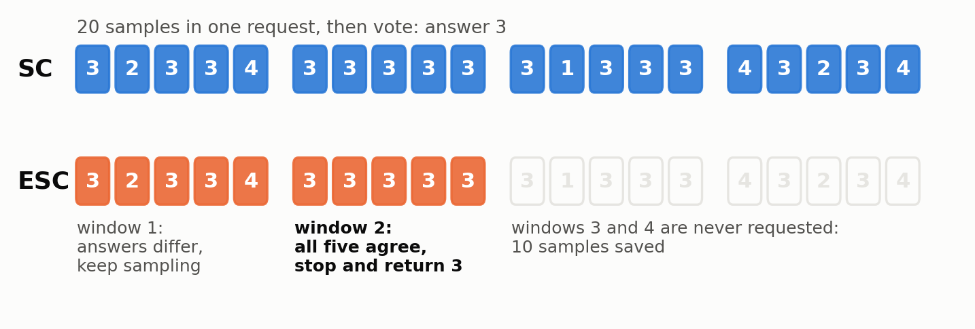
Method
ESC: stop when one window agrees with itself
Loop: draw w samples, check if all w answers are equal.
Equal: stop, return that answer.
Not equal: keep them, draw the next window.
Budget spent: vote over all L, exactly as SC.
No threshold to tune. Adaptive-Consistency checks a Beta posterior against 0.95 after every single sample.
Two supports: a z-test bound that an early stop rarely disagrees with full SC (Sec. 2.3), and a control scheme that predicts cost and accuracy for a choice of (w, L) (Sec. 2.4).
AI465 Research Project, Phase 1 | U23AI042
4

Slide 5
Evaluation
What the paper tested and what it reported
Setting | Value
Benchmarks | MATH, GSM8K, CSQA, StrategyQA, Last Letters, Coin Flip
Models | GPT-4, GPT-3.5-Turbo, Llama-2 7b
Prompts | few-shot chain of thought (Wei et al.)
Decoding | temperature 0.7 (0.5 for MATH)
ESC settings | w = 5, L = 40 (8 and 64 for MATH)
Runs | average of 10, variance omitted
GSM8K, GPT-4 (Table 1)
89.29%
the same accuracy as SC with 40 samples
7.98 samples
per question instead of 40
Reported saving in samples: GSM8K 80%, StrategyQA 77%, CSQA 79%, Coin Flip 84%, Last Letters 67%, MATH 34% (abstract).
AI465 Research Project, Phase 1 | U23AI042
5

Slide 6
Research gaps
Gaps 1 and 2: the comparison that matters is unmeasured
EVALUATION
COST AND LATENCY
The matched-budget gain is smaller than the noise nobody reported
Cost is counted in samples and dollars, never in time
Table 1: ESC beats SC at the same sample count by 0.22, 0.85 and 0.22 points on GSM8K.
Sec. 3.2: "averaged over 10 runs and omit variance".
0.22 points of 1,319 questions is three questions.
Tables 1 and 7: samples, tokens, dollars. No wall-clock figure.
SC asks for L samples in one parallel request. Algorithm 1 waits for each window: up to L/w = 8 round trips.
Llama-2 7b on GSM8K: 22% of samples saved, about six round trips.
AI465 Research Project, Phase 1 | U23AI042
6

Slide 7
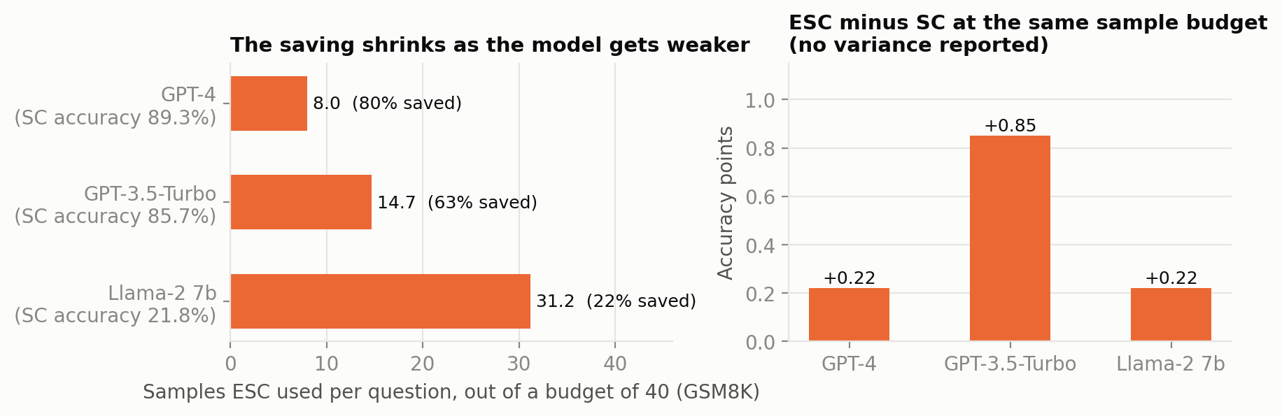
Research gaps
Gaps 3 and 4: weak models and wrong but confident answers
GENERALITY
Saving falls 80% to 22% as the model weakens.
Only open-weight model: Llama-2 7b at 21.75%. Nothing in the middle, nothing laptop-sized.
GSM8K numbers from Table 1 of the paper, plotted by me.
ASSUMPTION
The bound is about agreeing with SC, not about being right. Table 5 reports only the overlap of ESC and SC answers; no figure for how often a stop lands on a wrong answer.
It is quoted for w = 8 (at most 0.002). Five of six benchmarks use w = 5, where z = sqrt(5) gives about 0.013.
AI465 Research Project, Phase 1 | U23AI042
7

Slide 8
Objective
One objective, taken from Gap 1
To evaluate early-stopping self-consistency (window 5, at most 20 samples) for arithmetic word problems on a fixed 50-question subset of GSM8K test (1,319), with Qwen2.5-1.5B-Instruct run locally, compared against fixed-size self-consistency at a matched sample budget, measured by exact-match accuracy and by samples, tokens, rounds and latency per question, as mean and standard deviation over three seeded runs.
Why this one
Budget
Plan for Phase 2
Repeats the paper's matched-budget row, with the variance attached.
A 1.5B model sits in the regime Gap 3 says is missing.
Latency and stop-correctness (Gaps 2, 4) come from the same traces.
20 samples x 50 questions x 3 runs = 3,000 generations.
About 0.3M completion and 0.25M prompt tokens.
Laptop CPU, llama.cpp, three to four hours, zero cost.
Baselines first: greedy CoT and SC at k = 1 to 20.
Then ESC on the same samples, so only the stopping rule differs.
Ablation: random stopping with ESC's budgets.
AI465 Research Project, Phase 1 | U23AI042
8

