Slide 1
AI465 Agentic AI | Research Project, Phase 2
Early-Stopping Self-Consistency
On a small open-weight model at a matched budget: fewer samples, no clear accuracy gain, more tokens
Roll No. U23AI042
Implementation and evaluation of the objective approved in Phase 1
AI465 Research Project, Phase 2 | U23AI042
1

Slide 2
Objective
The approved objective, and what was built
To evaluate early-stopping self-consistency (ESC; window 5, at most 20 samples) for arithmetic word problems on a fixed random subset of 50 questions from the GSM8K test set (1,319 questions), using the open-weight Qwen2.5-1.5B-Instruct model run locally, compared against fixed-size self-consistency (SC) at a matched sample budget, measured by exact-match accuracy and by samples, tokens, sequential rounds and wall-clock latency per question, each reported as mean and standard deviation over three seeded runs.
Built: greedy CoT and SC-k baselines, ESC, a random-stopping ablation, Adaptive-Consistency for context, a resumable sampler with full traces, an offline evaluator and a live demo.
Scope: The objective was implemented as approved, with no change of scope.
AI465 Research Project, Phase 2 | U23AI042
2

Slide 3
Setup
Pinned configuration
Item | Value
Model | Qwen2.5-1.5B-Instruct, GGUF q4_k_m (sha256 6a1a2eb6...434e9407e)
Runtime | llama.cpp llama-server b11429, CPU only, 4 threads, 5 slots
Decoding | temperature 0.7, top-p 0.9, top-k off, repeat penalty 1.0, max 256 new tokens; greedy baseline at temperature 0
Prompt | system message + 3 worked examples of my own + question (prompts/, about 420 prompt tokens)
Tasks | GSM8K test, subset seed 465, 50 questions (data/subset_ids.json)
Runs | 3, seeds 11, 22, 33; sample seed = run x 10^6 + question x 100 + index
Checker | exact match on the number after "Final answer", else the last number in the reply; no LLM judge
Date, cost | 6 October 2026; 3000 sampled generations, 0.28M completion tokens, 3.1 h of CPU, zero rupees
Prompts are files in prompts/. Every run writes one JSON trace per question. Tables regenerate from the traces with no model call.
AI465 Research Project, Phase 2 | U23AI042
3

Slide 4
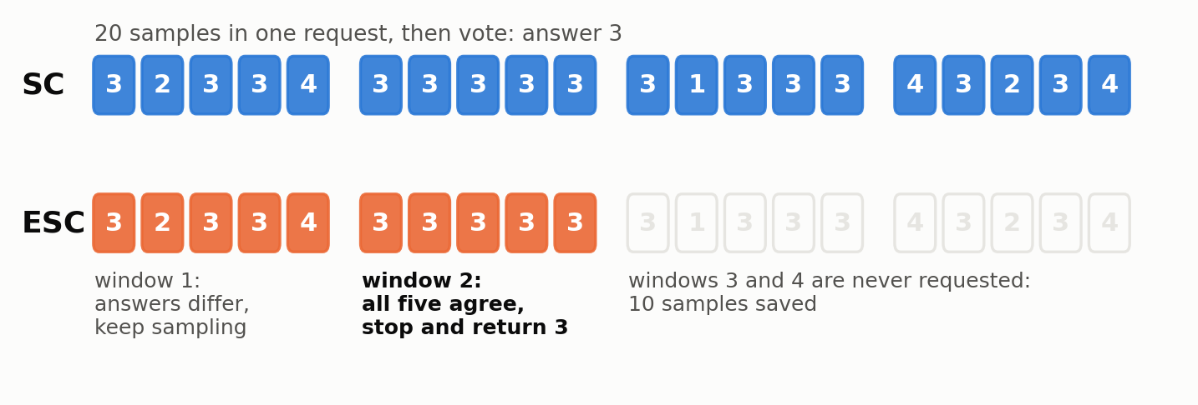
Design
One pool of samples, so only the stopping rule differs
Sample once: 4 rounds of 5 per question and run.
SC-k: reads the first k samples.
ESC: reads whole rounds until one is unanimous.
Same: model, prompt, decoding, samples.
Matched budget
Ablation
Cost
SC at ESC's mean sample count, rounded down (k = 15) and up (k = 16).
Random stopping: ESC's sample counts shuffled across questions. Same budget, no signal.
Samples, sequential rounds, prompt and completion tokens, measured wall-clock time per round.
AI465 Research Project, Phase 2 | U23AI042
4

Slide 5
Results
Results: mean and standard deviation over 3 runs
Method | Accuracy % | Samples | Rounds | Prompt tok | Compl. tok | Total tok | Latency s
CoT greedy (1 call) | 58.0 | 1 | 1 | 420 | 90 | 510 | 6.5
SC-5 | 62.7 ± 3.1 | 5.00 | 1.00 | 420 | 466 | 885 | 19.8 ± 2.4
SC-10 | 64.7 ± 6.4 | 10.00 | 1.00 | 420 | 918 | 1338 | 38.4 ± 3.7
SC-15 (matched, floor) | 67.3 ± 5.0 | 15.00 | 1.00 | 420 | 1376 | 1795 | 56.6 ± 4.9
SC-16 (matched, ceil) | 68.0 ± 4.0 | 16.00 | 1.00 | 420 | 1467 | 1886 | 60.2 ± 4.8
SC-20 (full budget) | 67.3 ± 3.1 | 20.00 | 1.00 | 420 | 1836 | 2256 | 74.6 ± 4.7
ESC (w=5, L=20) | 67.3 ± 3.1 | 15.30 | 3.06 | 1295 | 1487 | 2782 | 60.7 ± 5.3
Adaptive-Consistency | 67.3 ± 3.1 | 12.71 | 12.71 | 5391 | 1257 | 6648 | 52.0 ± 5.9
Random stopping (ablation) | 65.9 ± 3.4 | 15.30 | 3.06 | 1295
50 GSM8K questions, costs per question. Prompt tokens: one prompt per round. Source: results/summary.csv, python src/evaluate.py.
AI465 Research Project, Phase 2 | U23AI042
5

Slide 6
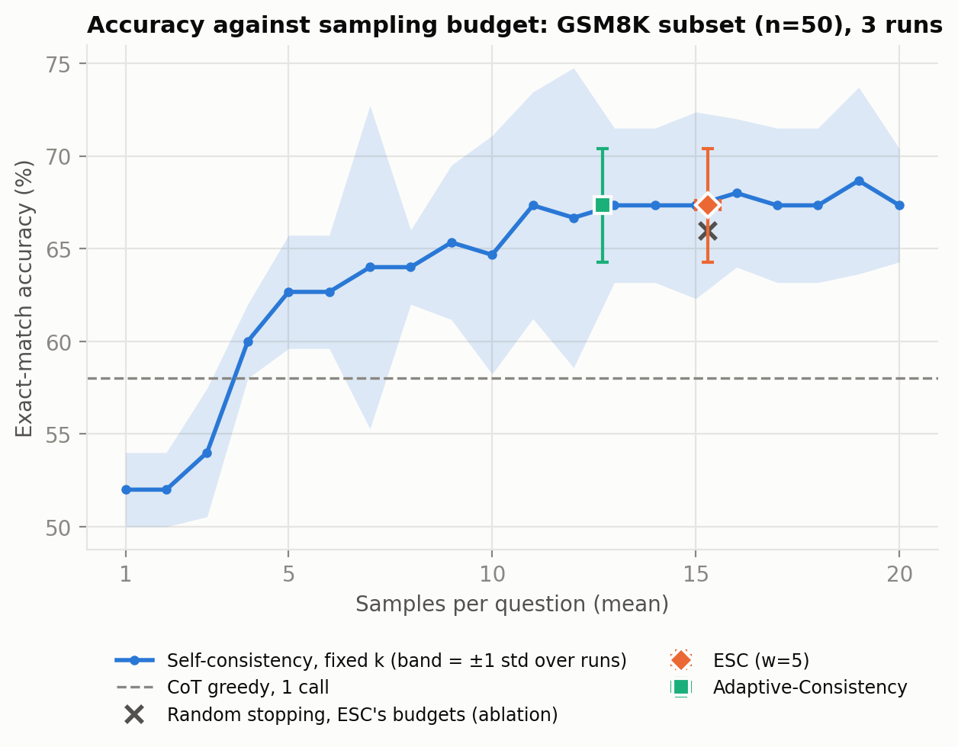
Analysis
Finding 1: no detectable accuracy gain at a matched budget
67.3%
ESC, 15.3 samples per question
68.0%
SC-16, the same budget
-0.7 ± 1.2
paired difference in points
Checker-sensitive: with replies that lack an answer line scored as no answer, ESC is ahead by +2.7 ± 1.2 points. Not settled at this sample size.
AI465 Research Project, Phase 2 | U23AI042
6

Slide 7
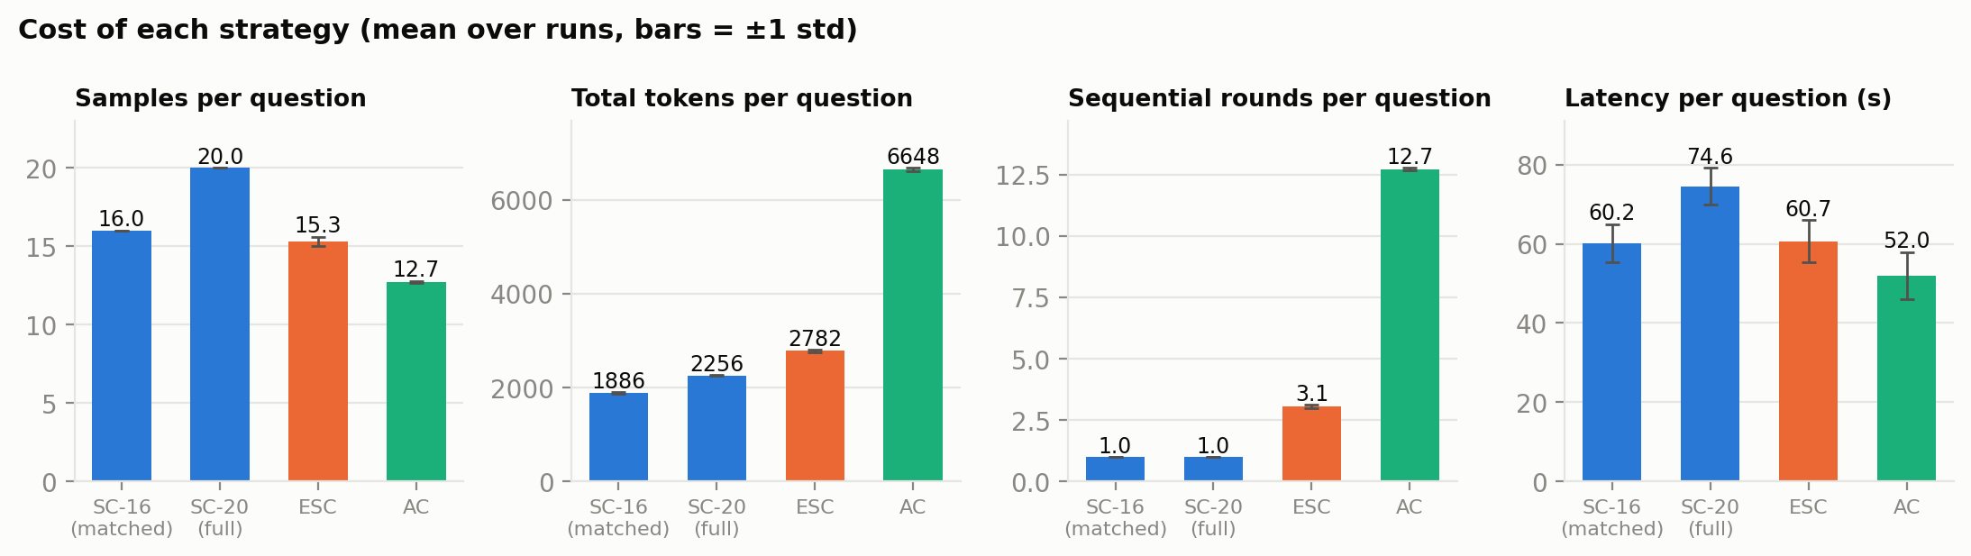
Analysis
Finding 2: fewer samples, but more tokens and more rounds
23% fewer samples than SC-20, with the same answers (agreement 100%).
23% more total tokens: every window re-sends the 420-token prompt.
3.1 sequential rounds against 1. Behind a parallel API the rounds are the latency.
AI465 Research Project, Phase 2 | U23AI042
7

Slide 8
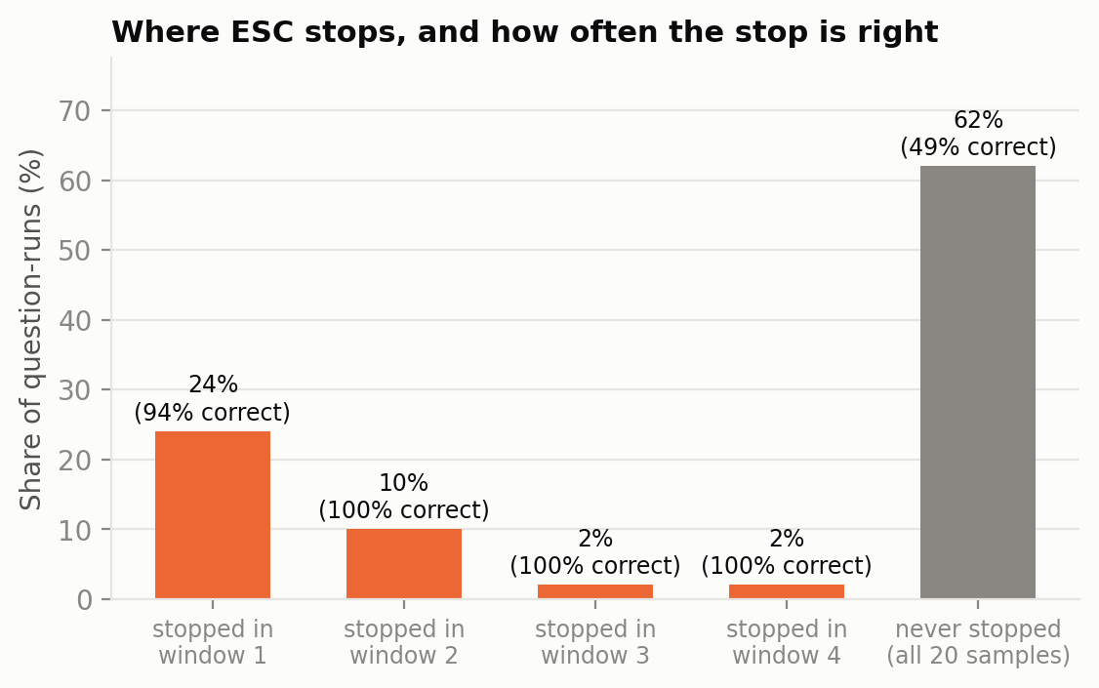
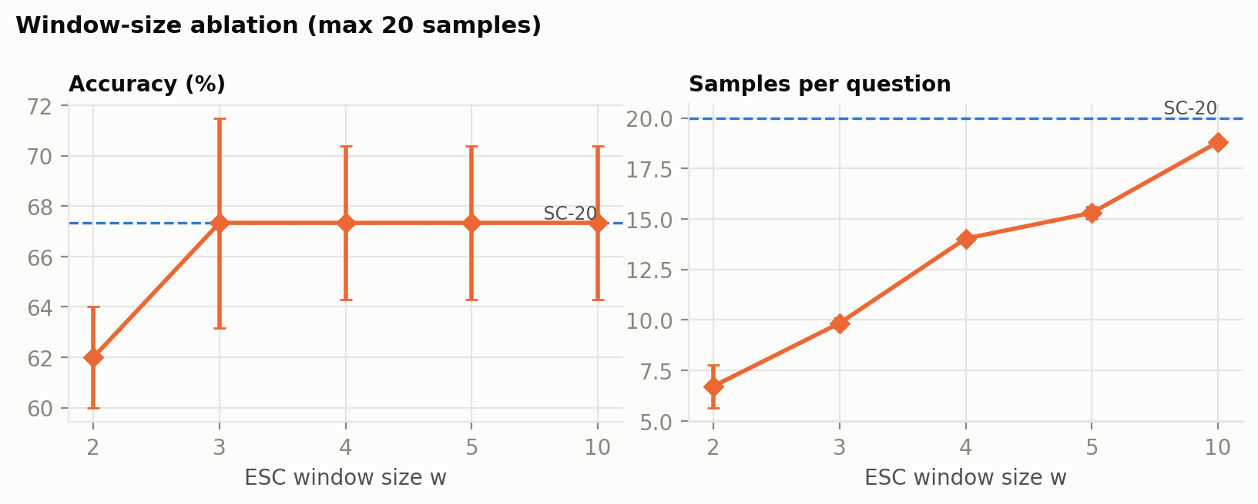
Ablation
Finding 3: the stopping signal is precise, and worth little
Random stopping with the same budgets: 65.9%. The signal is worth +1.4 ± 0.6 points.
Early stops: 57 of 150 question-runs; 2 of them wrong.
Window size: w = 2 uses 6.7 samples for 62.0%; w = 10 uses 18.8 for 67.3%.
AI465 Research Project, Phase 2 | U23AI042
8

Slide 9
Failure case
A failure read from the trace: a confident wrong stop
Question 99
From the trace (traces/run_11/q0099.json)
Mary receives 18 new potted plants. She already has 2 on each of her 40 window ledges. She gives away 1 plant from each ledge. How many plants does she keep?
"Mary has 2 plants on each of 40 ledges, so she has 2 * 40 = 80 plants already. She will give away 1 plant per ledge ... 80 - 40 = 40."
Gold: 58
Cause: the 18 new plants in the first sentence are never used.
Unanimity measures consistency, not correctness.
No harm here: SC-20 returns 40 as well, so ESC lost nothing and saved 15 samples.
2 of 57 early stops were wrong; 12 of 50 questions are wrong in every run.
Run 11, first window
40 40 40 40 40
ESC stops after 5 samples and returns 40. Of all 20 samples, 18 say 40.
AI465 Research Project, Phase 2 | U23AI042
9

Slide 10
Close
Limitations, next steps and the demo
Limitations
With four more weeks
50 questions, one model, one prompt: only large effects are visible.
L = 20, not the paper's 40.
Greedy baseline 58% against 73.2% published for this model (4-bit weights, own prompt, small n).
Latency from a shared laptop; the round count is the portable figure.
Full 1,319 questions and L = 40 on a GPU.
A second, stronger open-weight model.
Latency against a hosted API with parallel sampling.
ESC with the prompt cached across windows.
Live demo: python demo.py --task 6
ESC on one GSM8K question, window by window, with the trace written to traces/demo/.
AI465 Research Project, Phase 2 | U23AI042
10

