Slide 1

KIIT DEEMED TO BE UNIVERSITY · SCHOOL OF COMPUTER ENGINEERING
AI Shopping Agent
A conversational shopping agent grounded in a live cross-merchant catalogue, designed so that fabricated products are impossible rather than unlikely.
Ridhi Kumari
Roll No. 23052828
B.Tech, Information Technology
KIIT Deemed to be University
Notes:
Introduce the project in one line: a shopping agent that cannot invent a product, because the architecture will not let it. Say the report is 25 pages and this is the 5-minute version.

Slide 2
THE PROBLEM
Buyers think in intent. Search works in keywords.
— Translation burden. The shopper must convert a need into keywords, then filters, then a dozen open tabs.
— Stale results. A keyword match can be several hardware generations old, or an accessory rather than the device.
— Unsupported claims. “Yes, that works with your Mac” — with nothing behind it.
“something for editing 4K video on a budget”
Conventional search cannot answer this. It has no notion of what the sentence is for.
2
Notes:
Keep this short. The point: buyers think in intent, search works in keywords. The gap is where they give up. Give the 4K video example out loud.

Slide 3
WHY AN AGENT
Three properties make a single model call insufficient
01
02
03
Unknown depth
External truth
Recoverable failure
How many steps are needed is not knowable before the conversation starts.
The answer lives in a catalogue that changes hourly. A recalled price is worse than no price.
Searches come back empty or off-target often. The system must notice and re-query.
So the system plans, calls tools, observes results, corrects itself, and stops on an explicit condition — the standard agent loop.
3
Notes:
Explain why this needs an agent and not one model call. Three properties. Emphasise 'external truth' — the model's own memory is dangerous here.

Slide 4
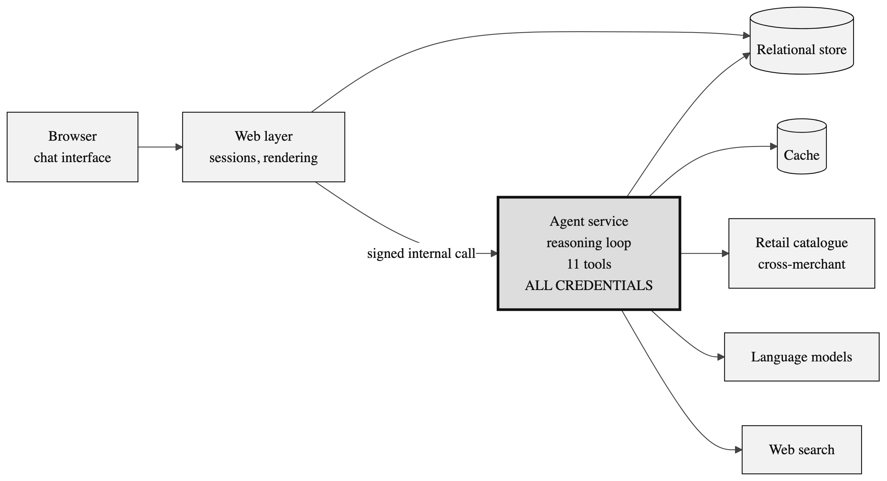
SYSTEM ARCHITECTURE
Three processes, one trust boundary
The agent service (heavy outline) is the only process holding catalogue, model or search credentials. The web layer proxies everything across an authenticated boundary.
4
Notes:
Walk left to right. The one thing to point at: the heavy box. All credentials live in that one process; the web layer holds none.

Slide 5
ENGINEERING
What the system is actually built from
Frontend
Agent service
Data
Verification
Next.js 16 App Router
React 19, server components
Tailwind CSS, shadcn/ui, Radix
SWR, next-auth
Node.js, strict TypeScript
Vercel AI SDK — streamText
Zod schemas on every tool
Hand-written MCP client
PostgreSQL 16, Drizzle ORM
Redis 7 for feed + evidence
Message parts stored as JSON
SSE response streaming
Vitest — unit and routes
Playwright — end to end
Scenario harness — behaviour
Static type checking
29 models
JSON-RPC 2.0
selectable at run time, 22 tool-capable — lets policy failures be separated from model failures
every catalogue call is wrapped in an MCP tools/call envelope with an agent-identity header
5
Notes:
The build itself. Strict TypeScript end to end, Zod at every tool boundary, and a hand-written MCP client rather than an SDK. Mention 29 models selectable at run time — that is what let me compare policy failures against model failures.

Slide 6
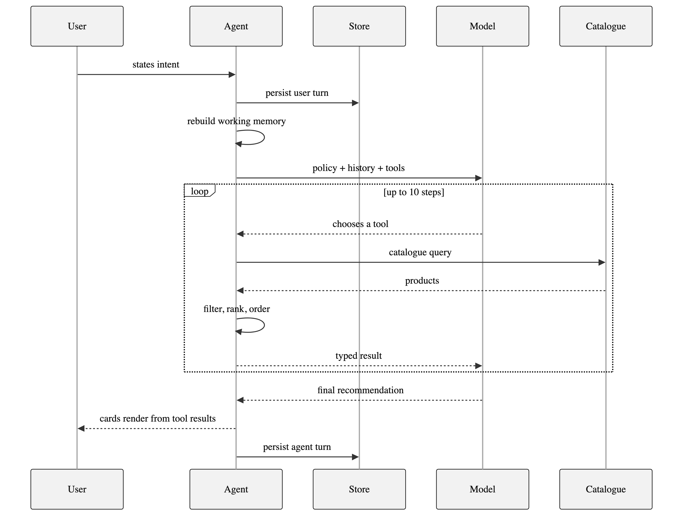
ONE TURN, END TO END
Up to ten reasoning steps per message
— User message is persisted before the stream opens.
— Working memory is rebuilt from the transcript.
— The boxed region is the agent loop.
— The model sees typed results, never raw network traffic.
6
Notes:
Point out the ordering: the user's message is saved BEFORE the stream opens, so a dropped connection can never lose it. Then the boxed loop.

Slide 7
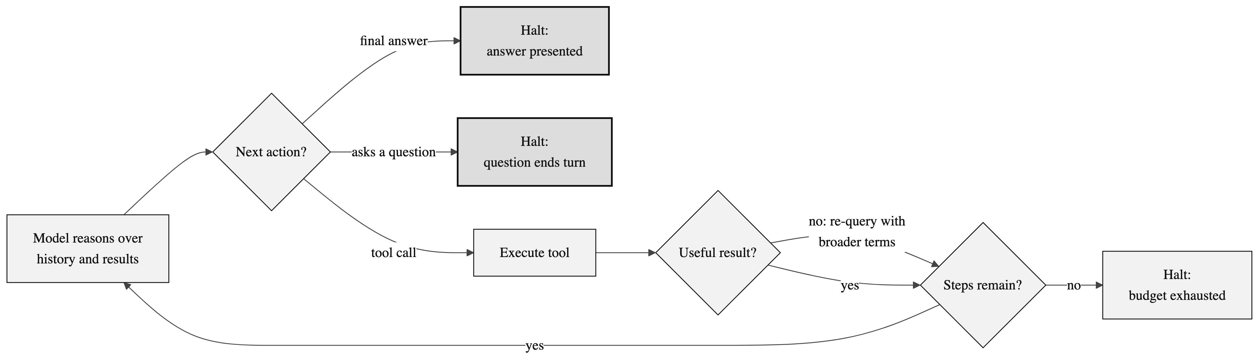
THE REASONING LOOP
Bounded, with two stopping conditions
Step budget
Clarification is terminal
Ten steps per turn. Bounds cost; stops a confused model looping on a failing search.
Asking the shopper a question ends the turn — enforced by the runtime, not requested in the prompt.
7
Notes:
Two stopping conditions. The interesting one is the second: asking a question ENDS the turn. Otherwise the model asks and then keeps working underneath it.

Slide 8
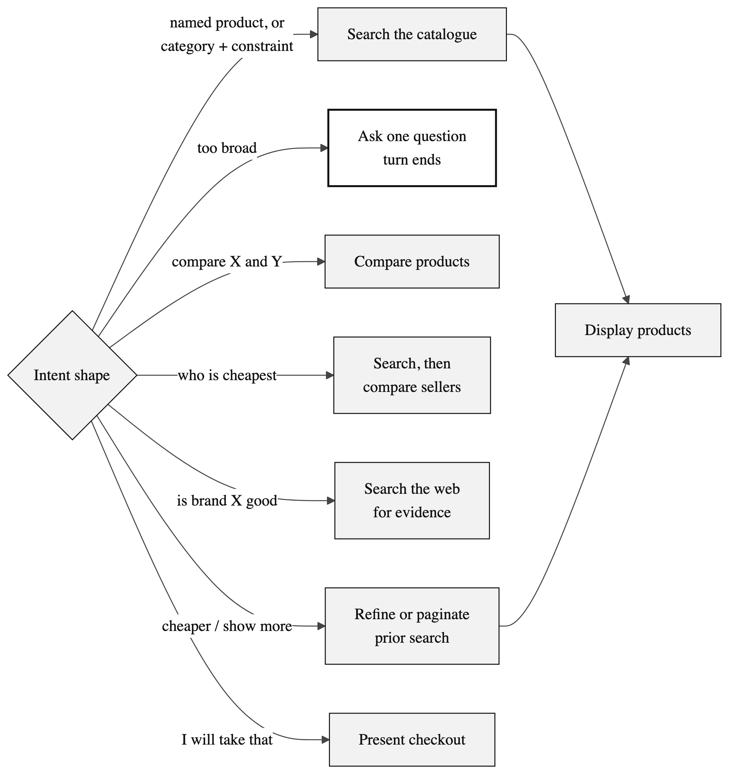
TOOLS AND DECISION POLICY
Eleven typed tools, routed by intent shape
Discovery
Search · Refine · Show more
Presentation
Display products
Analysis
Get product · Compare products · Compare sellers
Interaction
Clarify · Buy · Web search · Web fetch
Search and display are deliberately separate, so the agent can search three times, discard two, and show only the third.
8
Notes:
Eleven tools in four groups. The load-bearing detail: searching and displaying are separate actions, so the agent can discard bad result sets silently.

Slide 9
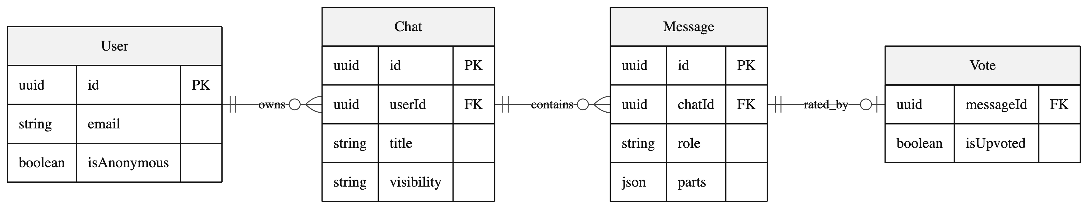
DATA AND STATE
Memory derived from the transcript, not stored beside it
Each message stores an ordered array of parts — text, reasoning, and every tool call with its input and output.
Replayable
Derived memory
Scoreable
Historical chats re-render exactly, because the tool results are still there.
Prior query, filters and seen IDs are rebuilt per request — no separate state to go stale.
The evaluation harness reads the tool sequence straight out of the transcript.
Caching: feed 1 hour · web evidence 5 minutes · catalogue never — freshness is the point, and the catalogue terms forbid it.
9
Notes:
One design decision to highlight: working memory is NOT stored separately. It is rebuilt from the transcript each request, because every tool result is already saved inside the message. That removes a whole class of stale-cache bug.

Slide 10
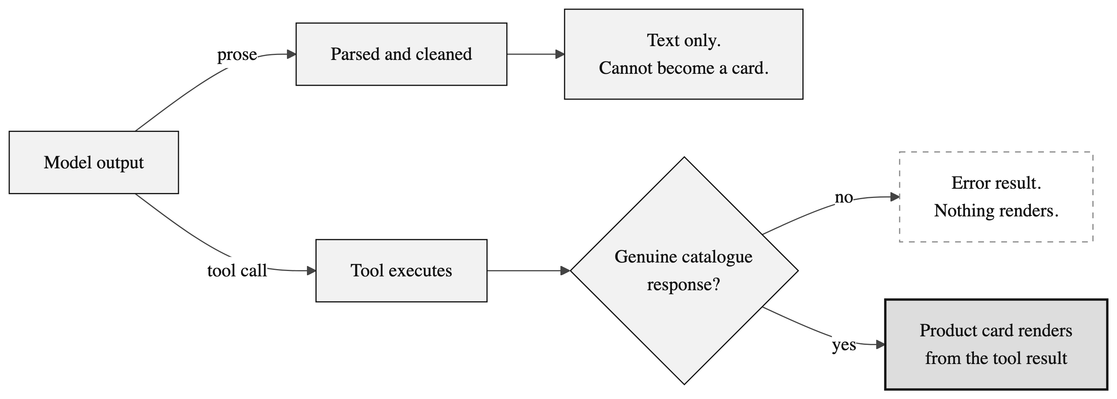
THE CENTRAL IDEA
Hallucinated products are impossible, not unlikely
The interface renders product cards only from tool results. The model can ask for a card, but it cannot supply its contents — so inventing a price or a product is not a behaviour it is discouraged from, but one the architecture does not permit.
10
Notes:
THE key slide. Two paths. The model fully controls the top one and it ends in text. A product card needs a real catalogue response it cannot fabricate.

Slide 11
EVALUATION
Judged on behaviour, not on how the reply reads
Named product
CLEAN
5 of 8 scenarios clean
Budget constraint
CLEAN
Comparison branch
CLEAN
three flagged, each with a diagnosed cause
Seller comparison
CLEAN
Category + use case
CLEAN
Two of the three failures produced output that looked entirely correct on screen. Reading the replies would have passed both. Only assertions over the tool sequence caught them. For agentic systems, behavioural evaluation is the primary instrument, not a supplement.
Broad request
QUESTION AS TEXT
Open-ended gift
QUESTION AS TEXT
Generation sensitivity
OFF-TARGET
11
Notes:
Be honest here — it is the strongest slide. Five of eight clean. The two failures LOOKED correct on screen. Only checking the tool sequence caught them.

Slide 12
CONCLUSION
What the project shows, and what comes next
The useful part of an agentic system is not the conversation — it is the constraints around it: the bounded loop, the typed tools, the derived memory, and the grounding contract.
Delivered
Next
— Live cross-merchant catalogue integration
— Eleven typed tools, bounded reasoning loop
— Grounding enforced by the interface contract
— Four-layer verification incl. behavioural harness
— Automatic failover between models
— Constrained output for clarifying questions
— Larger evaluation set covering multi-turn chains
12
Notes:
Close on the transferable claim, then the three next steps. Invite questions.

Slide 13
Thank you
Questions welcome
Ridhi Kumari · Roll No. 23052828
School of Computer Engineering · KIIT Deemed to be University
Notes:
Thank the panel and invite questions.

