Slide 1
Who pays the token tax?
Fertility inequality, SuperBPE, and a 100M → 1B bake-off
Aryan Verma · Frank Gonzalez
5-minute overview

Slide 2
Roadmap
Five minutes
1
2
3
4
The problem
What we measured
A candidate fix
Does it help LMs?
Same meaning → different token counts
FLORES premiums & fertility
SuperBPE + our Rust trainers
100M done · 1B running

Slide 3
Same sentence. Different bill.
Token fertility is unequal across languages
English
Hindi / Amharic
Agglutinative (e.g. Hungarian)
few tokens
many tokens
more pieces
API cost, context window, and training budget all track token count — not characters.

Slide 4
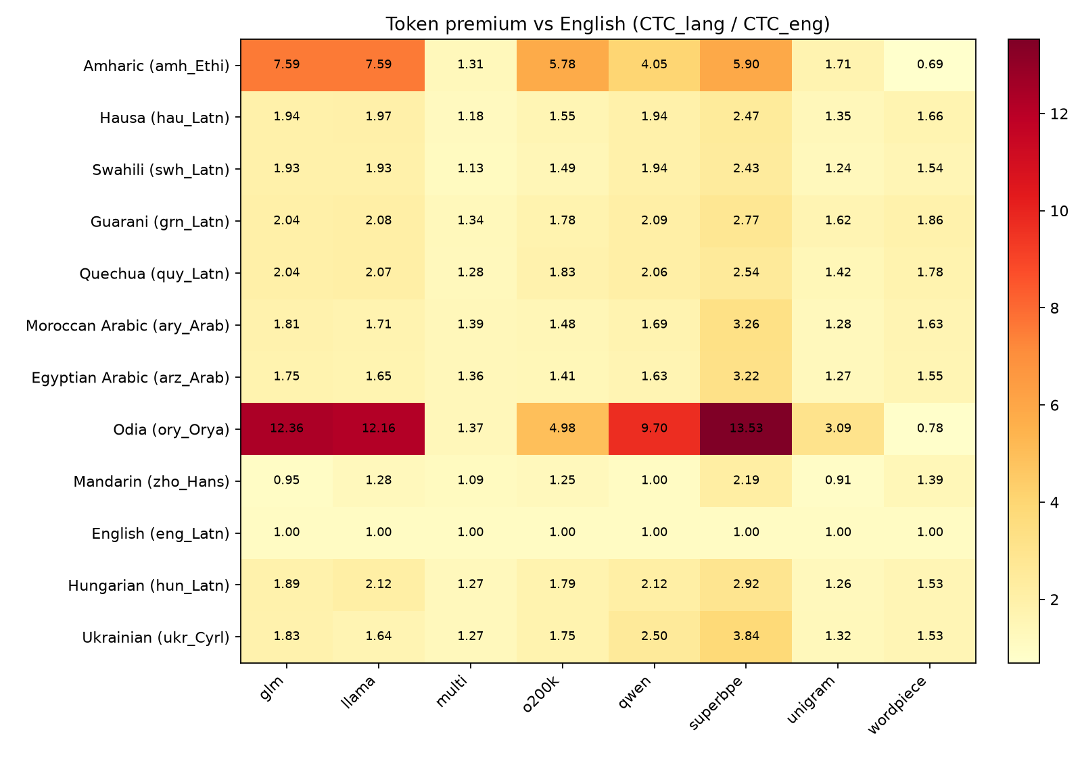
Our FLORES findings
English-relative token premium on parallel text
Target scripts
Amharic, Odia, dialectal Arabic
Controls
Swahili, Hausa (Latin African)
Signal
Premium ≥ 2 on ≥2 frontier BPEs

Slide 5
Three plain-language meters
What the numbers mean
Token premium
Fertility
Bits / byte (BPB)
How many more tokens than English for the same meaning?
How many tokens per word (or character unit)?
How hard is the text to predict, per byte?
1.0 = fair 2.0 = 2× English cost
Lower = packs more meaning per token
Fairer than bits/token when tokens differ in length

Slide 6
Why BPE overcharges some languages
Frequency + UTF-8 conspire
Train on English-heavy web
Merges favor frequent Latin pieces
Rare scripts stay as tiny fragments
→ BPE learns what it sees often — English digraphs win the vocab lottery.
→ UTF-8: non-Latin characters already cost more bytes before merges even start.
→ Whitespace pretok keeps one token = one word-ish unit — no multi-word packing.

Slide 7
SuperBPE: lift the word fence
Liu et al., 2025
Stage 1 — ordinary BPE
Stage 2 — superwords
Whitespace-pretokenized Learn subwords inside words
Whitespace restriction lifted Learn multi-word tokens
of
the
United
States
of the United States
4 tokens
1 token · same meaning

Slide 8
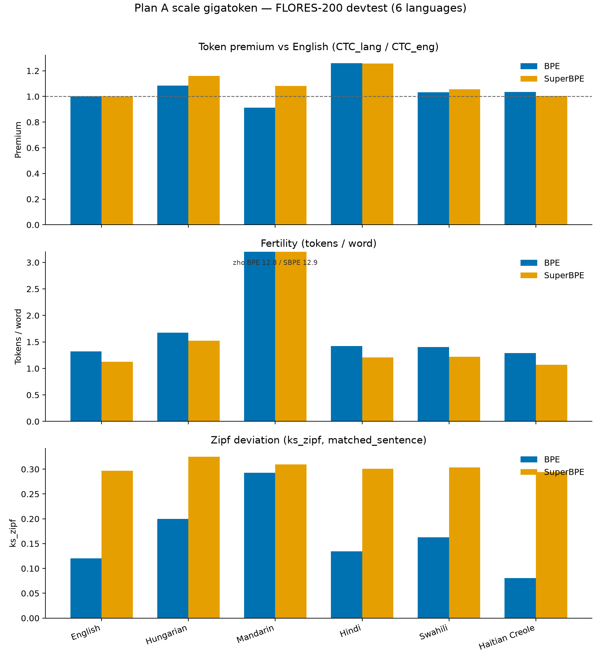
Matched BPE vs SuperBPE on FLORES
Equal-byte 6-language train · same vocab size
Fertility ↓
Fewer tokens/word for every whitespace language (Haitian, Hindi, …)
Premium mixed
Mandarin & Hungarian get worse vs English — choice is language-conditional

Slide 9
supergigatoken — how we train & encode
Rust fork of gigatoken · native SuperBPE
Trainers
Encoder
Eval suite
train_bpe (gigatoken)
Level 1 · cached subwords
• Encoding efficiency
• Encoding throughput
train_superbpe (fork)
Level 2 · superword merges
• Trainer vs HF / original
Two-stage: subwords → superwords Same vocab target as BPE
• Vocab overlap (Jaccard)
Bit-identical to full byte merge Recovers most of BPE speed

Slide 10
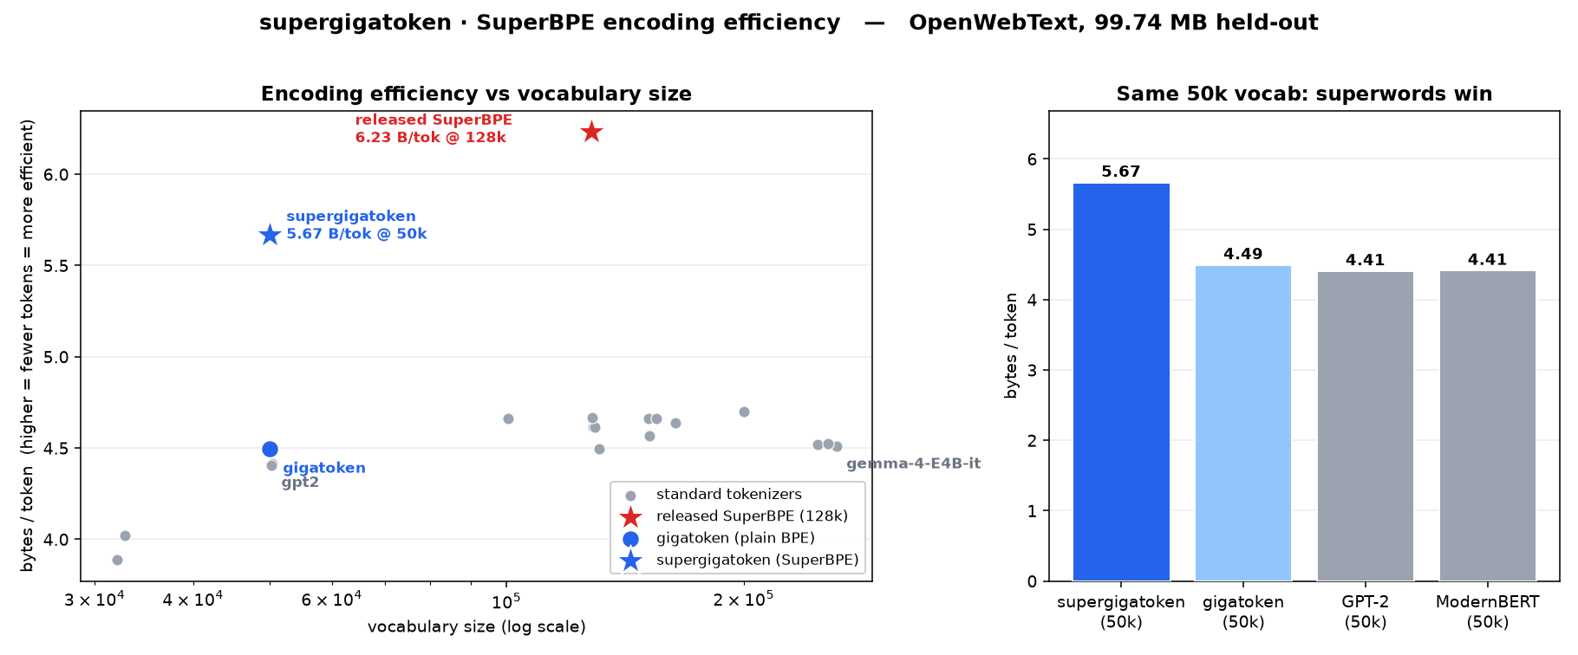
Same vocab: ~21% fewer tokens
50k SuperBPE vs 50k BPE · OpenWebText held-out
Matched 50k
SuperBPE 5.67 B/tok BPE 4.49 B/tok
→ 20.7% fewer tokens for the same text

Slide 11
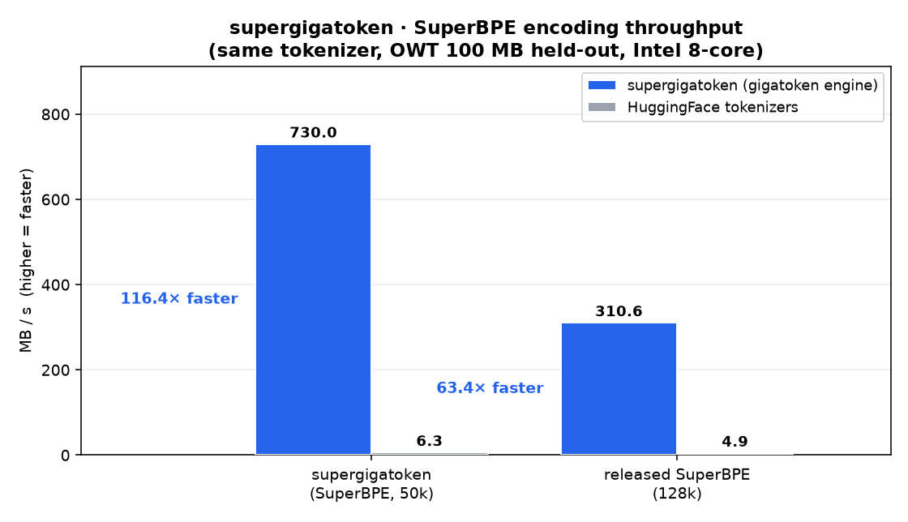
Fast enough to ship
Train & encode vs HuggingFace / original SuperBPE
8×
116×
3.8×
faster SuperBPE train vs original impl
faster SuperBPE encode vs HuggingFace
faster plain BPE train vs HF BpeTrainer

Slide 12
Does it help language models?
Phase 0 · 100M OLMo pilot
Data
Model
Tokenizers
Readout
Equal-token FineWeb 6 languages
olmo2_100M matched steps
gigatoken BPE supergigatoken SuperBPE
bits/token + approx BPB
Caveat: equal-token matching + bits/token bias against longer SuperBPE tokens → we also report fertility-normalized approx BPB.

Slide 13
100M results — the gap shrinks when fair
Raw bits/token vs fertility-normalized approx BPB
Raw bits / token
Approx BPB (fairer)
Favors shorter tokens
bits/token ÷ UTF-8 bytes/token
BPE
5.45
BPE
1.061
SuperBPE
6.29 (+0.84)
SuperBPE
1.085 (+0.025)
BPE wins on 5/6 languages. Chinese ≈ tie.
Gap mostly collapses. Haitian Creole: SuperBPE slightly better.

Slide 14
Next: 1B equal-bytes / equal-FLOPs
True BPB — the decision metric
Phase 0 is a pilot — not a cancel signal.
Raw bits/token looked bleak; fertility-normalized BPB says “keep going.”
Scale
Match
Metric
Status
olmo2_1B · ~20B tokens
Equal bytes → equal FLOPs
True UTF-8 BPB on val / FLORES
Training in progress

Slide 15
Takeaways
1
Languages pay unequal token taxes under frontier BPEs.
2
SuperBPE packs more text per token — but not uniformly fairer.
3
100M: raw bits/token scared us; approx BPB mostly closed the gap.
4
1B equal-FLOPs BPB is the real go/no-go — running now.

Slide 16
Bibliography
Key references
[1] Liu et al. (2025). SuperBPE: Space Travel for Language Models. arXiv:2503.13423
[2] Arnett & Bergen (2025). Why do language models perform worse for morphologically complex languages? / token premiums on FLORES.
[3] Goyal et al. (2022); NLLB (2022). FLORES-200 parallel evaluation.
[4] Penedo et al. (2024/2025). FineWeb / FineWeb-2 web corpora.
[5] Chowdhury & Woolf (2026). Benchmarking SuperBPE (BPB evidence on Mandarin/Hungarian).
[6] gigatoken (Roed et al.) — fast Rust BPE; supergigatoken — SuperBPE fork (this work).
[7] OLMo / OLMo-core (Ai2) — training stack for Phase 0 / Plan B.

