Slide 1
Token fertility, SuperBPE, and the token tax
Why some languages pay more tokens for the same meaning
Aryan Verma · Frank Gonzalez

Slide 2
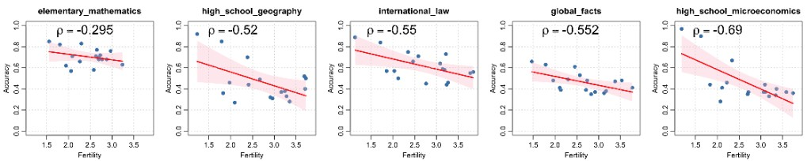
What is token fertility?
Tokens per word — higher means more fragmentation
Fertility = (number of tokens) / (number of words)
Same meaning, more tokens → higher API cost, less context, harder modeling.
"Tokenization inefficiency imposes structural disadvantages on morphologically complex, low-resource languages, inflating compute resources and depressing accuracy."
— Lundin et al., The Token Tax (arXiv:2509.05486)
Higher fertility → lower accuracy across AfriMMLU subjects (Lundin et al., 2025).

Slide 3
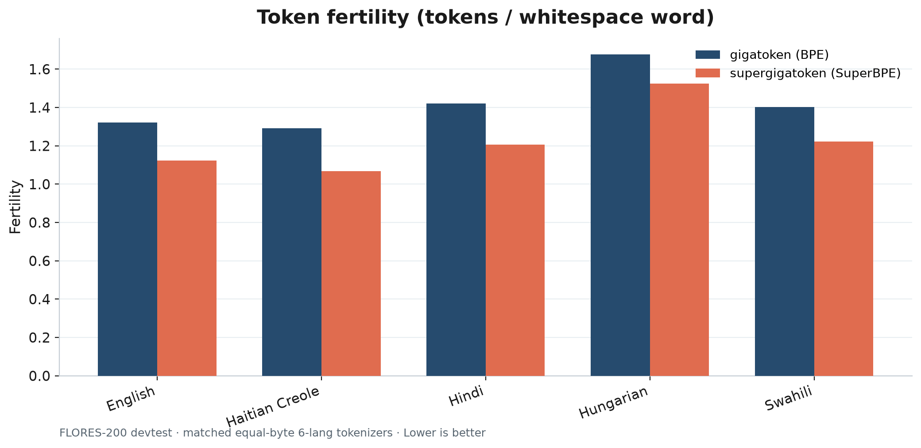
Our fertility results — BPE vs SuperBPE
FLORES-200 · matched equal-byte 6-language tokenizers · lower is better

Slide 4
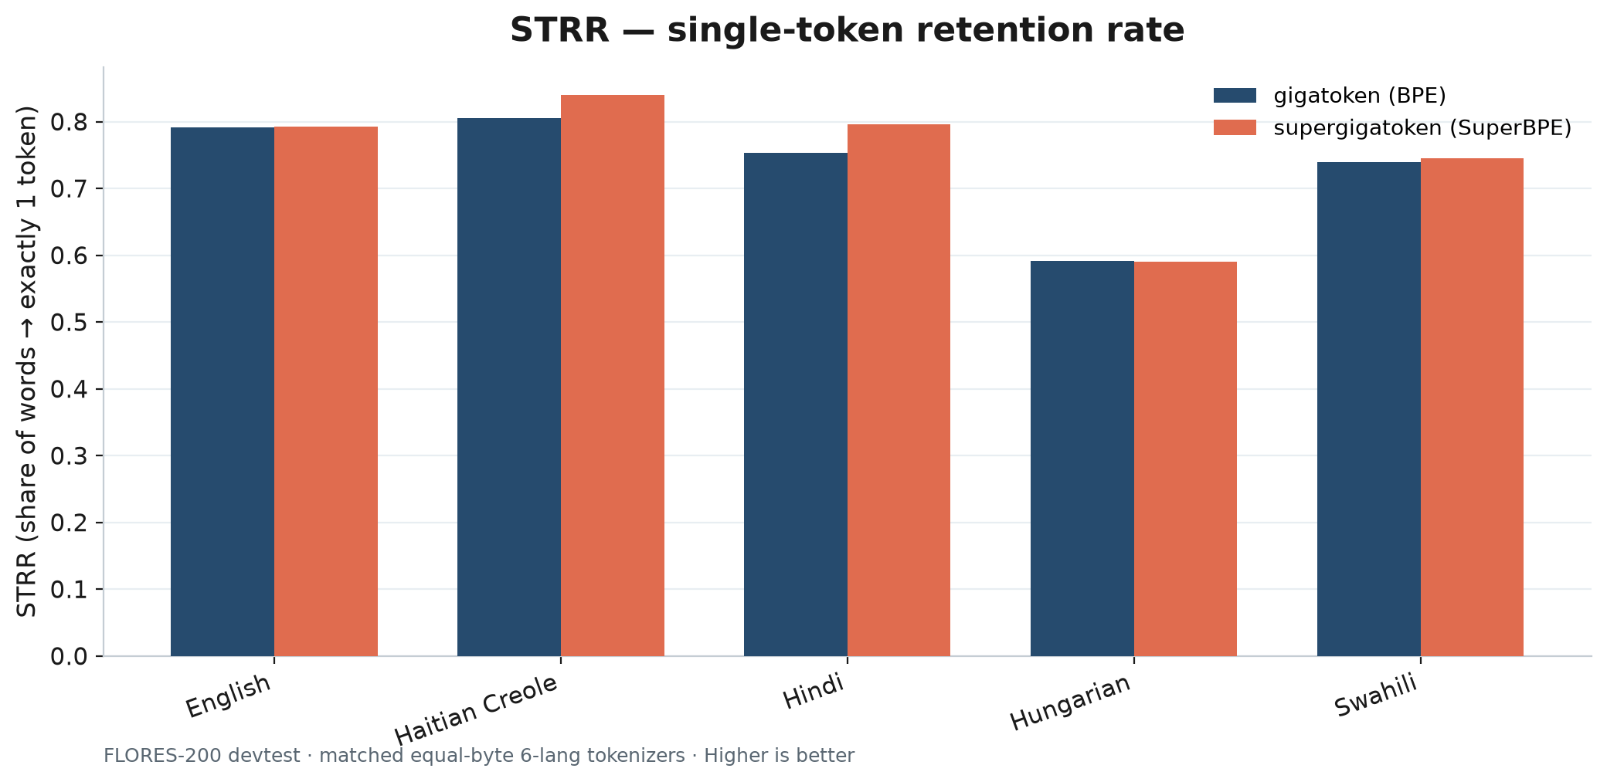
STRR — single-token retention rate
Share of whitespace words encoded as exactly one token · higher is better
Metric from Nayeem et al. (arXiv:2510.09947). Mandarin omitted (whitespace words N/A).

Slide 5
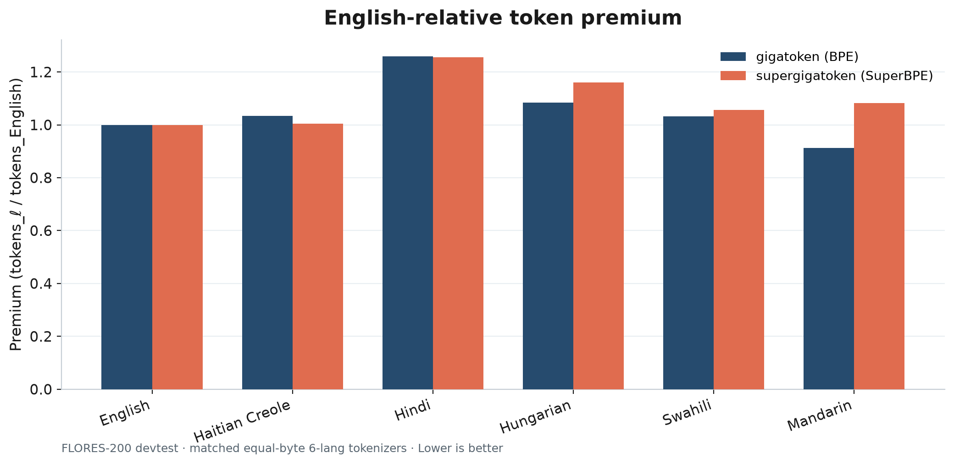
English-relative token premium
tokens_ℓ / tokens_English on parallel FLORES text · lower is fairer

Slide 6
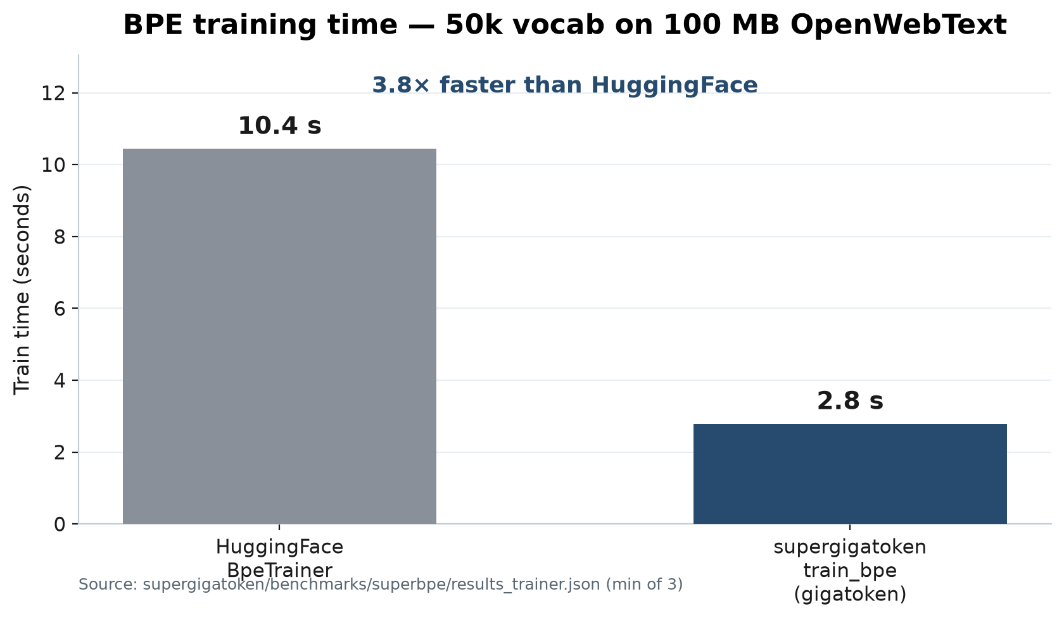
BPE training time on supergigatoken
50k vocab · 100 MB OpenWebText · train_bpe vs HuggingFace BpeTrainer

Slide 7
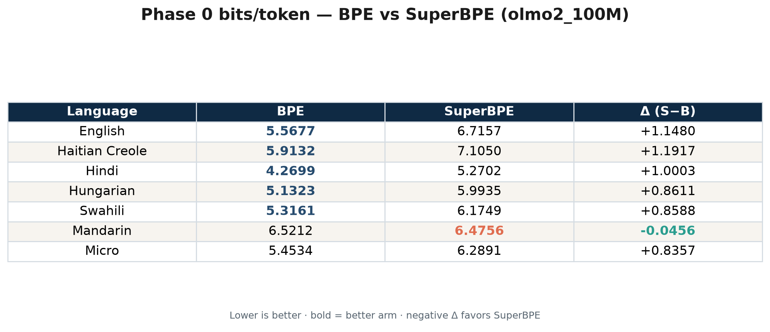
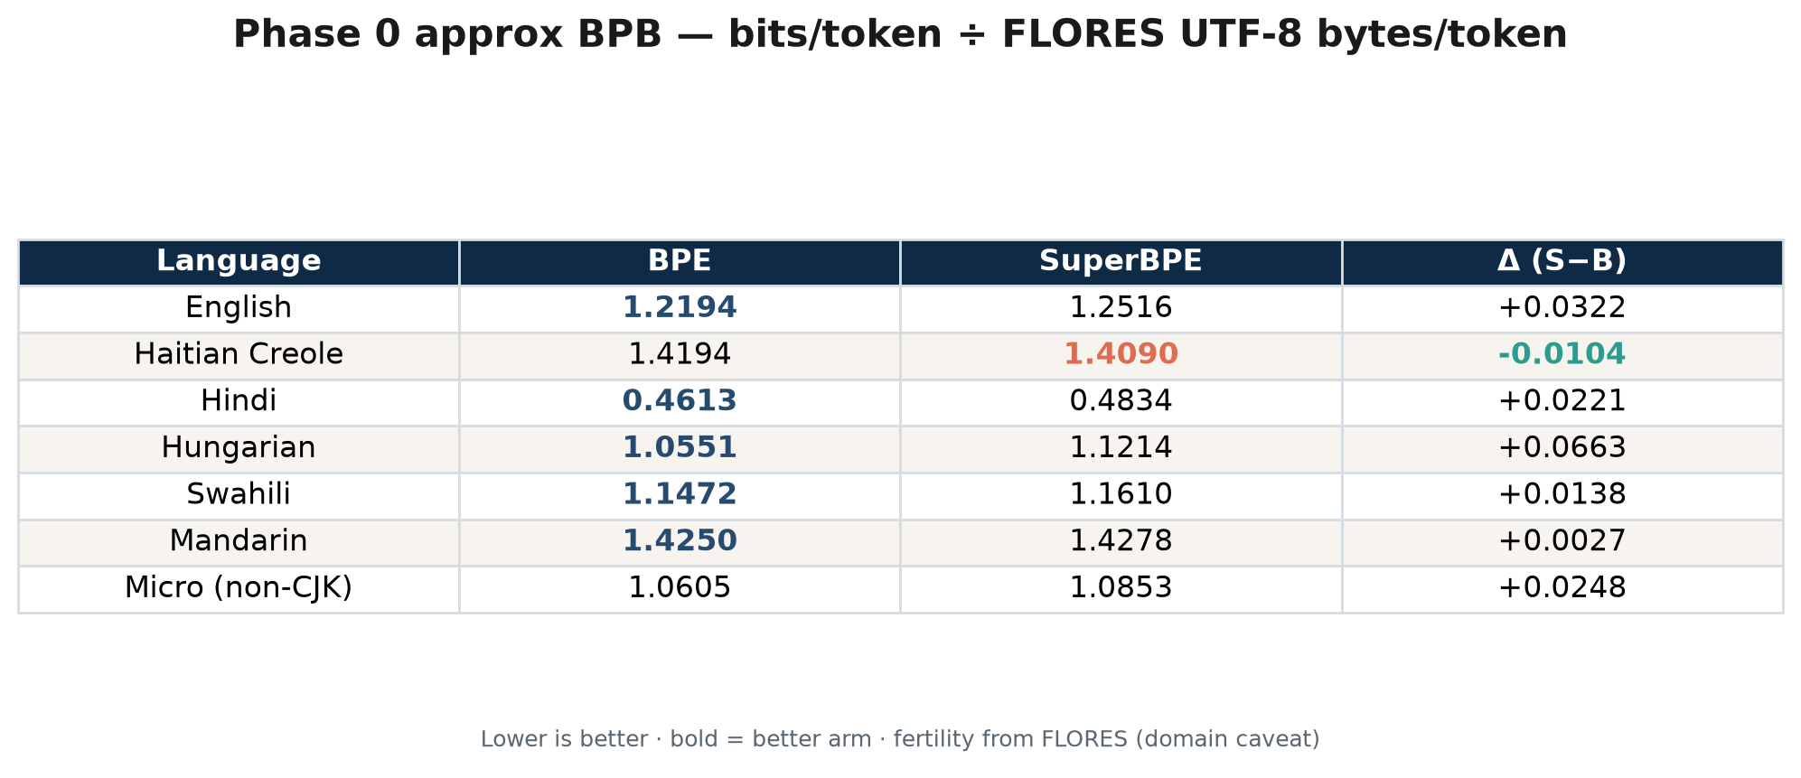
Phase 0 LM eval — bits/token and approx BPB
olmo2_100M @ step7629 · lower is better · bold in table = better arm
Bits / token
Approx BPB (fertility-normalized)

Slide 8
Table — bits/token by language
Phase 0 · BPE vs SuperBPE

Slide 9
Table — approx BPB by language
bits/token ÷ FLORES UTF-8 bytes/token

Slide 10
Bibliography
Papers cited in this talk
1
Lundin et al. (2025)
The Token Tax: Systematic Bias in Multilingual Tokenization.
https://arxiv.org/abs/2509.05486
2
Petrov et al. (2023)
Language Model Tokenizers Introduce Unfairness Between Languages. NeurIPS 2023.
https://arxiv.org/abs/2305.15425
3
Somide (2026)
The African Language Tax.
https://arxiv.org/abs/2606.24460
4
Arnett, Chang, Biderman, Bergen (2025)
Explaining and Mitigating Crosslingual Tokenizer Inequities.
https://arxiv.org/abs/2510.21909
5
Nayeem et al. (2025)
Beyond Fertility: Analyzing STRR as a Metric for Multilingual Tokenization Evaluation.
https://arxiv.org/abs/2510.09947
6
Liu et al. (2025)
SuperBPE: Space Travel for Language Models.
https://arxiv.org/abs/2503.13423

