Slide 1
Student Management System

Slide 2
Enter data
Search data
Show data
Main system
Update data
Delete data

Slide 3
Enter data
Search data
Show data
Main system
Update data
Delete data

Slide 4
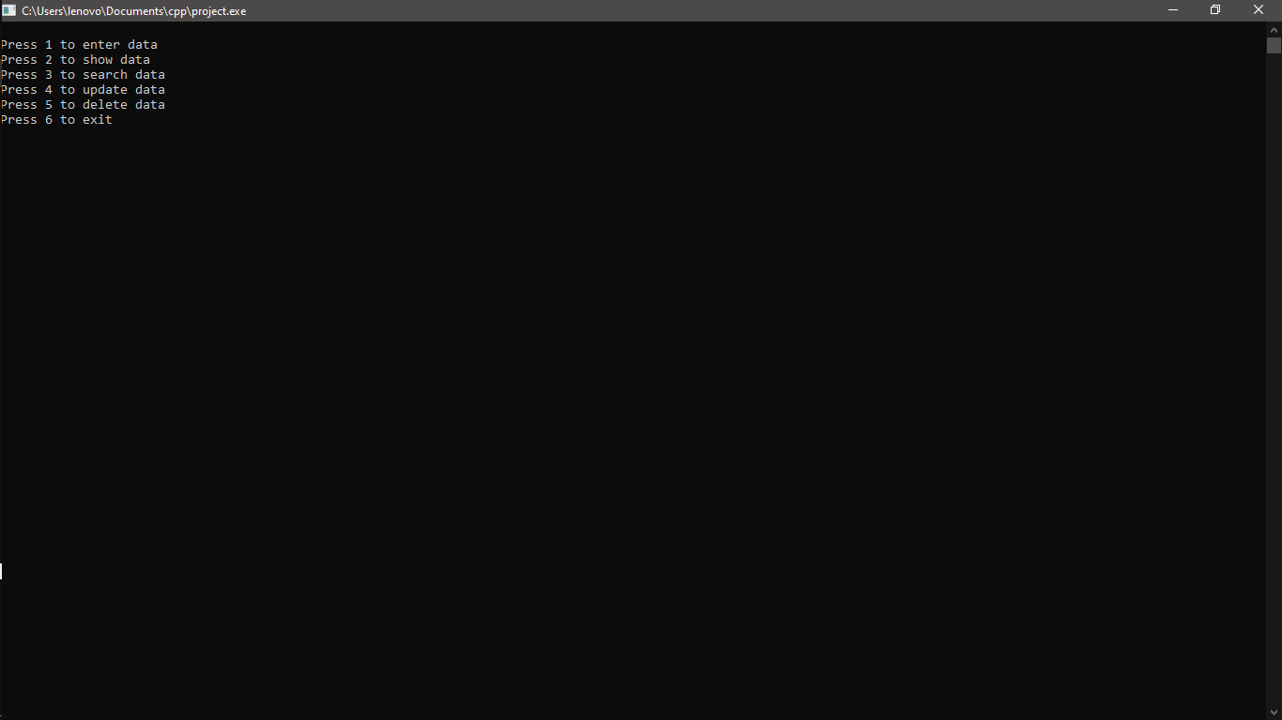

Slide 5
Enter data
Search data
Show data
Main system
Update data
Delete data

Slide 6
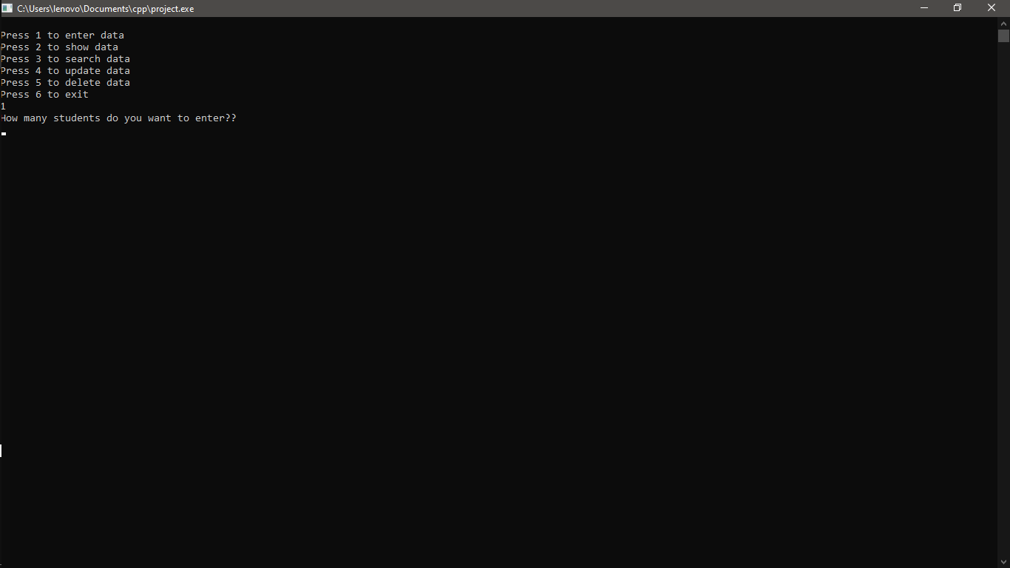

Slide 7
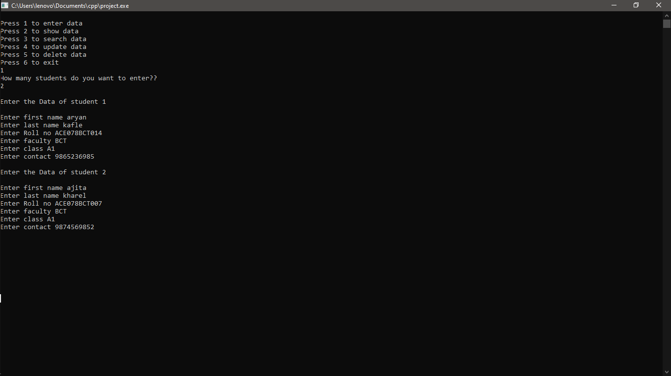

Slide 8
Enter data
Search data
Show data
Main system
Update data
Delete data

Slide 9
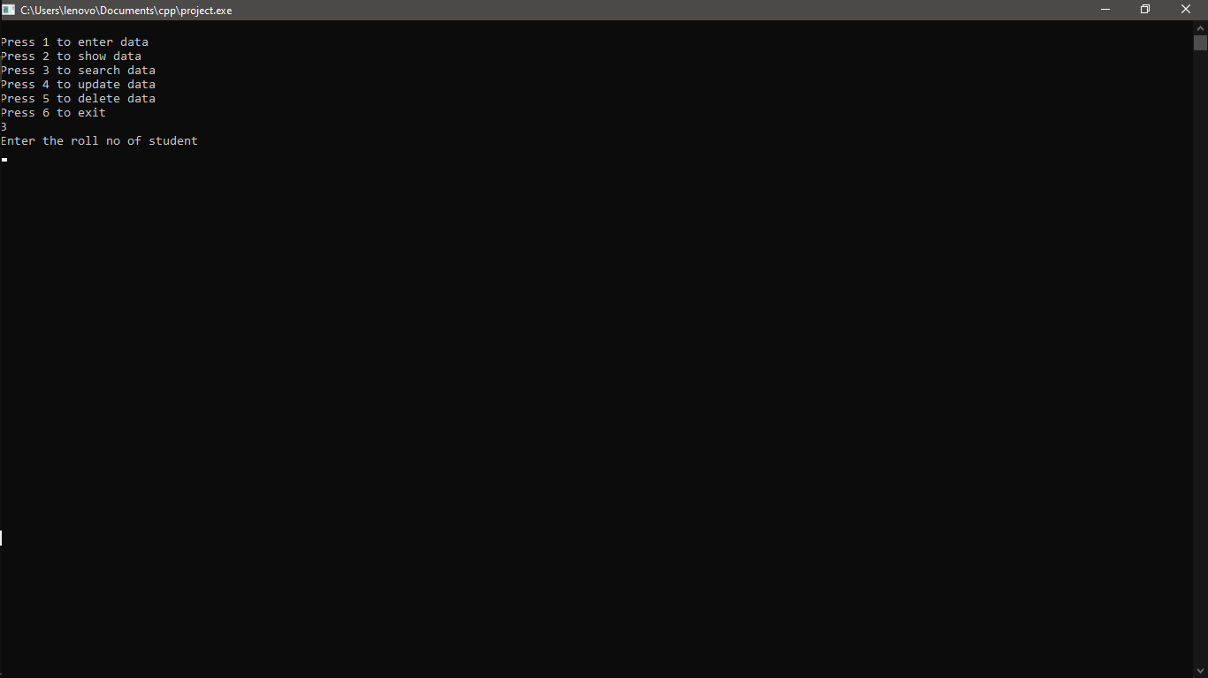

Slide 10
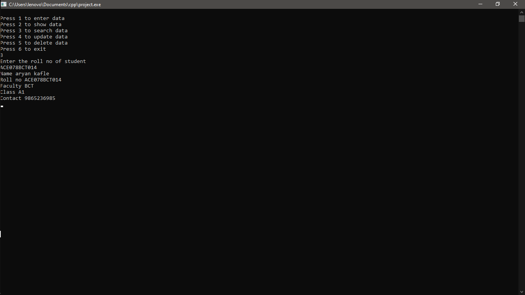

Slide 11
Enter data
Search data
Show data
Main system
Update data
Delete data

Slide 12


Slide 13
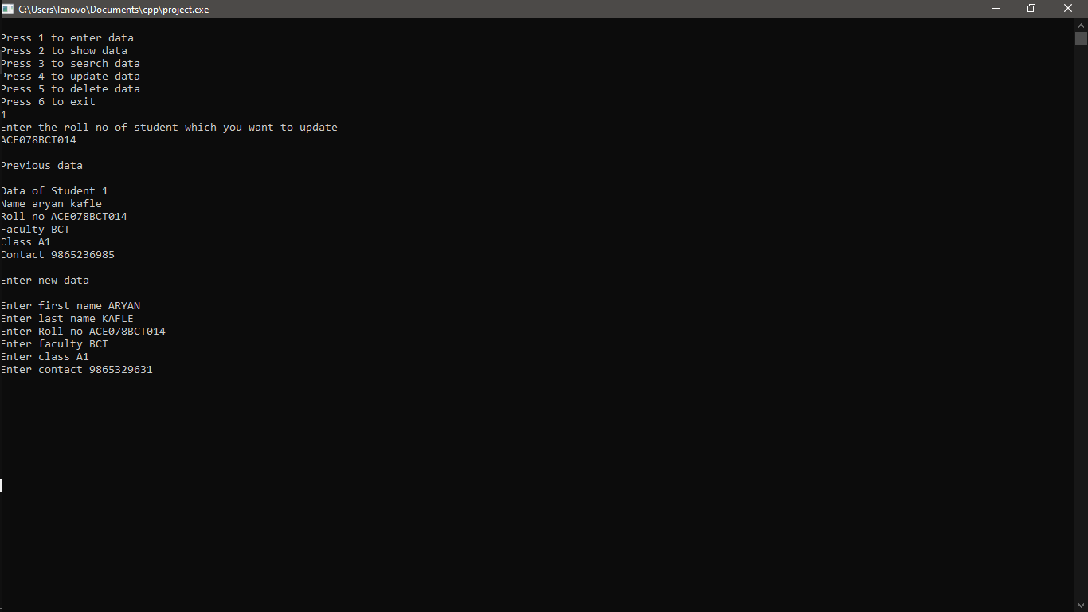

Slide 14
Enter data
Search data
Show data
Main system
Update data
Delete data

Slide 15
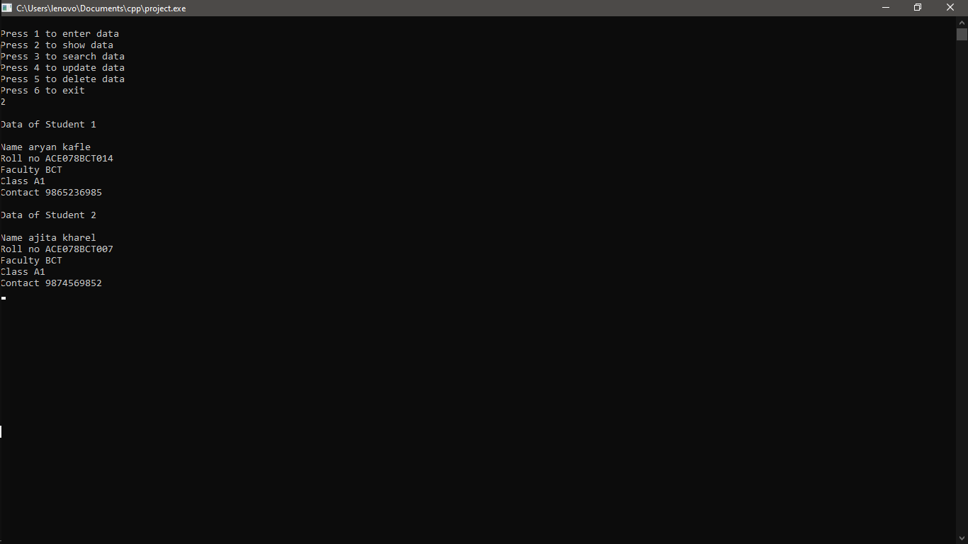

Slide 16
Enter data
Search data
Show data
Main system
Update data
Delete data

Slide 17
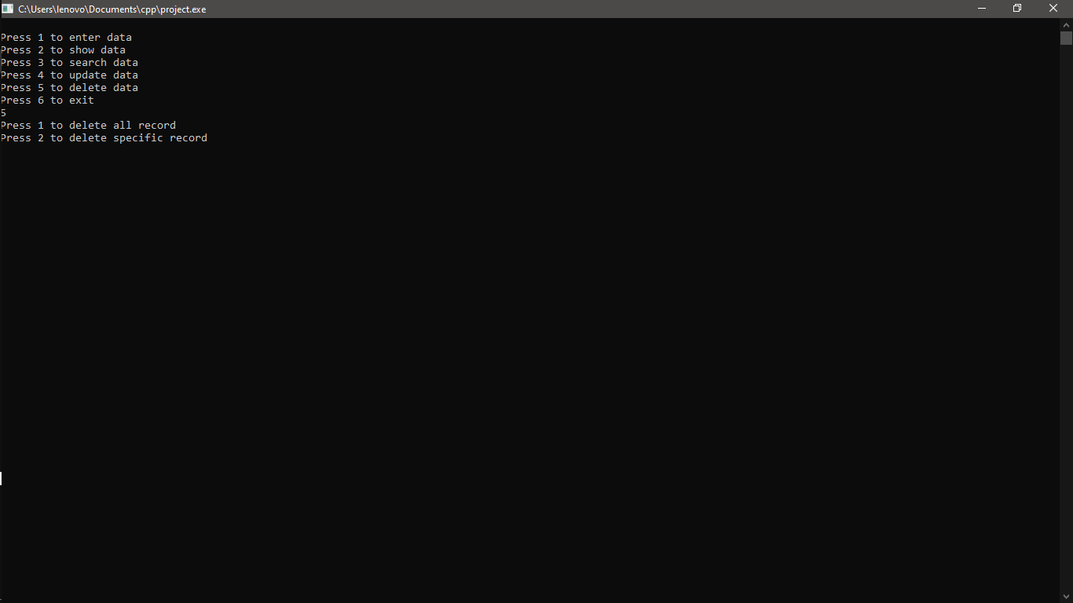

Slide 18


Slide 19
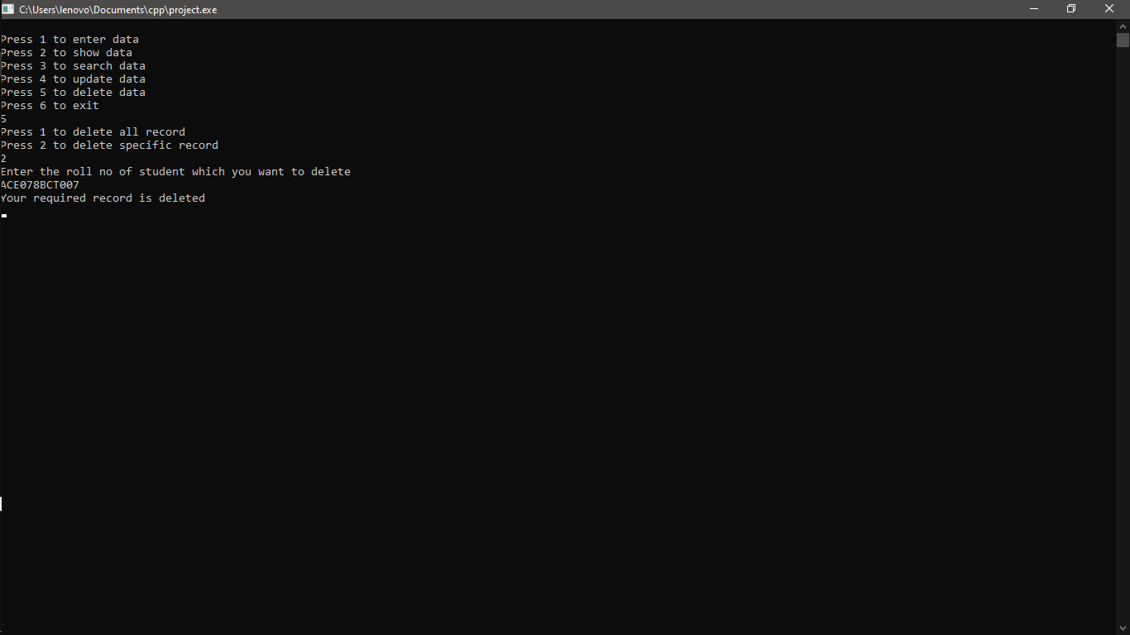

Slide 20
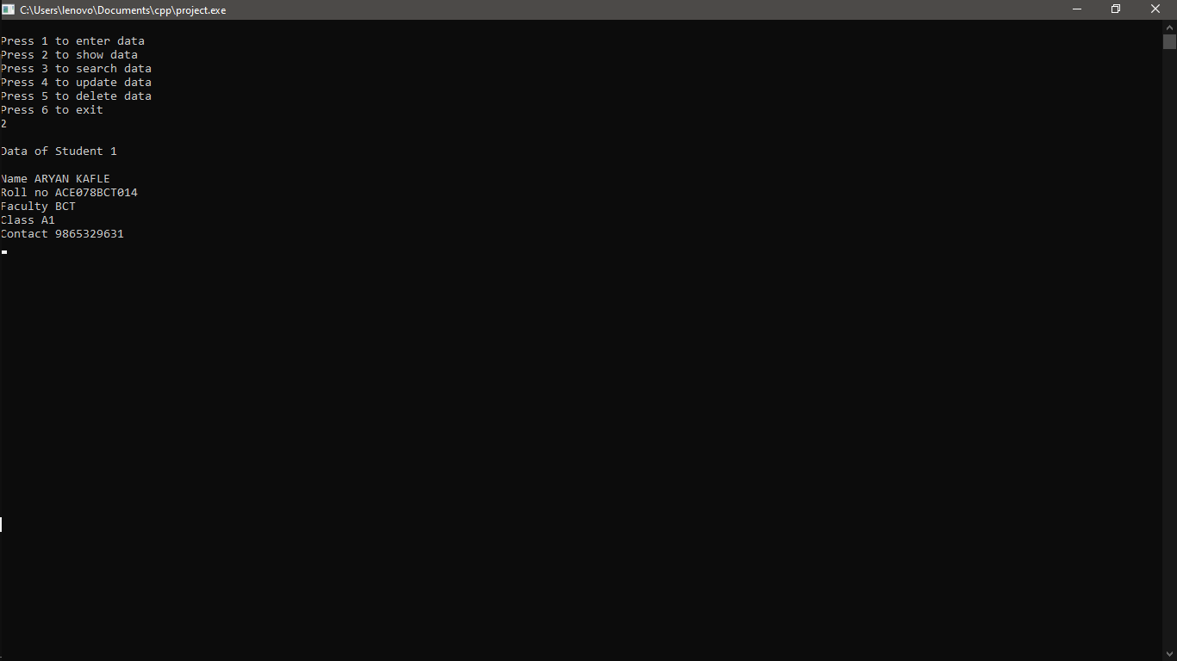

Slide 21


Slide 22
THE END

