Slide 1

Freelancing Platform Overview Freelancing refers to a flexible work arrangement where individuals offer specialized services to clients on a project, task, or hourly basis—without engaging in full-time employment. It empowers professionals to manage multiple projects simultaneously for diverse clients, fostering independence and self-employment. Recognized globally, freelancers operate across various industries, including technology, writing, marketing, and design, offering agility, cost-efficiency, and talent diversity to clients.
Freelancing Platform Overview Freelancing refers to a flexible work arrangement where individuals offer specialized services to clients on a project, task, or hourly basis—without engaging in full-time employment. It empowers professionals to manage multiple projects simultaneously for diverse clients, fostering independence and self-employment. Recognized globally, freelancers operate across various industries, including technology, writing, marketing, and design, offering agility, cost-efficiency, and talent diversity to clients.
Freelancing Platform Overview Freelancing refers to a flexible work arrangement where individuals offer specialized services to clients on a project, task, or hourly basis—without engaging in full-time employment. It empowers professionals to manage multiple projects simultaneously for diverse clients, fostering independence and self-employment. Recognized globally, freelancers operate across various industries, including technology, writing, marketing, and design, offering agility, cost-efficiency, and talent diversity to clients.

Slide 2

Technology Stack Implemented Frontend: HTML5, CSS3, JavaScript Utilized for building the user interface and ensuring a responsive, visually appealing experience. Backend: MySQL Used for database management, handling user data and project/task storage functionalities. This stack supports a lightweight and scalable freelancing web platform suitable for startups and small businesses.
Technology Stack Implemented Frontend: HTML5, CSS3, JavaScript Utilized for building the user interface and ensuring a responsive, visually appealing experience. Backend: MySQL Used for database management, handling user data and project/task storage functionalities. This stack supports a lightweight and scalable freelancing web platform suitable for startups and small businesses.
Technology Stack Implemented Frontend: HTML5, CSS3, JavaScript Utilized for building the user interface and ensuring a responsive, visually appealing experience. Backend: MySQL Used for database management, handling user data and project/task storage functionalities. This stack supports a lightweight and scalable freelancing web platform suitable for startups and small businesses.

Slide 3

Workflow & Operations Freelancers typically engage in contractual assignments, working part-time or full-time depending on project requirements. Before initiating any task, a mutual agreement—covering scope, deadlines, and payment—is usually signed. Compensation may be structured per hour, per task, or per project. Freelance jobs are most prominent in creative, technical, and digital sectors such as programming, marketing, UI/UX, writing, and customer support. This model offers scalable work engagement for both freelancers and clients.
Notes:
© Copyright Showeet.com – Free PowerPoint Templates

Slide 4

Key Advantages of Freelancing Platforms • Flexible Work Environment Freelancers have the liberty to define their own working hours and locations, contributing to a healthier work-life balance. • Project and Client Selection Freelancers can selectively work on projects aligned with their interests and skills, enhancing motivation and quality of work. • Autonomy Over Earnings By setting their own rates and negotiating project terms, freelancers control their income potential and workload. • Skill Enhancement Working on diverse projects sharpens professional skills and broadens exposure across industries.
Notes:
© Copyright Showeet.com – Free PowerPoint Templates

Slide 5

Global Adoption of Freelancing Platforms This chart illustrates the growing adoption of freelancing platforms across global regions. Professionals engage with companies or individual clients, undertaking tasks ranging from basic data entry to complex software development. Compensation varies based on skill level, task complexity, and regional market rates. The rising trend highlights freelancing as a viable, scalable employment alternative in the digital economy.
Notes:
© Copyright Showeet.com – Free PowerPoint Templates

Slide 6
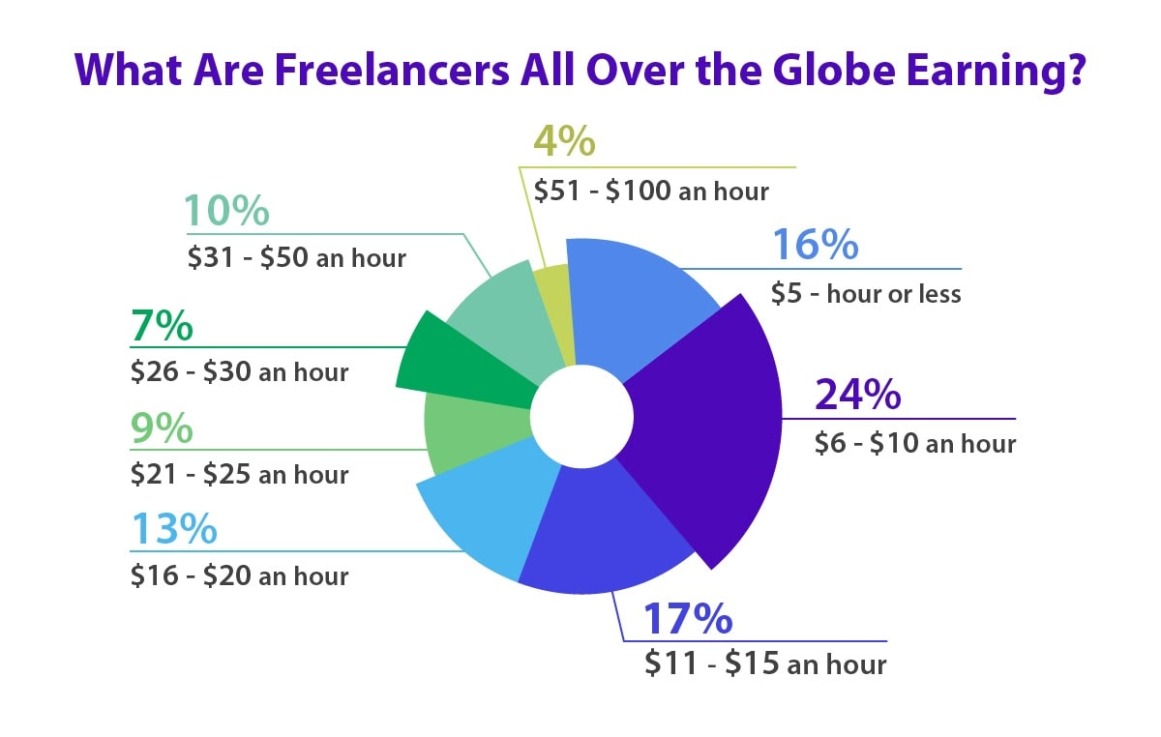
Freelancing vs. Traditional Employment | Criteria | Freelancing | Full-Time Job | |--------------------|----------------------------|----------------------------| | Work Hours | Flexible, project-based | Fixed, generally 9–5 | | Income Model | Per task/project/hour | Monthly salary | | Independence | High – Self-employed | Low – Employer-directed | | Skill Application | Wide-ranging across tasks | Specific to job role | | Growth Opportunity | Client-driven, variable | Often structured and fixed |

Slide 7
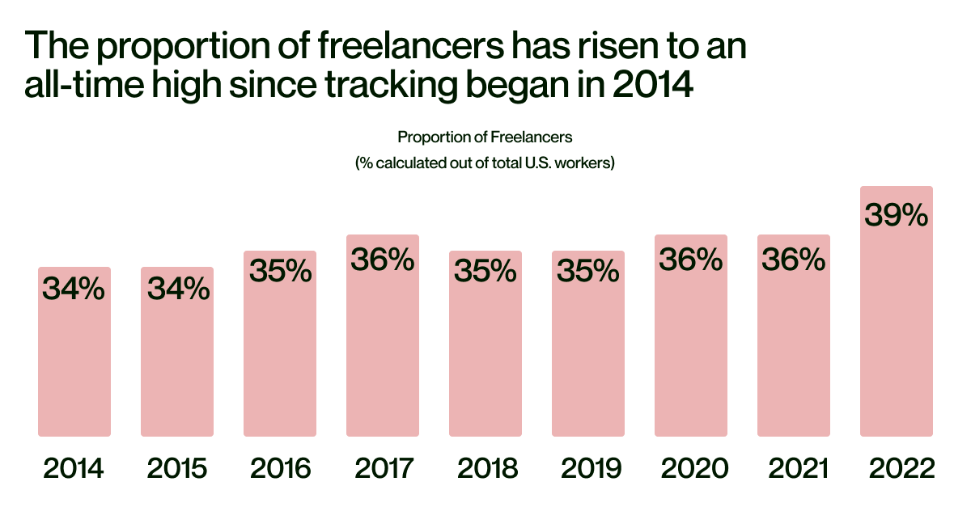
Large Image slide
Notes:
© Copyright Showeet.com – Free PowerPoint Templates

Slide 8
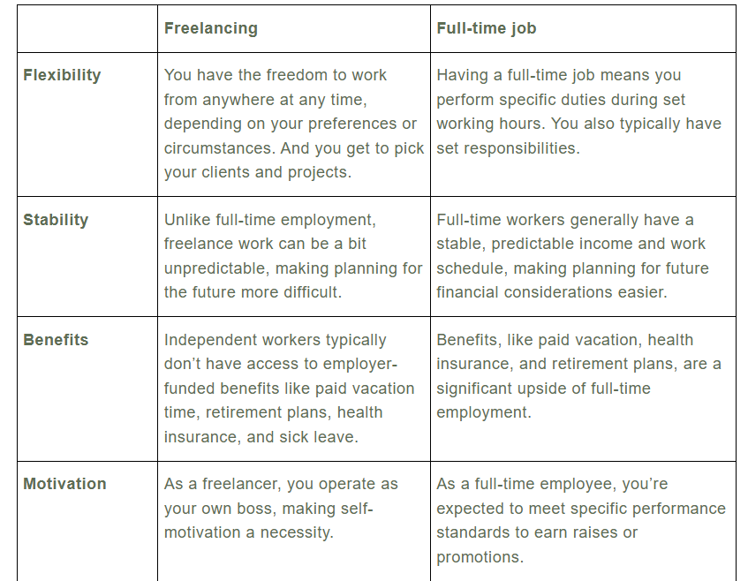
Thank You Submitted by: Aryan Kashyap Project Title: Freelancing Web Platform I appreciate your time and consideration. This project reflects my interest in freelancing systems, web development, and scalable platforms. I look forward to contributing meaningfully to LabMentix through this internship opportunity.

Slide 9

THANK YOU

