Slide 1
AEGIS-NET
From network symptoms to audited remediation
Technical walkthrough: C analysis, anomaly detection, correlation, AI root-cause analysis, and a policy-gated DevSecOps agent
VERIFIED
UNVERIFIED HERE
SIMULATED
NOT IMPLEMENTED
Status tags used on the following slides
All data is synthetic. Prototype, not production. Repository commit 5d742e7 - 2026-10-20
Notes:
SAY: Aegis-Net is a prototype that takes a degraded telecom network from alerts to an explained incident, an AI-assisted root-cause analysis, a report, and a policy-gated remediation, with every step recorded. Say up front that all data is synthetic and that the production rollback is a simulation. The next 18 minutes go from the problem, through the architecture and each stage, to the evidence that it works and the limits.
READING THE VISUAL: The four coloured tags on later slides mean: verified (a test or run in this repository exercised it), unverified here (code exists, not exercised in this environment), simulated, and not implemented.
LIKELY QUESTIONS: Is this production software? No: no TLS termination, no external identity provider, no secret manager, no high availability. Who wrote it? The title slide names no author on purpose; see the repository history.

Slide 2
THE PROBLEM
Troubleshooting a degraded network means stitching together scattered evidence
Evidence is scattered
Symptoms arrive in a cascade
Decisions need an audit trail
Metrics
Deployments
9 alerts → 1 fault
Rollback?
Approval
IDS alerts
Logs
memory, CPU, latency, jitter, loss, retransmits, drops, setup success, throughput
Record
Four tools, four formats, one question: what changed?
One fault, nine alerts. The first symptom is rarely the one people notice.
A production rollback is risky and must be justified, approved and recorded.
The seeded incident as an operator sees it
memory
CPU
latency
packet loss
dropped calls
Automated: evidence gathering, ordering, bookkeeping. Still human: judgement, approval, accepting risk.
Aegis-Net technical walkthrough - all data is synthetic; prototype, not production
2 / 22
Notes:
SAY: Three things make incidents slow. Evidence lives in different tools. One fault shows up as a cascade of alerts, and the first symptom is rarely the one people notice. And risky decisions such as rolling back a production release need justification and approval. Aegis-Net automates evidence gathering, ordering and bookkeeping. It does not automate judgement: causes are always called hypotheses, confidence is capped at 0.95, and risky actions need a human.
READING THE VISUAL: The chain at the bottom is the seeded incident: a memory leak raises memory, then CPU, then latency, packet loss and dropped calls. Nine KPIs alert; there is one fault.
LIKELY QUESTIONS: What counts as a symptom versus a cause? A symptom is a measurement that changed, such as high latency. A cause is the change that explains it, here a software release.

Slide 3
GOALS AND CAPABILITIES
Six capabilities, each with an honest status
C call analysis
Telemetry and detection
Correlation and RCA
Strict CSV parsing, per-cell and per-window statistics, robust outliers
17 KPIs, 9 incident types, 4 interpretable detectors
Ranked hypotheses; nine read-only tools; schema-validated answers
VERIFIED
SIMULATED DATA
VERIFIED
MOCK VERIFIED
LIVE LLM UNVERIFIED
Reports
DevSecOps agent
Platform
JSON, Markdown, HTML computed from stored figures
Deterministic playbooks, risk classes, approvals, sandbox
FastAPI, RBAC, hash-chained audit, React dashboard, Docker
VERIFIED
NO PDF
VERIFIED
ROLLBACK SIMULATED
VERIFIED
DOCKER NOT RE-RUN
Aegis-Net technical walkthrough - all data is synthetic; prototype, not production
3 / 22
Notes:
SAY: Walk the tiles. The C library, the analytics, the API and the agent policy were verified by tests and by runs for this handbook. The data is simulated by design. The AI investigation is verified only with the deterministic mock provider; the Anthropic, OpenAI and local providers are implemented but were never called live. Reports are JSON, Markdown and HTML; PDF is not implemented. The rollback is a simulation.
READING THE VISUAL: Green is verified, orange unverified here, purple simulated, red not implemented. A tile can carry two tags when part of it is verified and part is not.
LIKELY QUESTIONS: Why is the mock not an LLM? It is a rule-based investigator that uses the same read-only tools and the same answer validation; it exists to make the pipeline testable offline.

Slide 4
END TO END
One incident travels through ten stages, and later stages read stored evidence
1 Generate
simulator, events, CDR CSV
2 Call analysis
C library, ctypes
3 Detect
4 detectors per KPI
4 Correlate
cluster, score causes
5 Store
19 tables
state persisted: later stages read the database
6 Investigate
RCA + read-only tools
7 Report
JSON / MD / HTML
8 Act
playbook + policy gate
9 Verify
recovery vs baseline
10 Audit + show
hash chain, dashboard
Recorded run: make demo (seed 7) - INC-2026-001 CRITICAL, 13 steps, exit 0, rollback verified, audit chain valid (24 rows).
Aegis-Net technical walkthrough - all data is synthetic; prototype, not production
4 / 22
Notes:
SAY: Follow INC-2026-001. Stage 1 generates synthetic telemetry. Stage 2 runs the call log through the C library. Stage 3 detects anomalies. Stage 4 correlates them with events into one incident. Stage 5 stores everything. From then on, RCA, reporting and the agent work from the database. The agent proposes a rollback, the policy gates it, an approver and an admin act, recovery is verified, and the audit log records it.
READING THE VISUAL: Colours follow the architecture slide: amber native C, blue Python, purple AI, red policy, teal storage, green UI. The footer line is a recorded result: make demo ran for this handbook with exit 0 and a valid audit chain of 24 rows.
LIKELY QUESTIONS: Does everything run synchronously? Yes: the pipeline and agent runs execute inside the request, taking seconds; there is no job queue.

Slide 5
ARCHITECTURE
Four languages meet at three explicit interfaces
PRESENTATION
React + TypeScript dashboard
11 pages
nginx
serves SPA, proxies /api
API
FastAPI + ASGI middleware
Pydantic, bearer RBAC, limits, audit
Redis
rate limit
SERVICES
Pipeline
simulate, analyse, store
RCA engine + LLM provider
9 read-only tools
Reporting
JSON / MD / HTML
DevSecOps agent
planner, policy, sandbox
ANALYTICS + NATIVE
Simulator
17 KPIs
Detectors
z, EWMA, RoC, thresh.
Correlation
causes, timeline
libcallanalyzer (C11)
ctypes binding
PERSISTENCE
PostgreSQL 16 / SQLite
19 tables, Alembic
audit_logs
SHA-256 hash chain
Interfaces: C header, REST API (OpenAPI), database schema. Trust boundaries: CSV, LLM output, HTTP, agent to OS.
Aegis-Net technical walkthrough - all data is synthetic; prototype, not production
5 / 22
Notes:
SAY: C handles the untrusted, hot path of CDR parsing. Python orchestrates analytics, the API and the agent. TypeScript builds the dashboard so API shapes are checked at compile time. SQL holds relational integrity. The interfaces are the C header, the REST API and its OpenAPI schema, and the database schema. Four trust boundaries drive the security design: CSV into the parser, LLM output into the engine, HTTP into the API, and the agent into the operating system.
READING THE VISUAL: Read top to bottom: browser, API, services, analytics and native code, persistence. The dashed arrow from the C library marks that the call-analysis result feeds the pipeline through the binding.
LIKELY QUESTIONS: Why not do it all in Python? Parsing millions of untrusted rows with bounded memory and stable ABI suits C; the cost is memory-safety risk, which is why it has sanitizer and fault-injection tests.

Slide 6
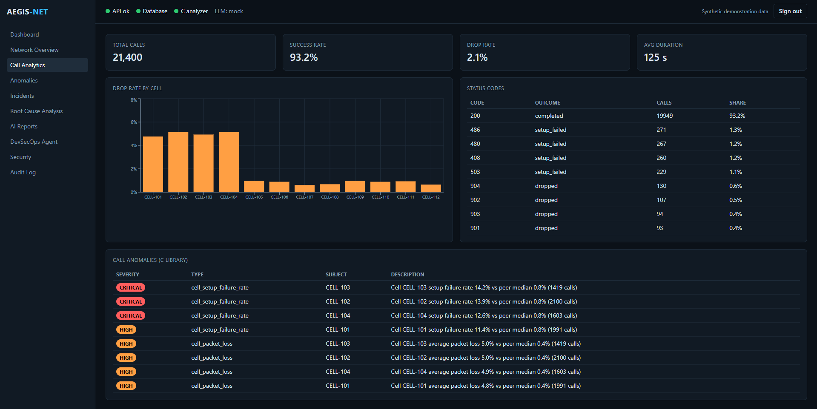
CALL ANALYSIS
A C library parses and analyses call records; Python only marshals results
CDR CSV
8 columns
libcallanalyzer
parse, aggregate, outliers
ctypes binding
struct check, free_*
Result dict
stats + anomalies
strict warnings, -Werror
ASan/UBSan/LSan + fault injection
drop = dropped / (completed + dropped)
Screenshot: Call Analytics page (supplied document, synthetic data). Bars CELL-101 to 104 are the cells behind the faulty gateway. Status-code classes are this project's convention.
VERIFIED
make c-test and make c-test-asan: 2 of 2 passed each; 28 test functions
Aegis-Net technical walkthrough - all data is synthetic; prototype, not production
6 / 22
Notes:
SAY: The library parses CSV strictly, aggregates by cell, code, window and caller, and flags outliers with a robust z-score against peer cells. It is built with strict warnings and -Werror, tested under address, undefined-behaviour and leak sanitizers, and with allocation-failure injection that fails every allocation in turn. Python loads it through ctypes, checks struct sizes at load time and frees every native array in a finally block.
READING THE VISUAL: In the screenshot the four tall bars are CELL-101 to 104, the cells behind the faulty gateway, and the table at the bottom is the C library's own output. Status-code classes are this project's convention, not a telecom standard.
LIKELY QUESTIONS: How do you know the binding matches the header? A load-time struct-size handshake and tests that compile an offsetof probe against the header and compare every field. Result: C 2/2 and 2/2 under sanitizers; 352 Python tests passed.

Slide 7
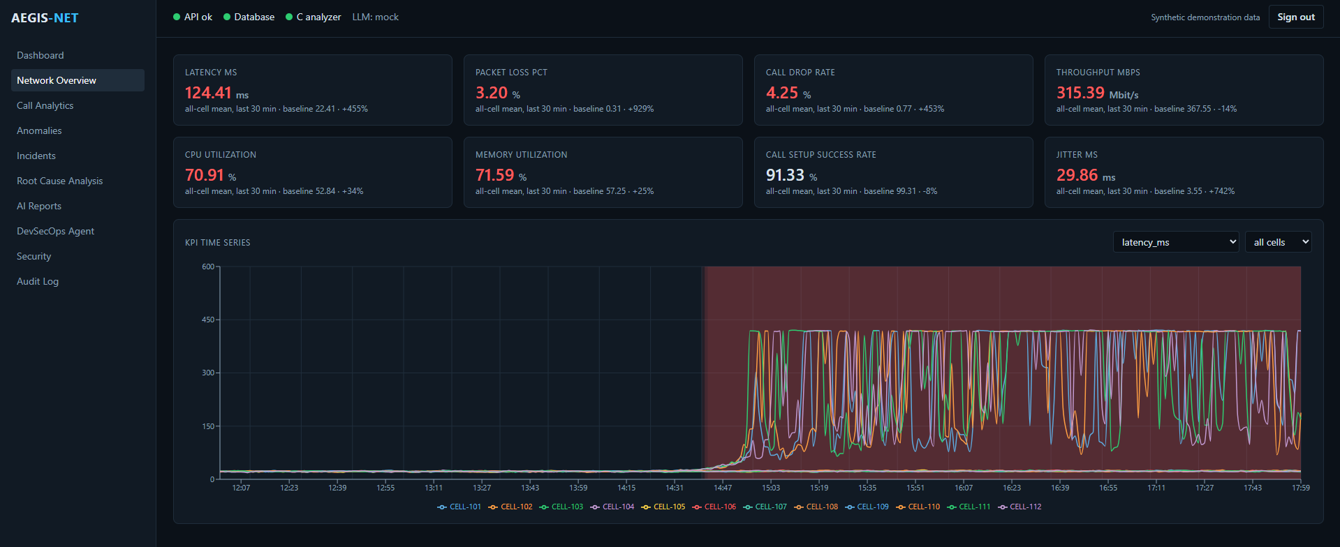
TELEMETRY
A causal simulator produces a repeatable memory-leak incident
deploy 2.4.1
14:05, pgw-1
memory leak
GC pressure -> CPU
queueing latency
packet loss
dropped calls
Screenshot: Network Overview (supplied document, synthetic data)
17 KPIs x 12 cells x 1 min, seed 7
distractor: hotfix on pgw-3 at 13:10
SIMULATED
A testing instrument, not real traffic. Detector results here do not show how detectors would perform on production telemetry.
Aegis-Net technical walkthrough - all data is synthetic; prototype, not production
7 / 22
Notes:
SAY: The simulator is a test instrument, not real traffic. It generates 17 KPIs for 12 cells every minute from an explicit causal model with autocorrelated noise. Incidents change only drivers, so symptoms emerge from the formulas. The seeded scenario deploys packet-gateway 2.4.1 to pgw-1 at 14:05 and leaks memory; a harmless hotfix to pgw-3 at 13:10 is a distractor.
READING THE VISUAL: Eight KPI cards compare the last 30 minutes with the baseline. The chart plots all twelve cells: four climb, eight stay flat. The shaded region is the detected anomaly window.
LIKELY QUESTIONS: Does detector performance on this generalise? No claim is made. Thresholds were tuned on this simulator.

Slide 8
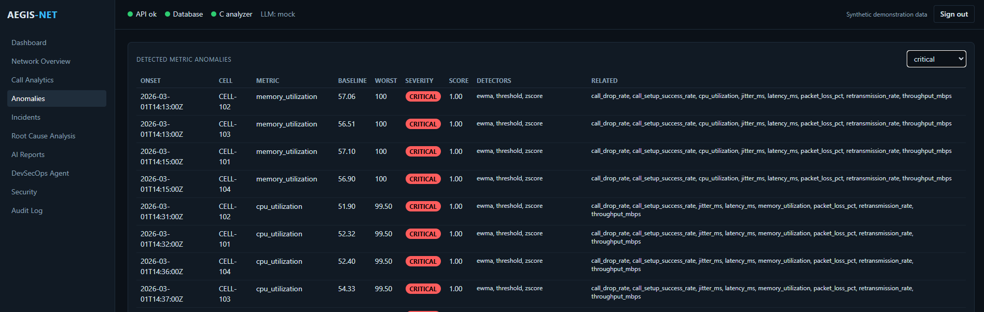
ANOMALY DETECTION
Four interpretable detectors must agree before a point is flagged
z-score
(x - mean) / max(std, floor), 60 min window
EWMA
alpha = 1 - exp(-dt/tau), tau 900 s
Threshold
warning / critical per KPI, e.g. latency 100 / 200 ms
Rate of change
per-minute change vs median / MAD, z >= 5
Flag: threshold OR (z AND EWMA) OR (RoC AND one), and the deviation must pass a practical minimum. Score: 1 - 2^(-z / threshold); 0.5 at the threshold. Baseline: only |z| < 2.5 points update it.
Chart data from the repository's own EWMA helper. Screenshot: Anomalies page, critical filter (supplied document, synthetic data).
Aegis-Net technical walkthrough - all data is synthetic; prototype, not production
8 / 22
Notes:
SAY: Each point is scored by a z-score against a trailing 60-minute baseline, a time-aware EWMA, static thresholds and a rate-of-change test. A point is flagged on a threshold breach, on z-score and EWMA together, or on rate of change plus one of them, and only if the deviation is practically meaningful. Only clearly normal points update the baseline, so a slow ramp cannot hide itself. Flagged points merge into episodes with a score and a severity.
READING THE VISUAL: The chart is the worked example: nine readings near 50, then 80. With the latency noise floor of 1.0 the z-score is 29.8, far past 4. The screenshot lists the critical episodes: memory first at 14:13 to 14:15, then CPU, then latency.
LIKELY QUESTIONS: False positives? The plan records 0.27 episodes per 100 series-days on healthy synthetic data, none high or critical. That is a recorded result and is synthetic. Isolation Forest and DBSCAN are not implemented.

Slide 9
CORRELATION
The correlation engine turns many symptoms into one ranked, caveated incident
Metric anomalies
36 episodes
1 Cluster
per cell <= 15 min; same node merges
symptoms
ordered by onset
Operational events
deploy, config, IDS
2 Gate
>= 2 metrics, one severity >= high
suspected causes
status: hypothesis
C call anomalies
cell + window
3 Score causes
0.45 time + 0.35 mechanism + 0.20 topology
excluded
with reasons
Causal graph
fixed, hand-written
4 Confidence
top x (0.6 + 0.4 consistency); cap 0.95
timeline + caveats
Correlation is not causation. The engine ranks hypotheses by time order, topology and a fixed causal graph; every cause carries status "hypothesis" and the incident carries a caveat to that effect.
VERIFIED
29 tests; 0 incidents over 20 healthy days (recorded); seeded run recomputed for this handbook
Aegis-Net technical walkthrough - all data is synthetic; prototype, not production
9 / 22
Notes:
SAY: Anomalies cluster per cell and merge across cells on the same node. An incident needs at least two metrics and one symptom of severity high or above. Each candidate cause is scored from temporal precedence, mechanism match against a fixed causal graph, and topology. Deployments on other nodes are listed as excluded with a reason. The result is a ranked list of hypotheses; correlation is not causation and the engine says so in a caveat.
READING THE VISUAL: Left to right: evidence in, four steps, incident out. The formula is score = 0.45 temporal + 0.35 mechanism + 0.20 topology; confidence is the top score scaled by chain consistency, with a cap of 0.95.
LIKELY QUESTIONS: Why is confidence capped? To avoid presenting a time-ordering argument as certainty. How did the distractor get excluded? It targeted pgw-3; the incident's node was pgw-1.

Slide 10
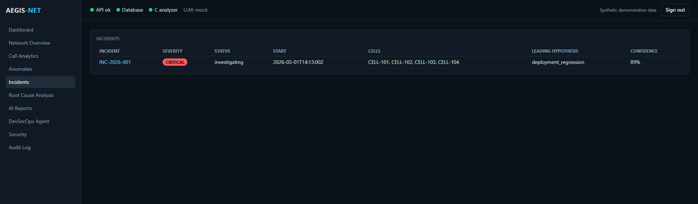
INCIDENT TIMELINE
The deployment outranks memory exhaustion because it preceded the first symptom on the same node
INC-2026-001 timeline (UTC, recomputed from seed 7)
14:50 loss
14:13 memory
14:40 latency
14:05 deploy
14:31 CPU
14:53 drops
13:00
14:00
15:00
13:10 hotfix to pgw-3: excluded (other node)
0.8947 deployment_regression
0.675 memory_exhaustion
deployment was 8 min before onset: temporal exp(-8/30) = 0.766
chain consistency 1.0, margin 0.22: confidence 0.8947
Screenshot: Incidents page (supplied document). 89% is the correlation confidence; the RCA states 85% separately.
Aegis-Net technical walkthrough - all data is synthetic; prototype, not production
10 / 22
Notes:
SAY: The timeline shows the deployment at 14:05, memory at 14:13, CPU at 14:31, latency at 14:40, packet loss at 14:50 and dropped calls at 14:53. Deployment regression scores 0.8947: temporal 0.766 because the deployment was 8 minutes before onset, mechanism 1.0, topology 1.0. Memory exhaustion has the same mechanism score but only neutral temporal and topology terms, so 0.675.
READING THE VISUAL: In the bar chart each bar is the sum of the three weighted terms. The incident list shows the result as the operator sees it: CRITICAL, four cells, leading hypothesis at 89 percent. The RCA's own figure on the next slide is 85 percent.
LIKELY QUESTIONS: Why two different confidences? The correlation engine and the RCA engine compute them separately. Cross-correlation lags came out mostly 0, so onset order, not lag, carries the temporal argument; the report says so.

Slide 11
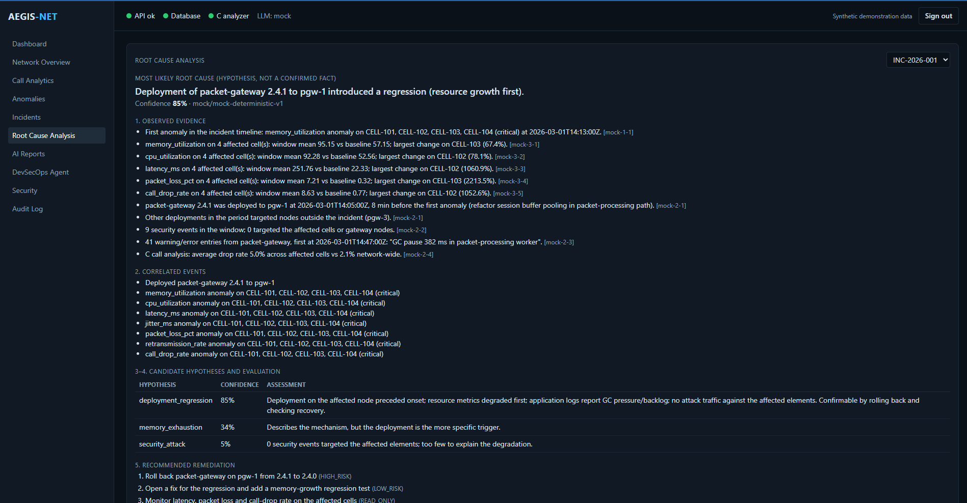
AI ROOT-CAUSE ANALYSIS
The model can only ask read-only tools; the engine validates every answer
Model asks, engine decides
9 read-only, incident-scoped tools
arguments validated twice (JSON schema, Pydantic)
results capped at 16 KB; at most 10 steps, 8 calls per step
answer: one JSON object (RCAAnswer)
facts must cite successful tool calls
leading hypothesis = root cause; confidence <= 0.95
3 attempts, then status failed; nothing invented
The mock is not an LLM. It is a rule-based investigator using the same tools and validation. Live providers were never called.
Screenshot: Root Cause Analysis page, provider mock (supplied document, synthetic data)
MOCK VERIFIED
LIVE LLM UNVERIFIED
12 tool calls in the seeded run; RCA confidence 85%
Aegis-Net technical walkthrough - all data is synthetic; prototype, not production
11 / 22
Notes:
SAY: The prompt holds only identifiers and symptom names. The model requests tools; the engine checks the name against an allowlist, validates arguments twice, runs a read-only incident-scoped query and returns a size-limited result with an id. The final answer must be one JSON object that validates against a schema, cite real, successful tool calls, and make the leading hypothesis the root cause. Rejected answers get feedback up to three times, then the RCA is stored as failed. Nothing is invented and private reasoning is never stored.
READING THE VISUAL: Each evidence bullet ends with a tool-call id such as mock-3-1. The hypothesis table lists deployment regression 85 percent, memory exhaustion 34 percent and security attack 5 percent, each with its reasoning. The header says LLM: mock.
LIKELY QUESTIONS: Was a real model tested? No. Anthropic, OpenAI and local providers were only tested with fake clients; the live test is opt-in and was skipped. How are prompt injections handled? Structurally: read-only tools, schema validation, citation checks and human approval, not prompt wording.

Slide 12
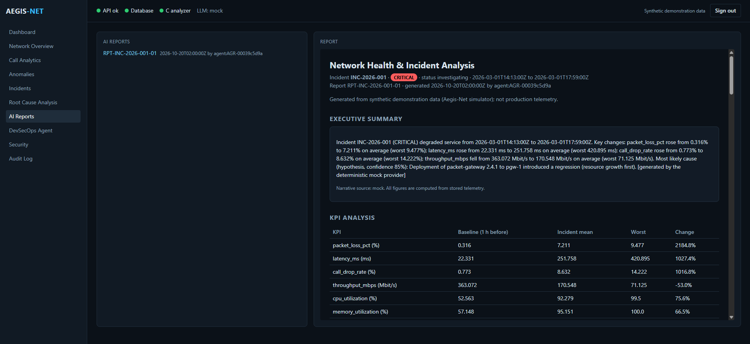
REPORTING
Reports compute every figure from stored data; only the summary is prose
Grounded by construction
every figure computed from the database
baseline = mean of the hour before onset
summary prose accepted only if all its numbers appear in the context; else template
JSON, Markdown, HTML from one document model
HTML autoescaped; CSP default-src 'none'; sandboxed iframe in the UI
root cause always labelled a hypothesis
Screenshot: AI Reports page (supplied document, synthetic data)
VERIFIED
PDF NOT BUILT
Aegis-Net technical walkthrough - all data is synthetic; prototype, not production
12 / 22
Notes:
SAY: The report builder takes the incident, the RCA and the stored telemetry and computes every number itself: baselines, incident means, worst values. The only generated text is the executive summary, accepted only if every number in it appears in the context given to the model; otherwise a template is used. Renderers produce JSON, Markdown and HTML with escaping; the HTML endpoint sends a strict content-security policy. PDF is not implemented.
READING THE VISUAL: The page shows a synthetic-data notice, the summary labelled as generated by the mock provider, and the KPI table, for example packet loss from 0.316 percent to 7.211 percent.
LIKELY QUESTIONS: Why not let the model write the whole report? Ungrounded numbers are the main risk; this design makes them mechanically checkable.

Slide 13
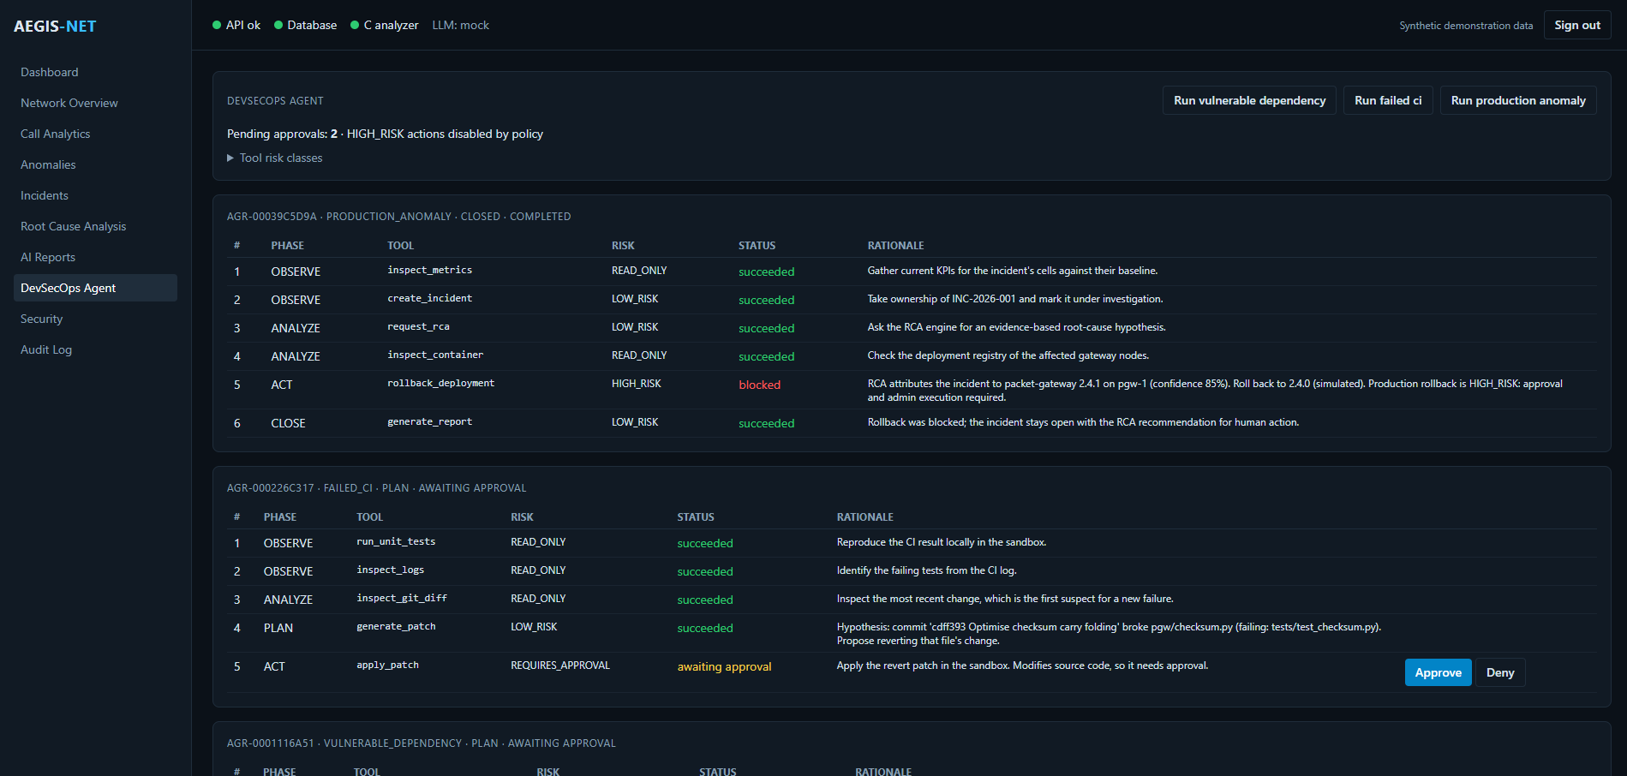
DEVSECOPS AGENT
The agent is a deterministic, policy-controlled playbook, not an LLM planner
OBSERVE
ANALYZE
PLAN
ACT
VERIFY
CLOSE
Three scenarios
vulnerable dependency: scan, pin bump (approval), tests, re-scan
failed CI: reproduce, diff, revert patch (approval), tests + linter
production anomaly: RCA, rollback proposal (HIGH_RISK), verify
Not an LLM planner: playbooks are pure functions of earlier results; rationale stored before execution.
Screenshot: DevSecOps Agent page (supplied document, synthetic data; bottom edge cropped in the source)
VERIFIED
ROLLBACK SIMULATED
Aegis-Net technical walkthrough - all data is synthetic; prototype, not production
13 / 22
Notes:
SAY: The loop is observe, analyze, plan, act, verify, close, and never moves backwards. The planner is a pure function of earlier results; the LLM never chooses tools, arguments or commands. Every action is stored with its rationale before it runs. There are three scenarios: a vulnerable dependency, a failed CI run, and a production anomaly. Code scenarios run in a disposable git copy of a fictional service.
READING THE VISUAL: The first run is closed: the rollback is blocked because high-risk actions are disabled, so the incident stays open with the RCA recommendation. The second run waits for approval to apply a revert patch for the commit that broke the checksum code.
LIKELY QUESTIONS: What is real? Tests, linting, git and file edits in the sandbox are real. The advisories are fictional and the rollback re-simulates telemetry. restart_service is registered but always fails by design.

Slide 14
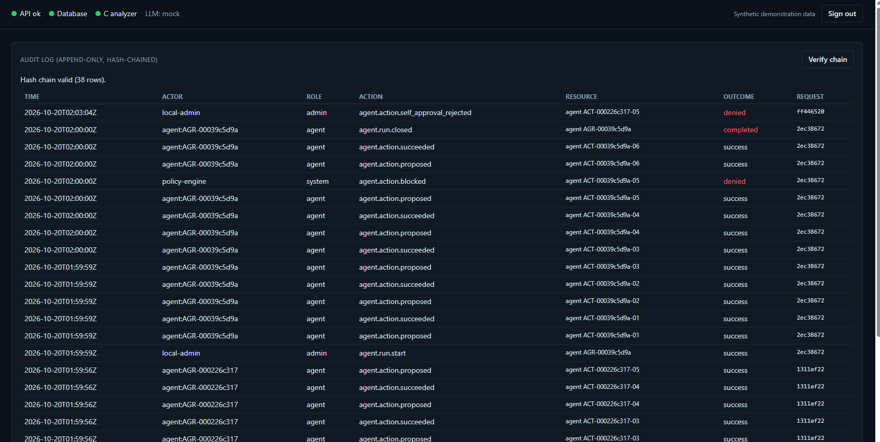
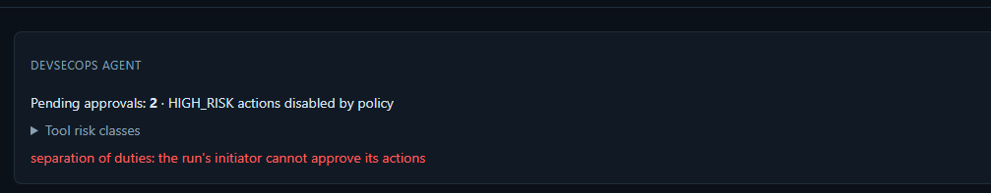
RISK POLICY AND AUDIT
Policy is enforced in code at execution time, and every action leaves a hash-chained record
Risk class | Policy | Approval | Executed by
READ_ONLY / LOW_RISK | allow | none | agent, automatically
REQUIRES_APPROVAL | needs approval | approver, not the initiator | operator or higher
HIGH_RISK (flag off) | deny: blocked | - | nobody (human acts)
HIGH_RISK (flag on) | needs approval | approver, not the initiator | admin only
BLOCKED | deny | - | never
policy re-checked inside execute_action, immediately before running
separation of duties: the run's initiator cannot approve
20 allowlisted tools; commands: python -m pytest|pyflakes and 9 git subcommands, no shell
audit row hash = SHA-256(content + previous hash); verify needs admin
rewriting a whole suffix could forge the chain: external anchoring not implemented
Audit log: chain valid (38 rows); policy block and denied self-approval visible
VERIFIED
36 agent tests, 22 security tests
Aegis-Net technical walkthrough - all data is synthetic; prototype, not production
14 / 22
Notes:
SAY: Read-only and low-risk tools run automatically. Approval-required tools wait for an approver who is not the run's initiator, then an operator or higher executes. High-risk actions are denied unless a flag is on, and then still need approval and an admin. Blocked tools never run. The service re-checks every rule immediately before executing, so bypassing the UI or the API route gains nothing. Each audit row hashes its content together with the previous row's hash.
READING THE VISUAL: The audit screenshot shows agent proposals and successes, a policy block and a denied self-approval, with chain valid for 38 rows. The small image is the separation-of-duties message.
LIKELY QUESTIONS: Can the chain be forged? A party who can rewrite the whole suffix and recompute hashes could; external anchoring of the head hash is not implemented.

Slide 15
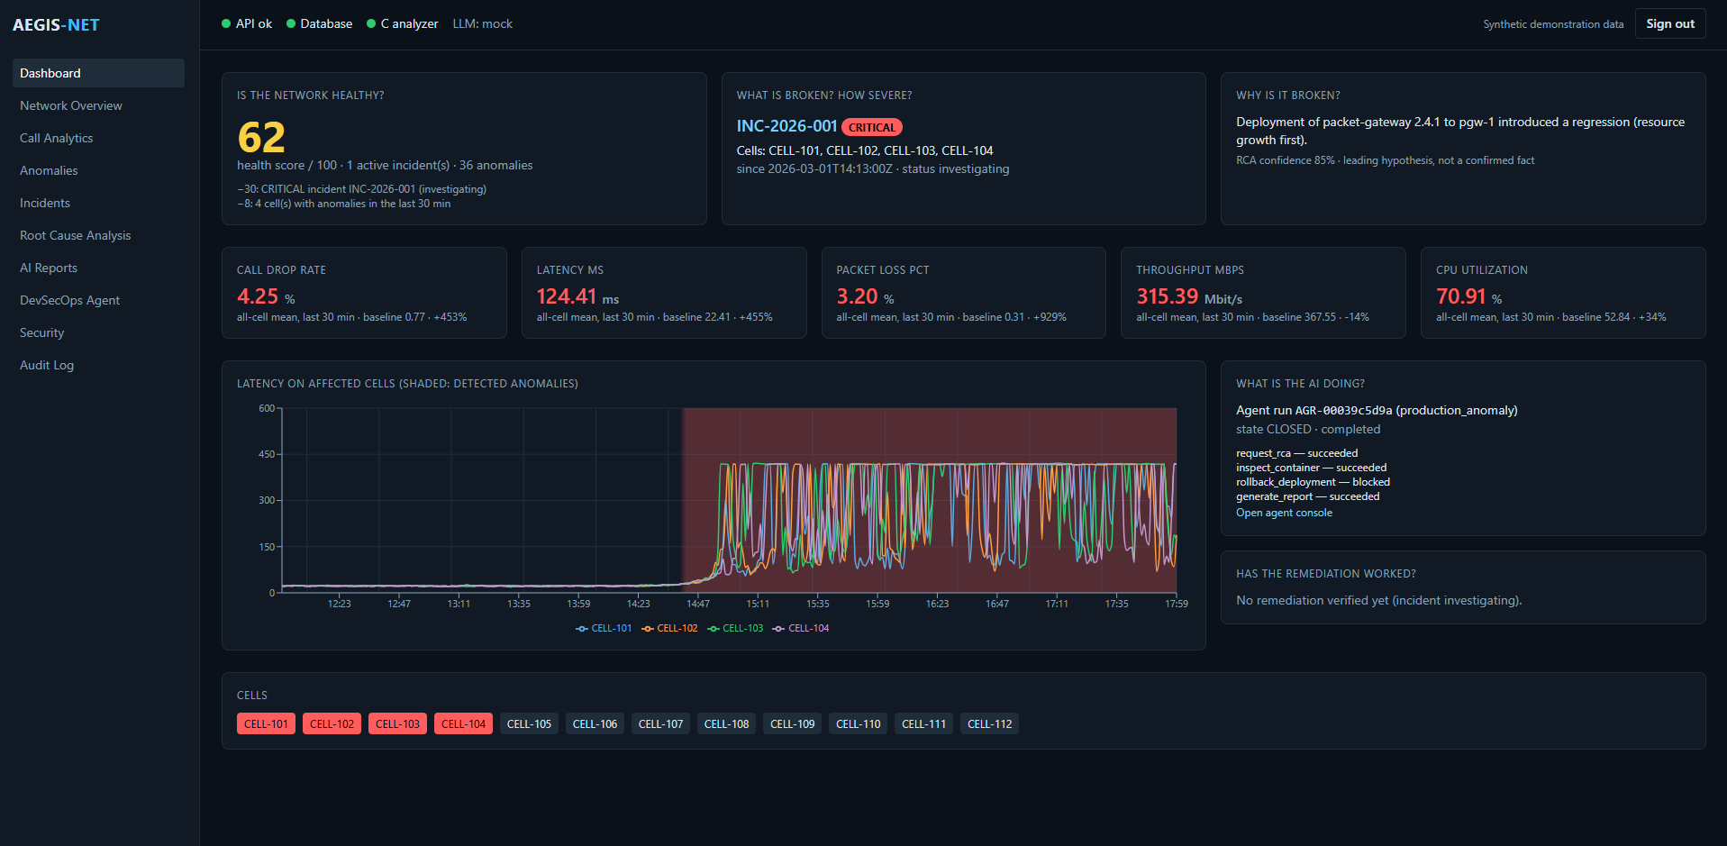
DASHBOARD
One screen answers the six operator questions
1
Healthy?
score 62 = 100 - 30 (critical) - 8 (4 cells)
2
What, how severe?
INC-2026-001, CRITICAL, CELL-101..104
3
Why?
RCA headline, 85%, a hypothesis
4
KPIs and chart
latency on affected cells, anomaly window shaded
5
What is the AI doing?
agent run and its actions
6
Did it work?
not yet: incident investigating
Screenshot: Dashboard (supplied document, synthetic data)
Token in sessionStorage; roles enforced by the server.
Aegis-Net technical walkthrough - all data is synthetic; prototype, not production
15 / 22
Notes:
SAY: Take the questions in order. Is the network healthy: a score of 62, which is 100 minus 30 for the critical incident minus 8 for four degraded cells. What is broken and how severe: INC-2026-001, critical, four cells. Why: the RCA headline with its confidence, labelled a hypothesis. What do the KPIs and chart show: latency on the affected cells with the detected window shaded. What is the AI doing: the agent run and its actions. Has the remediation worked: not yet.
READING THE VISUAL: The top bar shows API, database and C analyzer health, LLM: mock, and a synthetic-data notice. The cell strip colours the four affected cells red.
LIKELY QUESTIONS: Where is the token stored? In sessionStorage; every request sends it as a bearer header. Roles are enforced by the server, not by hiding buttons.

Slide 16
API, DATABASE, SERVICES
Twenty-six routes and nineteen tables, with roles enforced per endpoint
Endpoint group | Minimum role | Routes
health | public | 1
pipeline run / list | operator / viewer | 2
calls, network, incidents (reads) | viewer | 7
investigate (RCA), report generate, agent start | operator | 3
reports, RCA, deployments, findings, agent reads | viewer | 9
agent approve | approver | 1
agent execute | operator (admin if HIGH_RISK) | 1
audit list / verify | operator / admin | 2
19 tables (one Alembic migration)
Run data
pipeline_runs, network_metrics, anomalies, operational_events, deployments
Call analysis
call_analysis_runs, call_cell_statistics, call_anomalies
Incidents and AI
incidents, incident_cells, incident_anomalies, incident_events, root_cause_analyses, recommendations, reports
bodies use extra="forbid"; ids, metrics and cells are pattern-checked
401 / 403 / 404 / 409 / 413 / 422 / 429 mapped; 500 carries only a request id
every response has X-Request-ID; /metrics is not proxied
Agent and audit
agent_runs, agent_actions, security_findings, audit_logs
VERIFIED
POSTGRESQL TEST SKIPPED HERE
Aegis-Net technical walkthrough - all data is synthetic; prototype, not production
16 / 22
Notes:
SAY: The API has 26 routes plus a metrics endpoint. Most reads need a viewer; running pipelines, investigations, reports and agent runs need an operator; approvals need an approver; verifying the audit chain needs an admin. Request bodies reject unknown fields and parameters are pattern-checked. The 19 tables keep relational columns for filtering and JSON only for evidence documents; one migration runs on SQLite and PostgreSQL.
READING THE VISUAL: Table groups on the right follow the entity-relationship diagram in the handbook: run data, call analysis, incidents and AI, agent and audit.
LIKELY QUESTIONS: Is PostgreSQL verified? The plan records a run against postgres:16; the PostgreSQL test was skipped in this session's run.

Slide 17
DOCKER DEPLOYMENT
Four containers start with one command; the backend image builds and tests the C library
COMPOSE PROJECT aegis-net (ports bound to 127.0.0.1)
$ make env
hashed tokens -> .env
$ docker compose up --build
dashboard :8080, API docs :8000/docs
$ make docker-smoke
isolated build + API checks, then clean-up
$ docker compose down
keeps volumes
frontend
nginx :80 -> :8080
backend
uvicorn :8000, non-root
postgres:16
volume pgdata
/api
aegis-data
agent workspaces
redis:7
rate limit, no persistence
backend image: stage 1 builds + ctests the C library; stage 2 runs migrations, optional demo bootstrap, uvicorn
STACK NOT RE-RUN IN THIS SESSION
A clean --no-cache smoke build and four-service start are recorded in the implementation plan. Required secrets fail fast with a hint to run make env; no credentials appear in the deliverables.
Aegis-Net technical walkthrough - all data is synthetic; prototype, not production
17 / 22
Notes:
SAY: The backend image is two stages: the first builds libcallanalyzer and runs ctest, so a failing C test fails the build; the second is a slim Python runtime with a non-root user. The entrypoint runs migrations and optionally loads the seeded incident. nginx serves the dashboard and proxies only the API. Ports bind to localhost. Required secrets use a fail-fast form that tells you to run make env.
READING THE VISUAL: Arrows show who talks to whom. The Redis container only holds the rate-limit window and does not persist.
LIKELY QUESTIONS: Was Docker run for this deliverable? No: the recorded smoke test is in the plan; this session verified the host builds and tests instead.

Slide 18
TESTING
Layered tests give evidence, and the gaps are stated
Layer (command) | Result run for this handbook
C tests (make c-test) | 2 of 2 passed
C + ASan/UBSan/LSan + fault injection | 2 of 2 passed
Python (make py-test) | 352 passed, 3 skipped (207.7 s)
mypy --strict | 86 files, no issues
Dashboard (make frontend-test) | tsc ok, Vitest 10/10, build ok
Offline demo (make demo) | exit 0; audit chain valid (24)
Docker smoke, ASan Python, PostgreSQL, Redis, live LLM | not run here (recorded or opt-in)
Not proven: live LLM behaviour, PostgreSQL and Redis paths (3 opt-in skips), Docker in this session, real telemetry. Simulator, thresholds and tests were written together, so results show internal consistency, not field accuracy.
Aegis-Net technical walkthrough - all data is synthetic; prototype, not production
18 / 22
Notes:
SAY: Results from commands run for this handbook: C tests 2 of 2 normal and 2 of 2 under sanitizers; Python 352 passed and 3 skipped; mypy strict clean on 86 files; the frontend type-check, 10 Vitest tests and build; and the offline demo. The three skipped tests need PostgreSQL, Redis or a live LLM key. Passing tests show internal consistency, not field accuracy.
READING THE VISUAL: The chart counts collected pytest tests per module: 355 in total, of which 3 are opt-in skips.
LIKELY QUESTIONS: Mutation testing? Hand-applied mutations in a scratch copy are recorded in the plan; there is no mutation tool in the repository.

Slide 19
LIVE DEMO
The demo runs offline in seconds; the full stack needs Docker
1
make demo
offline: SQLite, mock LLM, 13 steps through the real API
2
make env + docker compose up --build
dashboard :8080 with the seeded incident
3
Sign in
token from .aegis-tokens: viewer, operator, approver, admin
4
Incidents > INC-2026-001 > Investigate
RCA with tool-call ids (operator)
5
AI Reports > Generate
JSON / Markdown / HTML report (operator)
6
DevSecOps Agent > run failed_ci
approve with a different user, then execute
7
Audit Log > Verify chain
admin; read proposals, blocks, denials
No LLM key needed. The mock provider is the default; a missing key or SDK falls back to it and reports why.
Aegis-Net technical walkthrough - all data is synthetic; prototype, not production
19 / 22
Notes:
SAY: For the offline path run make demo: it builds the library, runs 13 steps through the real API with role-scoped tokens, refuses an unapproved execution with a 409, then approves and executes the simulated rollback and verifies recovery. For the dashboard run make env once and docker compose up --build, then sign in with a token from the git-ignored token file. Use different users for starting and approving, because the same user is refused.
READING THE VISUAL: Nothing here needs an LLM key: the mock provider is the default and the system falls back to it with a visible reason.
LIKELY QUESTIONS: What if the key is wrong? The factory falls back to the mock and reports the reason; check the health endpoint.

Slide 20
STATUS
What is verified, unverified, simulated or not implemented
VERIFIED
UNVERIFIED HERE
SIMULATED
NOT IMPLEMENTED
C library (tests + sanitizers)
ctypes binding and ABI checks
detectors, correlation
API, RBAC, audit chain
agent policy and sandbox
offline demo, dashboard tests
Anthropic, OpenAI, local providers (no key)
Docker stack (recorded, not re-run)
PostgreSQL migration test (skipped)
live Redis test (skipped)
py-test-asan (recorded)
all telemetry, CDRs, events
incidents and deployments
DEMO-CVE advisories
production rollback
mock provider as the "LLM"
PDF reports
Isolation Forest, DBSCAN
OpenTelemetry, Grafana
restart_service model
TLS, external identity, HA
anything on real telemetry
Each item traces to a test, a command in Appendix B of the handbook, or a recorded result in IMPLEMENTATION_PLAN.md.
Aegis-Net technical walkthrough - all data is synthetic; prototype, not production
20 / 22
Notes:
SAY: Be direct. Verified: the C library, binding, analytics, correlation, API, security controls, agent policy and the offline demo. Unverified here: live LLM providers, Docker in this session, PostgreSQL and Redis tests. Simulated: all data and the rollback. Not implemented: PDF reports, Isolation Forest, DBSCAN, OpenTelemetry, Grafana, anything on real telemetry.
READING THE VISUAL: Every cell is traceable to a test, a command in the verification appendix, or a recorded result in the implementation plan.
LIKELY QUESTIONS: Is it production-ready? No.

Slide 21
FUTURE WORK
Priorities for closing the largest gaps
1
Scored live-LLM RCA evaluation
largest unverified claim; include adversarial log lines
2
Validate on recorded, anonymised telemetry
measure precision and recall outside the simulator
3
Asynchronous pipeline and agent runs
requests return immediately; job queue
4
Seasonal baselines + a model-based detector
keep interpretable explanations beside it
5
OIDC, TLS, secret manager, anchored audit head
close the production security gaps
6
Patches beyond reverts, real CI hooks
validated in the sandbox
7
OpenTelemetry traces
API, RCA and agent
RECOMMENDATIONS ONLY
None of these exists in the repository today.
Aegis-Net technical walkthrough - all data is synthetic; prototype, not production
21 / 22
Notes:
SAY: First evaluate live LLM RCA with adversarial log lines, because that is the largest unverified claim. Second validate detectors on recorded, anonymised telemetry. Third make pipeline and agent runs asynchronous. Then add seasonal baselines and a model-based detector beside the interpretable ones, harden identity, TLS and secrets, extend patch generation beyond reverts, and add OpenTelemetry. These are recommendations, not capabilities.
READING THE VISUAL: Rationale is given for each item; none is presented as built.
LIKELY QUESTIONS: Why not add Isolation Forest now? It is optional in the specification, and the interpretable path is easier to defend until real data exists.

Slide 22
TAKEAWAYS
Evidence-grounded, policy-controlled, and honest about limits
1
Native where it matters
A C library does the risky parsing; tests fail allocations on purpose.
2
Interpretable detection
Four detectors that must agree; every cause is a hypothesis with a cap of 0.95.
3
AI that can only read
Allowlisted read-only tools; answers validated and cited; no hidden reasoning stored.
4
Policy enforced in code
Risk classes re-checked at execution; separation of duties; hash-chained audit.
5
Honest limits
Synthetic data, mock AI by default, simulated rollback, unverified live providers.
Start reading: call_analyzer.h, _native.py, model.py, detectors.py, correlation.py, rca/engine.py, agents/policy.py, security/audit.py
Aegis-Net technical walkthrough - all data is synthetic; prototype, not production
22 / 22
Notes:
SAY: Close with five points. One: a compact native library does the risky parsing, with tests that fail allocations on purpose. Two: detection and correlation are interpretable and every cause is a hypothesis. Three: the AI can only read, and its answers are validated and cited. Four: actions are gated by policy re-checked at execution and recorded in a hash chain. Five: it is a prototype with synthetic data, and the limits are documented rather than hidden.
READING THE VISUAL: None.
LIKELY QUESTIONS: Where do I start reading? call_analyzer.h, _native.py, model.py, detectors.py, correlation.py, rca/engine.py, agents/policy.py and security/audit.py.

