Slide 1
Inventory Image Tagging, Phase 2
A small CNN, an ablation study and a hybrid. Same data and the same fair test as Phase 1.
87.61%
91.98%
92.49%
Phase 1 best
(Pixels + Random Forest)
Small CNN
(mean of 3 seeds)
Hybrid: CNN features
+ Random Forest
Notes:
Phase 2 adds a small CNN to the Phase 1 project. Same 48,000 training, 12,000 validation and 10,000 official test pictures. All three accuracies are on the official test set, scored once after the choices were frozen. CNN and hybrid are means of three seeds.

Slide 2
Phase 1 mixed up shirts, pullovers and coats
Phase 1: fixed description
Phase 2: learned description
Pixels or HOG edges, chosen before the model sees any data
Flattened pixels lose which pixels are neighbours
Only 59.2% of shirts found
Small filters learn edges and shapes from the pictures themselves
Same filter is used everywhere, so few weights are needed
Question: does that fix the similar categories?
Notes:
The brief asks whether a CNN resolves visually similar categories better than fixed image descriptors. In Phase 1 the best model found only 59.2 percent of shirts, confusing them with T-shirts, pullovers and coats. A convolution looks at neighbourhoods directly and learns its own filters.

Slide 3
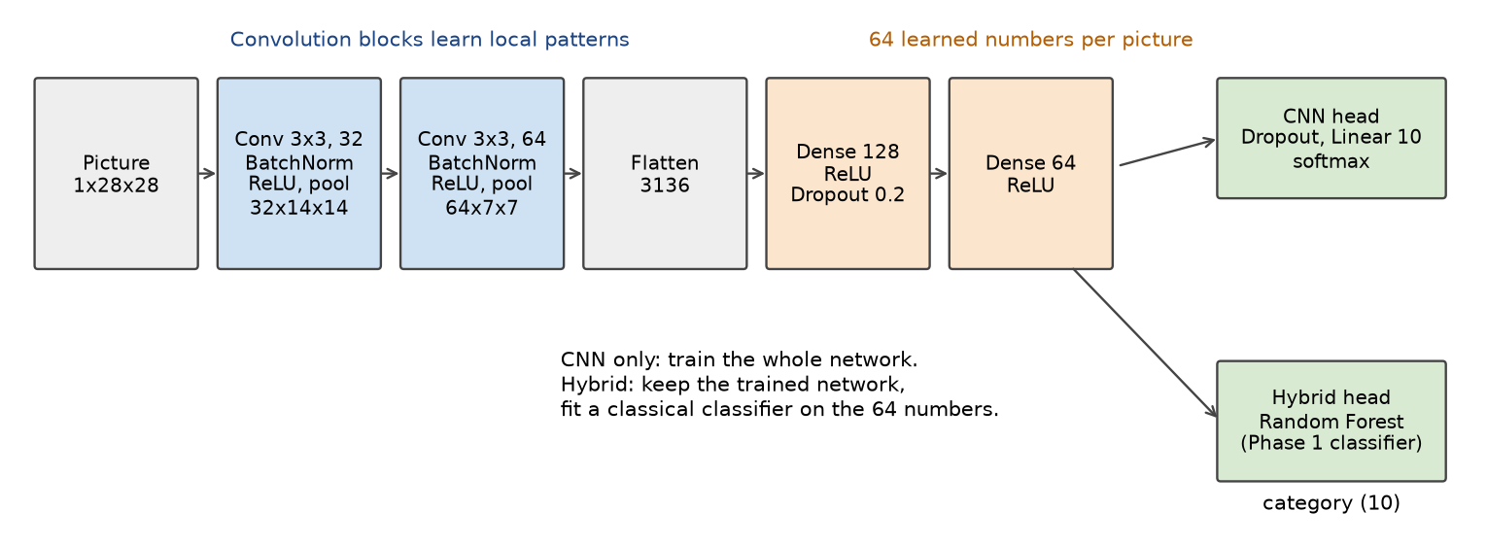
Two conv blocks, then 64 learned numbers
429,450
trainable weights
28 → 14 → 7
size after each pooling
64
numbers the hybrid reuses
Notes:
Convolution with 3 by 3 filters, batch normalisation, ReLU and max pooling, twice. Pictures shrink from 28 to 14 to 7. Two dense layers give a 64-number summary of each picture. The CNN head is one linear layer. The hybrid keeps the trained network and fits a Phase 1 classifier on those 64 numbers. We used two blocks because a third pooling would leave a 3 by 3 map; the ablation tests a third block anyway.

Slide 4
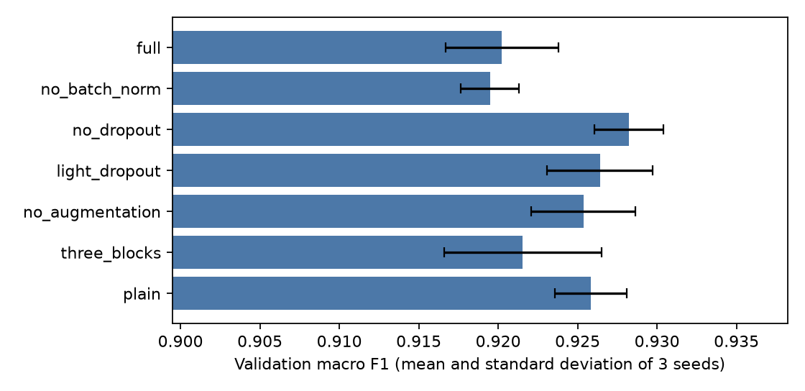
Ablation: most choices sit within the noise
All seven within 0.9 points
Dropout 0.4 hurt; 0.2 is about the same as none
Batch norm, augmentation and a third block gave no clear gain
Final CNN: best version with dropout, as the brief asks
Each version trained with 3 seeds. Bars show the mean and the spread.
Notes:
We removed one ingredient at a time from the full model and trained each version with three seeds. Validation macro F1 ranges from 0.9195 to 0.9282. Differences are about the size of the seed spread, so we rank loosely. Dropout of 0.4 hurt by 0.8 points. We added dropout 0.2 after seeing that, judged on validation data only. The brief asks for dropout, so the final model is the best version that uses it: light dropout at 0.9264. The best overall, no dropout, is 0.0018 higher, less than one standard deviation.

Slide 5
Hybrid: a classifier on the CNN features
The CNN is trained first. A Phase 1 classifier is then fitted on its 64 numbers.
Untrained features score far lower, so training makes them useful
Every classifier gains about half a point: the gain is small but real
The chart axis starts at 0.7.
Notes:
The justification: the final layer is one linear map, while a forest or margin classifier may draw a better boundary around the same 64 learned numbers. Two checks keep the claim honest. The comparison is the CNN own last layer at 0.9264. The control uses an untrained CNN of the same shape at 0.7944, so training, not shape alone, makes the features useful. Logistic regression, linear SVM and Random Forest land within 0.15 points of each other, so the gain comes from refitting on the learned features rather than from the forest. Note the bar axis starts at 0.7.

Slide 6
The CNN beats Phase 1 by about 4 points
Recall | Phase 1 | CNN | Hybrid
Shirt | 59.2% | 73.6% | 75.7%
Pullover | 80.2% | 88.7% | 89.6%
Coat | 82.2% | 87.0% | 88.2%
T-shirt/top | 85.2% | 88.9% | 88.5%
Paired bootstrap, 95% interval: CNN over Phase 1 +4.10 points [+3.52, +4.67]; hybrid over CNN +0.60 [+0.28, +0.94]. Pullover → Coat mistakes fell from 116 to 33.
The chart axis starts at 80%.
Notes:
Official 10,000 test pictures, scored once after the choices were saved in frozen.json. CNN is 91.98 plus or minus 0.24 over three seeds; hybrid 92.49 plus or minus 0.19. The bootstrap resamples the same test pictures 2,000 times for the seed 42 models. Shirt remains the hardest category, with about one in four still wrong. Cost: the CNN takes 0.17 ms per picture on the CPU, the Phase 1 forest 24.98 ms, and the hybrid 25.88 ms because its 400-tree forest dominates.

Slide 7
Limits and how to rerun
Limits
Rerun it
Fashion-MNIST is small and familiar, not a store catalogue
One split, 3 seeds, small search
Apple GPU training is not exactly repeatable
Not in the live dashboard
Install PyTorch:
pip install -r requirements-phase2.txt
Notebook (no download):
notebooks/phase2.ipynb
Retrain everything (about 45 min):
bash scripts/build_phase2.sh
Notes:
State the limits yourself before being asked. The hybrid classifier is fitted on training-picture features from a network that saw those pictures, which can make them look cleaner than features of new pictures. Light dropout and the final-model rule were decided after seeing validation results; the test set played no part. Everything is in the repository: report, notebook, tests, saved predictions and checkpoints.

