Slide 1
Inventory Image Tagging
Handcrafted visual features
and classical classifiers
Fashion-MNIST, ten clothing categories
Aryan · Divyanshu Singh · Jatin Kumar Singh
Jatin Verma · Kushagra Bhardwaj
PROJECT 11 / PHASE 1
01
Notes:
We compare classical classifiers for clothing category prediction. Every model uses the same 48,000 training images. Team details: docs/team.md. Course section and formal affiliation still need to be added.

Slide 2
Clothing category prediction
Input: one upright 28 × 28 grayscale clothing image
Output: one category from ten possible labels
Compare pixels and HOG under the same four classifiers
Compare errors, model size and prediction time
PROJECT 11 / PHASE 1
02
Notes:
We predict one category for one image. Identifying individual products, detecting several objects and counting stock are outside this experiment. We compare pixels and HOG within each classifier family, then inspect the errors and costs. Source: course Project Ideas p.12.

Slide 3
Dataset and shared split
Partition | Images | Images per class
Training | 48,000 | 4,800
Validation | 12,000 | 1,200
Official test | 10,000 | 1,000
Seed 42, equal class proportions, no split overlap
Archive checksums match. No exact training duplicates or blank images
PROJECT 11 / PHASE 1
03
Notes:
Fashion-MNIST has 60,000 official training images and 10,000 official test images. We split only the official training set, keeping equal class proportions. We save the indices for every model to reuse. Hashing checks exact duplicates, but similar images or repeated products may remain. Sources: https://arxiv.org/abs/1708.07747 and reports/data_audit.json.

Slide 4
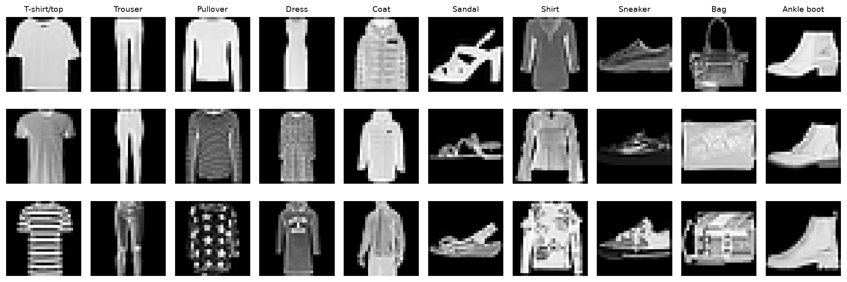
Training images
PROJECT 11 / PHASE 1
04
Notes:
These examples show the small grayscale images the models receive. We sample them from the training partition using a fixed seed. Test errors played no part in choosing them. Source: reports/figures/training_samples.png.

Slide 5
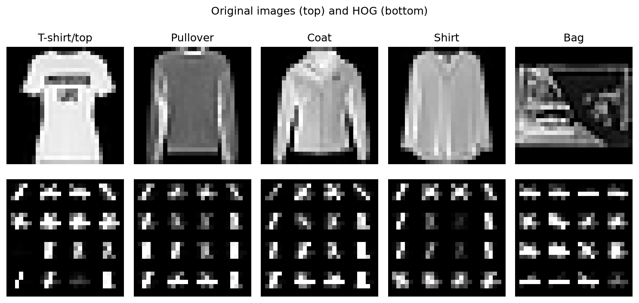
Pixels and HOG
Pixels: 784 brightness values scaled to [0,1]
HOG: edge directions grouped into normalized histograms
7-pixel cells give 324 values. 4-pixel cells give 1,296
PROJECT 11 / PHASE 1
05
Notes:
Flattening keeps every pixel value, so reshaping recovers the image. HOG summarizes edge directions within cells, then normalizes nearby cells in blocks. Its rules are fixed and use no category labels. Both versions use nine direction bins and 2x2-cell blocks. Sources: features.py and https://scikit-image.org/docs/stable/auto_examples/features_detection/plot_hog.html .

Slide 6
Eight classical comparisons
Classifier | Main idea | Two settings
Logistic Regression | Regularized linear scores | C: 0.1, 1
k-NN | Nearby examples vote | k: 3, 5
Random Forest | Combine randomized trees | 200 / 400 trees
Linear SVM | Margin-based boundaries | C: 0.1, 1
Each classifier is fitted on pixels and coarse HOG
PROJECT 11 / PHASE 1
06
Notes:
We train each of four classifier families on pixels and coarse HOG. Logistic Regression uses StandardScaler fitted only on training features. Linear SVM uses normalized features directly, with tolerance 1e-3 and max_iter 2,000. The forest settings pair 200 trees with depth 25, and 400 trees with unrestricted depth. Sources: models.py and train.py.

Slide 7
Model selection and RBF experiments
Reject candidates with convergence warnings
Choose by validation macro F1, using accuracy to break ties
RBF SVM runs on pixels, coarse HOG and fine HOG
Save model choices and hashes before test evaluation
PROJECT 11 / PHASE 1
07
Notes:
We try two settings for each combination and reject candidates with convergence warnings. Validation macro F1 selects the retained candidate, with accuracy breaking ties. Additional RBF runs test C values 3 and 10 on pixels, coarse HOG and fine HOG. Changing both the classifier and descriptor prevents us from attributing a gain to just one factor. We save model hashes before test evaluation. Sources: reports/training/*_trials.json and reports/frozen.json.

Slide 8
Test results for the eight core models
Model | Accuracy | Macro F1
Pixels + RF | 87.61% | 0.8747
Pixels + k-NN | 85.09% | 0.8515
Pixels + LR | 83.96% | 0.8390
Pixels + linear SVM | 83.97% | 0.8373
HOG + LR | 84.55% | 0.8450
HOG + linear SVM | 84.01% | 0.8385
HOG + RF | 84.59% | 0.8455
HOG + k-NN | 83.81% | 0.8382
PROJECT 11 / PHASE 1
08
Notes:
These are test scores for the eight retained core models. Validation selected the settings before this evaluation. Among the core models, validation selected Pixels + RF, which achieves 87.61% test accuracy. Source: reports/test/results.csv.

Slide 9
Selected model and test performance
Fine HOG + RBF SVM
90.87% test accuracy
0.9084 macro F1
All methods used the same 48,000 training images
The reference used 12,000 images. Training size and settings both changed
PROJECT 11 / PHASE 1
09
Notes:
Validation selected fine HOG with RBF SVM using C=3 and gamma=scale. Its validation accuracy is 91.36%. On the official test set, accuracy is 90.87% and macro F1 is 0.9084. These results apply to Fashion-MNIST. The reference used 12,000 training images and reported 85.27% for its best classical model. We changed training size and settings, so the difference cannot isolate either effect. Sources: reports/frozen.json, reports/test/results.csv and the supplied reference.

Slide 10
Per-category recall
PROJECT 11 / PHASE 1
10
Notes:
Recall is the proportion of a true category that the model identifies correctly. Shirt recall is 71.4%, the lowest category recall. Bag recall is 98.6%. Each test category has 1,000 images, so these percentages have equal denominators. Source: reports/test/per_class.csv.

Slide 11
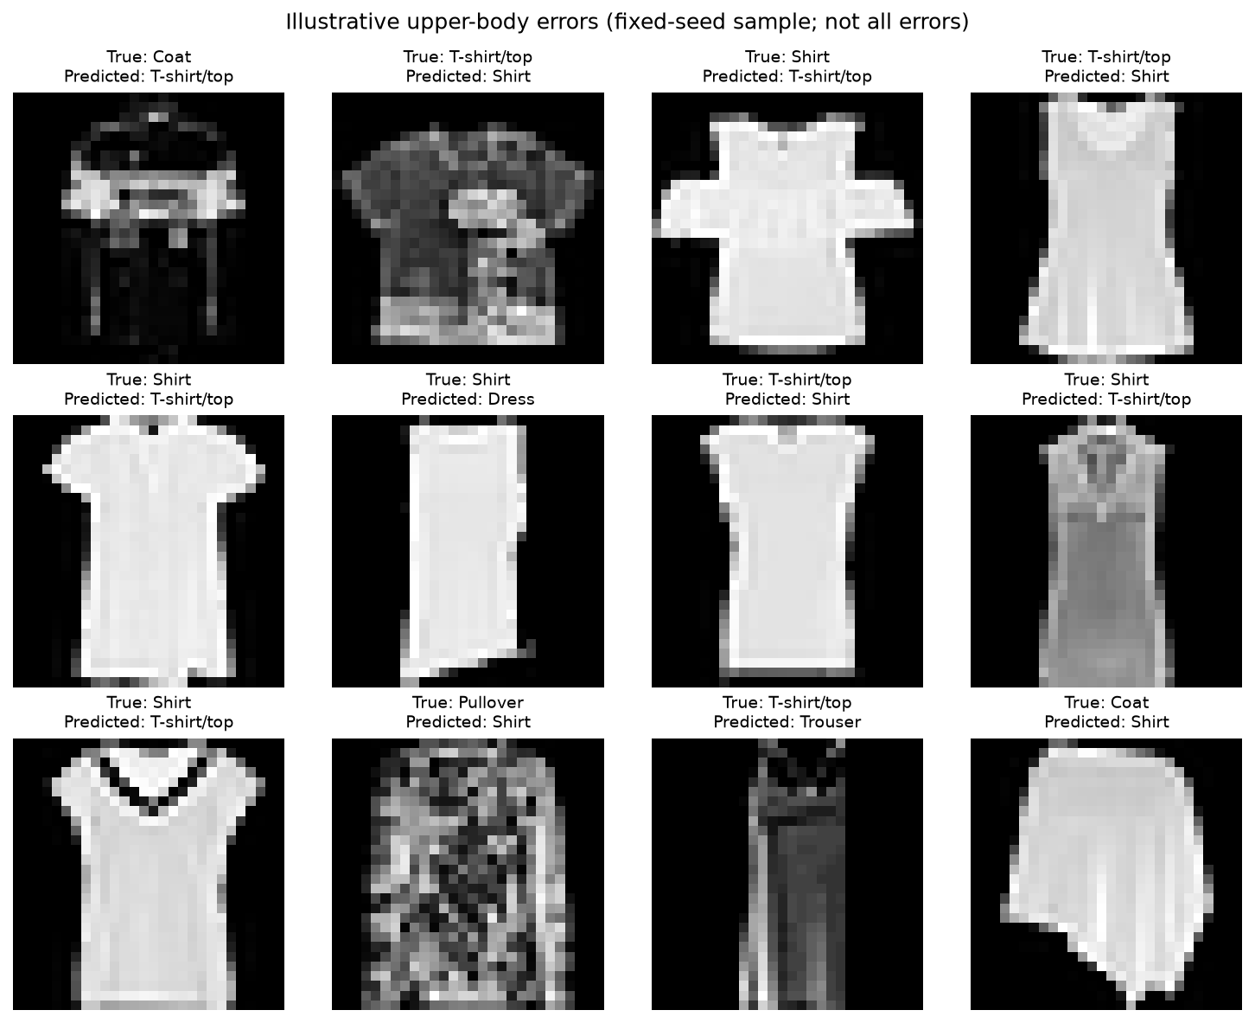
Common upper-body mistakes
Shirt as T-shirt/top
116 errors
T-shirt/top as Shirt
102 errors
Shirt as Coat
66 errors
PROJECT 11 / PHASE 1
11
Notes:
The counts show the direction of each mistake. A Shirt predicted as T-shirt/top differs from the reverse error. We sample upper-body mistakes with a fixed seed for inspection. The examples do not represent all failures. Similar shapes and textures may contribute, but these images cannot establish the cause. Sources: reports/test/upper_body_confusions.csv and error_examples.csv.

Slide 12
Prediction time and model size
Measure | Selected model
Single-image median | 10.17 ms
Batch throughput | 59 images/s
Saved model size | 52.74 MiB
support vectors | 17835
Capacity counts mean different things for each model family
PROJECT 11 / PHASE 1
12
Notes:
We use the same CPU with two threads and warm each model before timing. There are 20 single-image repetitions, plus five repetitions over 1,024 images in batches of 128. Timing includes HOG, scaling and prediction, while excluding file decoding and model loading. Single-image p95 is 15.732 ms. Batch throughput is a separate measure. Sources: reports/test/results.csv and timing_repeats.csv.

Slide 13
Limitations and the CNN phase
One split and seed, with a limited settings search
Phone photos and new categories still need testing
We acknowledge the reference. These scores come from our own runs
Phase 2: a small CNN and experiments on its design choices
PROJECT 11 / PHASE 1
13
Notes:
We use one split and a limited search. The public test benchmark also appeared in the supplied reference. We have not tested phone photos, new categories, near-duplicates, splits by product identity or calibration. Phase 2 should reuse the saved split for a CNN with two or three blocks, pooling and dropout. Validation should control early stopping. We will test architecture and regularization choices separately before comparing errors. Sources: report limitations and course Project 11 description.

Slide 14
Running the experiment
uv sync --locked
bash scripts/uv.sh run python scripts/reproduce.py
Notebook: notebooks/phase1.ipynb
Workflow: prepare data, extract features, train, validate, evaluate
PROJECT 11 / PHASE 1
14
Notes:
The reproduction script runs the full experiment in a separate directory, preserving the reported outputs. A fresh clone needs local data and fitted models. The uv wrapper handles the colon in our current folder path. Use the notebook to follow the results and the viva guide to practise explaining each stage. Sources: README.md and docs/viva_guide.md.

Slide 15
Project team
Member | Enrolment
Aryan | 2401020013
Divyanshu Singh | 2401010161
Jatin Kumar Singh | 2401010199
Jatin Verma | 2401010200
Kushagra Bhardwaj | 2401010247
PROJECT 11 / PHASE 1
15
Notes:
The five names and enrolment numbers come from the roster supplied on 23 October 2026. Add the course section and formal affiliation before submission. Record each member's actual contribution, and make sure everyone can explain the complete workflow. Source: docs/team.md.

