Slide 1

Company Engineering Handbook v4.2
Last Updated: August 2026

Slide 2
1. Deployment & Release Management
All production services follow a blue-green deployment strategy. New releases are deployed to the green environment first, where they undergo automated smoke testing for 15 minutes before traffic is shifted. If error rates exceed 2% during the smoke test window, an automatic rollback is triggered without human intervention.
Deployments are scheduled during the maintenance window (Tuesday and Thursday, 02:00-04:00 UTC). Emergency hotfixes may be deployed outside this window with approval from the Engineering Director and on-call SRE.
Every service must expose a /health endpoint that returns HTTP 200 within 500ms. The health check must verify database connectivity, cache availability, and downstream service reachability. A degraded health check (HTTP 503) should be returned when any non-critical dependency is unavailable.

Slide 3
1. Code Review Standards
Approval Requirements
Pull Request Requirements
All code changes require at least two approvals before merging: one from a peer engineer and one from a tech lead or senior engineer. The reviewer must verify correctness, test coverage, security implications, and adherence to coding standards.
Pull requests must include a clear description of the change, link to the relevant ticket, and screenshots or logs demonstrating the change works as expected. Automated CI checks (linting, unit tests, integration tests) must pass before review can begin.

Slide 4
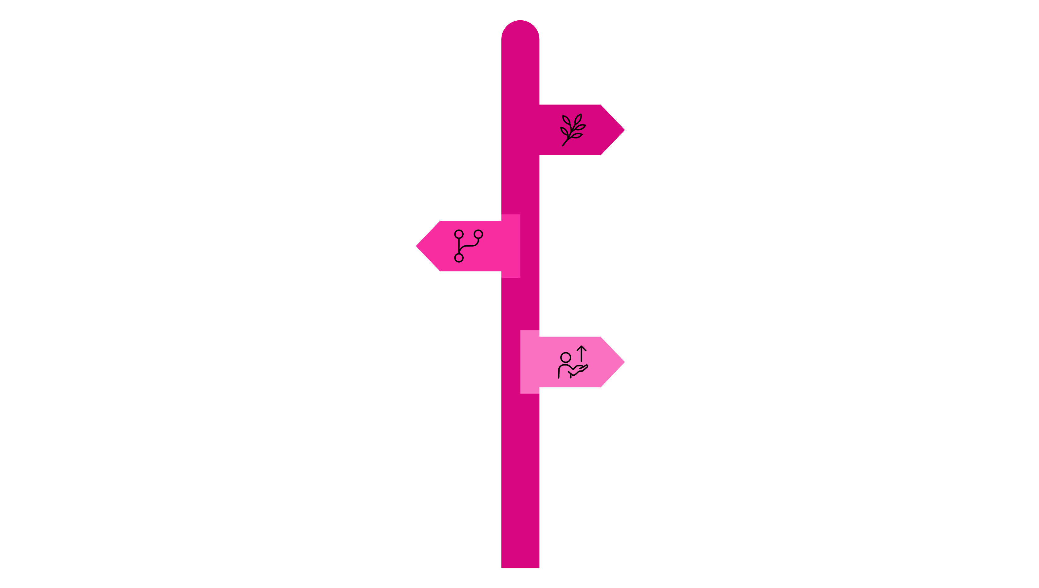
1. Branching Strategy
We follow a trunk-based development model. Feature branches should be short-lived (maximum 3 business days). Long-running features are broken into incremental PRs that can be merged safely.
Release branches are created from main only when preparing for a major release. Hotfixes are applied directly to the release branch and cherry-picked back to main.
Feature Branch
Short-lived (max 3 days); incremental PRs.
Trunk / Main
Continuous integration; merge small changes frequently.
Release Branch
For major releases and hotfixes; cherry-pick fixes back.

Slide 5
1. On-Call Rotation
Each team maintains a 24/7 on-call rotation with primary and secondary responders. The primary on-call engineer must respond to pages within 5 minutes during business hours and 15 minutes outside business hours.
Incident Severity Levels
SEV1
SEV2
SEV3
Complete service outage affecting all users. Response time: 5 minutes.
Partial outage or significant degradation. Response time: 15 minutes.
Minor issues with workarounds available. Response time: 1 hour.

Slide 6




1. Monitoring & Observability
All services must instrument the three pillars of observability: metrics (Prometheus), logs (structured JSON to ELK), and traces (OpenTelemetry). Custom business metrics must be registered in the team's Grafana dashboard.
Alert fatigue is managed through tiered alerting: warnings trigger Slack notifications, critical alerts trigger PagerDuty pages, and emergency alerts trigger phone calls.
Metrics
Prometheus
Logs
Structured JSON to ELK
Traces
OpenTelemetry

Slide 7
1. Database Management
Schema Migrations
Connection Pooling
Schema migrations must be backward-compatible to support zero-downtime deployments. All migrations are tested against a production snapshot in the staging environment before application.
Connection pooling is mandatory for all database interactions. The default pool size is 20 connections per service instance. Connection leaks are detected automatically and trigger service restarts.

