Slide 1

ENPM 818N - Cloud Computing
Midterm Group Project
Scalable and Secure E-Commerce Platform on AWS
Group 18
Aryan Kulshrestha, Aashay Mehta, Long Le, and Gideon Marcus Jayakumar
URL: https://group18ecommerce.com

Slide 2
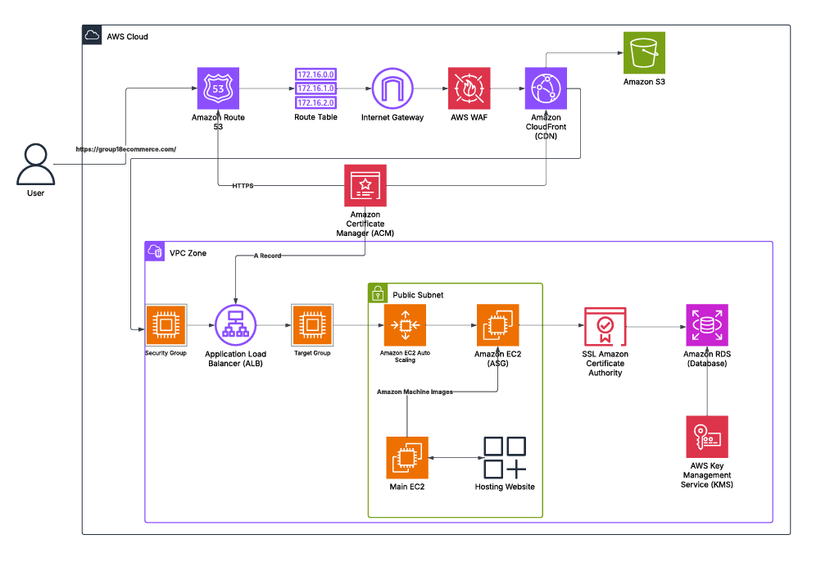
Architectural Diagram
Lucidchart Link

Slide 3
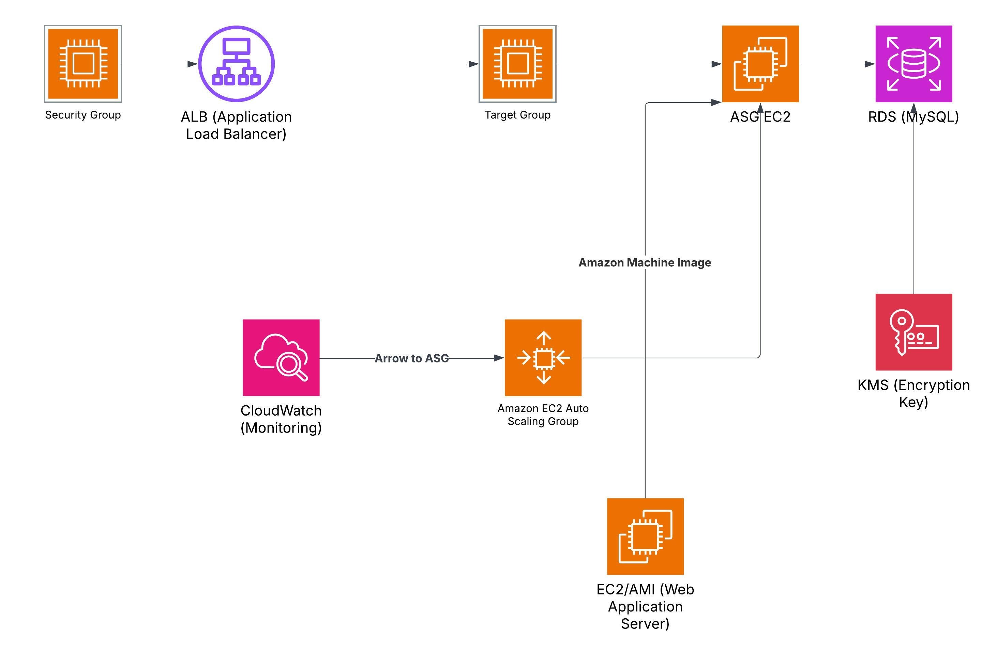
Phase 1 - Infrastructure Setup
This diagram represents the basic infrastructure deployed for our cloud-based e-commerce application. The diagram below captures this end-to-end flow from user access to backend data handling and monitoring. (Lucidchart link)

Slide 4
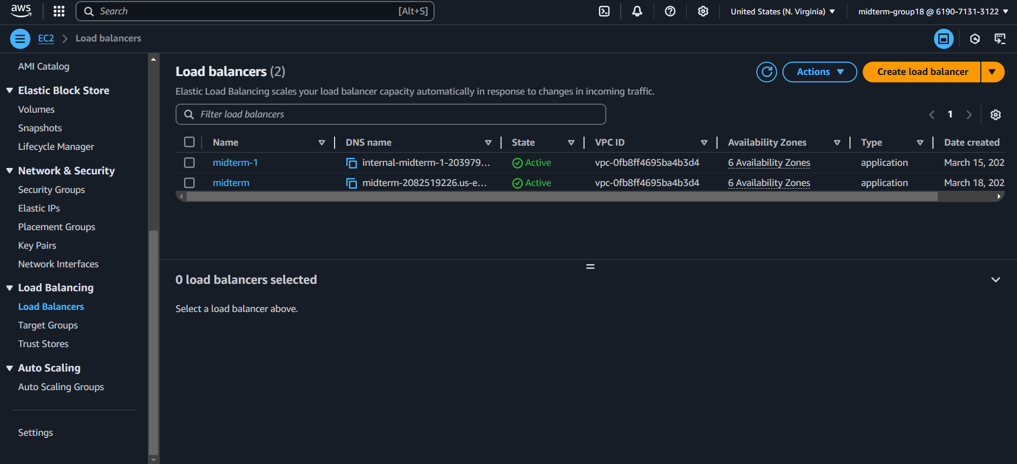
EC2 and Load Balancer
To ensure high availability, fault tolerance, and even distribution of traffic, the EC2 instance was integrated with an Application Load Balancer (ALB). The ALB acts as the single point of entry, intelligently routing user requests across one or more backend instances, and supporting both HTTP and HTTPS traffic with automatic redirection and SSL offloading.

Slide 5
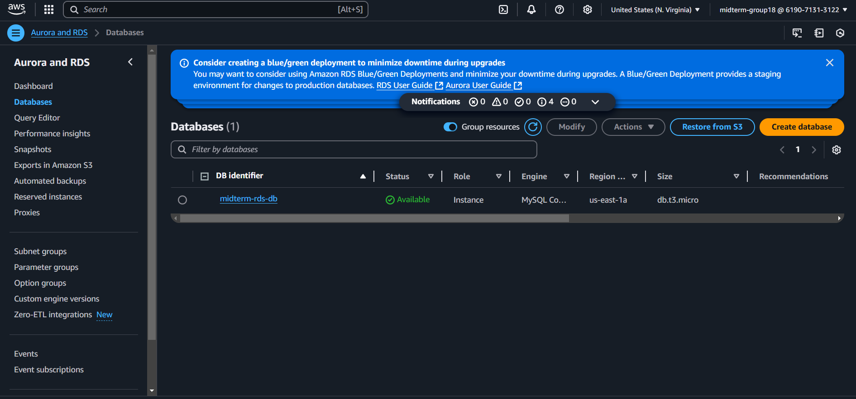
RDS Database
Amazon RDS was used to decouple the database layer from the application layer, enabling better manageability, scalability, and performance. It eliminates the need to manage database servers directly on EC2 and provides built-in features like automated backups, encryption, and monitoring.

Slide 6
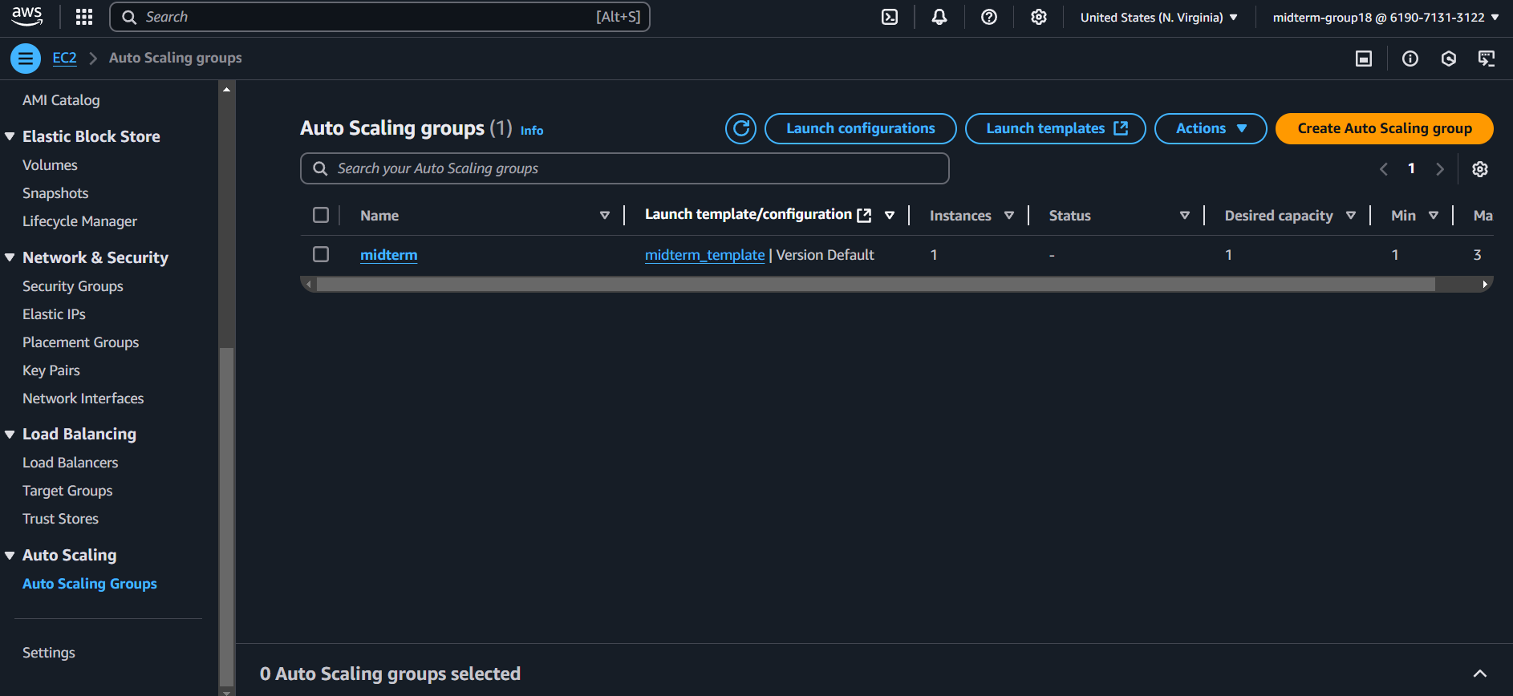
Auto Scaling & Monitoring
To ensure the web application can handle varying levels of incoming traffic, Auto Scaling was configured using an Amazon Machine Image (AMI) and tied to monitoring metrics through Amazon CloudWatch.

Slide 7
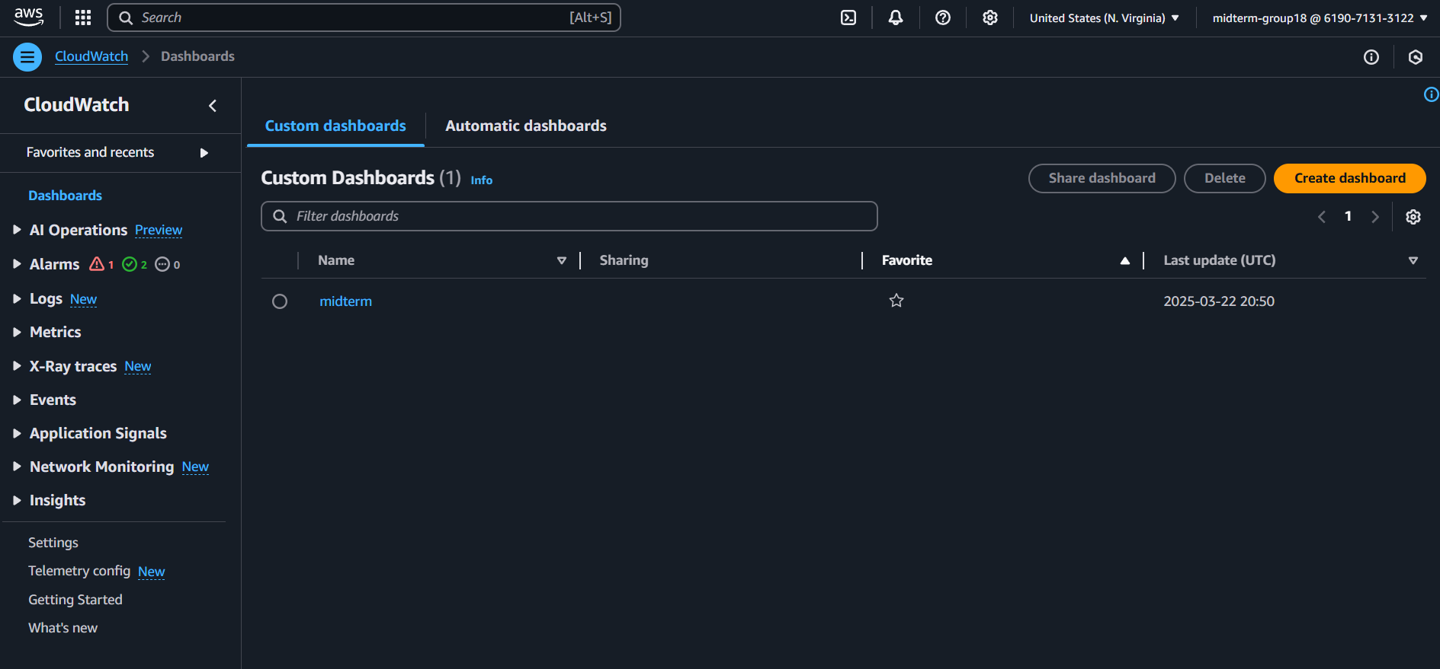
Auto Scaling & Monitoring
Amazon CloudWatch was used to create an alarm that monitors CPU utilization across instances within the Auto Scaling Group.

Slide 8
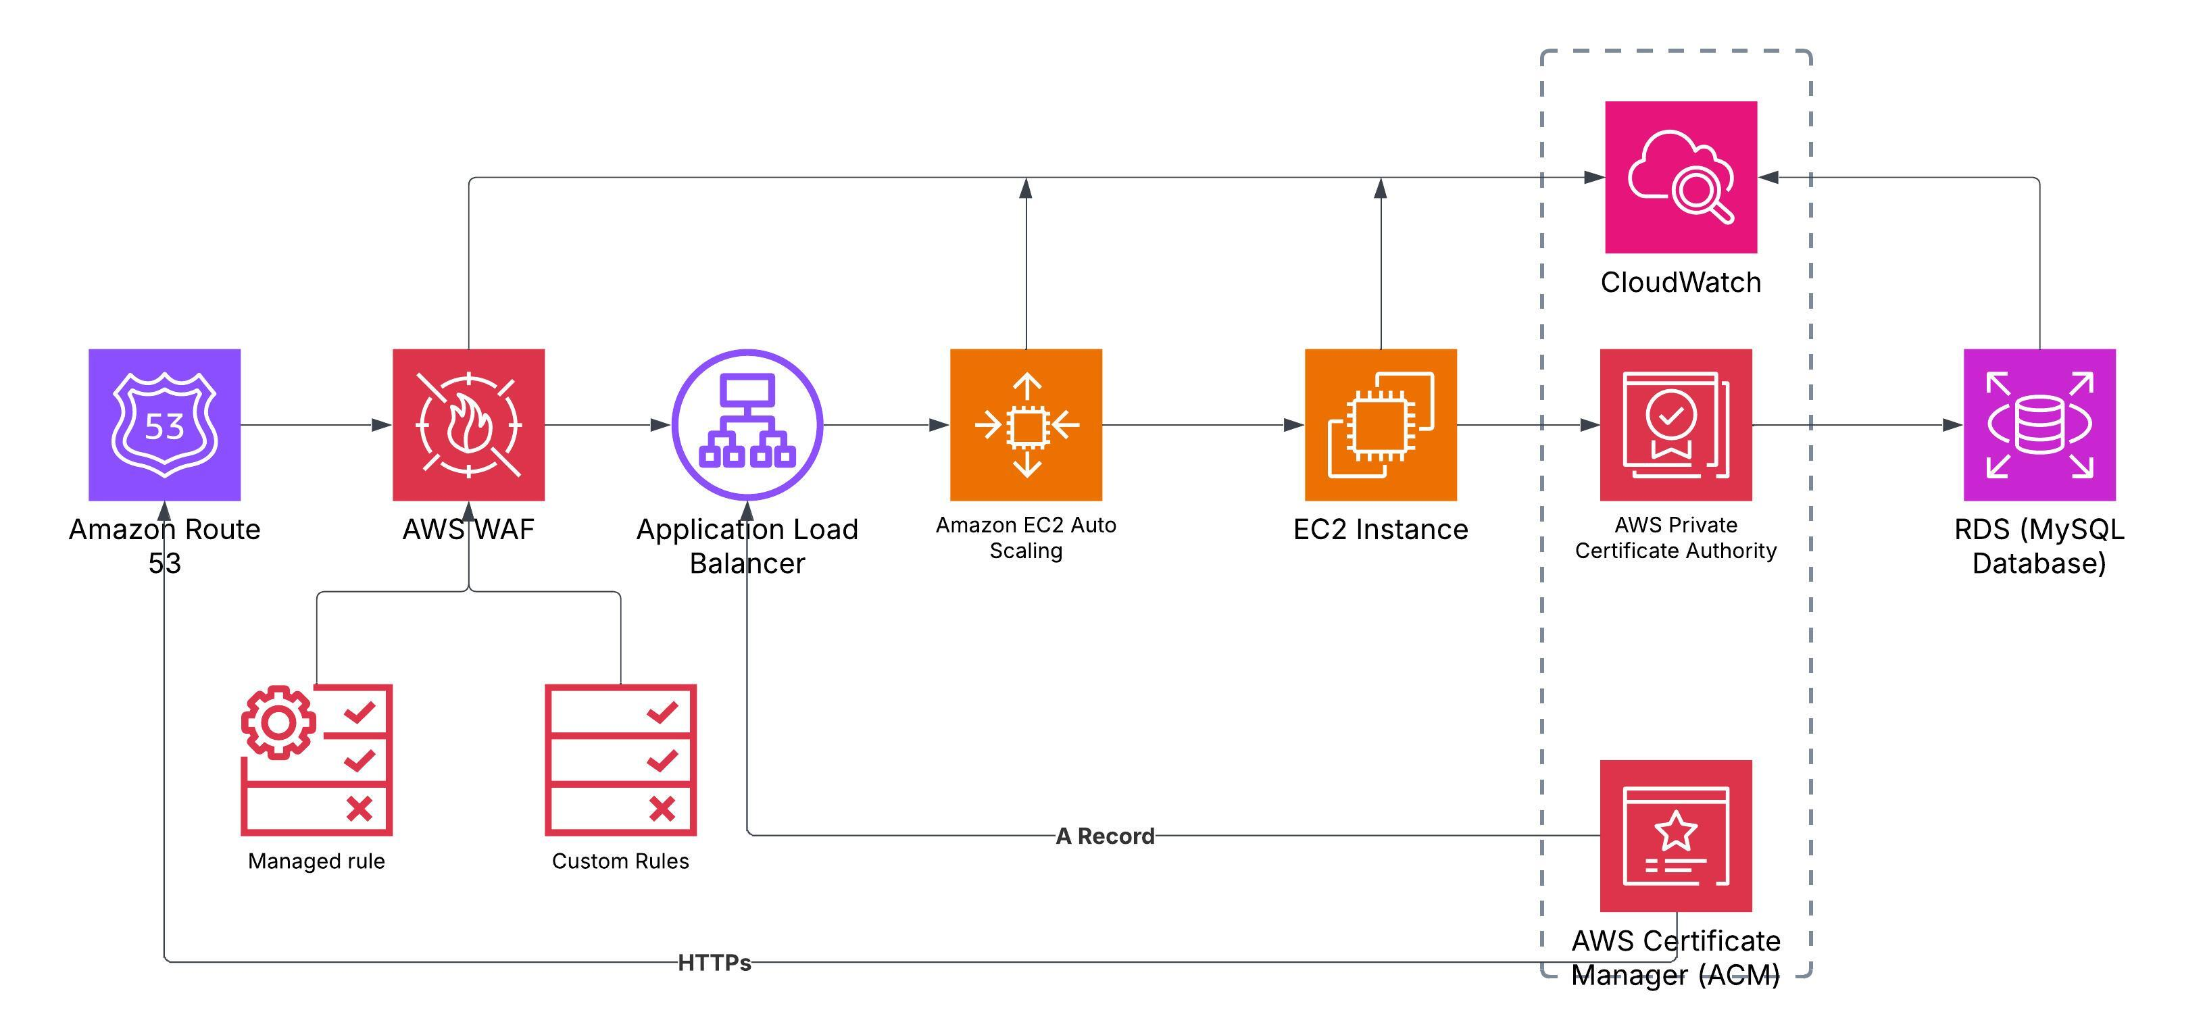
Phase 2 - Security Architecture
The purpose of this phase is to enhance the security of the E-commerce Web Application by implementing Web Application Firewall (WAF) with Application Load Balancer (ALB) to prevent SQL injection and XSS. We have also implemented SSL/TLS certificates through ACM. (Lucidchart Link)

Slide 9
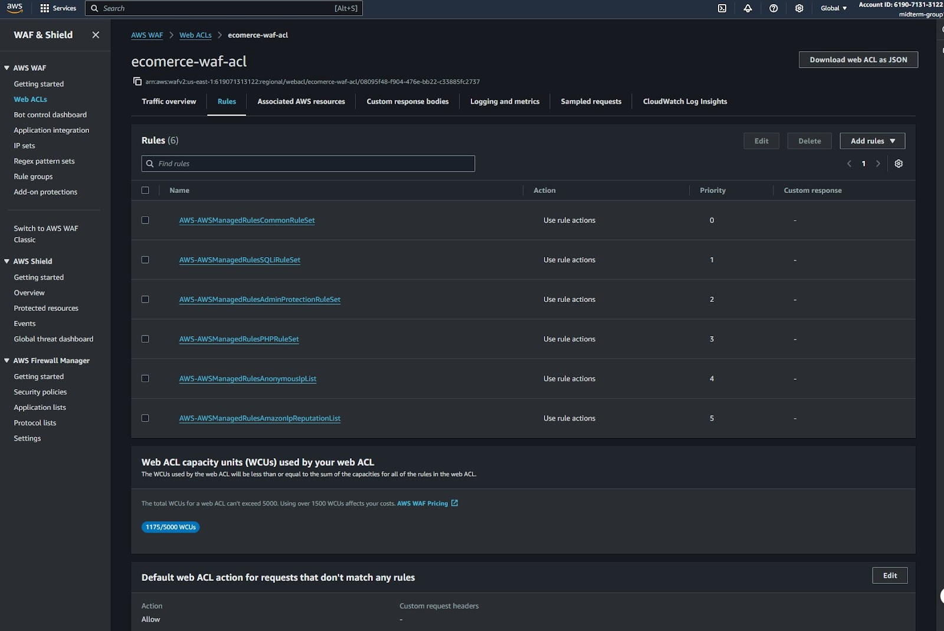
WAF and SSL
AWS WAF protects the e-commerce web application from common web attacks such as SQL Injection and Cross-Site Scripting (XSS) by filtering and blocking malicious requests from the internet.

Slide 10
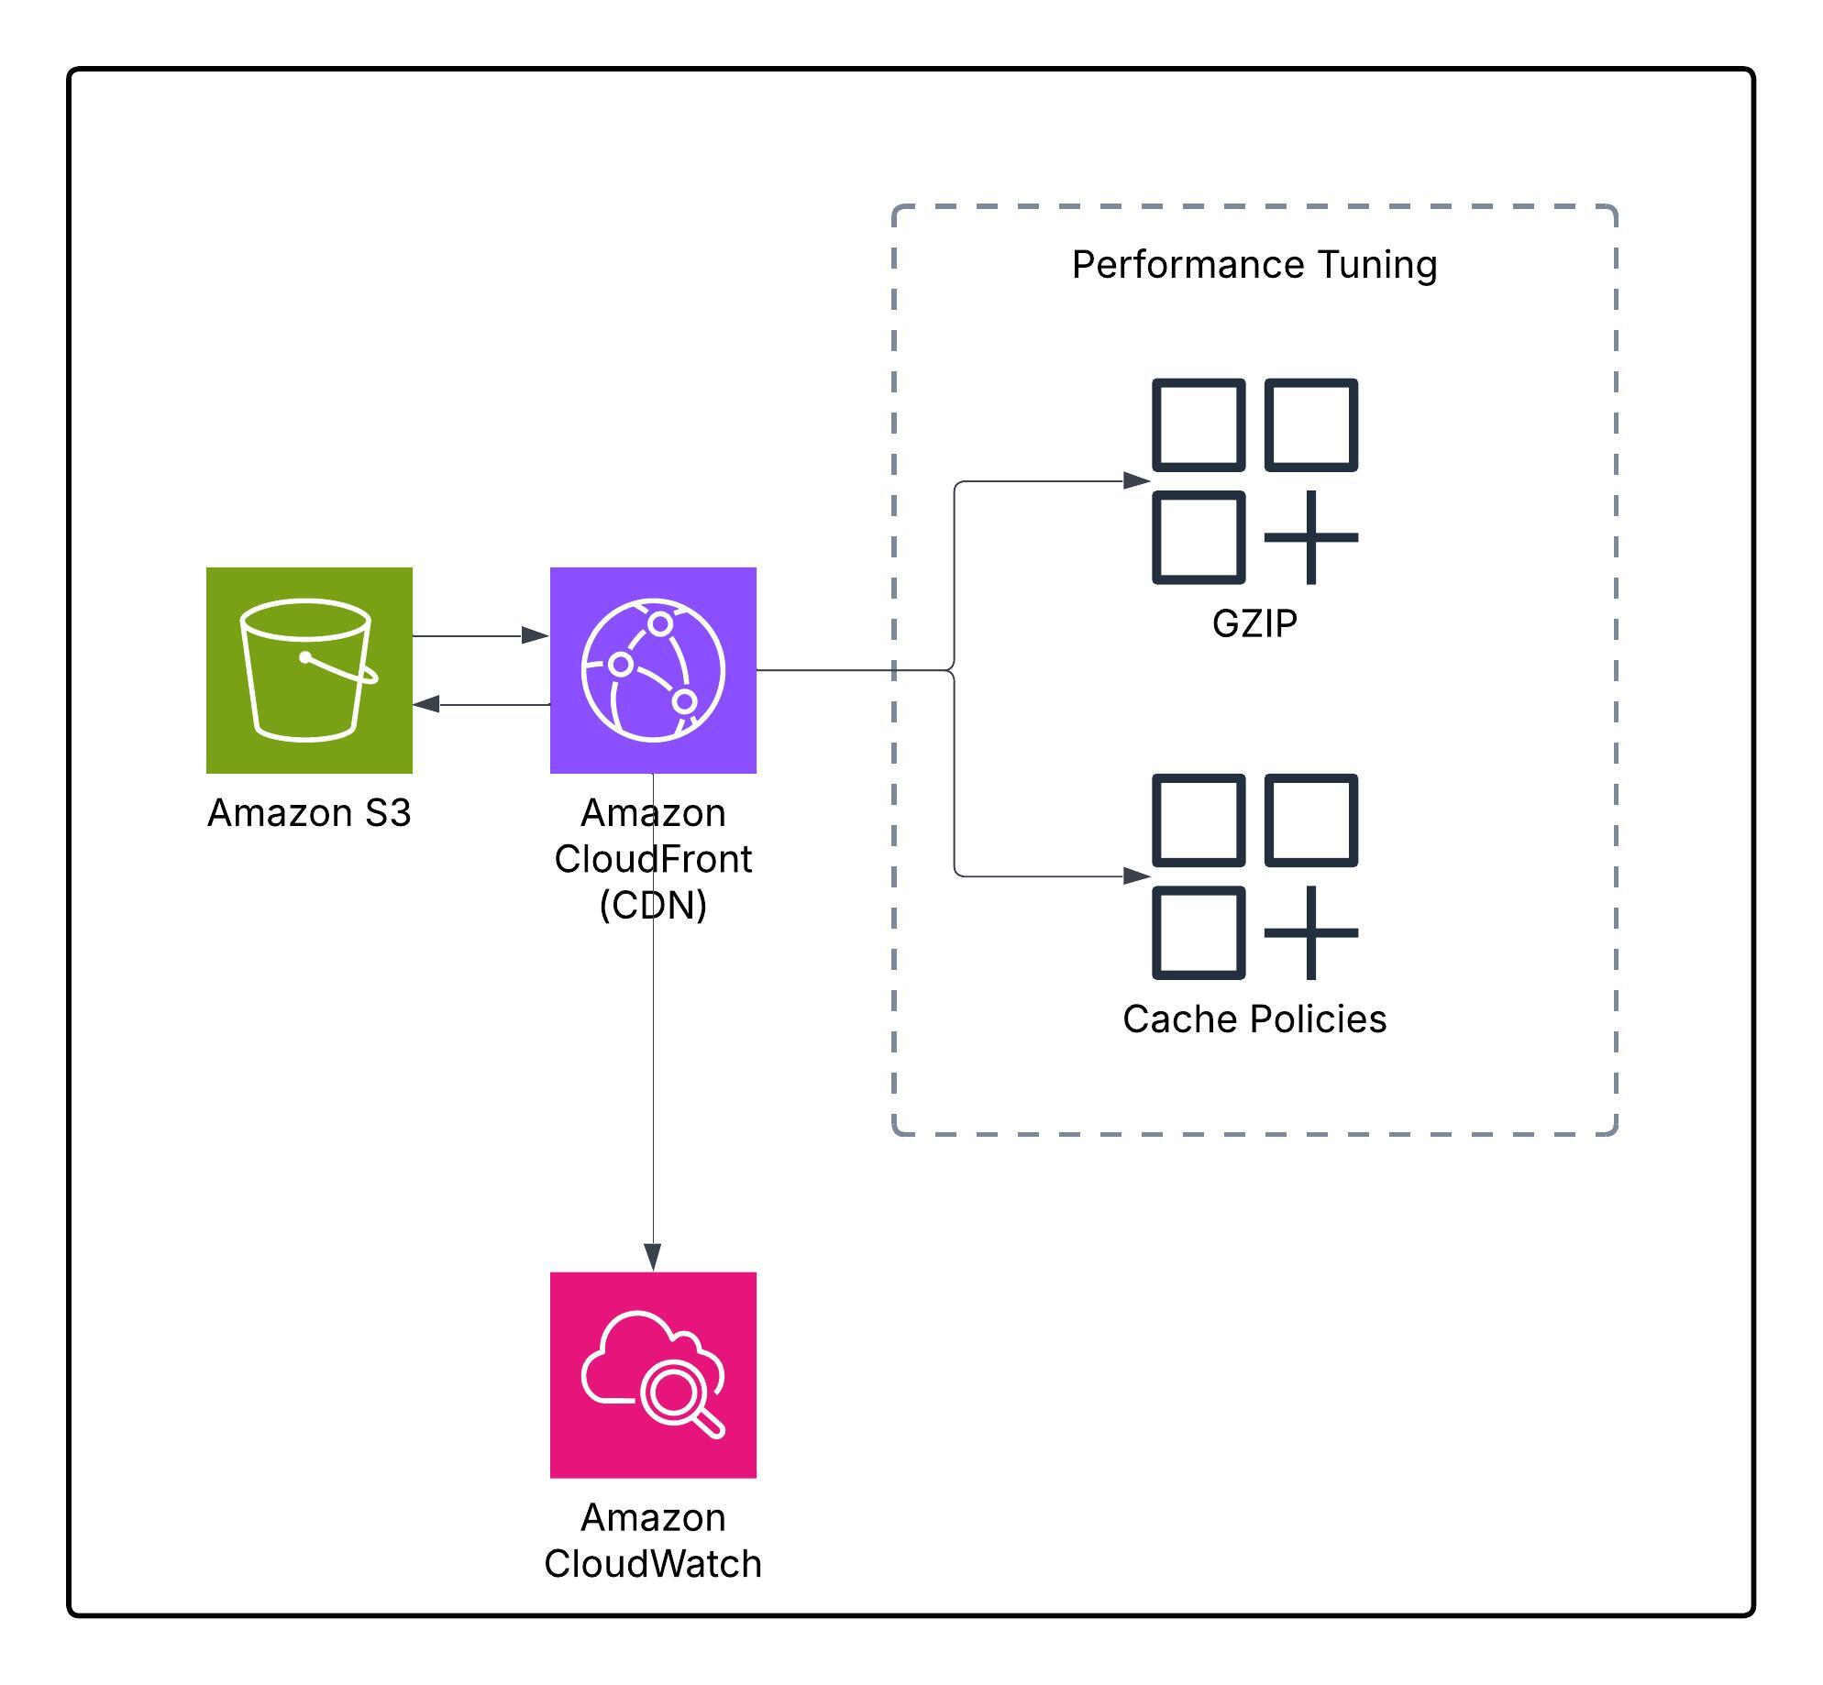
Phase 3 - CloudFront CDN
This phase focuses on improving the performance, scalability, and user experience of the web application by leveraging AWS content delivery and monitoring services. Amazon CloudFront is used as a CDN to cache and deliver static assets from S3 with low latency. To further enhance performance, GZIP compression and custom cache policies are applied. (Lucidchart Link)

Slide 11
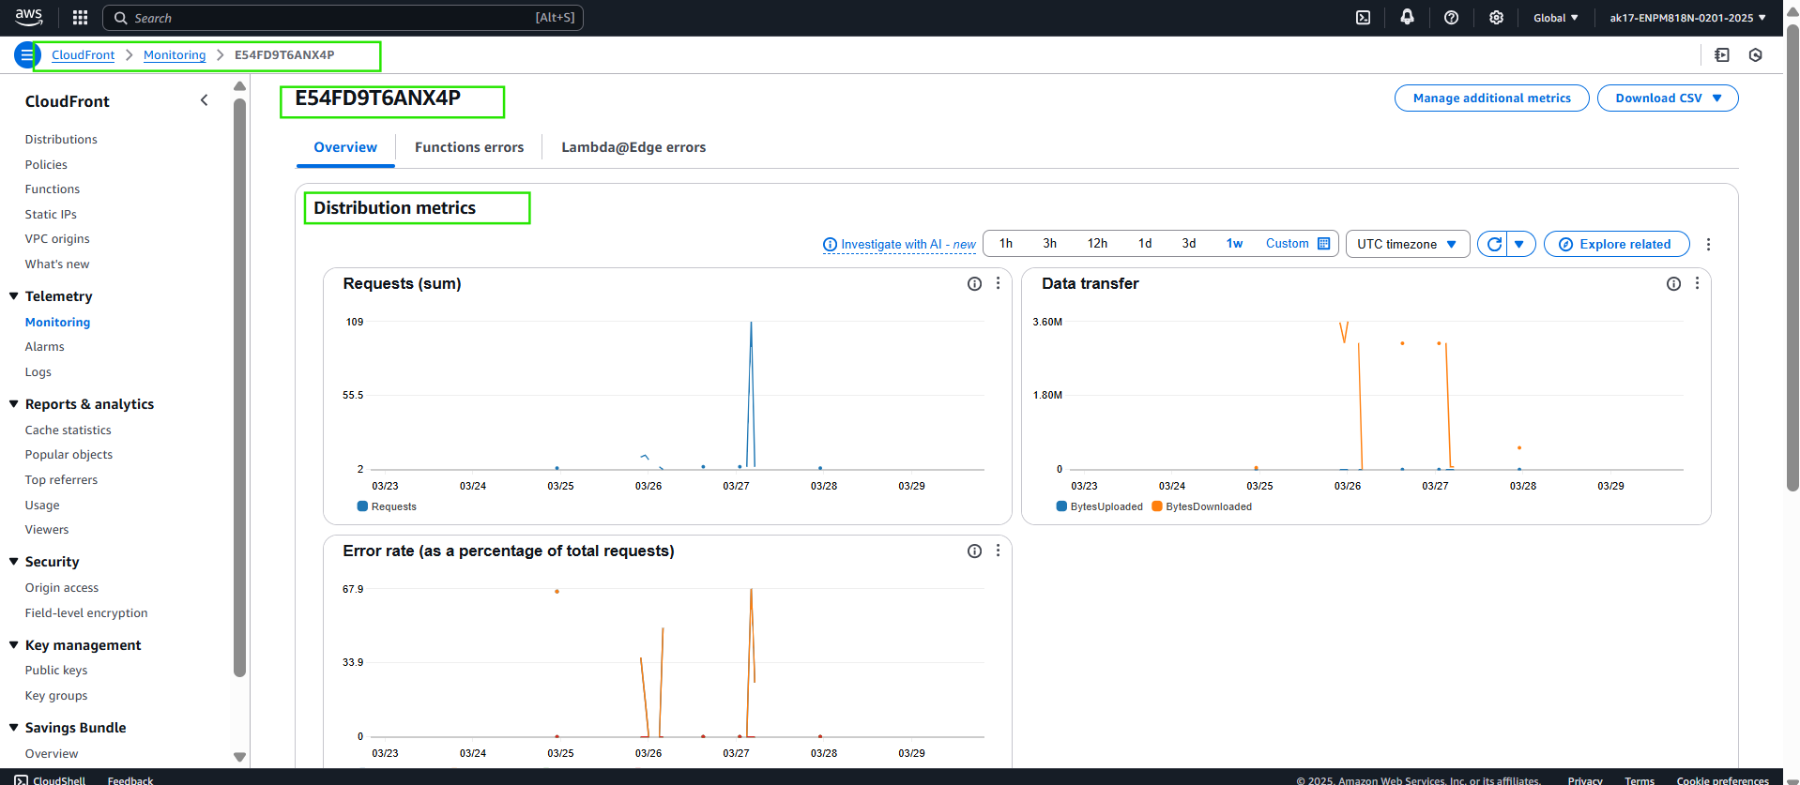
Phase 3 - Performance Monitoring
Amazon CloudWatch was configured to monitor CloudFront request rates, error responses, and cache hit/miss ratios. This setup helps in real-time monitoring of content delivery performance and identifying potential issues like latency spikes or caching inefficiencies.

Slide 12
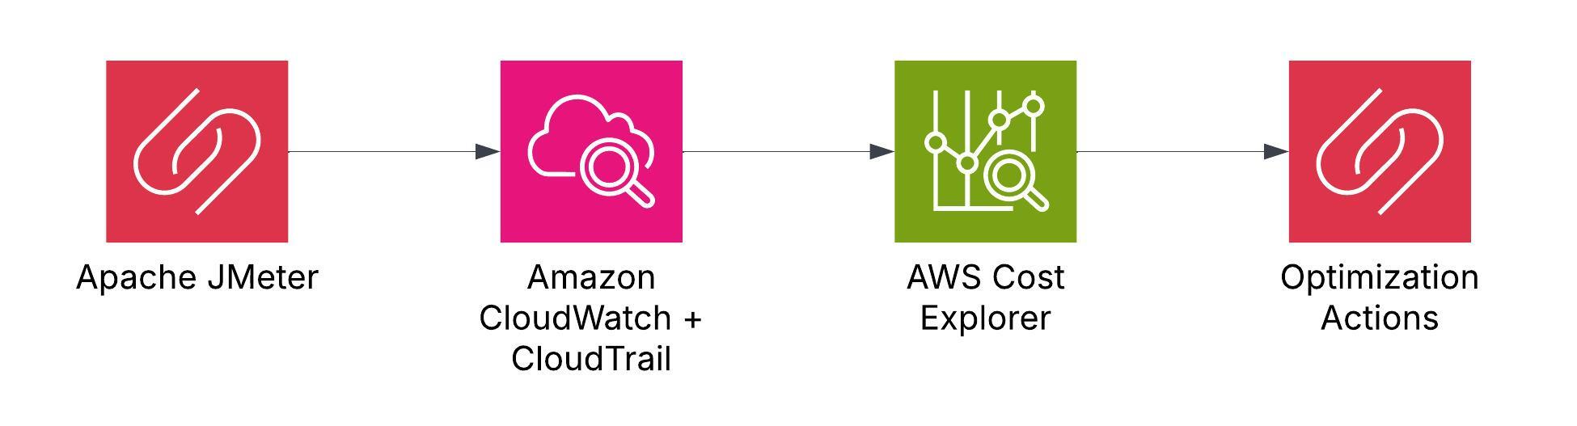
Phase 4 - Testing Architecture
This phase focuses on validating the scalability, performance, and cost-efficiency of the deployed cloud infrastructure. To simulate real-world traffic and stress test the system, Apache JMeter was used to generate load on both the web application and the RDS backend. Metrics like CPU utilization and database performance were monitored using Amazon CloudWatch and CloudTrail to ensure that the Auto Scaling Group reacts appropriately under varying loads. (Lucidchart Link)

Slide 13
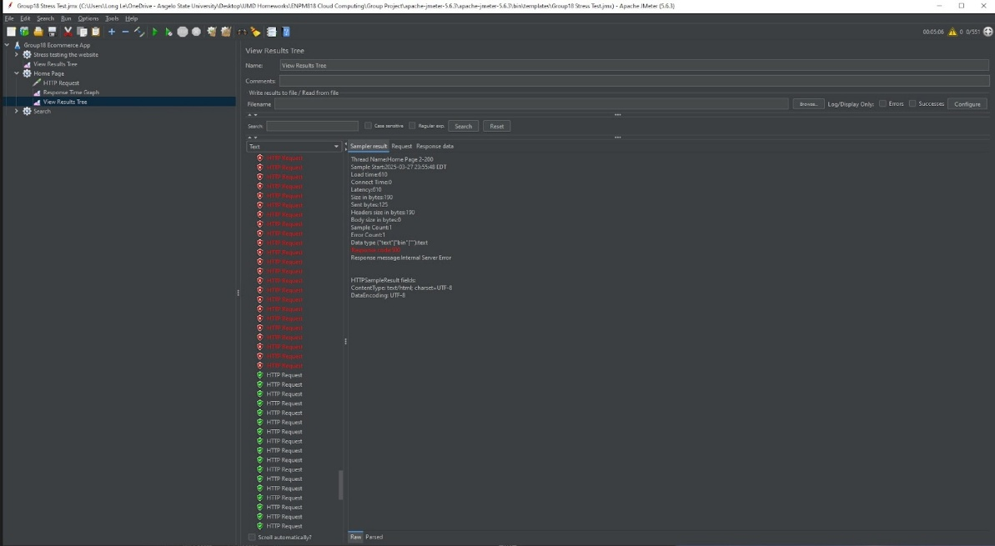
Stress Testing Results
Analysis for stress testing results using Jmeter.

Slide 14
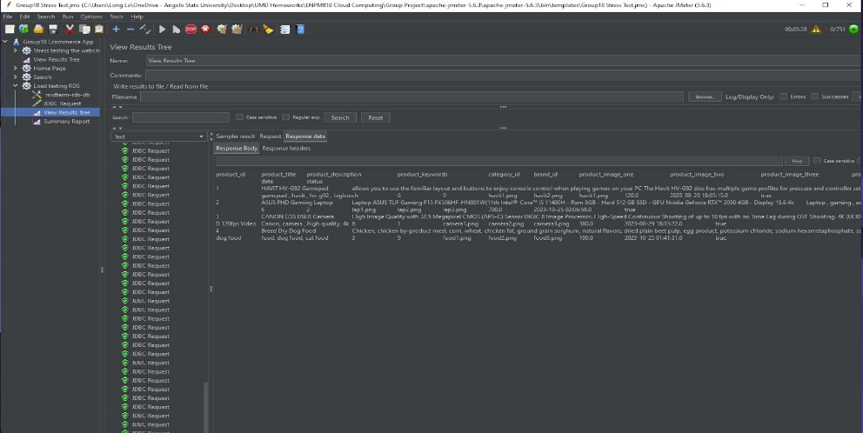
Stress Testing Results
Analysis for stress testing results using Jmeter.

Slide 15
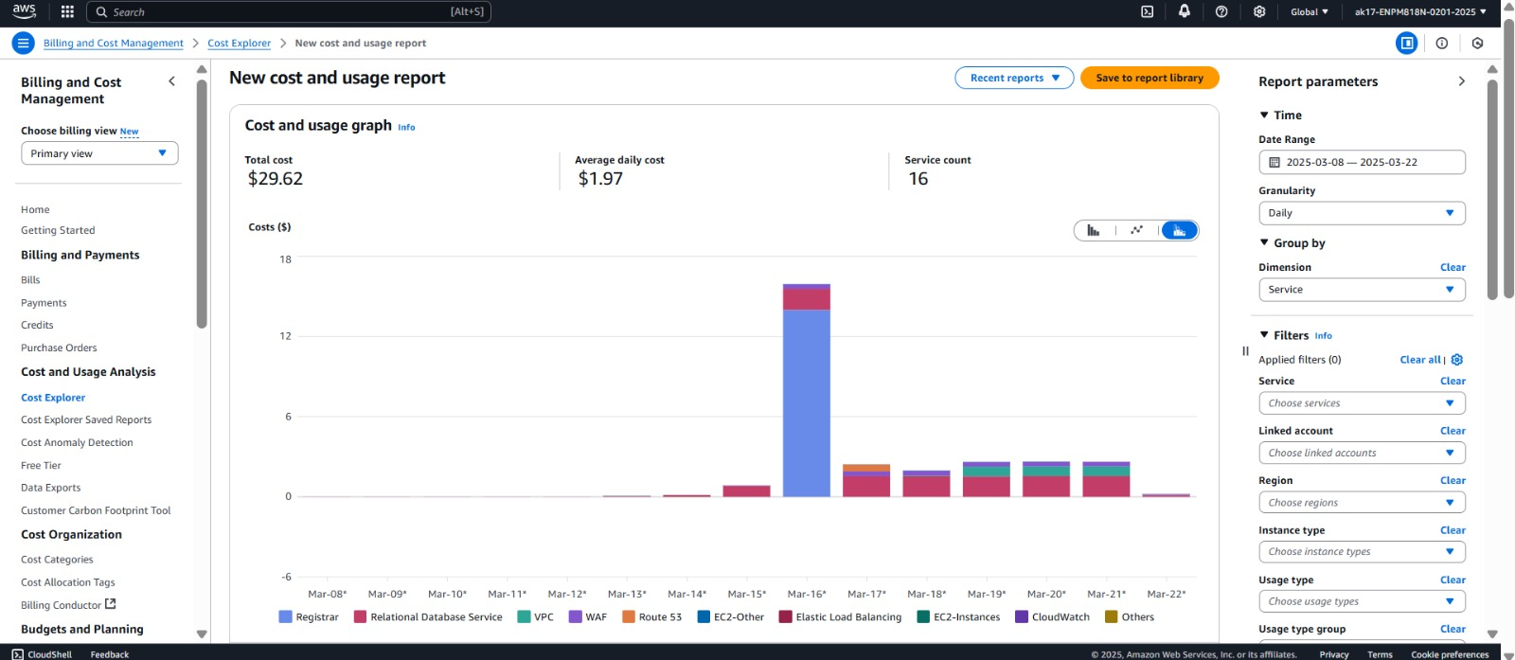
Cost Explorer
AWS Cost Explorer Reports

Slide 16
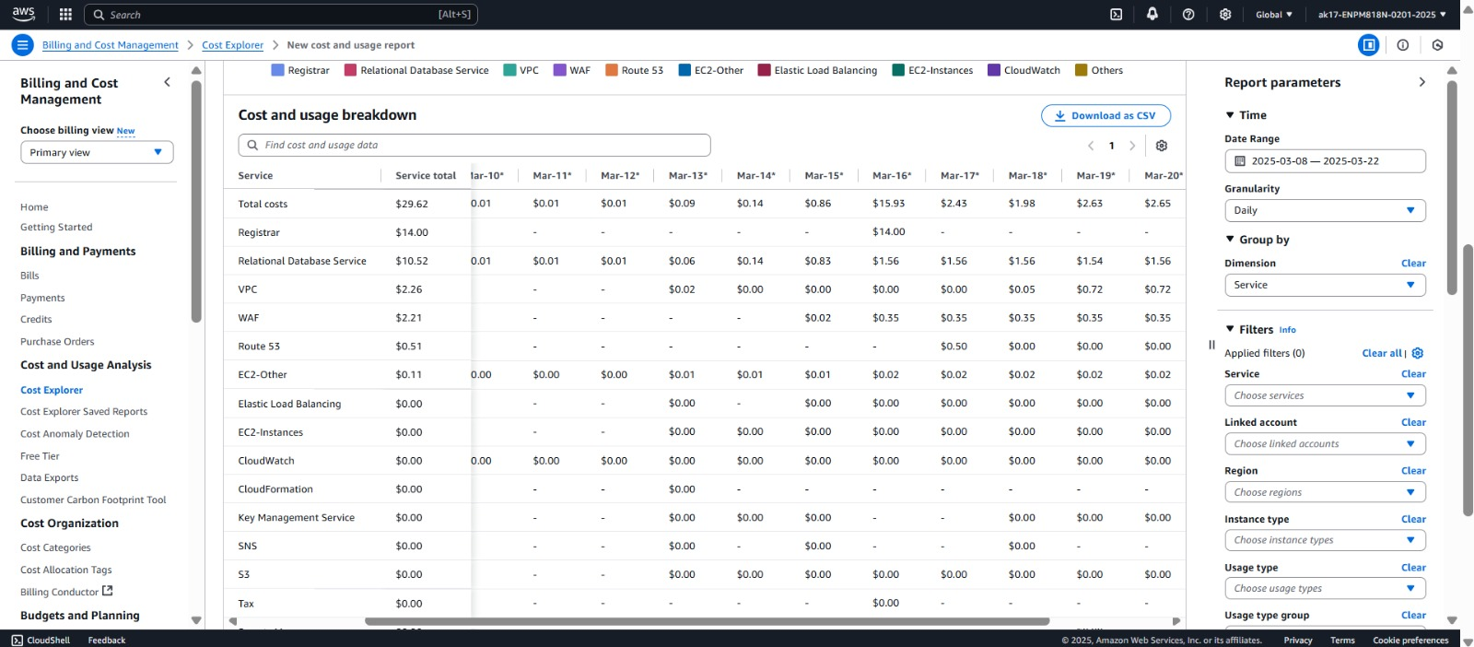
Cost Explorer
AWS Cost Explorer Reports

Slide 17
Lessons Learned
How to build infrastructure on AWS
⁠Best practices for Security- ⁠Scalability and Auto Scaling
⁠Monitoring and Troubleshooting- ⁠Performance Optimization
Cost Awareness- ⁠End to End Deployment Procedures

Slide 18
Future Improvements
Implement Automation techniques using CI/CD and IaC.
Use Amazon Cognito for User Authentication
Explore Serverless functionalities
Use Containerization techniques

