Slide 1
Linear vs Circular Convolution
LINEAR × CIRCULAR
CONVOLUTION
Understanding FFT length, zero-padding and output accuracy
ARYAN KULKARNI • ECE–AIML
DES Pune University
DSP / SIGNALS / SYSTEMS
DSP MINI-PROJECT / ECE–AIML
01

Slide 2
Problem Statement & Objectives
Compare direct linear and FFT-based circular convolution.
Show wraparound error from insufficient FFT length.
Determine minimum padding required for an accurate linear result.
Compare execution times for different input lengths.
DSP MINI-PROJECT / ECE–AIML
02

Slide 3
Theory: Zero-Padding
Full linear-convolution length = Lx + Lh − 1.
Lx = 64 and Lh = 5, so required output length = 68.
FFT multiplication naturally produces circular convolution.
Choose N ≥ 68 and zero-pad to recover the full linear result.
DSP MINI-PROJECT / ECE–AIML
03

Slide 4
Signals & Method
Input: two combined sinusoids, 64 samples.
Impulse response: [1.0, 0.5, 0.25, −0.1, 0.05].
Reference: NumPy direct linear convolution.
FFT lengths tested: 64, 68, 79, 96 and 128.
Runtime input lengths: 64, 256, 1,024 and 4,096; second sequence length 31.
DSP MINI-PROJECT / ECE–AIML
04

Slide 5
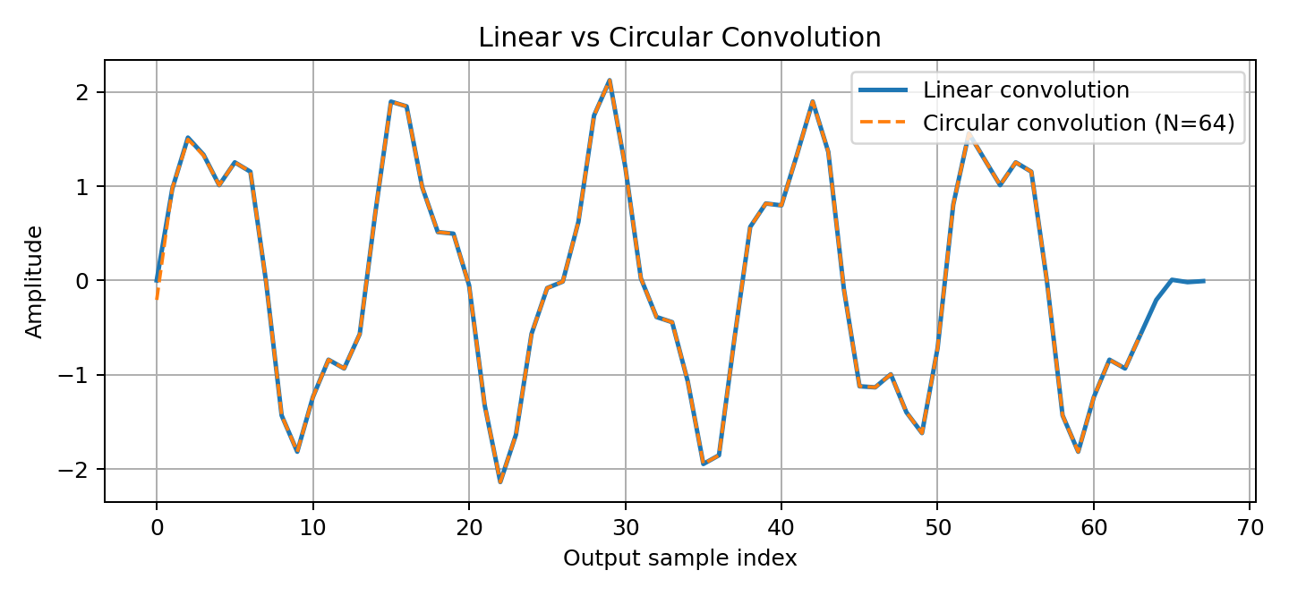
Linear vs Circular Output
DSP MINI-PROJECT / ECE–AIML
05

Slide 6
Error Metrics & Zero-Padding
N=64: MSE 0.0006708; RMSE 0.0259005; maximum error 0.2061794.
N=68: RMSE ≈ 2.69 × 10⁻¹⁶; effectively equal to the direct result.
N=79, 96 and 128 also matched to numerical precision.
Minimum sufficient FFT length for this case: 68.
DSP MINI-PROJECT / ECE–AIML
06

Slide 7
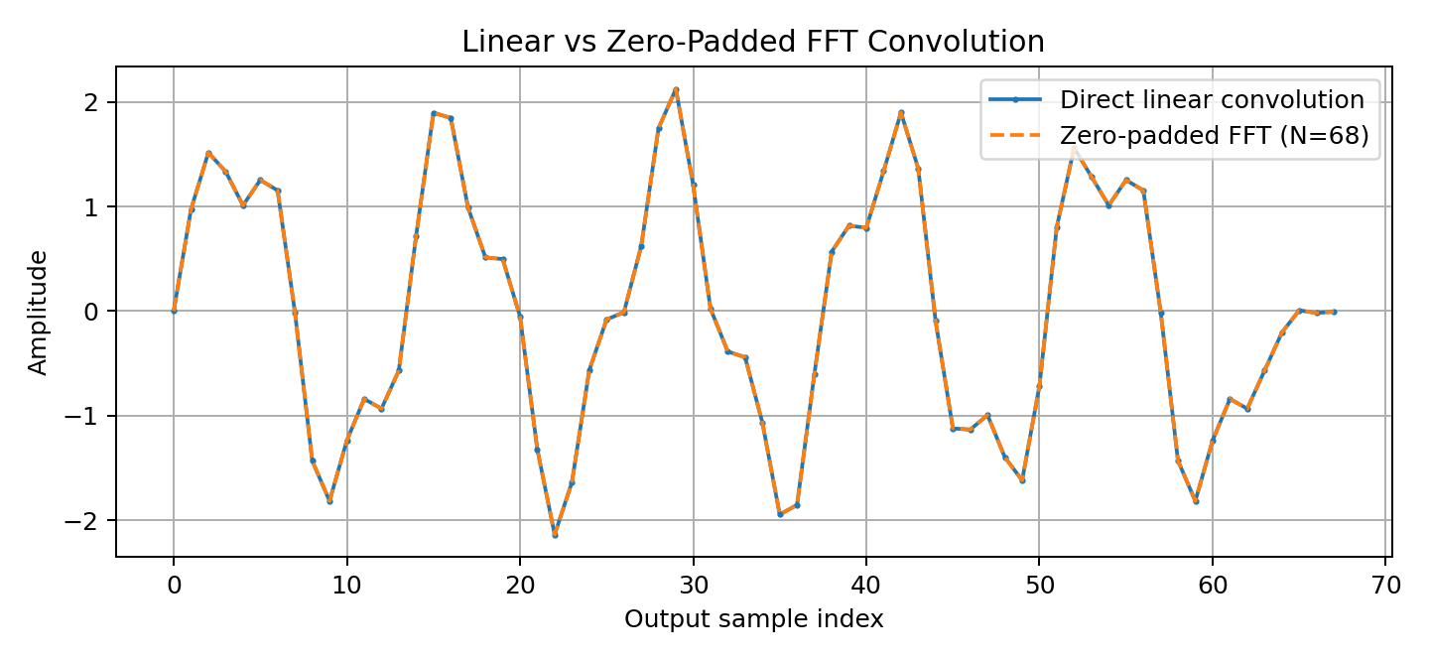
Zero-Padded FFT Result
DSP MINI-PROJECT / ECE–AIML
07

Slide 8
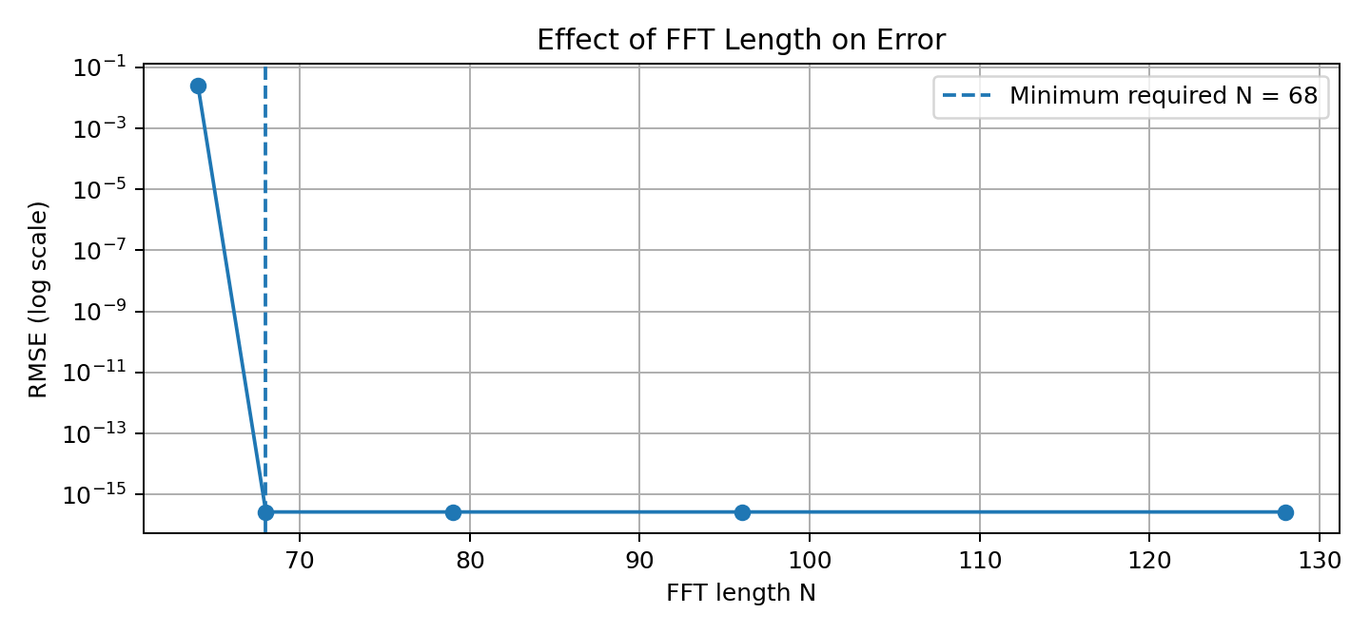
Effect of FFT Length
DSP MINI-PROJECT / ECE–AIML
08

Slide 9
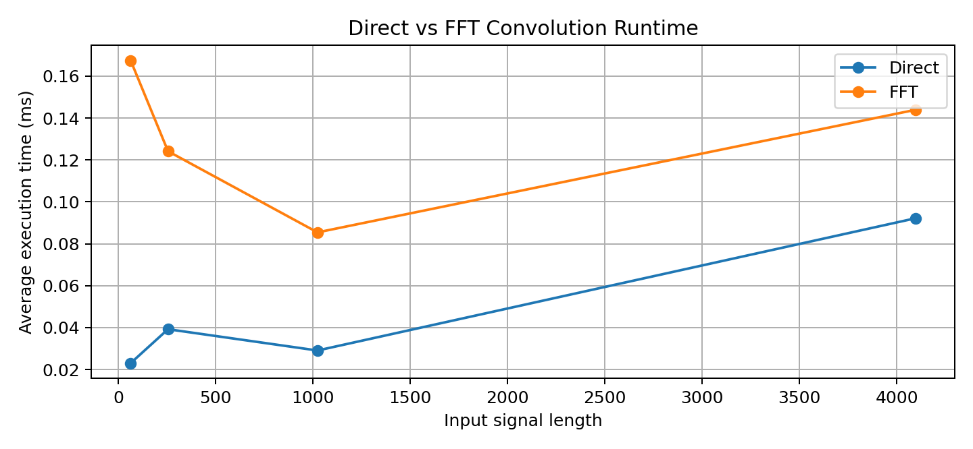
Runtime Comparison
DSP MINI-PROJECT / ECE–AIML
09

Slide 10
Runtime Results
Input 64: direct 0.02306 ms; FFT 0.16745 ms.
Input 4,096: direct 0.09216 ms; FFT 0.14390 ms.
Direct convolution was faster in this specific run at all tested lengths.
Timing depends on hardware and implementation; results are not universal.
DSP MINI-PROJECT / ECE–AIML
10

Slide 11
Conclusion & References
Insufficient FFT length causes circular wraparound error.
Padding to 68 samples reproduces the full linear result to numerical precision.
FFT methods are not automatically faster for short/moderate signals.
References: Oppenheim & Schafer (2010); Cooley & Tukey (1965); SciPy and NumPy documentation.
DSP MINI-PROJECT / ECE–AIML
11

