Slide 1
IMPLEMENTATION OF PLM TEAMCENTER IN THE Automotive Industry
Aryan Singh 2210994768
Supervised By
Dr. Swati Goel
Department of Computer Science and Engineering,
Chitkara University, Punjab

Slide 2
Introduction
Complex Automotive Production: Automotive manufacturing involves thousands of components, materials, and advanced systems that require seamless integration across various departments.
Global Supply Chain: With a global network of suppliers, manufacturers, and partners, automotive companies face significant challenges in managing collaboration and maintaining quality.
Regulatory Compliance: Automotive companies must adhere to strict regulatory standards (e.g., safety, environmental, and quality regulations) throughout the product lifecycle.
Challenges with Traditional Methods: Traditional systems often struggle with data silos, inefficiencies, and escalating costs, which can hinder innovation and timely decision-making.
Role of PLM Systems: Product Lifecycle Management (PLM) tools like Siemens Teamcenter provide a unified digital platform that connects all aspects of the product lifecycle, from design and development to manufacturing and service.
2

Slide 3
Industry Context & Challenges
Why Automotive is different?
Complex Integration Across Systems: Automotive products involve diverse engineering domains, including mechanical, electrical, software, and materials, which require seamless integration across each discipline.
Strict Regulatory Compliance: Automakers must meet various standards, including safety (e.g., crash tests, emissions), environmental regulations, and global certification requirements, driving rigorous documentation and audit trails.
Long Product Lifecycles: Vehicles have long lifespans, with ongoing maintenance, upgrades, and parts replacement needed, which require precise tracking of product configurations and warranties.
Cost, Schedule, and Safety Pressure: Automotive manufacturing faces high pressure to balance costs, meet tight production schedules, and ensure safety standards, all while driving innovation and performance improvements.

Slide 4
What PLM Delivers in Automotive Industry
From Design to Manufacturing: PLM in Automotive
Unified Product Backbone: Store all critical product data, including parts, BOMs, CAD models, documents, test reports, and change records in a single system, providing one reliable source of truth across the lifecycle.
Configuration Control: Track and manage parts and systems by serial number, lot, date, or specific vehicle model to ensure version control and accuracy in assembly and service.
Model-Based Definition (MBD): Use 3D models and Product Manufacturing Information (PMI) as the primary source of truth, reducing errors associated with traditional drawings and improving the clarity of designs.
Systems Engineering Integration (MBSE): Link system architecture (SysML) with detailed design data, ensuring that all requirements are seamlessly integrated into the engineering Bill of Materials (BOMs).
Secure Collaboration: Enable secure, controlled data sharing across OEMs, suppliers, and certification authorities. PLM workflows facilitate approval processes and ensure that all stakeholders are aligned on design and manufacturing requirements.
.

Slide 5
Implementation Framework
1. Strategic Planning and Goal Setting
Define Objectives: Understand what the company wants to achieve with PLM (e.g., improve collaboration, reduce time-to-market, ensure compliance).
Align with Business Goals: Ensure that PLM supports broader business goals, such as innovation, cost reduction, and improving product quality.
Stakeholder Involvement: Involve key stakeholders (engineering, IT, suppliers, and regulatory teams) in defining goals and requirements for PLM.
2. Requirements Gathering
Product Lifecycle Mapping: Understand the end-to-end lifecycle of the product, including design, prototyping, testing, production, and post-production (maintenance, service).
Process and Data Flow: Identify and document current processes, tools, and data flows within the company and supply chain.
3. PLM Solution Selection
Customization vs. Out-of-the-box: Decide whether to use a pre-configured system or customize based on company-specific needs (e.g., specific regulatory requirements or integration with legacy systems).

Slide 6
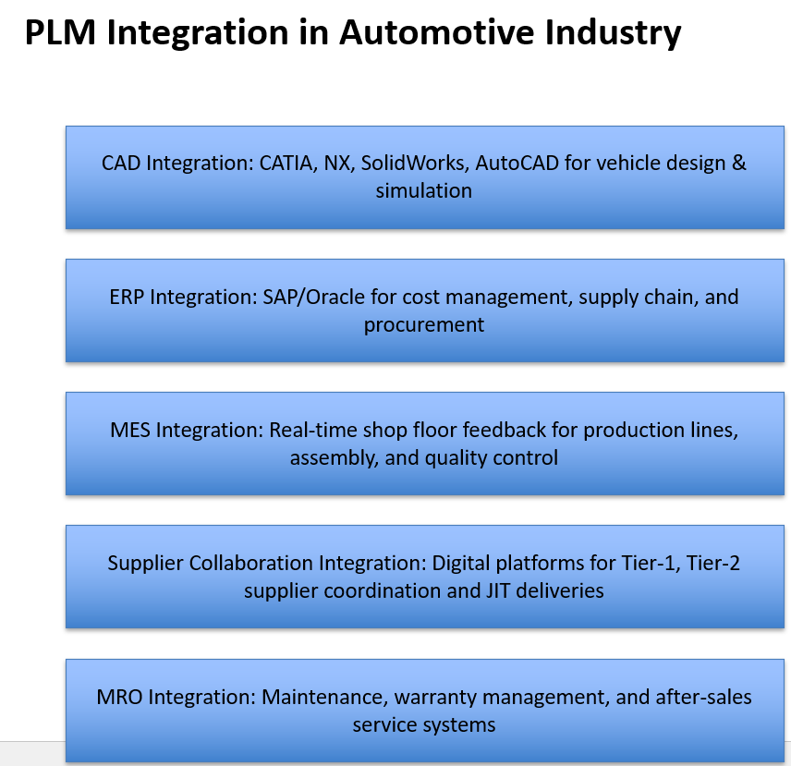
Integration Technologies
->

Slide 7
Performance Improvements
Design Cycle Time Implementation of PLM in automotive has achieved a 25–35% reduction, enabling faster concept-to-prototype-to-production transitions.
Engineering Changes Processing time for design and engineering changes is now 40–50% faster, reducing rework and supporting rapid model updates.
Supplier Collaboration Enhanced integration with Tier-1 and Tier-2 suppliers improves concurrent engineering, leading to shorter lead times and higher quality.
Product Quality & Compliance PLM ensures real-time quality checks and regulatory compliance, reducing defect rates and warranty costs.

Slide 8
Future Scope
AI for Predictive Maintenance Artificial Intelligence helps predict failures in vehicles before they occur, reducing downtime and warranty costs.
IoT for Connected Vehicles Sensors in cars send real-time performance data, enabling remote diagnostics, over-the-air updates, and improved driver safety.
Digital Twin of Vehicles A virtual replica of vehicles is created to test design changes, monitor performance, and optimize product lifecycle.
Blockchain for Supply Chain Transparency Ensures secure, transparent, and tamper-proof tracking of automotive parts, suppliers, and logistics.

Slide 9
Conclusion
PLM (Teamcenter) is a strategic enabler for automotive.
Enhances collaboration, compliance, and efficiency
Provides long-term ROI and competitive advantage
Future-ready with AI, IoT, and digital twin integration

Slide 10
Thank You
10

